Slide 1
Sumatory

Slide 2
Sumatoru full adder i half adder.
Tablica prawdy sumatora Full Adder - FA
Wejścia |  |  | Wyjścia
cin | a | b | cout | s
0 | 0 | 0 | 0 | 0
0 | 0 | 1 | 0 | 1
0 | 1 | 0 | 0 | 1
0 | 1 | 1 | 1 | 0
1 | 0 | 0 | 0 | 1
1 | 0 | 1 | 1 | 0
1 | 1 | 0 | 1 | 0
1 | 1 | 1 | 1 | 1

Slide 3
Równania logiczne dla sumatora Full Adder
s = a^b^cin;
cout = a&b | (a^b)&cin,
module full_adder(
input a,b,cin,
output s,cout);
assign s = a ^ b ^ cin;
assign cout = a & b | (a ^ b) & cin;
endmodule

Slide 4
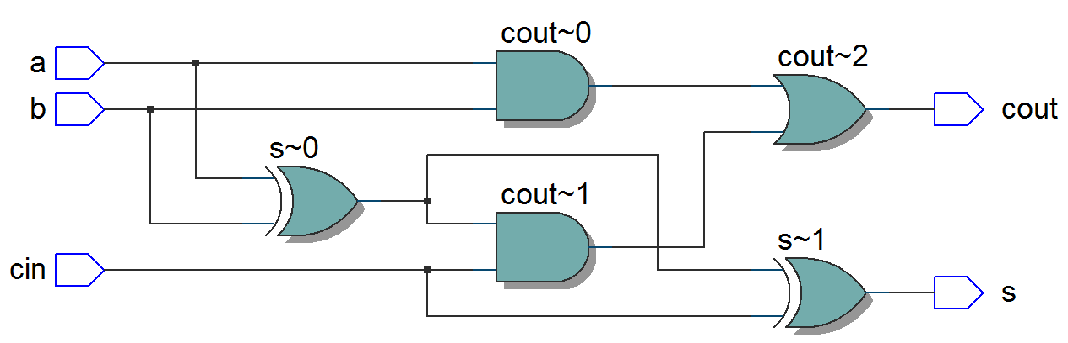
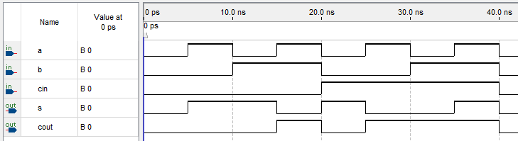
Rezultaty syntezy i symulacji

Slide 5
Symator Half Adder – HA
s = a^b;
cout = a&b.
module half_adder(
input a,b,
output s,cout);
assign s = a ^ b;
assign cout = a & b;
endmodule

Slide 6
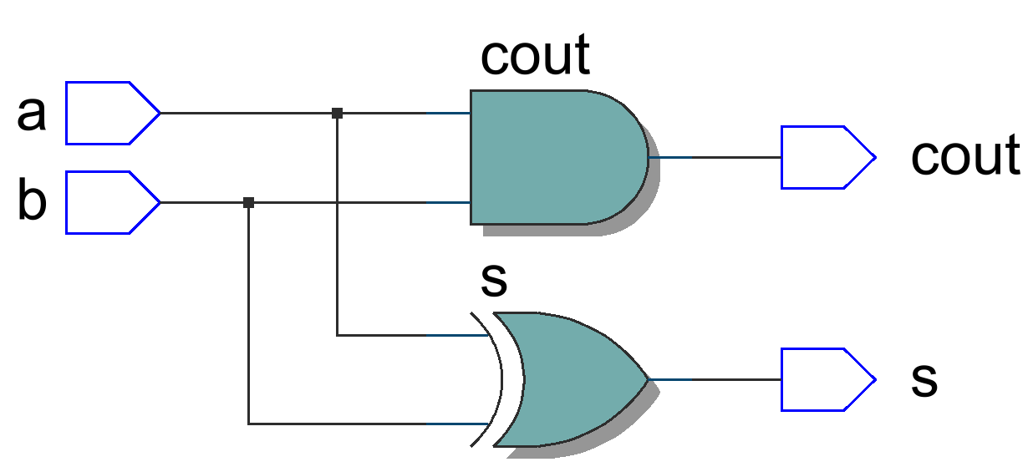
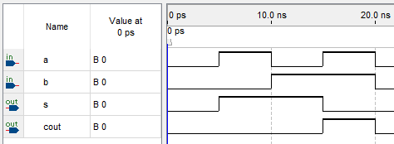
Rezultaty syntezy i symulacji

Slide 7
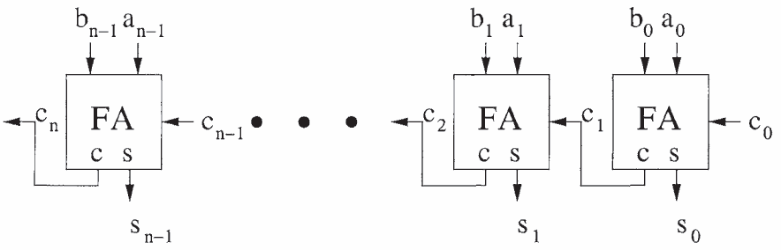
Sumator z szeregowym przeniesieniem

Slide 8
module ripple_carry_adder #(parameter N=4)
(input [N-1:0] A,B, input cin,
output [N-1:0] S, output cout);
wire [N-1:0] c;
generate
genvar i;
for (i=0; i<N; i=i+1)
begin: ad
case(i)
0: full_adder x(A[i],B[i],cin,S[i],c[i]);
N-1: full_adder x(A[i],B[i],c[i-1],S[i],cout);
default: full_adder x(A[i],B[i],c[i-1],S[i],c[i]);
endcase
end
endgenerate
endmodule

Slide 9
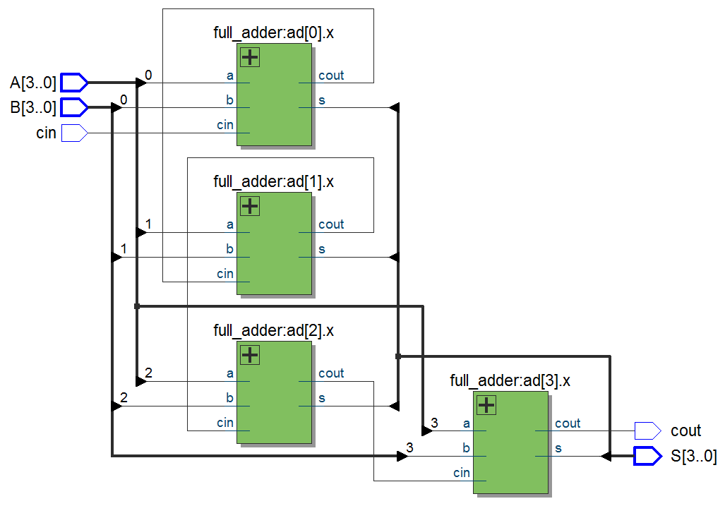
Rezultaty syntezy, N=4

Slide 10
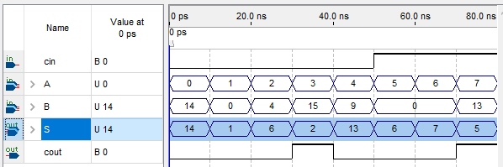
Rezultaty symulacji, N=4

Slide 11
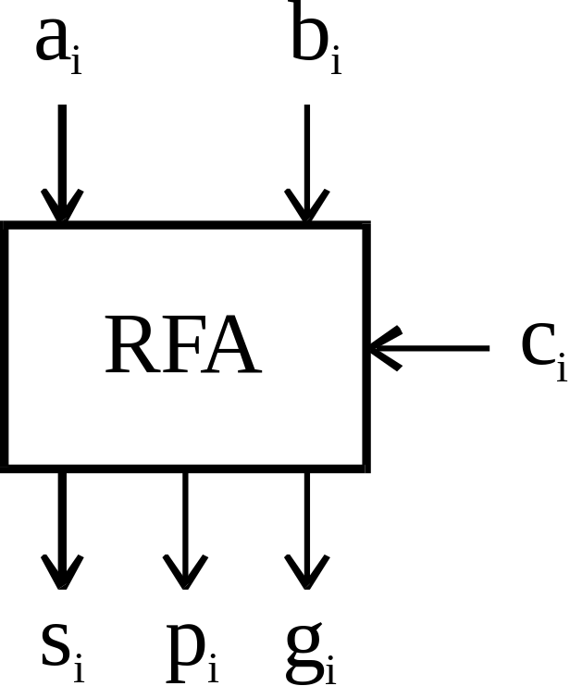
Sumator z równoległym przeniesieniem (Carry-Lookahead Adder – CLA).
Sumator Reduced Full Adder – RFA
pi = ai ^ bi;
gi = ai & bi.
s_{i} = p_{i} ^ c_{i};
c_{i+1} = g_{i} | p_{i} & c_{i}.

Slide 12
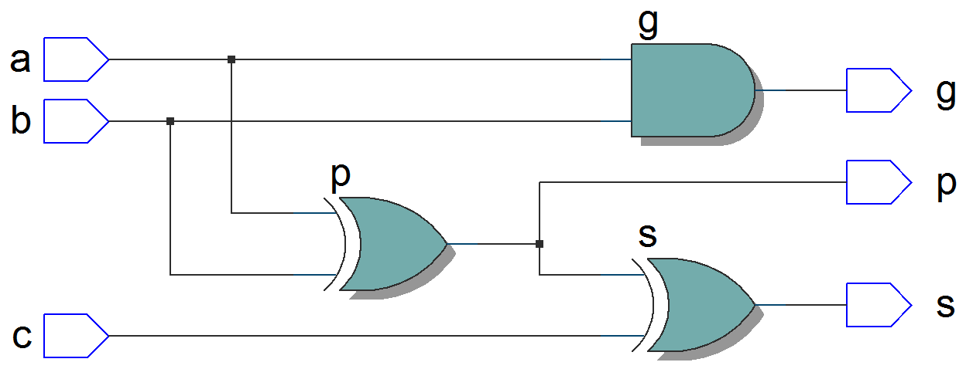
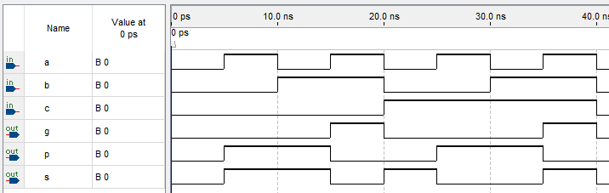
Rezultaty syntezy i symulacji

Slide 13
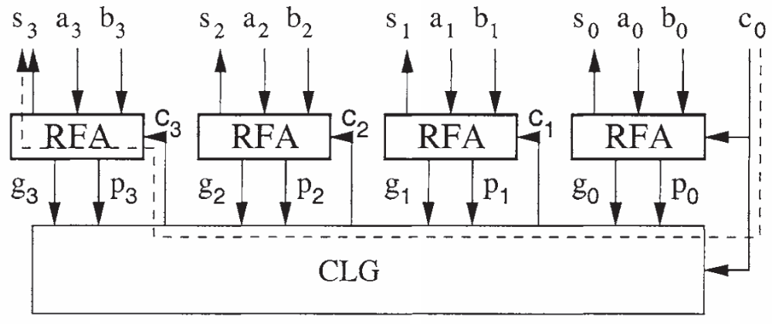
Carry Lookahead Generator – CLG

Slide 14
Carry Lookahead Generator – CLG
c₀ = g₀ + p₀∙cin;
c₁ = g₁ + p₁∙c₀;
c₂ = g₂ + p₂∙c₁;
c₃ = g₃ + p₃∙c₂;
c₀ = g₀ + p₀∙cin;
c₁ = g₁ + p₁∙g₀ + p₁∙p₀∙cin;
c₂ = g₂ + p₂∙g₁ + p₂∙p₁∙g₀ + p₂∙p₁∙p₀∙cin;
c₃ = g₃ + p₃∙g₂ + p₃∙p₂∙g₁ + p₃∙p₂∙p₁∙g₀ + p₃∙p₂∙p₁∙p₀∙cin;

Slide 15
Carry Lookahead Generator – CLG
pg = p₀∙p₁∙p₂∙p₃;
gg = g₃ + p₃∙g₂ + p₃∙p₂∙g₁ + p₃∙p₂∙p₁∙g₀.

Slide 16
module carry_lookahead_generator_4_bits(
input [3:0] p,g,
input cin,
output [3:0] c,
output pg, gg);
assign c[0] = g[0] | cin & p[0];
assign c[1] = g[1] | g[0] & p[1] | cin & p[0] & p[1];
assign c[2] = g[2] | g[1] & p[2] | g[0] & p[1] & p[2] |
cin & p[0] & p[1] & p[2];
assign c[3] = g[3] | g[2] & p[3] | g[1] & p[2] & p[3] |
g[0] & p[1] & p[2] & p[3] | cin & p[0] & p[1] & p[2] & p[3];
assign pg = p[0]&p[1]&p[2]&p[3];
assign gg = g[3] |
p[3]&g[2] |
p[3]&p[2]&g[1] |
p[3]&p[2]&p[1]&g[0];
endmodule

Slide 17
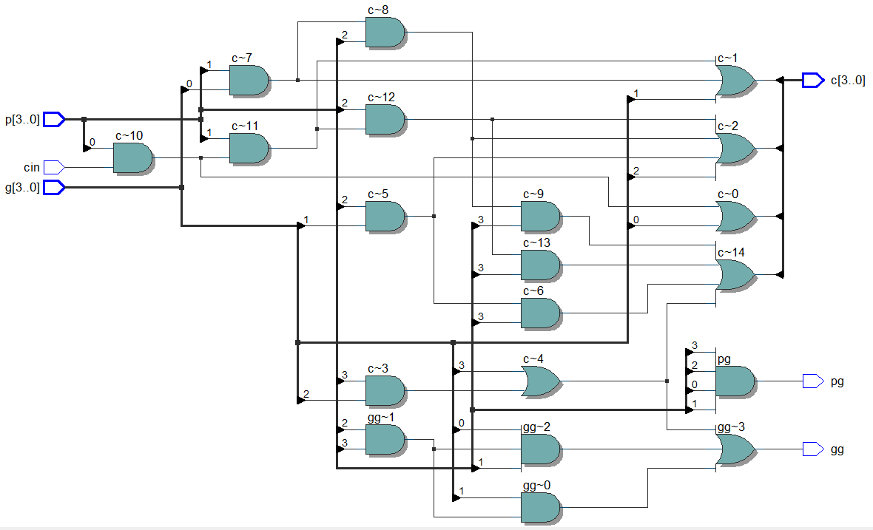
Rezultaty syntezy

Slide 18
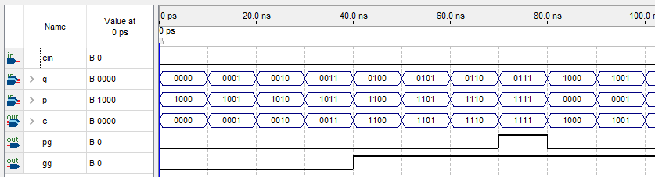
Rezultaty symulacji

Slide 19
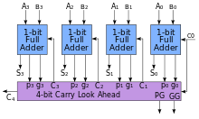
Sumator z równoległym przeniesieniem na 4 bity

Slide 20
module carry_lookahead_adder_4_bits(
input [3:0] a,b,
input cin,
output [3:0] s,
output cout,
output pg, gg);
wire [3:0] p,g;
wire [3:0] c;
reduced_full_adder ex0(a[0],b[0],cin,s[0],p[0],g[0]);
reduced_full_adder ex1(a[1],b[1],c[0],s[1],p[1],g[1]);
reduced_full_adder ex2(a[2],b[2],c[1],s[2],p[2],g[2]);
reduced_full_adder ex3(a[3],b[3],c[2],s[3],p[3],g[3]);
carry_lookahead_generator_4_bits exg(p,g,cin,c,pg,gg);
assign cout = c[3];
endmodule

Slide 21
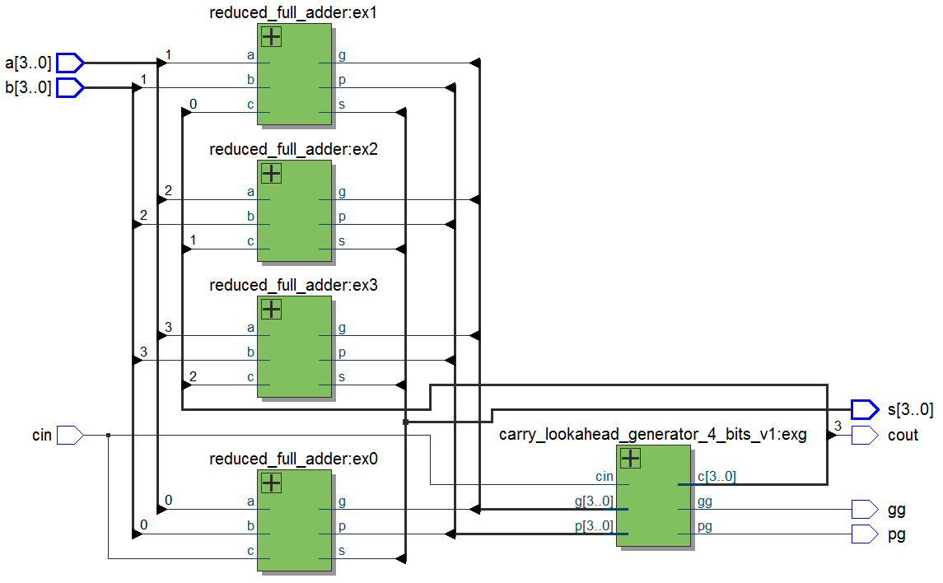
Rezultaty syntezy

Slide 22
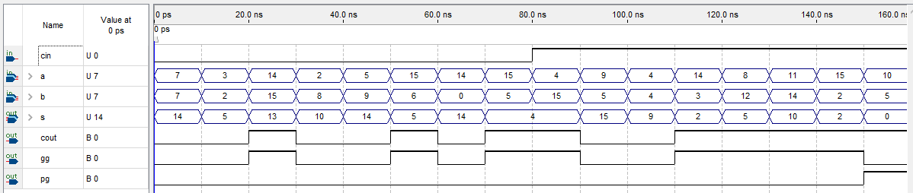
Rezultaty symulacji

Slide 23
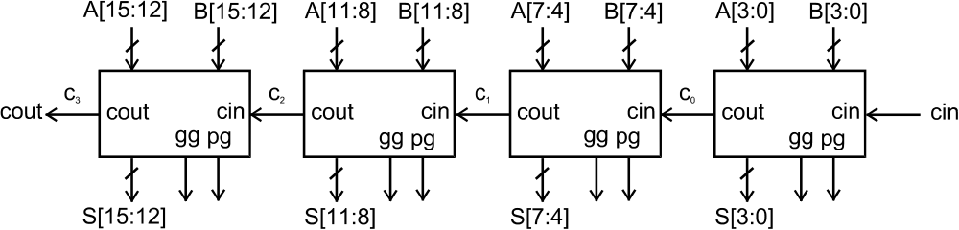
Sumator CLA na 16 bitów z równoleglych bloków na 4 bity z szeregowym przeniesieniem między blokami

Slide 24
module carry_lookahead_adder_16_bits_v1(
input [15:0] A,B,
input cin,
output [15:0] S,
output cout);
wire [3:1] c;
carry_lookahead_adder_4_bits ex0(A[3:0],B[3:0],cin,S[3:0],c[1]);
carry_lookahead_adder_4_bits ex1(A[7:4],B[7:4],c[1],S[7:4],c[2]);
carry_lookahead_adder_4_bits ex2(A[11:8],B[11:8],c[2],S[11:8],c[3]);
carry_lookahead_adder_4_bits ex3(A[15:12],B[15:12],c[3],S[15:12],cout);
endmodule

Slide 25
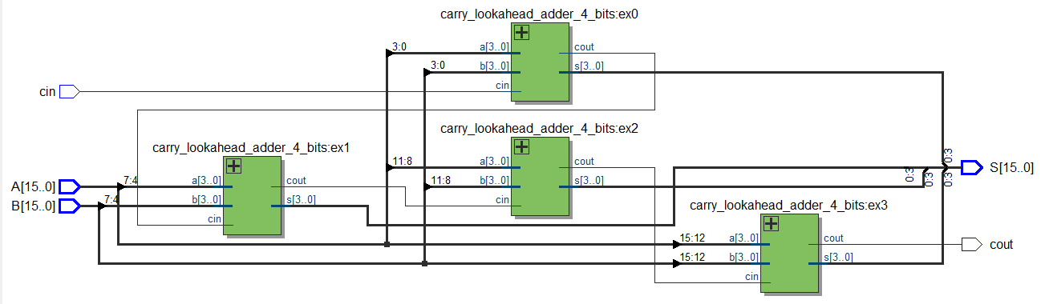
Rezultaty syntezy

Slide 26
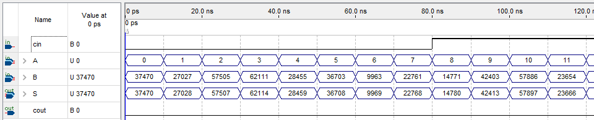
Rezultaty symulacji

Slide 27
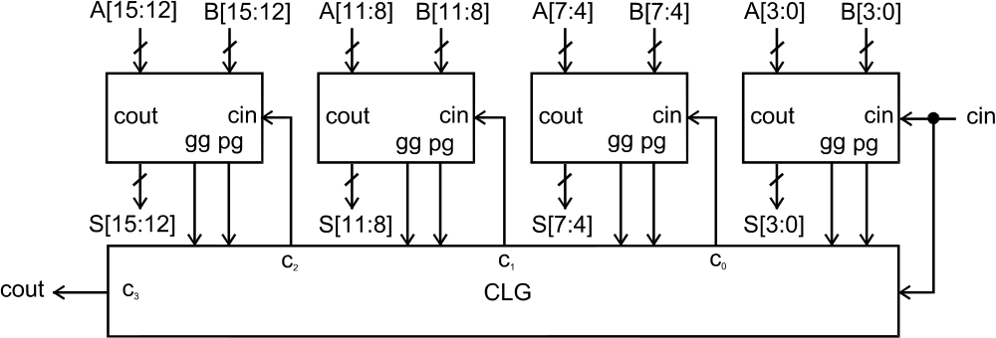
Sumator CLA na 16 bitów z równoleglych bloków na 4 bity z równoleglym przeniesieniem między blokami

Slide 28
module carry_lookahead_adder_16_bits_v2(
input [15:0] A,B,
input cin,
output [15:0] S,
output cout,
output pg,gg);
wire [3:0] p,g,c;
carry_lookahead_adder_4_bits ex0(A[3:0],B[3:0],cin,S[3:0],,p[0],g[0]);
carry_lookahead_adder_4_bits ex1(A[7:4],B[7:4],c[0],S[7:4],,p[1],g[1]);
carry_lookahead_adder_4_bits ex2(A[11:8],B[11:8],c[1],S[11:8],,p[2],g[2]);
carry_lookahead_adder_4_bits ex3(A[15:12],B[15:12],c[2],S[15:12],,p[3],g[3]);
carry_lookahead_generator_4_bits exg(p,g,cin,c,pg,gg);
assign cout = c[3];
endmodule

Slide 29
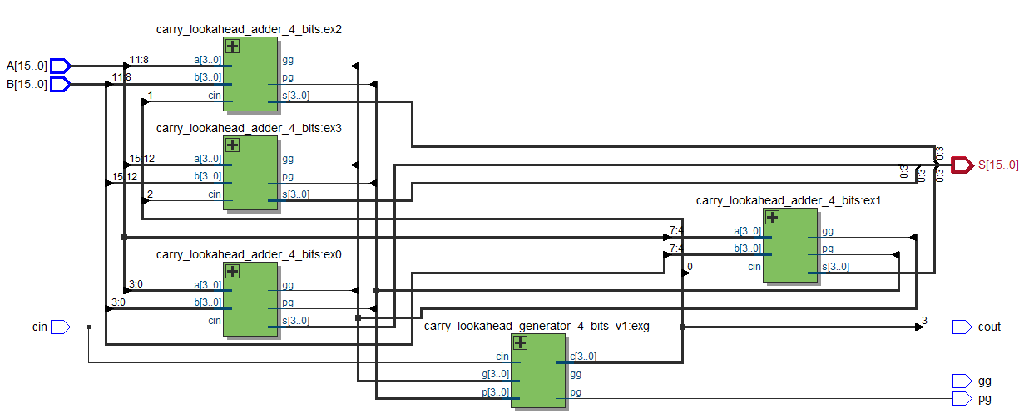
Rezultaty syntezy

Slide 30
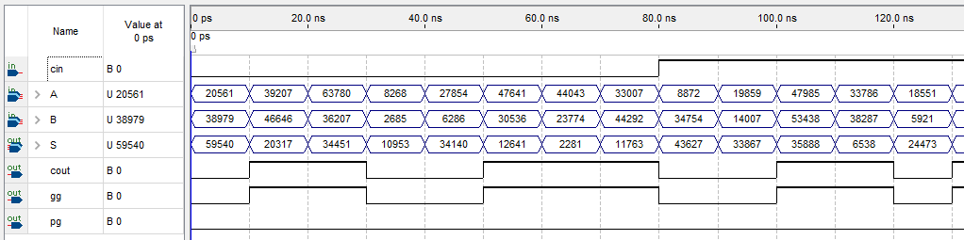
Rezultaty symulacji

Slide 31
Sumatory z wybodem przeniesienia (Carry-Select Adder – CSEA)

Slide 32
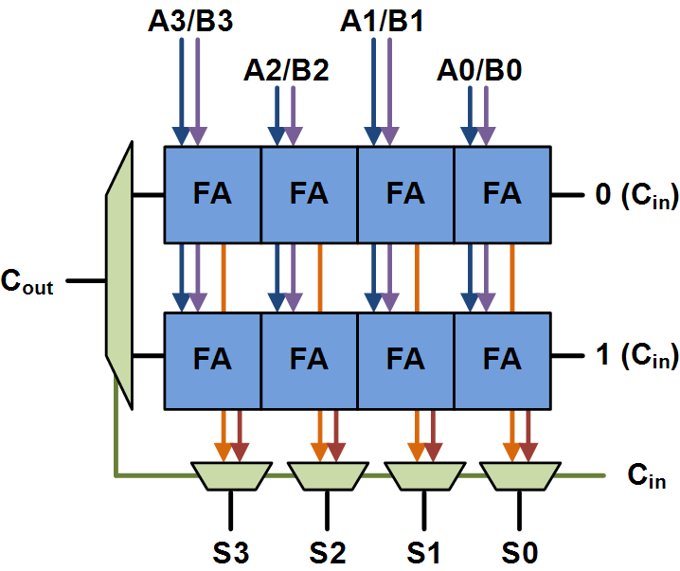
Blok sumatora Carry-Select Adder na 4 bity

Slide 33
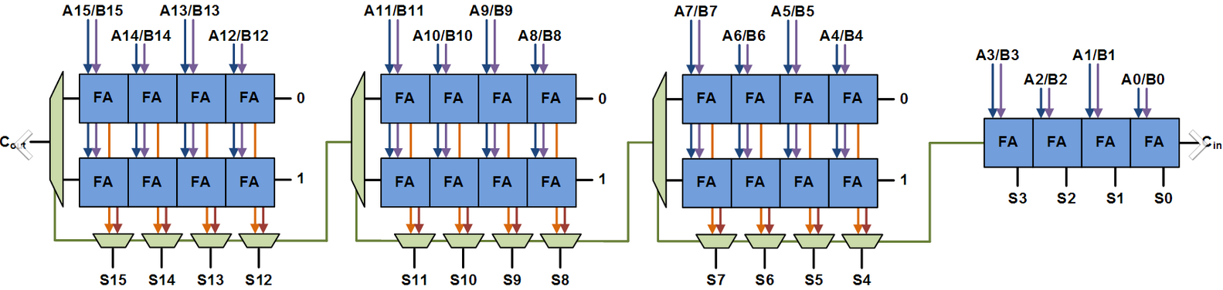
Sumator Carry-Select Adder na 16 bitów

Slide 34
module carry_select_adder_4_bits(
input [3:0] A,B,
input cin,
output [3:0] S,
output cout);
wire [3:0] S_0,S_1;
wire cout_0,cout_1;
ripple_carry_adder #(4) ex0(A,B,1'b0,S_0,cout_0);
ripple_carry_adder #(4) ex1(A,B,1'b1,S_1,cout_1);
MUX_2_1_if exm(cout_0,cout_1,cin,cout);
MUX_2_1_N_bits #(4) exm4(S_0,S_1,cin,S);
endmodule

Slide 35
module carry_select_adder_16_bits(
input [15:0] A,B,
input cin,
output [15:0] S,
output cout);
wire c1,c2,c3;
ripple_carry_adder #(4) ex0(A[3:0],B[3:0],cin,S[3:0],c1);
carry_select_adder_4_bits ex1(A[7:4],B[7:4],c1,S[7:4],c2);
carry_select_adder_4_bits ex2(A[11:8],B[11:8],c2,S[11:8],c3);
carry_select_adder_4_bits ex3(A[15:12],B[15:12],c3,S[15:12],cout);
endmodule

Slide 36
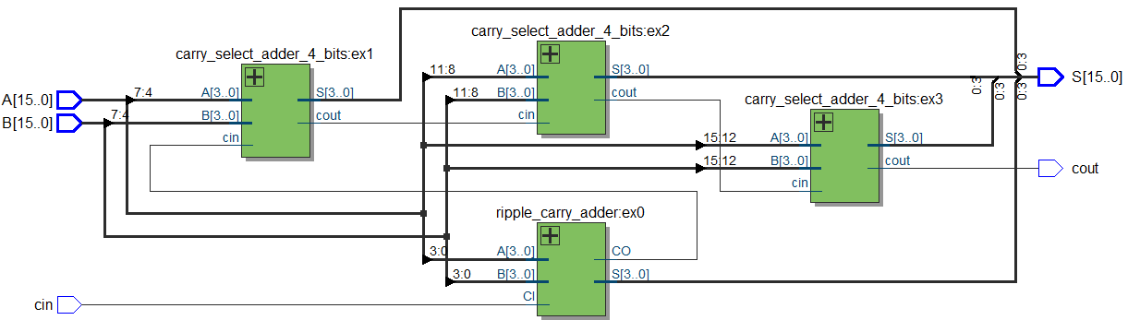
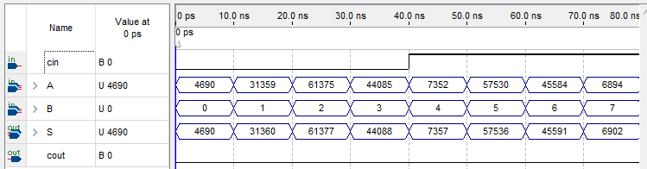
Rezultaty syntezy i symulacji

Slide 37
Sumatory Carry-Select Adder z bloków 2-2-3-4-5

Slide 38
module CSEA_16_var_blocks(
input [15:0] A,B,
input cin,
output [15:0] S,
output cout);
wire c1,c2,c3,c4;
wire c2_0,c2_1,c3_0,c3_1,c4_0,c4_1,c5_0,c5_1;
wire [1:0] S2_0,S2_1;
wire [2:0] S3_0,S3_1;
wire [3:0] S4_0,S4_1;
wire [4:0] S5_0,S5_1;

Slide 39
ripple_carry_adder #(2) ex1(A[1:0],B[1:0],cin,S[1:0],c1);
ripple_carry_adder #(2) ex2_0(A[3:2],B[3:2],1'b0,S2_0,c2_0);
ripple_carry_adder #(2) ex2_1(A[3:2],B[3:2],1'b1,S2_1,c2_1);
ripple_carry_adder #(3) ex3_0(A[6:4],B[6:4],1'b0,S3_0,c3_0);
ripple_carry_adder #(3) ex3_1(A[6:4],B[6:4],1'b1,S3_1,c3_1);
ripple_carry_adder #(4) ex4_0(A[10:7],B[10:7],1'b0,S4_0,c4_0);
ripple_carry_adder #(4) ex4_1(A[10:7],B[10:7],1'b1,S4_1,c4_1);
ripple_carry_adder #(5) ex5_0(A[15:11],B[15:11],1'b0,S5_0,c5_0);
ripple_carry_adder #(5) ex5_1(A[15:11],B[15:11],1'b1,S5_1,c5_1);
MUX_2_1_if mc1(c2_0,c2_1,c1,c2);
MUX_2_1_if mc2(c3_0,c3_1,c2,c3);
MUX_2_1_if mc3(c4_0,c4_1,c3,c4);
MUX_2_1_if mc4(c5_0,c5_1,c4,cout);
MUX_2_1_N_bits #(2) ms1(S2_0,S2_1,c1,S[3:2]);
MUX_2_1_N_bits #(3) ms2(S3_0,S3_1,c2,S[6:4]);
MUX_2_1_N_bits #(4) ms3(S4_0,S4_1,c3,S[10:7]);
MUX_2_1_N_bits #(5) ms4(S5_0,S5_1,c4,S[15:11]);
endmodule

Slide 40
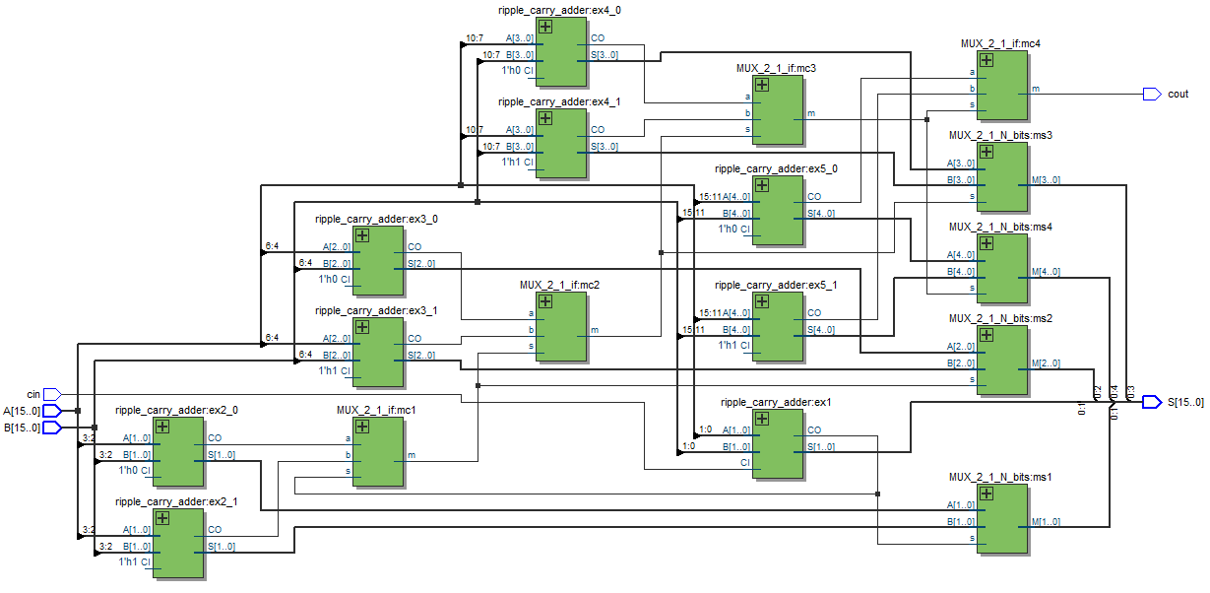
Rezultaty syntezy

Slide 41
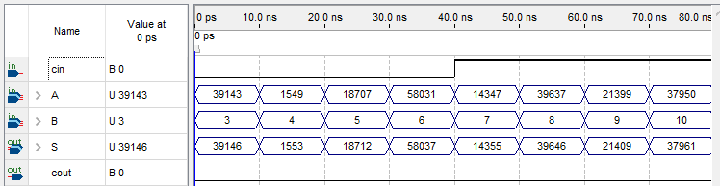
Rezultaty symulacji

Slide 42
Sumator z przepuszczeniem przeniesienia (Carry-Skip Adder – CSKA)

Slide 43
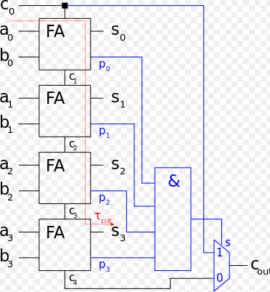
Blok sumatora Carry-Skip Adder na 4 bity

Slide 44
Modyfikowany sumator Full Adder - Modified Full Adder – MFA
s = p^cin;
cout = a&b + p&cin;
p = a&b.
module modified_full_adder(
input a,b,cin,
output s,cout,p);
assign p = a ^ b;
assign s = p ^ cin;
assign cout = a & b | p & cin;
endmodule

Slide 45
Blok sumatora Carry-Skip Adder na 4 bity
module carry_skip_adder_4_bits(
input [3:0] A,B,
input cin,
output [3:0] S,
output cout);
wire c1,c2,c3,c4;
wire sel;
wire [3:0] P;
modified_full_adder ex0(A[0],B[0],cin,S[0],c1,P[0]);
modified_full_adder ex1(A[1],B[1],c1,S[1],c2,P[1]);
modified_full_adder ex2(A[2],B[2],c2,S[2],c3,P[2]);
modified_full_adder ex3(A[3],B[3],c3,S[3],c4,P[3]);
assign sel = P[0]&P[1]&P[2]&P[3];
MUX_2_1_if mux(c4,cin,sel,cout);
endmodule

Slide 46
Sumator z przepuszczeniem przeniesienia Carry-Skip Adder na 16 bitów
module carry_skip_adder_16_bits(
input [15:0] A,B,
input cin,
output [15:0] S,
output cout);
wire c1,c2,c3;
carry_skip_adder_4_bits ex0(A[3:0],B[3:0],cin,S[3:0],c1);
carry_skip_adder_4_bits ex1(A[7:4],B[7:4],c1,S[7:4],c2);
carry_skip_adder_4_bits ex2(A[11:8],B[11:8],c2,S[11:8],c3);
carry_skip_adder_4_bits ex3(A[15:12],B[15:12],c3,S[15:12],cout);
endmodule

Slide 47
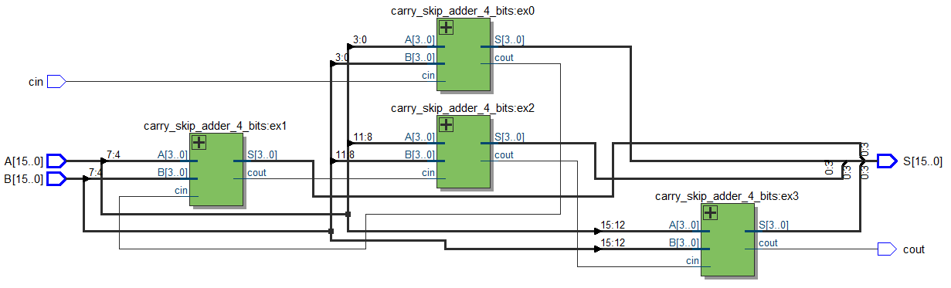
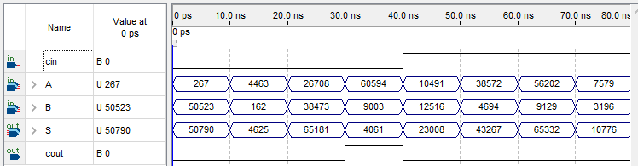
Rezultaty syntezy i symulacji

Slide 48
Sumator z warunkowym dodawaniem (Conditional sum adder – CSA)

Slide 49
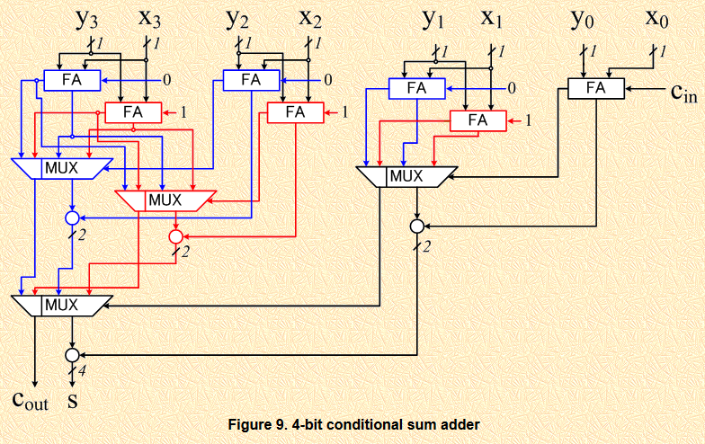

Slide 50
module CSA_2(
input [1:0] A,B,
input cin,
output [1:0] S,
output cout);
wire S_0,S_1;
wire c,c_0,c_1;
full_adder ex_0(A[0],B[0],cin,S[0],c);
full_adder ex_1_0(A[1],B[1],1'b0,S_0,c_0);
full_adder ex_1_1(A[1],B[1],1'b1,S_1,c_1);
MUX_2_1_if muxs(S_0,S_1,c,S[1]);
MUX_2_1_if muxc(c_0,c_1,c,cout);
endmodule

Slide 51
module CSA_4(
input [3:0] A,B,
input cin,
output [3:0] S,
output cout);
wire [1:0] S_0,S_1;
wire c,c_0,c_1;
CSA_2 ex_1_0(A[1:0],B[1:0],cin,S[1:0],c);
CSA_2 ex_3_2_0(A[3:2],B[3:2],1'b0,S_0,c_0);
CSA_2 ex_3_2_1(A[3:2],B[3:2],1'b1,S_1,c_1);
MUX_2_1_N_bits #(2) muxs(S_0,S_1,c,S[3:2]);
MUX_2_1_if muxc(c_0,c_1,c,cout);
endmodule

Slide 52
module CSA_8(
input [7:0] A,B,
input cin,
output [7:0] S,
output cout);
wire [3:0] S_0,S_1;
wire c,c_0,c_1;
CSA_4 ex_3_0(A[3:0],B[3:0],cin,S[3:0],c);
CSA_4 ex_7_4_0(A[7:4],B[7:4],1'b0,S_0,c_0);
CSA_4 ex_7_4_1(A[7:4],B[7:4],1'b1,S_1,c_1);
MUX_2_1_N_bits #(4) muxs(S_0,S_1,c,S[7:4]);
MUX_2_1_if muxc(c_0,c_1,c,cout);
endmodule

Slide 53
module CSA_16(
input [15:0] A,B,
input cin,
output [15:0] S,
output cout);
wire [7:0] S_0,S_1;
wire c,c_0,c_1;
CSA_8 ex_7_0(A[7:0],B[7:0],cin,S[7:0],c);
CSA_8 ex_15_8_0(A[15:8],B[15:8],1'b0,S_0,c_0);
CSA_8 ex_7_4_1(A[15:8],B[15:8],1'b1,S_1,c_1);
MUX_2_1_N_bits #(8) muxs(S_0,S_1,c,S[15:8]);
MUX_2_1_if muxc(c_0,c_1,c,cout);
endmodule

Slide 54
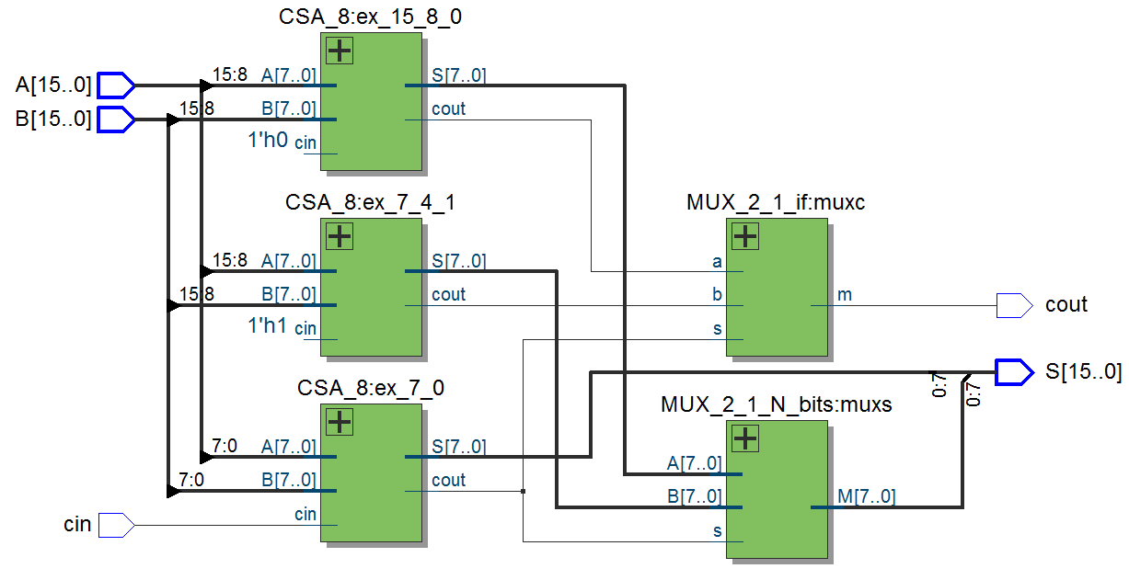
Rezultaty syntezy

Slide 55
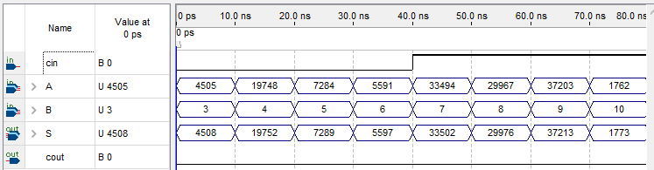
Rezultaty symulacji

Slide 56
Badania eksperymientalne sumatorów
Adders | MAX II |  | MAX V |  | MAX 10 |  | Arria II |  | Cyclone IV |  | Cyclone V
 | L | F | L | F | L | F | L | F | L | F | L | F
RCA | 32 | 124 | 32 | 80 | 42 | 145 | 37 | 193 | 41 | 144 | 25 | 146
CLA(R) | 65 | 250 | 65 | 140 | 66 | 335 | 61 | 1075 | 65 | 397 | 35 | 454
CLA(L) | 73 | 293 | 72 | 148 | 73 | 396 | 74 | 1030 | 72 | 576 | 38 | 510
CSEAF | 47 | 157 | 47 | 93 | 48 | 157 | 36 | 590 | 47 | 207 | 25 | 294
CSEAV | 50 | 196 | 50 | 115 | 52 | 184 | 45 | 665 | 51 | 246 | 25 | 296
CSKA | 47 | 132 | 47 | 72 | 56 | 134 | 59 | 502 | 55 | 175 | 37 | 222
CSA | 52 | 145 | 52 | 94 | 60 | 198 | 63 | 640 | 59 | 257 | 28 | 342
Quartus | 19 | 331 | 19 | 191 | 19 | 409 | 17 | 767 | 18 | 494 | 10 | 403

