Slide 1
Automaty skończone

Slide 2
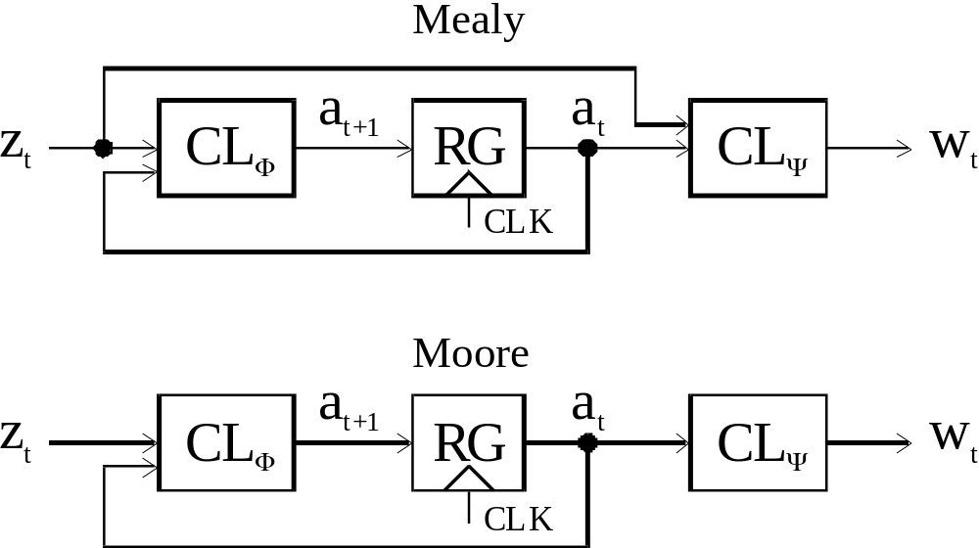
Strukturalne modeli automatów skończonych

Slide 3
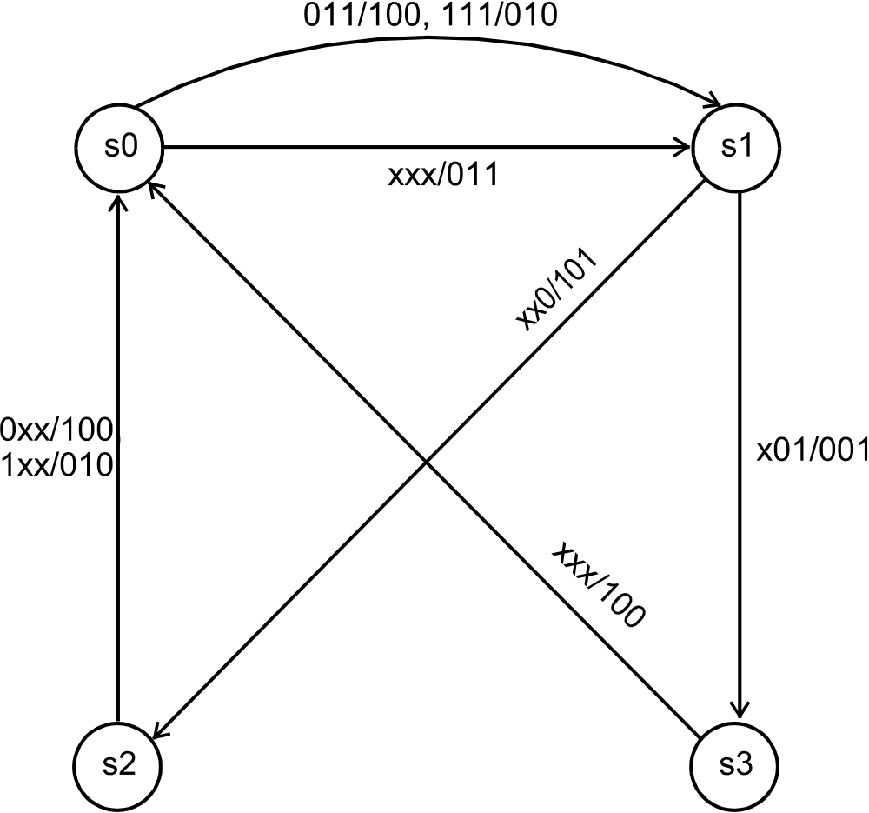
Graf automatu Mealy

Slide 4
Tablica przejść
a_{m} | X(a_{m}, a_{s}) x₂x₁x₀ | Y(a_{m}, a_{s}) y₂y₁y₀ | a_{s}
s₀ | - - - | 0 1 1 | s₁
s₁ | - - 0 | 1 0 1 | s₂
s₁ | - 0 1 | 0 0 1 | s₃
s₁ | 0 1 1 | 1 0 0 | s₀
s₁ | 1 1 1 | 0 1 0 | s₀
s₂ | 0 - - | 1 0 0 | s₀
s₂ | 1 - - | 0 1 0 | s₀
s₃ | - - - | 1 0 0 | s₀

Slide 5
Specyfikacja automatu Mealy w wersji z 3 procesami, style 1 (1)
module Mealy_style_1(
input clk,reset,
input [2:0] x,
output reg [2:0] y);
(* keep *) reg [1:0] state, next;
localparam [1:0]
s0=2'b00,
s1=2'b01,
s2=2'b10,
s3=2'b11;
always @(posedge clk, negedge reset)
if (~reset) state <= s0;
else state <= next;

Slide 6
Specyfikacja automatu Mealy w wersji z 3 procesami style 1 (2)
always @(*)
case (state)
s0: next = s1;
s1: if (~x[0]) next = s2;
else if (~x[1] && x[0]) next = s3;
else if (~x[2] && x[1] && x[0]) next = s0;
else next = s0;
s2: if (~x[2]) next = s0;
else next = s0;
s3: next = s0;
endcase

Slide 7
Specyfikacja automatu Mealy w wersji z 3 procesami style 1 (3)
always @(*)
case (state)
s0: y = 3'b011;
s1: if (~x[0]) y = 3'b101;
else if (~x[1] && x[0]) y = 3'b001;
else if (~x[2] && x[1] && x[0]) y = 3'b100;
else y = 3'b010;
s2: if (~x[2]) y = 3'b100;
else y = 3'b010;
s3: y = 3'b100;
endcase
endmodule

Slide 8
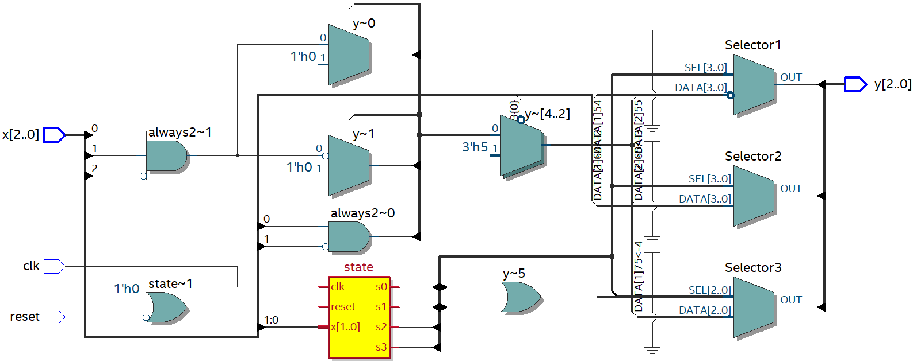
Rezultat syntezy

Slide 9
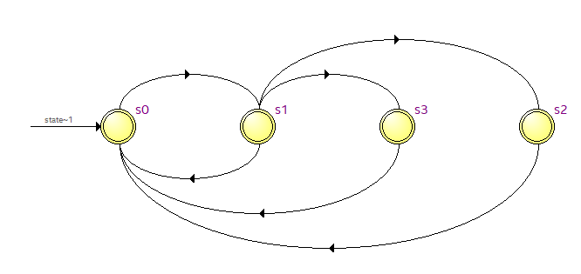
Rezultat syntezy. Graf automatu

Slide 10
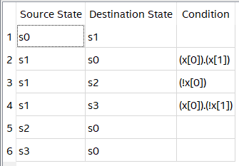
Rezultat syntezy. Tablica przejść

Slide 11
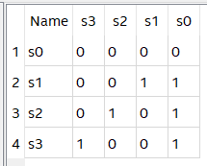
Rezultat syntezy. Kody stanów

Slide 12
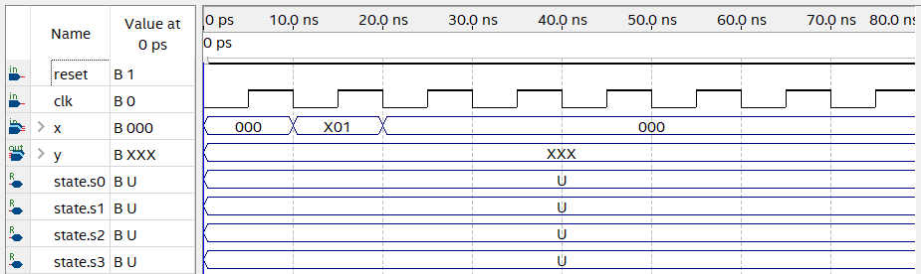
Dane wejściowe do symulacji

Slide 13
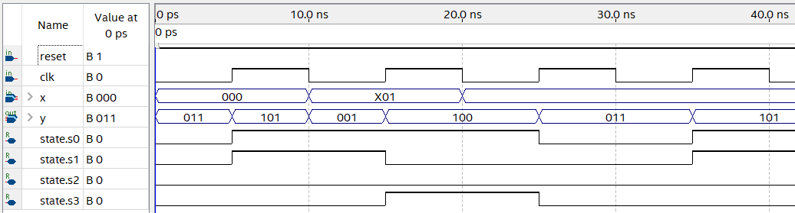
Rezultat symulacji funkcjonalnej

Slide 14
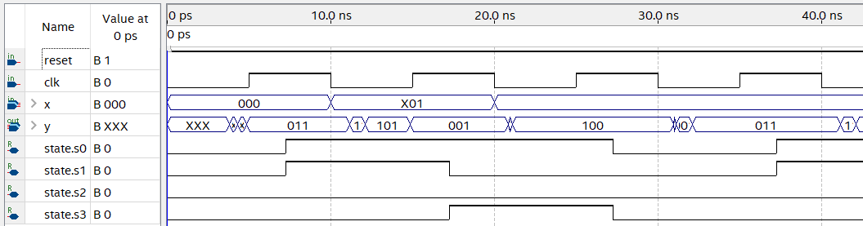
Rezultat symulacji czasowej

Slide 15
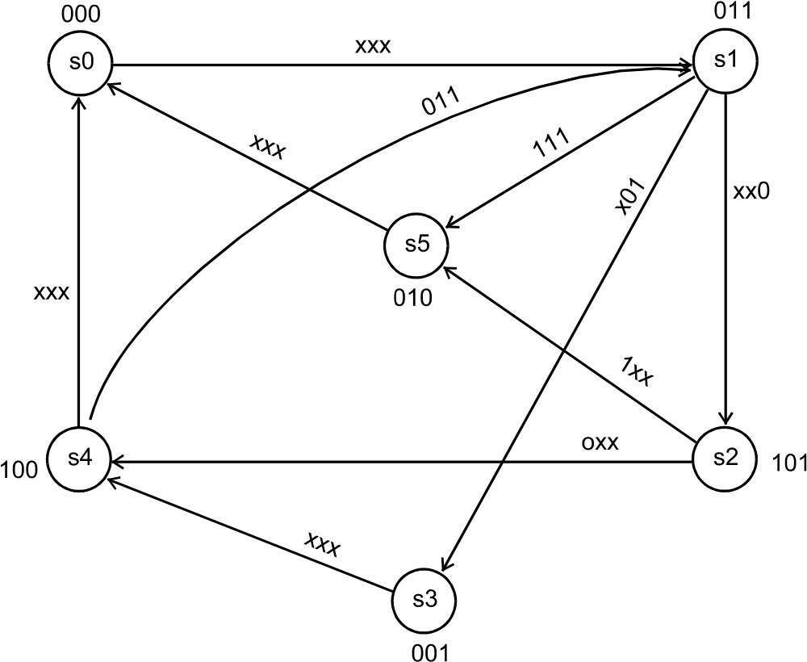
Graf automatu Moore

Slide 16
Tablica przejść automatu Moore
a_{m} | X(a_{m}, a_{s}) x₂x₁x₀ | Y(a_{m}, a_{s}) y₂y₁y₀ | a_{s}
s₀ | - - - | 0 0 0 | s₁
s₁ | - - 0 | 0 1 1 | s₂
s₁ | - 0 1 | 0 1 1 | s₃
s₁ | 0 1 1 | 0 1 1 | s₄
s₁ | 1 1 1 | 0 1 1 | s₅
s₂ | 0 - - | 1 0 1 | s₄
s₂ | 1 - - | 1 0 1 | s₅
s₃ | - - - | 0 0 1 | s₄
s₄ | - - - | 1 0 0 | s₀
s₅ | - - - | 0 1 0 | s₀

Slide 17
Specyfikacja automatu Moore w wersji z 3 procesami (style 1) (1)
module Moore_style_1(
input clk,reset,
input [2:0] x,
output reg [2:0] y);
reg [2:0] state, next;
localparam [2:0]
s0=3'b000,
s1=3'b001,
s2=3'b010,
s3=3'b011,
s4=3'b100,
s5=3'b101;

Slide 18
always @(posedge clk, negedge reset)
if (~reset) state <= s0;
else state <= next;
always @(*)
case (state)
s0: next = s1;
s1: if (~x[0]) next = s2;
else if (~x[1] && x[0]) next = s3;
else if (~x[2] && x[1] && x[0]) next = s4;
else next = s5;
s2: if (~x[2]) next = s4;
else next = s5;
s3: next = s4;
s4: next = s0;
s5: next = s0;
endcase

Slide 19
always @(*)
case (state)
s0: y = 3'b000;
s1: y = 3'b011;
s2: y = 3'b101;
s3: y = 3'b001;
s4: y = 3'b100;
s5: y = 3'b010;
endcase
endmodule

Slide 20
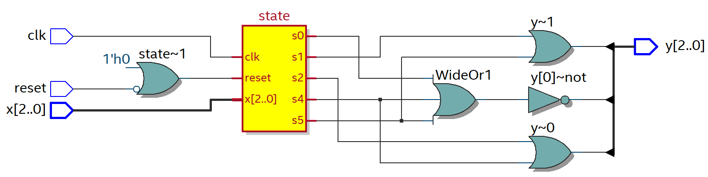
Rezultat syntezy

Slide 21
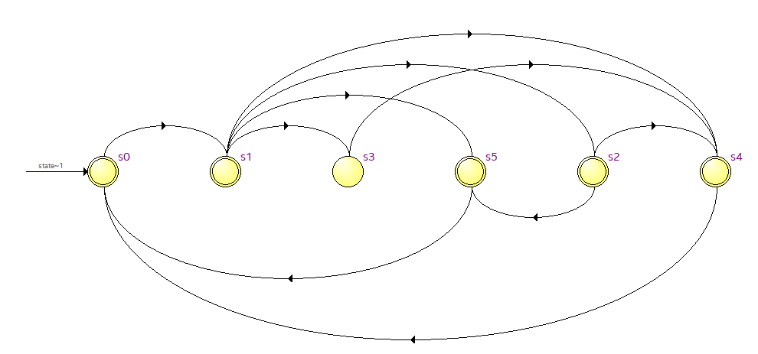
Graf automatu

Slide 22
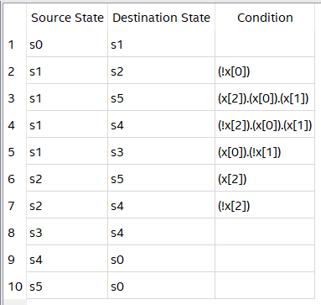
Tablica przejść

Slide 23
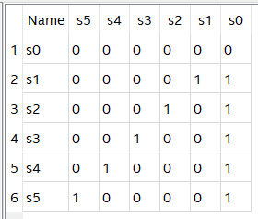
Kody stanów

Slide 24
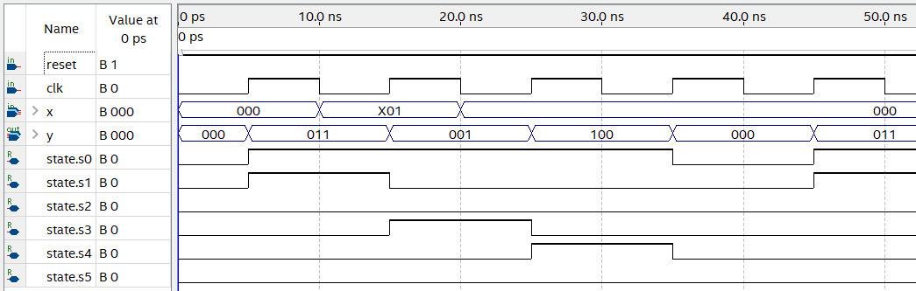
Rezultat symulacji funkcjonalnej

Slide 25
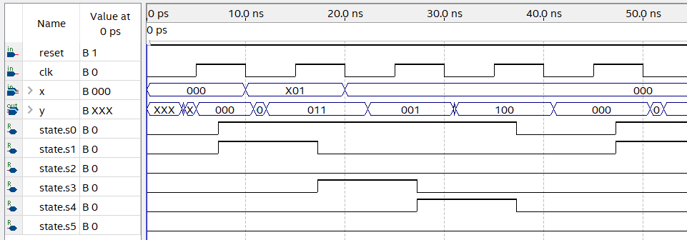
Rezultat symulacji czsowej

Slide 26
Specyfikacja automatu Mealy z 2 procesami (style 2): pamęć i przejścia jako jeden proces
always @(posedge clk, negedge reset)
if (~reset) state <= s0;
else
case (state)
s0: state = s1;
s1: if (~x[0]) state = s2;
else if (~x[1] && x[0]) state = s3;
else if (~x[2] && x[1] && x[0]) state = s0;
else state = s0;
s2: if (~x[2]) state = s0;
else state = s0;
s3: state = s0;
endcase

Slide 27
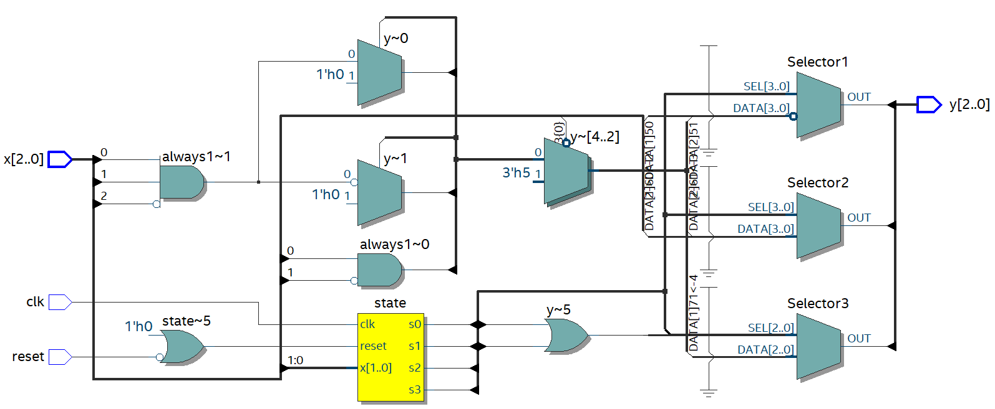
Rezultat syntezy

Slide 28
Specyfikacja automatu Moore z 2 procesami: pamęć i przejścia jako jeden proces (style 2)
always @(posedge clk, negedge reset)
if (~reset) state <= s0;
else
case (state)
s0: state = s1;
s1: if (~x[0]) state = s2;
else if (~x[1] && x[0]) state = s3;
else if (~x[2] && x[1] && x[0]) state = s4;
else state = s5;
s2: if (~x[2]) state = s4
else state = s5;
s3: state = s4;
s4: state = s0;
s5: state = s0;
endcase

Slide 29
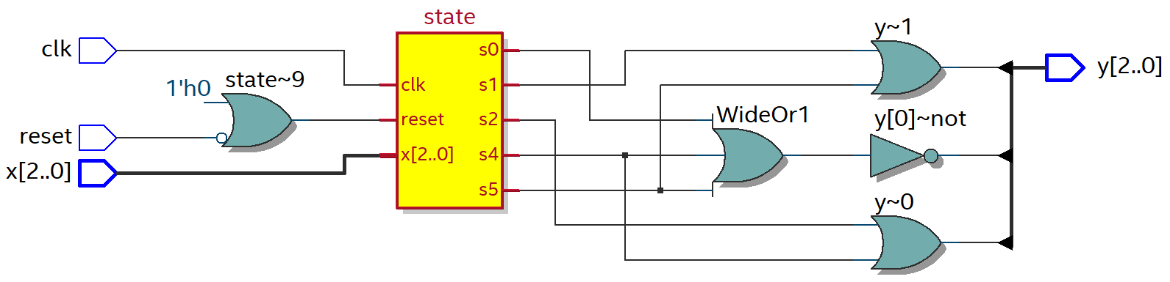
Rezultat syntezy

Slide 30
Specyfikacja automatu Mealy z 2 procesami: przejścia i wyjścia jako jeden proces (style 3)
always @(*)
case (state)
s0: begin next = s1; y = 3'b011; end
s1: if (~x[0]) begin next = s2; y = 3'b101; end
else if (~x[1] && x[0]) begin next = s3; y = 3'b001; end
else if (~x[2] && x[1] && x[0]) begin next = s0; y = 3'b100; end
else begin next = s0; y = 3'b010; end
s2: if (~x[2]) begin next = s0; y = 3'b100; end
else begin next = s0; y = 3'b010; end
s3: begin next = s0; y = 3'b100; end
endcase

Slide 31
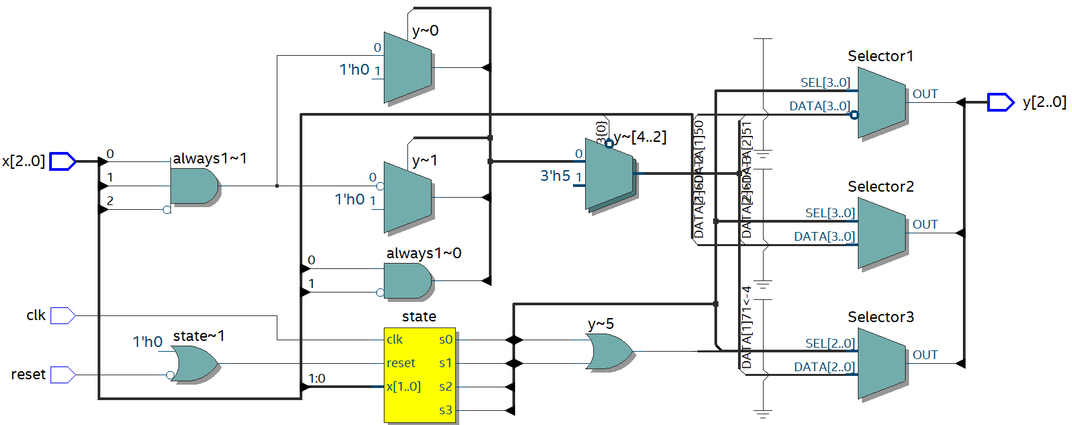
Rezultat syntezy

Slide 32
Specyfikacja automatu Moore z 2 procesami: przejścia i wyjścia jako jeden proces (style 3)

Slide 33
always @(*)
case (state)
s0: begin y = 3'b000; next = s1; end
s1: begin y = 3'b011;
if (~x[0]) next = s2;
else if (~x[1] && x[0]) next = s3;
else if (~x[2] && x[1] && x[0]) next = s4;
else next = s5;
end
s2: begin y = 3'b101;
if (~x[2]) next = s4;
else next = s5;
end
s3: begin y = 3'b001; next = s4; end
s4: begin y = 3'b100; next = s0; end
s5: begin y = 3'b010; next = s0; end
endcase

Slide 34
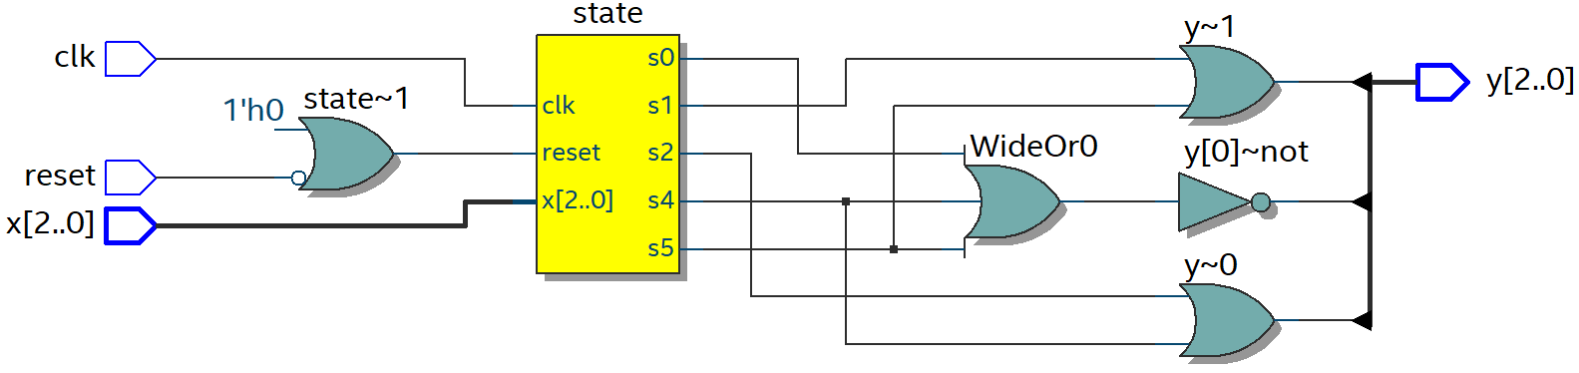
Rezultat syntezy

Slide 35
Specyfikacja automatu Mealy z 1 procesem: pamęć, przejścia i wyjścia jako jeden proces (style 4)

Slide 36
always @(posedge clk, negedge reset)
if (~reset) state <= s0;
else
case (state)
s0: begin state = s1; y = 3'b011; end
s1: if (~x[0]) begin state = s2; y = 3'b101; end
else if (~x[1] && x[0]) begin state = s3; y = 3'b001; end
else if (~x[2] && x[1] && x[0]) begin state = s0; y = 3'b100; end
else begin state = s0; y = 3'b010; end
s2: if (~x[2]) begin state = s0; y = 3'b100; end
else begin state = s0; y = 3'b010; end
s3: begin state = s0; y = 3'b100; end
endcase

Slide 37
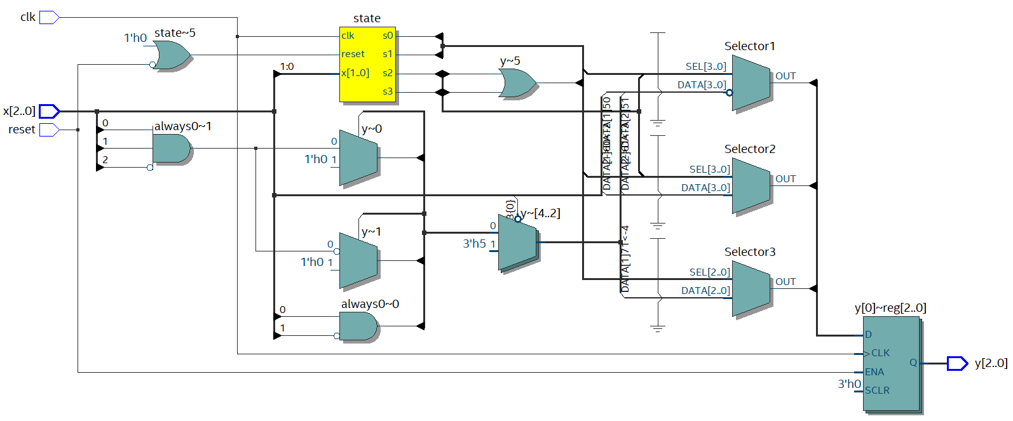
Rezultat syntezy

Slide 38
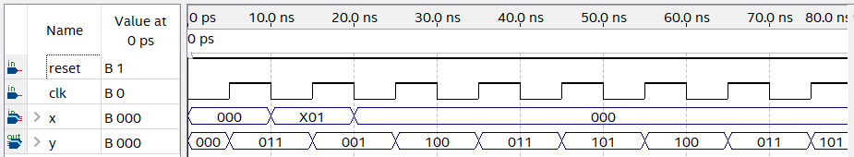
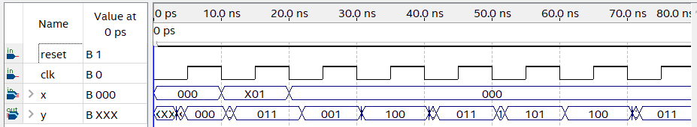
Rezultat symulacji

Slide 39
Specyfikacja automatu Moore z 1 procesem: pamęć, przejścia i wyjścia jako jeden proces (style 4)

Slide 40
always @(posedge clk, negedge reset)
if (~reset) state <= s0;
else
case (state)
s0: begin y = 3'b000; state = s1; end
s1: begin y = 3'b011;
if (~x[0]) state = s2;
else if (~x[1] && x[0]) state = s3;
else if (~x[2] && x[1] && x[0]) state = s4;
else state = s5;
end
s2: begin y = 3'b101;
if (~x[2]) state = s4;
else state = s5;
end
s3: begin y = 3'b001; state = s4; end
s4: begin y = 3'b100; state = s0; end
s5: begin y = 3'b010; state = s0; end
endcase

Slide 41
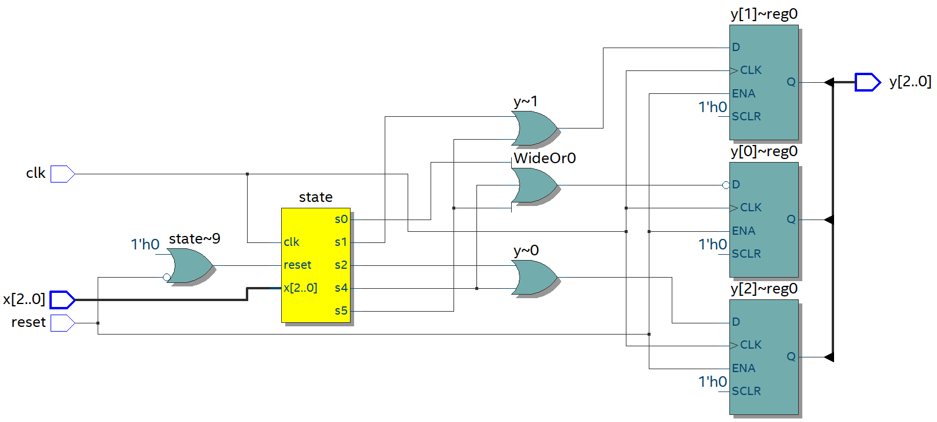
Rezultat syntezy

Slide 42
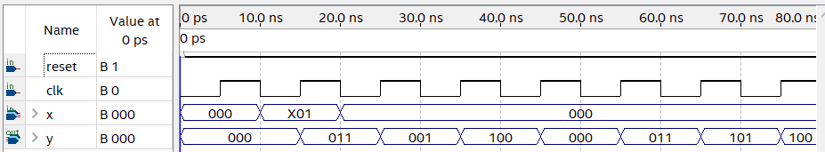
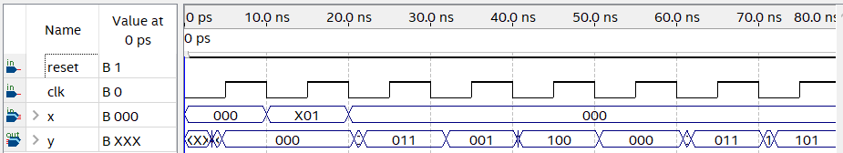
Rezultat symulacji

Slide 43
Automat Mealy z rejestrami na wyjściu (style 5)
always @(posedge clk)
case (state)
s0: y <= 3'b011;
s1: if (~x[0]) y <= 3'b101;
else if (~x[1] && x[0]) y <= 3'b001;
else if (~x[2] && x[1] && x[0]) y <= 3'b100;
else y <= 3'b010;
s2: if (~x[2]) y <= 3'b100;
else y <= 3'b010;
s3: y <= 3'b100;
endcase

Slide 44
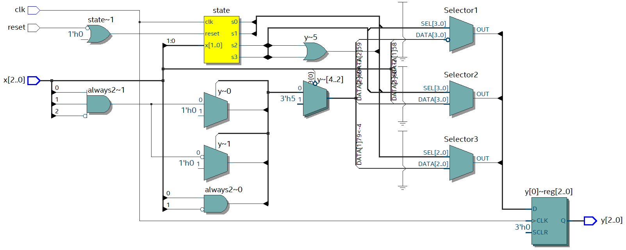
Rezultat syntezy

Slide 45
Automat Moore z rejestrami na wyjściu (style 5)
always @(posedge clk)
case (state)
s0: y <= 3'b000;
s1: y <= 3'b011;
s2: y <= 3'b101;
s3: y <= 3'b001;
s4: y <= 3'b100;
s5: y <= 3'b010;
endcase

Slide 46
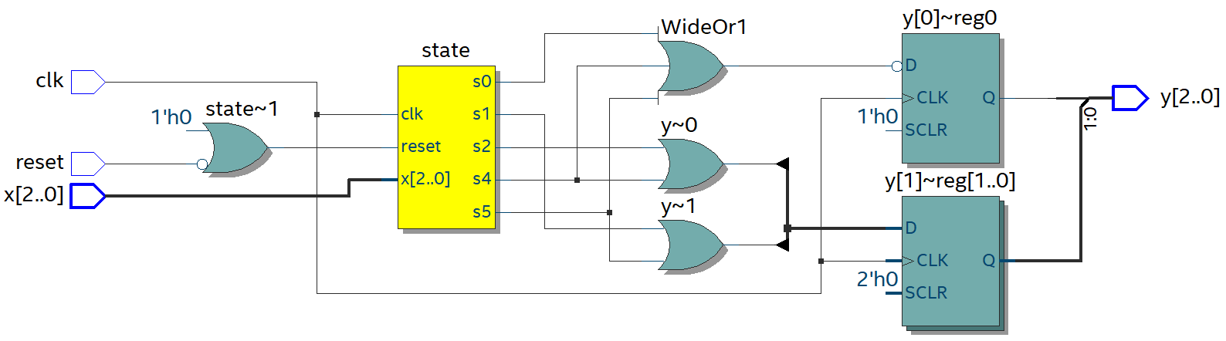
Rezultat syntezy

Slide 47
Specyfikacja automatu Mealy z 3 procesami, warunki przejść realizowany rozkazem case (style 6)
always @(*)
case (state)
s0: next = s1;
s1: casex (x)
3'b??0: next = s2;
3'b?01: next = s3;
3'b011: next = s0;
3'b111: next = s0;
endcase
s2: casex (x)
3'b0??: next = s0;
3'b1??: next = s0;
endcase
s3: next = s0;
endcase

Slide 48
always @(*)
case (state)
s0: y = 3'b011;
s1: casex (x)
3'b??0: y = 3'b101;
3'b?01: y = 3'b001;
3'b011: y = 3'b100;
3'b111: y = 3'b010;
endcase
s2: casex (x)
3'b0??: y = 3'b100;
3'b1??: y = 3'b010;
endcase
s3: y = 3'b100;
endcase

Slide 49
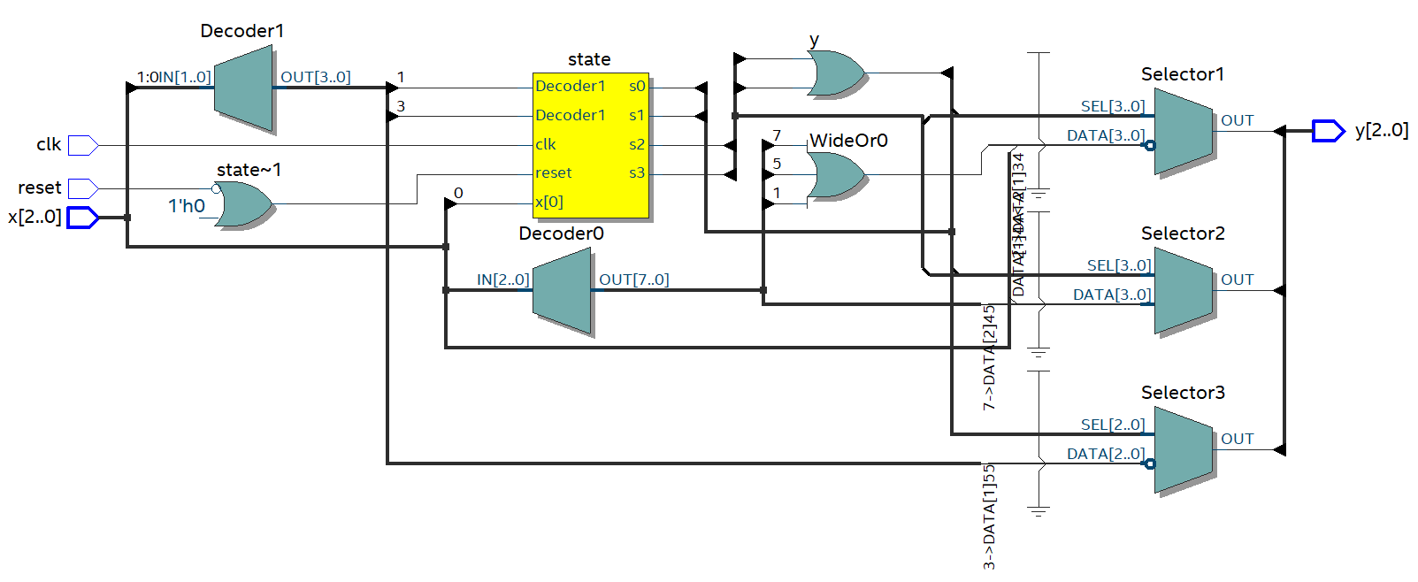
Rezultat syntezy

Slide 50
Specyfikacja automatu Moore z 3 procesami, warunki przejść realizowany rozkazem case (style 6)
always @(*)
case (state)
s0: next = s1;
s1: casex (x)
3'b??0: next = s2;
3'b?01: next = s3;
3'b011: next = s4;
3'b111: next = s5;
endcase
s2: casex (x)
3'b0??: next = s0;
3'b1??: next = s0;
endcase
s3: next = s4;
s4: next = s0;
s5: next = s0;
endcase

Slide 51
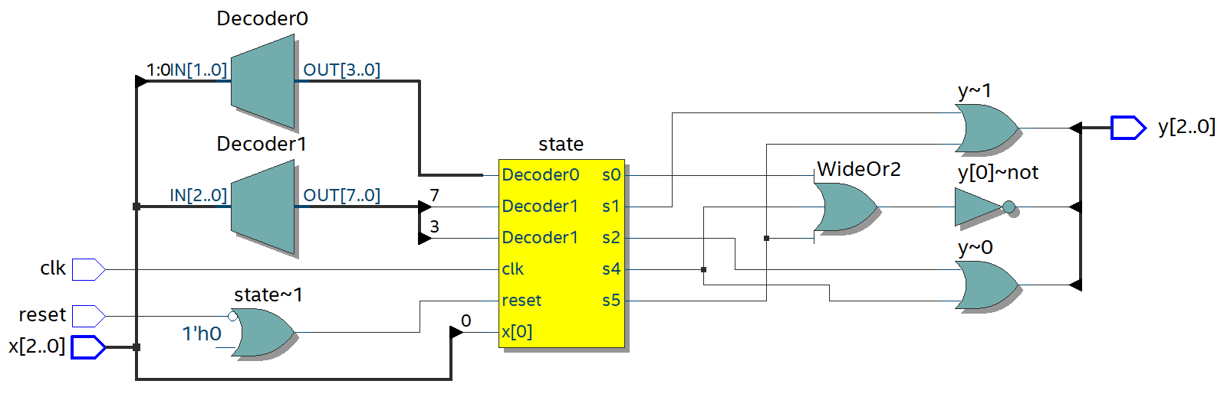
Rezultat syntezy

Slide 52
Niezawodny automat Mealy z 3 procesami (style 7)
always @(*)
case (state)
s0: next = s1;
s1: if (~x[0]) next = s2;
else if (~x[1] && x[0]) next = s3;
else if (~x[2] && x[1] && x[0]) next = s0;
else next = s0;
s2: if (~x[2]) next = s0;
else next = s0;
s3: next = s0;
default: next = s0;
endcase

Slide 53
always @(*)
case (state)
s0: y = 3'b011;
s1: if (~x[0]) y = 3'b101;
else if (~x[1] && x[0]) y = 3'b001;
else if (~x[2] && x[1] && x[0]) y = 3'b100;
else y = 3'b010;
s2: if (~x[2]) y = 3'b100;
else y = 3'b010;
s3: y = 3'b100;
default: y = 3'b000;
endcase

Slide 54

Rezultat syntezy

Slide 55
Niezawodny automat Moore z 3 procesami (style 7)
always @(*)
case (state)
s0: next = s1;
s1: if (~x[0]) next = s2;
else if (~x[1] && x[0]) next = s3;
else if (~x[2] && x[1] && x[0]) next = s4;
else next = s5;
s2: if (~x[2]) next = s4;
else next = s5;
s3: next = s4;
s4: next = s0;
s5: next = s0;
default: next = s0;
endcase

Slide 56
always @(*)
case (state)
s0: y = 3'b000;
s1: y = 3'b011;
s2: y = 3'b101;
s3: y = 3'b001;
s4: y = 3'b100;
s5: y = 3'b010;
default: y = 3'b000;
endcase

Slide 57
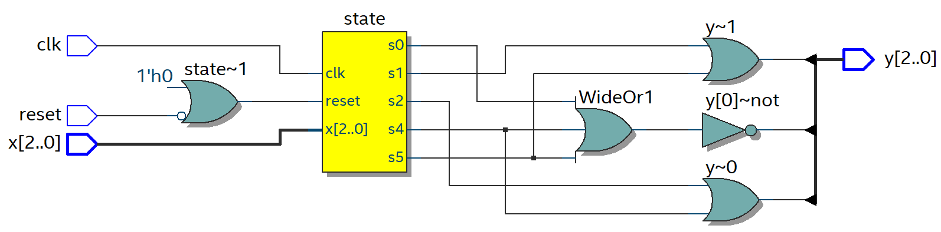
Rezultat syntezy

Slide 58
Superniezawodny automat Mealy z 3 procesami (style 8)

Slide 59
always @(*)
case (state)
s0: next = s1;
s1: casex (x)
3'b??0: next = s2;
3'b?01: next = s3;
3'b011: next = s0;
3'b111: next = s0;
default: next = s1;
endcase
s2: casex (x)
3'b0??: next = s0;
3'b1??: next = s0;
default: next = s2;
endcase
s3: next = s0;
default: next = s0;
endcase

Slide 60
always @(*)
case (state)
s0: y = 3'b011;
s1: casex (x)
3'b??0: y = 3'b101;
3'b?01: y = 3'b001;
3'b011: y = 3'b100;
3'b111: y = 3'b010;
default: y = 3'b000;
endcase
s2: casex (x)
3'b0??: y = 3'b100;
3'b1??: y = 3'b010;
default: y = 3'b000;
endcase
s3: y = 3'b100;
default: y = 3'b000;
endcase

Slide 61

Rezultat syntezy

Slide 62
Superniezawodny automat Moore z 3 procesami (style 8)

Slide 63
always @(*)
case (state)
s0: next = s1;
s1: casex (x)
3'b??0: next = s2;
3'b?01: next = s3;
3'b011: next = s4;
3'b111: next = s5;
default: next = s1;
endcase
s2: casex (x)
3'b0??: next = s0;
3'b1??: next = s0;
default: next = s2;
endcase
s3: next = s4;
s4: next = s0;
s5: next = s0;
default: next = s0;
endcase

Slide 64
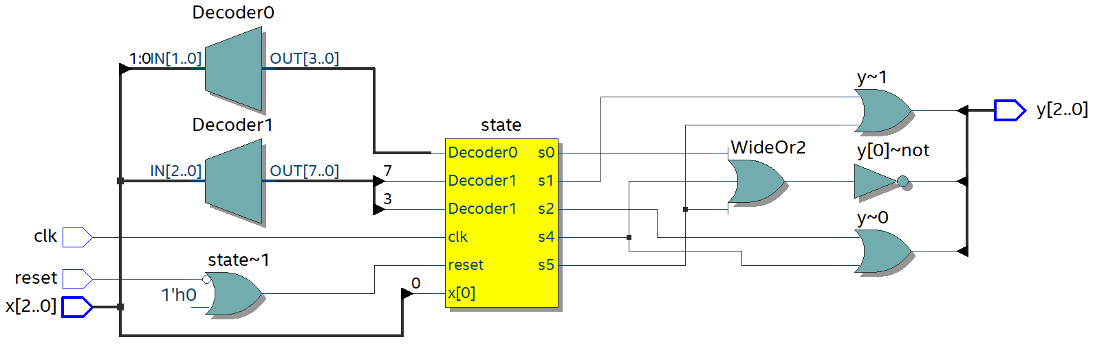
Rezultat syntezy

Slide 65
Wyniki badań specyfikacii automatów Mealy
Styles | MAX II |  | MAX V |  | MAX 10 |  | Arria II |  | Cyclone IV |  | Cyclone V |  | Cyclone 10
 | L | F | L | F | L | F | L | F | L | F | L | F | L | F
1,2,3,7 | 10 | 539 | 10 | 310 | 11 | 760 | 7 | 1241 | 10 | 935 | 5 | 701 | 10 | 891
4 | 10 | 466 | 10 | 257 | 11 | 572 | 7 | 1174 | 10 | 785 | 5 | 646 | 11 | 572
5 | 10 | 459 | 10 | 236 | 11 | 644 | 7 | 1144 | 10 | 799 | 5 | 672 | 10 | 777
6,8 | 10 | 539 | 10 | 310 | 11 | 760 | 7 | 1217 | 10 | 935 | 5 | 703 | 10 | 891
Best | 10 | 539 | 10 | 310 | 11 | 760 | 7 | 1241 | 10 | 935 | 5 | 703 | 10 | 891

Slide 66
Wyniki badań specyfikacii automatów Moore
Styles | MAX II |  | MAX V |  | MAX 10 |  | Arria II |  | Cyclone IV |  | Cyclone V |  | Cyclone 10
 | L | F | L | F | L | F | L | F | L | F | L | F | L | F
1,2,3,7 | 10 | 504 | 10 | 276 | 12 | 748 | 9 | 1175 | 11 | 833 | 6 | 669 | 11 | 902
4 | 10 | 491 | 10 | 280 | 12 | 680 | 9 | 1115 | 11 | 902 | 6 | 656 | 11 | 820
5 | 10 | 504 | 10 | 274 | 12 | 675 | 9 | 1168 | 11 | 895 | 6 | 670 | 11 | 917
6,8 | 10 | 572 | 10 | 314 | 11 | 805 | 9 | 1086 | 10 | 962 | 5 | 701 | 10 | 964
Best | 10 | 572 | 10 | 314 | 11 | 805 | 9 | 1175 | 10 | 962 | 5 | 701 | 10 | 964

Slide 67
Kodowanie stanów automatów skończonych

Slide 68
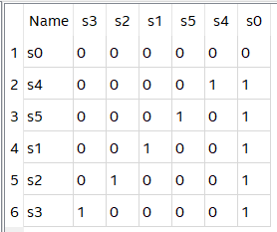
Auto

Slide 69
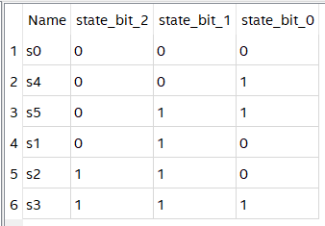
Gray

Slide 70
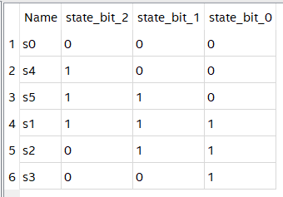
Johnson

Slide 71
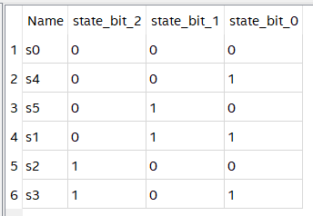
Minimal Bits

Slide 72
One-Hot

Slide 73

Sequential

Slide 74
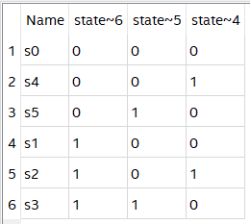
User-Encoded

Slide 75
Wyniki badań kodowania stanów automatów Mealy
Styles | MAX II |  | MAX V |  | MAX 10 |  | Arria II |  | Cyclone IV |  | Cyclone V |  | Cyclone 10
 | L | F | L | F | L | F | L | F | L | F | L | F | L | F
1,5 | 10 | 539 | 10 | 310 | 11 | 760 | 7 | 1241 | 10 | 935 | 5 | 701 | 10 | 891
2,3 | 7 | 646 | 7 | 384 | 8 | 1071 | 5 | 1422 | 7 | 1229 | 4 | 730 | 7 | 1221
4,6,7 | 7 | 633 | 7 | 383 | 8 | 1073 | 5 | 1422 | 7 | 1232 | 4 | 730 | 7 | 1221
Best Mealy | 7 | 646 | 7 | 384 | 8 | 1073 | 5 | 1422 | 7 | 1232 | 4 | 730 | 7 | 1221
1 – Auto; 2 – Gray; 3 – Johnson; 4 – Minimal Bits;
5 – One-Hot; 6 – Sequential; 7 – User-Encoded

Slide 76
Wyniki badań kodowania stanów automatów Moore
Styles | MAX II |  | MAX V |  | MAX 10 |  | Arria II |  | Cyclone IV |  | Cyclone V |  | Cyclone 10
 | L | F | L | F | L | F | L | F | L | F | L | F | L | F
1,5 | 10 | 504 | 10 | 276 | 12 | 748 | 9 | 1175 | 11 | 833 | 6 | 669 | 11 | 902
2 | 8 | 409 | 8 | 212 | 8 | 631 | 6 | 1134 | 7 | 789 | 4 | 686 | 7 | 787
3 | 8 | 503 | 8 | 300 | 9 | 666 | 6 | 1134 | 8 | 836 | 4 | 670 | 8 | 836
4,6 | 8 | 416 | 8 | 234 | 8 | 582 | 5 | 1171 | 7 | 737 | 4 | 685 | 7 | 725
7 | 7 | 516 | 7 | 250 | 7 | 664 | 4 | 1148 | 7 | 837 | 4 | 678 | 7 | 833
Best Moore | 7 | 516 | 7 | 300 | 7 | 748 | 4 | 1175 | 7 | 837 | 4 | 686 | 7 | 902

Slide 77
Porównanie automatów Mealy i Moore
Styles | MAX II |  | MAX V |  | MAX 10 |  | Arria II |  | Cyclone IV |  | Cyclone V |  | Cyclone 10
 | L | F | L | F | L | F | L | F | L | F | L | F | L | F
Best Mealy | 7 | 646 | 7 | 384 | 8 | 1073 | 5 | 1422 | 7 | 1232 | 4 | 730 | 7 | 1221
Best Moore | 7 | 516 | 7 | 300 | 7 | 748 | 4 | 1175 | 7 | 837 | 4 | 686 | 7 | 902

Slide 78
Metoda kodowania stanów dla minimalizacji kosztów realizacji

Slide 79
Tablica przejść automatu Moore
a_{m} | X(a_{m}, a_{s}) x₂x₁x₀ | Y(a_{m}, a_{s}) y₂y₁y₀ | a_{s}
s₀ | - - - | 0 0 0 | s₁
s₁ | - - 0 | 0 1 1 | s₂
s₁ | - 0 1 | 0 1 1 | s₃
s₁ | 0 1 1 | 0 1 1 | s₄
s₁ | 1 1 1 | 0 1 1 | s₅
s₂ | 0 - - | 1 0 1 | s₄
s₂ | 1 - - | 1 0 1 | s₅
s₃ | - - - | 0 0 1 | s₄
s₄ | - - - | 1 0 0 | s₀
s₅ | - - - | 0 1 0 | s₀

Slide 80
Możliwe kody
000
001
010
011
100
101
110
111

Slide 81
Wybór kodów
a_{m} | C(a_{m}) | K(a_{m})
s₀ | 2 | 000
s₁ | 1 | 100
s₂ | 1 | 101
s₃ | 1 | 110
s₄ | 4 | 001
s₅ | 2 | 010

