Slide 1
W_9_2. Pamięć

Slide 2
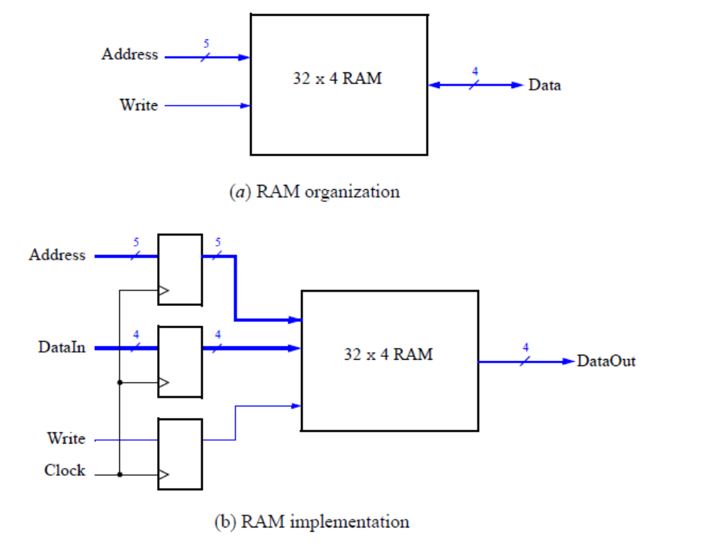
Pamięć 32 x 4 RAM

Slide 3
Tworzenie pamięci w Quartus
Tools > IP Catalog
Basic Functions > On Chip Memory
RAM: 1-PORT module
HDL Verilog > ram32x4.v > OK

Slide 4
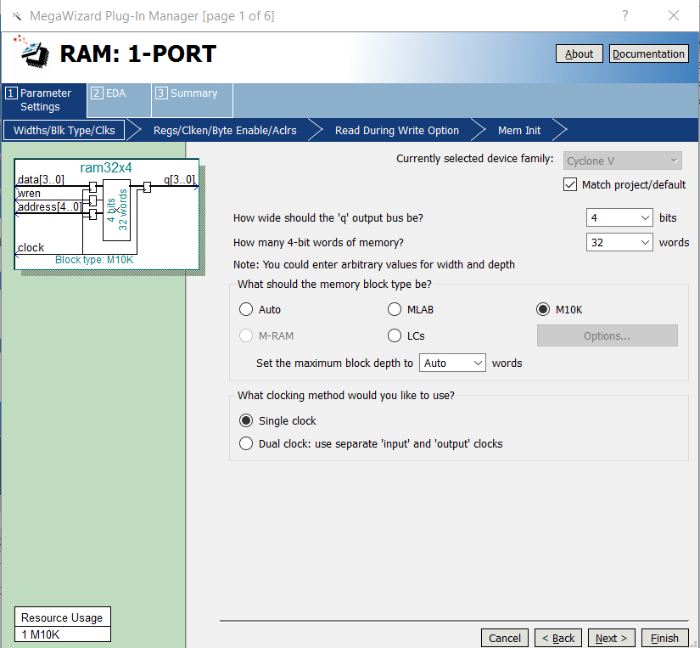

Slide 5
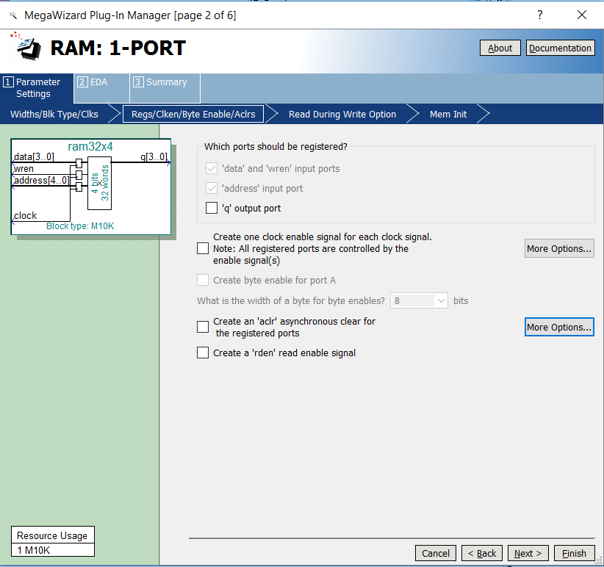

Slide 6
Kod moduła
module my_ram32x4(
input [4:0] Address,
input clk,
input [3:0] DataIn,
input Write,
output [3:0] DataOut);
ram32x4 my(Address,clk,DataIn,Write,DataOut);
endmodule

Slide 7
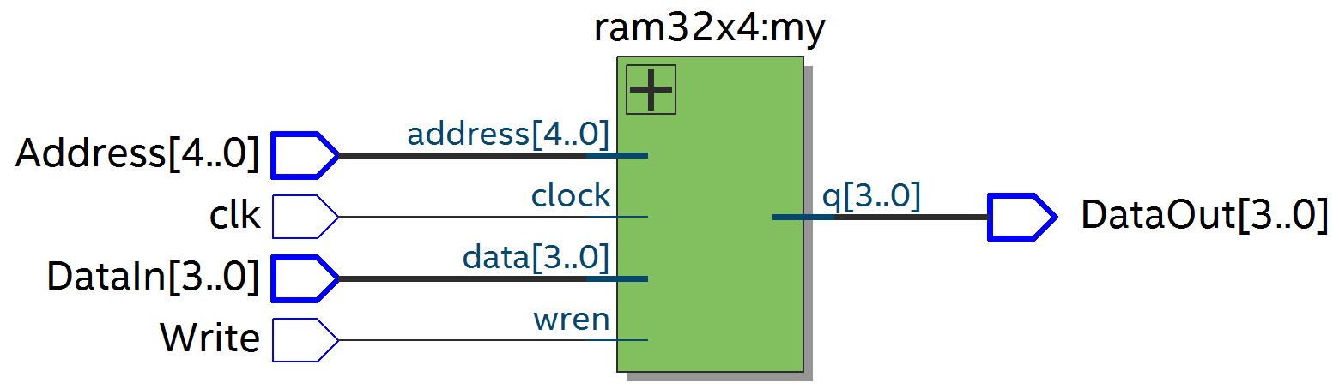
Rezultat syntezy

Slide 8
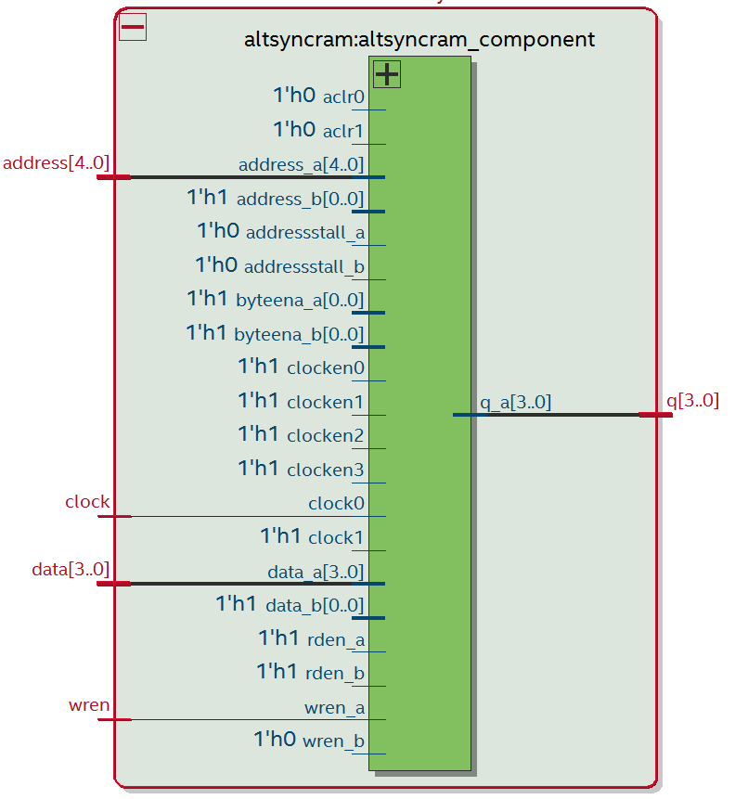
Rezultat syntezy

Slide 9
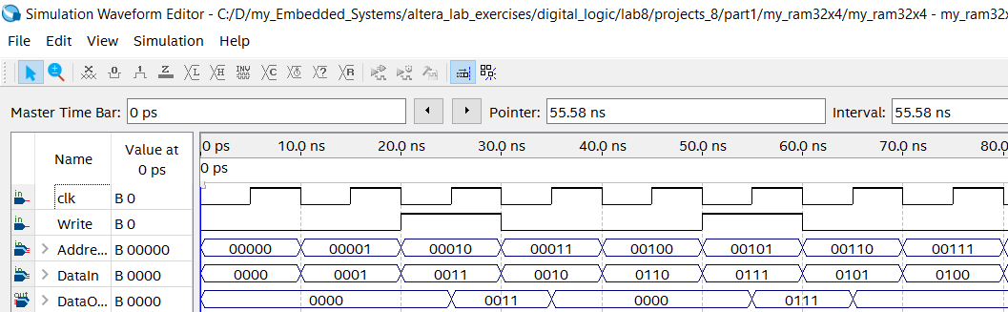
Rezultat symulacji

Slide 10
Część 2. Realizacja pamięci na plycie DE1-SoC
module lab8_part2(
input [9:0] SW,
input [1:0] KEY,
output [0:6] HEX0,HEX2,HEX4,HEX5);
wire [3:0] h0;
ram32x4 exm(SW[8:4],KEY[0],SW[3:0],SW[9],h0);
decoder_hex_16 d5({3'b000,SW[8]},HEX5);
decoder_hex_16 d4(SW[7:4],HEX4);
decoder_hex_16 d2(SW[3:0],HEX2);
decoder_hex_16 d0(h0,HEX0);
endmodule

Slide 11
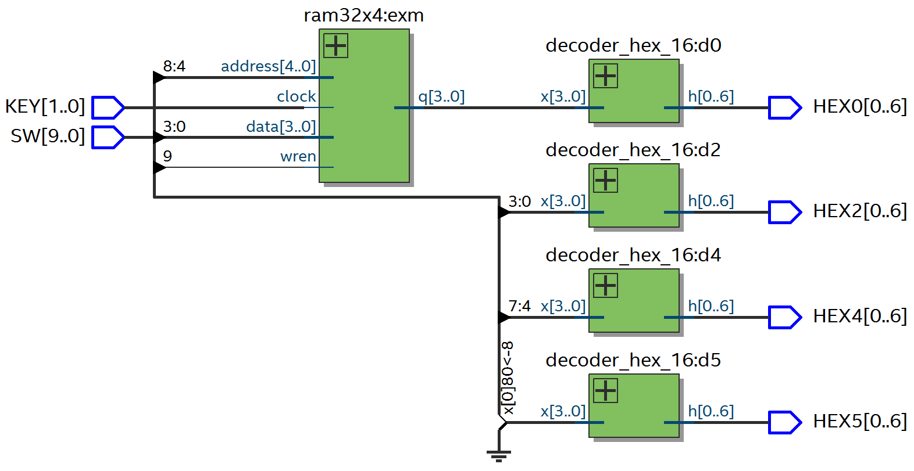
Rezultat syntezy

Slide 12
Część 3. Realizacja pamięci w Verilog
module my_ram32x4_3(
input [4:0] Address,
input clk,
input [3:0] DataIn,
input Write,
output [3:0] DataOut);
reg [3:0] memory_array[31:0];
reg [4:0] reg_Address;
reg [3:0] reg_DataIn;
reg reg_Write;

Slide 13
always @(posedge clk)
begin
reg_Address <= Address;
reg_DataIn <= DataIn;
reg_Write <= Write;
end
always @(*)
if (reg_Write) memory_array[reg_Address] = reg_DataIn;
assign DataOut = memory_array[reg_Address];
endmodule

Slide 14
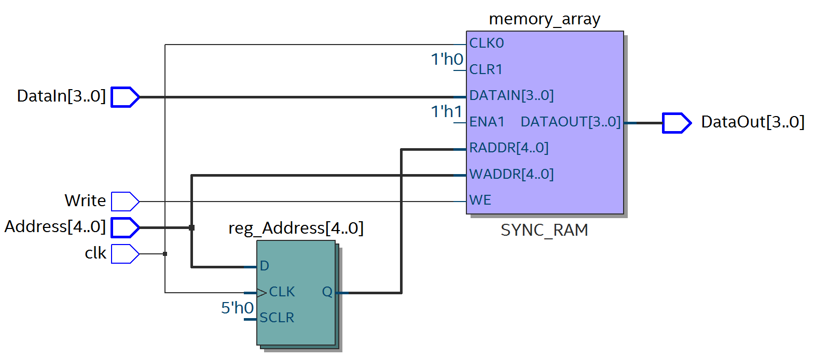
Rezultat syntezy

Slide 15
Realizacja na płycie
module lab8_part3(
input [9:0] SW,
input [1:0] KEY,
output [0:6] HEX0,HEX2,HEX4,HEX5);
wire [3:0] h0;
my_ram32x4_3 exm(SW[8:4],KEY[0],SW[3:0],SW[9],h0);
decoder_hex_16 d5({3'b000,SW[8]},HEX5);
decoder_hex_16 d4(SW[7:4],HEX4);
decoder_hex_16 d2(SW[3:0],HEX2);
decoder_hex_16 d0(h0,HEX0);
endmodule

Slide 16
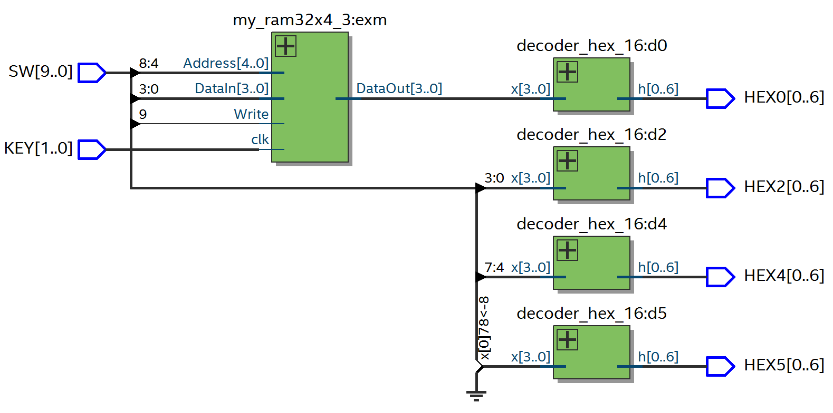
Rezultat syntezy

Slide 17
Część 4. Realizacja pamięci RAM: 2-PORT module
IP Catalog
Basic Functions > On Chip Memory
RAM: 2-PORT module
How will you be using the dual port ram?
With one read port and one write port

Slide 18
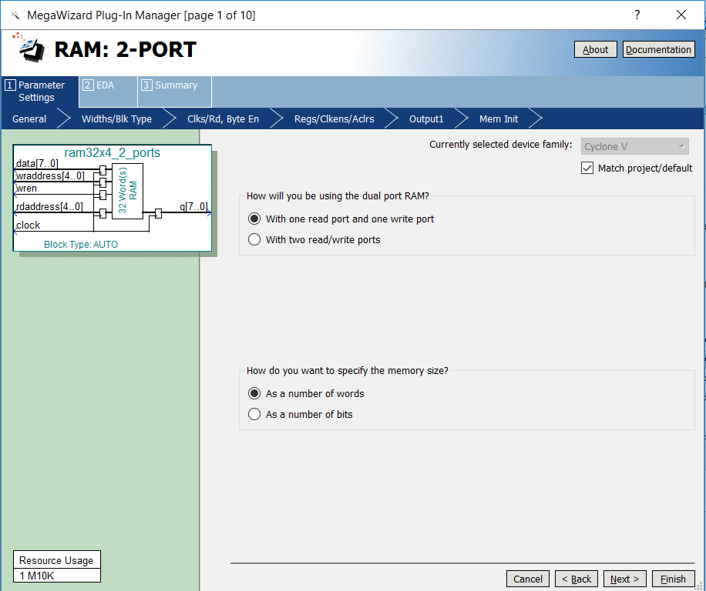

Slide 19
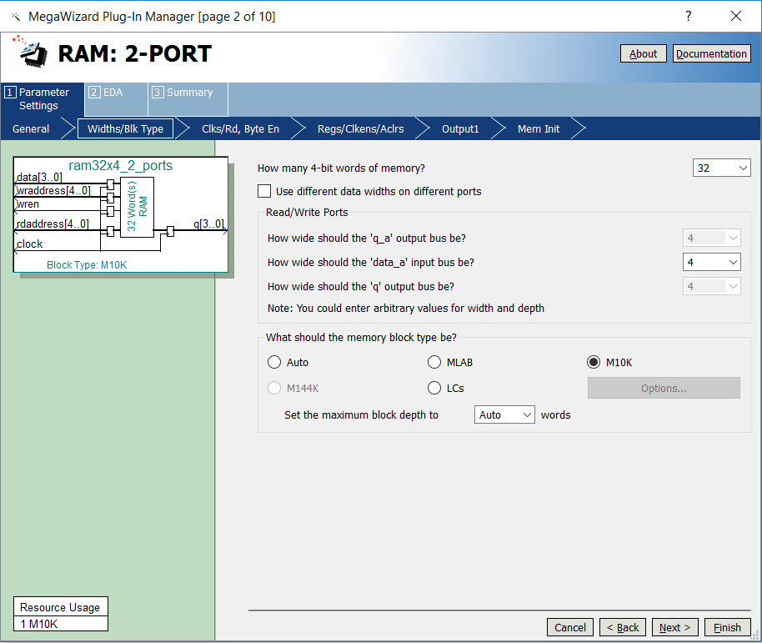

Slide 20
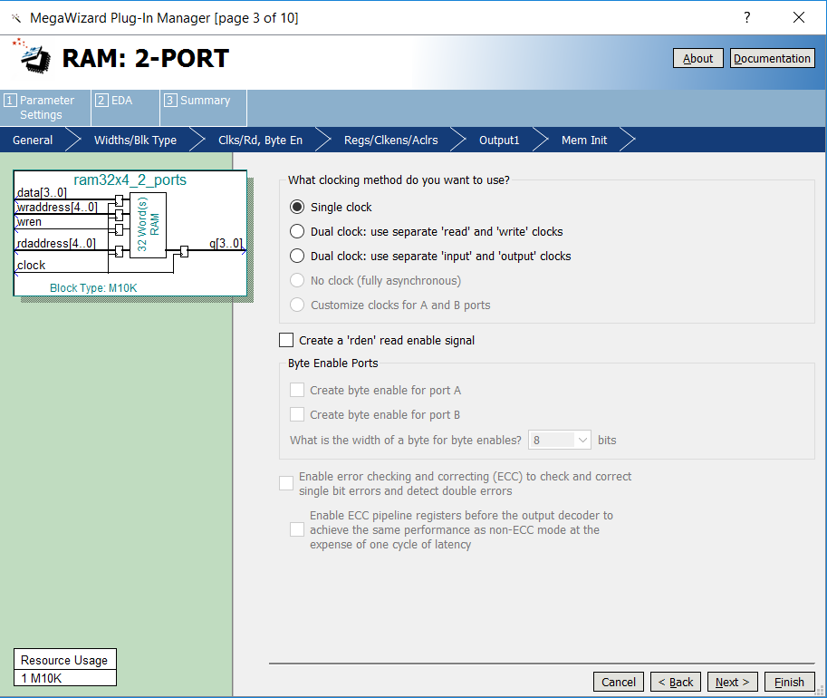

Slide 21
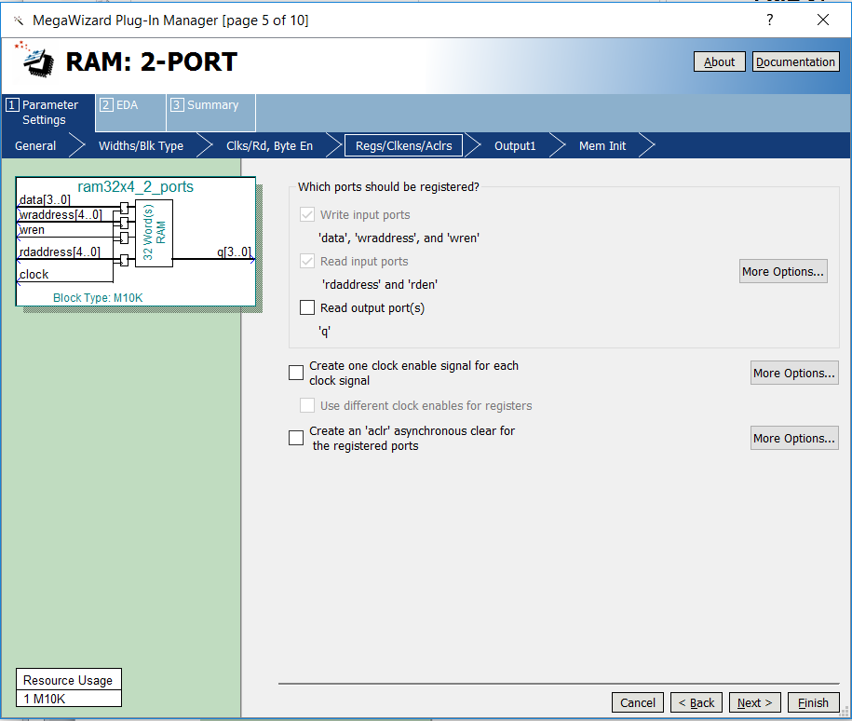

Slide 22
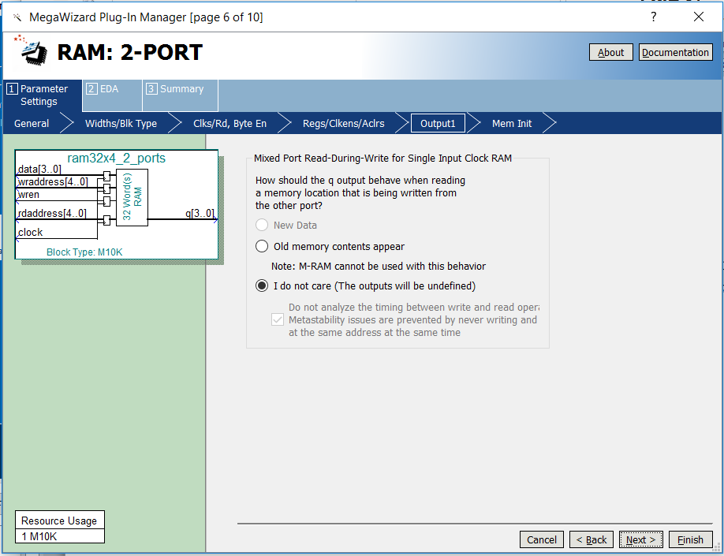

Slide 23
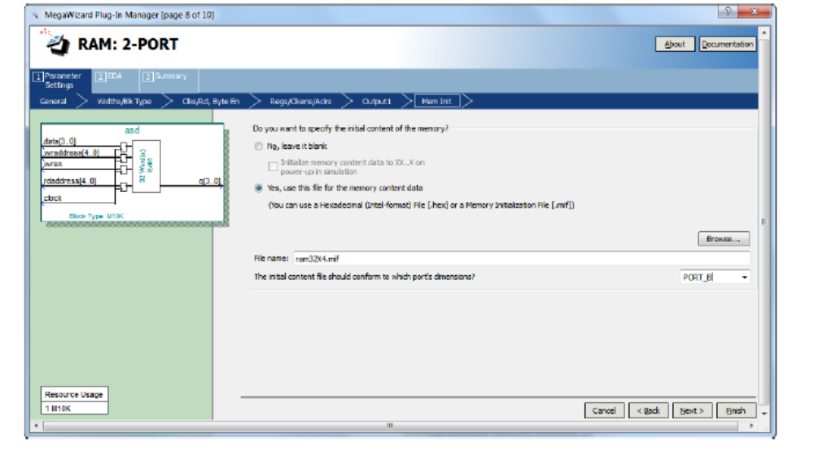
Tworzenie pliku .mif

Slide 24
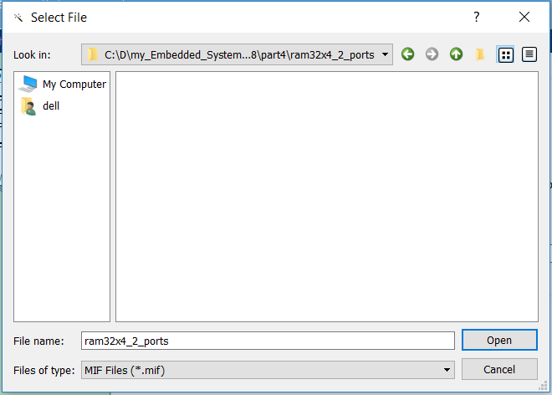

Slide 25
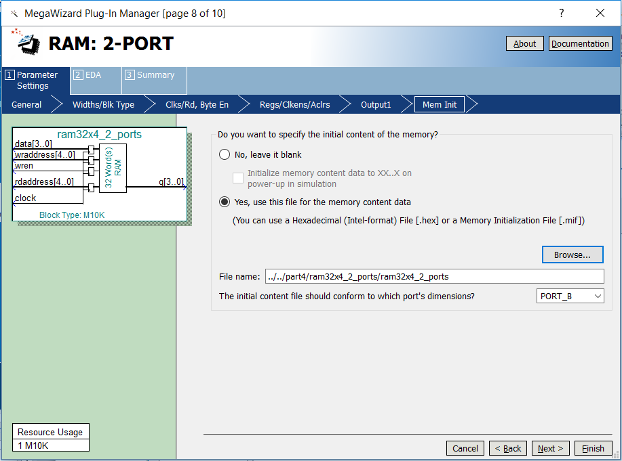

Slide 26
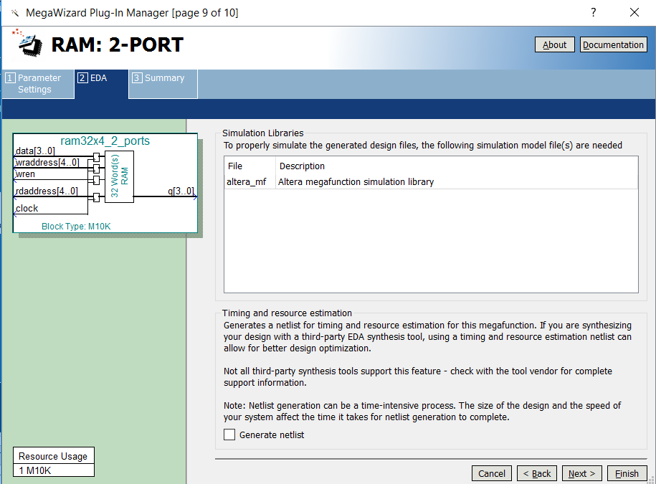

Slide 27
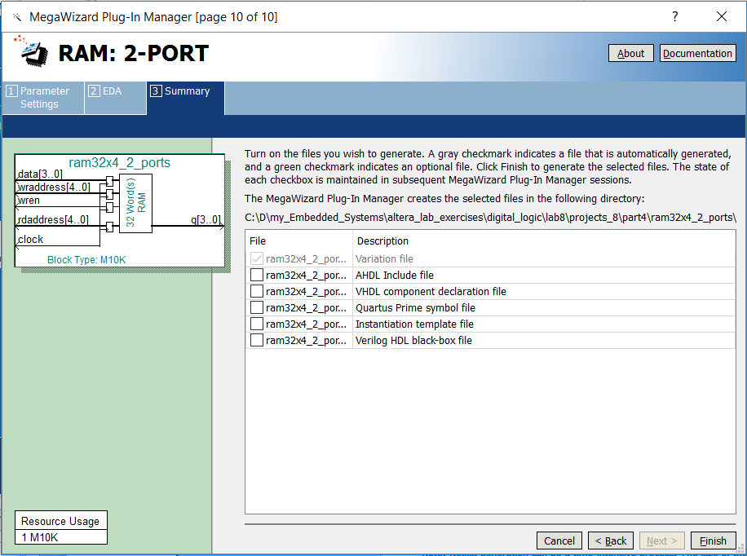

Slide 28
Plik .mif
DEPTH = 32;
WIDTH = 4;
ADDRESS_RADIX = HEX;
DATA_RADIX = BIN;
CONTENT
BEGIN
0 : 0000;
1 : 0001;
2 : 0010;
3 : 0011;
… (some lines not shown)
1E : 1110;
1F : 1111;
END;

Slide 29
Realizacja pamięci na płycie
module lab8_part4(
input CLOCK_50,
input [9:0] SW,
input [1:0] KEY,
output [0:6] HEX0,HEX1,HEX2,HEX3,HEX4,HEX5);
wire clk_1_sec;
wire [4:0] read_addr;
wire [3:0] q;

Slide 30
delay_1_sec del_1_sec(CLOCK_50,clk_1_sec);
counter_N_bits #(5) cnt_addr(clk_1_sec,KEY[0],1'b1,read_addr);
ram32x4_2_ports mem(CLOCK_50,SW[3:0],read_addr,SW[8:4],SW[9],q);
decoder_hex_16 d0(q,HEX0);
decoder_hex_16 d1(SW[3:0],HEX1);
decoder_hex_16 d2(read_addr[3:0],HEX2);
decoder_hex_16 d3({3'b000,read_addr[4]},HEX3);
decoder_hex_16 d4(SW[7:4],HEX4);
decoder_hex_16 d5({3'b000,SW[8]},HEX5);
endmodule

Slide 31
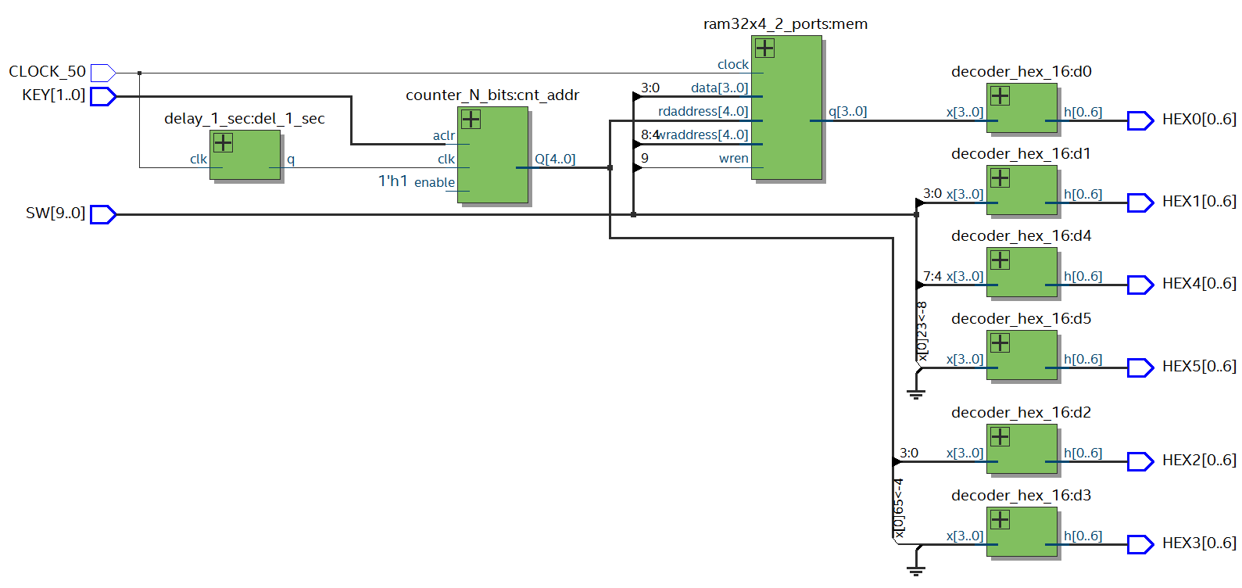
Rezultat syntezy

