Slide 2
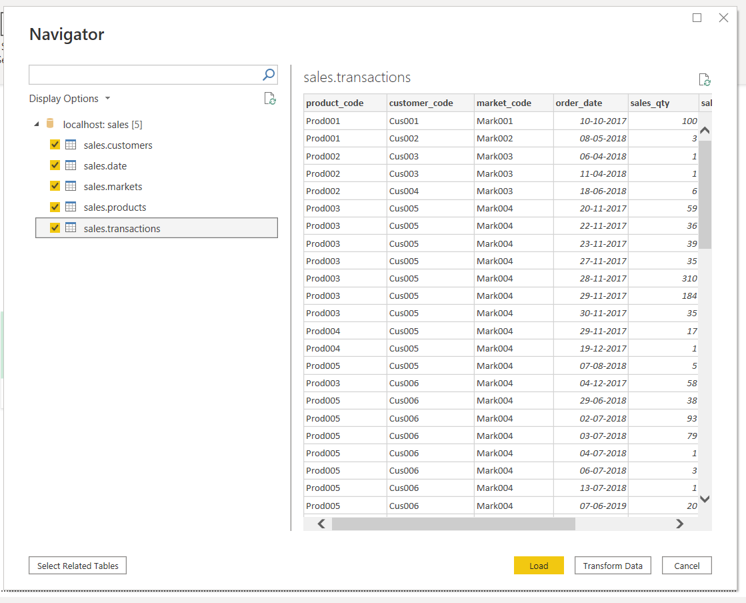
Connect to SQL and load all the tables in DB

Slide 3
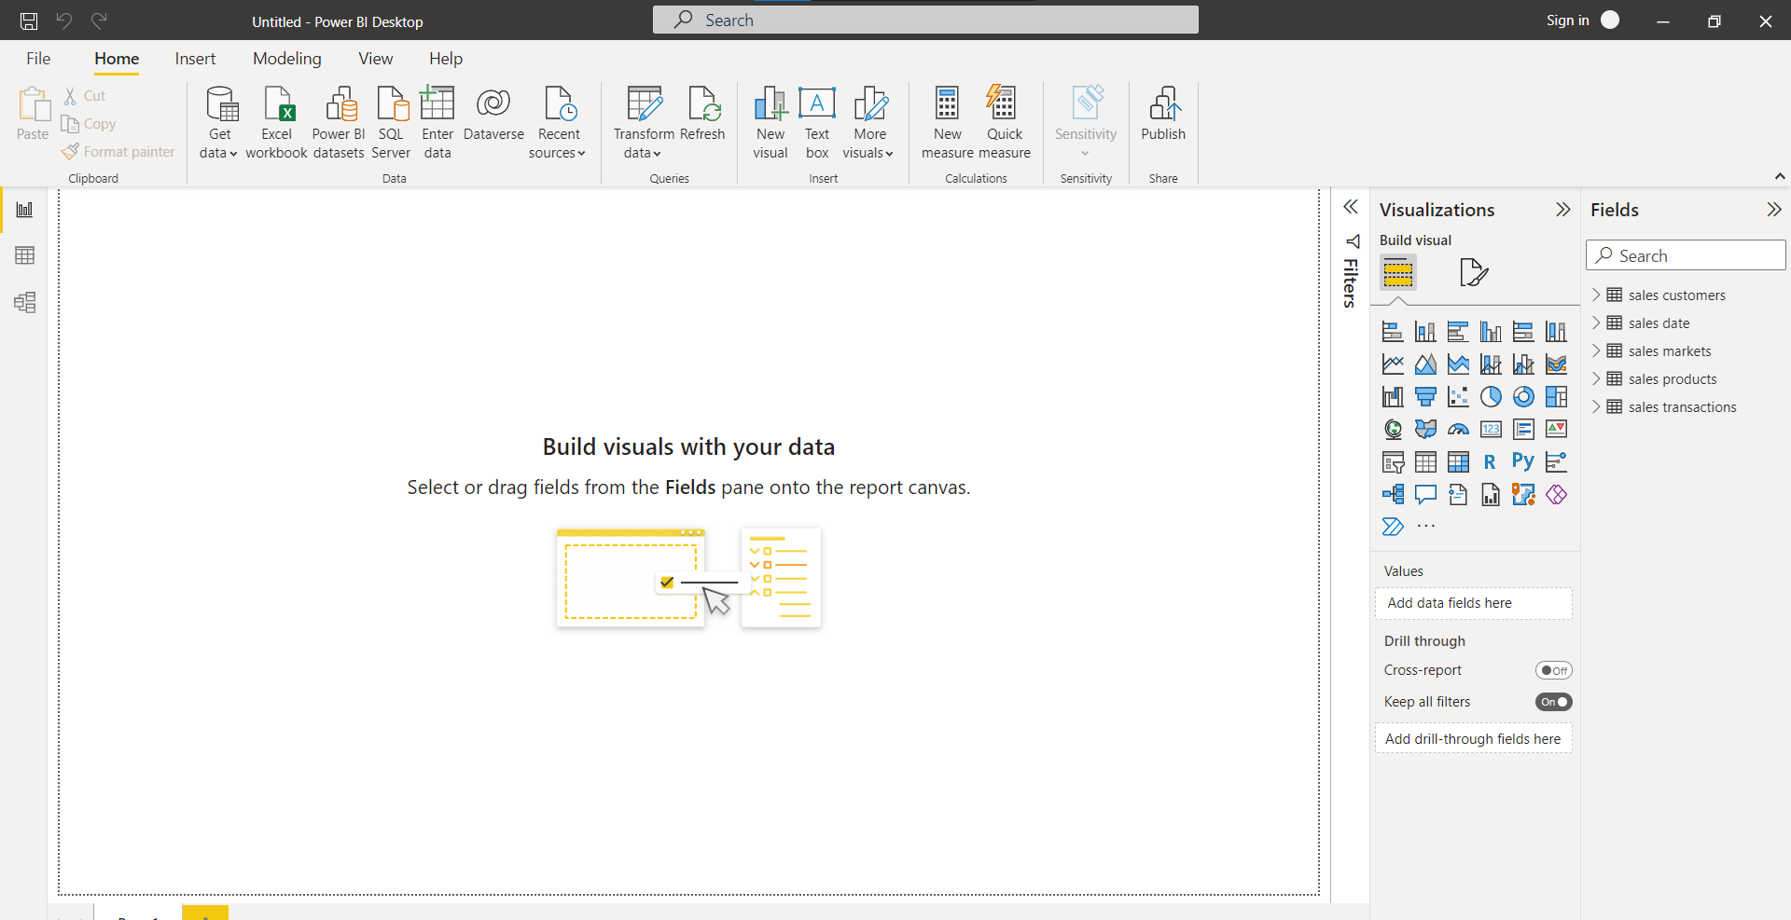
Different windows available in the left border. On right most column the loaded tables are seen

Slide 4
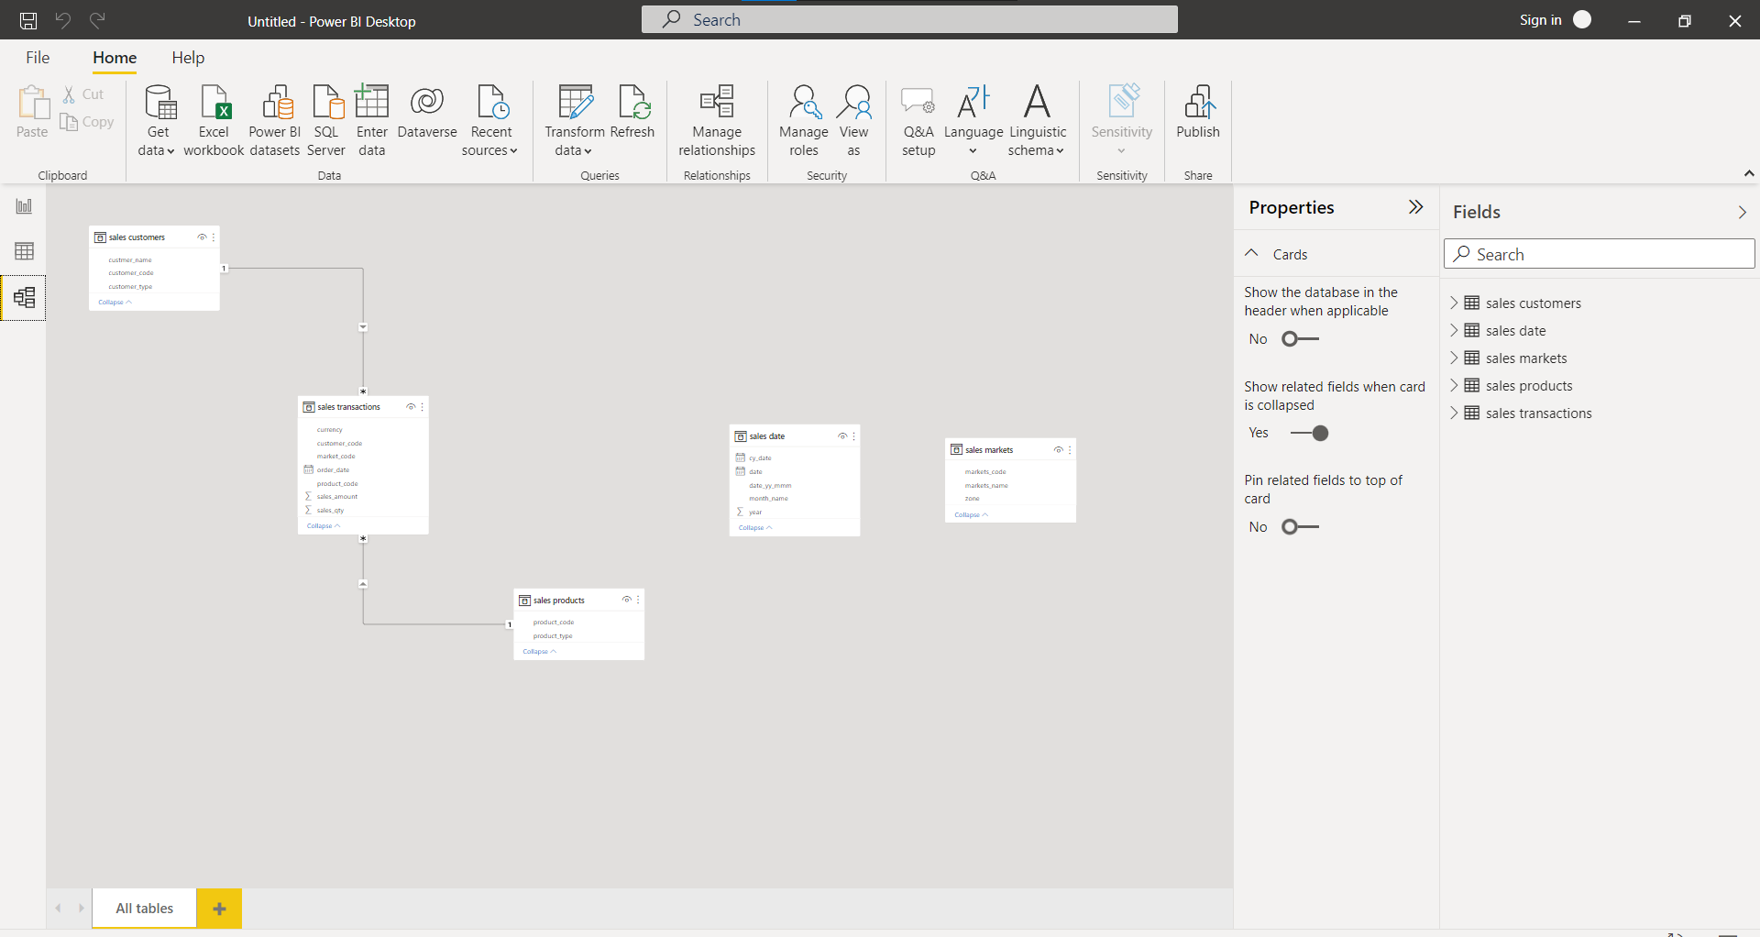
Last button has the model schema, here the star schema. Ensure that the schema is properly established.
STAR SCHEMA explained in the next slide

Slide 5
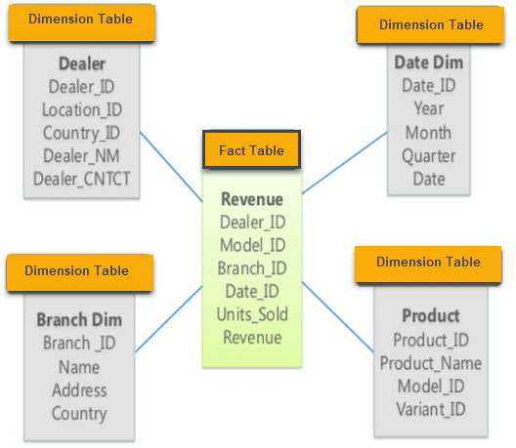
Contains the primary table called FACT TABLE and other tables that are called DIMENSION TABLE.
The fact table is having common columns to the dimension tables and connecting that common table we make the star schema.
This multiple table system is an outcome of Normalized Data Storage System in RDMS where the entire tables are not stored all at once and rather they are divided into logical parts and stored separately and hence most often we do JOIN operations in the RDMS to get the desired table we want.

Slide 6
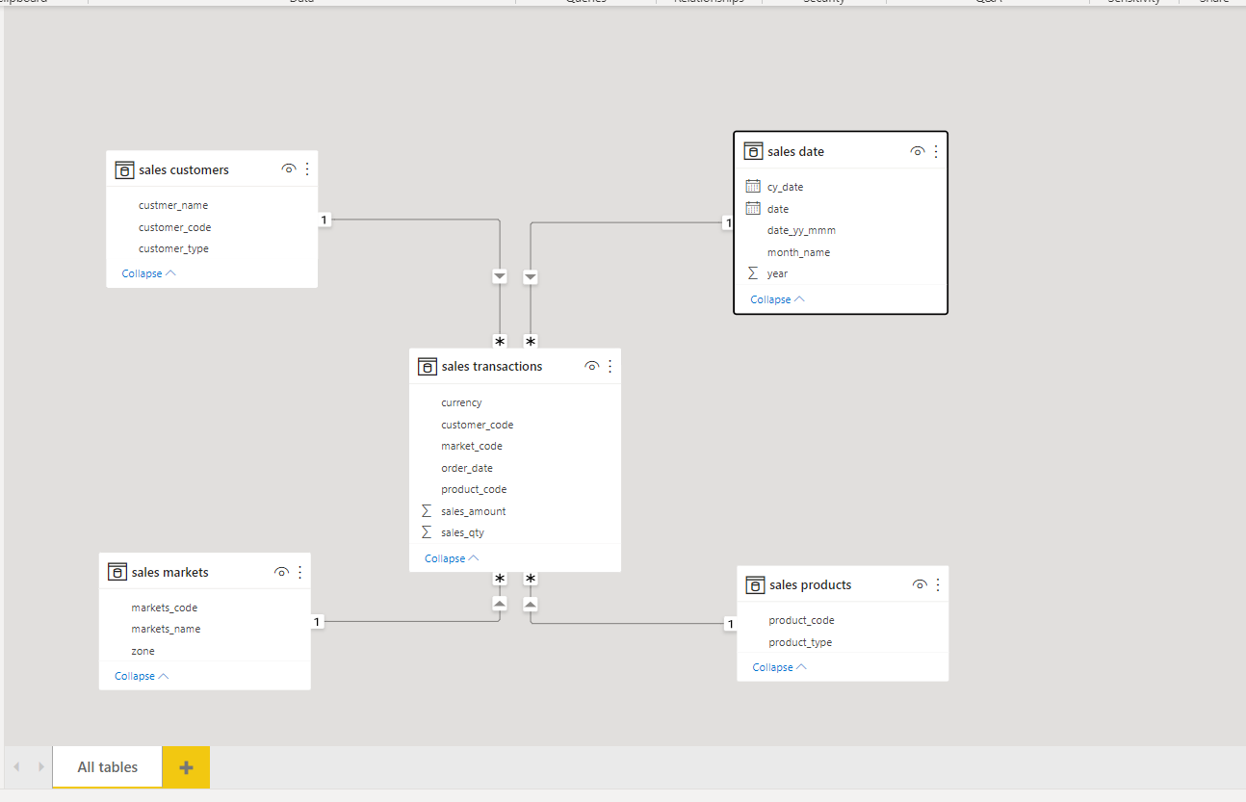
Appropriate schema is established by dragging and dropping common columns from the dimension table to the fact table over that common column. (The column name can be different but the content matter)

Slide 7
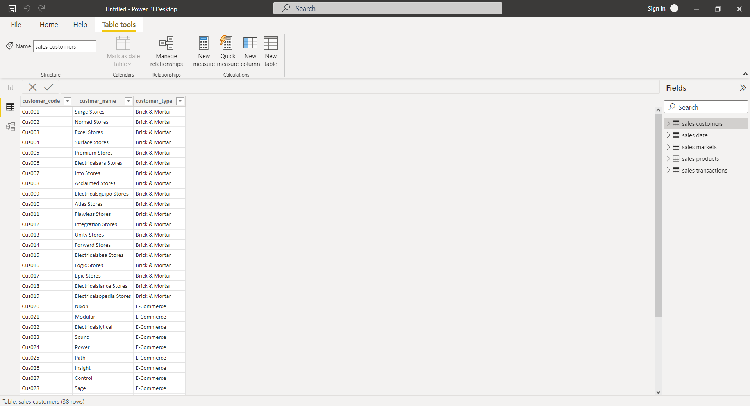
Go to second button and click to get a window where ETL and all Data Engineering can be conducted

Slide 8
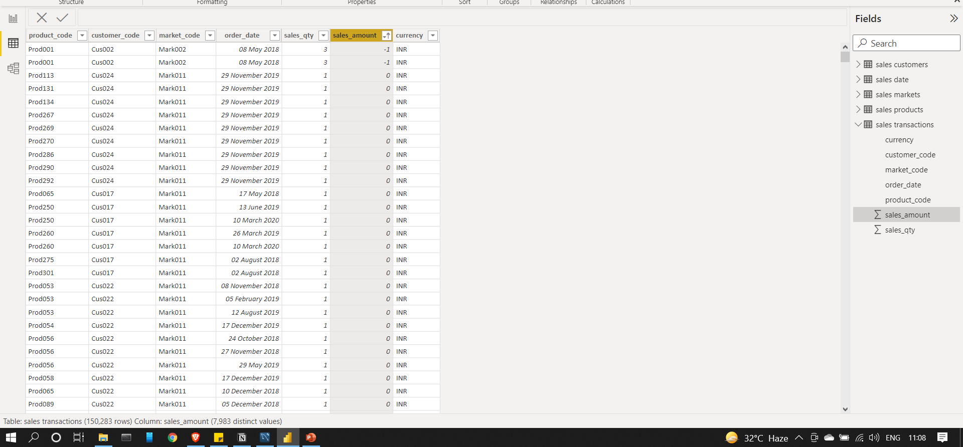
In the Transactions table, some records have 0 sales_amount and some have -1, this is garbage value as it does not make on selling items at -1 and 0 rate. Hence, they are needed to be filtered.
There are transactions made in USD and we need all the transitions in terms of INR only, So we need to make new column where we will have normalized sales_amount

Slide 9
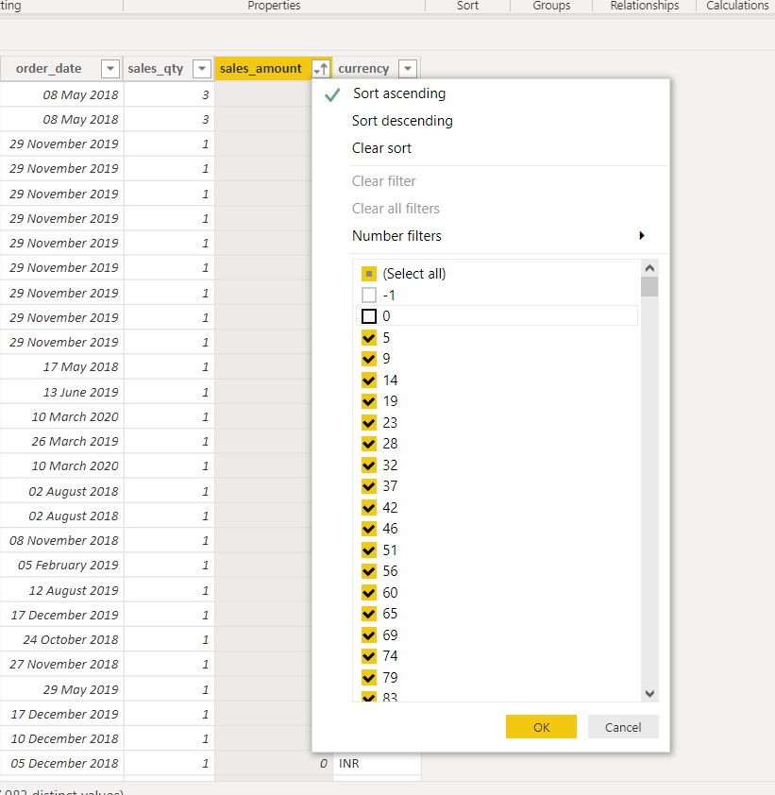
Similar to filter in excel, filter out the undesirable records

Slide 10
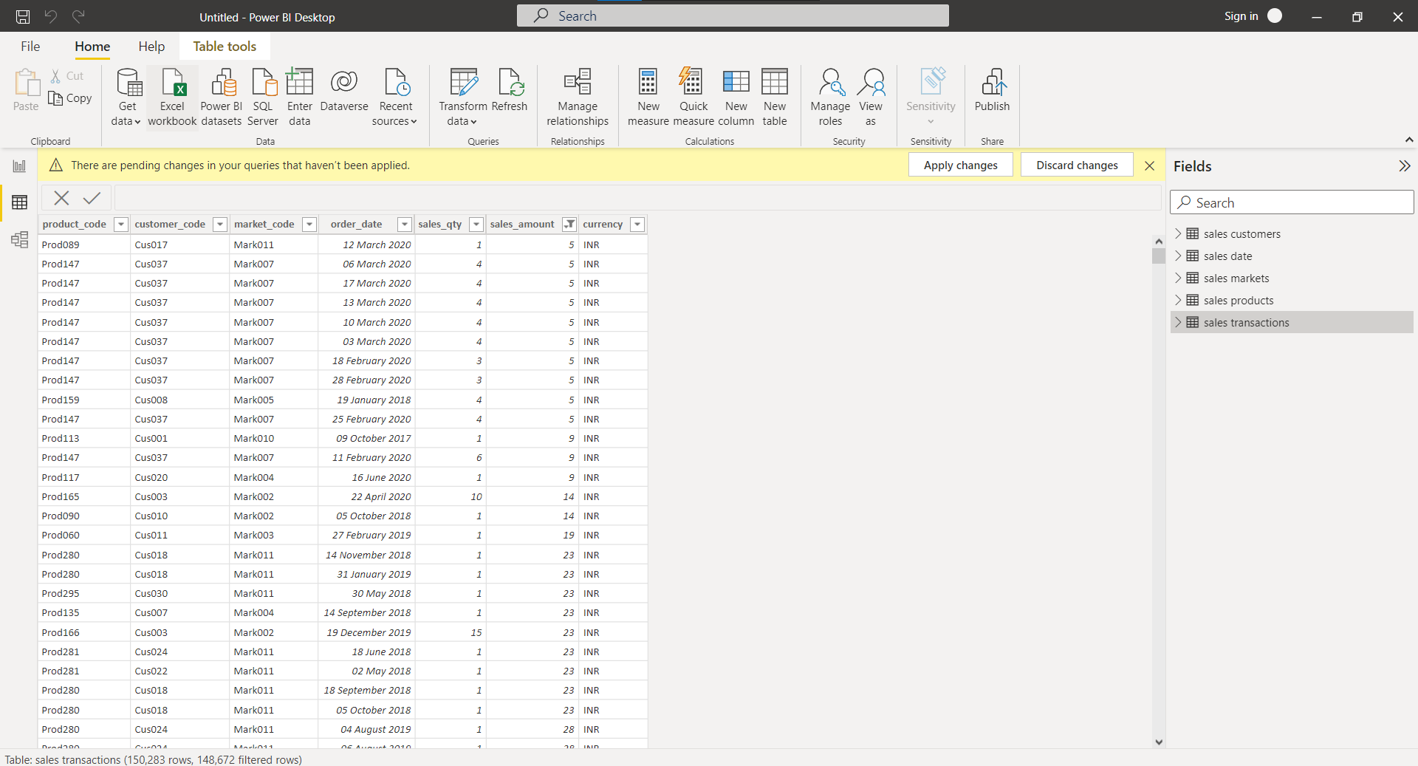
To carry out data transformation, go to home and click data transformation. A new window will appear, and you can initiate the process

Slide 11
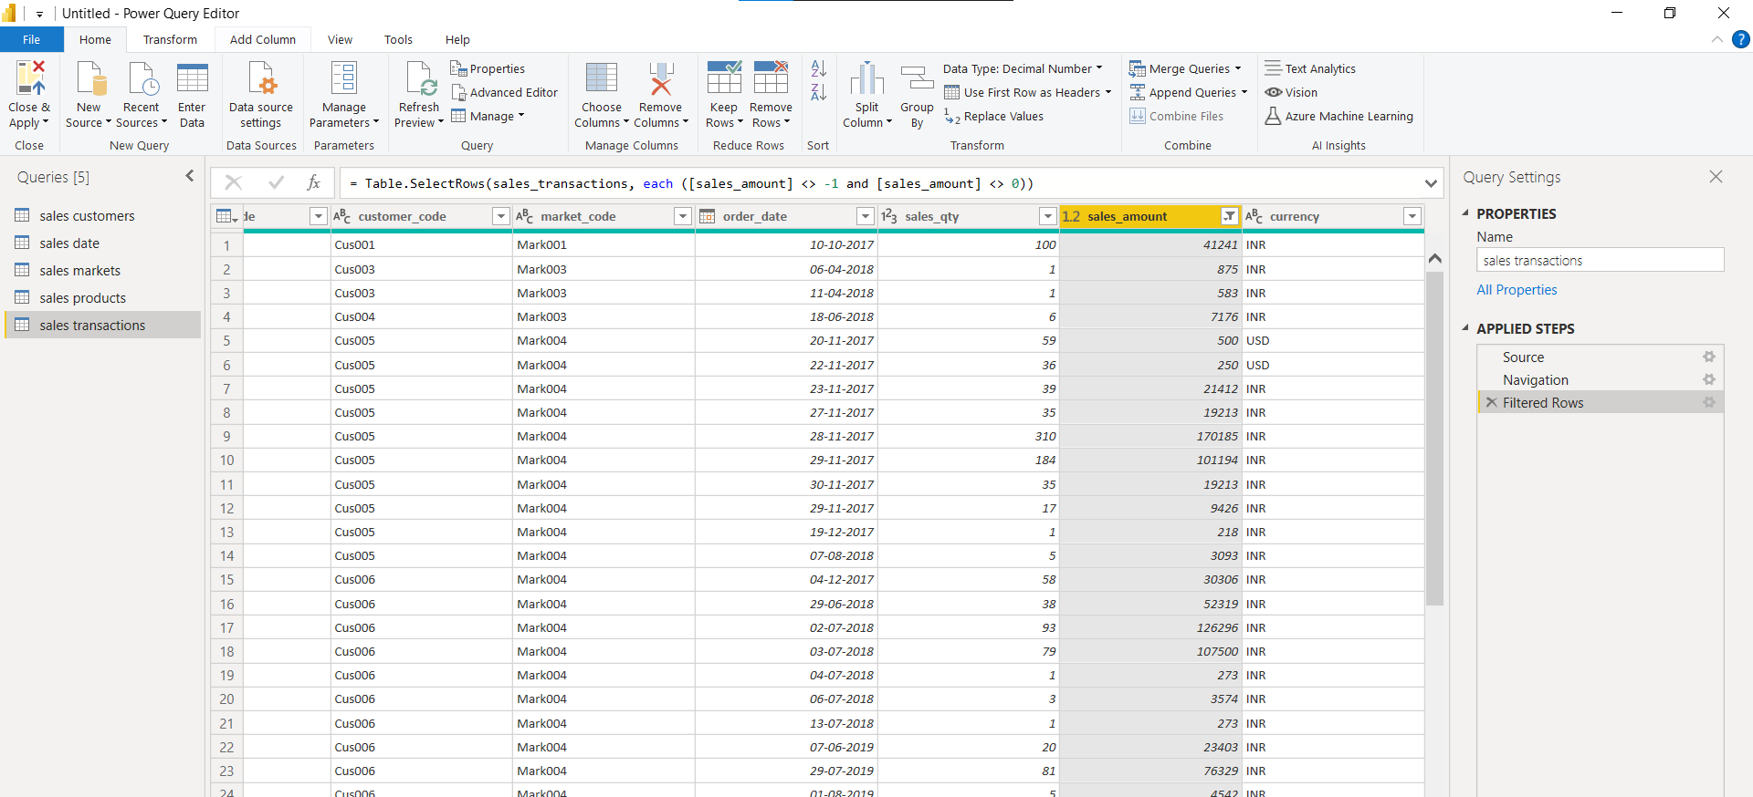
On right, the data transformation pipeline will be seean where, I have removed records with sales_amount -1, 0. The command line on top shows the same operations in terms of command

Slide 13
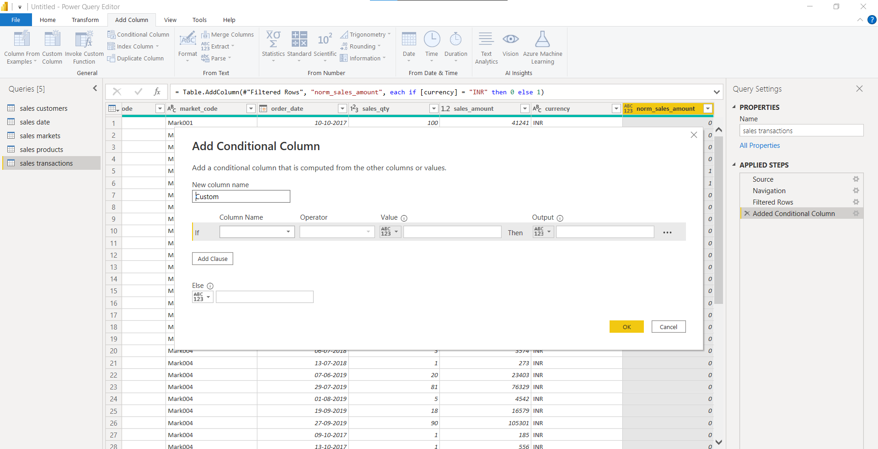
To add a new column, either conditional or custom column can be selected

Slide 14
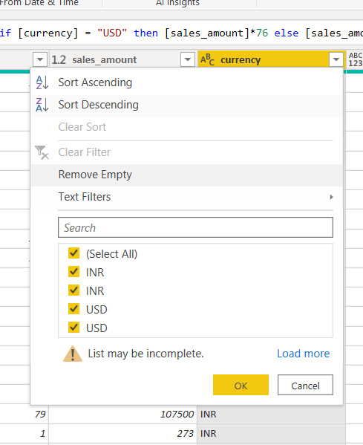
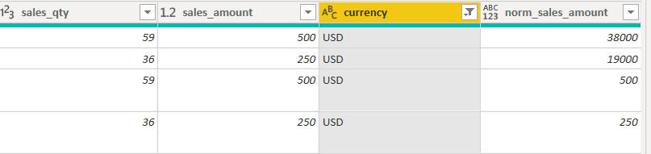
For making a custom column where the USD amount will be converted into INR and the rest will be replicated, the following command is written or modified
But there is a problem with the currency table and for some reason there are two USD, this can be a character difference. And this USD may not have got transformed

Slide 15
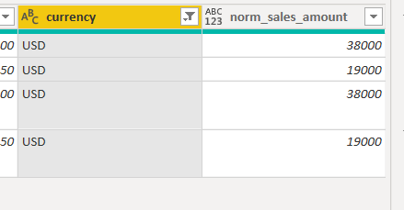
By modification of the formula the above issue is fixed

