Slide 1



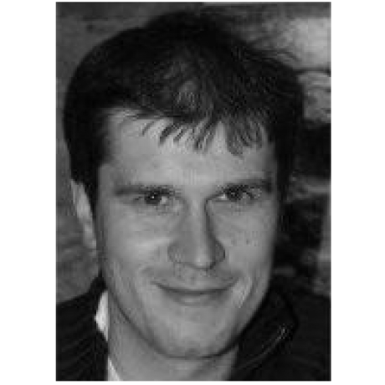
www.linkedin.com/in/mazurov
github.com/mazurov
alexander.mazurov@gmail.com
Alexander (Sasha) MAZUROV

Slide 2

Education
M.Sc in Mathematics &
Computer Science
Ph.D in Physics
University of Ferrara (Italy),
2011-2014 (March)
Lomonosov's Moscow State
University (Russia), 1997-2002

Slide 3
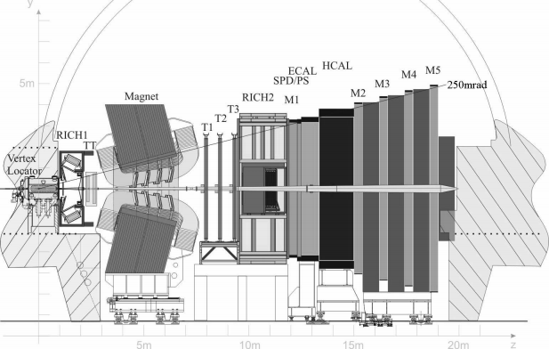
2005 – 2014: LHCb experiment

Slide 4
2005-2007: Summer student, INTAS-CERN fellowship
2005-2007: Summer student, INTAS-CERN fellowship
New Gaudi Job Options Service's string parsers (based on Boost.Spirit v1.x library)
  String parsers in GaudiKernel
  Job options file parser
2007-2010: Project Associator at the Online group
LHCb User management interface. User migration to Active Directory
Setup and configuration of Helpdesk System, Twiki, web services.
Run database web interface
CastorFS (FUSE file system). Poster at CHEP 2009, Prague
(source code: https://github.com/mazurov/castorfs)
2011-2014: Doctoral student
Gaudi Parsers v2.0 (based on Boost.Spirit v2.x library)
Intel VTune Amplifier Gaudi Auditor. Talk at CHEP 2012, New-York
Thesis: Profiler & study of χb production.

Slide 5
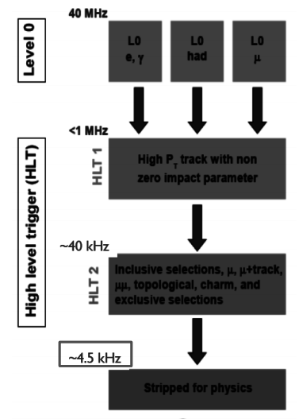
Trigger CPU profiling
Most experiments require a trigger in order to record interesting events at a suitable rate.
L0 Hardware Trigger 40 MHz -> 1 MHz. Search for high pt, mu, e, gamma, hadron candidates.
High Level Software Trigger Farm
  HLT1: Add Impact parameter cuts
  HLT2: Global event reconstruction
  100 man/years work that has only 20-30 ms to process an average event.
  29K CPUs or 1700 servers
The trigger needs fast algorithms!

Slide 6
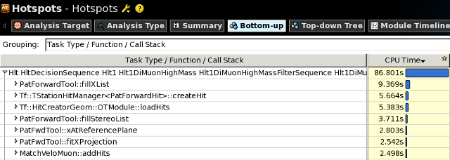
CPU profiler tool is vital for trigger optimization
Gaudi Intel Profiler Auditor (C++ library)
  Deployed into the core software framework in LHCb — Gaudi.
  Based on Intel VTune Amplifier XE User API.
Reports grouping:
Static properties: method's names
Dynamic properties: value of algorithm's “Name” property (set by Profiler Auditor)

Slide 7
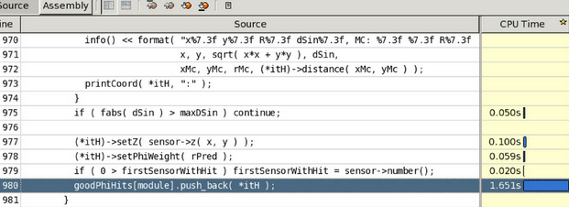
CPU consumption by source code lines

Slide 8
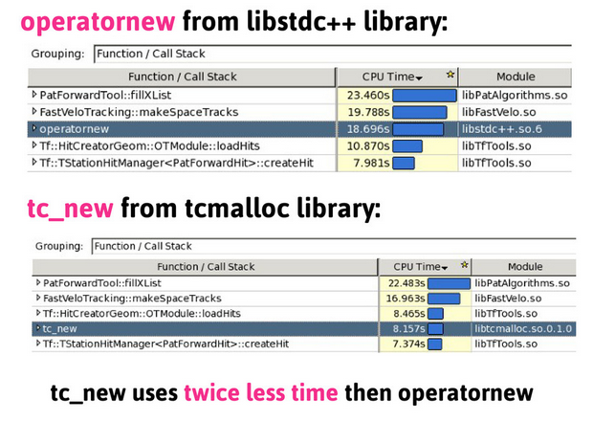
Example of HLT hotspot
Hotspot was detected
CPU consumption decreasead by 5%

Slide 9

CHEP2012: Talk and Paper
A. Mazurov and B. Couturier, “Advanced modular software performance monitoring”,
Journal of Physics: Conference Series 396 (2012), no. 5 052054.
Source code: https://github.com/mazurov/IntelProfiler

Slide 10
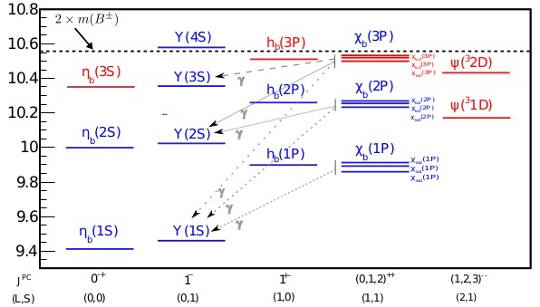
χb production study
bb system, which can be produced in different spin configurations, is ideal laboratory for QCD tests. It's like a hydrogen atom in QCD.
States with parallel quark spins (S=1):
  S-wave ϒ state
  P-wave χb states, composed by 3 spin states χb0,1,2. Can be readily produced in the radiactive decays of ϒ
χb(3P) state recently observed by ATLAS, D0 and LHCb.
Mass (Gev/c²)
In the Thesis:
Measurement for ϒ(NS) (N=1, 2, 3) cross sections in χb decays as a function of pT(ϒ)
Measurement of χb(3P) mass.
http://amazurov.web.cern.ch/amazurov/mazurov-thesis-2.11.pdf

Slide 11
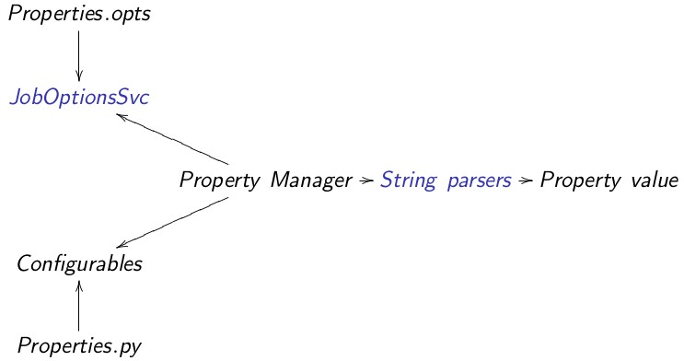
Gaudi String Parsers
LHCb Week Slides (2011): http://cern.ch/go/7VTl
Flexible with respect to a addition of new types
Readable and robust source code
Based on Boost.Spirit v2, that is modern version with guaranteed long-term support
Besides configuration parsers are used in DecayFinder and some other places.

Slide 12
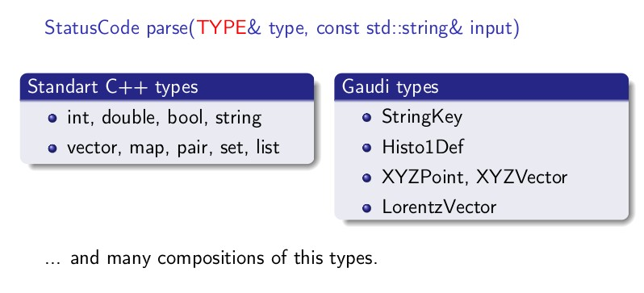
Standalone version: https://github.com/mazurov/parsim

Slide 13
Thank you!

