Slide 1

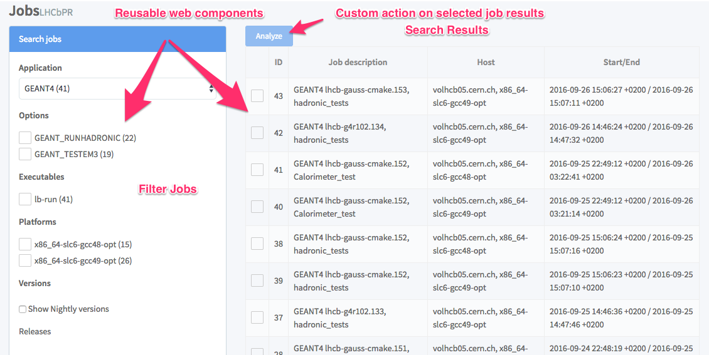
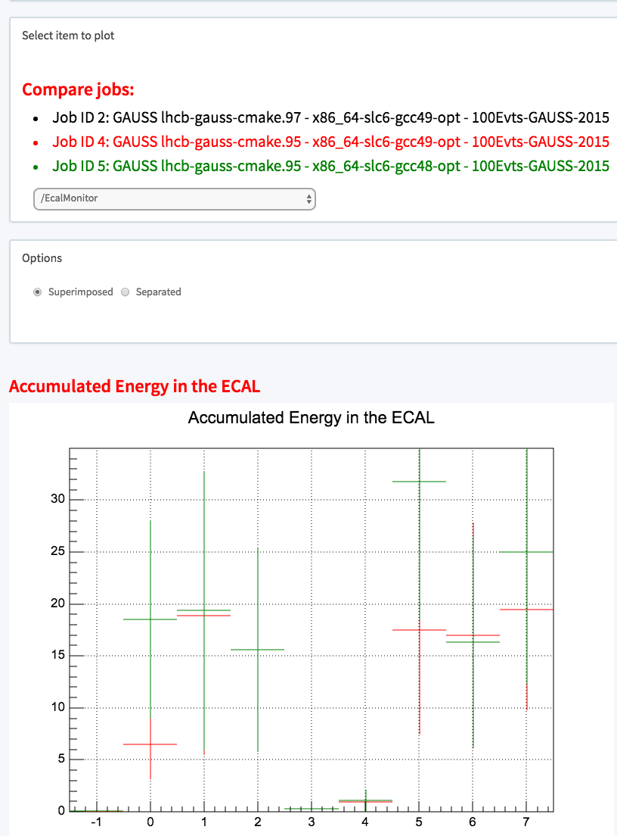
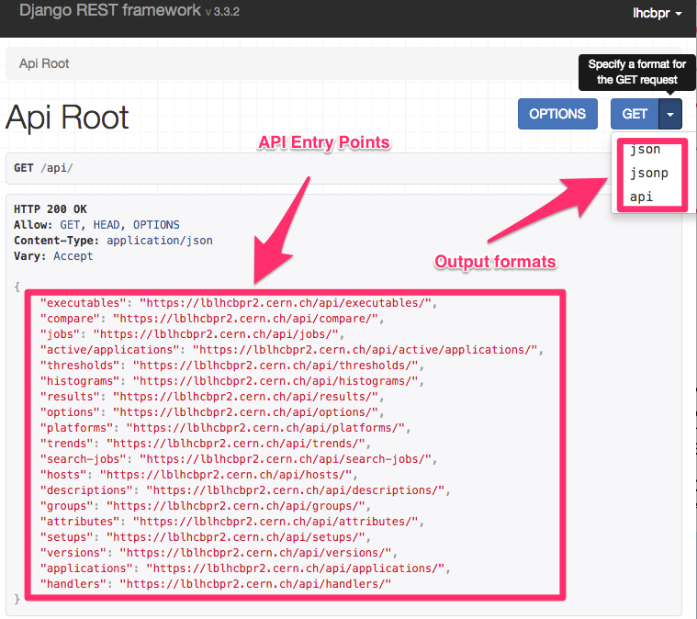
Microservices for Systematic Profiling and Monitoring of the Refactoring
Alexander Mazurov*, Ben Couturier** * Corresponding author: alexander.mazurov@cern.ch, University of Birmingham
** CERN
1. LHCbPR
2. LHCbPR Workflows
LHCb Performance and Regression Tests (LHCbPR) - systematize profiling that helps developers to evaluate how their recent code changes behave in provided test cases for different setup environments.
Main use cases
Physics performance
Histogram comparison
Trend analysis for selected attribute.
Monitor regression in memory and CPU consumption
Possible setup environments
Versions of application
Compiler versions
Operating Systems (SLC6, CentOS7)
Architecture (x86_64, x86)
Build system (CMT or CMake)
Example of regression tests matrix
 | Geant v96r4 | Geant v10r2
CMT | x | x
CMake | x | x
SLC6 | x | x
CentOS7 | x | x
X86_64 optimized | x | x
X86_64 debug | x | x
3. Components
4. Deployment
5. Web Application
Build and Test Services
Continuous Integration (CI) Service – schedule and initiate test runs
Artifacts Storage– store projects builds for different configurations
Test service – read LHCbPR configuration for tests, download the corresponding builds, execute tests and transfer it to the Storage Element
Storage Element – virtual storage for jobs output with the interface to quite diverse real storage systems like grid storage.
LHCbPR v2
Database – relational database for job descriptions and job outputs. We use MySQL, but it can be any other.
REST API service – provides REST access to the database and adds some business logic for special API requests. Technologies: python, Django + REST Framework.
ROOT HTTP service – helper service for returning content of ROOT files in JSON format. Relies on ROOT TBufferJSON.ConvertToJSON functionality. Technologies: Flask , ROOT.
Web frontend is a javascript single-page application that is composed of analysis modules for presenting specific logic and views for inspecting test results.
Each analysis module is an application extension and can be simply added or removed without breaking the main application
Common web components are provided for building modules. For example, search jobs and draw histograms.
Docker is used to manage applications’ containers and docker-compose is used for orchestrate containers in different environments.
The same applications’ images are used for production and development environments that allow quickly test and deploy new versions of services.
Images are publicly accessible at the Docker Hub registry.
Current infrastructure relies on CERN services like OpenStack Cloud, Database On Demand and Foreman for control virtual machines
User Clients
Users can create any data handling client that use LHCbPR REST API: web applications, scripts
We created web frontend for visualizing regression tests' results. Technologies: javascript, angular framework; nodejs and gulp for development.
6. API Service
LHCbPR not coupled to the LHCb software stack and can be adapted for other experiments and projects
We are working on extending repository of web components and analysis modules for web frontend.
Easy to develop new clients for API service.
Resources
Web application:
https://lblhcbpr2.cern.ch (available from CERN network)
https://lblhcbpr2.cern.ch/api/
https://gitlab.cern.ch/lhcb-core/LHCbPR2FE
API service:
https://gitlab.cern.ch/lhcb-core/LHCbPR2BE
ROOT HTTP service:
https://gitlab.cern.ch/lhcb-core/LHCbPR2ROOT
Tests’ output handlers:
https://gitlab.cern.ch/lhcb-core/LHCbPR2HD
Proxy server and project builder:
https://gitlab.cern.ch/amazurov/LHCbPR2
Provides access to the application objects
Combines several sql queries into one HTTP request
Output results in the desired format. Currently JSON and JSONP are supported.
Automatic Swagger/OpenAPI documentation and test application generator
Includes CERN Single Sign-On for authentication

