Slide 1
LHCb
Online
Sasha Mazurov

Slide 2

@mazurov
alexander.mazurov@cern.ch

Slide 3

Lomonosov's Moscow State University
1997 – 2002

Slide 4
Department
Calculate Mathematics and Cybernetics
Master
Applied mathematician and
system programmer

Slide 5
European Organization for Nuclear Research
CERN
2005 - present

Slide 6
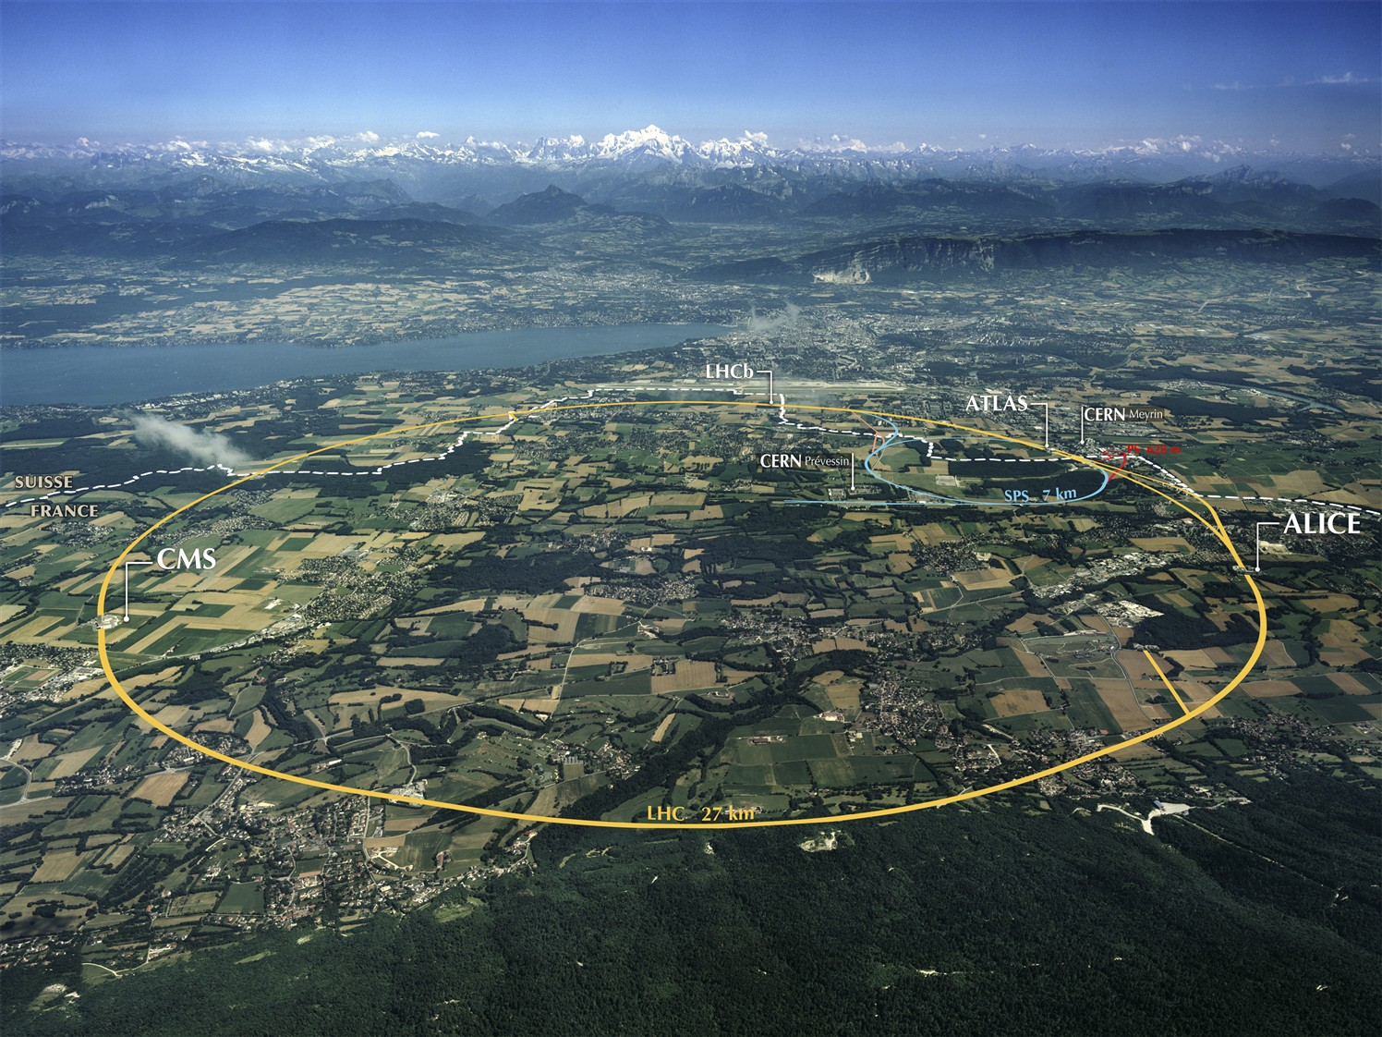
Notes:
The instruments used at CERN are particle accelerators and detectors. Accelerators boost beams of particles to high energies before they are made to collide with each other or with stationary targets. Detectors observe and record the results of these collisions.

Slide 7
LHCb
Core physics program is in the study of processes
with hadrons formed by b- and c-quarks
B-mesons
D-mesons

Slide 8
LHCb Hot Results
Observed direct CP violation in neutral
D-meson decays. Measured the difference
of time-integrated CP asymmetries of
D0→ π+π- and D0→ K+K- decays
3.5 sigma away from the Standard Model

Slide 9
My research activity
1. High Level Trigger Profiling
2. Gaudi Parsers

Slide 10
Activity #1
HLT Profiling

Slide 11
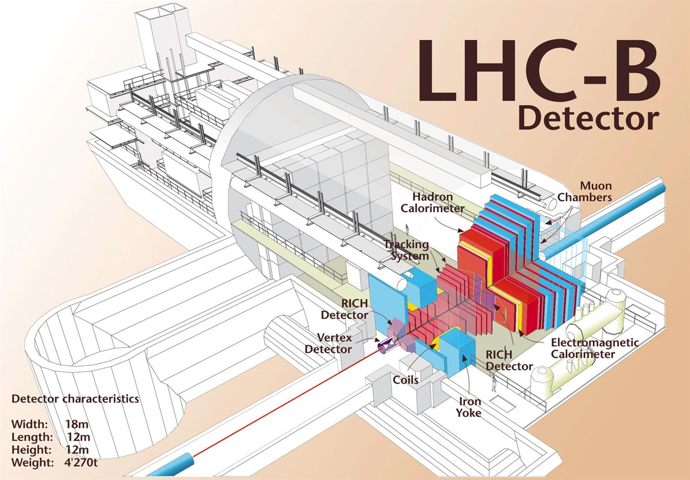
Notes:
The LHCb experiment will help us to understand why we live in a Universe that appears to be composed almost entirely of matter, but no antimatter.
It specialises in investigating the slight differences between matter and antimatter by studying a type of particle called the 'beauty quark', or 'b quark'.
Instead of surrounding the entire collision point with an enclosed detector, the LHCb experiment uses a series of sub-detectors to detect mainly forward particles. The first sub-detector is mounted close to the collision point, while the next ones stand one behind the other, over a length of 20 m.
An abundance of different types of quark will be created by the LHC before they decay quickly into other forms. To catch the b-quarks, LHCb has developed sophisticated movable tracking detectors close to the path of the beams circling in the LHC.
The LHCb collaboration has 650 scientists from 48 institutes in 13 countries (April 2006).

Slide 12
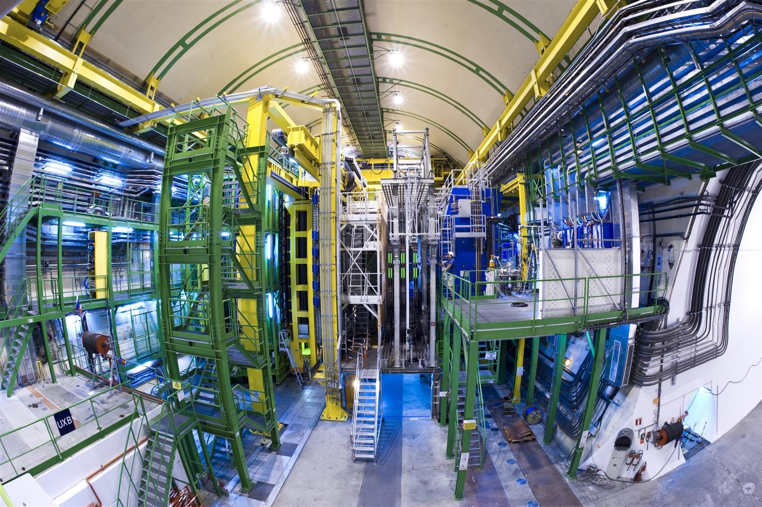

Slide 13
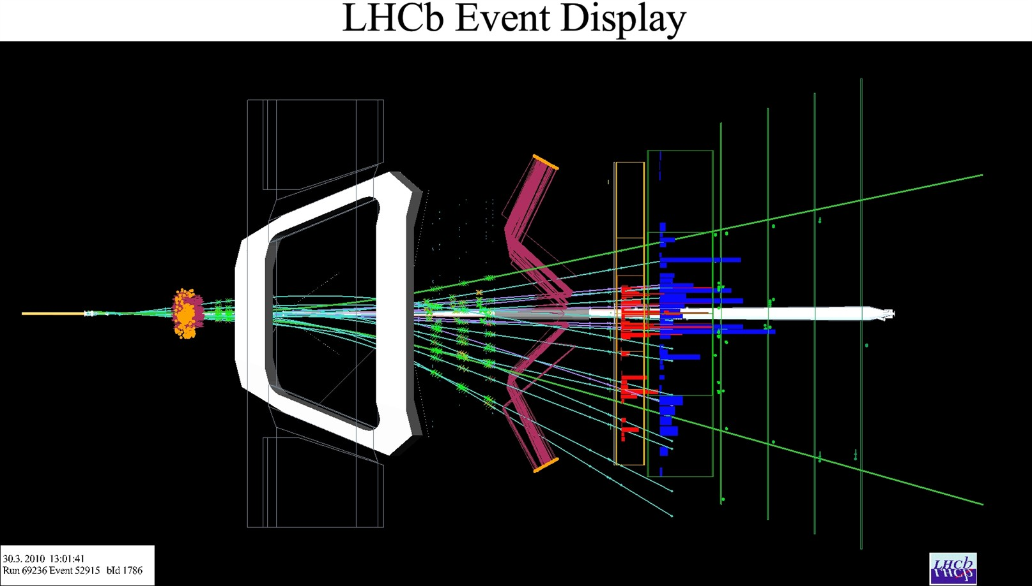

Slide 14
Why do we need trigger?

Slide 15
Not all LHC
bunch crossings are interesting!
LHC bunch crossing
40 MHz
Non empty bunch crossing
30 MHz
Visible rate (LHCb)
~ 15 MHz

Slide 16

Interesting
bb production
100 kHz
B decay in acceptance
15 kHz
BR 10⁻⁴ – 10⁻⁹
1 kHz

Slide 17

Can't store all events
Max. readout (TELL1)
1 MHz
Per event
55 kB
55 GB/s

Slide 18
LHCb and Other
 | L cm⁻²s⁻¹ | pp int. rate | Max DAQ readout | Event size | Rate to storage
LHCb | 4*10³² | 15 MHz | 1 MHz | 55 kB | 2 kHz 120 MB/s
CMS/Atlas | 3.6*10³³ | 1 GHz | 100 kHz | ~1.6 MB | 200 Hz ~500 MB/s
CMS/Atlas
Greater rate reduction before full experiment readout
Lower event rate to storage, but higher in MB/s

Slide 19
Two-stage Trigger Strategies
Hardware trigger
Software trigger

Slide 20
Hardware trigger
Simple strategies, but fast response.
Synchronous decision with LHC clock.
Output rate is conditioned by
frequency of DAQ (1.1 MHz for LHCb).

Slide 21
Software trigger
Time demanding sophisticated
strategies.
Asynchronous to LHC clock.
Computing power for long term
analysis limits the final output rate.

Slide 22
Main LHCb Trigger Objective
Reject
non interesting events

Slide 23
Quickly identify possible events
of interest based on
properties of B decays
Relatively high mass
p_{T} and E_{T} of decay products
Long lived
Displaced tracks and vertices

Slide 24
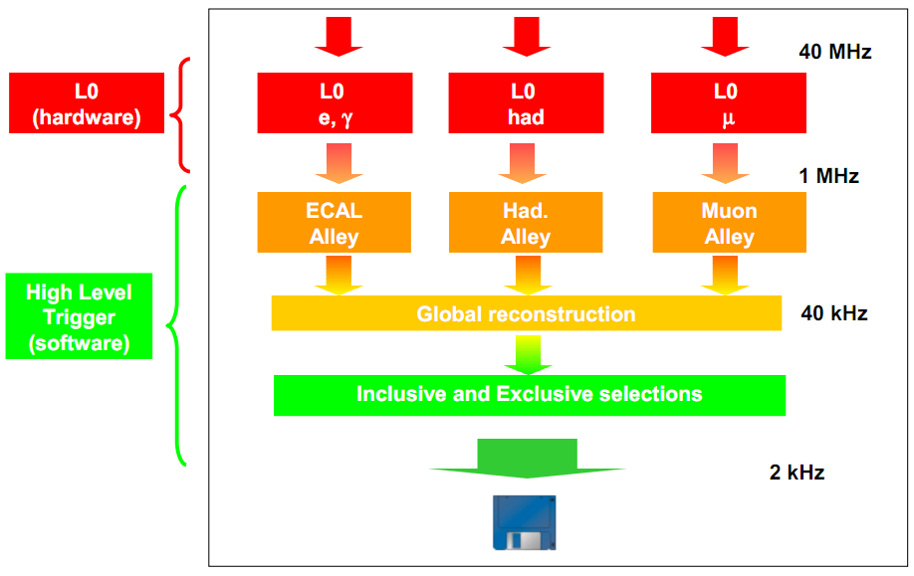
Trigger Structure

Slide 25
Gaudi
Core software framework at LHCb
Event processing
Trigger
Reconstruction
Moore
Brunel
Monitoring
Simulation
Analyses
Gauss
DaVinci

Slide 26
Gaudi Building Blocks
Algorithms
Tools
Services
Auditors
DataSource

Slide 27
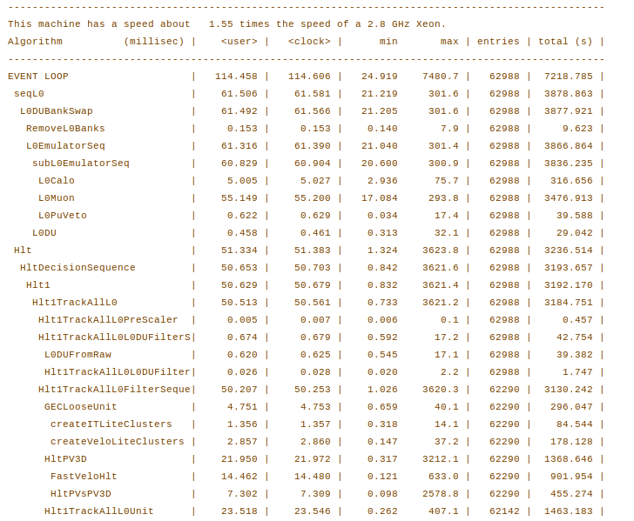

Slide 28
My work on HLT
Software trigger
Gaudi Profiling Auditors Done
Optimization Next Step

Slide 29
Profiling
Measuring of dynamic metrics of code
CPU time spent in function
Memory MB allocated in function

Slide 30
CPU Profiling Technique
Sampling
Interrupt application every 10 ms.
Accumulate data from function call chain.
Main → Function_1 → Function_called_from_2
Report functions frequencies.

Slide 31
Memory Profiling Technique
Substitution
substitute memory allocation functions
malloc, new operator
… with special functions, which collect allocation information

Slide 32
Existing Profiling Tools
Intel VTune Amplifier
Google Performance Tools
Valgrind

Slide 33
Implemented Auditors
Integrate tools to Gaudi
IntelProfilerAuditor
GoogleProfilerAuditor

Slide 34
Where are the hot spots?
metrics
How time changed after updates?
comparison

Slide 35
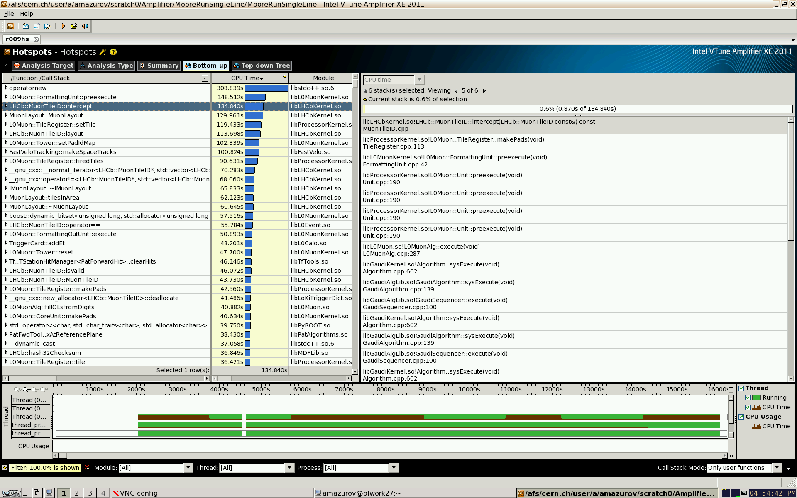

Slide 37
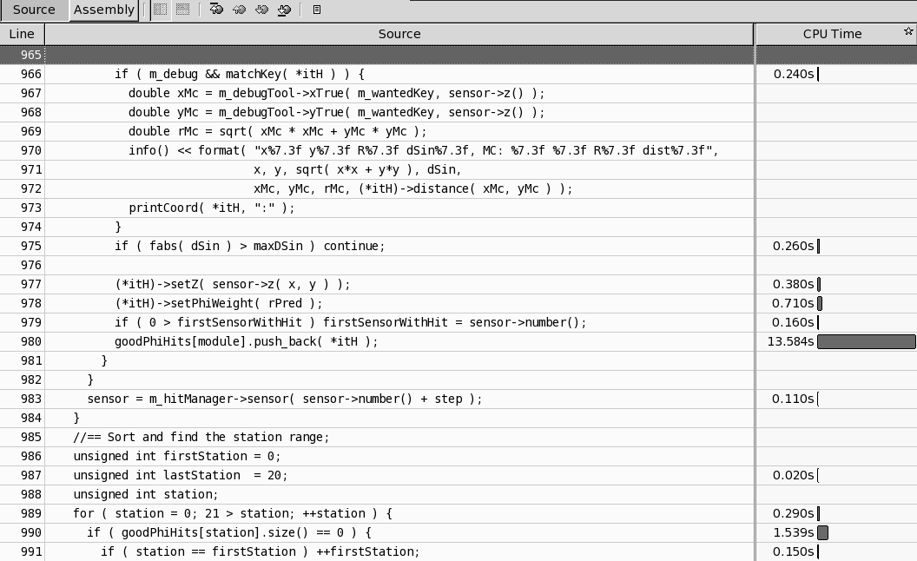

Slide 38
HLT Profiling
We can emulate online processes with
raw event data from files (offline mode)
Can run profiling many times on
the same events

Slide 39
Activity
Hot spots founded
Optimization needed
Abstract submitted to CHEP 2012

Slide 40
Abstract: Advanced Modular Software Performance Monitoring
The LHCb software is based on the Gaudi framework, on top of which are built several large and complex software applications. The LHCb experiment is now in the active phase of collecting and analyzing data and significant performance problems arise in the Gaudi based software beginning from High Level Trigger (HLT) programs and ending with data analysis frameworks (DaVinci). It’s not easy to find hot spots in the code - only special tools can help to understand where CPU or memory usage is not reasonable. There exist many performance analyzing tools, but the main problem is that they show reports in terms of class and function names and such information usually is not very useful - the majority of algorithm developers use the Gaudi framework abstractions and usually do not know about functions which lie at the lower level. We will show a new approach which adds to performance reports a higher abstraction level based on knowledge of framework architecture and run-time object properties. A set of profiling tools (based on sampling and unwind library - a software for introspection of the program call-chain) and visualizing interfaces has been developed and deployed.

Slide 41
Activity #2
Gaudi Parsers

Slide 42
Gaudi Job
Run from command line
$> Gaudi Moore/MyProcess.opts
With option file we can configure property values of Gaudi components (Algorithms, Tools, Services, Auditors).

Slide 43
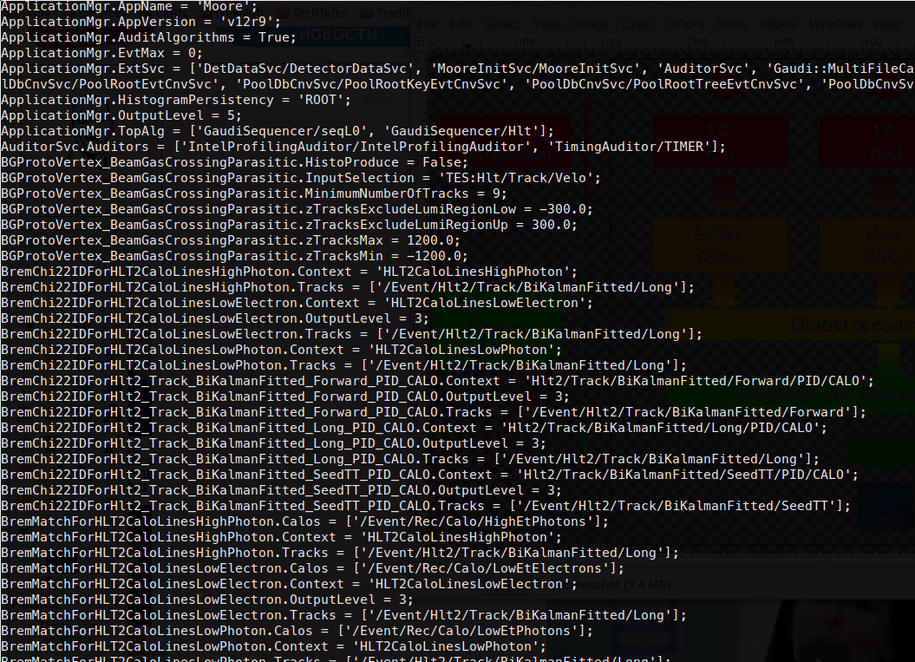

Slide 44
Trigger Job Configuration
12883 lines
159784 words
Options example http://cl.ly/013t2W2d3q3Z1C3R401Q/options.opts

Slide 45
Gaudi Parsers
My C++ library for reading property values from files or strings

Slide 46
Signature
StatusCode parse(TYPE& type, const std::string& input)
Example
Gaudi: :LorentzVector result ;
Status Code sc =
parse(result , "( ’px’:10.0 ,’py’:11.0, ’pZ ’:12.0, 100.0)" ) ;
If you write parser for one type you automatically get
parsers for vectors, maps and sets with this type
(and their compositions)

Slide 47
Changelog
Before Gaudi v18r6
Hand made parsers
A few basic types
It’s TOO hard to add new types
Gaudi v18r6
Started by me at CERN summer school (2005).
Based on Boost.Spirit v1.x parser generator
Many new types and ability to extend them
First release at Gaudi v18r6 (2006-07-14)
Gaudi v22r3 (2011):
Based on Boost.Spirit v2.x parser generator
Fully rewritten
Backward compatible with the previous version

Slide 48
New version (Results)
Contains significantly less (about a factor 5) amount of
code lines.
Is much more flexible with respect to addition of new types.
Is more readable and more robust.
Requires less resources for compilation both in terms of CPU
and required memory.
Results in sizable reduction in size for GaudiKernel and
GaudiSvc libraries.
Is based on Boost.Spirit v2, that is modern version with
guaranteed long-term support.

Slide 49
What next?
Finish the CHEP article “Advanced Modular Software Performance Monitoring”.
HLT Algorithms optimizations.
Thank you!

