Slide 1
MBSE Team 1 – Relevant Models & Analysis Framework
Module 5
Presented by:
David Basala
Bill Berklich
Christy Brennan
Steve Mazza
Joe Rambousek
Dan Torres

Slide 2
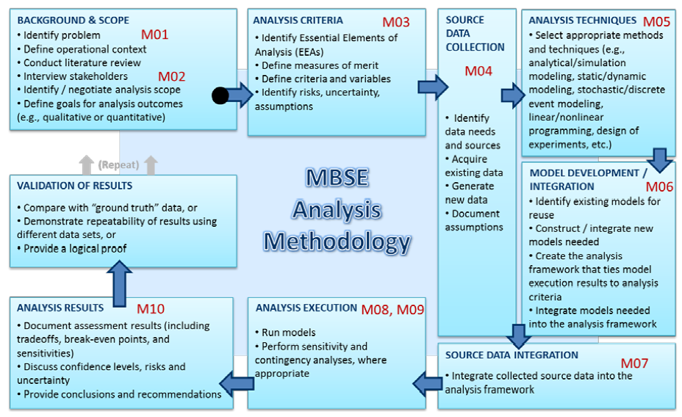
Process Status

Slide 3
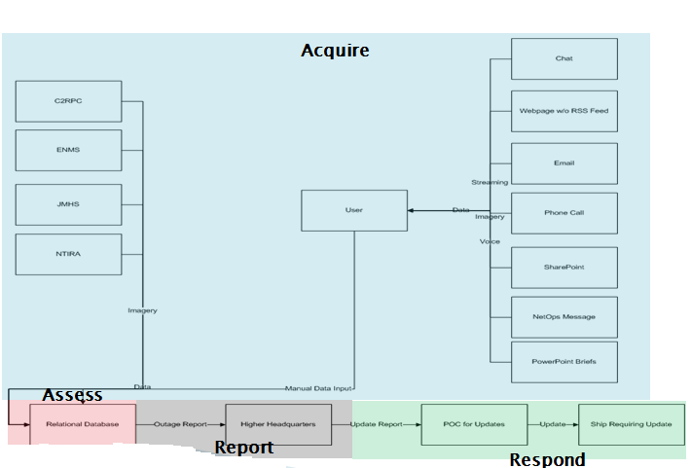
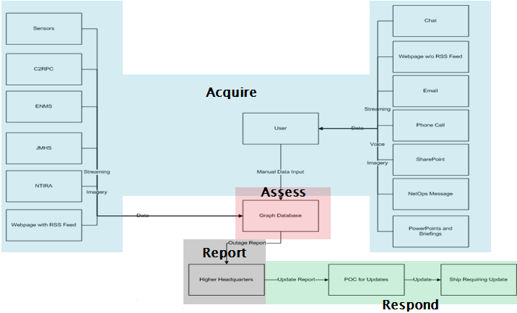
Analysis Techniques
Model existing and new processes

Slide 4
Analysis Techniques (cont…)
BOE calculations (Acquire)
Data collection (elements)
Download size/speed
Format type (auto/manual)
Time to retrieve
Time to integrate
Frequency
Summary of results
Processing time by data type
Process times (current vs new)
Total change (by type and collective)

Slide 5
Project Feedback
Current approach involving Graph DB does not include voice, imagery or streaming input
No influence on data size or download speeds
No issues in the areas of downloading data
Notes:
1. As seen in the example to the right, please provide the necessary data elements as they relate to each of the data sources.
2. If the data element does not apply to a data source indicate such as "N/A"
3. Each of the data categories has a definition on how to define the information at hand, simply place your cursor over the cell to see the definition
4. If the information does apply, but is not known state unknown
5. Please provide any sources for the information being utilized including document, author, date and location of information
6. Please fill this out for both the Current Process to identify the baseline and the proposed process

Slide 6
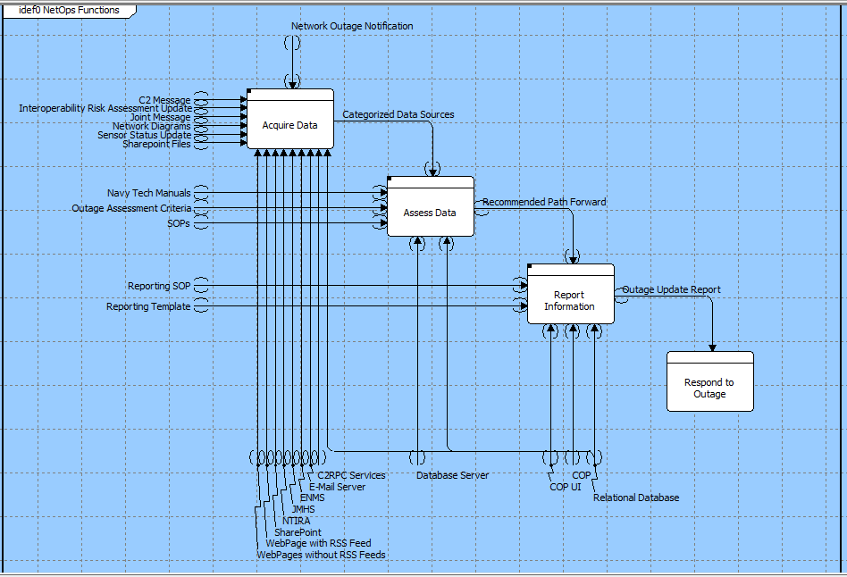
Current State Models

Slide 7
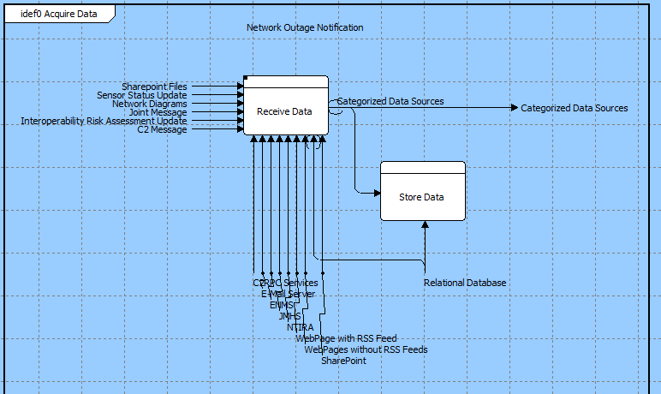
Current State Models (cont…)

Slide 8
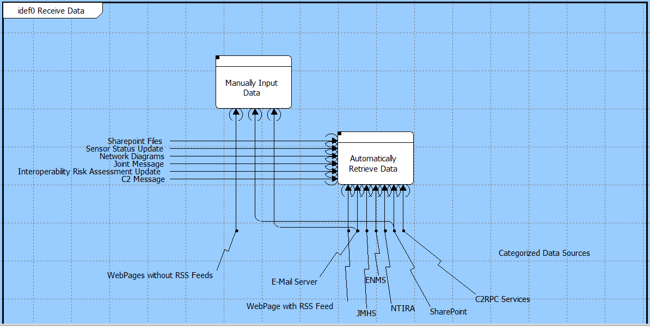
Current State Models (cont…)

Slide 9
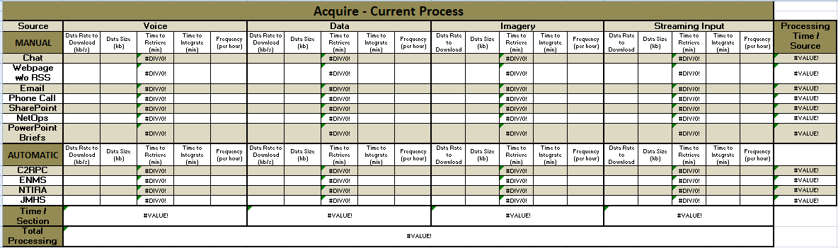
Back-of-the-envelope (BOE)

Slide 10
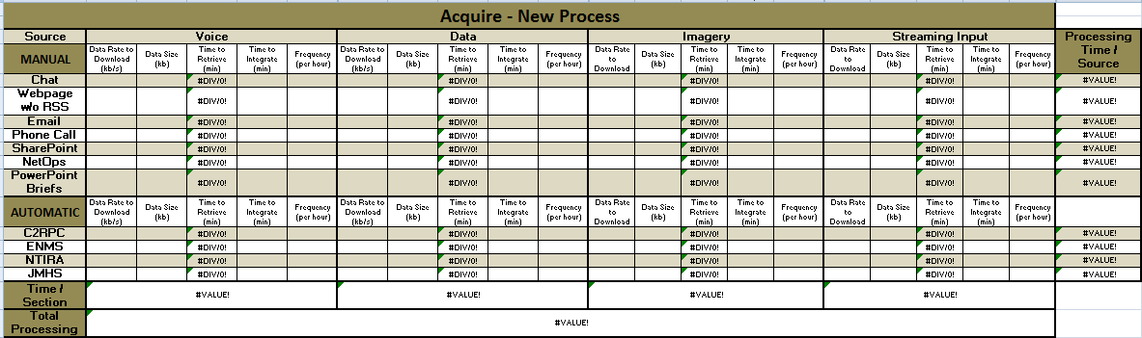
BOE (cont…)

Slide 11
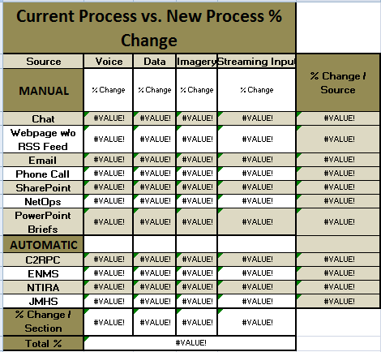
BOE (cont…)

Slide 12
Summary of Work
Identified main functions of the current process
Identified hierarchy of the current functions
Incorporated inputs, outputs and components for the top level functions and the lower level “Acquire” functions
Developed IDEF0s for current process, top level and “Acquire”
Constructed BOE to evaluate data collection

Slide 13
Path Forward
Continue drilling into each of the functional elements in the Current process
Detail out the Future Process
Identify all inputs, outputs, triggers and components
Analyze the two processes to determine areas for improvement and key elements the graph database can affect
BOE can give an initial quantitative analysis, when coupled with the architecture analysis identification of areas of focus to achieve those numbers can be determined.

Slide 14
QUESTIONS??

