Slide 1
Team 1: Operational Energy
Status Update: Data Collection
Bill Berklich
Christy Brennan
Steve Mazza
Dan Torres

Slide 2
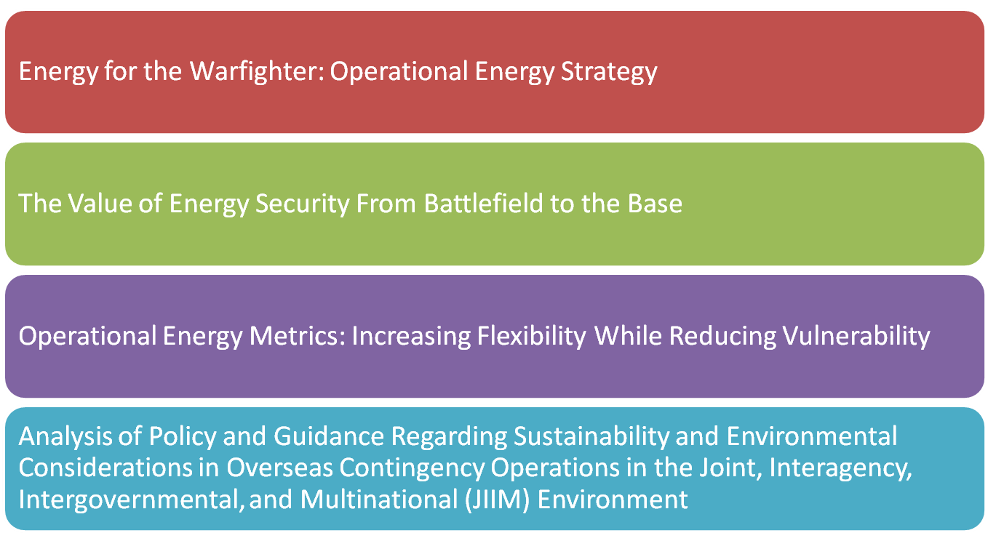
Principal Sources

Slide 3
Energy for the Warfighter…

Slide 4
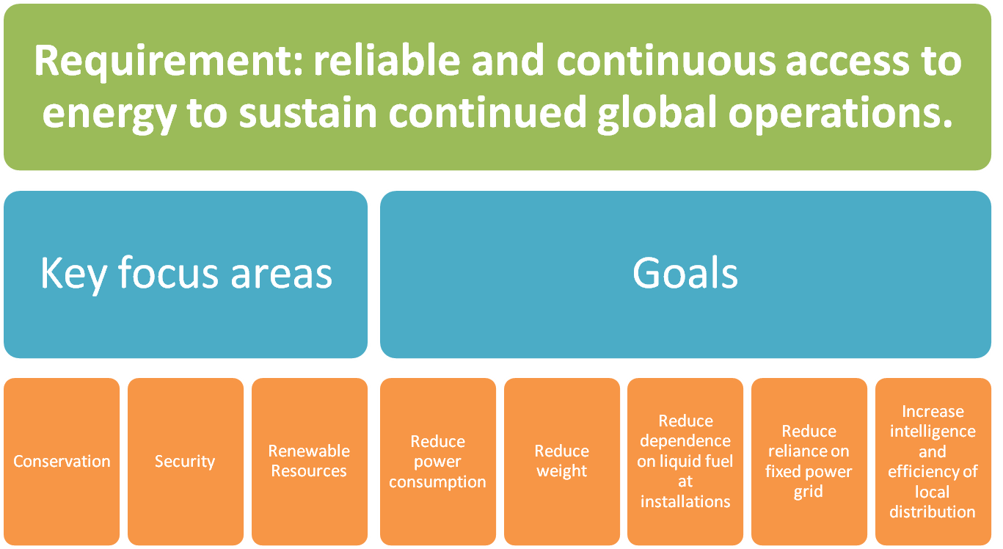
The Value of Energy…

Slide 5
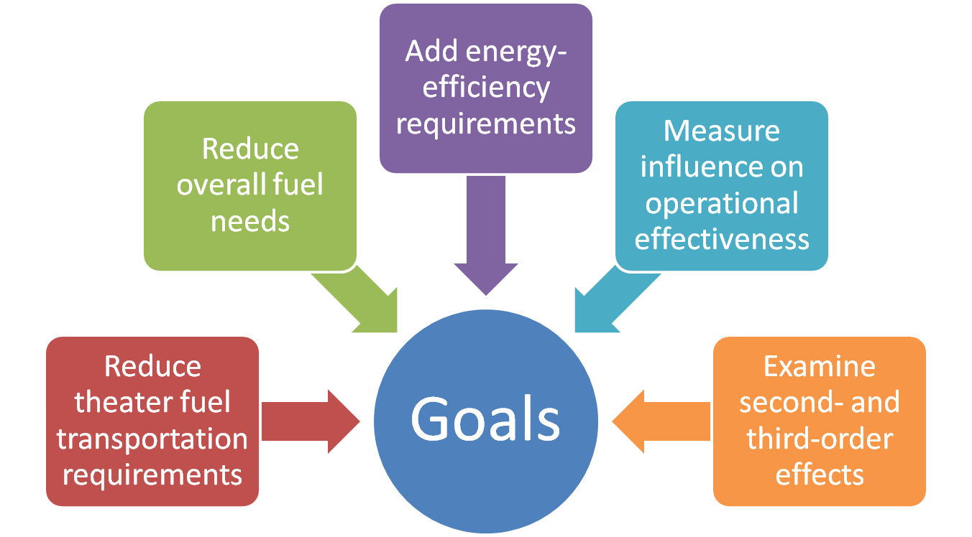
Operational Energy Metrics…
Notes:
“Properly applied, operational-energy metrics can increase operational flexibility [while reducing vulnerability].”

Slide 6
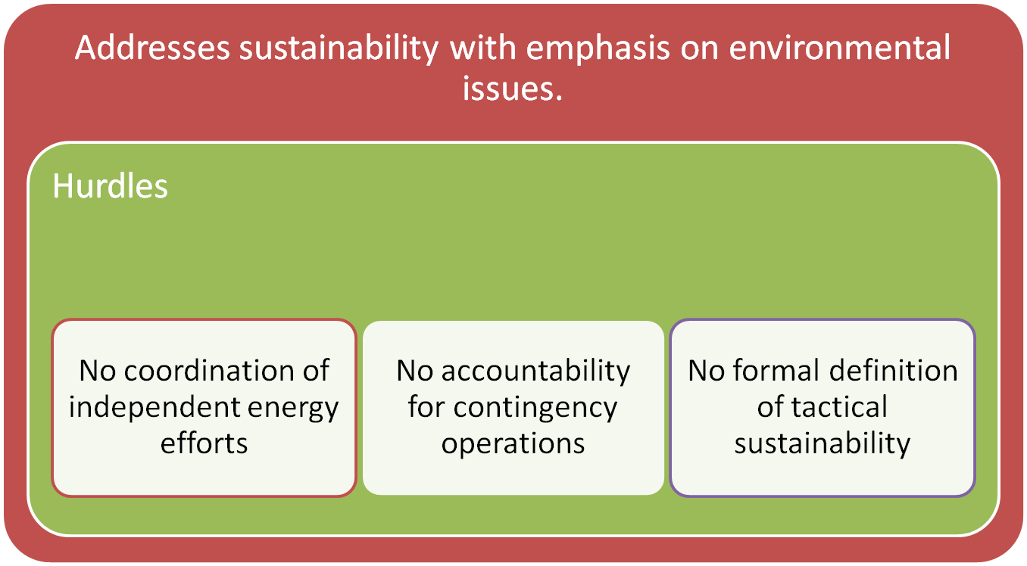
Analysis of Policy…
Notes:
that Congress is becoming more concerned with environmental impacts of OCONUS contingency operations and recommends that DoD/US Army develop a proactive approach to formulating the needed set of laws, doctrine, and policy for combatant commanders of OCONUS contingency operations.

Slide 7
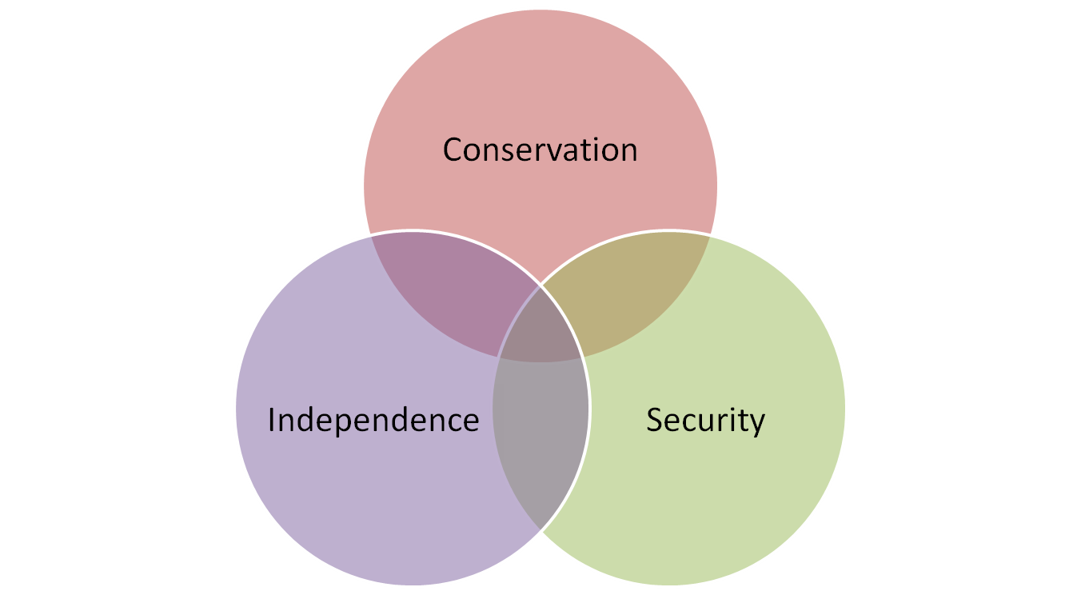
Summary: Themes

Slide 8

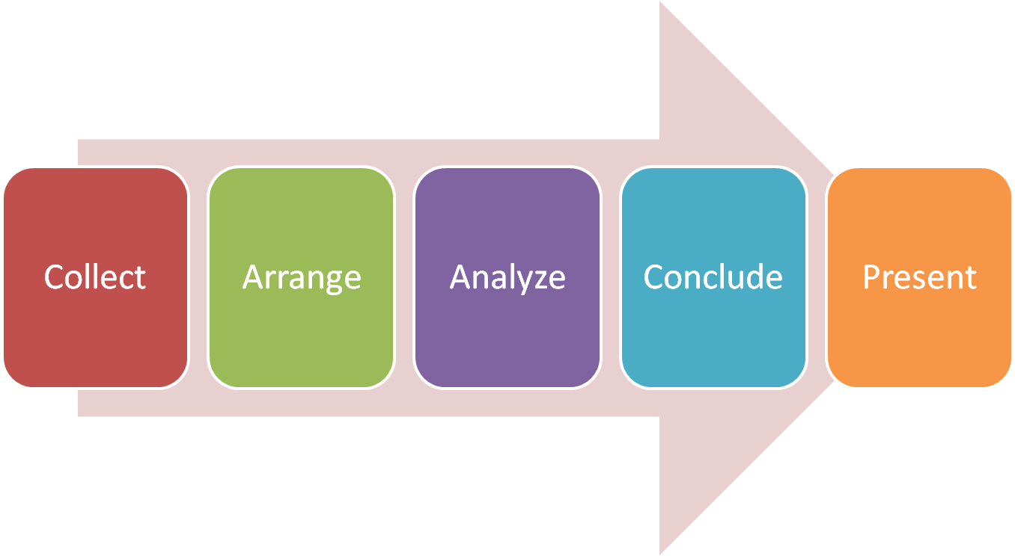
Next Steps

