Slide 1
Survivability
Vehicle Survivability Capstone

Slide 2
Definition of Survivability
“Survivability may be defined generally as the ability of a system to minimize the impact of a finite disturbance on value delivery, achieved through either the satisfaction of a minimally acceptable level of value delivery during and after a finite disturbance or the reduction of the likelihood or magnitude of a disturbance.”
Avoid penetration, kill
Avoid acquisition, detection, encounter
Avoid hit, penetration

Slide 3
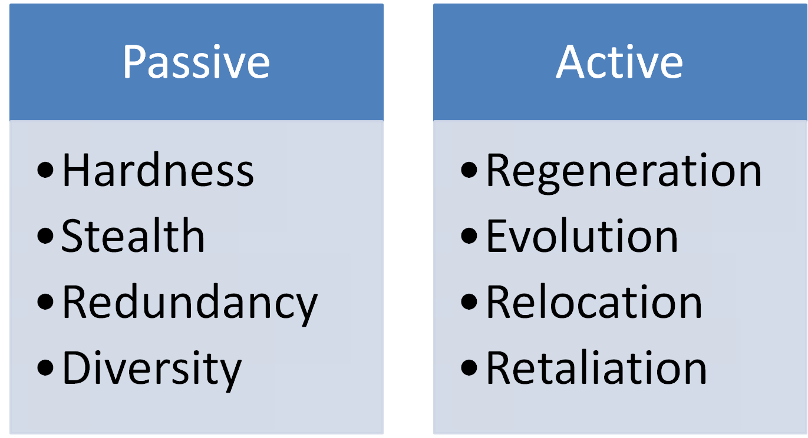
Types of Survivability

Slide 4
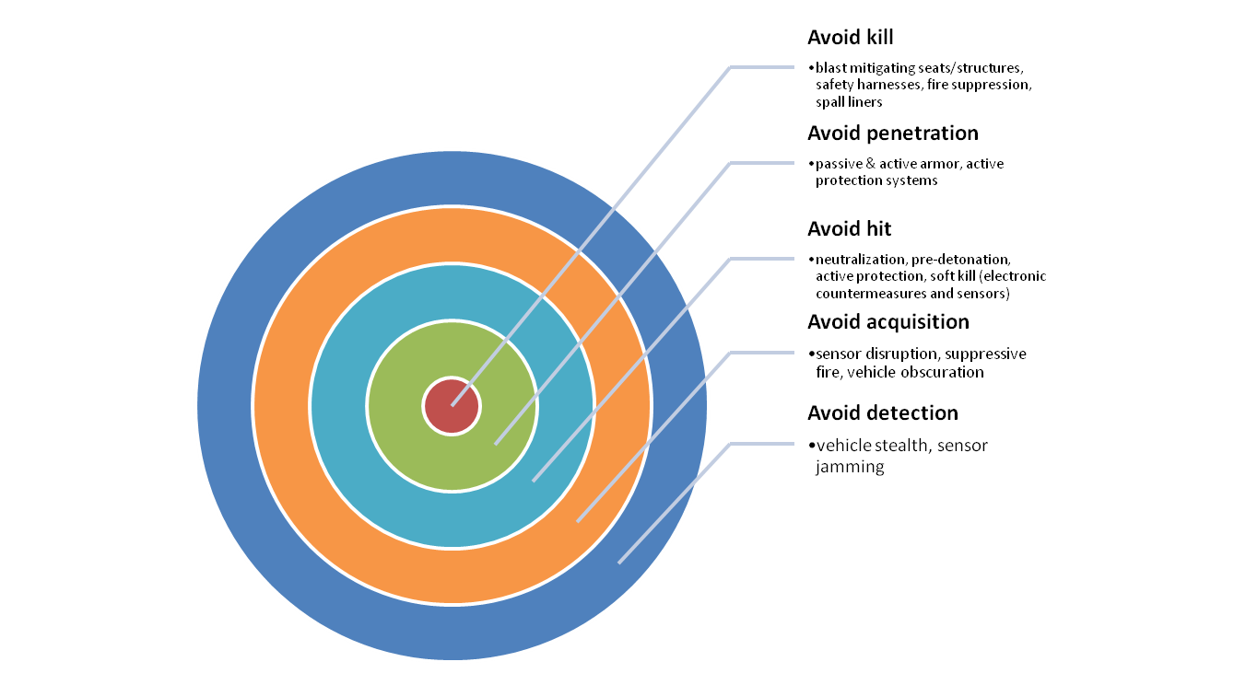
The Onion

Slide 5
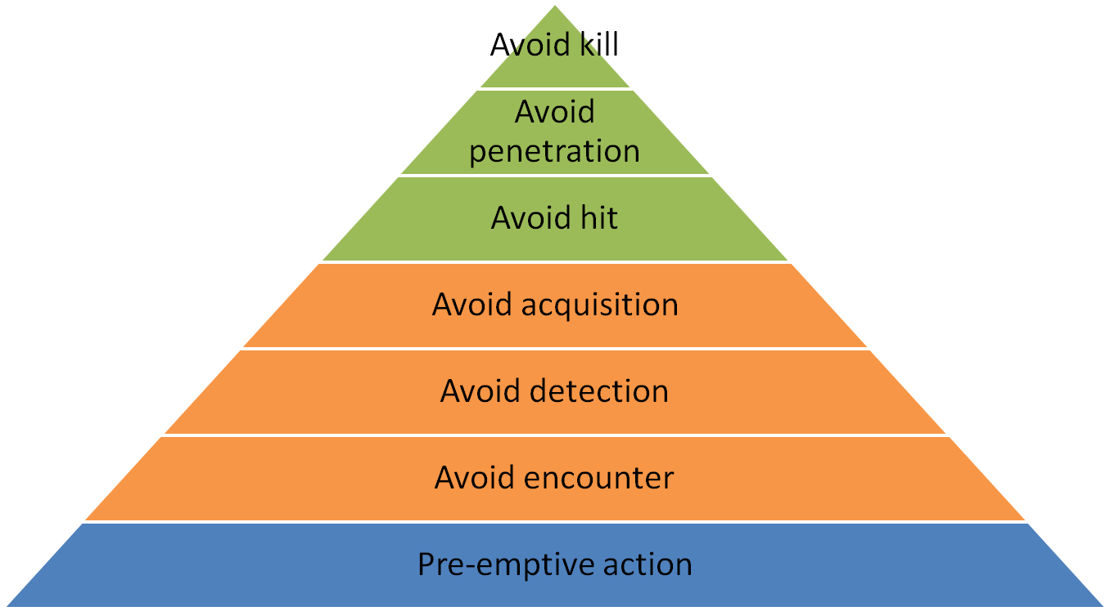
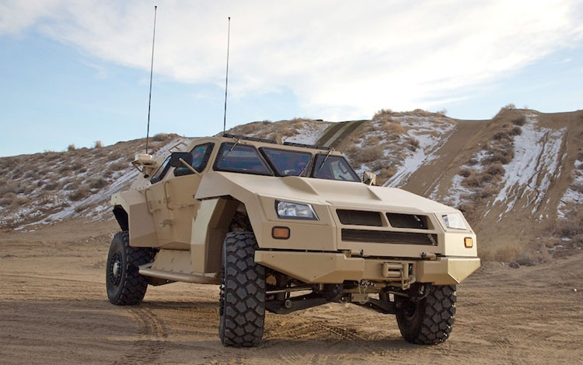
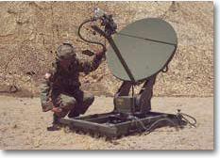
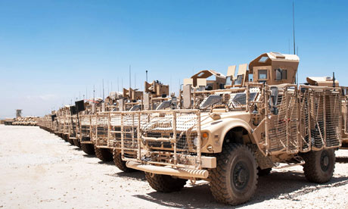
Peeling the Onion

Slide 6
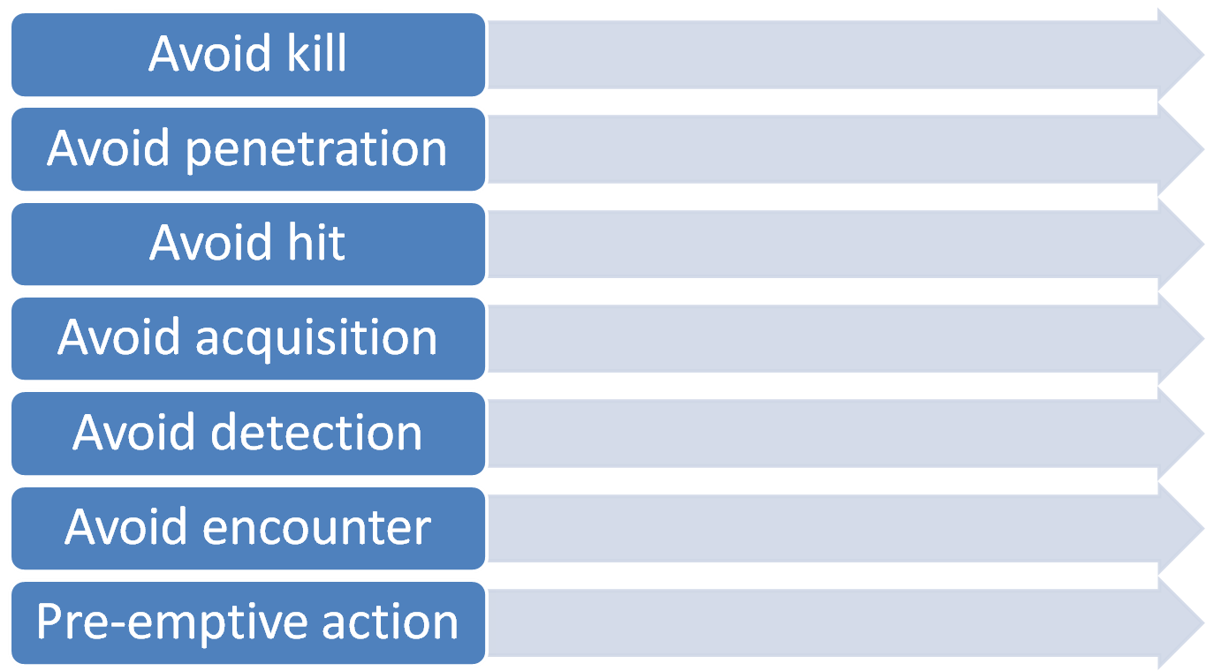






MOEs

Slide 7
More Definitions
Lethality
Agility
Mobility
Stealth
Resilience
Durability

