Slide 1



Ground Systems Survivability Robustness Analysis through Model- Based Systems Engineering (MBSE)
Final Capstone Presentation
4 June 2013
Presented by:
David Basala Bill Berklich
Christine Brennan Steve Mazza
Joe Rambousek Donna Ray
Dan Torres
SE311-114G Vehicle Survivability

Slide 2
AGENDA
Introduction – Bill - 8 min
MBSE methodology – Donna - 7 min
Systems architecture – Dan - 7 min
Model development – Joe - 7 min
Model Execution – David - 7 min
Results – Christy - 12 min
Conclusions – Steve - 12 Min

Slide 3
BACKGROUND
Combat vehicles have historically balanced the iron triangle of survivability, lethality, and mobility in design to meet the requirements of affordable force effectiveness. To date, increasing protection has meant adding armor (or other technologies such as soft and hard-kill active protection and signature management) adding weight which decreased mobility and adding significant cost. The idea that increasing lethality or mobility would also increase survivability has been supported with professional military judgment, but no analytic metrics have been developed that can trade the weight of armor protection for increased mobility or increased lethality.

Slide 4
PRIMITIVE NEED
The U.S. Army Maneuver Center of Excellence (MCoE) has interest in analytically understanding the interplays and interactions with respect to the integrated survivability of a combat unit. More specifically they need to understand how the addition or subtraction of specific capabilities impact the overall unit survivability and mission success.

Slide 5
PROBLEM STATEMENT
This Team will design and analyze a company-level ground combat mounted maneuver unit in a combined arms scenario, with the intent of providing clear, quantitative understanding of the design trade-space. The trade-space consists of the combat vehicle and its infantry squad and relates to other mission capabilities such as mobility, lethality, networked communications, and others as they apply to survivability outcomes. The design solutions will include the breadth of DOTMLPF considerations.

Slide 6
RESEARCH QUESTIONS
Can a relationship be demonstrated between survivability of a small, task organized combined arms unit and improvements in lethality, mobility, and situational awareness through quantitative simulation analysis?
Can the trade-space among key input variables (lethality, mobility, etc.) be quantified and understood?
What are appropriate analytic metrics that can indicate the potential impact on combat infantry vehicle survivability due to increased mobility or increased lethality?

Slide 7
PROBLEM SPACE BOUNDARIES
focused on defining a process to assess combat vehicle survivability within the context of the combined arms unit.
did not address force protection and assumed in the context of the model that if a vehicle did not survive its crew also did not survive.
basis for the model development in this paper was, Alternative approach for the development of future Ground Combat System specification (Tobias Treml 2013) and Treml’s concurrent supporting model
model and model analysis is unclassified and contained no classified or For Official Use Only (FOUO) data
Notes:
The purpose for the methodology is so that each time a new unit, mission or system is introduced it would not require a start from scratch approach, but rather identify the key data necessary to implement the process and achieve the desired analysis and provide a results driven design. It is key to identify that this process will be a scoped down version of the necessary process required to carry out a fully integrated evaluation of survivability in terms of system of systems.
This will allow for a weighting factor to be included in the evaluation of the mission likelihood as well as to explore multiple uses for the process.
With the vast definition of the system of systems and the scope to identify all the integration elements, the team will limit the interdependencies and relationships to the systems directly impacted by the identified parameters. Therefore, the team will not be looking at the secondary and tertiary effects of the interdependencies such as fuel economy or reliability. This is critical to understand because the SoS relationships are incredibly integrated, expansive and difficult to identify. Therefore, it is necessary to scope the limits of our SoS architecture development.
Finally, an analysis of alternatives will be completed to identify the current capabilities and tools that exist to implement this process for a more user friendly interface as well as to recommend the path forward for follow-on efforts

Slide 8
MBSE PROCESS DEVELOPMENT

Slide 9
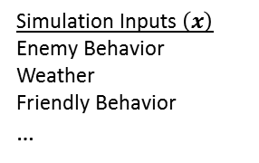
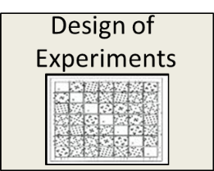
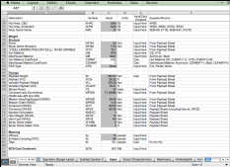
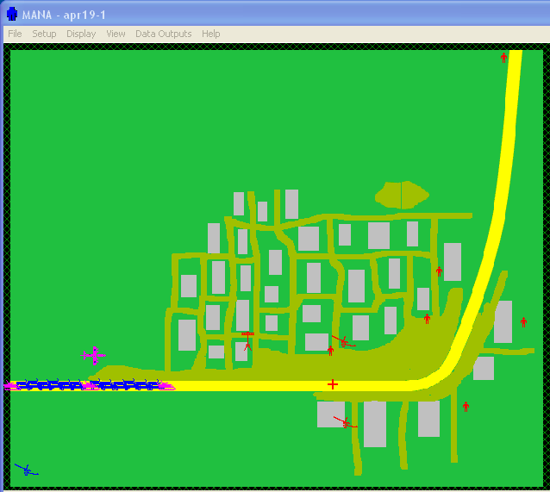
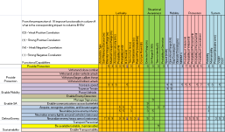

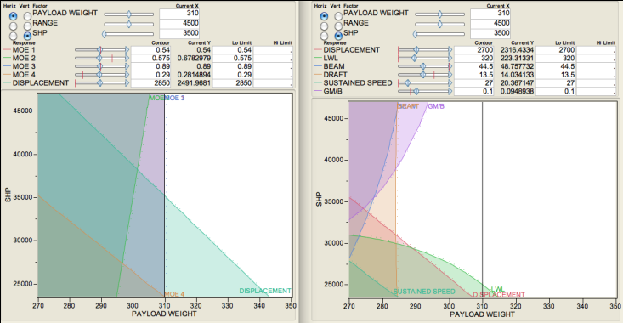


Army Survivability Project Using MBSE
Real Environment
Design-To Specifications
Environmental / Operational Factors
Operational Simulation Model
Synthesis Model
Design Parameters
Simulation Inputs $\left(x\right)$
Mobility (vehicle speed)
Lethality (weapon range,
weapon type, P(K))
Lethality (weapon type)
SA (detection range,
P(detect)
Tactics…
Synthesis Inputs $\left(x\right)$
C² System
Sensor Type
# of Guns
Gun Type
…
Excel
MANA
Operational Surrogate Model of Simulation
Physical Surrogate Model of Synthesis
*Map simulation inputs to synthesis inputs using heuristics, regression analysis or directly.
Operational Constraints
Trade Space
Physical Constraints
Synthesis Outputs (DOTMLPF)
MOEs
Simulation Outputs y(x)
Survivability
Force Protection
Mission Success
Synthesis Outputs y(x)
Doctrine changes
Organization changes
Materiel (Bradley, Abrams, etc)
Personnel, Training
Deployability
Cost
Operational Space
Solution Design Space

Slide 10
PROCESS
Operational Analysis
System Architecture
System Analysis
Model Development
Model Execution
Define unit operations
Develop Use Cases
Develop MOEs
Outputs: Scenarios for analysis, Unit for Analysis
Define functionality
Determine flows
Identify MOPs
Outputs: Operational Architectures, Use Cases, MOEs
Gather data Specify analysis Identify data requirements
Outputs: Architectures
Architecture defines SoS
Build simulation
Outputs: Model with data requirements and System Metrics
Execution Use Case
Evaluate data
Outputs: Baseline Results, Alternative Configuration Results
* Tailored version of the DoD SE “V” and the current process being implemented within the PEO CS&CSS Product Manager Contingency Basing Infrastructure

Slide 11
STAKEHOLDERS

Slide 12
Baseline Mission Scenario
BLUE Force is a balanced company team (1 mech platoon, 1 tank platoon) of a Combined Arms Battalion which attacks along a major highway 30 km south to take Objective 1 as prerequisite for the future attack of the Battalion against Objective HAWK.
The company is the major effort with priority indirect fire support and is the main focus of the Battalion UAV reconnaissance effort. Apache attack helicopters will provide close air support and additional reconnaissance capabilities.
The Battalion Commander's intent for the company team is to maintain as much offensive momentum as possible to keep the enemy off balance but also to destroy detected enemy in the area of operations. After reaching Objective 1 the company team will secure the objective until follow-on forces attack over own positions to Objective HAWK.
Notes:
Several reasons lead the Team to select Mr. Treml’s Operations Research Thesis “New Approach for the Development of Specifications for a Future Ground Combat Vehicle“ and supporting model as a basis for our model development. First, as we studied the problem it became apparent that using ExtendSym would be problematic due to it’s limitations with respect to defining terrain, sight lines and agent interaction to the level needed. Second, Treml’s completed model, on inspection, offered the team a far richer environment than we could create in the given time and with our existing skill set. Last, because the model was developed in MANA, it provided the Team with very solid technical support as we made modifications.
Additionally, the Treml model already incorporated both the terrain type and the force disposition (reinforced Mech Company with air support) which we had decided on as our key model elements.

Slide 13
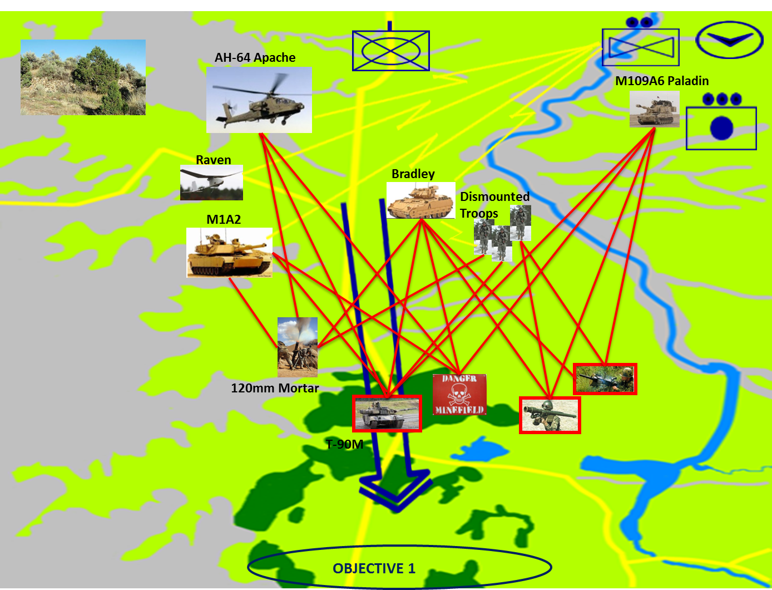
OV-1
Notes:
The OV-1 here shows the relative initial disposition of Blue Company (+). The Blue line of attack is shown as the Blue Arrow running from North to South ; 2-way voice and data communication linkages from Company elements to HQ (Yellow Bolts) and Blue - Red tactical engagements (red lines). Objective 1 for Blue Company (+) is at the southern extreme of the battle area.

Slide 14
FUNCTIONAL DECOMPOSITION
Notes:
The functional hierarchy aids in decomposing high level abstractions into elements that have measureable properties and can be instantiated as physical elements in the simulation model.

Slide 15
PHYSICAL DECOMPOSITION
Notes:
The architectural view of the baseline high level physical architecture is shown above, these elements are indicated on the IDEF0 diagram as the components which are host to the functions. The component descriptions are defined without associated physical instantiations such that a diverse set of design solutions can be integrated into the system model.

Slide 16
SYSTEMS ANALYSIS
Notes:
Actual success criteria for a particular system is Based on the operational capabilities as Defined in the system’s capability definition document. The objective of these simulations is not to establish a mission threshold limit, but to determine the factors Which have the greatest positive influence on Survivability A constraint of mission equivalent run time equal to less than 14 combat hours for the BLUE tanks is an artifact of the model to ensure the model does not allow scenarios of indefinite run lengths.

Slide 17
MODEL DEVELOPMENT
ANALYSIS TOOLS
1. Sanchez, S. M. 2011. NOLHdesigns spreadsheet. Available online via http://harvest.nps.edu/
[accessed 02/18/2013]
Notes:
Prior to developing a design of experiment (DOE), the team needed to have a better understanding in two key areas. 1) What are the required capabilities of ground combat vehicles (both legacy and future design)? 2) Which combat vehicle performance capabilities are the most critical to mission success, and which possess the greatest trade space? That is, which performance modifications will have the greatest impact (positive or negative) on mission success?
The team spoke with subject matter experts that were part of the GCV Whole Trades Analysis Team, as well as reviewed the GCV WSTAST technical report. The information obtained help to glean which combat vehicle attributes would be most essential in our analysis. An initial assembly of 15 performance attributes were narrowed down to 9 through a value weighting exercise, as well as by understanding which attributes were modifiable within MANA (our modeling software).
These 9 attributes were defined as our design factors, and through research of current combat vehicle performance requirements, as well as SME input, assigned an appropriate design space for each factor. With the ranges in hand, the team utilized the NPS SEED Nearly Orthogonal Latin Hypercubes design of experiments worksheet for 11 factors (a 10 factor worksheet was not available, but would contain fewer trial runs).
The NOLH 11 factor worksheet specified 33 trial runs, defining various configurations of the design factors. To minimize the chance involved in a single run outcome, the team settled on a 5-run series for each defined trial configuration, totalling 165 MANA runs. All output data from each 5-run series would be averaged, and that value included as the trial result.

Slide 18
MODEL DEVELOPMENT
SIMULATIONS

Slide 19
RESULTS
Notes:
Utilizing the NOLH 11 factor DOE, along with the Tremel OR scenario, the team modified attributes within MANA to align with the design factor configurations.
The baseline squad properties, as defined by the Tremel scenario, were modified in accordance with each trial run, and then run 5 times. Design factors “Top Sustained Speed” (Bradley), “Armor Thickness” (Bradley & Abrams), “Armor penetration” (Abrams 120mm, Bradley & Abrams 7.62mm), and “Rounds Fired” (Abrams 120mm & Bradley/Abrams 7.62mm) all aligned with specific modifiable attributes within the MANA squad properties.
Design factors “Detection Range” (Raven UAV), “Max Effective Primary Weapon Range” (Abrams 120mm), and “Max Effective Secondary Weapon Range” (Bradley & Abrams 7.62mm) all are assigned in accordance with a matrix design. That is, for increasing ranges, beginning with 0, the detection accuracy and weapon hit rate decrease in probability. Because this type of data is either unavailable or classified, the team could not attempt to modify the baseline values for all ranges.
Assumption for detection range were made such that the detection of a vehicle was at least as accurate as the detection of infantry. Additionally, the assigned probability for the greatest baseline detection range, was assumed as the probability for the new detection range, defined by the DOE trials (all of which were lower than baseline).
Assumption for max effective weapon range is that to be “effective,” a weapon possess a hit rate of 90%. Thus, at range 0, P(h) = 100%, and at max effective weapon range (defined by the DOE trial) P(h) = 90%. No other interim ranges were assigned. Additionally, the team utilized the MANA internal interpolation algorithm for all ranges between 0 and MAX.

Slide 20
BASELINE ANALYSIS

Slide 21
ALTERNATIVE CONFIGURATIONS

Slide 22
OVERALL MEASURES OF EFFECTIVENESS (OMOE)

Slide 23
COST AS AN INDEPENDENT VARIABLE (CAIV) ASSESSMENT

Slide 24
OMOE AND CAIV RESULTS

Slide 25
SUMMARY AND CONCLUSIONS
Challenges
Toolset
Data classification
Follow-on work
Dashboard
In-depth analysis
Emerging technologies
Trade-space
Conclusions
Value created by this effort

Slide 26
CHALLENGES
Lack of integrated MBSE toolset
Choice of tools is left up to the engineer
Developed process is independent of toolset
Classified data
Prohibited the use of realistic data in many cases
Forced several assumptions
Forced alteration of some data
Developed process is independent of the data

Slide 27
FOLLOW-ON WORK
Development of dashboard
Performance of analysis in greater depth
Investigation of emerging technologies
Broadening of the trade-space

Slide 28
Dashboard
Direct end-user manipulation of model parameters.
Extend technical capabilities to a broader audience.
Provide abstraction on the underlying analysis tools.
Provide early insight into the effects of design changes.
Help identify important design parameters.

Slide 29
Further Analysis
Interactions between MBT armor penetration and IFV maximum effective range.
Interactions between IFV rate of fire and IFV maximum effective range.
Lack of effectiveness in the model of IFV armor.
Detrimental effects in the model of IFV top speed.
Impact of increased situational awareness.

Slide 30
Emerging Technologies
Examples
High-energy weapons
E-ink camouflage
New ground combat systems
Could be evaluated under the developed process.

Slide 31
Trade Space
Currently limited to ground combat
Opportunities
Inclusion of consideration for air support
Factor limitations and improvements in logistics
Create scenarios for joint operations
Provide a more complete picture of unit effectiveness and health.

Slide 32
CONCLUSIONS
Developed a process that is:
Effective
Repeatable
Adaptable
Lays groundwork for additional research
Provide support for doctrinal and organizational changes
Demonstrate importance of SoS factors and effects
Provide support for feasibility study for emerging technologies

Slide 33
QUESTIONS

Slide 34
Back up

