Slide 1


Integrated Base Defense Interim Program Review (IPR)
ROBOCOP
Present to: Mrs. Bridgette Kwinn, COCOM
By: ROBOCOP (Reliable Offensive Base Overwatch and Command Outpost Protection) LLC
US FOB
1
“Our Mission is to ensure you complete yours”
Notes:
BRENNAN

Slide 2
Agenda
Problem/Capability Need
Background/Stakeholder requirements
Value System
Operational Architecture
Top level system functions
Top level system requirements ranking (how did you get there?)
Functional Architecture
Concept Designs
System Tradeoff analysis
Concept recommendation to include baseline
Recommendations for future projects
2
Notes:
BRENNAN

Slide 3
ROBOCOP Development Team
Christine Brennan
Systems Engineering Process Team Lead
Based out of TARDEC in Warren, MI
Bill Berklich
Architecture and Logical Design Lead
Based out of TARDEC in Warren, MI
Steve Mazza
Requirements Lead
Based out of CERDEC in APG, MD
Michael Oexmann
Systems Integration Lead
Based out of CERDEC in APG, MD
Ralph Pinnock
Reliability, Availability, Maintainability – Test (RAM-T) Lead
Based out of TARDEC in Warren, MI
Dan Torres
Risk and Technical Planning Lead
Based out of TARDEC in Warren, MI
3
Notes:
BRENNAN

Slide 4
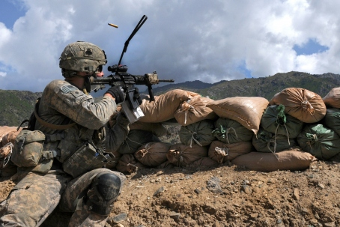
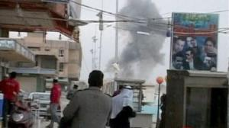
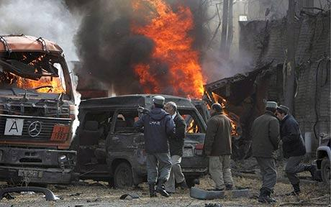
Problem Background
In Operation Iraqi Freedom (OIF) and Operation Enduring Freedom (OEF) there are over 200,000 soldiers supporting the fight and hundreds of men and women have lost their lives in base attacks. In the early 1990’s the United States Army decided to become a mobile expeditionary force, that there would be a more sweep through, execute and leave. Thus, the Army eliminated the capability to build and defend base camps. The face of war has changed again with a greater focus on “Hearts and Minds”, leading to the need for the small base camps to set up, defend, and provide mission support at the front lines. These front lines and type of warfare being used against these camps are insurgent and irregular warfare, which presents a huge issue. Because of this, the expeditionary base camps of today are not designed to handle types of threats posed by insurgents in irregular warfare and leads to adverse mission impact and loss of life.
4
Notes:
BERKLICH

Slide 5
Capability Needs Functional
Detect
Sense Objects
Determine Initial Position of Objects
Track Objects
Transportability
Reliability
Assess
Continually Evaluate Threat Vectors
Continually Classify Objects
Communicate
Warn Personnel
Record Activities
Feed Data
Supportability
Availability
Defend
Engage Threat
Prevent Penetration
5
Notes:
MAZZA

Slide 6



Stakeholder Expectations
COCOM, FOB Commanders, Warfighters, Allied Forces: reduce casualties, not kill/injure locals, not damage property or environment, install/retrieve quickly, small installation /operation crew, require small operational crew, identify and interdict threat, discriminate targets, high reliability/availability, easily repairable, all weather operation
Maintainers: very reliable, easily repairable/replaceable, install/retrieve quickly, require small installation/operational crew, no preventative maintenance, parts easily available.
Logisticians: Inexpensive, easily packed, easily shipped, Highly reliable, Low cube, low weight, weather resistant, environmentally friendly, easily disposed/demil’d
Taxpayers, Congress: Inexpensive, reduce casualties, not kill/injure locals, “hearts and minds” ,not damage property, not damage environment, not be a persistent threat
Acquisition, DoD: Inexpensive, reduce casualties, not kill/injure locals, not damage property, not damage environment, not be a persistent threat, high volume, reusable technology, scalable, open architecture, easily upgradeable, potential foreign military sales
Contractors, investors: Profitable; high volume, reusable technology, scalable, proprietary content, potential FMS sales, wide acceptance across DoD, Services, DHS.
Local Populous, NGOs: not kill/injure locals, not damage property, not damage environment, not be a persistent threat
6
Notes:
BERKLICH

Slide 7
Value System
Update since IPR1:
Added 2 functions
We felt it was necessary to add these functions into the value system after analyzing the Operational Architectures and determining that there was a missing piece of the system that was necessary to enable to completion of the mission required.
Determine Capability Level
Prioritize Threats
Deleted 2 Evaluation Measures
After the analysis of the needs, architectures and mission scenarios it was determined that there were additional constraints placed on the system that were not mission essential and therefore we felt could be lifted.
Logistical Down Time – Not controlled directly by the system design or architecture, can impact but not at a high enough level to include in the value system.
Reliability Confidence – It is a way to test the reliability of a system but not an overall requirement of the system
Updated 2 Goals
Analysis lead the team to believe that either the goals were too stringent or too loose based upon the mission requirements and constraints. We also did an initial feasibility study to determine if the initial thresholds and objectives were achievable, with the results we determined it was necessary to reduce or expand the goal.
Deployability – The deployability requirement was reduced to 24 Hours from 18 hours due to a review of the preliminary system requirements enclosure from the stakeholders
Sense Potential Threats – The mission called for 1500m protection therefore the original goals were expanded

Slide 8
Value System Functions, Sub-functions, and non functions
Functions
Non-Functions
1 Detect all objects of interest
1.1 Sense Object
1.2 Locate Object
1.3 Track Object
2 Assess data to relay relevant intelligence
2.1 Identify Object
2.2 Classify Object
2.3 Determine Intent
2.4 Determine Capability
2.5 Prioritize Threats
3 Communicate to appropriate personnel of pending threat
3.1 Transport Data
3.2 Disseminate Information
4 Defend personnel, facilities, and equipment
4.1 Engage Threat
4.2 Prevent Penetration
5 Transportability
5.1 Man Power
5.2 Deployability
5.3 Two Man Lift
5.4 Unit Load
6 Availability
6.1 Operational Availability
6.2 Logistical Down Time
7 Reliability
7.1 Time Between Failures
7.2 Confidence
8 Supportability
8.1 Level of Repair
8.2 Time to Repair
8
Notes:
BRENNAN

Slide 9
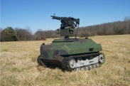
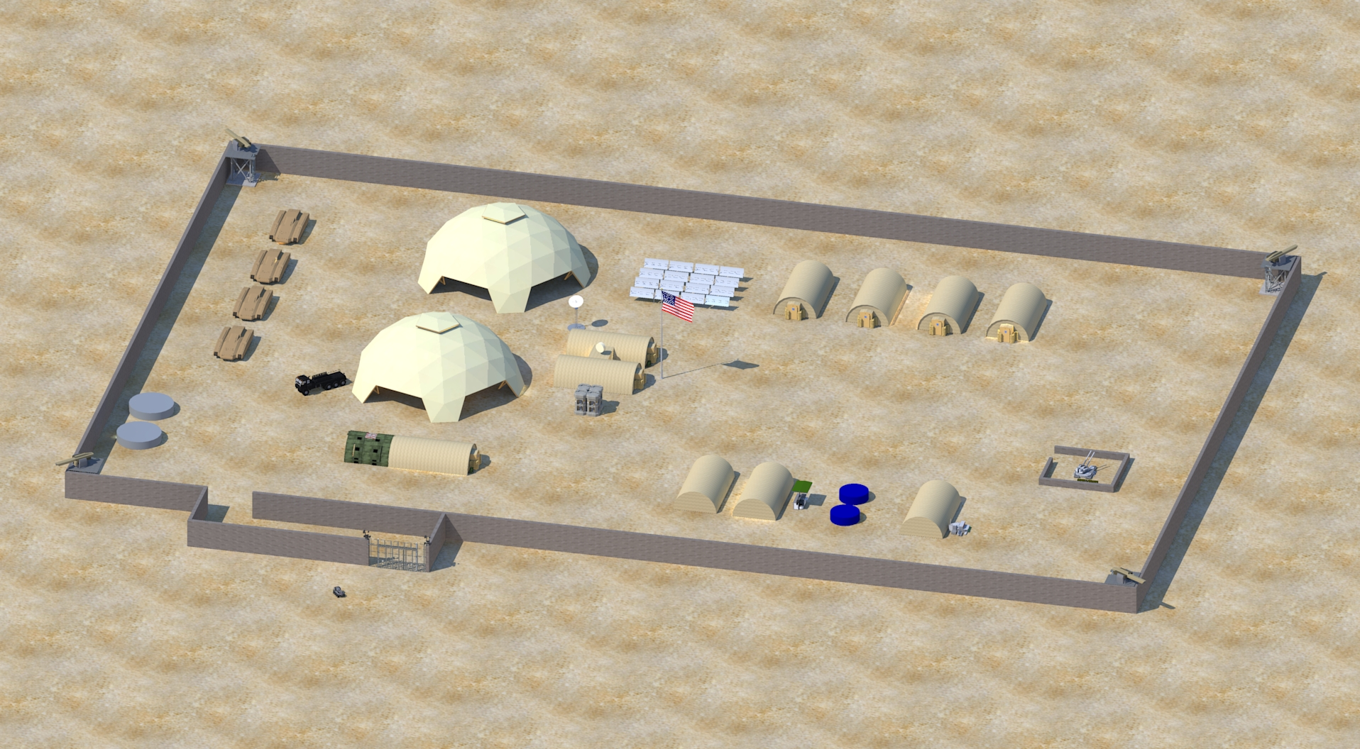
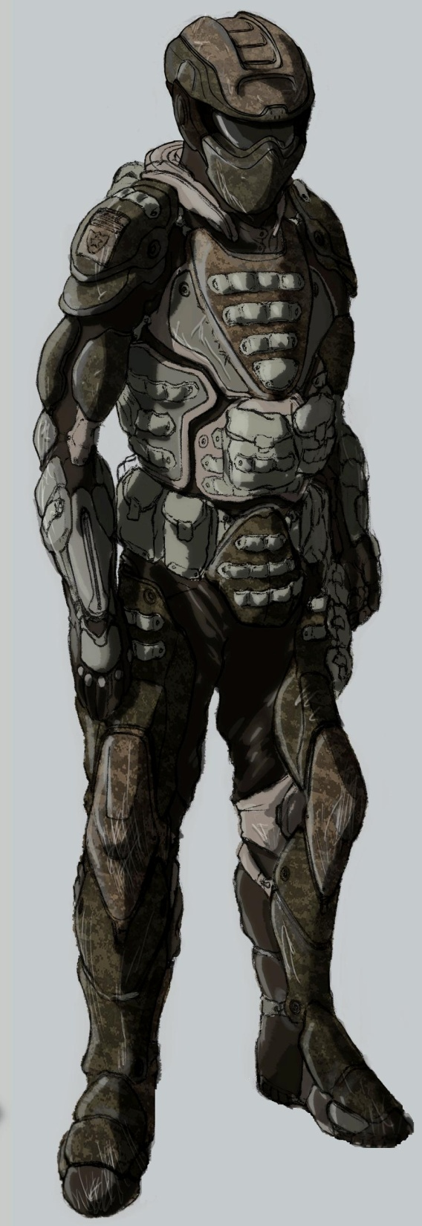

OV-1
Semi Automated UGV
Adjacent Units
Higher Headquarters
BDOC
Control
Semi Automated Weapon
FOB Command
Detect
Detect
Early Warning System
Mortar attack
Bed Down
Entry Control Point
QRF
Local Contractor
Enemy
Logistics Convoy
Subordinate Unit
Data
Comms
Fires
Notes:
Monitor AOR
Sense movement
Identify Threat
Notify Chain of Command
Make A Decision
Give Warning Command
Warn Personnel
Give Command to fire
Receive Command to fire
Engage Threat
Kill Threat
Monitor ECP
Check identity of incoming personnel
Inspect Incoming vehicles and packages
Give Command to engage (apprehend)
Receive Command to engage
INTERFACES
Communicate Threat information to Higher Headquarters
Communicate Threat information to dismounted troops
Communicate Threat information to adjacent Unit

Slide 10
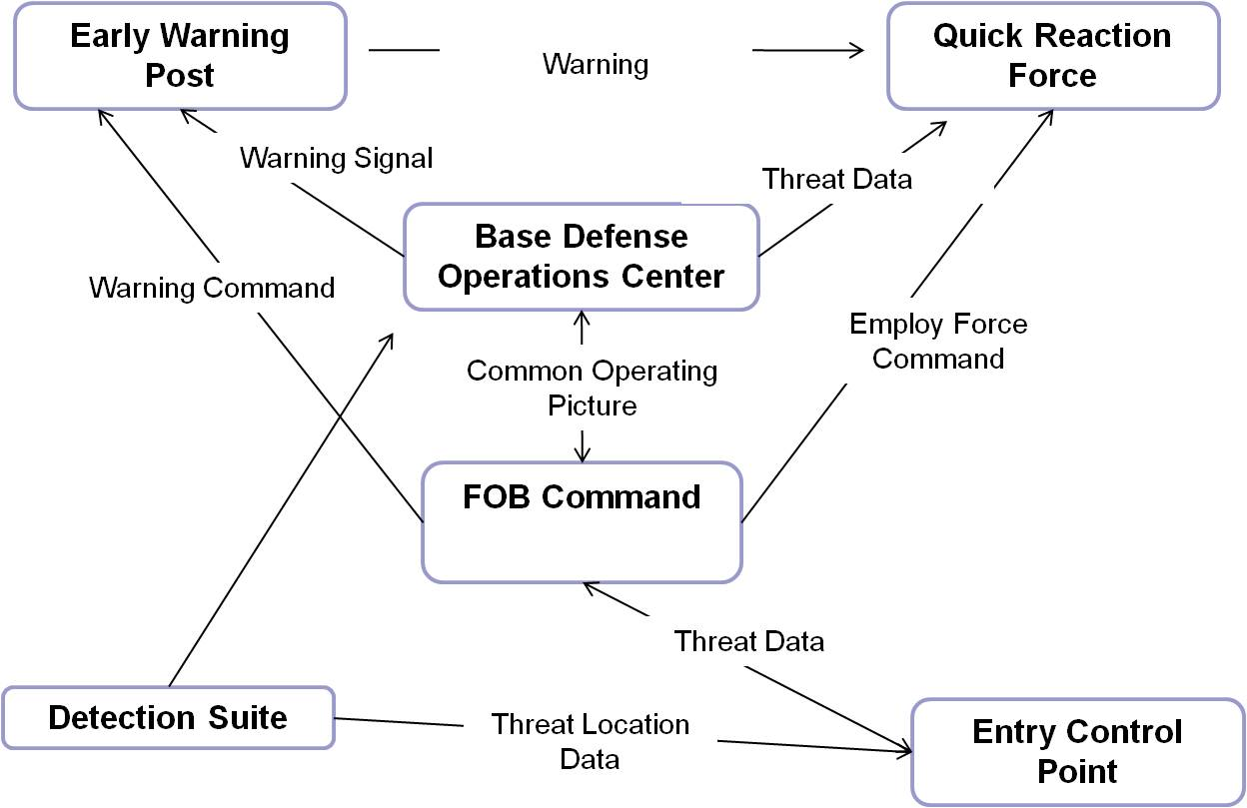

Slide 11
Operational Nodes
Nodes | Mission | Activities
BDOC
FOB Command
Entry Control Point
External Units

Slide 12
Top Level System Functions
1
Protect the Base
1.1
Detect all potential threats
1.2
Assess all potential threats
1.3
Communicate Information
1.4
Defend all personnel, equipment and facilities
Definition:
Sense, Locate and track the full range of air and land activities to maintain real time situational awareness
Definition:
Definition:
Definition:
Notes:
Will pull from CORE

Slide 13
Top Level Requirements Indicates Top Level Requirement
6.3.1. Detect Potential Threat
The IBDS shall be capable of detecting all potential threats in the air and on the land.
6.3.2. Assess Potential Threat
The IBDS shall assess incoming data and relay relevant intelligence to necessary recipients.
6.3.3. Communicate Information
The IBDS shall communicate all information to the necessary recipients.
6.3.4. Defend all personnel, facilities and equipment
The IBDS shall defend all base personnel, facilities and equipment.
6.3.3. Operational System Requirements
The IBDS shall be capable of operation with the assistance of any existing infrastructure utilities.
The IBDS shall be installed and configured by a crew of 10(T), 9(O) personnel
The IBDS shall have an Ao = 0.90(T), 0.95(O).
The IBDS shall have an MTBF = 750 hours(T), 1000 hours(O).
The IBDS shall operate in all weather and visibility conditions in which an enemy could employ direct or indirect fires.

Slide 14
Ranking Process

Slide 15
Functional Interface Architecture (SV-1)
Shall interface with system user
User Node
C4ISR Node
System 5
Make Decisions
Shall integrate with current C4ISR suite
System 6
Provide Maintenance
System 10
Enable Interbase Communication
System 7
Operate System
System 11
Enable External Command and Control
System 12
Enable FOB Commander Decisions
IBDS Node
Shall integrate with current stand-alone UHF/VHF radio systems
System 1
Detect Potential Threats
System 2
Larger Protection Node
Assess Threats
System 3
Communicate Information
System 13
Protect Larger Bases
System 4
Defend Base
Shall interface with current protection systems on larger bases
Shall integrate with existing sensor systems
Sensor Node
Shall accept power and utilities from existing base supplies
Power Node
System 8
Identify Threats on larger bases
System 14
System 9
Generate Power for Larger Bases
Perform ISR on larger bases

Slide 16
Functional Hierarchy (SV-4)
1
Protect the Base
1.1
Detect all potential threats
1.2
Assess all potential threats
1.3
Communicate Information
1.4
Defend all personnel, equipment and facilities
1.1.1
Sense Potential Threats
1.2.1
Identify Potential Threats
1.3.1
Disseminate Information
1.4.1
Engage Threat
1.1.2
Locate Potential Threats
1.2.2
Classify Potential Threat
1.3.2
Disseminate Warning
1.4.2
Prevent Penetration
1.1.3
Track Potential Threats
1.2.3
Determine Intent
1.3.3
Transport data
1.2.4
Determine Capability
1.2.5
Prioritize Threat
Notes:
Monitor AOR
Sense movement
Identify Threat
Notify Chain of Command
Make A Decision
Give Warning Command
Warn Personnel
Give Command to fire
Receive Command to fire
Engage Threat
Kill Threat
Monitor ECP
Check identity of incoming personnel
Inspect Incoming vehicles and packages
Give Command to engage (apprehend)
Receive Command to engage
INTERFACES
Communicate Threat information to Higher Headquarters
Communicate Threat information to dismounted troops
Communicate Threat information to adjacent Unit

Slide 17
Concept Designs
Utilized a morphology matrix (See back up slides) for each of the major sub system areas as defined by the functional architecture
An initial set of feasibility criteria was developed to rule out obviously infeasible technologies. The criteria
included:
Deployed within 18 months
All weather
All Terrain
Deployable by 10 men
Graceful Degradation
Reliability
Within Scope
Protect Allies and Troops
Deployable with 48 hours
Current Training Strategies
Integration
Narrowed down the 808856036400 possible combinations to the top 4 instantiated concepts. After the initial
assessment of infeasible technologies and then utilizing subject matter experts to help narrow down to the
best optimization of technologies based on the top level functions and requirements.

Slide 18
Top Instantiated Concepts
Concept | Detection System | Assessment System | Communication System | Defense System
1 | Passive Infrared Detector Radar Semi Autonomous UMS | Blue Force Tracker Biometric Scanner Computer RF Detection Threat Prioritization Matrix | Computer Siren Intrabase Network | Semi Autonomous Weapon Semi Autonomous Armed UGV Deployable Tire Spikes
2 | Radar Infrared Camera Camcorder | Blue Force Tracker IR/Thermal/NV Imaging Vector Analysis Video TPM | Siren Intrabase Network Server System | Semi-Autonomous Armed UGV Deployable Tire Spikes
3 | Microphone Boomerang Radar | IR/Thermal/NV Imaging Biometric Scanner Computer Threat Prioritization Matrix | Radio Lights Computer System | Semi-Autonomous Armed UGV Deployable Tire Spikes
4 | Inertia Sensor Microphonic Systems Unmanned Aerial Vehicle (UAV) | Ground Sensor Sonic Signature Computer Response Matrix | Satellite Phone Computer | Semi – Autonomous Weapon Deployable Tire Spikes
Notes:
Teram…Elluminate Session to do this

Slide 19
Systems Analysis
Value System Weighting Results
Swing Weight Rankings
Variant Value Scores
Value Curves
OMOE vs Cost Evaluations
Preferred Concept Alternative

Slide 20
Variant Value Score

Slide 21
OMOE vs Cost Evaluation
Concept | Cost Score | Performance Score
1 | 1.00 | 0.6252
2 | 0.82 | 0.5676
3 | 0.75 | 0.4782
4 | 0.79 | 0.4425
Assessed the performance based on the previously prioritized stakeholders and their importance placed on the individual Evaluation
measures used to determine the value system.
The Evaluation Measures were weighted based upon the importance to the stakeholders and the weighting placed on the individual
stakeholders.
The performance was then normalized.
The cost was determined utilizing a high level assessment of expensive, moderately expensive and affordable (1,2,3 respectively) that was
then summed up and normalized as well.
Those normalized numbers were then graphed against each other

Slide 22
Preferred Concept Alternative
Concept | Detection System | Assessment System | Communication System | Defense System
1 | Passive Infrared Detector Radar Semi Autonomous UMS | Blue Force Tracker Biometric Scanner Computer RF Detection Threat Prioritization Matrix | Computer Siren Intrabase Network | Semi Autonomous Weapon Semi Autonomous Armed UGV Deployable Tire Spikes
Justification:
There is no cost constraint , however we are aware that cost is never a non factor. It was assessed independently and
then utilized to help determine the best ROI for the system.
We took all the data for the OMOE and the cost and we normalized that data. Utilizing a formula to account for the
higher cost we weighted the cost of the system to be a 20% impact to the overall system total. We are also aware that
performance is of great importance to the user because of the nature of the system which will help alleviate adverse
mission impacts and loss of life due to small FOB attacks.
The chosen system has a higher level of risk because it is a semi autonomous system, however it will be progressively
advanced and will meet the requirement of automating lower level functions such as detection, target acquisition,
threat assessment and automated warnings.
The system is slightly more expensive then the other concept options, however we feel this system will be the most
efficient because it will rely heavily on those automated responses and require only the input of the user to make
decisions such as commands to mobilize, command to apprehend or command to engage.

Slide 23
System Baseline

Slide 24
Overarching Summary
Notes:
BRENNAN

Slide 25
Way Ahead
Requirements
Interface Matrix
Tech Planning
IPT Development
Technology Landscaping to identify current systems and technologies
Risk Assessment
Architecture and Logical Design
Logical Design
CORE Diagramming
RAM-T
TEMP
25
Notes:
BRENNAN

Slide 26
Back Up
26

Slide 27
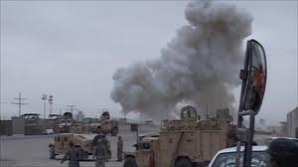
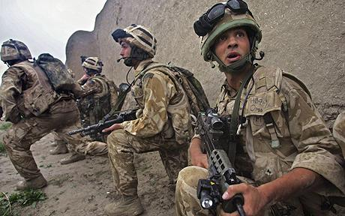
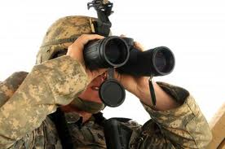
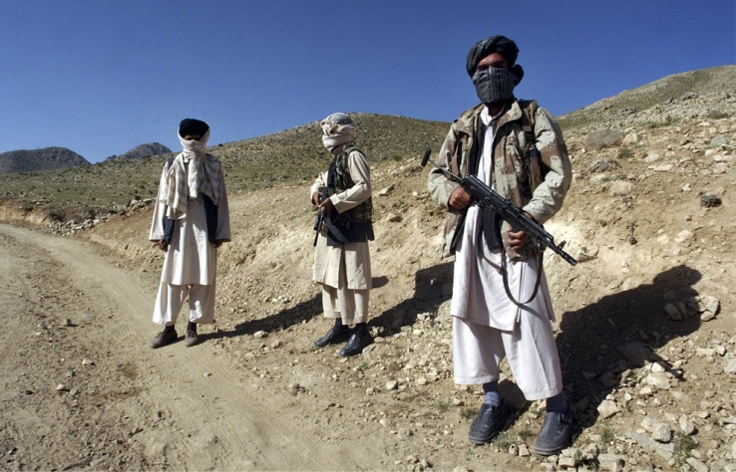
Problem Background
Attacks on Southwest Asian bases happen regularly. The types of attacks are harassment, denial, and tactical. Harassment being the highest frequency of engagement.
Protection for the FOBs is kinetic and non-kinetic and the IBDS should perform both. Non-kinetic reduces civilian casualties and improve relations
These attacks have resulted in significant single operation casualties; interfere, interrupt, and impair base operations and also disrupt military operations and local government and services
27
Notes:
BERKLICH –

Slide 28
Effective Need
“The FOB Commander has a need to mitigate the external defense issues within small camps, reduce causalities, increase mission performance and protect the Force within the AOR and across the full spectrum of operations from direct and indirect threats with an effective, tailorable, supportable, logistically feasible, integrated, and rapidly deployable protection system. The system needs to be operable in all weather, all visibility, all terrain with independence from utility infrastructure.”
The effective need was derived from the initial stakeholder requirements to identify what was needed and was desired.
28
Notes:
BRENNAN –

Slide 29
Value System (Con’t) Functions, Sub-functions, EM, Definitions and Goals
Sub Function | Objective | EM | Definition | Goal
1.1 Sense Potential Threats | Maximize sensing Range | Distance from object | To initial sense a potential threat at the furthest distance from the base gives the greatest chance of defense, due to more time to react | T =500m O =1500m
1.2 Locate Potential Threats | Maximize geospatial accuracy | % of accurate coordinates | Accurately generate the coordinates (distance, elevation, azimuth) of an object of interest | T = 90% O = 95%
1.3 Track Potential Threats | Minimize latency | Time from signal to refresh | To follow a moving object through the recognition of it's changing coordinates, requires a quick response time to relocate each movement | T = 400ms O = 100ms
2.1 Identify Potential Threats | Maximize recognition of data anomalies | % of correct identification | Identify that there is an anomally in the data that implicates an object that has not been present previously | T = 92% O = 99%
2.2 Classify Potential Threats | Maximize friend vs foe accuracy | % of correct identification | Initially classify the object as possible threat or as a friendly | T = 95% O = 99%
2.3 Determine Intent | Maximize hostile intent recognition | % of hostile intent identification | Identify hostile intent utilizing markers (weapons, facial expressions, hostile body language, clothing etc.) | T = 95% O = 99%
2.4 Determine Capability | Maximize threat capability level recognition | % of accurately identified capability levels | Identify the consequence of the threat by identifying markers (number of hostiles, type of weapon, distance from FOB etc.) and report level according to matrix level | T = 95% O = 99%
2.5 Prioritize Threats
3.1 Transport data | Minimize time to transmit data | Time from signal output to point of reception | Necessary to Transmit data to the appropriate decision makers to aid in decision making and asset integration | T= 1s O = 500ms
3.2 Disseminate Information | Minimize time to output warning | Time from signal output to information reception | Time from recognition of hostile intent to receipt of warning by identified means. | T = 5s O = 3s
4.1 Engage Threat | Minimize time to destroy target | Time from target sensing to kill | Time it takes from the recognition of threat through sensed information to the time it is rendered neutral or dead. | T = 50s O = 30s
 | Maximize kill accuracy | % munitions kills | The % of times the incoming munitions are rendered neutralized and cause no damage | T= 85% O = 90%
4.2 Prevent Penetration | Minimize threats penetrating system boundary | % perimeter breaches | % of actual breaches to possible threats. This includes threats (vehicles, people, packages) passing through at the ECPs, over walls, or penetrating the boundary in any way. Excludes Munitions | T = 2% O = 1%
 | Minimize Friendly Casualties | % Threats neutralized | The % of times the incoming threats are rendered neutralized and cause no damage to include munitions, packages, ECP entrance etc. | T = 95% O = 99%
29
Notes:
Yellow – Changed Goal
Red – Deleted
Green - Added

Slide 30
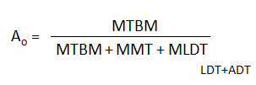
Value System (Con’t) Non-Functions, Sub Categories, EM, Definitions and Goals
Sub Function | Objective | EM | Definition | Goal
5.1 Man Power | Minimize Soldiers needed for assembly | # of soldiers required for transport | # of soldiers required for the configuration and set up of the system without special equipment. Most of the units using this system will be mobile units and it will be carried with them as part of their equipment. | T = 10 O =9
5.2 Deployability | Minimize time to deploy the system | Time to Deploy System | The time it takes to remove, configure and make the system operational | T=48 hours O = 24 hours
5.3 Two Man Lift | Minimize subsystem weight | # of pounds | Weight of individual subsystem, each component must be capable of being lifted by 2 or less men. | T = 174 lb O = 84 lb
5.4 Unit Load | Minimize system weight for the unit to transport | # of pounds | Total System Weight | T= CH-47 Transport O = UH-60 Transport
6.1 Operational Availability | Maximize Operational Availability |  | Availability is the probability that at any point in time the system is either operating satisfactorily or ready to be placed in operation on demand when used under stated conditions. | T = 90% O = 95%
6.2 Logistical Down Time | Minimize Mean Logistical Down Time | MLDT | Logistical Down Time is a combination of the Logistical Delay Time (Parts Availability ("In the Bin”, Needed items awaiting transportation, etc.) and the Administrative Delay Time ( Locating tools, Setting up test equipment, Finding trained personnel, Reviewing manuals, Complying with supply procedures, etc.) | T = 30 Hours O =25 Hours
7.1 Time between failures | Minimize Mean Time between Failures | MTBF | A failure is any loss of mission essential functions due to a malfunction of any hardware component or a critical or catastrophic hazard to personnel or equipment. Loss of mission essential functions due to “outside” influences such as crew/maintenance error | T =750 hours O = 1000 hours
7.2 Confidence | Maximize Reliablity Confidence | % confidence | the probability of an item to perform a required function under stated conditions for a specified period of time | T = 80% O = 90%
8.1 Level of Repair | Maximize Operator level repairs required | % Operator level repairs | Operator maintenance shall be conducted forward in the battlespace as the battle rhythm of the supported unit permits and shall be conducted by the system crew chief/operator | T = 75% O = 85%
8.2 Time to Repair | Minimize Mean Time to Repair | MTTR | MTTR is the sum of corrective maintenance times divided by the total number of repairs of the item | T = 2 clock-hours, O = 1 clock-hour
30
Notes:
BRENNAN

Slide 31
Top Level Requirements Indicates Top Level Requirement
6.3.1. Detect Potential Threat
The IBDS shall be capable of detecting all potential threats in the air and on the land.
6.3.1.1. Sense Potential Threat
The IBDS shall distinguish a XXX sized object through variations, changes or disturbances in and across the full spectrum including audio, visual IR, UHF, VHF, Microwave; and chemical detection from 500m (T), 1500m (O). (See Classified Annex)
6.3.1.2. Locate Potential Threat –
The IBDS shall determine the relative location of a stationary object by generating the coordinates of a XXX sized object in terms of azimuth, elevation and distance with a 90%(T), 95%(O) accuracy. (See Classified Annex)
6.3.1.3. Track Potential Threat –
The IBDS shall follow a moving object, XXX sized object and up to speeds of XXX lateral motion, through the recognition of it’s changing coordinates with a latency of 400ms (T), 100ms(O).
6.3.2. Assess Potential Threat
The IBDS shall assess incoming data and relay relevant intelligence to necessary recipients.
6.3.2.1. Identify Object –
The IBDS shall correctly identify common objects, including common military objects, animal, person, environmental etc, with a 92%(T), 99%(O) accuracy.
6.3.2.2. Classify Object -
The IBDS shall correctly classify the potential threat as friend, foe, munition or neutral with an accuracy of 95%(T), 99%(O).
6.3.2.3. Determine intent –
The IBDS shall correctly determine the probability that the object will be employed as a threat with an accuracy of 95%(T), 99%(O).
6.3.2.3. Calculate Threat Capability Level -
The IBDS shall identify the capability level of the threat utilizing the criteria and evaluation factors with an accuracy of 95%(T), 99%(O).
6.3.2.3. Prioritize Threats -
The IBDS shall correctly prioritize all assessed threats from most catastrophic to benign according to prioritization criteria with an accuracy of 93%(T), 97%(O).

Slide 32
Top Level Requirements Indicates Top Level Requirement
6.3.4. Communicate Information
The IBDS shall communicate all information to the necessary recipients.
6.3.4.1. Transport Data
The IBDS shall transmit data to necessary sources including personnel, systems and storage within 1s(T), 500ms(O) from the signal output to the point of reception.
6.3.4.2. Disseminate Information
The IBDS shall output a message or command within 5s(T), 3s(O) of command decision.
6.3.4.3. Disseminate Warning
The IBDS shall output an audible warning automatically within 3s(T), 1s(O) of the recognition of an incoming munition.
6.3.3. Defend all personnel, facilities and equipment
The IBDS shall defend all base personnel, facilities and equipment.
6.3.3.1. Engage Threats
The IBDS shall render a threat neutral (unable to cause damage) within 50s(T), 30s(O) of recognition of the potential threat.
The IBDS shall automatically engage attacks by indirect fire within specified fire zones at a distance of 100m (T), 300m (O) from the base perimeter.
The IBDS shall render 95%(T), 99%(O) of the incoming munitions neutralized.
6.3.3.2. Prevent penetration
The IBDS shall prevent 98%(T), 99%(O) of perimeter breaches passing through the Entry Control Points, including people, packages and vehicles.
6.3.3. Operational System Requirements
The IBDS shall be capable of operation with the assistance of any existing infrastructure utilities.
The IBDS shall be installed and configured by a crew of 10(T), 9(O) personnel
The IBDS shall have an Ao = 0.90(T), 0.95(O).
The IBDS shall have an MTBF = 750 hours(T), 1000 hours(O).
The IBDS shall operate in all weather and visibility conditions in which an enemy could employ direct or indirect fires.

Slide 33
Morphology Matrix Detection Sub-system
Detection Device
Sensing Device | Location Device | Tracking Device
Radar | Radar | Radar
Passive Sound Navigation Ranging (SONAR) | Passive SONAR | Passive SONAR
Active SONAR | Active SONAR | Active SONAR
Passive Infrared Detector | Camcorder | Unmanned Aerial Vehicle (UAV)
Microphone | Infrared Camera | Semi Autonomous UMS Silent Stare
Semi Autonomous UMS (Silent Stare) | Semi Autonomous UMS Silent Stare | Human
Ultrasonic Detector | Light Detection and Ranging (LIDAR) | Dog
H-Field | Boomerang | Unmanned Ground Vehicle (UGV)
Photo Electric Beams | Passive Magnetic Field Detection | Camcorder
Smoke/Chemical Detector | Taut wire fence
E-Field | Microwave Barriers
TIFT Terahertz Imaging Focal Plane Array | Microphonic Systems
Inertia Sensor
Red – Infeasible with initial criteria
Summary of Matrix:
Many technologies for detection are available but each have there own strengths and weaknesses. No signal technology can completely satisfy sensing, locating, or tracking the enemy over various distances from the FOB but a combination of different hardware can meet the required inputs.
Notes:
Michael

Slide 34
Morphology Matrix Assessment Sub-system
Assessment Device
Identification Device | Classification Device | Determination of Intent Device | Determination of Capability Device | Prioritization Device
Human | IFF System | Human | IR/Thermal/NV Image Analysis | Threat Priority Matrix
Fully Autonomous UGV | Blue Force Tracker | Fully Autonomous UGV | Human | Mathematical Model
IFF System | Human | Computer | Reference Database | Human
Blue Force Tracker | Reference Models | Vector Analysis | High Resolution Video | Response Matrix
RADAR | Sonic Signature | IFF System Request | RF Detection | Proximal Analysis
Ground Sensor | IR/Thermal/NV Imaging | Automated Radio Contact | C-Sniper | Vector Analysis
IR/Thermal/NV Imaging | Recovered Ballistics | C-Sniper | LASER detection
LASER Rangefinder | Biometric Scanner
Red – Infeasible with initial criteria
Summary of Matrix:
An implementation that leverages a combination of computational capability, static data and models, program of record input, and human analysis will result in highly reliable assessments. Components can be traded off in the interest of supportability, availability, and other logistics at the expense of reliability, the metrics of which we have yet to compute.
Notes:
Steve

Slide 35
Morphology Matrix Communication Sub-system
Communication Device
Dissemination Device | Warning Device | Data Transportation Device
Computer | Lights | Server system
Loud Speaker | Siren | Filing cabinet
Email | Loud Speaker | Human
Postal Service | Smoke Signal | Fully Autonomous UGV
Text Message | Morse Code | Computer system
Classified Phone | Text Message | Printed Orders
Intra base Network | Strobe | Dog
Handheld Radio | Air Horn | Classified Phone
Satellite | Classified Phone | Intra base Network
Red – Infeasible with initial criteria
Summary of Matrix:
Though a variety of communications devices can be considered, security is a consideration here and only DoD approved media should be part of the original list, particularly with respect to data transportation device options.
At a high level most of the communication subsystems are mature. However, implementation and integration, as well as, ensuring the design of the system does not rely on an existing network or utility is going to be key in the stages going forward. As well as, system response time thresholds and objectives may render a number of the device options infeasible for the automated IBDS. So for the time being it appears that there are many feasible options, as we begin our in depth analysis in the next stages of the program, we may have to rule out, scope or modify technologies to ensure compliance with the preliminary operational requirements and more specific system requirements.
Notes:
Dan

Slide 36
Morphology Matrix Defense Sub-system
Defense Device
Engagement Device | Penetration Prevention Device
Teleop Weapon | Metal Detector
Stimulated Light Amplification (LASER) | Smart Shack
High Pressure Water System | Automated Guard Towers
Hand to Hand Combat | Semi Autonomous Armed UGV
Fully Autonomous Armed Robot | Active Barrier
Manned Weapon | Deployable Tire Spikes
Semi-Autonomous Weapon (Slew to Cue)
Red – Infeasible with initial criteria
Summary of Matrix:
In particular on this matrix it is apparent that the functions are not decomposed to the leaf node or primary function level. Because of that, there are multiple components necessary to ensure the fulfillment of this function. For example, the base needs to prevent penetration of people, vehicles and packages. Those are all going to call for different components to meet that requirement.
Notes:
Ralph

Slide 37
Value System Weighting Prioritized Stakeholders Assessment of Priority

Slide 38
Swing Weight Rankings
Notes:
Christy – Need to update Highlighted ones

Slide 39
Value Curves
Notes:
Getting these!

Slide 40
Other Boundary and Interface Assumptions Necessary for the basis of the value system hierarchy
Inside the wire is considered “safe” so the system will not address breach issues or “insider” threats.
Will not protect against CBRN or heavy artillery/tanks
Electronic Protection is the responsibility of the C3 community within the Contingency Base effort, however will address specific interfaces and necessary equipment for protecting defense systems.
Will not protect against sub-terrain threats
Environmental threats such as hurricane, earthquake, flooding etc. are not included in base defense. However, normal operating condition extremes and a need to operate in all visibility conditions will be included as assumptions, requirements and constraints for system elements to define necessary performance parameters and create threshold criteria for acceptance testing.
Maximum attack of 25-150 enemy troops at a time
As a Combat Outpost (COP) there may be Patrol Bases or convoys that is the responsibility of the COP to defend. If the base has 150-500 on post, there may be an additional 100-150 off post on small patrol bases that fall within the Area of Responsibility (AOR).
There are no cost constraints
An initial surveillance baseline identifying all terrain and natural objects has been conducted and recorded
Modification of the TTPs may be necessary
Modification of the MTOEs is not allowed
Will provide perimeter defense for up to 2000 meters of perimeter in a 500mx500m base area
Air Space is owned and therefore out of scope
AOR is 1500m, max effective range of 50 cal machine guns and gives an area of suppressive fire
18
Notes:
TORRES

Slide 41
System Boundary and External Interfaces
The system boundary consists of the physical and functional boundaries between various elements that will be employed in the operational protection system.
Physical boundaries will include the perimeter of the FOB to be protected, any of the hardware components that will capture and supply data for the system and any required protection for those elements, as well as physical boundaries for any system elements that may be required to engage enemies or any other deterrent that may be employed against insurgents.
Other physical boundaries for the protection system will exist within the FOB, such as the human interface to operators/users, and sustainers/maintainers. Operators/users and sustainers/maintainers as a community constitute a laterally interoperating system.
Any required power sources, as well as any consumable inputs required for system operation and maintenance, ammunition, lubrication, etc. can be considered to be crossing the system boundary (though possibly contained in stores within the FOB).
Functional boundaries/external interfaces will include all elements listed, software & hardware interfaces that process, transmit, analyze and display data for users and other system elements. As well as those that transmit to existing C3 and/or other protection systems.
It is necessary for the system to be capable of integrating with an existing C4 or Protection system if one is established, but will not depend on the existence of such systems. The system boundary will consist of the interfaces with those systems and ensuring that the system does not cause operational mission failures.
Elements clearly outside these system boundaries are the enemy, higher HQ personnel, the local populace, as well as higher level defense systems that may interoperate with other service branches supporting field operations. Also, non Kinetic protection measures are not within the scope of this first increment of the FOB protection system. Area beyond the reach of detection, counter attack and fire capability are also outside the system boundary.
Notes:
TORRES

Slide 42
Feasibility Criteria
Criteria | Description | Unfeasible | Rationale
Deployed within 18 months | The system shall be deployed within the next 18 months | Autonomous Guard Shack, Fully Autonomous UGV, Fully Autonomous Armed UGV, LIDAR, Automated Radio Contact, C-Sniper | Technology is not there yet
All weather | The system shall operate in all weather conditions | E-field, Microwave barriers, Dogs, Smoke Signals | Extreme weather causes false alarms. Animals get cold, hot, don’t perform well in rain etc. Smoke Signals will not be effective in a threat environment that will likely have smoke as an effect produced by the threats
All Terrain | The system shall operate in all terrain, including near urban environments | Passive/Active SONAR | Most effective detecting threats that are underwater.
Deployable by 10 men | They system shall be transported and configured by no more than 10 men | Active Barrier | Improbable to bury and integrate the system on such a small base, in a small time.
Graceful Degradation | The system shall display graceful degradation | Smart Shack | This means it should not suffer a catastrophic failure, this component would
Reliability753694 | The system shall have a reliability of 750 hours | LASER Rangefinder, LASER detection, Stimulated Light Amplification (LASER) | LASERs have significant reliability issues
Within Scope | The technology needs to be within the scope of the problem | Chemical/Smoke Detector | Current Iteration does not call for CBRNE, Subterranean etc. Protection
Protect Allies and Troops | The system shall protect all troops and allies | Human | This will put troops in the direct line of fire if they are the primary “system”
Deployable with 48 hours | The system shall be configured and operational within 48 hours | Taut wire fence, H-field | Complicated/Difficult to install
Current Training Strategies | The system shall utilize current training structures. | Morse Code, Smoke Signals | Current training does not include outdated modes of communication
Integration | The systems does not interfere with systems currently in place. | Passive magnetic field detection | Cannot be installed near high voltage lines, or radar transmitters
Notes:
Everyone give input as to what you think the criteria should be AND define it…I will finish defining some of these!

Slide 43
References
DoD RAM Guide, August 2005
Contingency Basing Functional Decomposition
Interviewed Bobbe Desmond, ASA(ALT), Lead for Contingency Basing
JLTV PD, Requirements Definitions
MIL-STD 810F
TRADOC PAM 525-7-7
JP 1-02
Interviewed LTC Brad Hodge, PM FSS, previously Acquisition Manager of a base camp
Wikipedia
A Quick Review of Combat Outposts (COPs), Timothy Hsia, http://smallwarsjournal.com/blog/journal/docs-temp/138-hsia.pdf
http://asc.army.mil/docs/pubs/alt/2009/3_JulAugSep/articles/34_UAVs_Thrive_With_PEO_IEW&S_Payloads,_Ground_Assets_200907.pdf
www.Howstuffworks.com
MORTAR Tactics in Open Terrain; http://www.2ndbn5thmar.com/fight/MortarTactics.pdf
Mil-Std 1472F – Human Engineering
43

