Slide 1
Integrated Base Defense Interim Program Review (IPR)
Present to: Mrs. Bridgette Kwinn, COCOM
By: ROBOCOP (Reliable Offensive Base Overwatch and Command Outpost Protection) LLC
1
“Our Mission is to ensure you complete yours”
Notes:
BRENNAN

Slide 2
Agenda
Introduction
Problem Background
Effective Need
Capability Needs
Threat Assessment
Operation Concept
System Boundaries and External Interfaces
Stakeholder Analysis
IBD Value System
Conclusion
Requirements Summary
Next Steps
2
Notes:
BRENNAN

Slide 3
ROBOCOP Development Team
Christine Brennan
Systems Engineering Process Team Lead
Based out of TARDEC in Warren, MI
Bill Berklich
Architecture and Logical Design Lead
Based out of TARDEC in Warren, MI
Steve Mazza
Requirements Lead
Based out of CERDEC in APG, MD
Michael Oexmann
Systems Integration Lead
Based out of CERDEC in APG, MD
Ralph Pinnock
Reliability, Availability, Maintainability – Test (RAM-T) Lead
Based out of TARDEC in Warren, MI
Dan Torres
Risk and Technical Planning Lead
Based out of TARDEC in Warren, MI
3
Notes:
BRENNAN

Slide 4
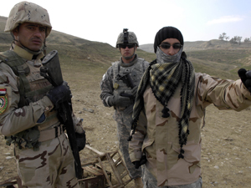
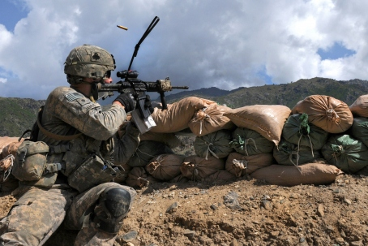
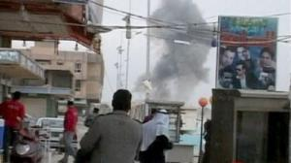
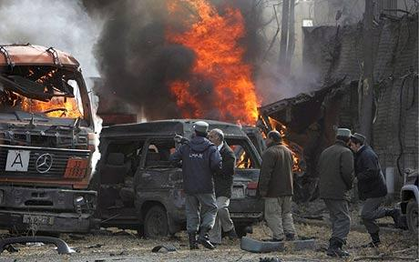
Problem Background
In Operation Iraqi Freedom (OIF) and Operation Enduring Freedom (OEF) there are over 200,000 soldiers supporting the fight and hundreds of men and women have lost their lives in base attacks. In the early 1990’s the United States Army decided to become a mobile expeditionary force and eliminated the capability to build base camps.
The face of war has changed again and the expeditionary base camps of today are not designed to handle types of threats posed by insurgents in irregular warfare.
4
Notes:
BERKLICH

Slide 5
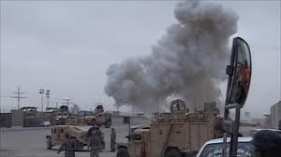
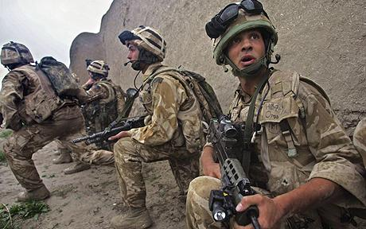
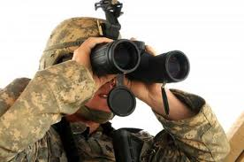
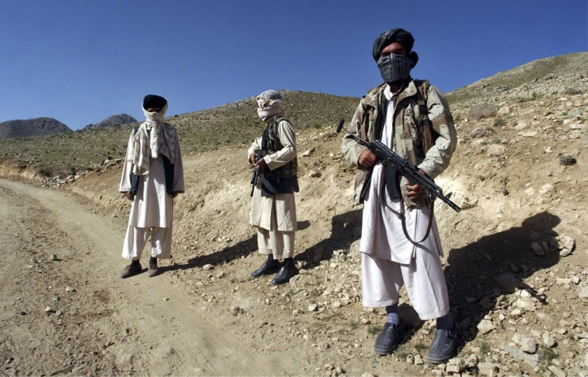
Problem Background
Attacks on Southwest Asian bases happen regularly. The types of attacks are harassment, denial, and tactical. Harassment being the highest frequency of engagement.
Protection for the FOBs is kinetic and non-kinetic and the IBDS should perform both. Non-kinetic reduces civilian casualties and improve relations
These attacks have resulted in significant single operation casualties; interfere, interrupt, and impair base operations and also disrupt military operations and local government and services
5
Notes:
BERKLICH – 1 minute

Slide 6
Effective Need
“The FOB Commander has a need to mitigate the external defense issues within small camps, reduce causalities, increase mission performance and protect the Force within the AOR and across the full spectrum of operations from direct and indirect threats with an effective, tailorable, supportable, logistically feasible, integrated, and rapidly deployable protection system. The system needs to be operable in all weather, all visibility, all terrain with independence from utility infrastructure.”
The effective need was derived from the initial stakeholder requirements to identify what was needed and was desired.
6
Notes:
BRENNAN – 30-45 sec

Slide 7
Capability Needs Functional
Detect
Sense Objects
Determine Initial Position of Objects
Track Objects
Assess
Continually Evaluate Threat Vectors
Continually Classify Objects
Communicate
Warn Personnel
Record Activities
Feed Data
Defend
Engage Threat
Prevent Penetration
7
Notes:
MAZZA

Slide 8
Capability Needs Non-Functional
Transportability
Reliability
Supportability
Availability
8
Notes:
MAZZA – 2 minutes

Slide 9
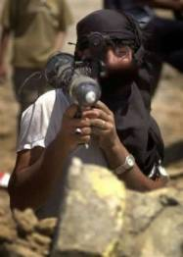
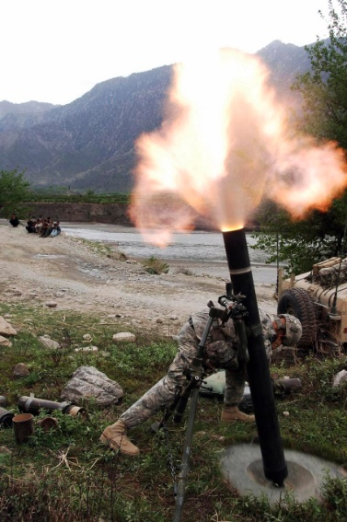
Threat Analysis
Rocket Propelled Grenade (RPG)
Description:
Shoulder fired, anti-tank weapon system used by many militaries around the world.
Explosive projectile weapon comprised of the grenade with a small rocket engine and the launching device.
Range of the weapon is usually between 150-300 meters (short range weapon).
Target:
Lightly armored vehicles, helicopters, personnel and buildings are the most vulnerable to this type of weapon.
Fragments or shrapnel is expelled from the exploding grenade (particularly destructive to personnel)
Tactics:
Operator will try to get as close to its target as possible
Generally deployed in small groups to improve chance of destroying a target before fire can be returned.
Mortars
Description:
Shell dropped into tube with a firing pin at the bottom causing propellant inside the shell to detonate.
Mortars are immediately available indirect fires with weapon range is usually between 70-3800 meters.
Target:
Stationary vehicles, lightly armored vehicles (particularly in convoys), helicopters, personnel behind walls and buildings are the most vulnerable to this type of weapon.
Fragments or shrapnel expelled from the exploding grenade are particularly destructive to personnel.
Tactics:
Inaccurate weapons, utilized against enemies that are dug in or in positions where direct fire cannot be effective.
Can be used from behind the obstacles for added protection from return fire.
9
Notes:
OEXMANN

Slide 10
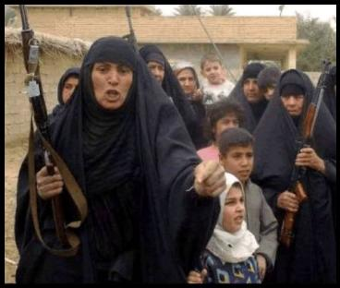
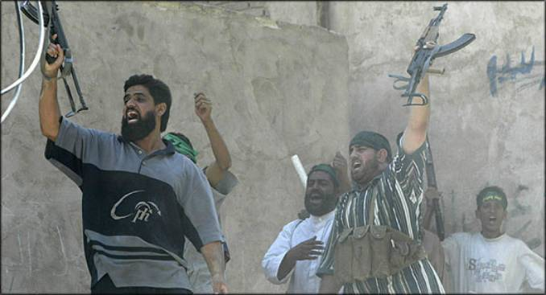
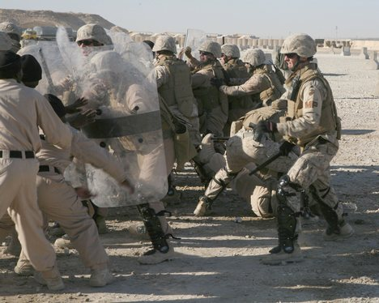
Threat Analysis (Con’t)
Small Arms
Description:
Man portable, individual, and crew-served weapon systems up to 20mm (ref. JP 1-02).
Examples include machine guns, hand guns, assault rifles, and sometimes hand grenades.
Target:
Mainly used against personnel and lightly/unarmored equipment often in patrols or convoys.
Tactics:
Fire often originates from buildings, streets, vehicles, prepared positions or hidden locations.
Used both in planned attacks and in unplanned targets of opportunity (difficult to predict).
Civil Disturbances
Description:
Two types of civil disturbances: harassment ambushes and combat ambushes.
Harassment ambushes attack and then withdraw; they are not heavily armed.
Combat ambushes attack and destroy the target possibly with IEDs, RPGs, AK-47s and mortars.
Insurgent strength of 1 to 200 (avg ≈ 30) with min to moderate training in weapons and tactics.
Target:
Convoys and Patrol bases are the target of both harassment and combat ambushes.
Tactics:
Harassment ambushers lay in wait, attack and withdraw; they are preplanned
Combat ambush has the intent to cause maximum damage.
10
Notes:
OEXMANN

Slide 11
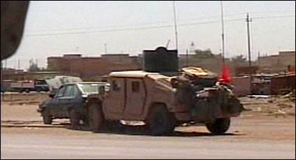
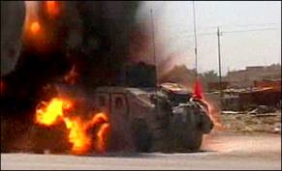
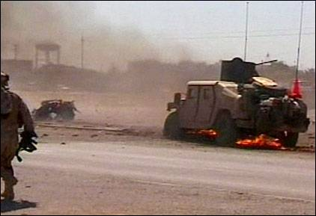
Threat Analysis (Con’t)
Vehicle Bourne Improvised Explosive Device (VBIED)
Description:
Homemade bombs and are comprised of five basic parts; a power supply, a trigger, a detonator, a main charge and a container to hold everything together.
Are easily assembled explosives that can cause catastrophic damage. The main charge can be comprised of C4, dynamite or Semtex; all readily available explosives. In most cases the container is filled with shrapnel, anything from pellets to nuts and bolts.
VBIEDs can be any means by which the IED is transported, a car, truck, airplane or boat.
Target:
Lightly armored vehicles, buildings and personnel.
Tactics:
Remotely detonated (when the target walks by or when the target is most crowded) or dropping off a vehicle, walking away and detonating.
Suicide Bomber
Description:
Homemade bombs and are comprised of five basic parts; a power supply, a trigger, a detonator, a main charge and a container to hold everything together.
Are easily assembled explosives that can cause catastrophic damage. The main charge can be comprised of c4, dynamite or Semtex; all readily available explosives. In most cases the container is filled with shrapnel, anything from pellets to nuts and bolts.
Target:
Personnel, often key personnel in their homes, offices or cars or personnel on bases or posts.
Tactics:
Utilize IEDs (as described above) and will carry them in some sort of suitcase, bag, backpack, briefcase or strapped directly to their chest; often will walk into the intended target.
11
Notes:
OEXMANN – 3 minutes

Slide 12
Operational Concept
Mission Definition
The system will be expected to protect personnel, equipment and assets located on the base camp and within the AOR. There are three main scenarios this base will support in order ensure mission effectiveness. Mission one is to prevent intrusion, mission two is to defend base against direct attack, including early warning to the FOB Commander and mission three is to be capable of defending patrol bases and incoming convoys.
Entry Check Point Protection:
A local vendor has been contracted to provide bottled water the COP. The driver has arrived at the Entry Check Point and is being inspected along with all his cargo and his entire vehicle. During inspection a suspicious package is found within the bed of the truck, the object of interest must be assessed and it must be determined whether the driver himself can be rendered safe or if he is a potential hostile threat before access can be granted or denied.
Direct Attack on Base:
There is a disturbance out in the hills 200m outside the base perimeter. The object of interest is identified as foe with a RPG. The base is being ambushed. The adversary has attacked the base utilizing RPGs, mortars, and small arms. The enemy is not more that 100 strong and has moved within 150m to utilize the short range weapons.
Convoy Security:
A convoy patrol is on its way in from a super FOB 150Km away. As the patrol draws within a 100m of the base they are ambushed by group of insurgents who appear to be armed with small arms and RPGs. There also appears to be an abandoned vehicle 30m in front of the convoy. The base radios this information to the convoy commander and prepares to engage the enemy from the base perimeter.
12
Notes:
BRENNAN

Slide 13
Operational Concept (Con’t)
Performance and Physical Parameters
The System shall not increase soldier workload and implement systems that require limited soldier interactions (ie automated lower level functions). However the system shall ensure soldier safety (provide a means for human over-rides). The expected population for protection is between 150-500 troops.
Operational Deployment and Distribution
The System shall be transported and configured by combat or combat support teams of not more than 10 personnel. The System shall be independent of the utility infrastructure normally found at larger bases. Operators shall be fully trained prior to system deployment.
Operational life cycle
The proposed system shall be constructed and operational within 18 months of contract award, and the operational life cycle for the bridge shall be 6-12 months. However, depending upon economic and political climates it may be longer. Therefore, the system is expected to have an operational life cycle of 5 years. The system will be utilized on more than one base, if applicable.
Effectiveness Factors
The System shall exhibit an availability parameter of Ao=0.90 and shall follow the traditional O-level, I-level and D-level paradigm for preventive and corrective maintenance, unless other approaches prove to be more effective. The System should utilize remote trouble-shooting and corrective action is also preferred. Finally, the System shall exhibit a reliability of MTBF = 750 hours. The maintenance support system shall rely on organic system support, limiting the number of contractors required, and utilize a sense-and-respond logistics approach. This incorporates the prognostic and CBM approach. Finally, the system shall display graceful degradation to avoid catastrophic failure or the complete failure of mission essential equipment.
13
Notes:
BRENNAN

Slide 14
Operational Concept (Con’t)
Environmental Factors
The System shall operate in all weather and visibility conditions identified in MIL-STD 810F, including sand or dust storms, smoke screens or obscurants employed by hostile adversaries, in which an enemy could employ direct or indirect fires. The System should be tailorable for different terrain, including but not limited to mountainous, desert, forest, rural and operation near an urban environment. Temperature ranges for operation are hot to severe cold (-60ºF to 160ºF ).
Utilization requirements
The system will be utilized 24 hours a day, 7 days a week, however the prioritization of loads may allow for certain non mission essential elements of the system to be operated only when a threat is identified. The operator will use the system to detect, identify, assess, warn and defend the base. Many of these defensive functions will require limited human interfacing, however there is a need have a decision maker involved if the system is used as an offensive attack, or a preemptive strike to counter an oncoming attack.
14
Notes:
BRENNAN – 3 min

Slide 15
System Boundary and External Interfaces
The system boundary consists of the physical and functional boundaries between various elements that will be employed in the operational protection system.
Physical boundaries will include the perimeter of the FOB to be protected, any of the hardware components that will capture and supply data for the system, such as cameras, other motion sensors, audio detection equipment, microphones, and any required protection for those elements, as well as physical boundaries for any system elements that may be required to engage enemies such as remote operated weapon systems, unmanned autonomous ground mobile protection platforms or any other deterrent that may be employed against insurgents.
Other physical boundaries for the protection system will exist within the FOB, such as the human interface to operators/users, and sustainers/maintainers. Operators/users and sustainers/maintainers as a community constitute a laterally interoperating system.
Any required power sources, as well as any consumable inputs required for system operation and maintenance, ammunition, lubrication, etc. can be considered to be crossing the system boundary (though possibly contained in stores within the FOB).
Functional boundaries/external interfaces will include all elements listed & software & hardware/cable interfaces that process, transmit, analyze and display data for users and other system elements. As well as those that transmit to existing C3 and/or other protection systems.
It is necessary for the system to be capable of integrating with an existing C4 or Protection system if one is established, but will not depend on the existence of such systems. The system boundary will consist of the interfaces with those systems and ensuring that the system does not cause operational mission failures.
Elements clearly outside these system boundaries are the enemy, higher HQ personnel, the local populace, as well as higher level defense systems that may interoperate with other service branches supporting field operations. Also, non Kinetic protection measures are not within the scope of this first increment of the FOB protection system. Area beyond the reach of detection, counter attack and fire capability are also outside the system boundary.
Notes:
TORRES

Slide 16
Other Boundary and Interface Assumptions Necessary for the basis of the value system hierarchy
Inside the wire is considered “safe” so the system will not address breach issues or “insider” threats.
Will not protect against CBRN or heavy artillery/tanks
Electronic Protection is the responsibility of the C3 community within the Contingency Base effort, however will address specific interfaces and necessary equipment for protecting defense systems.
Will not protect against sub-terrain threats
Environmental threats such as hurricane, earthquake, flooding etc. are not included in base defense. However, normal operating condition extremes and a need to operate in all visibility conditions will be included as assumptions, requirements and constraints for system elements to define necessary performance parameters and create threshold criteria for acceptance testing.
Maximum attack of 25-150 enemy troops at a time
As a Combat Outpost (COP) there may be Patrol Bases or convoys that is the responsibility of the COP to defend. If the base has 150-500 on post, there may be an additional 100-150 off post on small patrol bases that fall within the Area of Responsibility (AOR).
There are no cost constraints
An initial surveillance baseline identifying all terrain and natural objects has been conducted and recorded
Modification of the TTPs may be necessary
Modification of the MTOEs is not allowed
Will provide perimeter defense for up to 2000 meters of perimeter in a 500mx500m base area
Air Space is owned and therefore out of scope
AOR is 1500m, max effective range of 50 cal machine guns and gives an area of suppressive fire
18
Notes:
TORRES – 2 Min

Slide 17
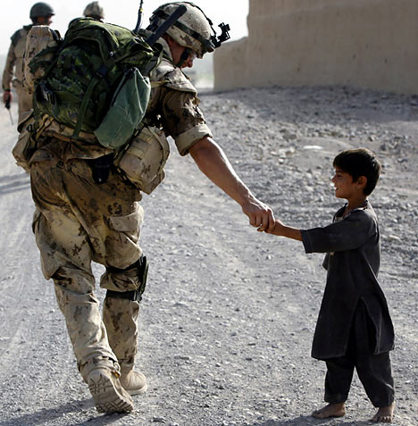
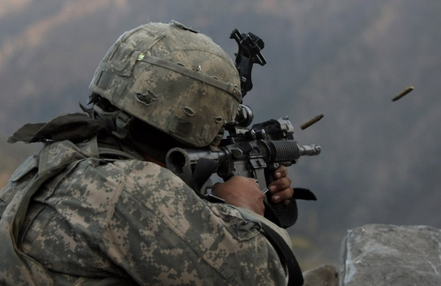

Stakeholder Types
The system stakeholders come in two flavors those that actively participate in the acquisition, development, deployment, and use of the system and those that are not actively engaged in the system but can be affected by its employment. We also have “in-theater” stakeholder roles. An example would be an Afghani and his herd that could be mistaken for infiltrators.
17
Notes:
BERKLICH

Slide 18

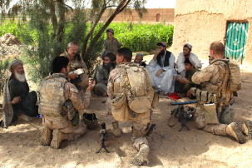



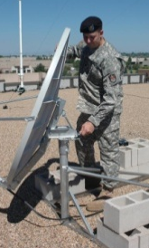

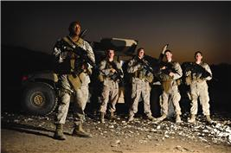
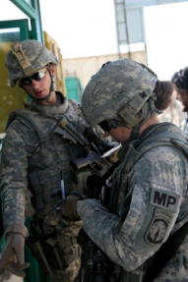

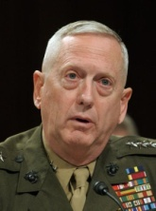
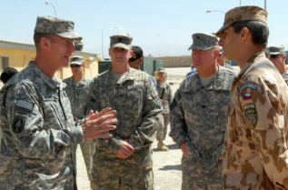
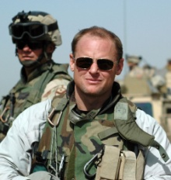
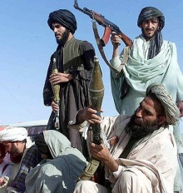
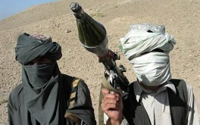
Stakeholders
In theater
Active: COCOM, FOB Commanders, Warfighters, Maintainers, enemy, Logistics, Allied Forces, Local Contractors
Passive: Local Populous, NGOs
Other
Active: Acquisition, Contractors, DoD
Passive: Taxpayers, Congress, investors
Notes:
BERKLICH

Slide 19



Stakeholder Expectations
COCOM, FOB Commanders, Warfighters, Allied Forces: reduce casualties, not kill/injure locals, not damage property or environment, install/retrieve quickly, small installation /operation crew, require small operational crew, identify and interdict threat, discriminate targets, high reliability/availability, easily repairable, all weather operation
Maintainers: very reliable, easily repairable/replaceable, install/retrieve quickly, require small installation/operational crew, no preventative maintenance, parts easily available.
Logisticians: Inexpensive, easily packed, easily shipped, Highly reliable, Low cube, low weight, weather resistant, environmentally friendly, easily disposed/demil’d
Taxpayers, Congress: Inexpensive, reduce casualties, not kill/injure locals, “hearts and minds” ,not damage property, not damage environment, not be a persistent threat
Acquisition, DoD: Inexpensive, reduce casualties, not kill/injure locals, not damage property, not damage environment, not be a persistent threat, high volume, reusable technology, scalable, open architecture, easily upgradeable, potential foreign military sales
Contractors, investors: Profitable; high volume, reusable technology, scalable, proprietary content, potential FMS sales, wide acceptance across DoD, Services, DHS.
Local Populous, NGOs: not kill/injure locals, not damage property, not damage environment, not be a persistent threat
19
Notes:
BERKLICH – 3 min

Slide 20
Value System Functions, Sub-functions, and non functions
Functions
Non-Functions
1 Detect all objects of interest
1.1 Sense Object
1.2 Locate Object
1.3 Track Object
2 Assess data to relay relevant intelligence
2.1 Identify Object
2.2 Classify Object
2.3 Determine Intent
3 Communicate to appropriate personnel of pending threat
3.1 Transport Data
3.2 Disseminate Information
4 Defend personnel, facilities, and equipment
4.1 Engage Threat
4.2 Prevent Penetration
5 Transportability
5.1 Man Power
5.2 Deployability
5.3 Two Man Lift
5.4 Unit Load
6 Availability
6.1 Operational Availability
6.2 Logistical Down Time
7 Reliability
7.1 Time Between Failures
7.2 Confidence
8 Supportability
8.1 Level of Repair
8.2 Time to Repair
20
Notes:
BRENNAN

Slide 21
Value System (Con’t) Functions, Sub-functions, EM, Definitions and Goals
Sub Function | Objective | EM | Definition | Goal
1.1 Sense Object | Maximize sensing Range | Distance from object | To initial sense a potential threat at the furthest distance from the base gives the greatest chance of defense, due to more time to react | T =200m O =500m
1.2 Locate Object | Maximize geospatial accuracy | % of accurate coordinates | Accurately generate the coordinates (distance, elevation, azimuth) of an object of interest | T = 90% O = 95%
1.3 Track Object | Minimize latency | Time from signal to refresh | To follow a moving object through the recognition of it's changing coordinates, requires a quick response time to relocate each movement | T = 400ms O = 100ms
2.1 Identify Object | Maximize recognition of data anomalies | % of correct identification | Identify that there is an anomally in the data that implicates an object that has not been present previously | T = 92% O = 99%
2.2 Classify Object | Maximize friend vs foe accuracy | % of correct identification | Initially classify the object as possible threat or as a friendly | T = 95% O = 99%
2.3 Determine Intent | Maximize hostile intent recognition | % of hostile intent identification | Identify hostile intent utilizing markers (weapons, facial expressions, hostile body language, clothing etc.) | T = 95% O = 99%
3.1 Transport data | Minimize time to transmit data | Time from signal output to point of reception | Necessary to Transmit data to the appropriate decision makers to aid in decision making and asset integration | T= 1s O = 500ms
3.2 Disseminate Information | Minimize time to output warning | Time from signal output to information reception | Time from recognition of hostile intent to receipt of warning by identified means. | T = 5s O = 3s
4.1 Engage Threat | Minimize time to destroy target | Time from target sensing to kill | Time it takes from the recognition of threat through sensed information to the time it is rendered neutral or dead. | T = 50s O = 30s
 | Maximize kill accuracy | % munitions kills | The % of times the incoming munitions are rendered neutralized and cause no damage | T= 85% O = 90%
4.2 Prevent Penetration | Minimize threats penetrating system boundary | % perimeter breaches | % of actual breaches to possible threats. This includes threats (vehicles, people, packages) passing through at the ECPs, over walls, or penetrating the boundary in any way. Excludes Munitions | T = 2% O = 1%
 | Minimize Friendly Casualties | % Threats neutralized | The % of times the incoming threats are rendered neutralized and cause no damage to include munitions, packages, ECP entrance etc. | T = 95% O = 99%
21
Notes:
BRENNAN

Slide 22
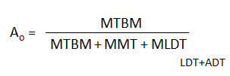
Value System (Con’t) Non-Functions, Sub Categories, EM, Definitions and Goals
Sub Function | Objective | EM | Definition | Goal
5.1 Man Power | Minimize Soldiers needed for assembly | # of soldiers required for transport | # of soldiers required for the configuration and set up of the system without special equipment. Most of the units using this system will be mobile units and it will be carried with them as part of their equipment. | T = 10 O =9
5.2 Deployability | Minimize time to deploy the system | Time to Deploy System | The time it takes to remove, configure and make the system operational | T=24 hours O = 18 hours
5.3 Two Man Lift | Minimize subsystem weight | # of pounds | Weight of individual subsystem, each component must be capable of being lifted by 2 or less men. | T = 174 lb O = 84 lb
5.4 Unit Load | Minimize system weight for the unit to transport | # of pounds | Total System Weight | T= CH-47 Transport O = UH-60 Transport
6.1 Operational Availability | Maximize Operational Availability |  | Availability is the probability that at any point in time the system is either operating satisfactorily or ready to be placed in operation on demand when used under stated conditions. | T = 90% O = 95%
6.2 Logistical Down Time | Minimize Mean Logistical Down Time | MLDT | Logistical Down Time is a combination of the Logistical Delay Time (Parts Availability ("In the Bin”, Needed items awaiting transportation, etc.) and the Administrative Delay Time ( Locating tools, Setting up test equipment, Finding trained personnel, Reviewing manuals, Complying with supply procedures, etc.) | T = 30 Hours O =25 Hours
7.1 Time between failures | Minimize Mean Time between Failures | MTBF | A failure is any loss of mission essential functions due to a malfunction of any hardware component or a critical or catastrophic hazard to personnel or equipment. Loss of mission essential functions due to “outside” influences such as crew/maintenance error | T =750 hours O = 1000 hours
7.2 Confidence | Maximize Reliablity Confidence | % confidence | the probability of an item to perform a required function under stated conditions for a specified period of time | T = 80% O = 90%
8.1 Level of Repair | Maximize Operator level repairs required | % Operator level repairs | Operator maintenance shall be conducted forward in the battlespace as the battle rhythm of the supported unit permits and shall be conducted by the system crew chief/operator | T = 75% O = 85%
8.2 Time to Repair | Minimize Mean Time to Repair | MTTR | MTTR is the sum of corrective maintenance times divided by the total number of repairs of the item | T = 2 clock-hours, O = 1 clock-hour
22
Notes:
BRENNAN – 3 min

Slide 23
Conclusions – Requirements Summary
The key system functions include:
Prevention from unlawful entry (Included in prevention of unlawful entry is protection against suicide bombing)
Neutralization of direct and indirect fire
Active defense against incoming rounds with elimination of hostile fire at its source
Passive defense with barriers and non-active protection elements.
Accurate detection and assessment of threats
Early and accurate warnings which will provide reaction time and maneuver space to defend the FOB
*These functions are also sufficiently broad as to include protection against base over-run and deceptive penetration
Other Key Considerations:
Ensure minimization of the impact to existing force workload
Reduce cognitive loads on current force
The system shall be easily transportable
Training strategy should incorporate traditional school-house training
Provide accessibility, visibility and limit the specialized tools and training required for maintenance.
Reliability to ensure constant protection, accurate and timely information and minimal exposure of transport convoys
The system shall be interoperable with the Army's current protection and C4 systems.
It is necessary for the system to be capable of integrating with an existing C4 or Protection system if one is established, but will not depend on the existence of such systems.
In short we shall provide maximum effectiveness at minimal cost and risk to existing troops.
23
Notes:
BRENNAN

Slide 24
Requirements Summary Example
All of the stakeholders may have had common functionality or capability requirements, however the reasons for why was very different. This shows the underlying reason and can lead to derived or additional requirements.
For instance, reliability
FOB Commander: wants the system reliable so that it is not down and there is a constant flow of information to make sure decisions can be made to ensure the mission is completed on time and accurately.
Combat Soldier: wants the system reliable so that it doesn’t fail at a time when they need to be protected so that they experience no unnecessary causalities.
Logistics convoys: want the system reliable so that it cuts down on the number of parts needed to repair it and therefore less convoys are on the road and put in harm’s way.
This is how the stakeholder functions were determined, with the prioritization of the stakeholders, frequency of the need and mapping against the initial system capability requirements to determine what the top level functions will be to drive the program.
By looking at the system from many different views and finding where the most seemed to have common interest. This led to the functions, objectives and measures.
Notes:
BRENNAN

Slide 25
Overarching Summary
Mission, Mission, Mission, Protection
Cost was not considered in this evaluation because there was no constraint – This removes a large burden as part of the triangle – Cost, Schedule and Performance.
There seemed to be a common theme amongst many stakeholders. They want protection from the system without mission impact, but also speed, accuracy and reliability.
One takeaway from the study is the scope of the assignment is broad considering the extent of the effective need for one set of stakeholders and that does not even consider all of the stakeholders identified.
Further analysis will reveal the validity and feasibility of these capabilities based on the voice of the customers.
Determining appropriate Evaluation Measures that when decomposed will be repeatable and testable down the road is a challenge.
With the short suspense we may leverage existing military technology and integrate it into a unified package, as more of a systems integrator with the development of new interface hardware and/or software.
Many systems already exist to enable the mitigation of these threats. However, the piece part application and patch work solutions currently seen the in field without considering a unified approach are the basis for many of the performance, reliability and cost issues seen today. In addition, without taking all factors into consideration up front it becomes a bigger, heavier, more expensive solution which makes it less expeditionary and less user friendly.
Much more work to do!
Notes:
BRENNAN

Slide 26
Way Ahead
WILL PUT IN WHEN I GET HOME!!
26
Notes:
BRENNAN – 2 minutes

Slide 27
Back Up
27

Slide 28
References
DoD RAM Guide, August 2005
Contingency Basing Functional Decomposition
Interviewed Bobbe Desmond, ASA(ALT), Lead for Contingency Basing
JLTV PD, Requirements Definitions
MIL-STD 810F
TRADOC PAM 525-7-7
JP 1-02
Interviewed LTC Brad Hodge, PM FSS, previously Acquisition Manager of a base camp
Wikipedia
A Quick Review of Combat Outposts (COPs), Timothy Hsia, http://smallwarsjournal.com/blog/journal/docs-temp/138-hsia.pdf
http://asc.army.mil/docs/pubs/alt/2009/3_JulAugSep/articles/34_UAVs_Thrive_With_PEO_IEW&S_Payloads,_Ground_Assets_200907.pdf
www.Howstuffworks.com
MORTAR Tactics in Open Terrain; http://www.2ndbn5thmar.com/fight/MortarTactics.pdf
Mil-Std 1472F – Human Engineering
28

