Slide 1


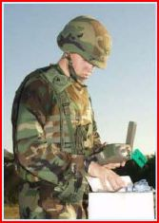
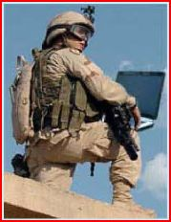
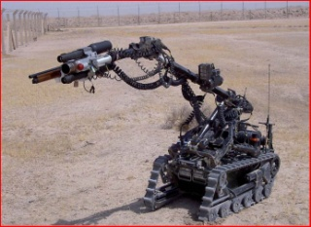



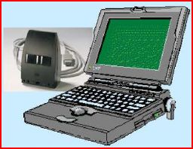


OV-1
Programming Unit Operator
Vehicle Operator
METAL-V Subsystem
BDE CP
Vehicular
Based Station
Programming Unit
IED Clearing Patrol

Slide 2
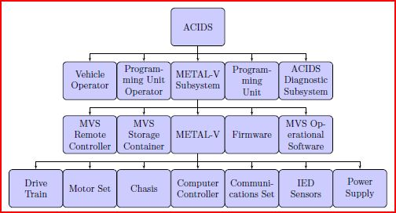
Functional Hierarchy Decomposition

Slide 3
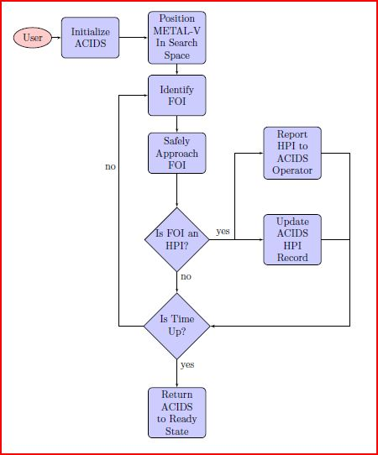
Functional Flow Diagram

Slide 4
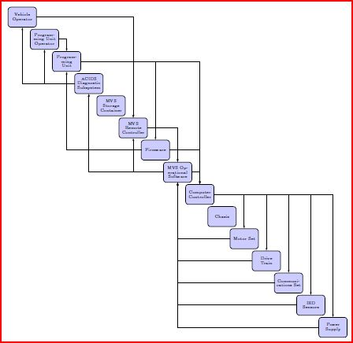
Data Flow Diagram

