Slide 1
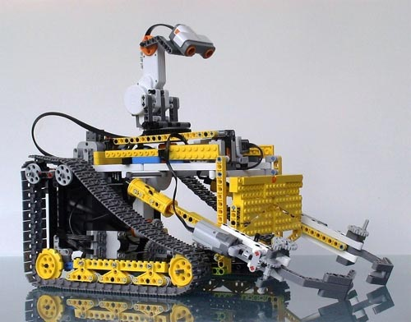
Robot detection of Improvised explosive devices (IEDS) se3303 – Final presentation
Team C.L.E.A.R –
Convoy Level Explosive Ammunition Removal
Chris Aall, Steve Mazza, Mike Oexmann, Liz Swisher
9 Mar 2012

Slide 2
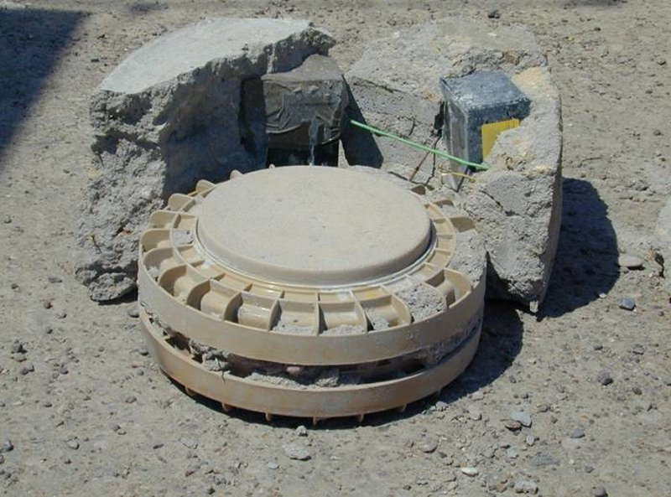
PROBLEM Description

Slide 3
Process
Requirements Analysis
Test and Evaluation (T & E)
Cost Analysis
Overall Measures of Effectiveness (OMOE) and Risk Analyses
Trade-offs and System Selection
Conclusion and Recommendation

Slide 4
Critical STAKEHOLDERS
Systems Engineering Experts, Inc. (SEE, Inc.)
Testers-R-Us (responsible for testing the prototype against requirements)
Contracting Companies (competing in advanced development prototype competition)
Warfighter (the end user)
Taxpayer (financial support)
Congress (budget approval)
PEO-IED (where our IPT works)
Lego, Inc. (manufactures a critical component used to create METAL-V)
PEO C3T
PM Mission Command
Tank Automotive Research, Development and Engineering Center (TARDEC)
Project Manager Close Combat Systems (PM CCS)
Product Manager Countermine and Explosive Ordnance Disposal (PdM CM&EOD)
Product Manager IED Defeat/Protect Force (IEDD/PF)

Slide 5
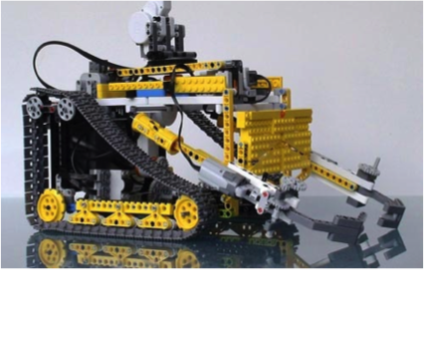
System Description

Slide 6
PHYSICAL System
IED Sensor
Comms
Chassis & Drive Train
NXT Brick

Slide 7
Key Performance parameters
Mission Reliability
DRM Elapsed Time
DTR Time
Operational Team Size
Refueling Time
Life-cycle cost
Operational Availability
Vehicle Weight

Slide 8
System thresholds
Parameter | Threshold | Goal
Mission Reliability (DRM) | 0.9 | 0.95
Operational Availability | 0.8 | 0.9
Life-cycle Cost per Unit | $50K | $25K
Vehicle Weight | 18oz | 14oz
Vehicle Drop Height | 1” | 3”
Refueling Time | 60 sec. | 30 sec.
DRM Elapsed Time | 5 min. | 3 min.
Deployed-to-Ready Time | 10 min. | 5 min.
SMETAL-V Storage | 216 cu. In. | 120 cu. In.
Operational Team Size | 2 warfighters | 1 warfighter

Slide 9
System requirements
The system shall have a mission reliability of at least 0.90.
The system shall have an operational availability of at least 0.80.
The system shall indicate a false negative less than 3% of the time
The system shall indicate a false positive less that 2% of the time.
The system shall successfully detect and distinguish 95% of threats in a given area over a given time.
The system shall successfully alert the IED-clearance operator of a threat 98% of the time.
The system shall require an average training period not to exceed 4 hours.
The system's deployment-to-ready time shall not exceed 10 minutes.
The system shall have an average usability score of at least 8 based on end-user input.

Slide 10
System requirements (cont.)
The system shall require no more than 2 people to operate.
The system shall not require any specialized parts or training for routine maintenance or repair.1
The system vehicle's weight shall not exceed 18 ounces.
The systems SMETAL-V storage container shall have a volume not to exceed 216 cubic inches.
The system's DRM elapsed time shall not exceed 5 minutes.
The system vehicle shall have a drop height of at least 1 inch.
The refueling time of the system shall not exceed 60 seconds.
The system's life-cycle cost shall not exceed $50,000.

Slide 11
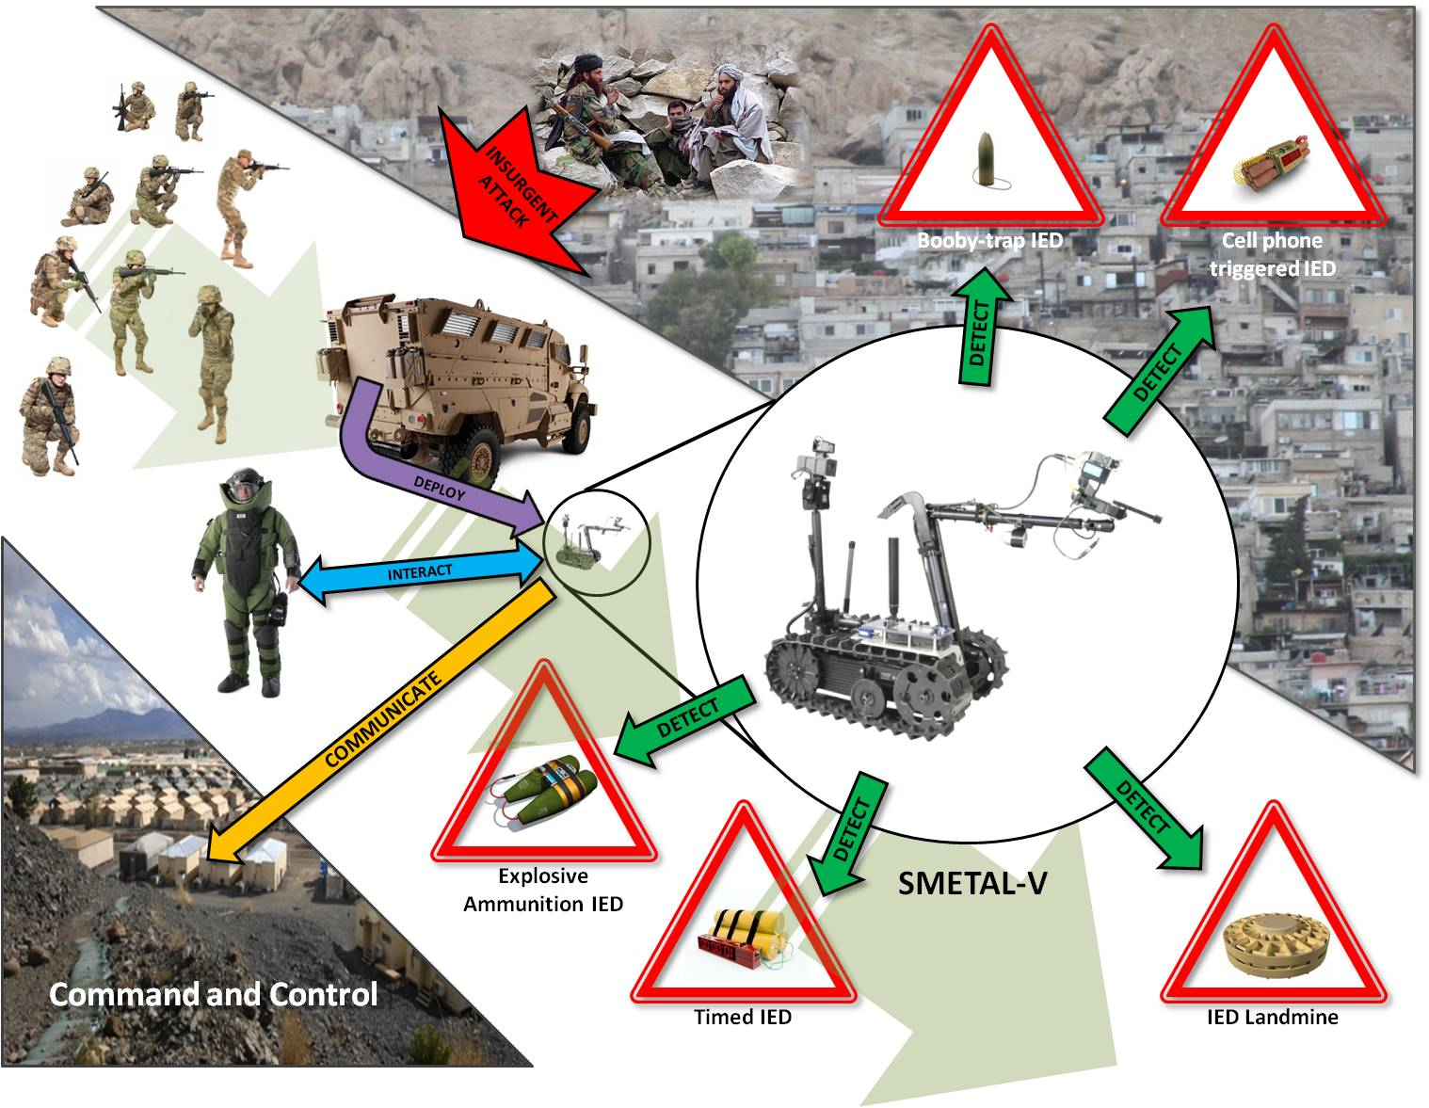
ov-1

Slide 12
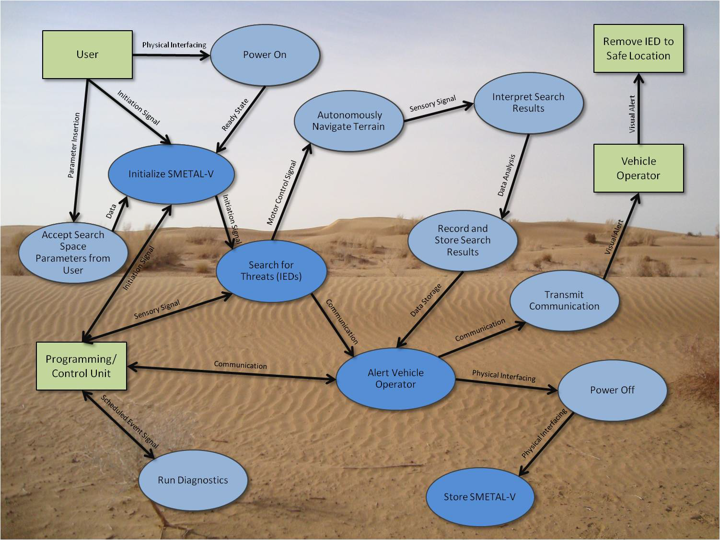
Sv-4b

Slide 13

Test and Evaluation

Slide 14
Limited objective exercise
Determine the size of the SMETAL-V Storage Container.
Place the SMETAL-V in the deployed state with batteries removed and SMETAL-V Programming Unit off.
Place the SMETAL-V into the ready state and determine Deployed-to-Ready Time.
Drop the SMETAL-V onto the DRM start position and verify Vehicle Drop Height threshold.
Carry out the DRM and measure DRM Elapsed Time. Then place the SMETAL-V in the ready state.
Carry out a battery replacement with new batteries to determine Refueling Time.
Carry out the DRM a second time and measure DRM Elapsed Time. Then place the SMETAL-V in the ready state.
Weigh the SMETAL-V to determine Vehicle Weight using a suitable postage or other scale.
Place the SMETAL-V into the deployed state, collect and organize the recorded data, and terminate the LOE.

Slide 15
Test results
Given a thorough and complete analysis of the provided data and test results, prototype D has been determined to outperform prototypes A, B, and C overall.

Slide 16
Cost Analysis
Cost by Variant for a Single System
Cost by Variant for 10 Systems at a Discount of 6%
Rankings of Variants based on Cost (LIB):
Variant A (meets threshold KPP)
Variant C (meets threshold KPP)
Variant D (does not meet KPP)
Variant B (does not meet KPP)

Slide 17
Overall Measures of effectiveness
Comparison of OMOEs by Variant
Rankings of Variants based on OMOEs (HIB):
Variant D
Variant C
Variant A
Variant B

Slide 18
OMOEs and Risk Analysis
Variant A
Variant B
Variant C
Variant D

Slide 19
OMOEs and Risk Analysis Overall Risk Analysis of All Variants
Variant Ranking Based on Risk (LIB):
Variant D
Variant B & C (very similar risk levels)
Variant A

Slide 20
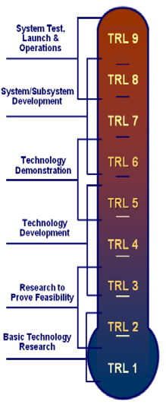
Technology readiness levels
TRL 7: Drive Mechanism (D)
TRL 6: Power Source (B & C),
Drive Mechanism (A & B). Architecture (D)
TRL 5: Sensor (D), Drive Mechanism (C)
TRL 4: Sensor (A & D), Power Source (A),
Architecture (A&B&C)
TRL 3: Sensor (B & C)
*Variants color-coded to visually analyze
overall TRL level by variant

Slide 21
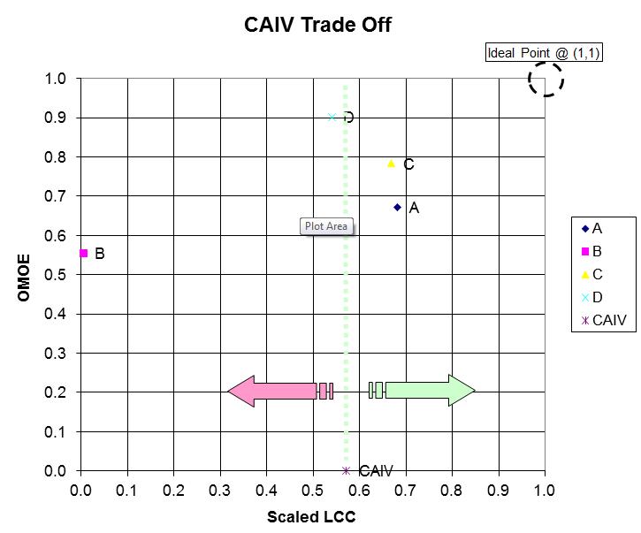
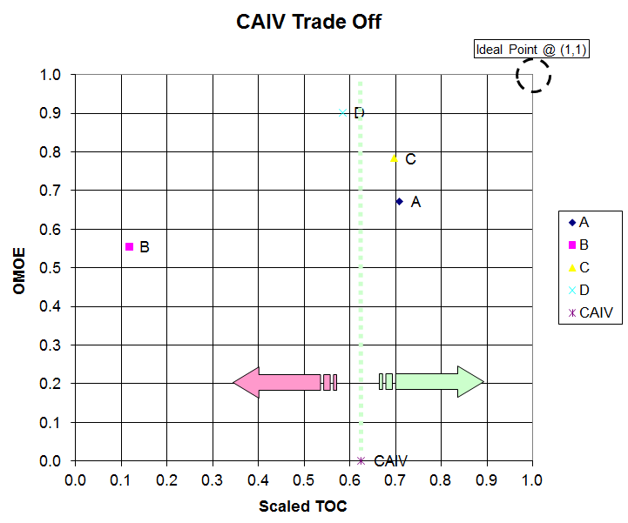
caiv assessment

Slide 22
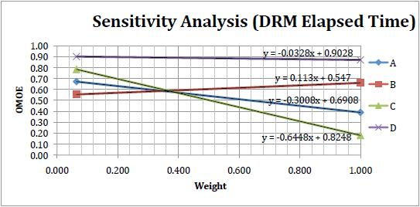
Sensitivity assessment

Slide 23
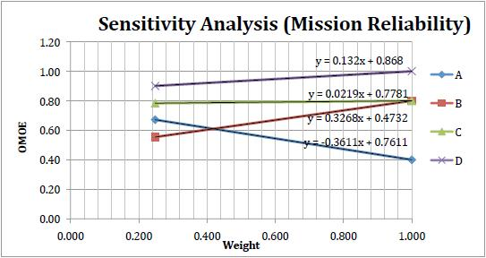
Sensitivity assessment

Slide 24
Conclusions
Variant D has performed significantly better in almost all OMOEs, while exhibiting reasonable lifecycle costs, total ownership costs, and low risk.
Variant D’s consistency in test results indicates that it exhibits stability and predictability in most aspects of operation.
Further developmental activities and spending shall be focused on variant D.

Slide 25
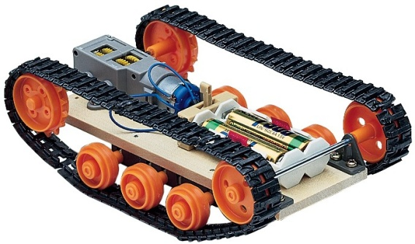
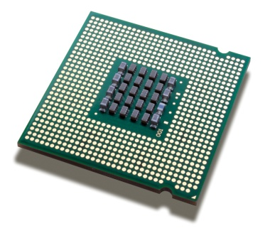
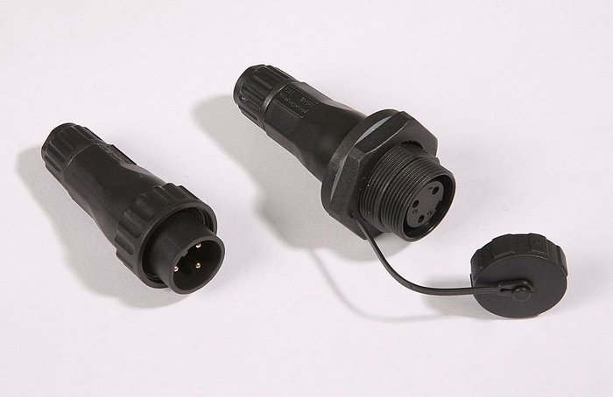
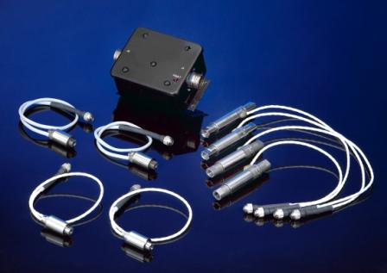
recommendations
Increase Mission Reliability – Incorporate water tight electrical connections and hardened (drive) track links.
Decrease DRM Elapsed time – Incorporate high speed drive train, faster computing hardware and higher sensitivity sensor system

