Slide 1

Modelio
An Open Source Modeling Tool

Slide 2
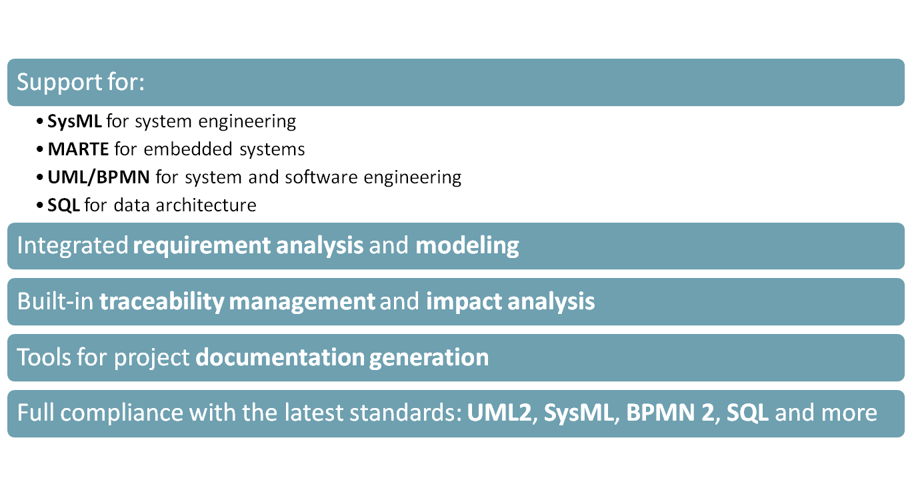
Tool Profile
Notes:
MARTE: modeling and analysis of real-time embedded systems
BPMN: business process management notation

Slide 3
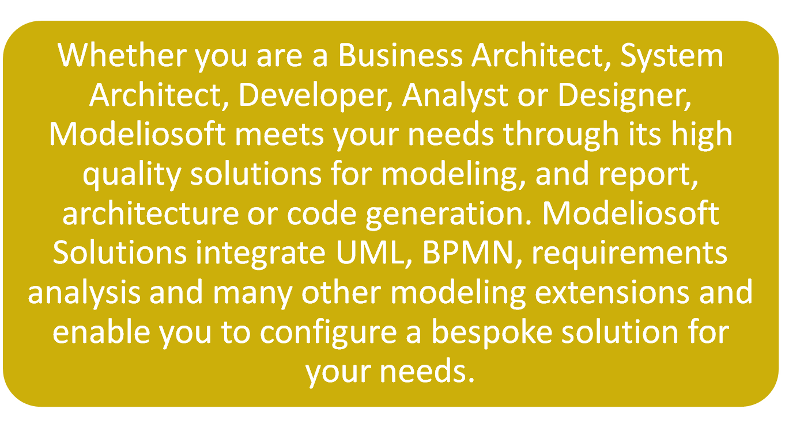
Marketing Statement

Slide 4
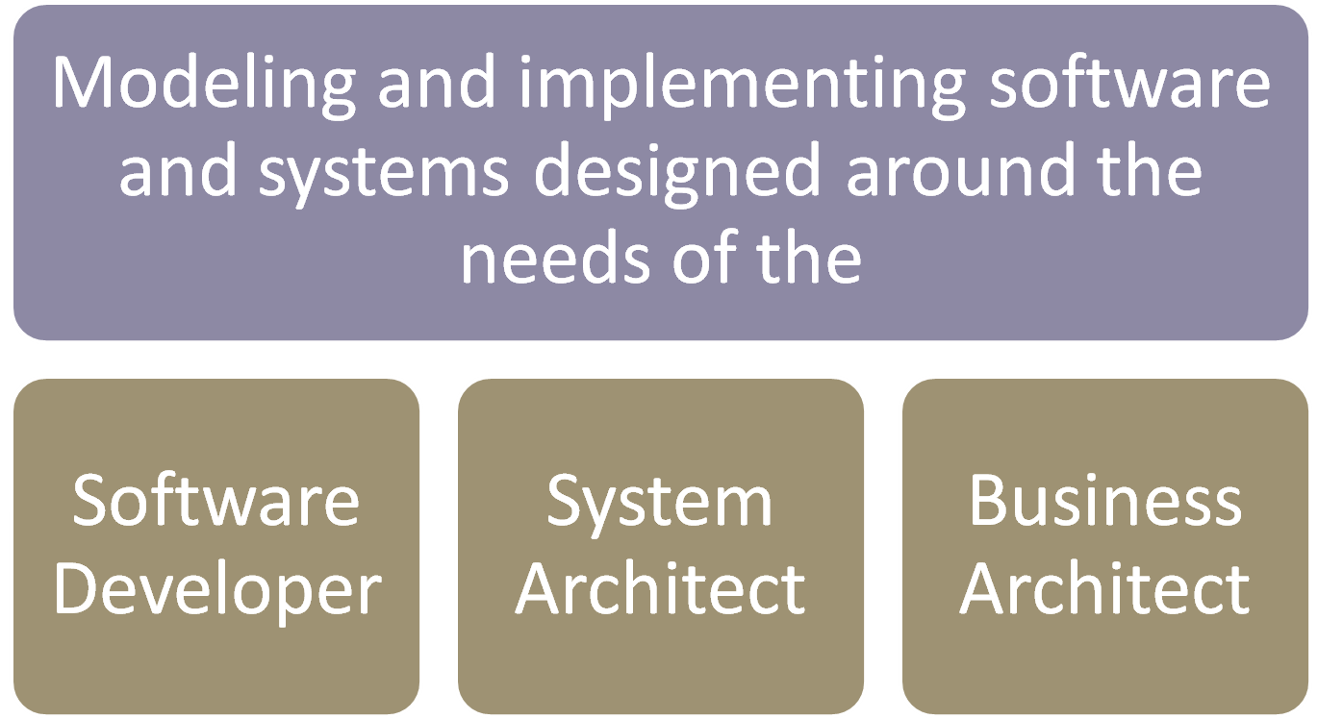
What Is It?

Slide 5
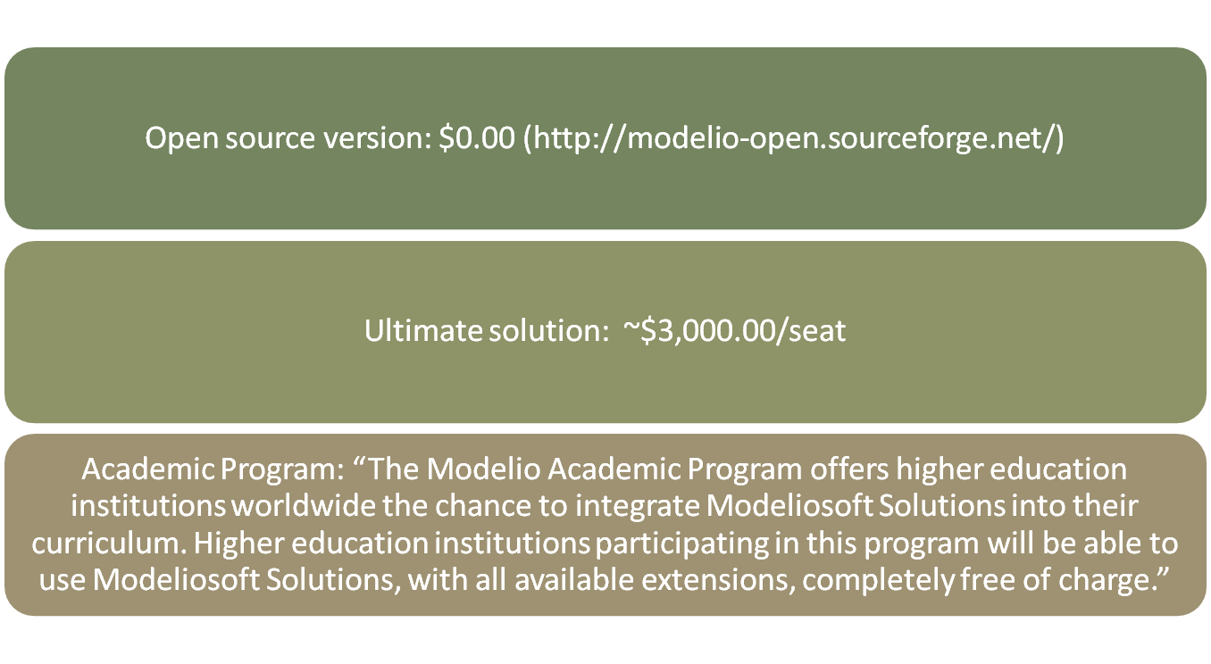
Cost
Notes:
Cost (Ultimate solution): ~$3,000.00
Academic Program: “The Modelio Academic Program offers higher education institutions worldwide the chance to integrate Modeliosoft Solutions into their curriculum. Higher education institutions participating in this program will be able to use Modeliosoft Solutions, with all available extensions, completely free of charge.”

Slide 6
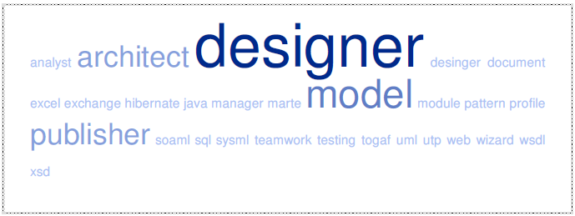
Extensibility/Integration
Notes:
Analyst: Requirements analysis integrated in the model. Dedicated diagrams and spreadsheets.
C# Designer: Generation and reverse of C# code from/to UML. Model/Code consistency management.
C++ Designer: Generation and reverse of C++ code from/to UML2. Model/Code consistency management. Support of the C++ standard, CLI, STL and MFC libraries.
Document Publisher: Document generation for MS-Word, LibreOffice or HTML; customizable using document templates.
Excel Exchange: Excel spreadsheet generation and reverse.
Hibernate Designer: Model and automate Hibernate mapping and Java classes generation.
Java Designer: UML to Java code Generation, Java to UML reverse engineering. Permanent code/model consistency.
MARTE Designer: Embedded software systems modeling using the OMG MARTE standard.
Modeler Module: Provides standard UML extensions.
Modeling Wizard: Creation of model elements from other elements through deduction.
Pattern Designer: Implement patterns from your model, publish and apply them to create instantiated models.
SoaML Designer: Model SOA Architectures using SoaML, an OMG standard (UML Profile).
SQL Designer: UML to SQL Generation, SQL to UML reverse engineering. Logical and physical database modeling support.
SysML Architect: Complex system modeling, complete SysML support.
Teamwork Manager: Distributed team collaboration tool, versioning and configuration management using Subversion.
TOGAF Architect: Enterprise Architecture modeling with the TOGAF Standard. BPM support, SOA Architecture modeling.
UML Testing Profile (UTP): Implements the UML Testing Profile (U2TP), an OMG standard, for modeling software tests.
Web Model Publisher: Generates documentation in HTML for web publishing.
WSDL Designer: Web services modeling using diagrams and definition of the exchange message types.
XSD Designer: Generation and reverse of XSD schemas from/to UML models.

Slide 7
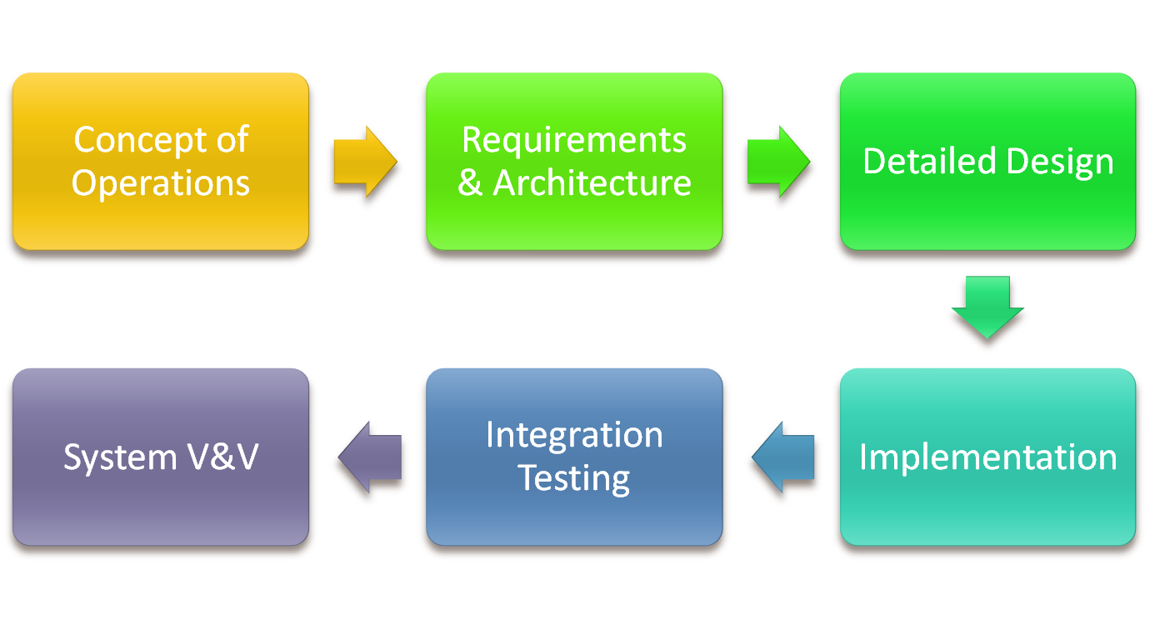
Lifecycle Activities
Notes:
Implementation depends on version.
Nothing noteworthy for supporting Operations & Maintenance

Slide 8
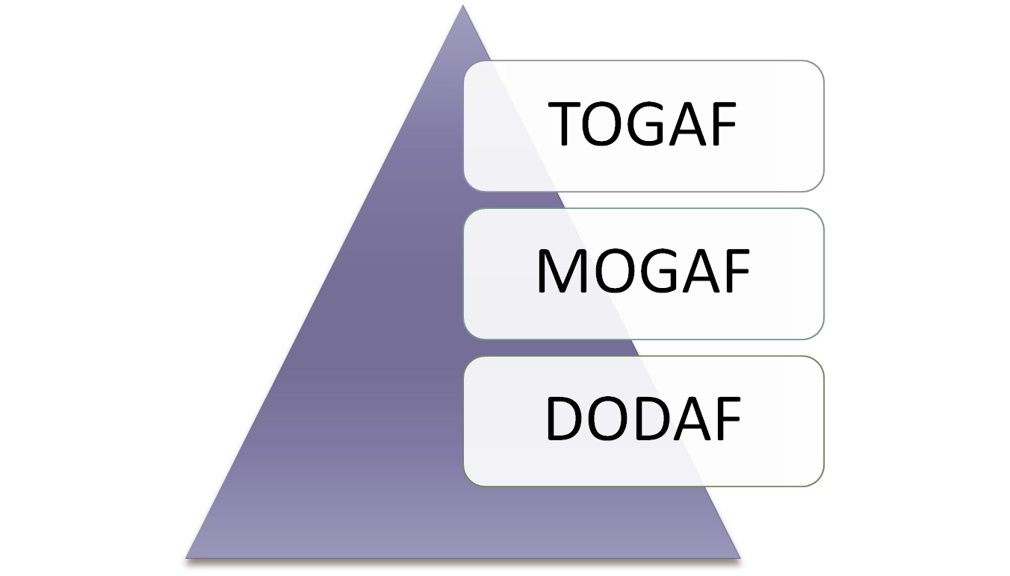
Supported Diagrams

Slide 9
MBSE Capabilities Comparison
Capability | Open Source | Payware
UML2 Support | All but profile diagrams | Yes
Goals Analysis | No | For purchase
Model Decomposition | No | Yes
MDA Support | No | Yes
Document Generation | HTML only | All
Code Generation | None | For purchase
Teamwork Management | No | For purchase
Notes:
Both have full GUI.
Both support plug-ins available from the Modeliosoft store.
Both have same modeling facilities.
Both support the same editor operations.
Both support the same layout and formatting options.
Both support consistency checks.
Both support model browser and search engine.
Both support business process modeling.
Code generation is available for Java, C++, and .Net
IDE integration is only with Eclipse but code synchronization between Visual Studio and others.

Slide 10
Output Options
Document Type | Open Source | Payware
HTML | Yes | For purchase
Word 2007 (Open XML) | No | For purchase
LibreOffice | No | For purchase
Predefined templates | No | For purchase
Image formats (JPG, PNG) | No | For purchase
Integrate notes in docs | No | For purchase
Hypertext within docs | No | For purchase
Document composition | No | For purchase

Slide 11
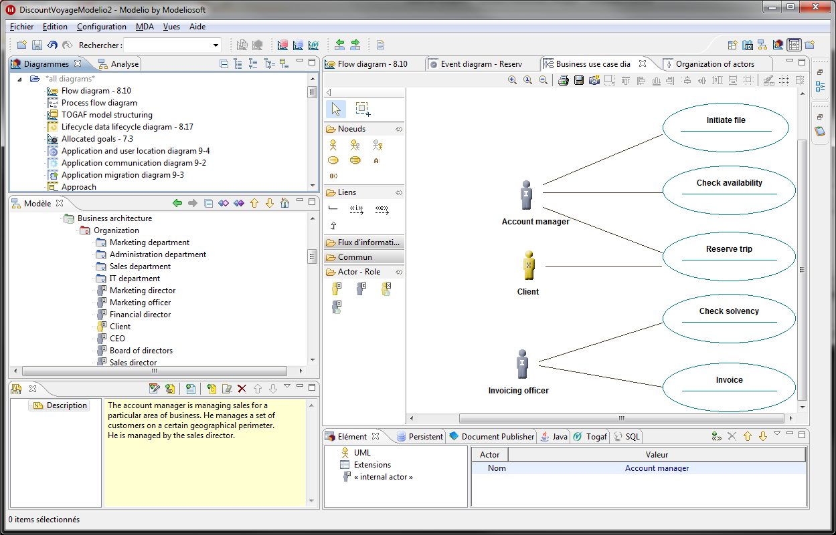
Use Case Diagrams

Slide 12
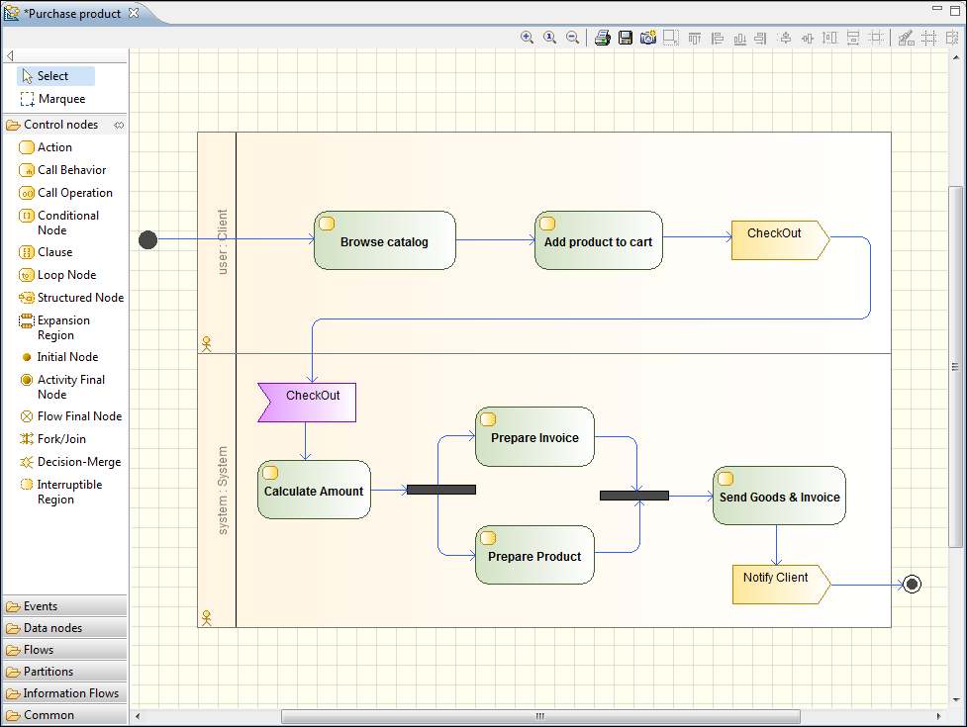
Activity Diagrams

Slide 13
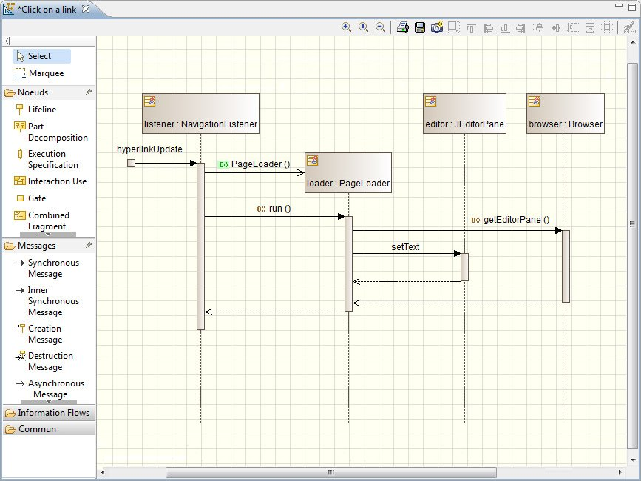
Sequence Diagrams

Slide 14
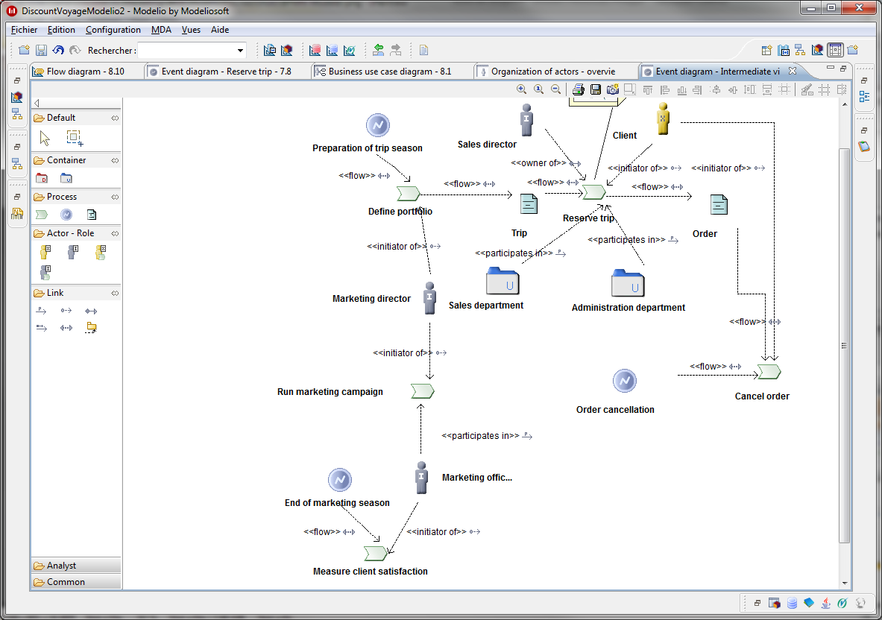
Process Map Modeler

Slide 15
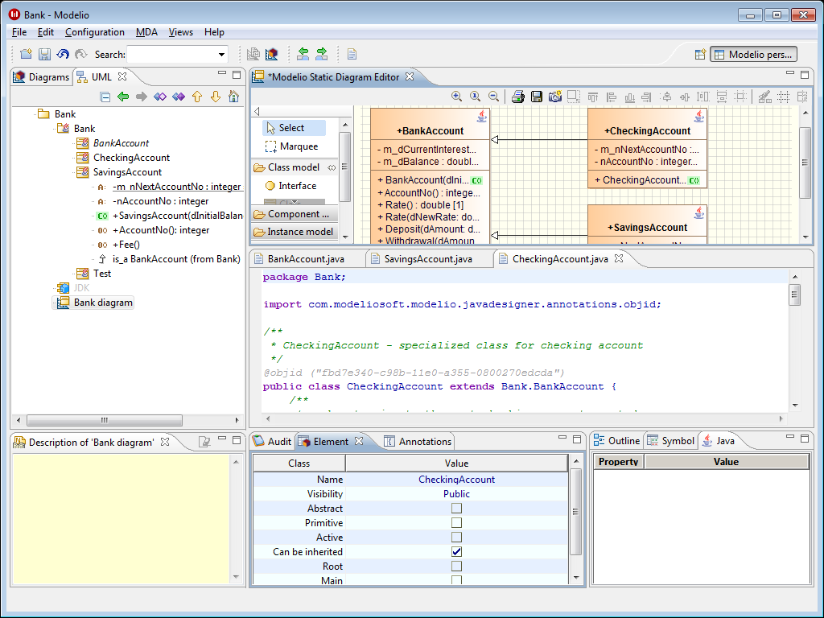
Code Generation (Java)

Slide 16
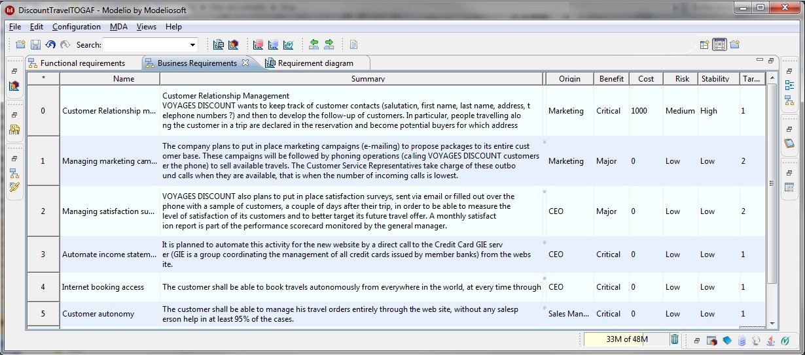
Requirements Analysis

Slide 17

Questions?

