Slide 1

BMIN503/EPID600 Final Project
Identification of Sleep Complaints Using Social Media: Geographic Distribution and Effect of Changes from Daylight Savings to Standard Time
Diego R. Mazzotti, Ph.D.
Division of Sleep Medicine
Department of Medicine
University of Pennsylvania Perelman School of Medicine

Slide 2
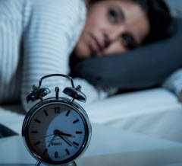

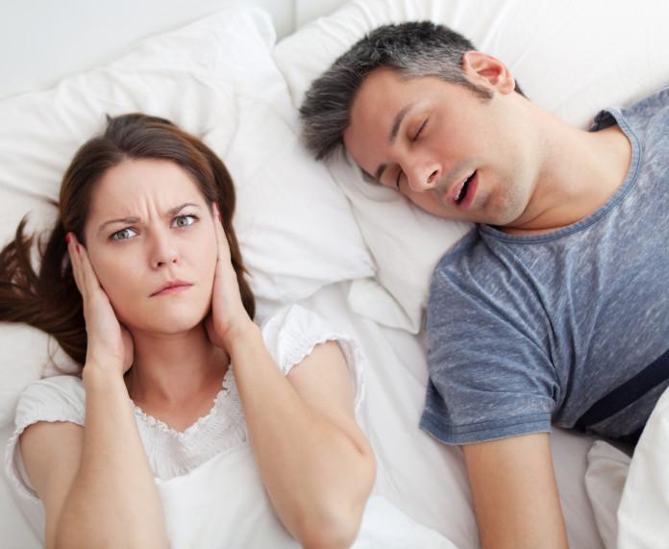
Background
Sleep disorders affect a large proportion of the population in the US and worldwide
Sleep complaints: manifestation of an acute or chronic state of a sleep disturbance
Questionnaires
Objective measurements
Alternative sources of data about human behavior: social media
Can Twitter be used to understand sleep complaints in response to changes to and from daylight savings time?
Seng EK, et al. J Prim Care Community Health 2016; Sarker A, et al. JAMA Netw Open. 2019

Slide 3
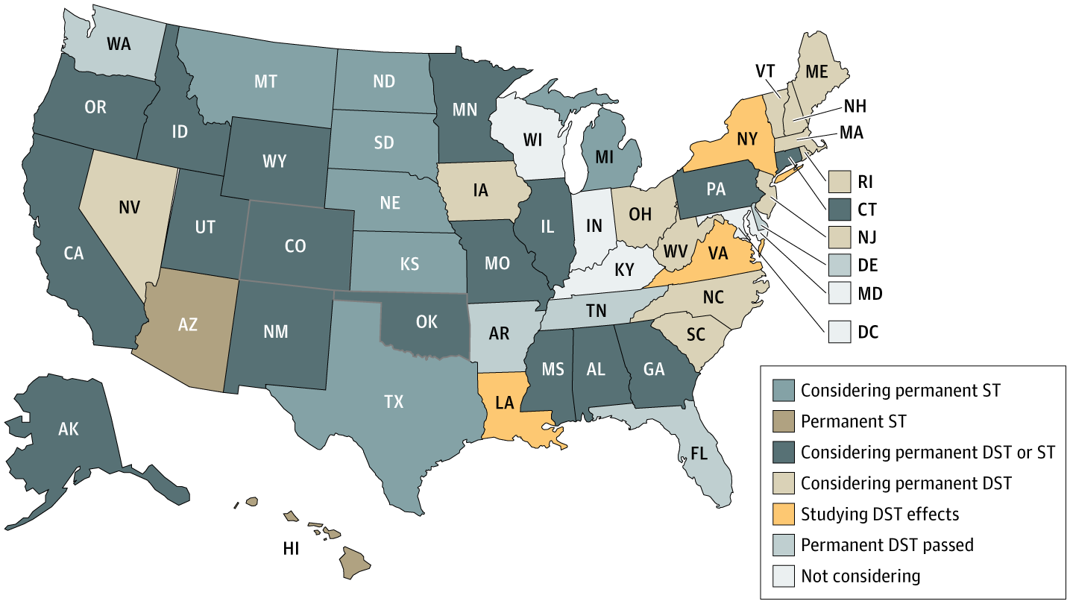
Are Daylight Saving Time Changes Bad for the Brain?
Malow BA, Veatch OJ, Bagai K. JAMA Neurol. 2019

Slide 4
Aims
Aim 1: Evaluate whether a machine learning classifier can be used to detect tweets mentioning sleep complaints at the time of posting
Aim 2: Evaluate the effect of a change from daylight savings time (DST) to standard time (ST) in the number and temporal distribution of tweets mentioning sleep complaints
Aim 3: Evaluate the geographic distribution of tweets mentioning sleep complaints in the United States

Slide 5
Methods
Experiment 1
Experiment 2
Classification of tweets mentioning sleep complaints at the time of posting
Temporal and geographic distribution of identified tweets in response to changes from DST to ST
Collect tweets
rtweet, Twitter API
Collect geotagged tweets
rtweet, Twitter API, spanning DST-ST
Extract text features
Term frequency – inverse document frequency
Apply best classifier
Manual annotation (N=500)
Train machine learning classifier
Support vector machines, Random forests, 3-fold CV
Adjust timestamps
Fix time zones and DST / ST
Evaluate
AUC, ROC curves
Temporal
profile
Geographic profile

Slide 6
Twitter search criteria and examples
Collect tweets
Package rtweet
can't sleep
have trouble sleep
have trouble sleeping
have problem sleep
have problem sleeping
had trouble sleep
had trouble sleeping
had problem sleep
had problem sleeping
hate sleep
hate insomnia
insomnia
snore
snoring
wide awake
Class | Example Tweet
With sleep complaint | Hi, it’s 2:58AM rn and I can’t sleep
Uncertain | When you can’t sleep stay awake to morning
Without sleep complaint | I can’t wait to sleep in tomorrow.

Slide 7
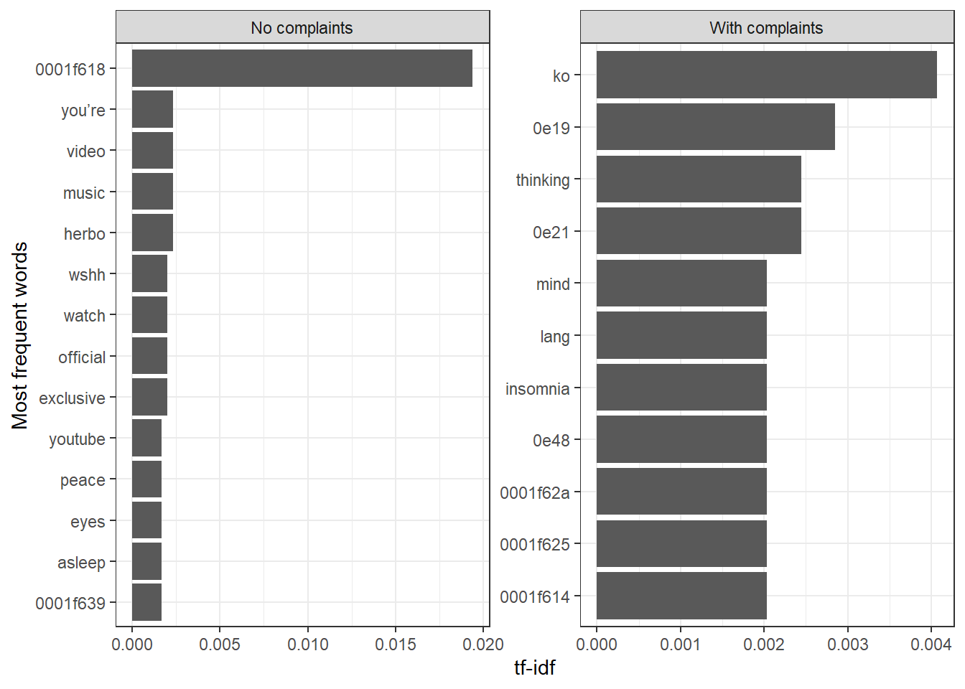

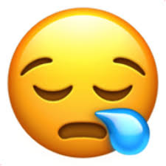
Results – Experiment 1
Different tf-idf term frequencies in tweets manually annotated as reporting sleep complaints
0001f618
0001f62a

Slide 8
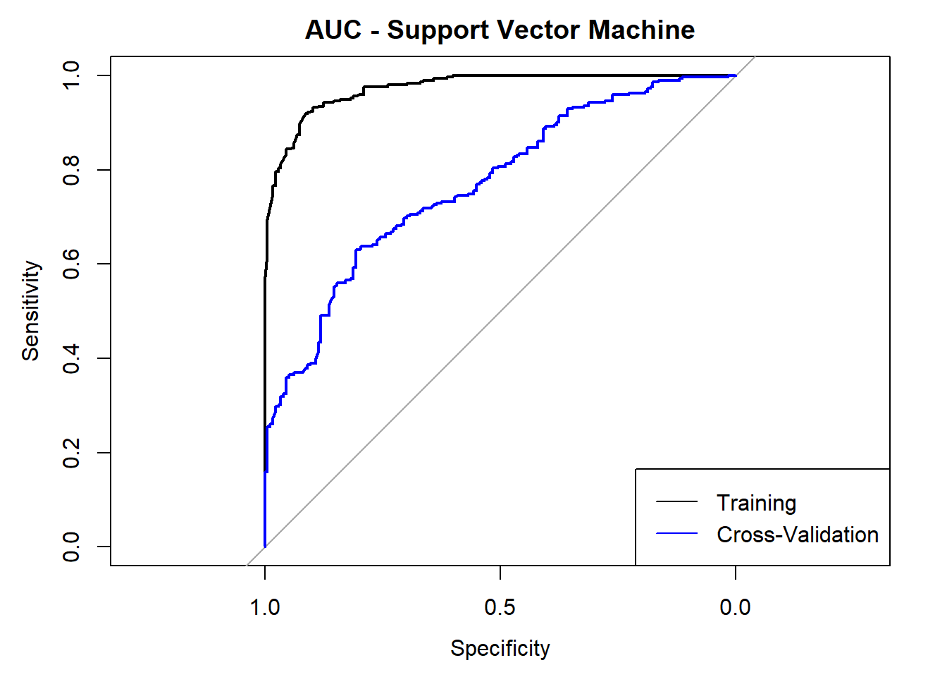
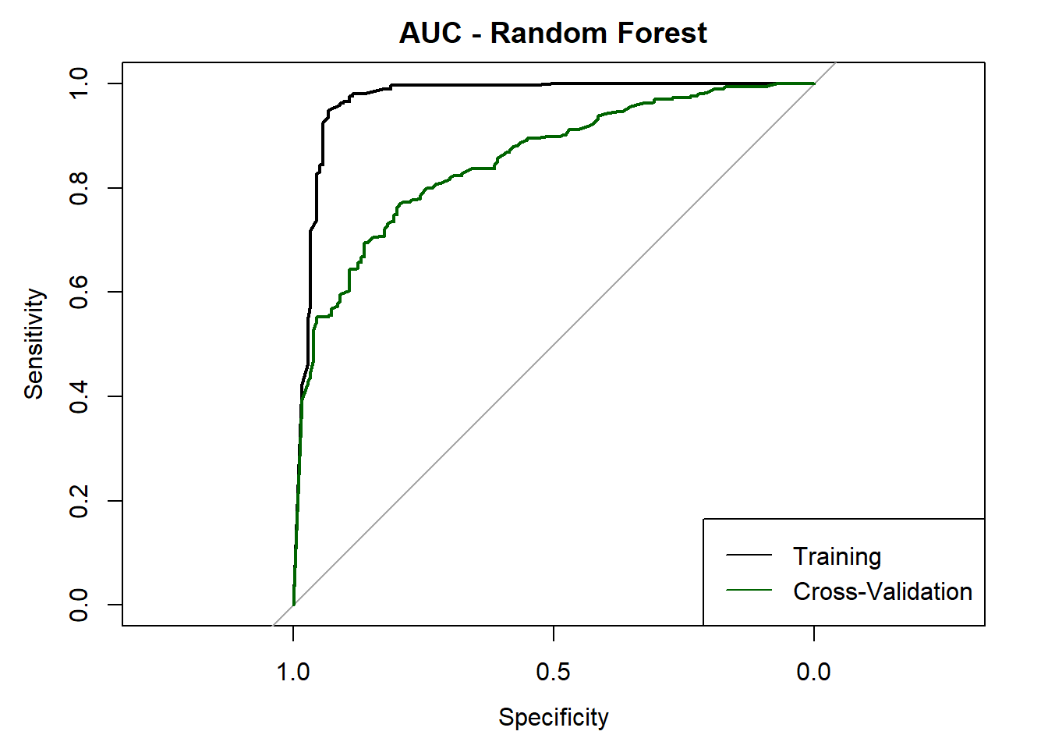
Results – Experiment 1 (Aim 1)
Random forest using tf-idf features showed best classification performance
AUC (95% CI) | SVM | RF
Training data | 0.97 (0.96-0.98) | 0.97 (0.95-0.99)
3-fold cross validation | 0.77 (0.73-0.81) | 0.85 (0.82-0.89)

Slide 9
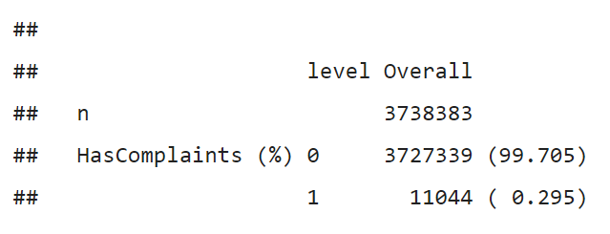
Results – Experiment 2
Valid data collection period
Wed Oct 30 13:37:51 +0000 2019 to Wed Nov 06 13:37:51 +0000 2019 (1 week)
Number of valid tweets – N = 3,738,383
Breakdown by tweet reporting sleep complaints, based on trained classifier:

Slide 10
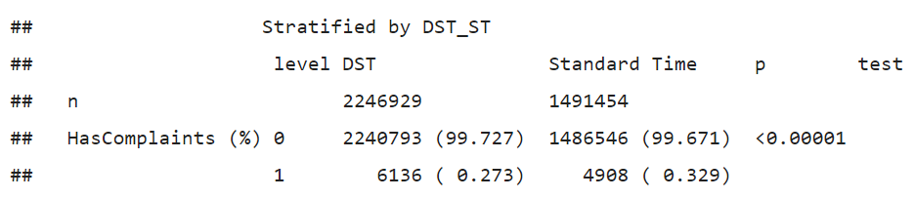
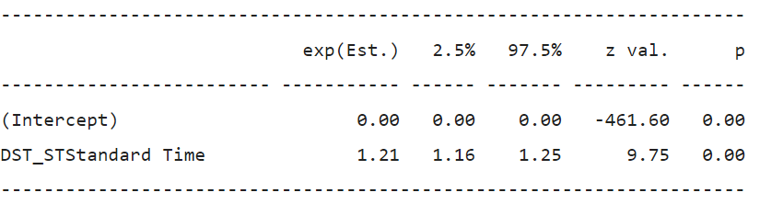
Results – Experiment 2 (Aim 2)
There is a higher frequency of tweets reporting sleep complaints after the change from DST to ST
Fisher’s exact test
Univariate (unadjusted) logistic regression

Slide 11
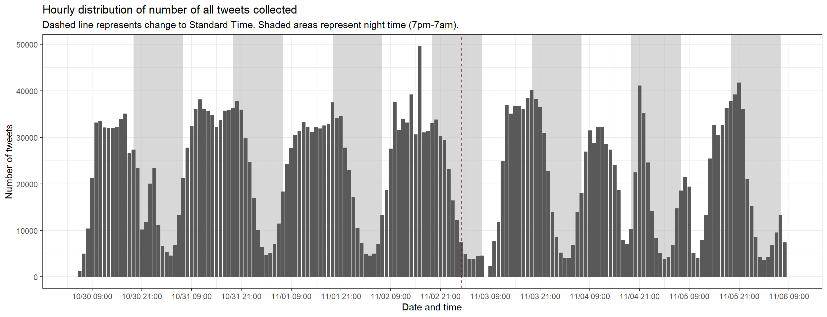
Results – Experiment 2 (Aim 2)

Slide 12
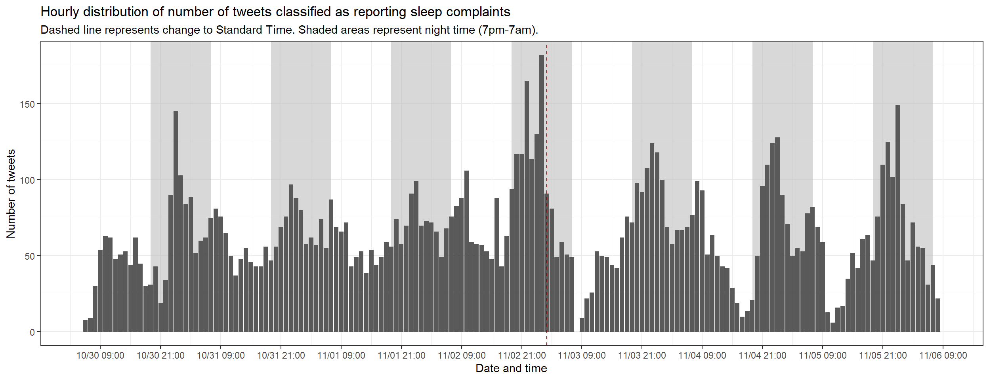
Results – Experiment 2 (Aim 2)

Slide 13
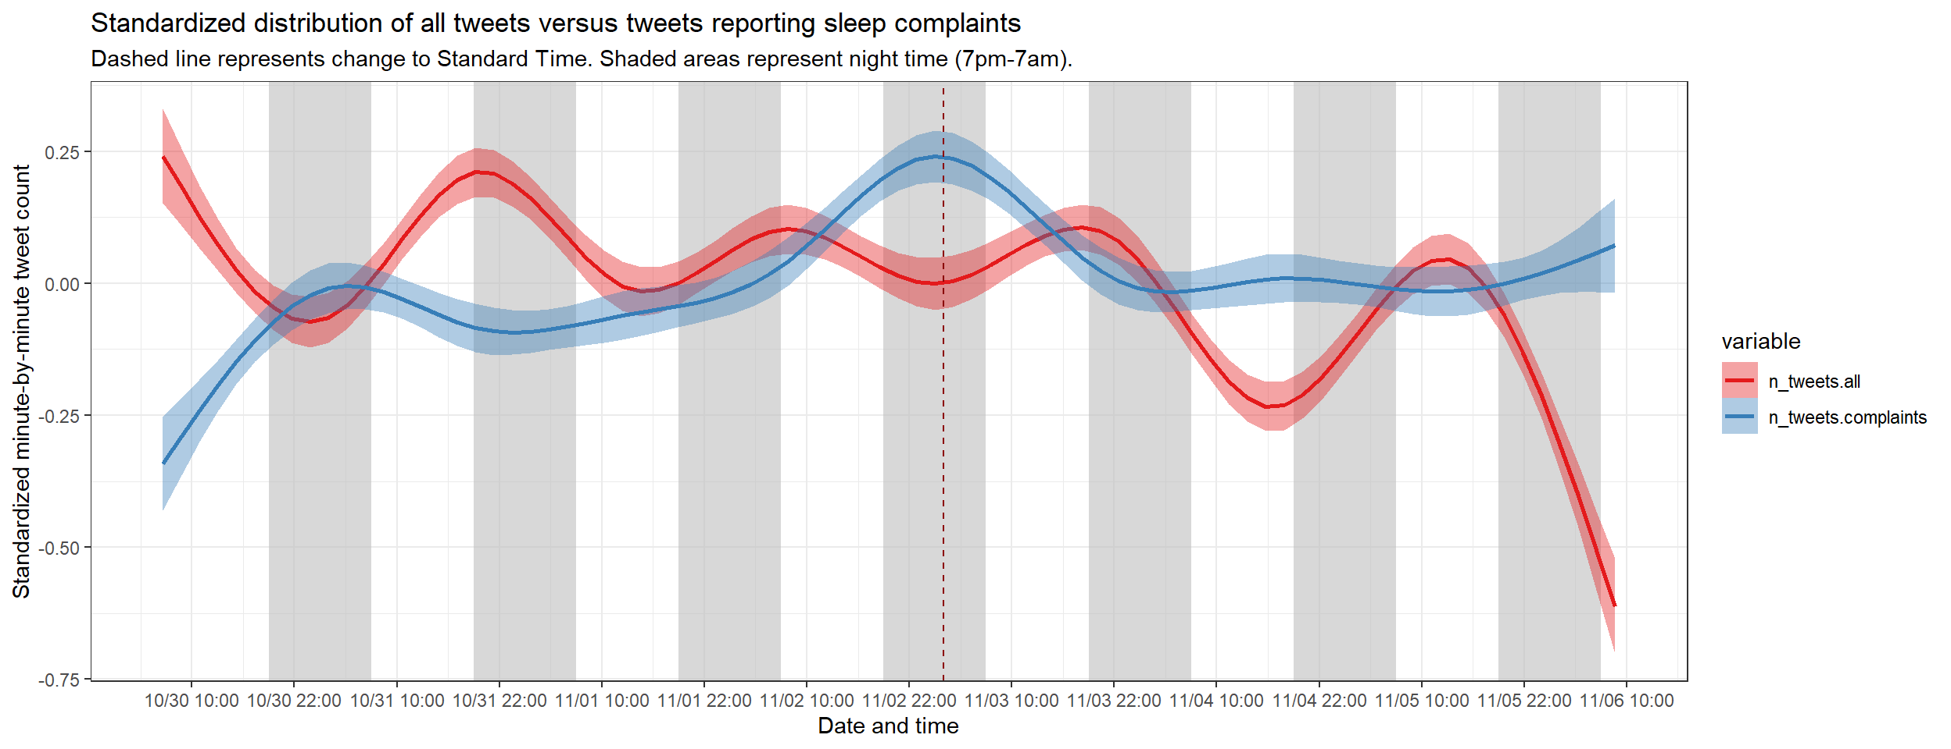
Results – Experiment 2 (Aim 2)

Slide 14
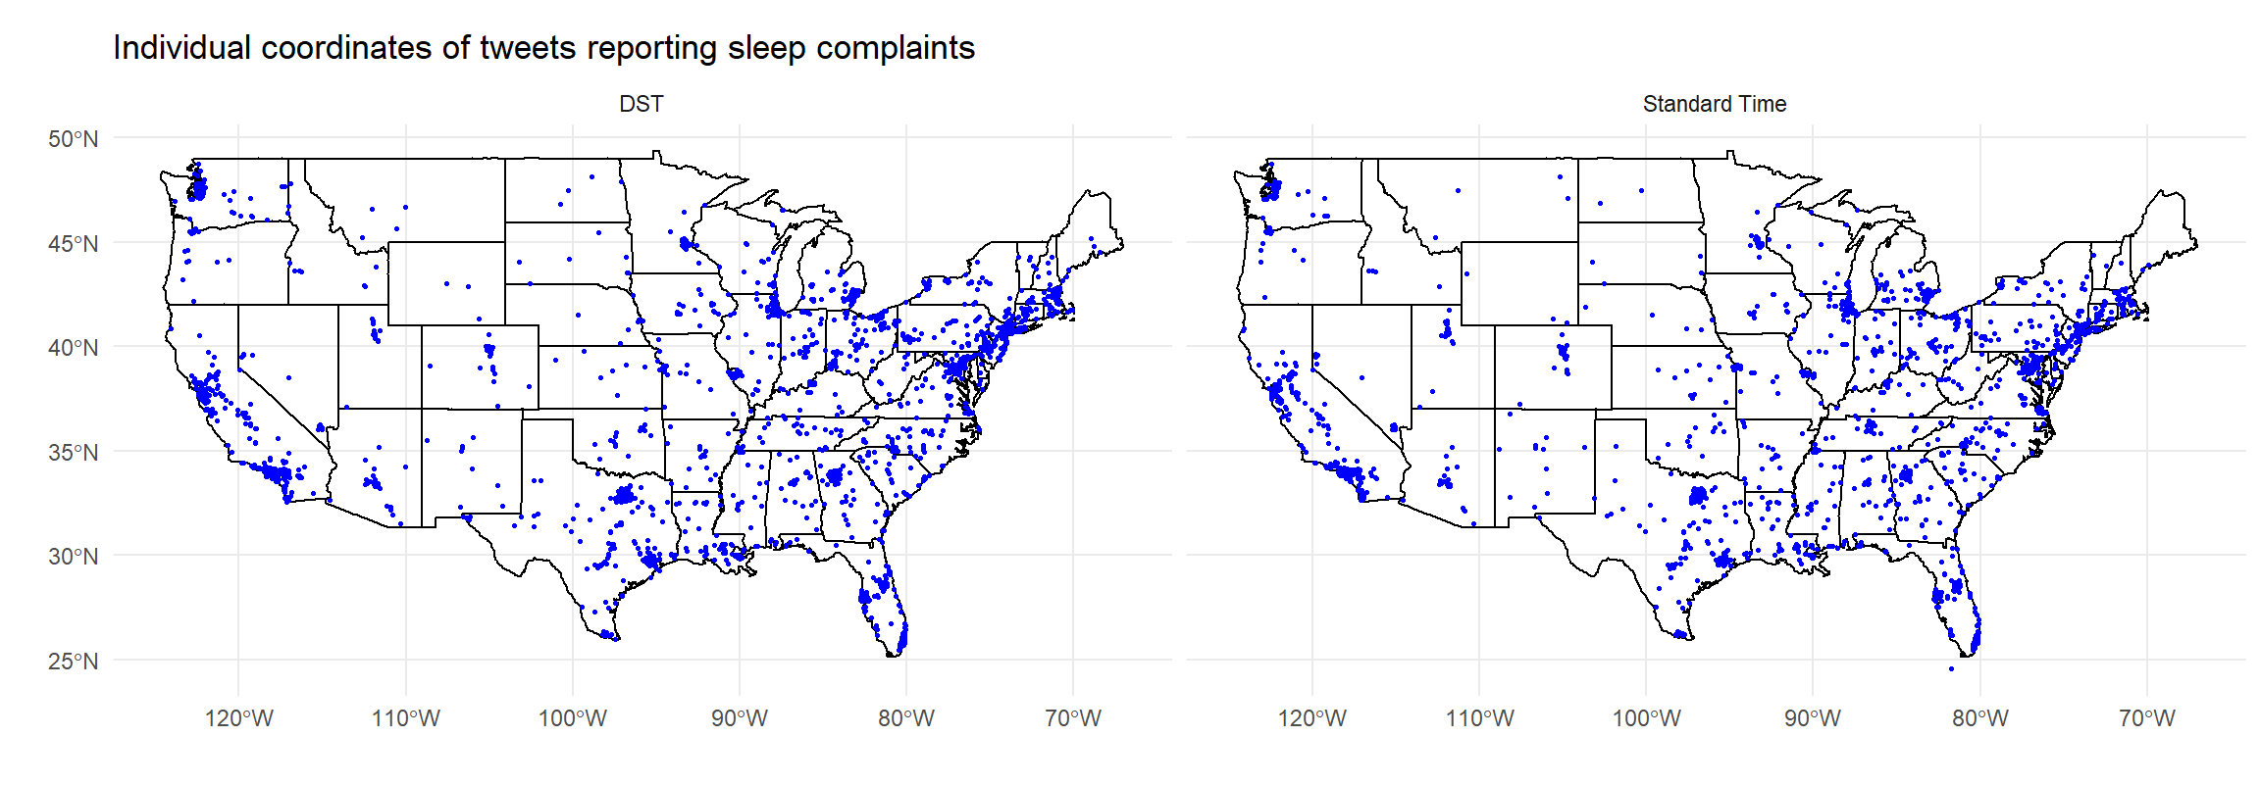
Results – Experiment 2 (Aim 3)

Slide 15
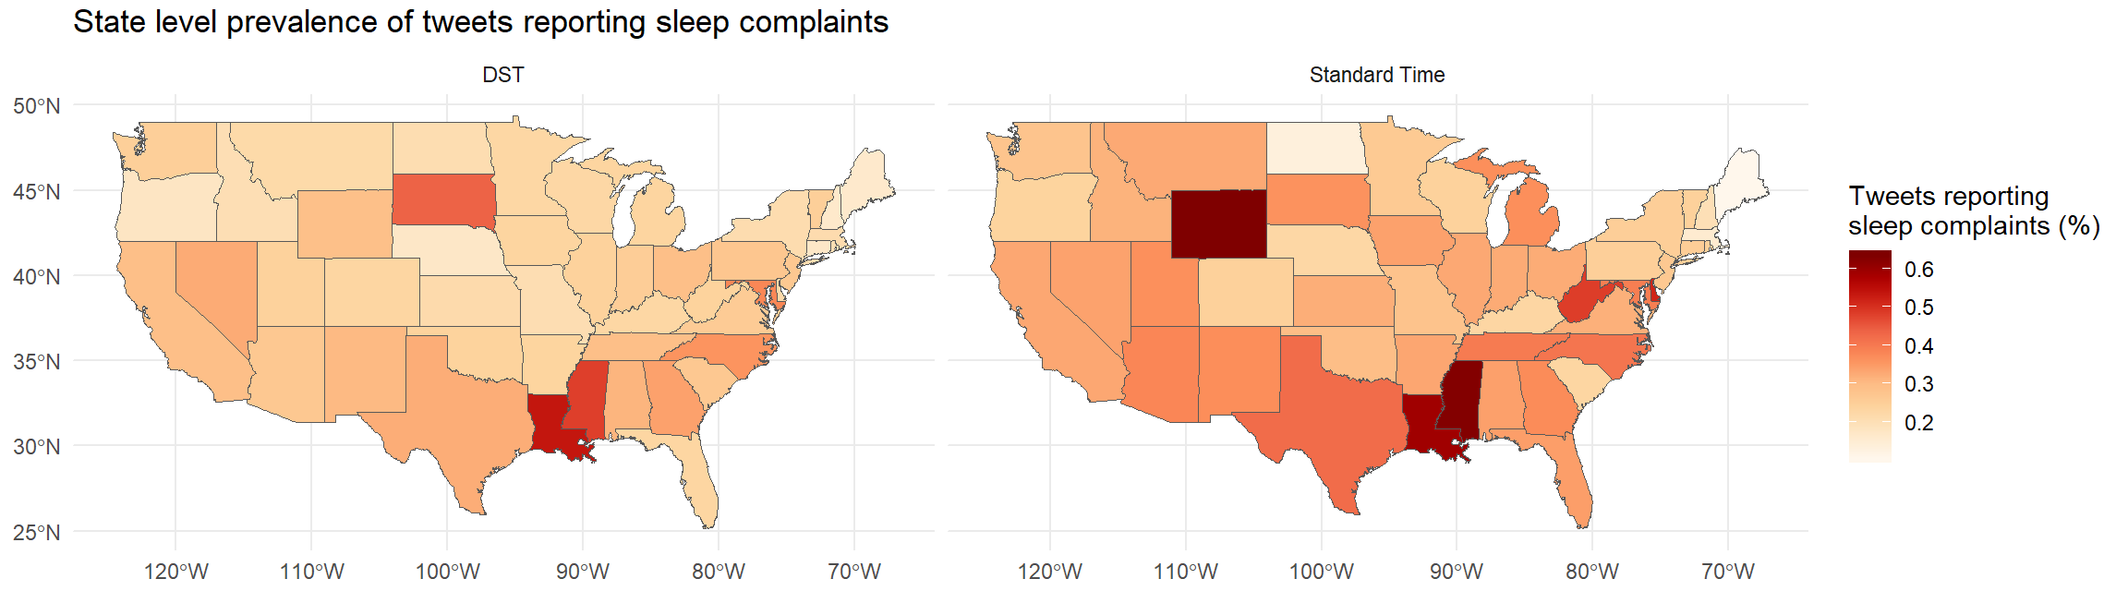
Results – Experiment 2 (Aim 3)

Slide 16
Conclusions
Random forests can be used with text-derived features to classify tweets reporting sleep complaints
Tweets reporting sleep complaints are more prevalent at night time
A change from DST to ST was associated with increased prevalence of tweets reporting sleep complaints
Future Directions
Increase the number of manual annotation instances
Explore changes from ST to DST (March 8th 2020)
Distances from time zone boundaries
Look at data from other countries and languages

Slide 17
Acknowledgements
Dr. Graciela Gonzalez-Hernandez (Epidemiology, Biostatistics, and Informatics)
Haitao Cai (Epidemiology, Biostatistics, and Informatics)
Dr. Philip Gehrman (Psychiatry)
Dr. Allan Pack (Medicine)

