Slide 1
Flask app
Cyverse
Discovery environment
Mojib Wali 22-11-2019

Slide 2
About Flask app
Simple Web Server using Flask Framework of Python.
Developed to deploy as VICE APP in Cyverse Discovery Environment
Created at Cyverse Austria workshop November 18-22, 2019
Mojib Wali

Slide 3
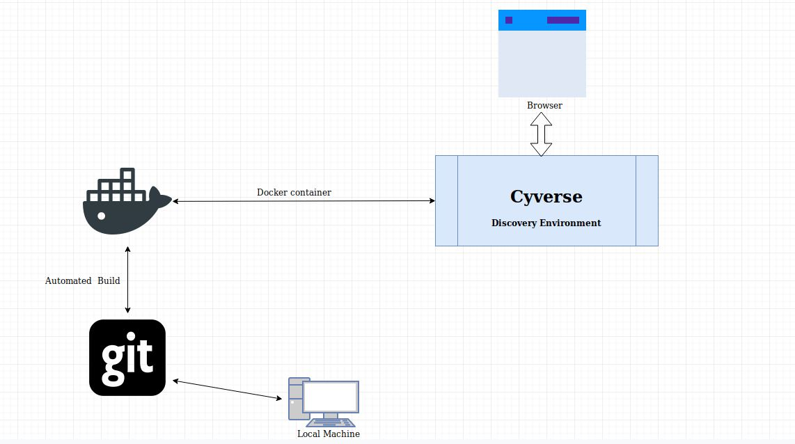
Automated Build

Slide 4
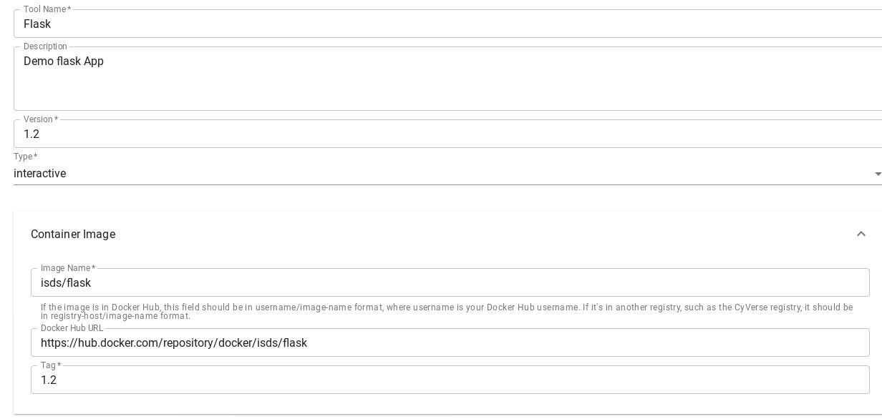
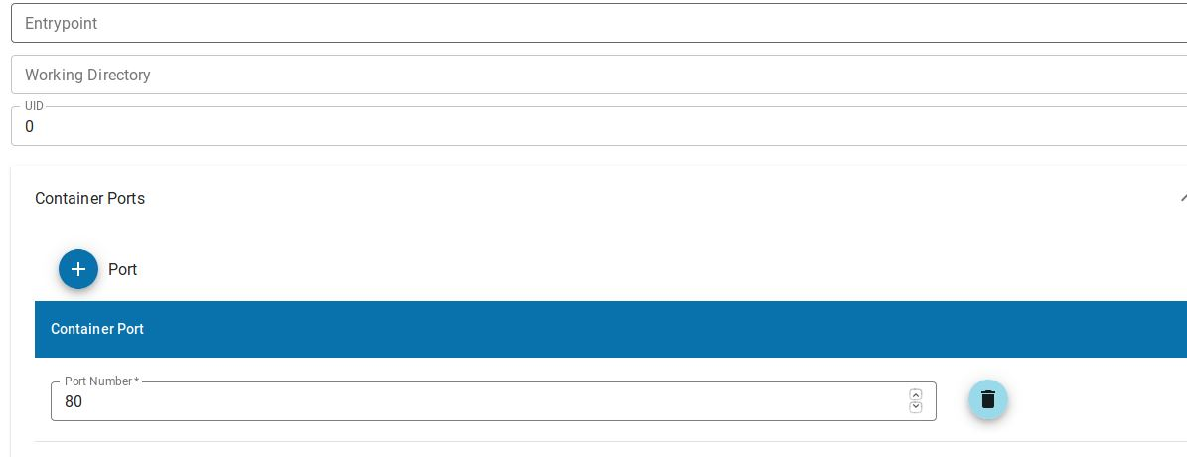
Create App from Docker Container
Discovery Environment
Apps
Manage Tools
Add Tool

Slide 5
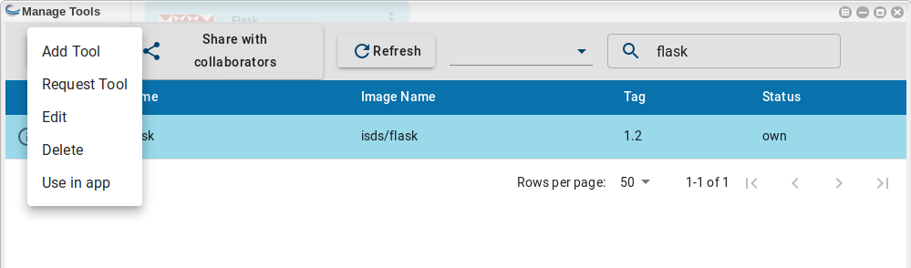
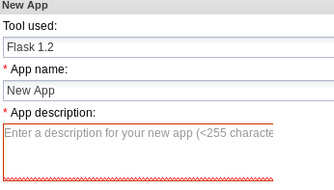
Use in App

Slide 6
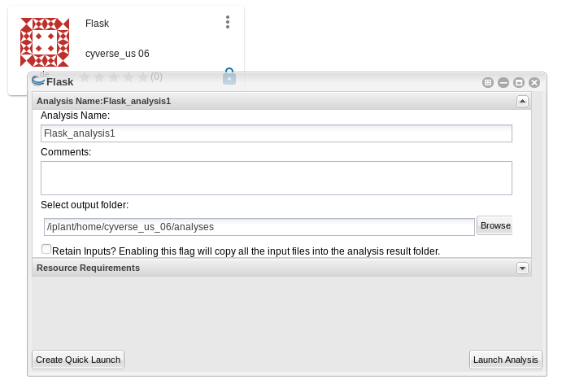
Launch the App

Slide 7
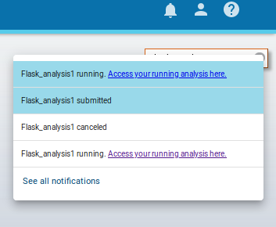
Open in Browser

Slide 8
Codes
GITHUB: https://github.com/mb-wali/flask
DockerHub: https://hub.docker.com/repository/docker/isds/flask

