Slide 1
House Price Prediction Using Data Mining
By Taylor Anderson & Mariah Borges Zuanazzi

Slide 2
Introduction to Data Mining
- Definition: Discovering patterns and knowledge from large datasets.
- Purpose: Transform raw data into useful information.
- Applications: Fraud detection, recommendation systems, and predictive modeling.

Slide 3
Project Overview
- Goal: Predict house prices using machine learning.
- Techniques: Feature engineering, Gradient Boosting, Pre-Processing residual analysis, Auto-encoding.
- Tools: Python, Scikit-learn, and Matplotlib, Pandas.

Slide 4
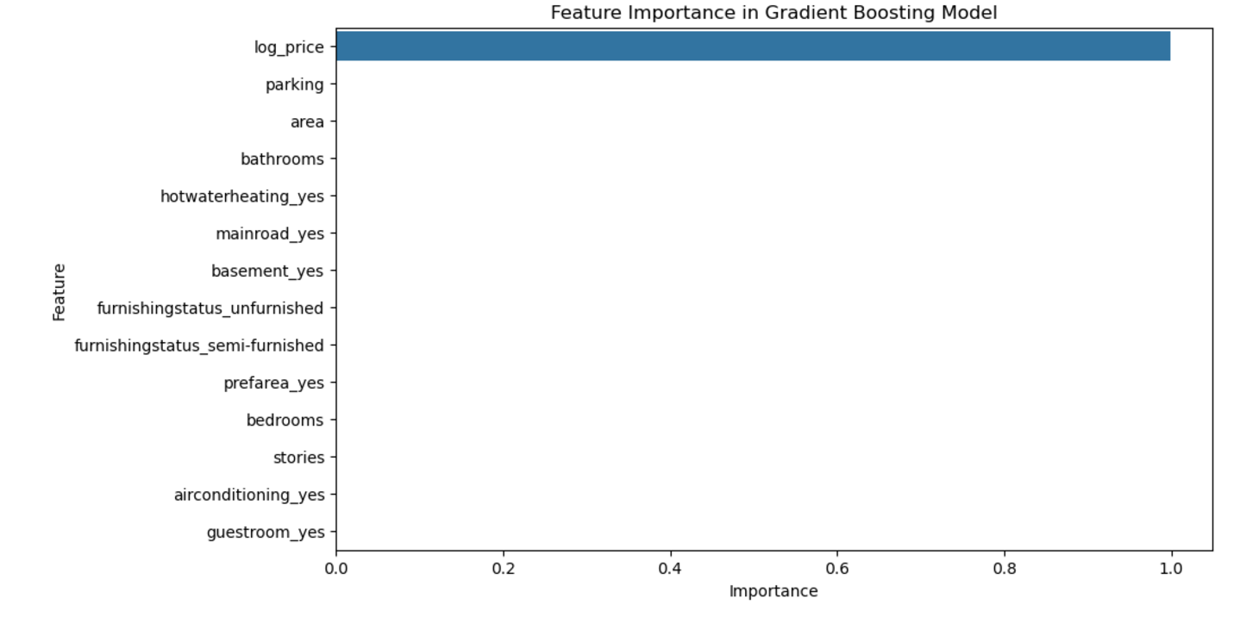
Feature importance visualization identifies the key predictors of house prices.

Slide 5
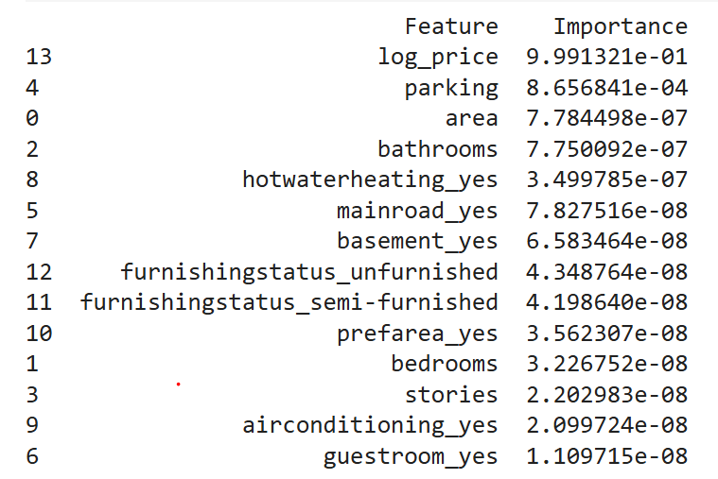
Feature importance visualization identifies the key predictors of house prices.

Slide 6
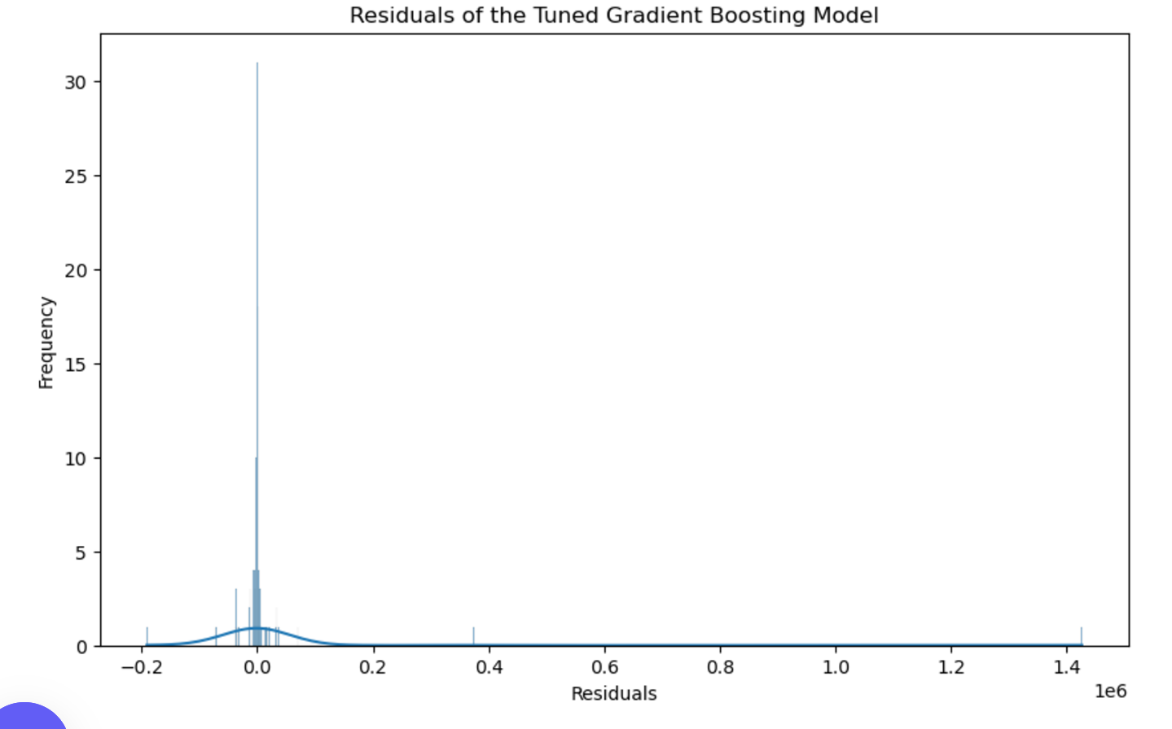
Residual distribution helps evaluate the accuracy of the model.

Slide 7
Model Performance
- Evaluation Metrics:
- R² Score: Proportion of variance explained by the model.
- MAE: Average prediction error in dollars.
- Gradient Boosting achieved the best performance with tuned parameters.

Slide 8
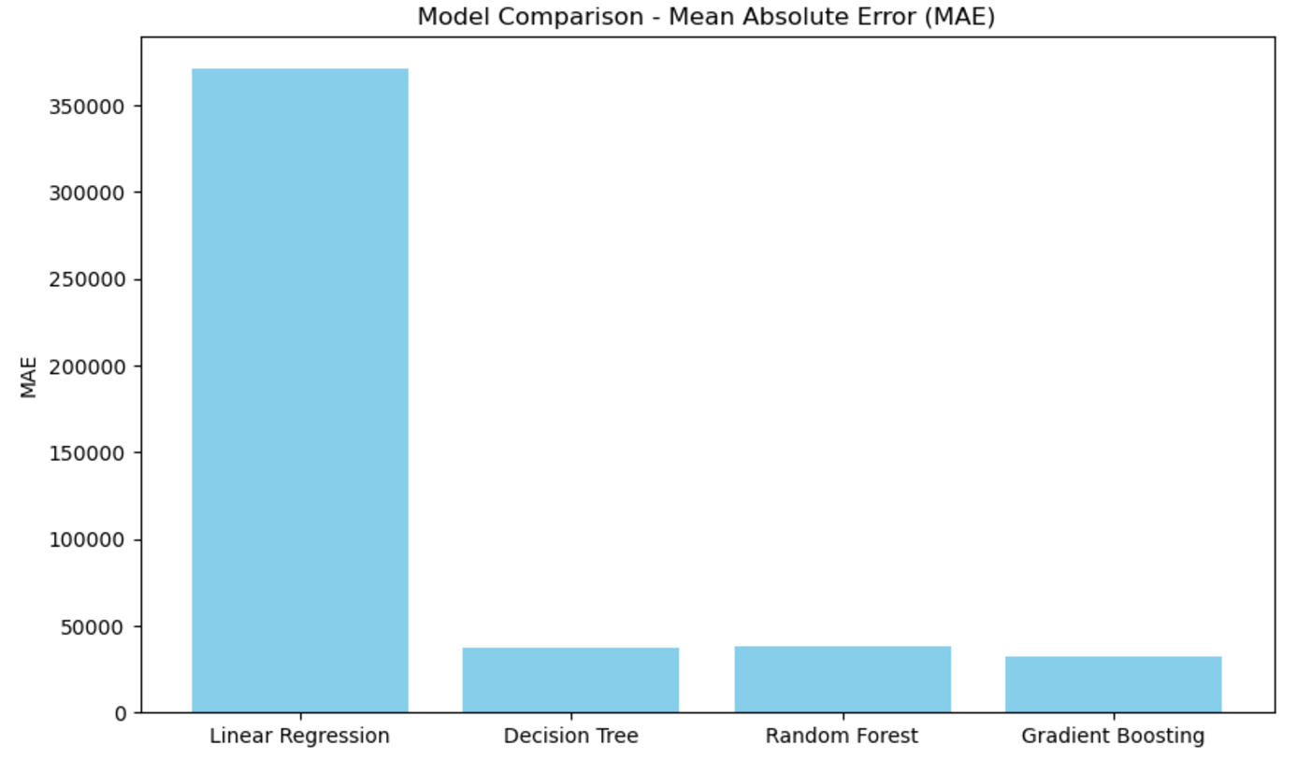
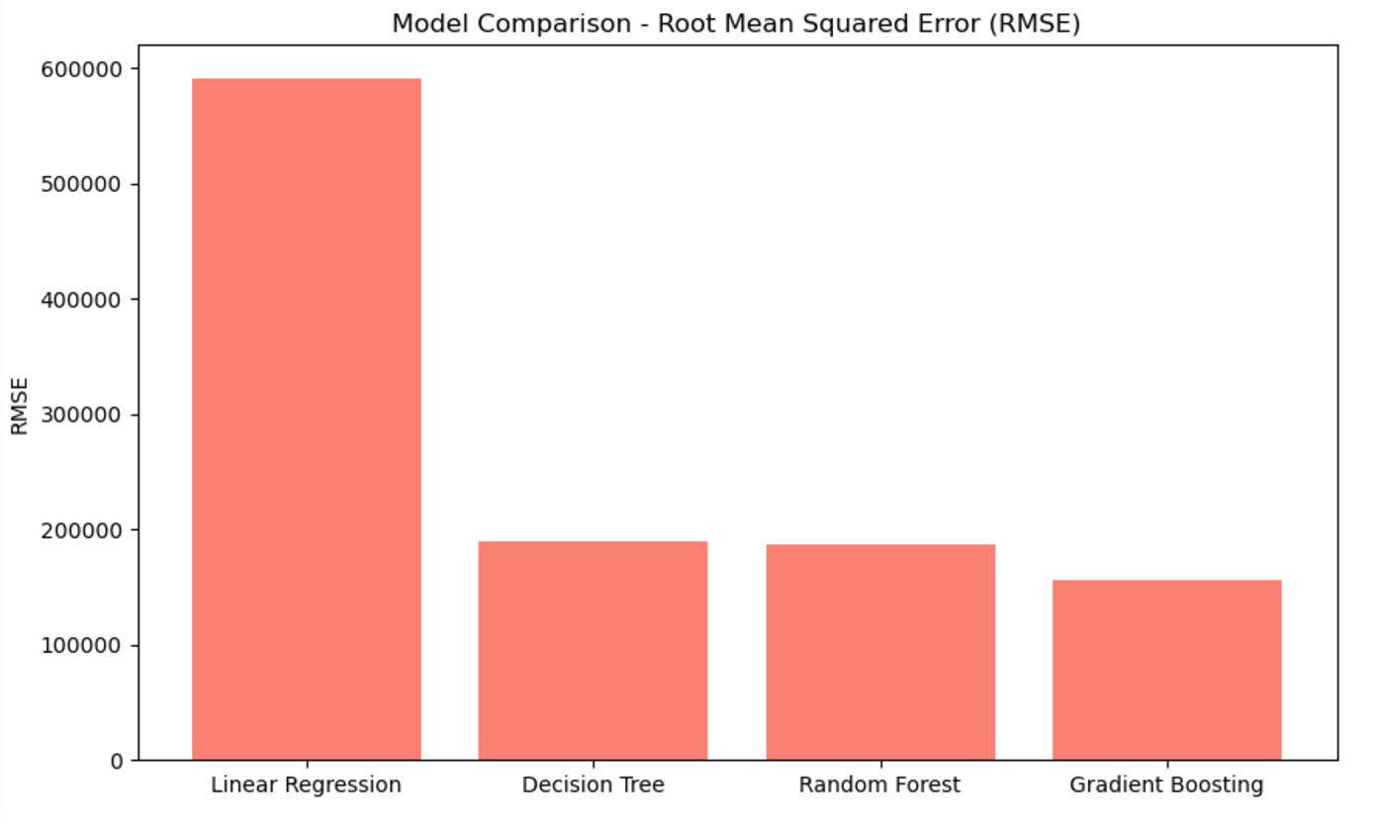
Model Performance

Slide 9
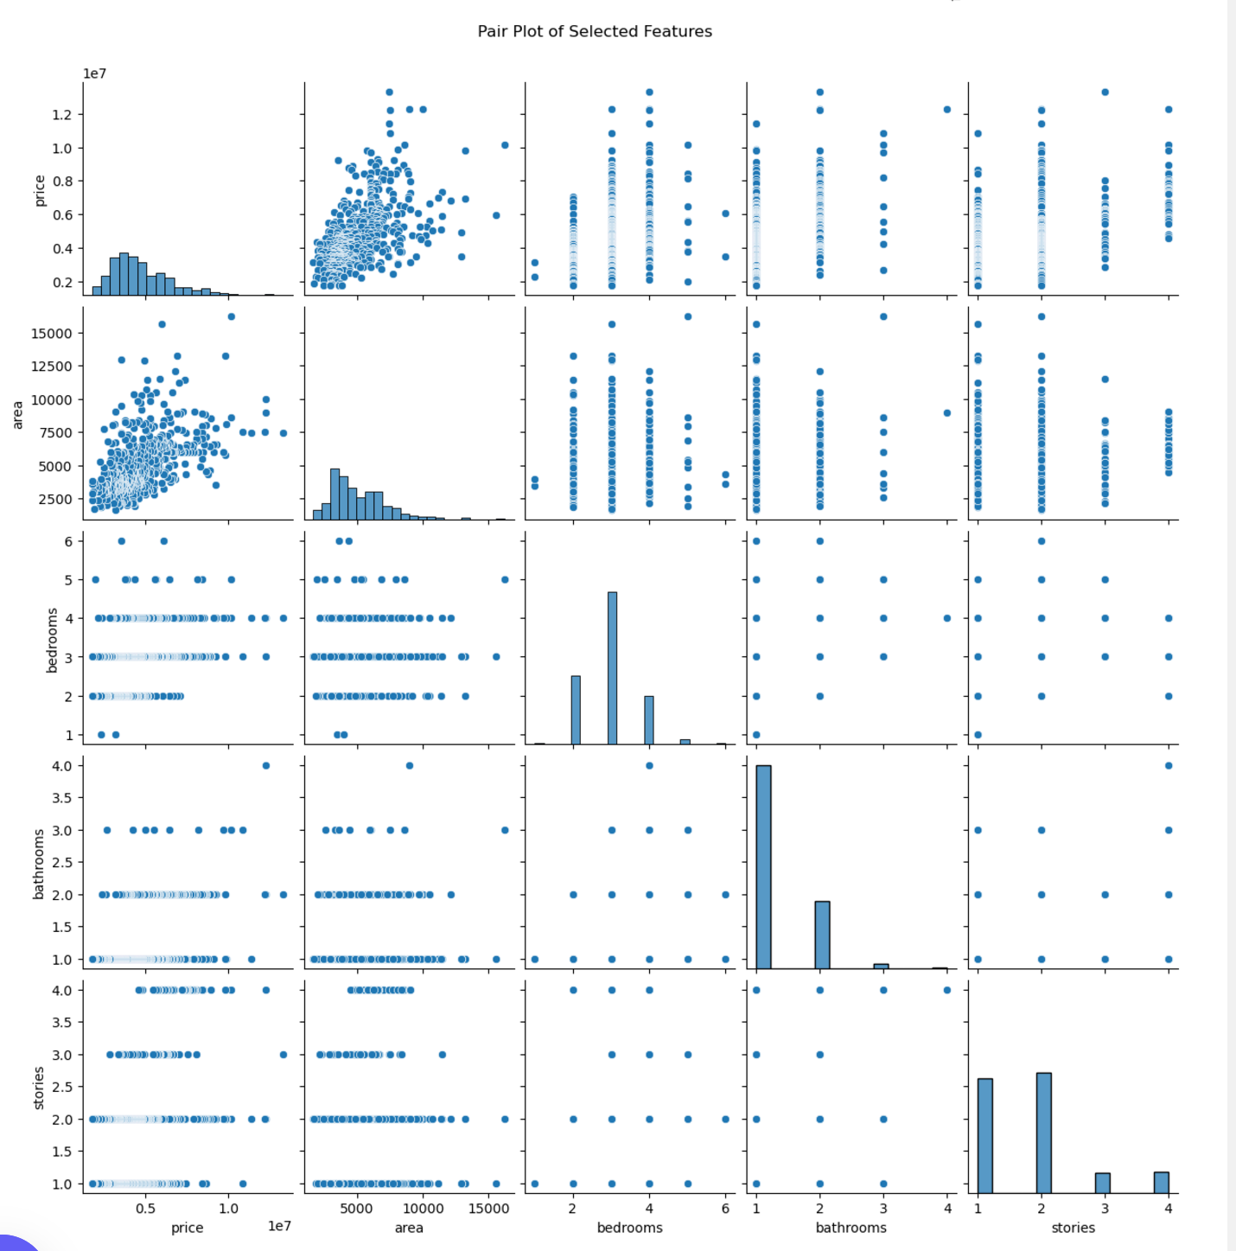
A scatter plot visualizes residuals against predicted prices to identify biases.

Slide 10
Conclusion and Future Work
- Conclusion: Gradient Boosting effectively predicts house prices with minimal error.
- Future Steps:
- Incorporate additional features (e.g., market trends).
-world market?

