Slide 1
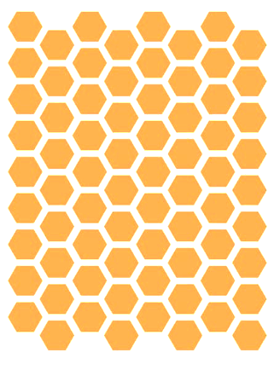
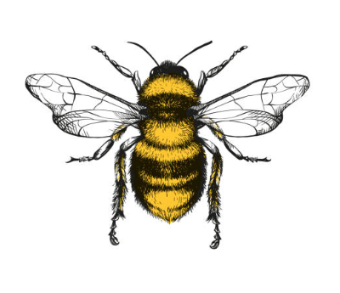
Bee Colonies: What’s the Recent Buzz?
zzzz
zzz

Slide 2
History of Honey Bee Losses
A timeline of the landslide in colony losses
Over 50% reduction in number of colonies from 1940’s
Introduction of DDT & other harmful pesticides
1987
1940’s
Introduction of Invasive Varroa Mites + other pathogens
6 million
1970’s
2021
# of Small Farms After WW2
2.8 million
3 million
Notes:
Sources:
https://www.ars.usda.gov/oc/br/ccd/index/#history
https://www.intechopen.com/chapters/50073

Slide 3
A Mystery Plague: Colony Collapse Disorder (CCD)
First characterized in 2006, beekeepers reported as much as 30-90% loss of their hives
Signs of CCD:
Sudden vanishing/loss of a colony’s worker bee population
Little to no dead bees
Queen and young brood remain
Abundant honey and pollen reserves remain
Without worker bees, the hives eventually die off
Despite intense research, no definitive underlying cause has been identified for CCD
Suspected causes:
Parasites
Diseases
Pesticides
Loss of habitat
Poor nutrition
Notes:
Source:
https://www.epa.gov/pollinator-protection/colony-collapse-disorder#:~:text=Pesticide%20poisoning%20through%20exposure%20to,the%20habitat%20where%20bees%20forage.

Slide 4
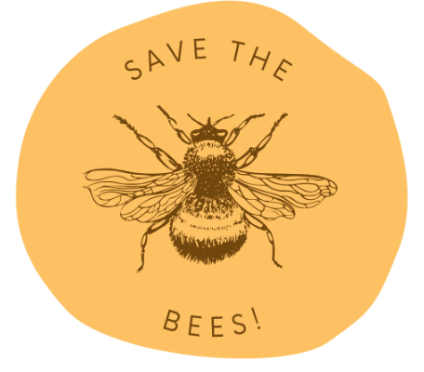
Save The Bees!
The bee die off has been called the Bee-pocalypse or Beemageddon
Image Source: https://shorebags.com/blogs/news/were-honoring-the-disappearing-honey-bee
Notes:
Source: https://www.washingtonpost.com/news/wonk/wp/2015/07/23/call-off-the-bee-pocalypse-u-s-honeybee-colonies-hit-a-20-year-high/

Slide 5
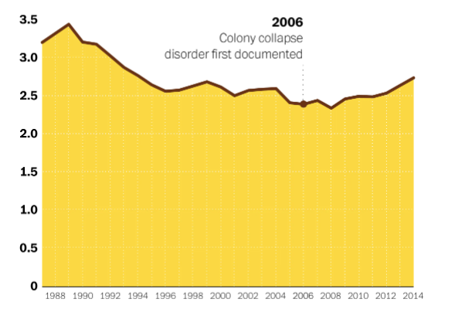
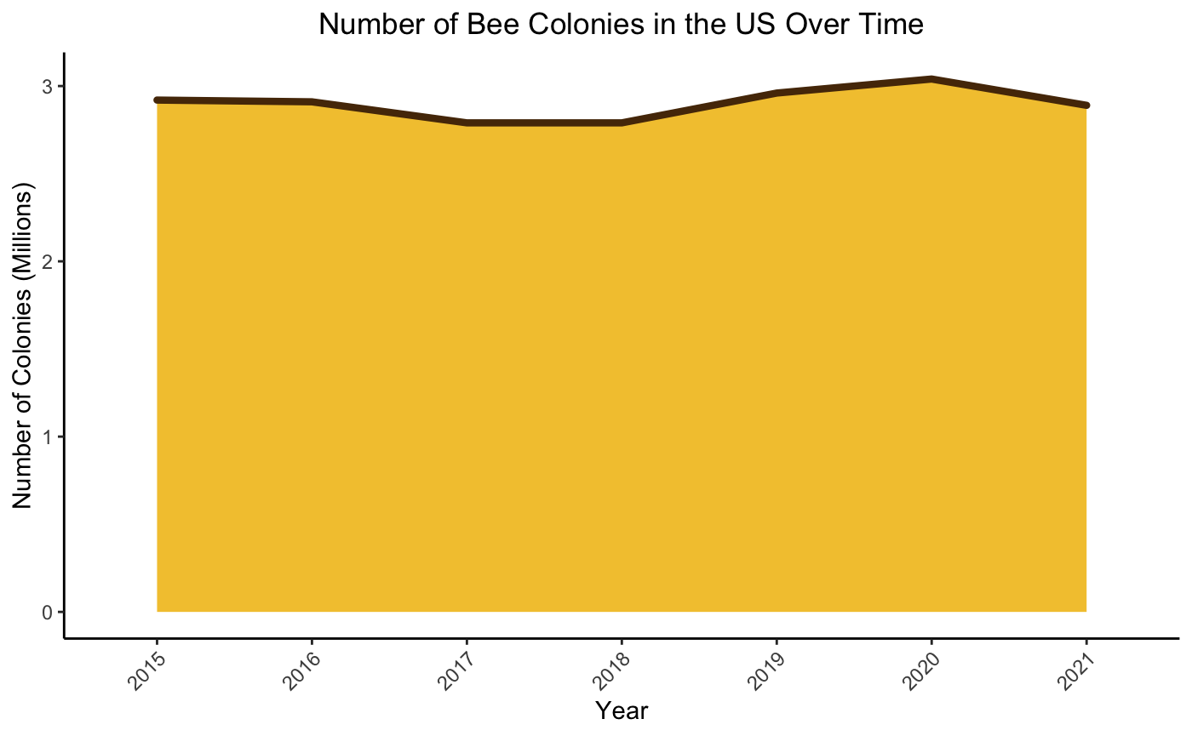
How Have the Bees Been Doing?
Colony Collapse Disorder (CCD) first characterized
2006
Stable populations in recent years
Source: USDA Honey Production Surveys

Slide 6
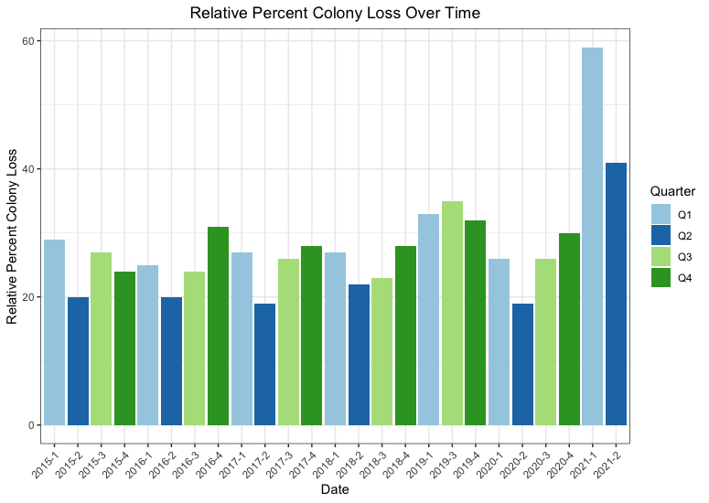
Is There a Pattern in Colony Loss Across the US?

Slide 7
Colony loss across the US appears to have a cyclical nature
Colony losses appear to occur more in the colder months (Q4 & Q1)
Colony loss is consistently lowest in the spring months (Q2) when nectar and pollen are most readily available
This makes good sense…

Slide 8
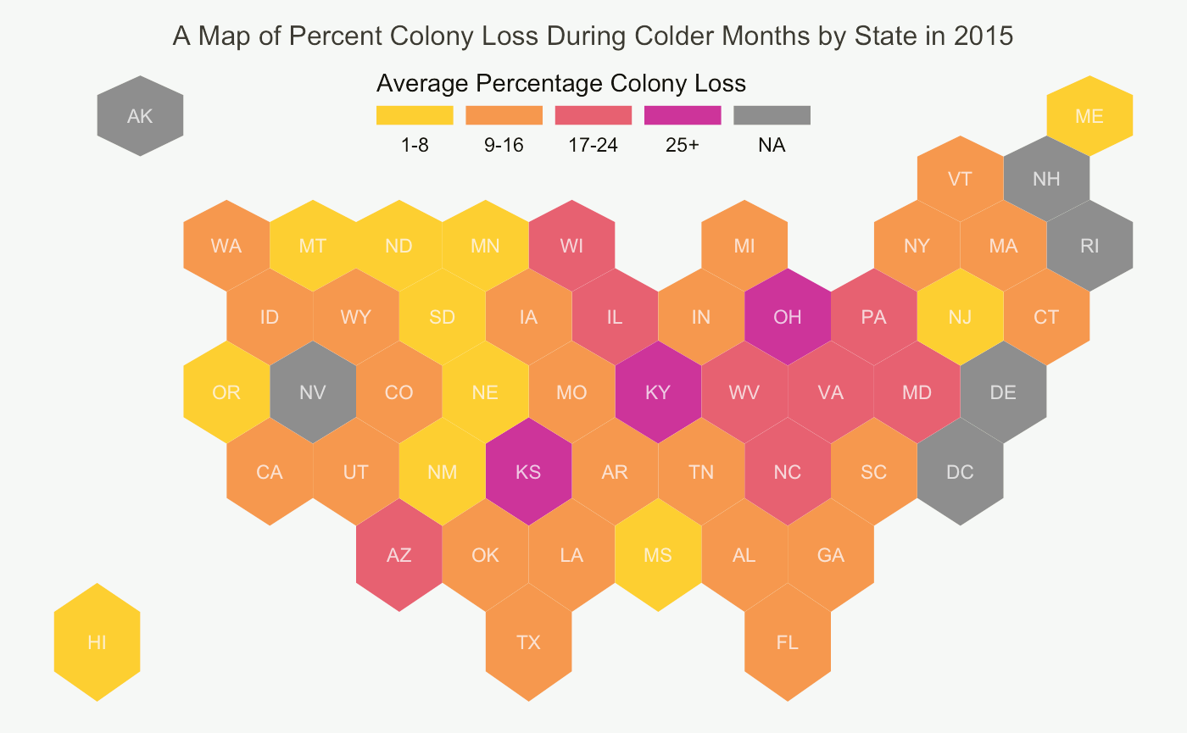

Slide 9
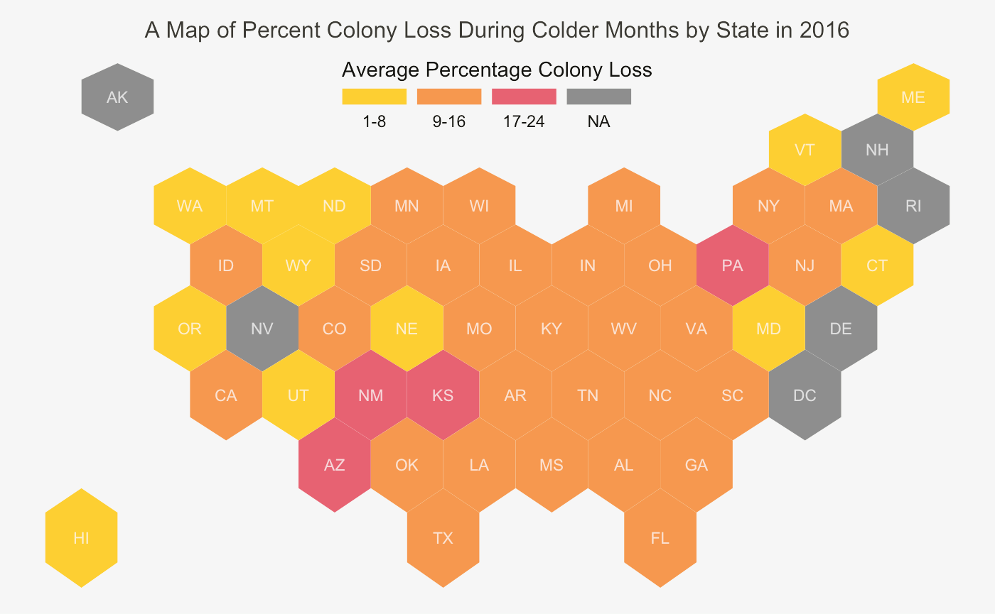

Slide 10
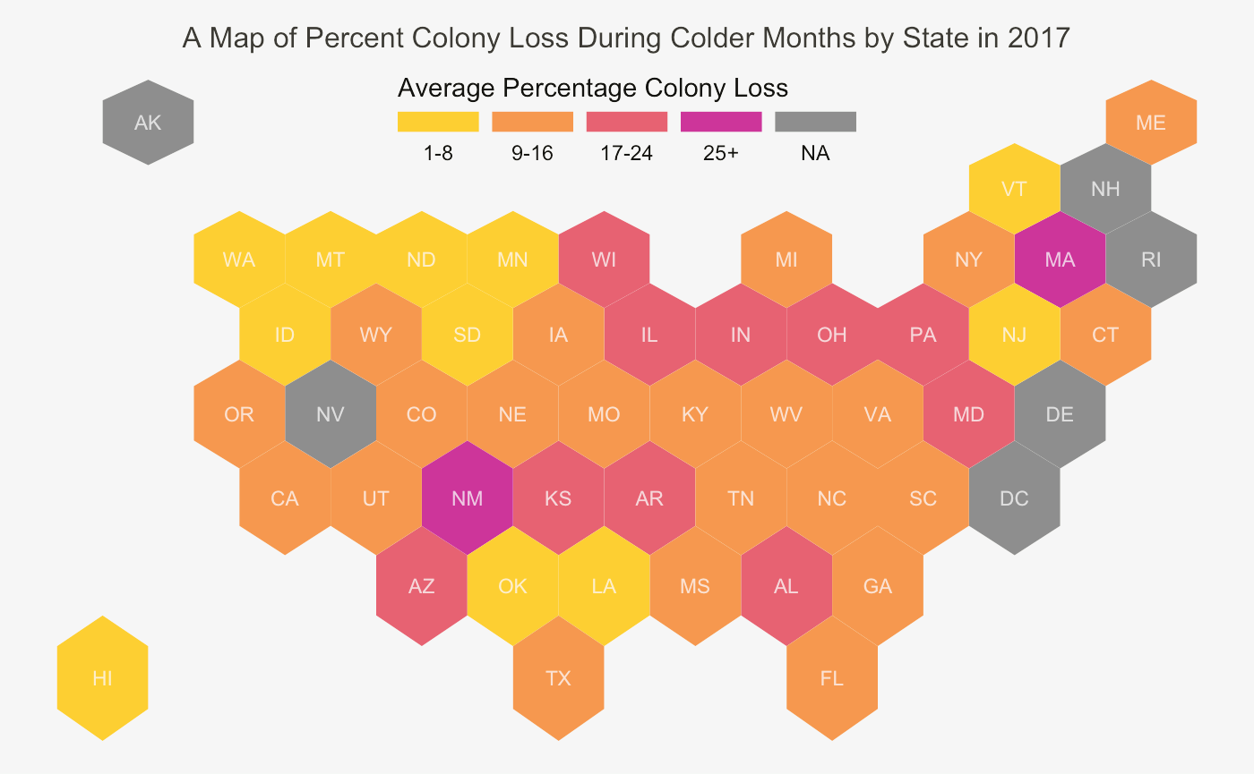

Slide 11
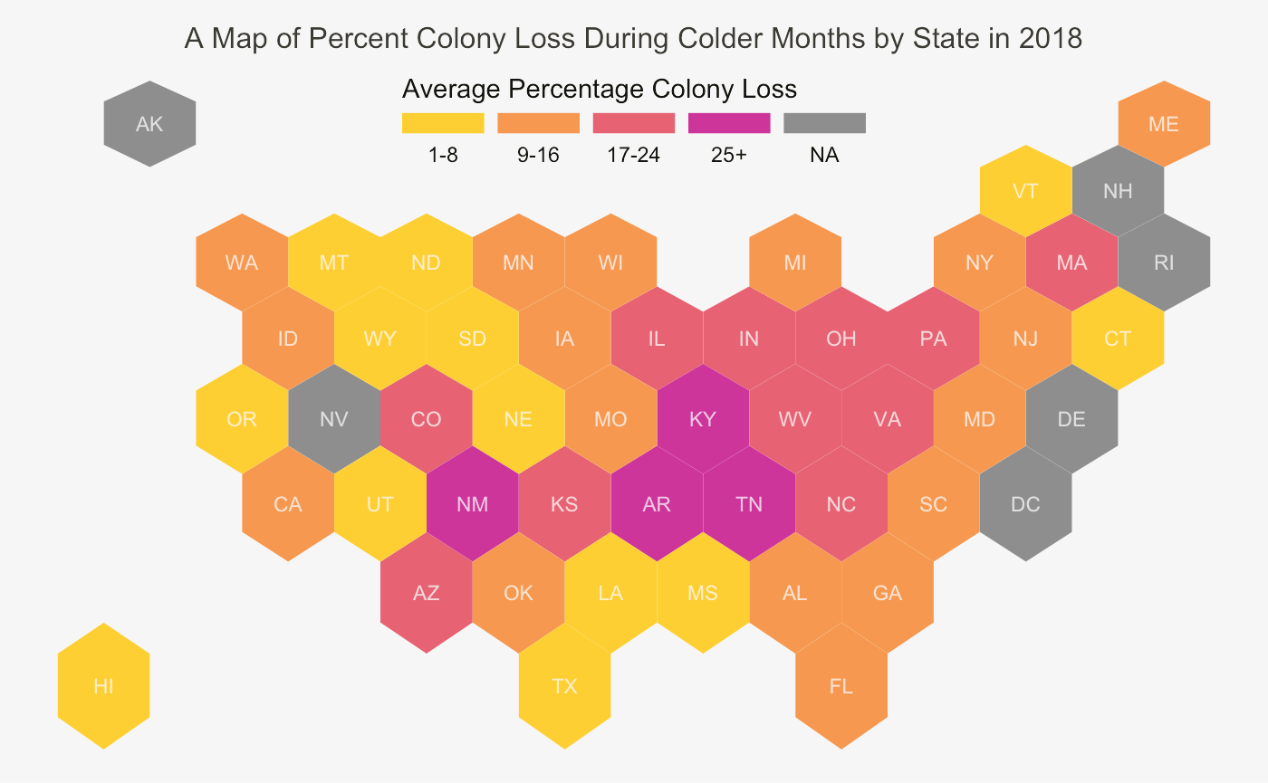

Slide 12
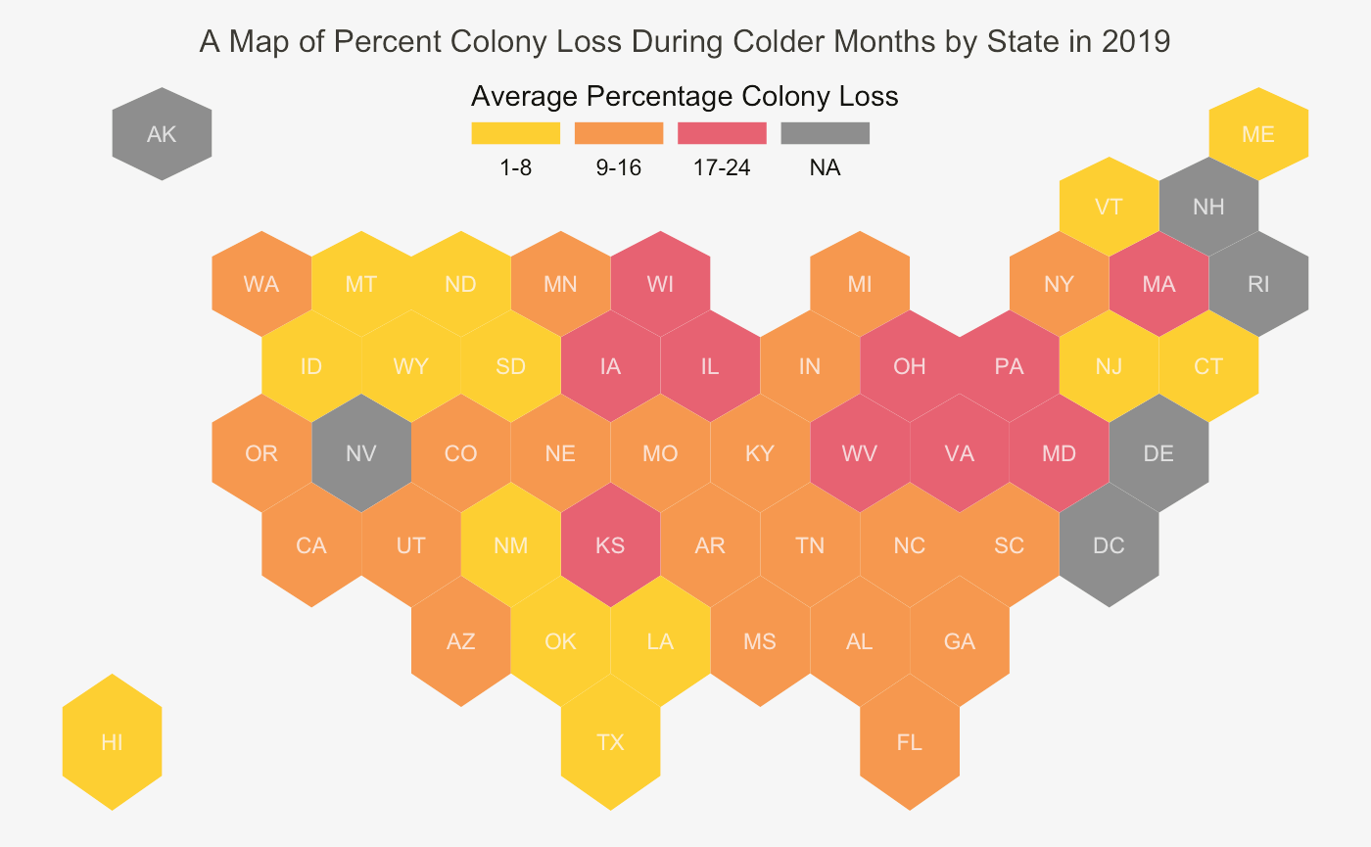

Slide 13
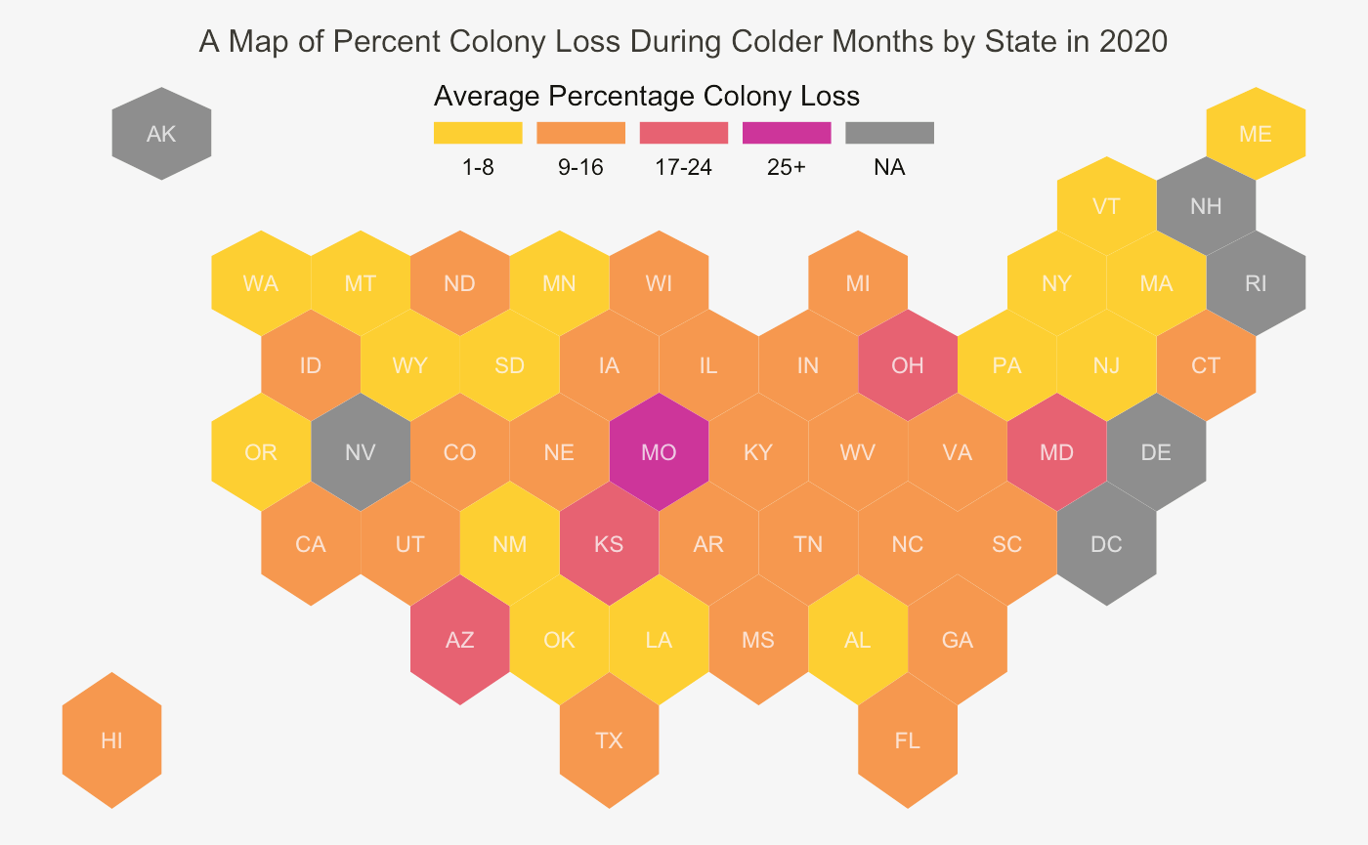

Slide 14
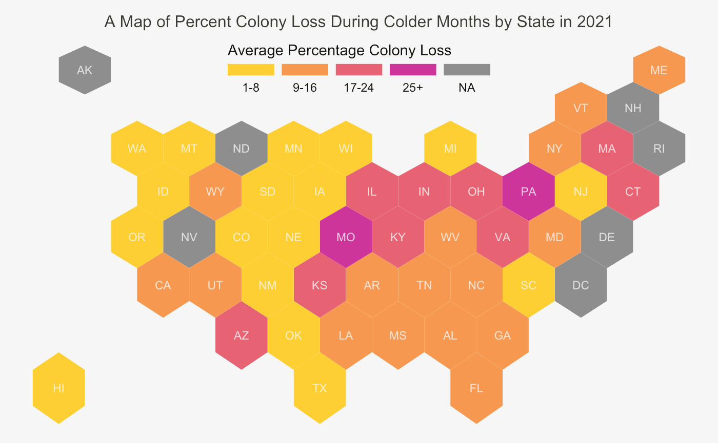

Slide 15

Data Sources
Don’t worry, bee happy
https://www.kaggle.com/datasets/kyleahmurphy/nass-honey-bee-20152021

