Slide 1
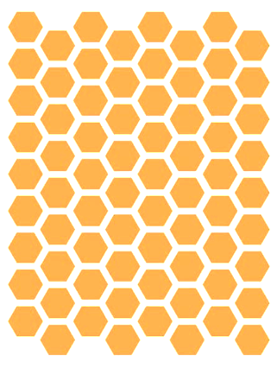
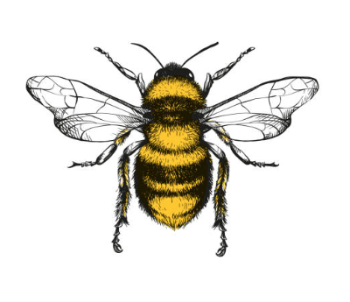
Bee Colonies: What’s the Recent Buzz?

Slide 2
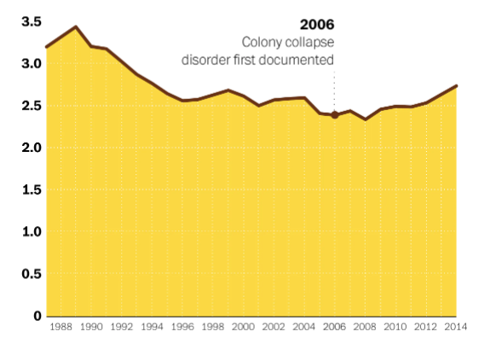
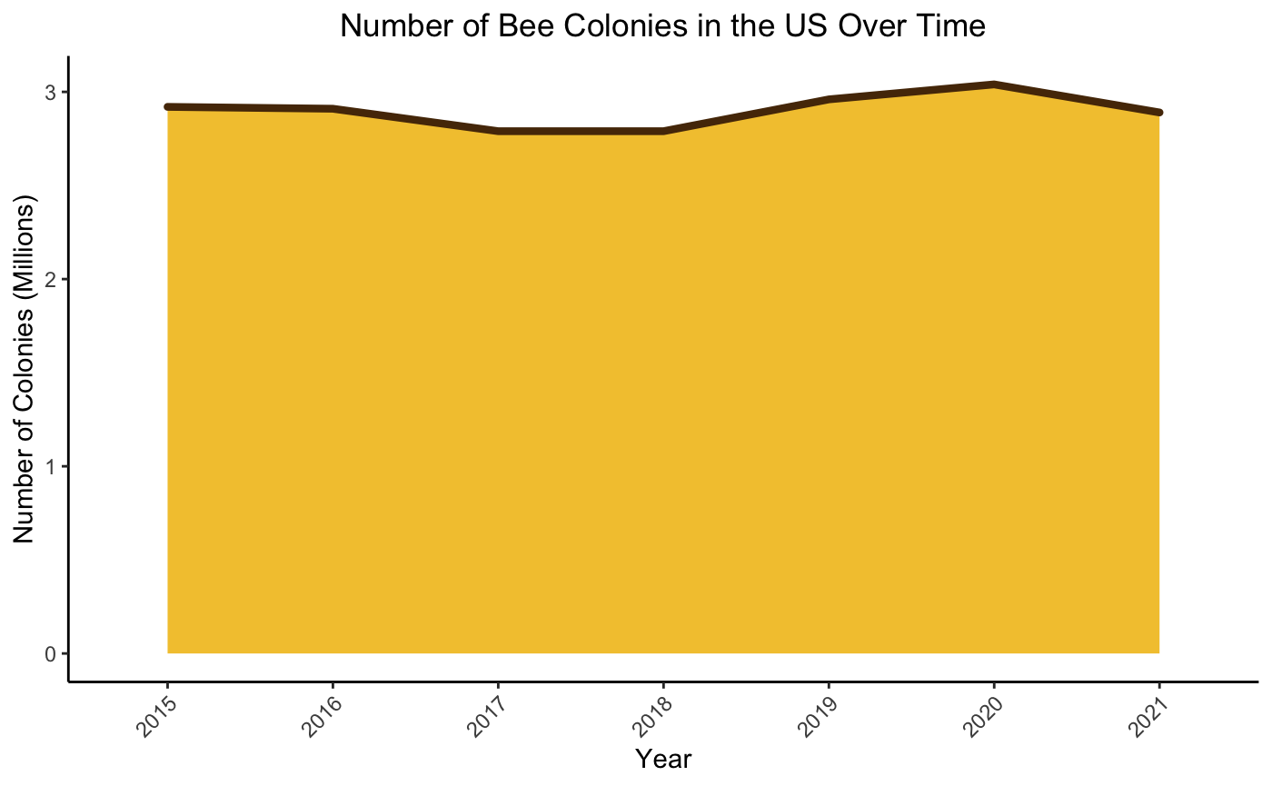
How Have the Bees Been Doing?
Colony Collapse Disorder (CCD) first characterized
2005
Stable populations in recent years
Source: USDA Honey Production Surveys

Slide 3
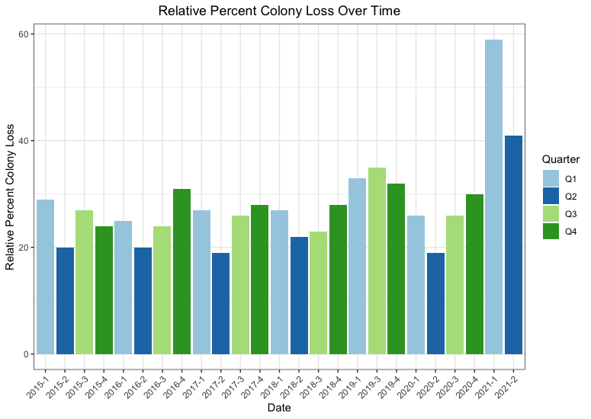
Is There a Pattern in Colony Loss Across the US?

Slide 4
Colony loss across the US appears to have a cyclical nature
Colony losses appear to occur more in the colder months (Q4 & Q1)
Colony loss is consistently lowest in the spring months (Q2) when nectar and pollen are most readily available
This makes good sense…

Slide 5
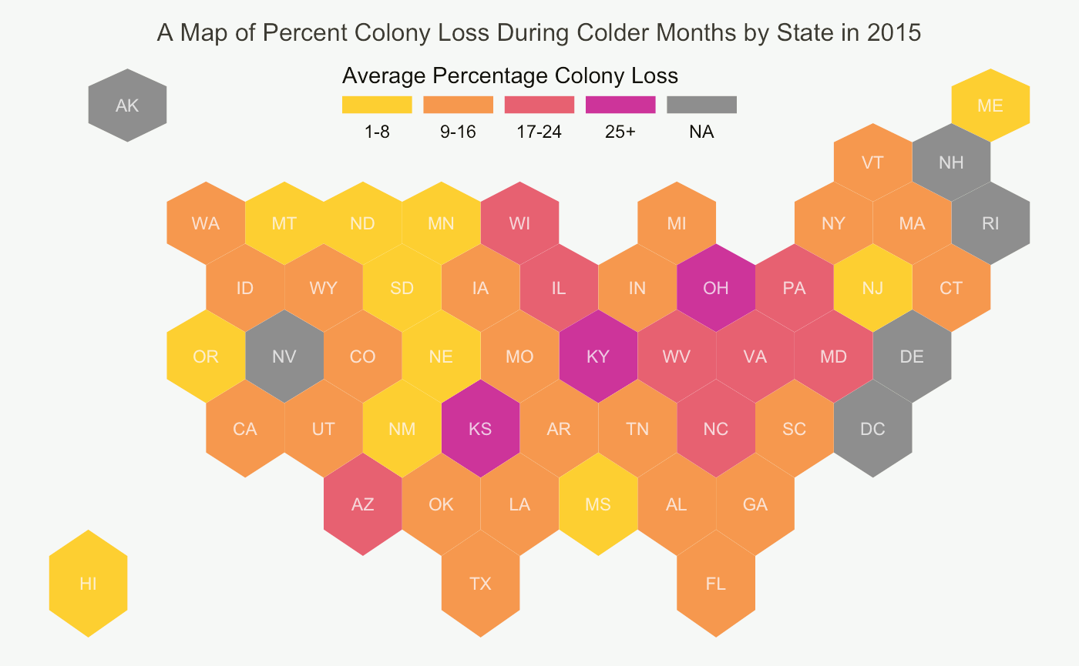

Slide 6
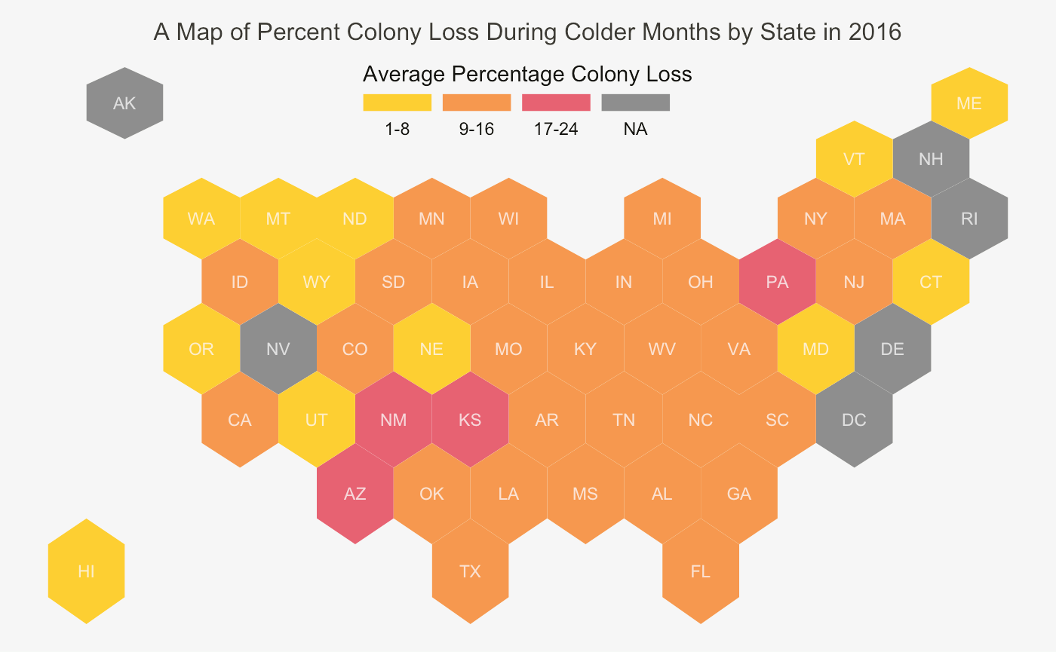

Slide 7
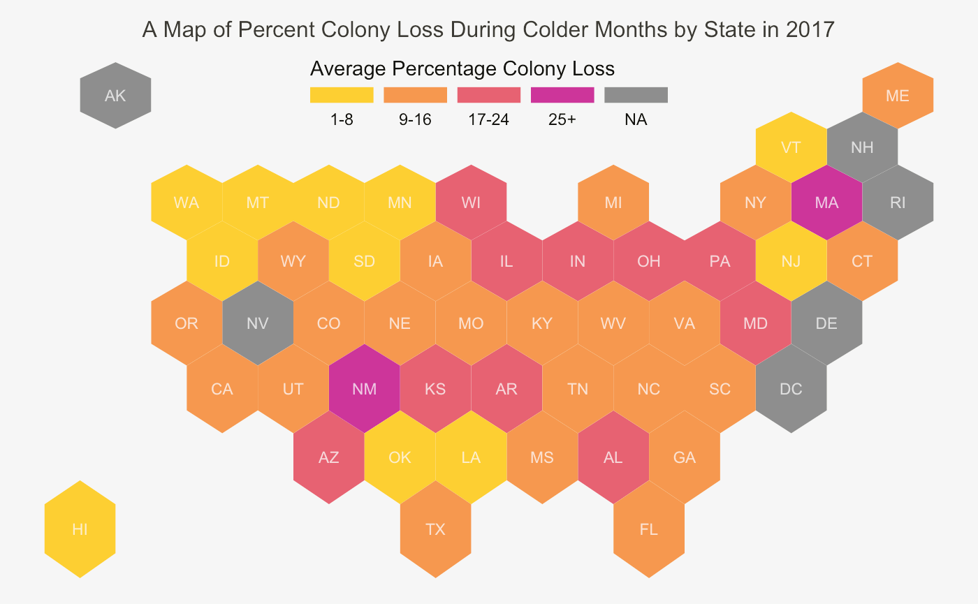

Slide 8
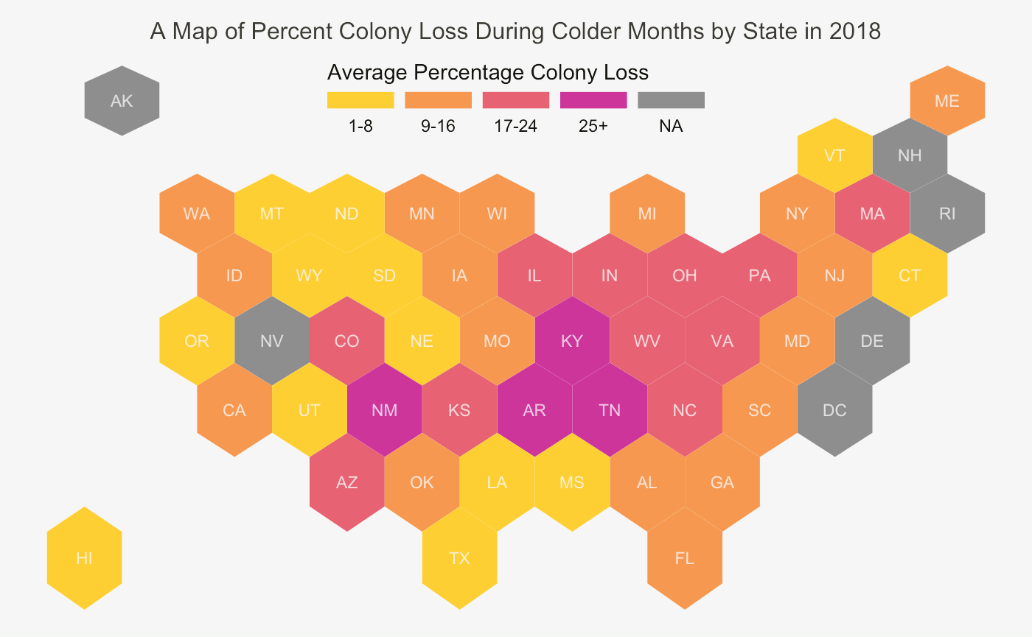

Slide 9
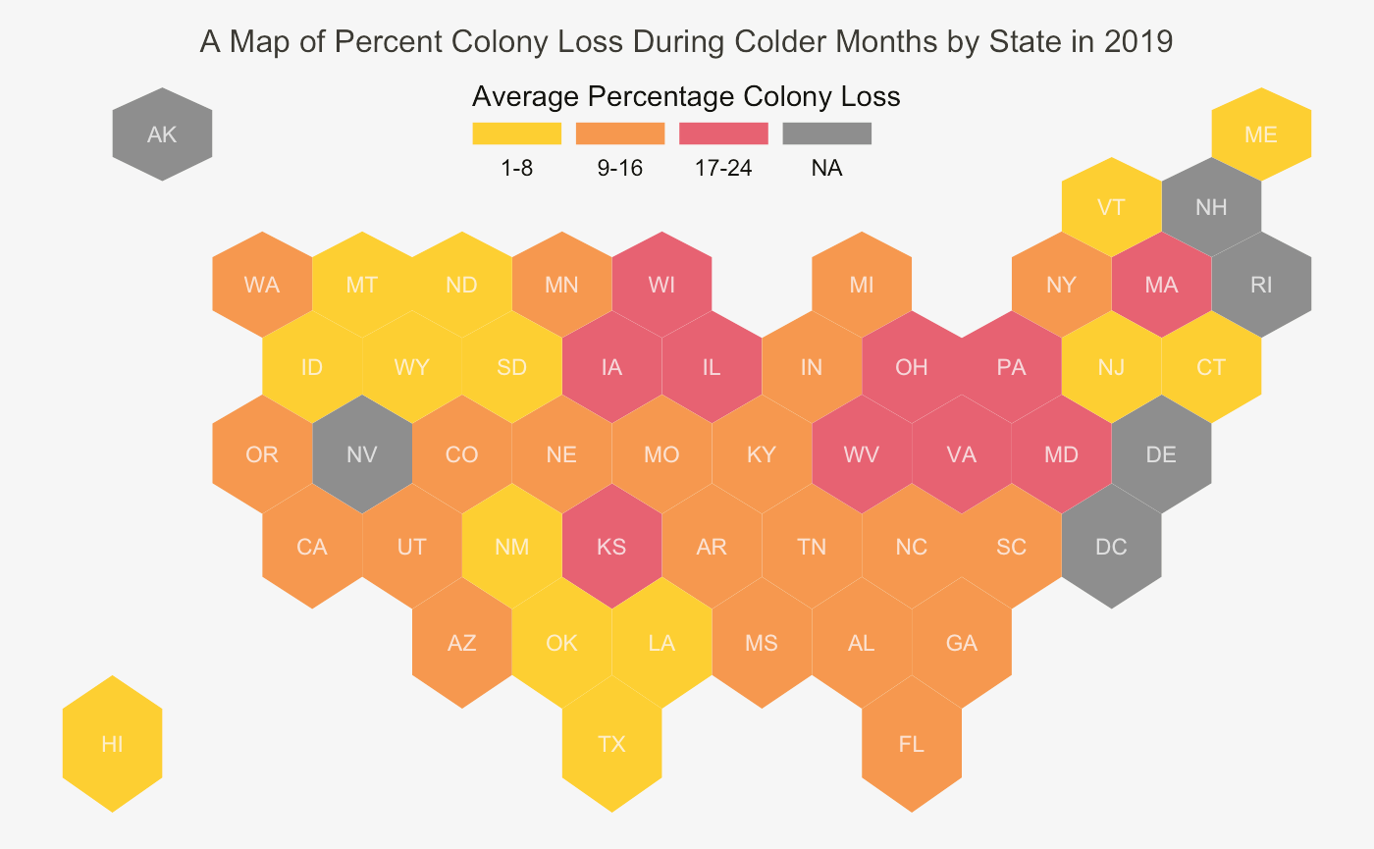

Slide 10
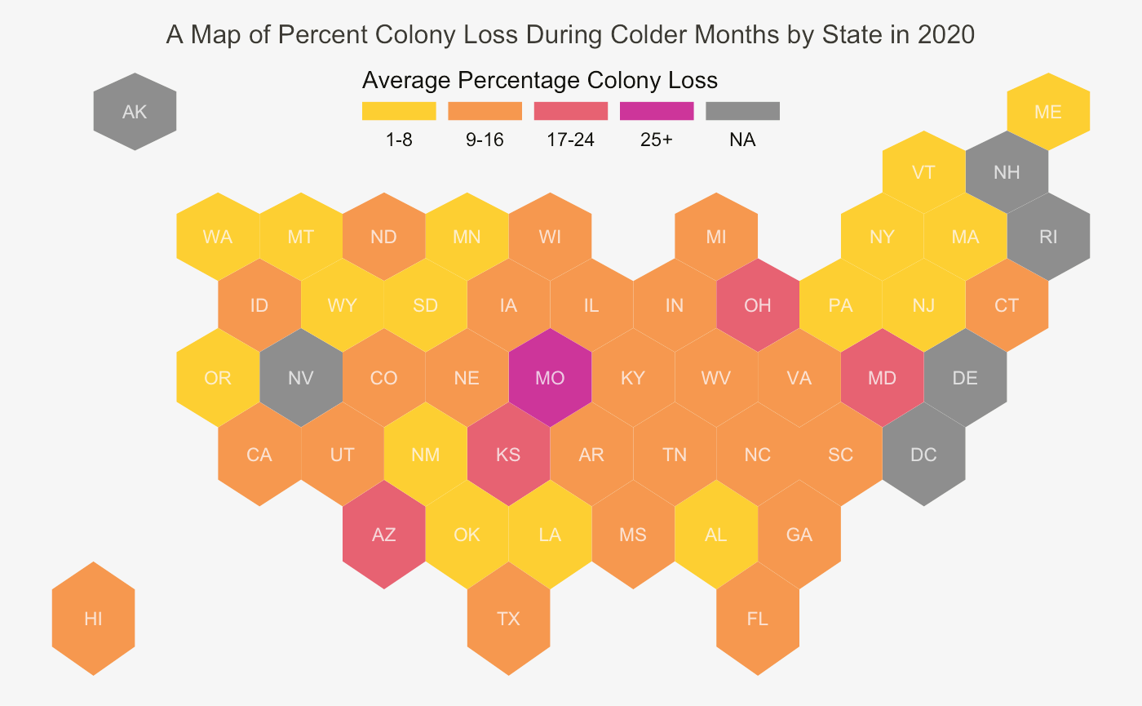

Slide 11
