Slide 1
Comparing Clang-Tidy and CMBC on Wireshark Application
Miguel Belfort - mb4270
Sachchidanand Deo - ssd2149

Slide 2
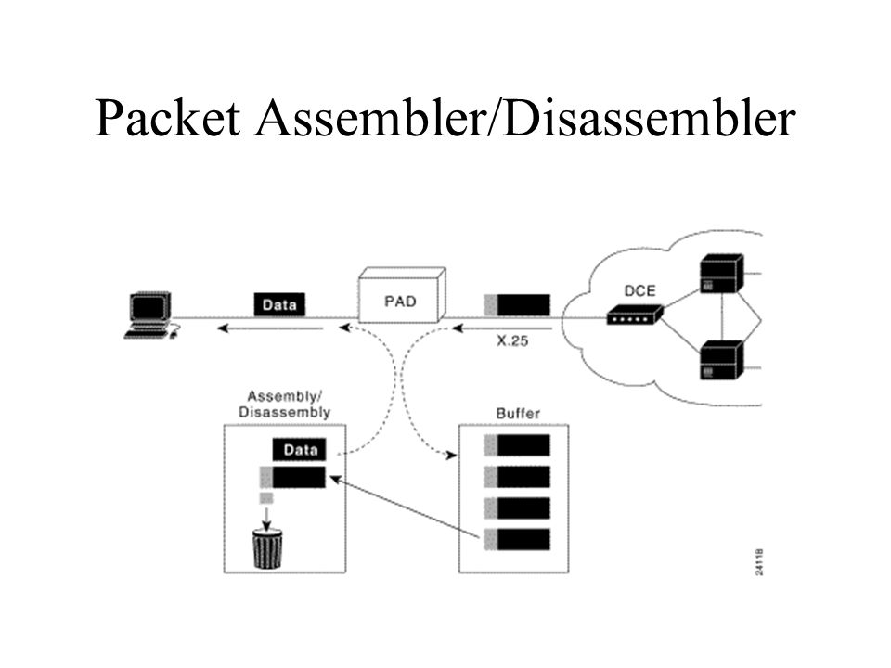
Description
In this project, we tried to verify a software application. The software verified is used by the Wireshark Foundation and is responsible for PPP packet disassembly.
The piece of software that we are studying includes two files:
Packet-ppp.c : This file has routines for packet disassembly
Proto.c : This contains routines for protocol tree, with protocol being used here as P2P protocol

Slide 3
Clang-Tidy
Clang-tidy is a clang-based C++ tool. Its purpose is to provide an extensible framework for diagnosing and fixing typical programming errors, like style violations, interface misuse, or bugs that can be deduced via static analysis. clang-tidy is modular and provides a convenient interface for writing new checks. It can be used to find many “simple bugs”. Sample errors:
Dereferencing null pointers
Left Operand of ‘if’ statement is garbage value.
Unused variables ( never read or used).
Left Operand of ‘statement’ is always true.

Slide 4
Clang-Tidy Sample Outputs

Slide 5
CBMC
Formal verification based bounded model checker
Can run as: 1. Command line tool 2. Eclipse plugin added manually
Widely used to check: 1. Array bounds (buffer overflows) 2. Pointer Safety 3. Exceptions 4. User-specified Assertions
Supports a lot of flags including flags for loop unwinding, specifying for various types of div-by-zero, bounds check and other features
Detects properties automatically, but properties can also be user-specified

Slide 6
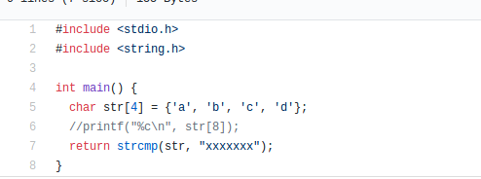
Null termination detection not possible!!
It isn’t possible to detect if character array is null-terminated or not using CBMC. Although, this kind of problem can be inferred, if array out of bounds issue occurs.
- iT IS

Slide 7
Tool Comparison
Clang Tidy | CBMC
Utility: False bugs | Utility: True bugs
Performance: Very Quick | Performance: Assertions & Loop Unwindings can result in more time being taken
Easiness: Easy to run, easy to install | Easiness: Many options available, Model checker installation is required
Other Features: Self fix | Other Features: Numerous flags

Slide 8
Issues Encountered
Code Cleanup
Large CodeSample
Compile Flags
Clang-Tidy compile database
CBMC Options and Features
Detect Null Termination
Detected bug but not know what causes it: huge codebase

Slide 9
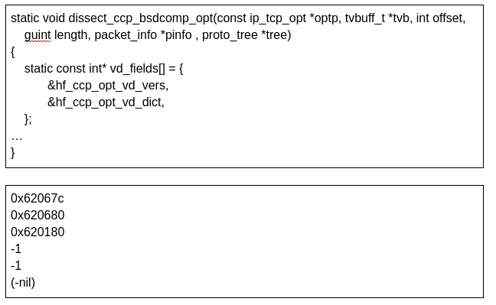
BUG

Slide 10
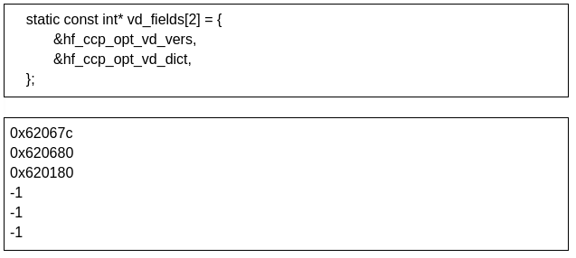
BUG

Slide 11
References
Code repository: https://samate.nist.gov/SRD/view_testcase.php?tID=231344 (lines of code : 15k+)
About the PPP dissector crash bug: https://www.wireshark.org/lists/wireshark-bugs/201305/msg00259.html
How wireshark works through dissectors: https://www.wireshark.org/docs/wsdg_html_chunked/ChapterDissection.html
More about bug #8638 : https://bugs.wireshark.org/bugzilla/show_bug.cgi?id=8638
Clang : https://clang.llvm.org/
CBMC : http://www.cprover.org/cbmc/

