Slide 1
Lecture 2: Applied Quantum Mechanics

Slide 2



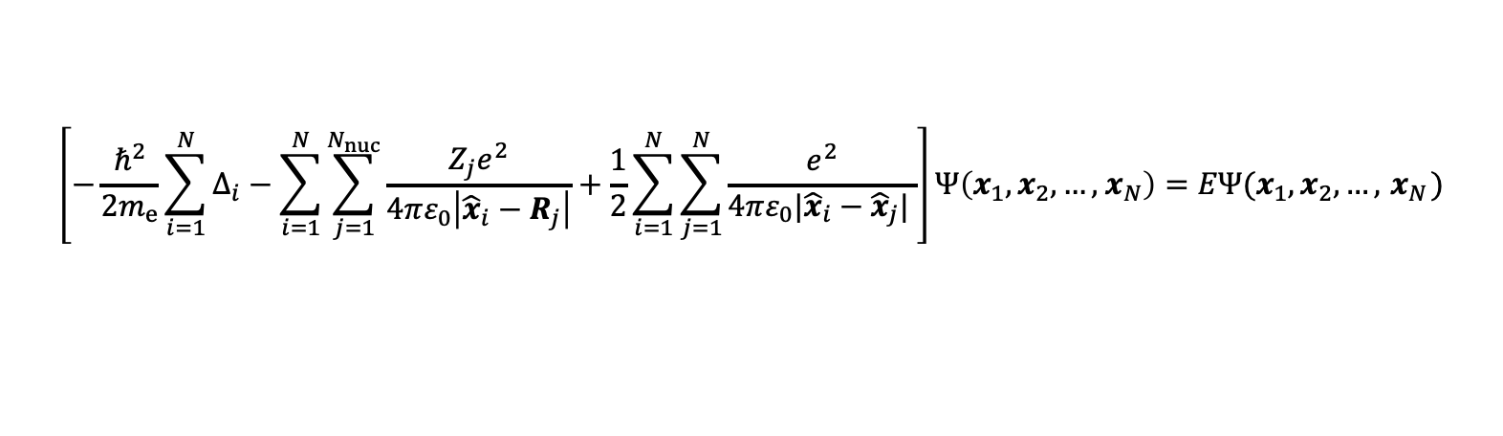

Extended Hückel method
The Schrödinger equation for a system of $N$ electrons even with classical nuclei is hopelessly intractable.
$N$-electron wave-function
$$\left[−\frac{ℏ^{2}}{2m_{e}}\sum_{i=1}^{N}{Δ_{i}}−\sum_{i=1}^{N}{\sum_{j=1}^{N_{nuc}}{\frac{Z_{j}e^{2}}{4πε_{0}\left|{\hat{x}}_{i}−R_{j}\right|}}}+\frac{1}{2}\sum_{i=1}^{N}{\sum_{j=1}^{N}{\frac{e^{2}}{4πε_{0}|{\hat{x}}_{i}−{\hat{x}}_{j}| }}}\right]Ψ\left(x_{1},x_{2},…,{ x}_{N}\right)=EΨ(x_{1},x_{2},…,{ x}_{N})$$
electron kinetic energy
electron-nuclei interaction
electron-electron interaction
energy of the electronic system
With the advent of computing, the latter 20th century saw the development of methods for approximately solving the SE. One approach is to express the $N$-electron WF as a $1$-electron WF in an effective mean-field potential:
$${\hat{H}}_{full}Ψ\left(x_{1},x_{2},…,{ x}_{N}\right)=EΨ\left(x_{1},x_{2},…,{ x}_{N}\right)$$
$N$-electron system
$${\hat{H}}_{eff}Ψ\left(x_{1}\right)=EΨ(x_{1})$$
$1$-electron system
But how should an effective Hamiltonian ${\hat{H}}_{eff}$ be chosen for this approximation to be accurate?

Slide 3
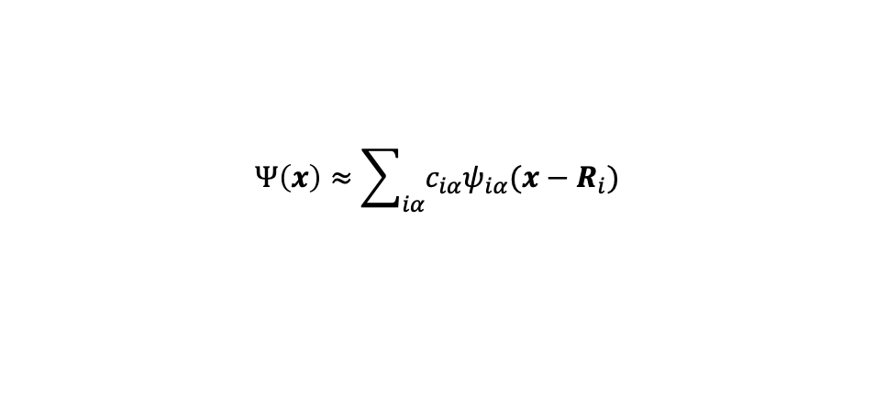




Extended Hückel method
First, we choose an appropriate known basis set to expand the unknown wave-function.
One common choice is to use a superposition of H-like orbitals, centred on every nucleus:
$$Ψ\left(x\right)≈\sum_{iα}{c_{iα}ψ_{iα}(x−R_{i})}$$
e.g. index $i$ runs over nuclei, index $α=\{nlm\}$ runs over quantum numbers of nucleus at $R_{i}$
expansion coefficients
Motivation
s & p type orbitals
The electron wave-function is typically confined by the positively-charged nuclei
Using atomic orbitals (H-like) centered on each atom results in a flexible basis set
Such a basis set, however, is not complete! It is an approximation.
This is called the Linear Combination of Atomic Orbitals (LCAO) method
s type orbitals
$$R_{2}$$
nuclei
$$R_{1}$$
$$R_{3}$$

Slide 4

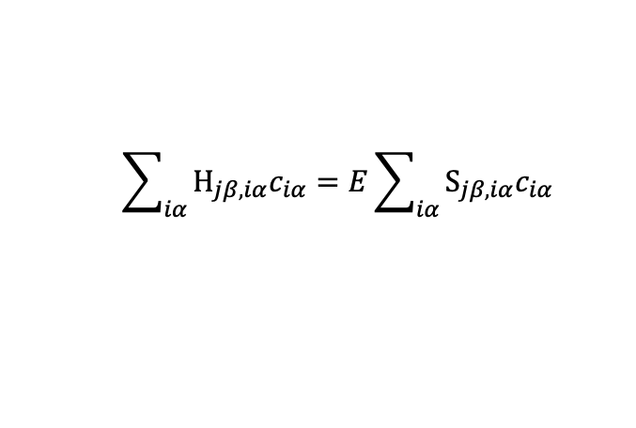

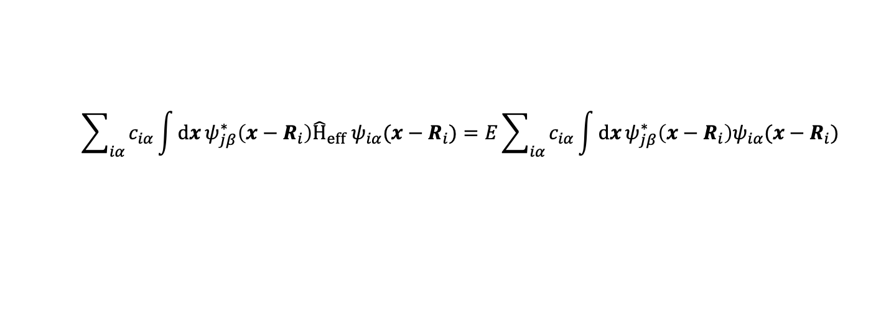

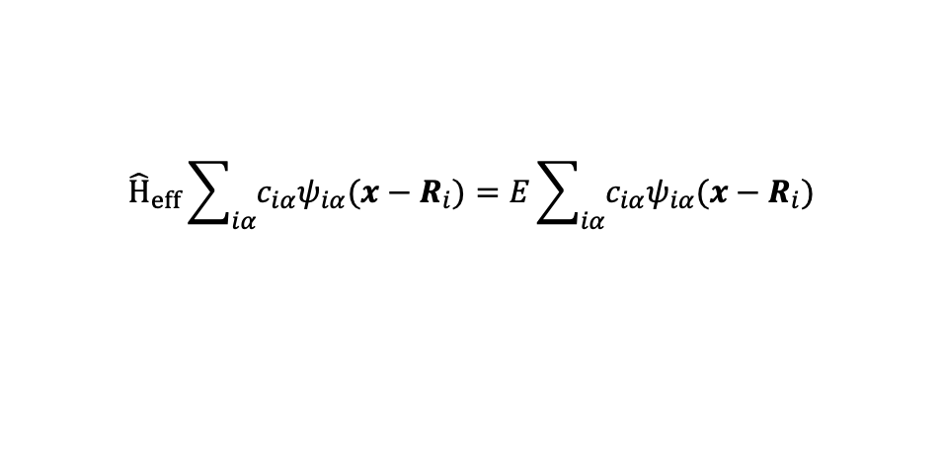

Extended Hückel method
First, we choose an appropriate known basis set to expand the unknown wave-function.
One common choice is to use a superposition of H-like orbitals, centred on every nucleus:
$$Ψ\left(x\right)≈\sum_{iα}{c_{iα}ψ_{iα}(x−R_{i})}$$
e.g. index $i$ runs over nuclei, index $α=\{nlm\}$ runs over quantum numbers of nucleus at $R_{i}$
We can then find the eigenstates by expressing the SE as an eigenproblem:
$${\hat{H}}_{eff}Ψ\left(x\right)=EΨ(x)$$
$${\hat{H}}_{eff}\sum_{iα}{c_{iα}ψ_{iα}(x−R_{i})}=E\sum_{iα}{c_{iα}ψ_{iα}(x−R_{i})}$$
apply basis set expansion
$$\sum_{iα}{c_{iα}\int{dx}ψ_{jβ}^{∗}\left(x−R_{i}\right){\hat{H}}_{eff} ψ_{iα}(x−R_{i})}=E\sum_{iα}{c_{iα}\int{dx}ψ_{jβ}^{∗}\left(x−R_{i}\right)ψ_{iα}(x−R_{i})}$$
multiply by $ψ_{jβ}^{∗}$ from left, integrate over $dx$
$$\sum_{iα}{H_{jβ,iα}c_{iα}}=E\sum_{iα}{S_{jβ,iα}c_{iα}}$$
define left integral as $H_{jβ,iα}$ (“Hamiltonian”) and right integral as $S_{jβ,iα}$ (“Overlap”)
$$H⋅c=E S⋅c$$
Expressed in matrices and vectors, it is an eigen-problem. Let the computer solve for $E_{n }\& c_{n}$!

Slide 5
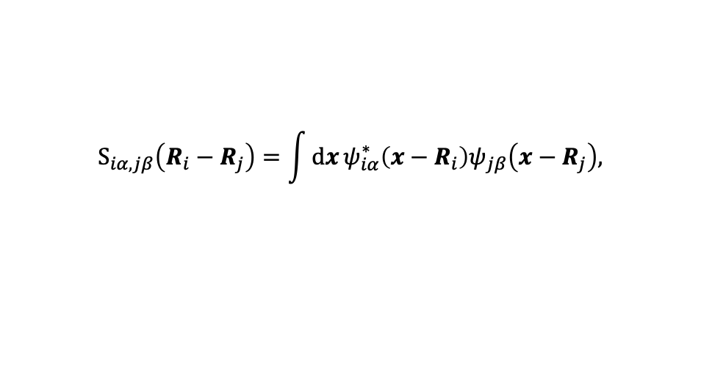
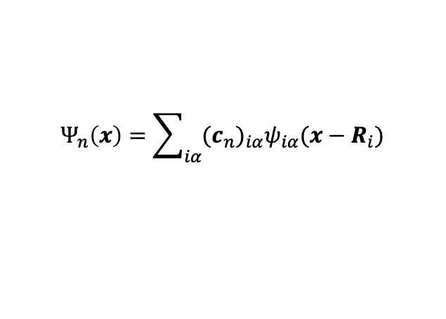
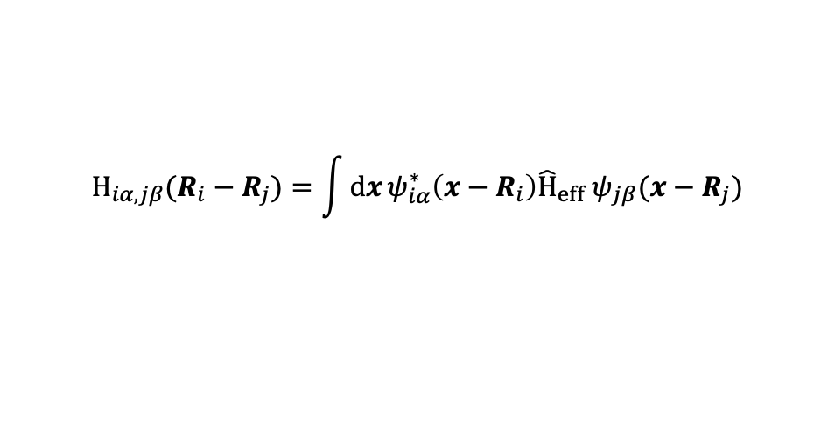
Extended Hückel method
Once the eigensystem is solved for $E_{n }\& c_{n}$, we can reconstruct the eigenstates:
$$Ψ_{n}\left(x\right)=\sum_{iα}{{{(c}_{n})}_{iα}ψ_{iα}(x−R_{i})}$$
However, while overlap matrix elements are easily evaluated for a given basis set (typically analytically)
$$S_{iα,jβ}\left(R_{i}−R_{j}\right)=\int{dx}ψ_{iα}^{∗}\left(x−R_{i}\right)ψ_{jβ}\left(x−R_{j}\right),$$
evaluating the Hamiltonian matrix elements is a problem, since we do not know what ${\hat{H}}_{eff}$ is!
$$H_{iα,jβ}(R_{i}−R_{j})=\int{dx}ψ_{iα}^{∗}\left(x−R_{i}\right){\hat{H}}_{eff} ψ_{jβ}(x−R_{j})$$
In the (extended) Hückel method, we construct $H_{iα,jβ}$ using empirically-motivated rules.

Slide 6
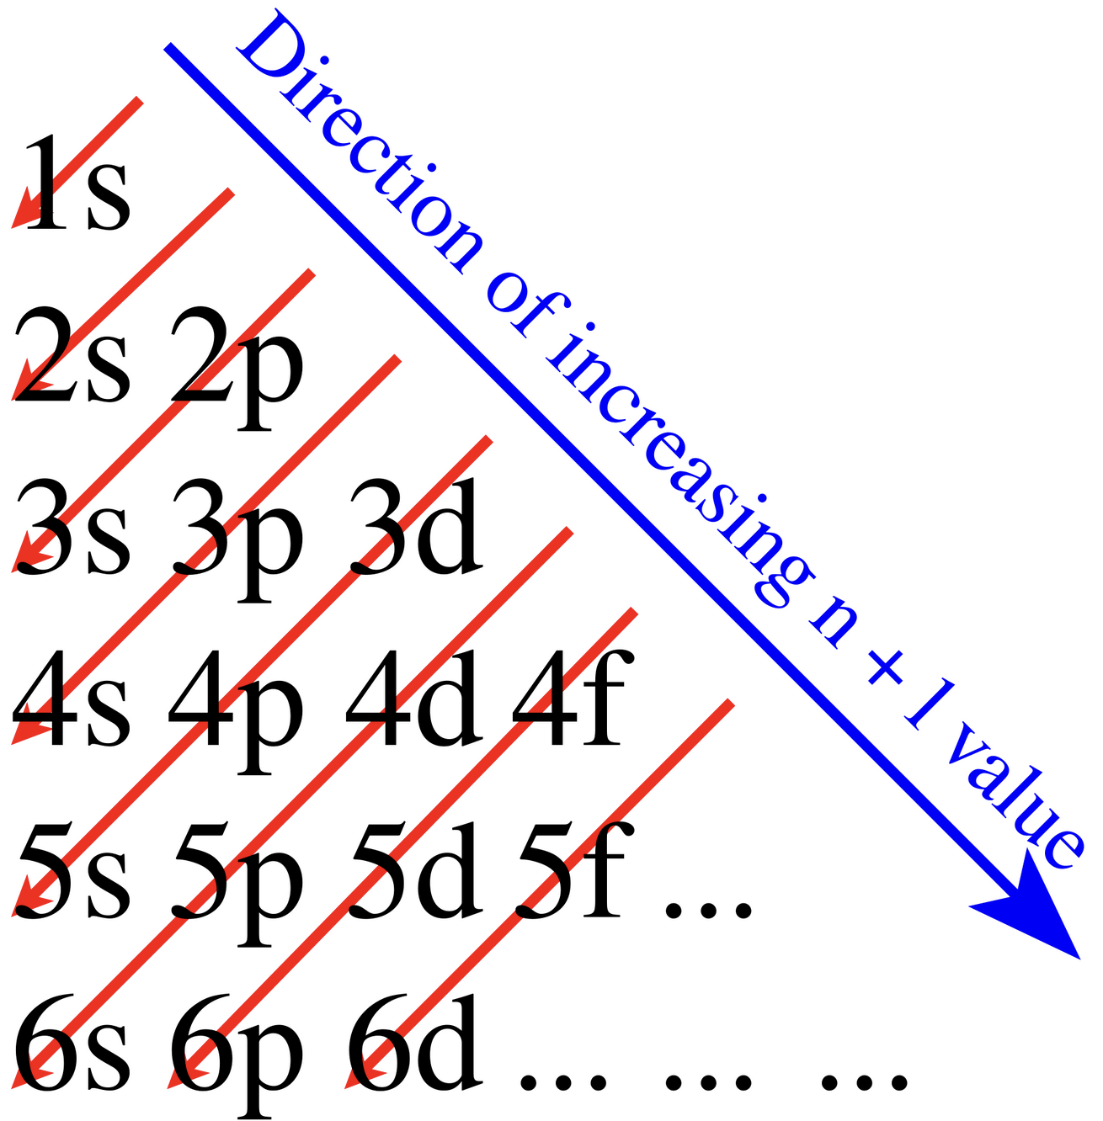

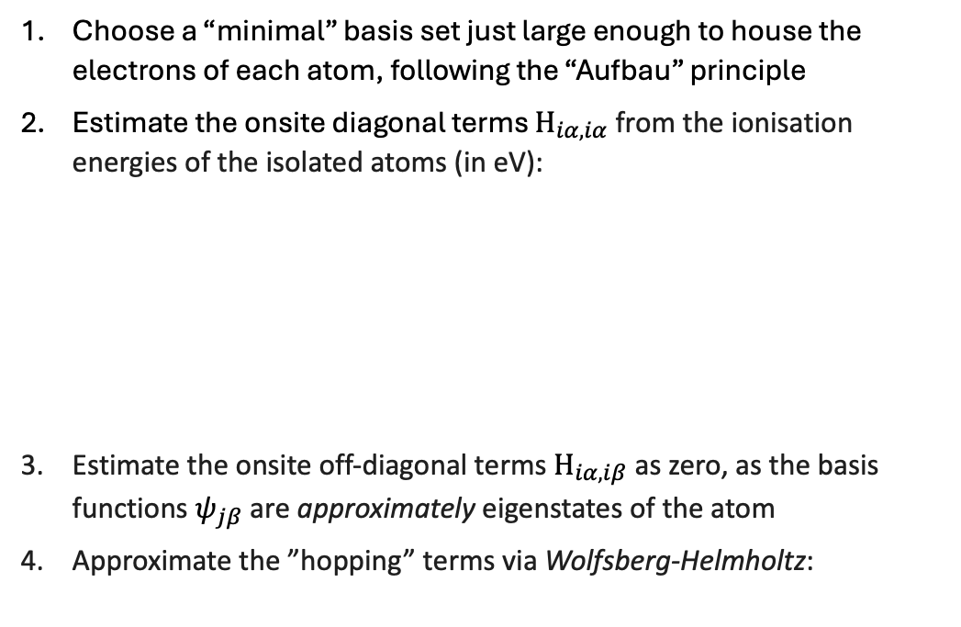



Extended Hückel method
H (1e⁻): 1s¹
(nlm) orbitals:
(100): 1s¹
In the extended Hückel method, we construct ${\hat{H}}_{iα,jβ}$ using empirically-motivated rules:
C (6e⁻): 1s²2s²2p²
(nlm) orbitals:
(100): 1s²
(200): 2s²
(210): 2p^{2/3}
(211): 2p^{2/3}
(212): 2p^{2/3}
Choose a “minimal” basis set just large enough to house the electrons of each atom, following the “Aufbau” principle
Estimate the onsite diagonal terms $H_{iα,iα}$ from the ionisation energies of the isolated atoms (in eV):
Estimate the onsite off-diagonal terms $H_{iα,iβ}$ as zero, as the basis functions $ψ_{jβ}$ are approximately eigenstates of the atom
Approximate the ”hopping” terms via Wolfsberg-Helmholtz:
#e⁻: | 1st | 2nd | 3rd | 4th | 5th | 6th
H: | 13.60
C: | 11.26 | 24.38 | 47.89 | 64.49 | 392.10 | 489.99
1s
$$H_{iα,iβ}^{(H)}= eV$$
13.60
avg. across shells:
for 2p²: 17.8
for 2s²: 56.2
for 1s²: 441.0
1s
2s
2p
1x1 matrix
441 | 0 | 0 | 0 | 0
0 | 56.2 | 0 | 0 | 0
0 | 0 | 17.8 | 0 | 0
0 | 0 | 0 | 17.8 | 0
0 | 0 | 0 | 0 | 17.8
$$H_{iα,iβ}^{(C)}=$$
$$eV$$
$$H_{iα,jβ}=\frac{1}{2}κ S_{iα,jβ}(H_{iα,iα}+H_{jβ,jβ})$$
5x5 matrix
R. Hoffmann (1963), J. Chem. Phys. 39, 1397
J. P. Lowe and K. Peterson (2011). Quantum chemistry. Elsevier

Slide 7





Extended Hückel method in Python
https://github.com/mb4512/extended_hueckel
Example: Methane CH₄
H
global atomic info:
global model info:
{“H”: {N: 1, “n: 1”, “l”: 0, “V”: [-13.60]}
{“C”: {N: 4, “n: 2”, “l”: 1, “V”: [-19.44, -10.67]}
"Bohr_radii": [0.52917721, 4*0.52917721]
"Wolfsberg–Helmholtz" : 1.75
I use the onsite parameters from Lowe & Peterson,. chosen to better describe sp-hybridisation
C
H
H
H
class Atom (“C”, $R_{1}$)
fetch atomic properties from global info, stors as class property
class Molecule ([“C”,”H”,”H”,”H”,”H”], [$R_{1}$, $R_{2}$, $R_{3}$, $R_{4}\text{,} R_{5}]$)
initialise an Atom() instance for each atom, stores them as class property
GTO: Gaussian-type orbitals
Very approximately:
class GTO (exponents)
$$φ_{i,100}\left(r\right)\sim e^{−a{\left|r−R_{i}\right|}^{2}}$$
orbital(r, atom, l): evaluate orbital value at position r for given atom
overlap(atom1, atom2, l1, l2): evaluate overlap matrix between two atoms
$$φ_{i,200}\left(r\right)\sim \left|r−R_{i}\right|φ_{i,100}(r)$$
In the code, I describe 2s orbitals with a 1s basis function because I did not implement 2s integrals.
class Electronic_Structure (Molecule, Basis, *modelpars)
$$φ_{i,210}\left(r\right)\sim (x−X_{i})φ_{i,100}(r)$$
update_matrices(): construct Overlap and Hamiltonian matrices using functions from Basis class, with information taken from Molecule class
solve_eigensystem(): solve the eigensystem and reports on the result
$$φ_{i,211}\left(r\right)\sim (y−Y_{i})φ_{i,100}(r)$$
$$φ_{i,212}\left(r\right)\sim (z−Z_{i})φ_{i,100}(r)$$

Slide 8
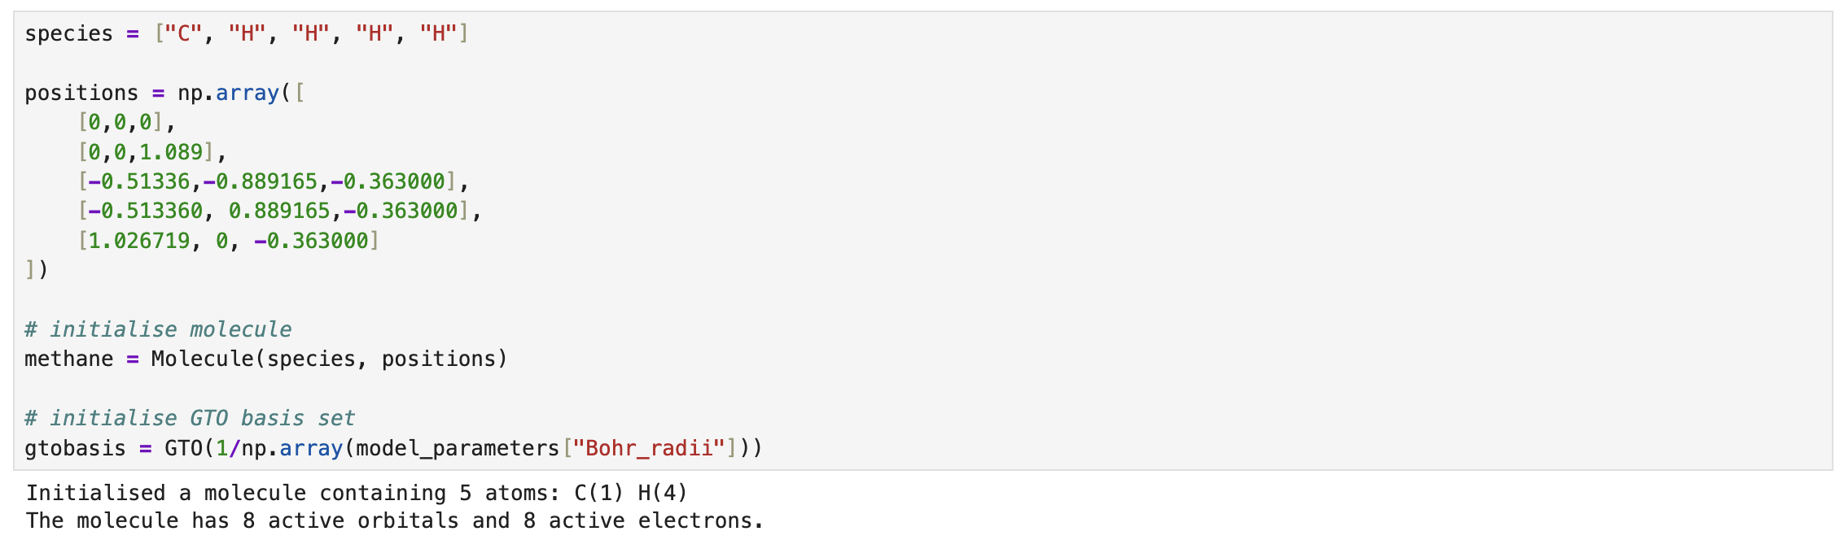
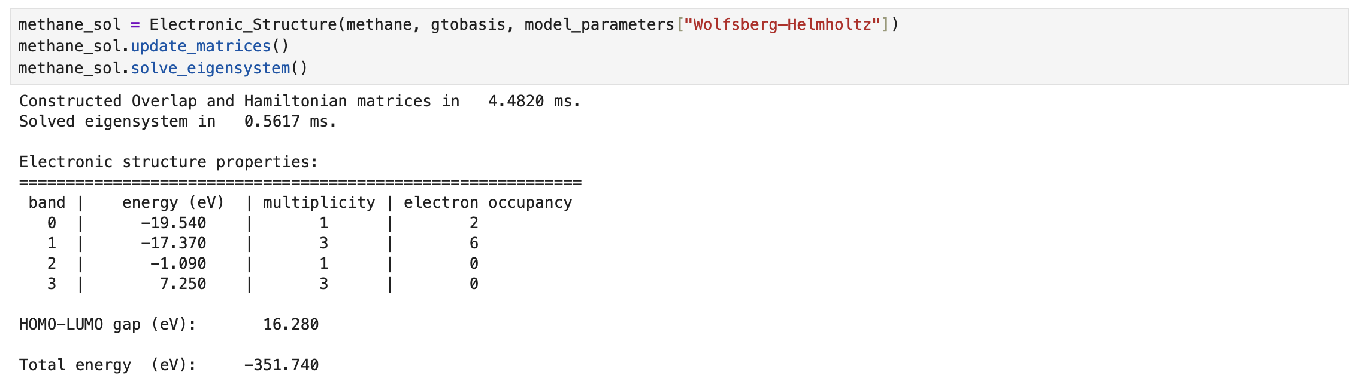
Extended Hückel method in Python
https://github.com/mb4512/extended_hueckel
Example: Methane CH₄
H
C
H
H
H
Live demo

Slide 9
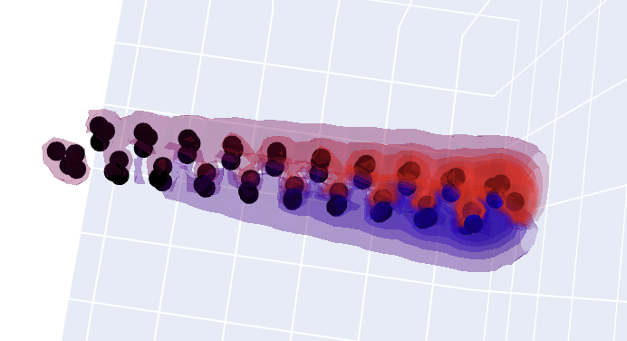
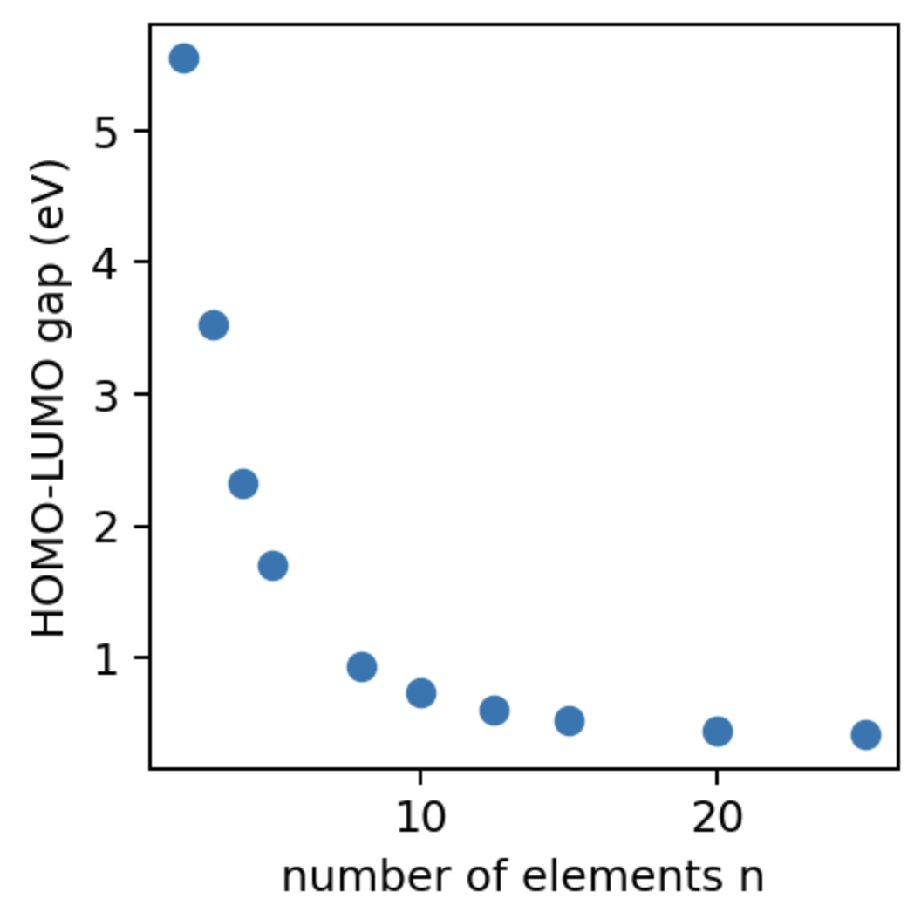
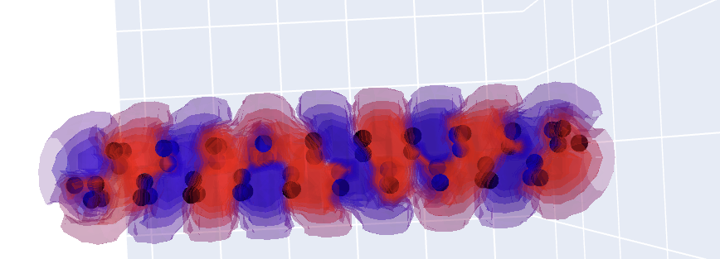
Extended Hückel method in Python
https://github.com/mb4512/extended_hueckel
Example: Polyethylene CH₄
H
H
A polyethylene chain of varying length.
Remember the particle in a well?
1st unoccupied molecular orbital
C
C
H
H
n
2nd unoccupied molecular orbital
less confinement

