Slide 1
COPD Multi-Model Analysis System using Agentic AI
Muhammad Babar
Student ID: 111866322
CSCI-5240: Final Project Presentation
Instructor: Prof. Farnoush Banaei-Kashani
Teaching Assistant: Vicente Ramos
Department of Computer Science and Engineering
College of Engineering, Design and Computing
University of Colorado Denver

Slide 2
Problem Statement
Healthcare professionals need fast and accurate patient risk analysis
Existing systems often:
Use only one model
Lack transparency
Are difficult to use
Need for a system that:
Compares multiple models
Explains results
Provides easy interaction

Slide 3
Motivation
COPD is a serious lung disease
Early risk prediction can improve patient care
AI can help automate analysis
Multi-model systems improve reliability

Slide 4
Performance Metrics
System evaluated using:
Confidence score
Best model selection
Response generation
User-friendly visualization
Successful report generation

Slide 5
Proposed Agentic AI System
Uses agent-based architecture
Functionalities
Data Analysis
Model comparison
Single analysis
Reporting
Email integration
Chat History
System monitoring & evaluation

Slide 6
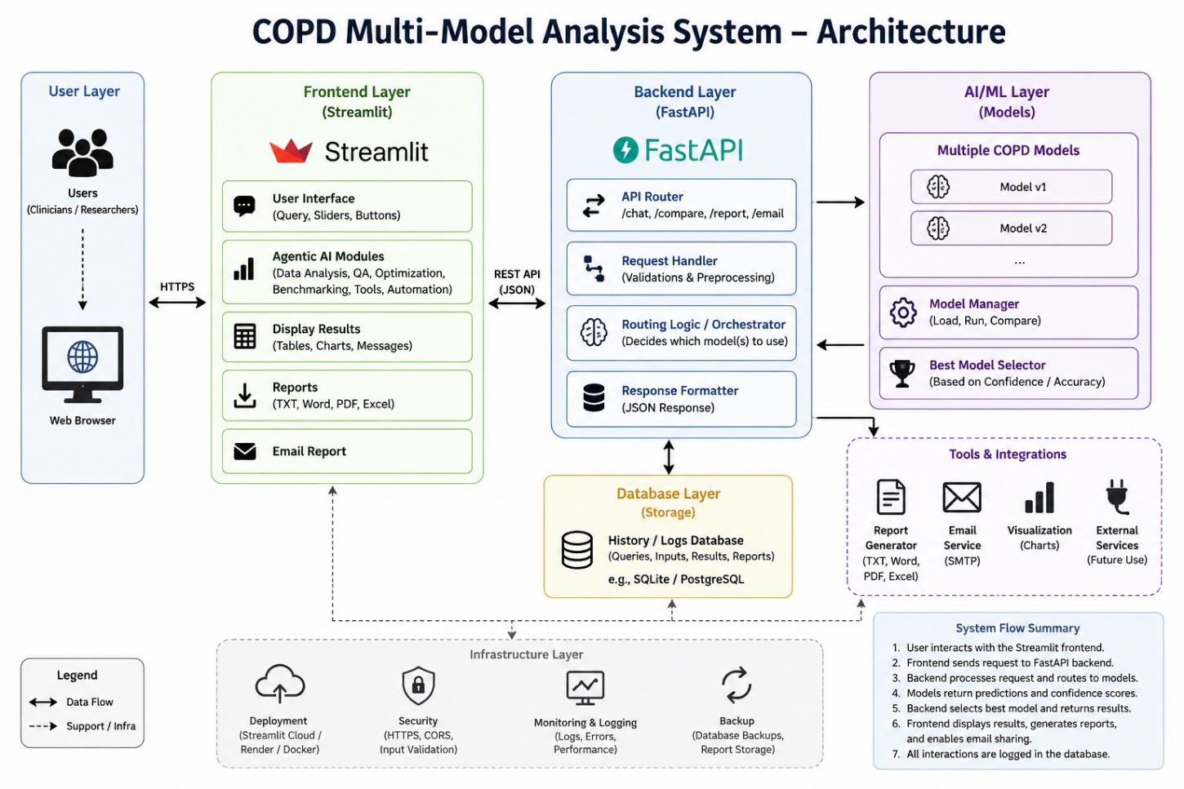
System Architecture

Slide 7
Model Design
Model 1:
Age-focused
Formula:
score = 0.6 * age + 0.4 * smoking
Model 2:
Smoking-focused
Formula:
score = 0.4 * age + 0.6 * smoking

Slide 8
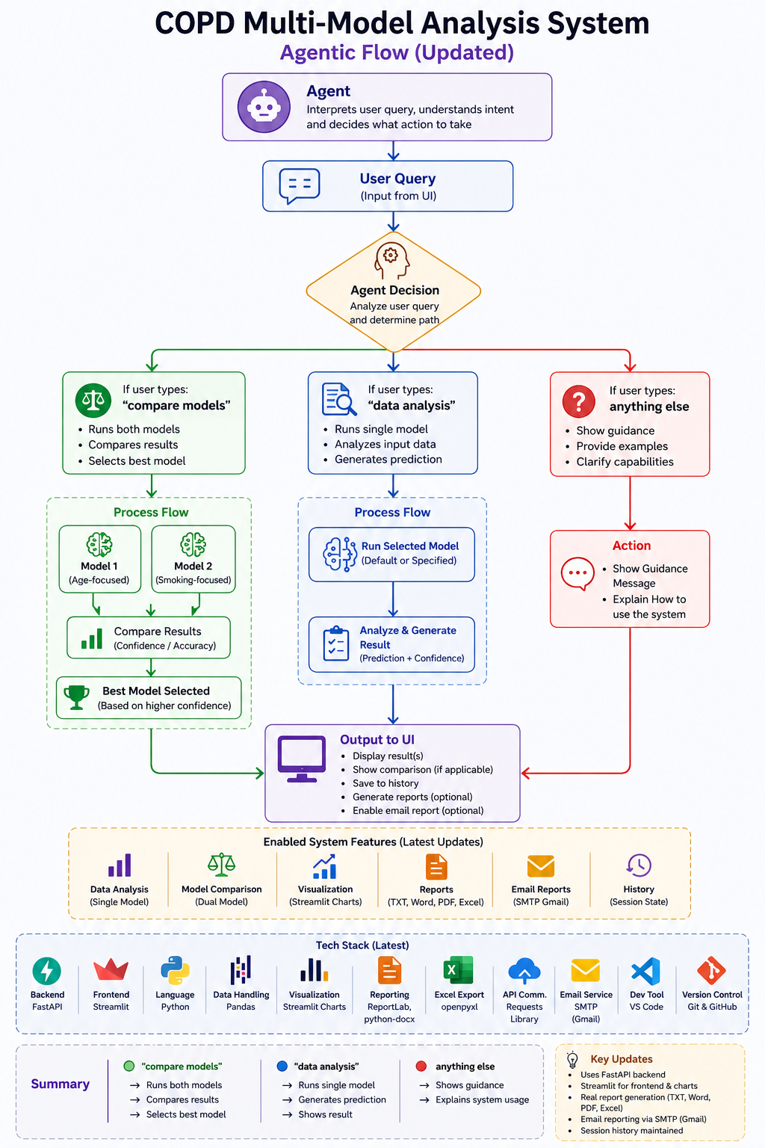
Agent Logic

Slide 9
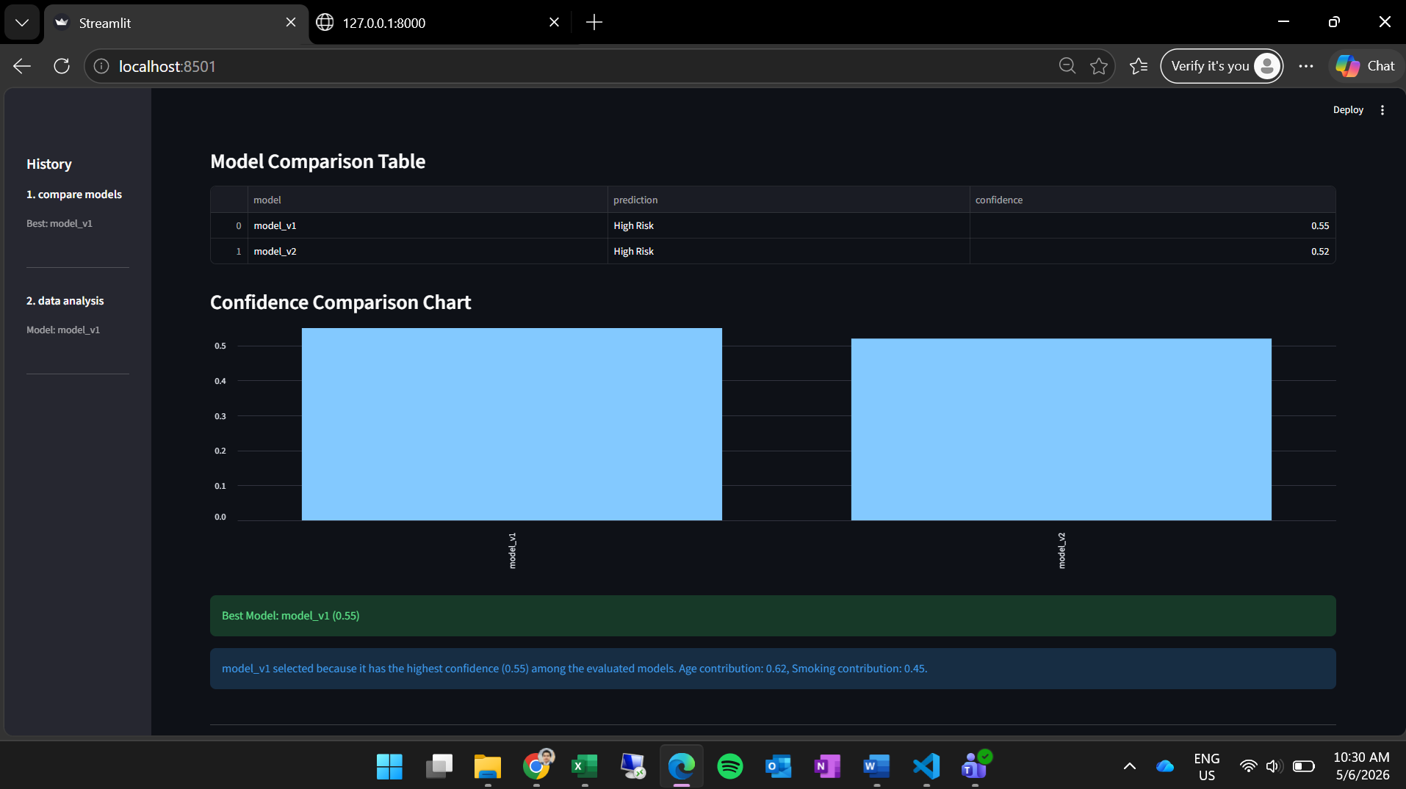
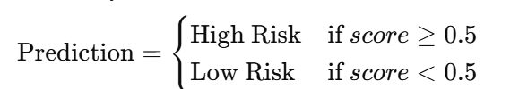
Prediction Logic
Score range: 0–1
High Risk if score ≥ 0.5
Low Risk otherwise
Best model selected using confidence score

Slide 10
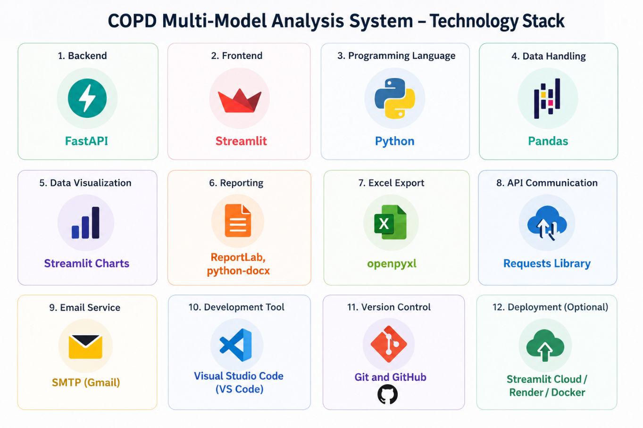
Technology Stack

Slide 11
Development Tools
Visual Studio Code
GitHub
Python Libraries
Streamlit Charts
Why used:
Easy development
Fast prototyping
Interactive UI

Slide 12
Rationale for Tool Selection
FastAPI → fast backend APIs
Streamlit → quick interactive UI
Python → AI/data processing support
Pandas → data management
ReportLab → PDF generation

Slide 13
Results & Demonstration

Slide 14
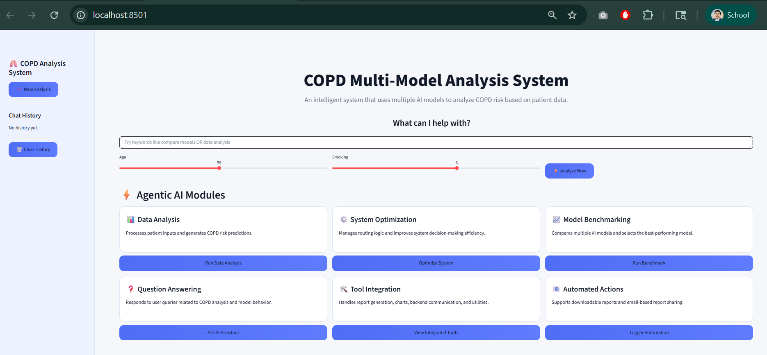
User Interface

Slide 15
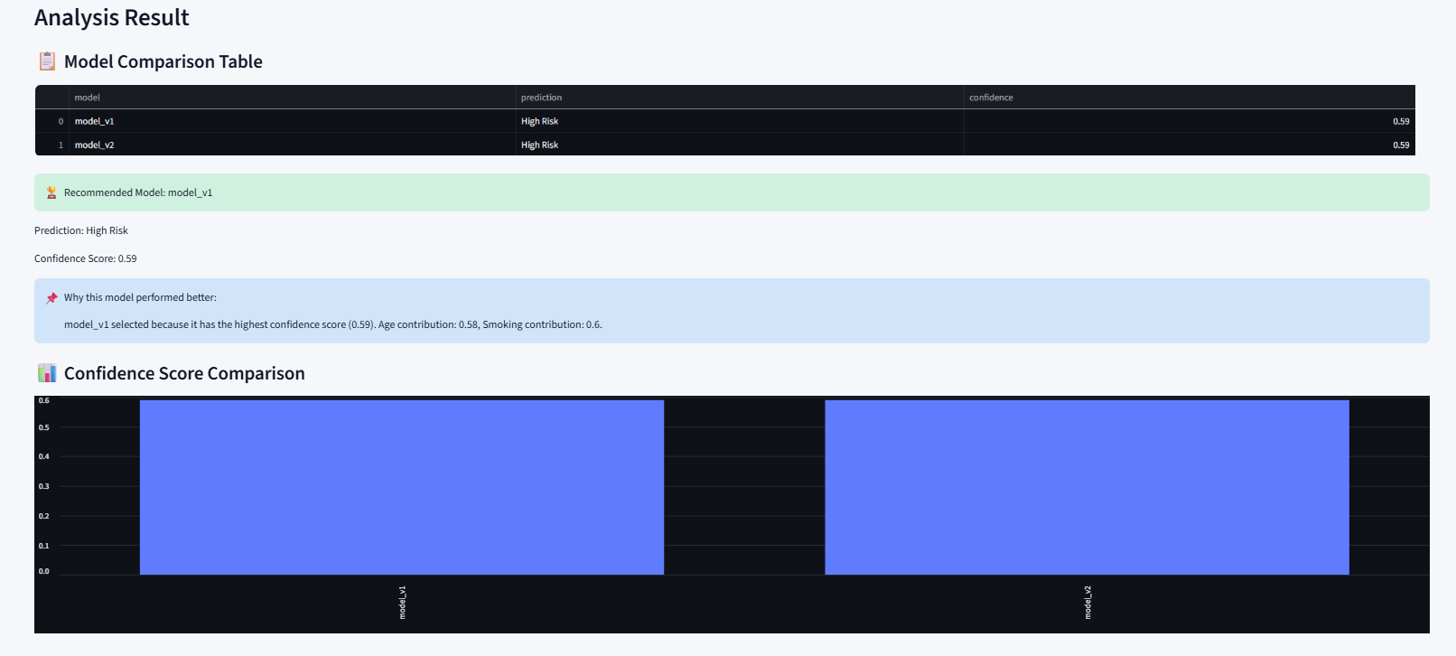
Model Comparison Result (Visualization)

Slide 16
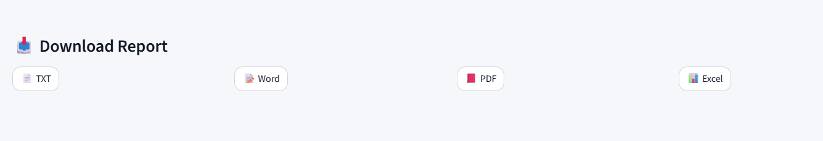
Report Generation
Supports:
TXT
Word
PDF
Excel

Slide 17
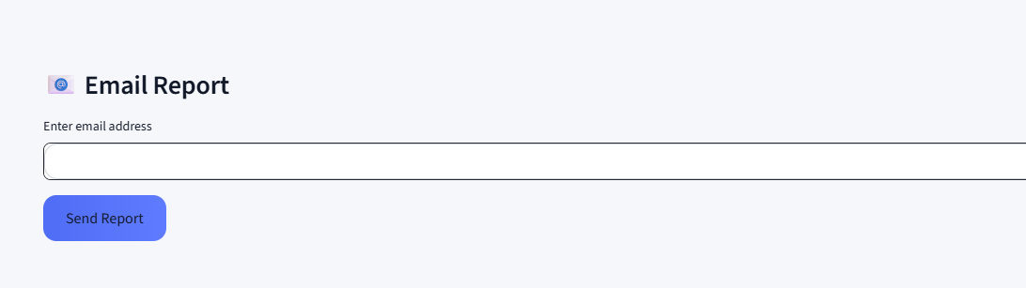
Email Integration
User enters email
System sends report directly
Uses SMTP + Gmail App Password

Slide 18
Challenges & Solutions
Challenges
UI customization in Streamlit
Layout handling
Email authentication
Model routing logic
Solutions
CSS customization
Error handling
Gmail App Password setup

Slide 19
Lessons Learned
Importance of modular architecture
Multi-model comparison improves analysis
UI design affects usability
Error handling is critical

Slide 20
Future Work
Real ML models
Voice input
File upload
Cloud deployment

Slide 21
Conclusion
Successfully developed an Agentic AI prototype
Combined AI logic + UI + reporting
Can be extended into real healthcare systems

Slide 22
Thank You Questions?

