Slide 1

SIGSEC
February 28, 2017

Slide 2
News and Events
Please have some means of running Kali Linux if you want to participate in next week’s lab.
Topic: Basic Network Security and IDS
Please grab the appropriate virtual image from the USB; there’s one specifically built for VirtualBox and another for Vmware.
If you are interested in creating a live USB I can assist you with that as well.

Slide 3
Microsoft’s Patch Tuesday
Microsoft cancels its monthly patch for February
First time Microsoft has ever cancelled (not delayed) an entire month.
https://blogs.technet.microsoft.com/msrc/2017/02/14/february-2017-security-update-release/
Lots of speculation
Microsoft has been missing a lot of 90-day disclosure windows...
Two well known vulnerabilities out in the wild right now:
Microsoft Edge and IE
http://searchsecurity.techtarget.com/news/450414012/Edge-and-IE-vulnerability-disclosed-by-Project-Zero
Remote-code execution vulnerability
SMB Kernel Crash
Could possibly lead to code execution with kernel privileges.
https://github.com/lgandx/PoC/blob/master/SMBv3%20Tree%20Connect/Win10.py
The Lock Screen of Win10 & 8.1 Leaks Clipboard Contents
Demo

Slide 4
SHAttered
First non-trivial collision using the SHA-1 hash.
http://shattered.io/
SHA-1 has been thought to be vulnerable for a while now
CA’s are no longer allowed to issue SHA-1 certificates
“This attack required over 9,223,372,036,854,775,808 SHA1 computations. This took the equivalent processing power as 6,500 years of single-CPU computations and 110 years of single-GPU computations.”

Slide 5
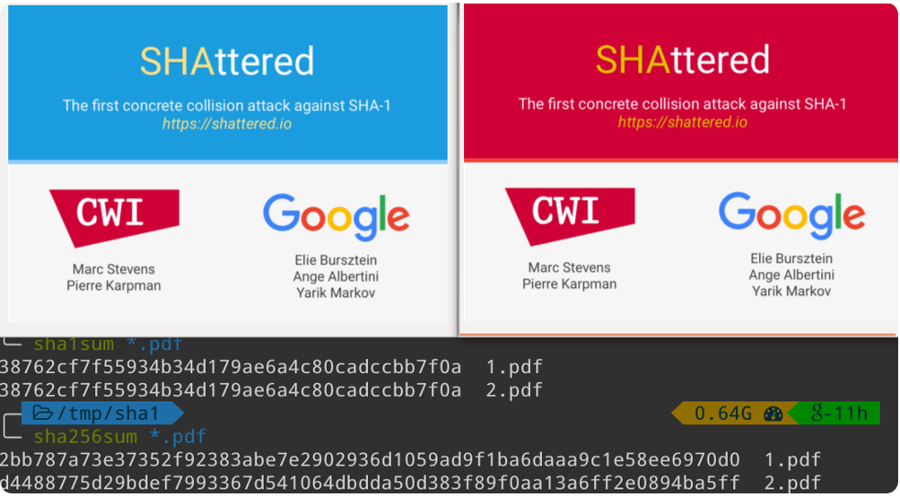
Example

Slide 6
Cloudbleed
Sensitive data leak from multiple domains that rely on CloudFlare’s services.
“The problem occurred when the company decided to develop a new HTML parser for its edge servers. The parser was written using Ragel, and turned into machine-generated C code. This code suffered from a buffer overflow vulnerability triggered by unbalanced HTML tags on pages.”
https://www.theregister.co.uk/2017/02/24/cloudbleed_buffer_overflow_bug_spaffs_personal_data/
Multiple domains affected:
uber.com, discordapp.com, reddit.com
and many more!

Slide 7
/* generated code. p = pointer, pe = end of buffer */ if ( ++p == pe ) goto _test_eof;
The Problem Code

