Slide 1

SIGSEC
April 18, 2017

Slide 2
News and Events
OWASP released their 2017 Top 10 release candidate!
Mostly same-old, with the addition of two new categories:
Insufficient Attack Protection
Underprotected APIs
Link
USCC Cyber Quests deadline approaching:
April 22: Registration Closes
April 23: Quiz Closes
https://uscc.cyberquests.org/

Slide 3
Bricker “Botnet”
“BrickerBot is malware that targets Linux-based IoT devices running the BusyBox toolkit that have their Telnet ports open and publicly exposed. It conducts brute force attacks against the devices by using a list of known default credentials. This is similar to the attack vector conducted by the Mirai botnet. Once BrickerBot gains access to a vulnerable device, it conducts a Permanent Denial-of-Service (PDoS) attack by deploying a set of Linux commands designed to corrupt storage, disrupt internet connectivity, and delete all of the device's files. It writes random bits to the storage drives, rendering the device's flash storage unusable, disables TCP timestamps which hampers internet connectivity, stops all kernel operations, and then reboots the device. Within seconds of becoming infected, the targeted device will stop working, leaving the victim with only two options: reinstall the firmware or replace the device.”
https://www.cyber.nj.gov/threat-profiles/botnet-variants/brickerbot

Slide 4

Privacy

Slide 5
Virtual Private Networks (VPNs)
Creates an encrypted tunnel between your machine and the VPN server.
All traffic is first sent encrypted to the VPN server (in theory) before making its way to the final destination.
This masks the source address (your address) to that of the VPN server, making it appear that the traffic originated from the server.

Slide 6
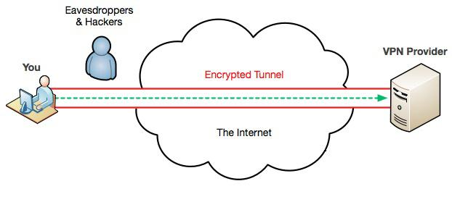
Virtual Private Networks (VPNs)

Slide 7
Virtual Private Networks (VPNs)
In practice, there are a couple of ways for information to leak...
DNS Leaks
Your DNS requests are still being made through your default DNS servers, leaking information about the websites/services you are visiting.
Could be caused by a client misconfiguration.
Web Real Time Communication (WebRTC)
Used for browser-to-browser communication (video chat, file sharing, etc.)
Disable it in your browser settings!

Slide 8
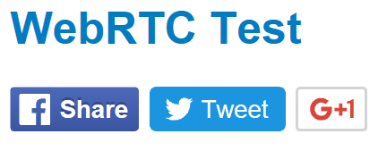
Cookies
Used to keep track of sessions, since HTTP is inherently a stateless protocol.
Can also be used to track users.
Lots of websites install third-party cookies in your browser.
Ex. The Facebook, Twitter and Google+ share buttons.
Can disable the use of third party cookies in your browser as well.

Slide 9
VPN Takeaway?
VPNs are a useful tool, but are by no means an “ultimate” solution.
E.g. Can be effective at hiding your information from your ISP, but its still possible for Facebook, Google etc. to track you.
Do you trust your VPN to not keep logs of its users?
Can they be compelled by their hosting government to reveal information?
“Five Eyes” Nations
What is your goal?

Slide 10
Browser Extensions
Various browser extensions are available to help keep your activities private
Disconnect
Privacy Badger and Ghostery
uBlock Origin/Matrix
Self-Destructing Cookies
NoScript

Slide 11

TOR
The Onion Router!
Masks the source and destination from eavesdroppers via multiple layers of encryption.

Slide 12
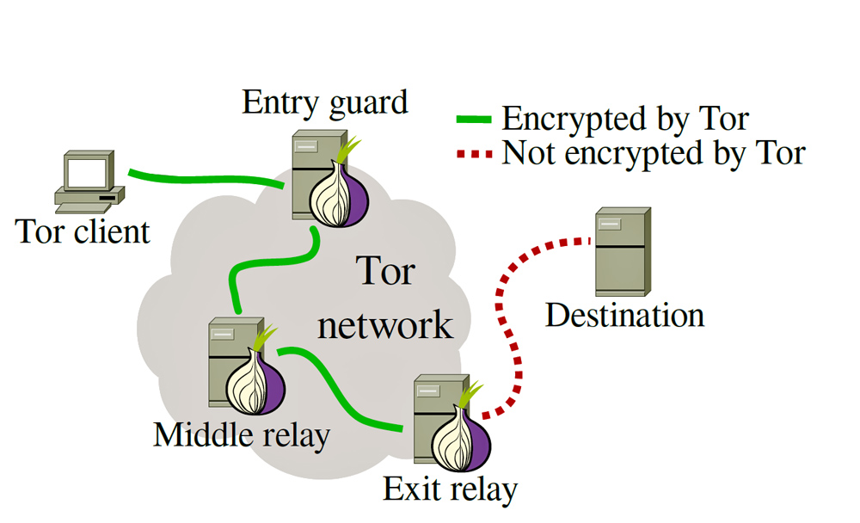
TOR

Slide 13
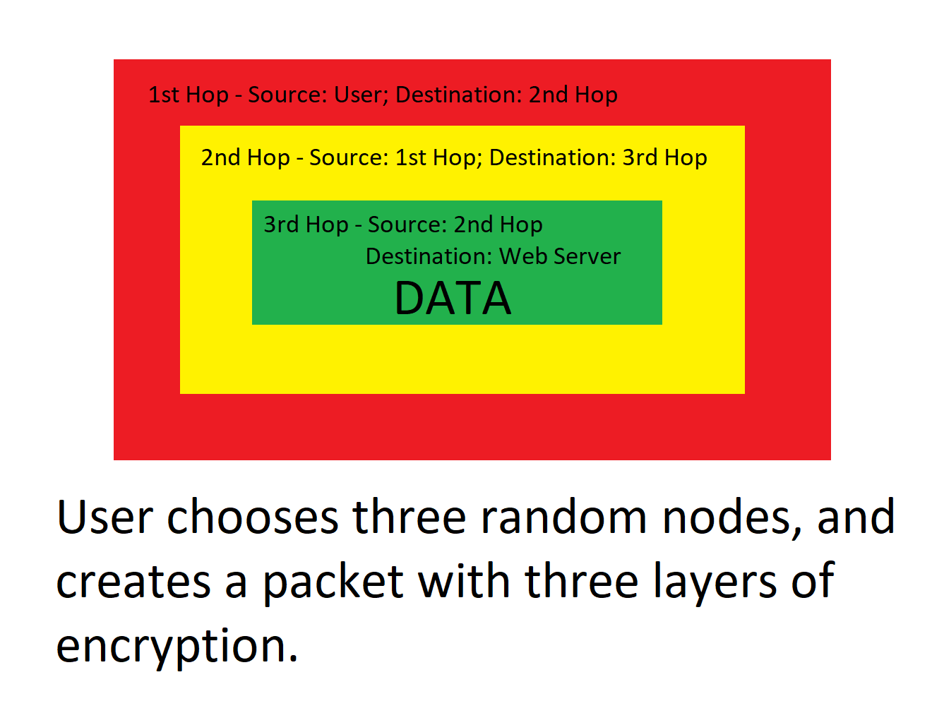
TOR

Slide 14
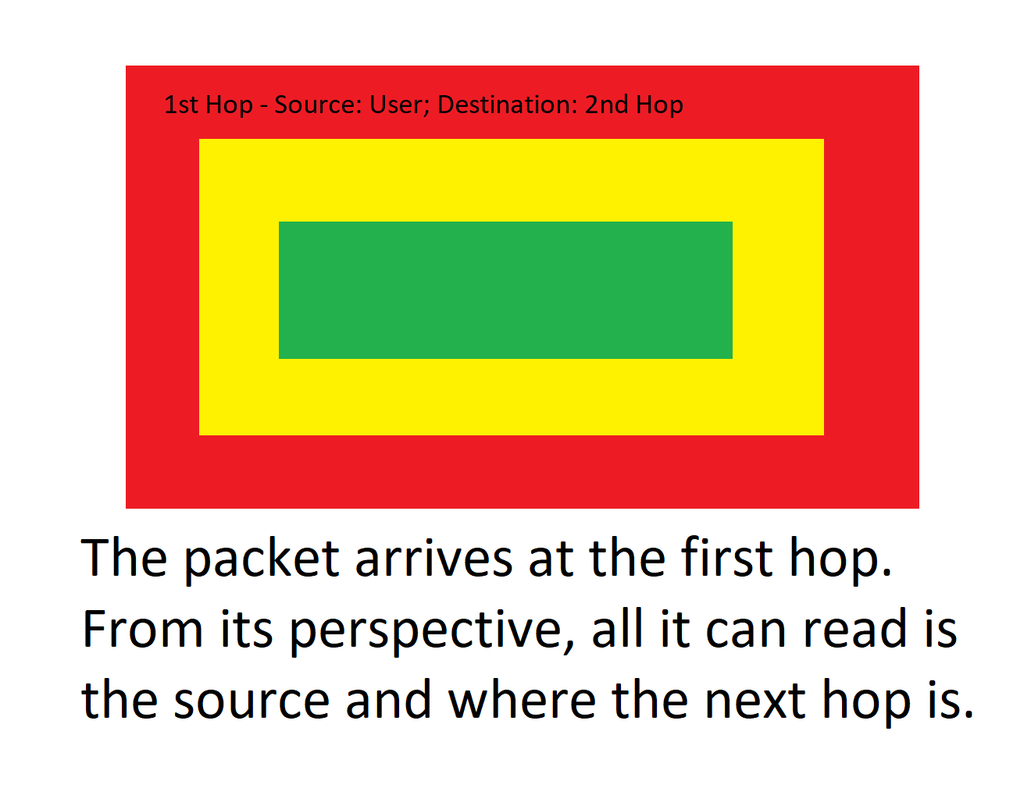
TOR

Slide 15
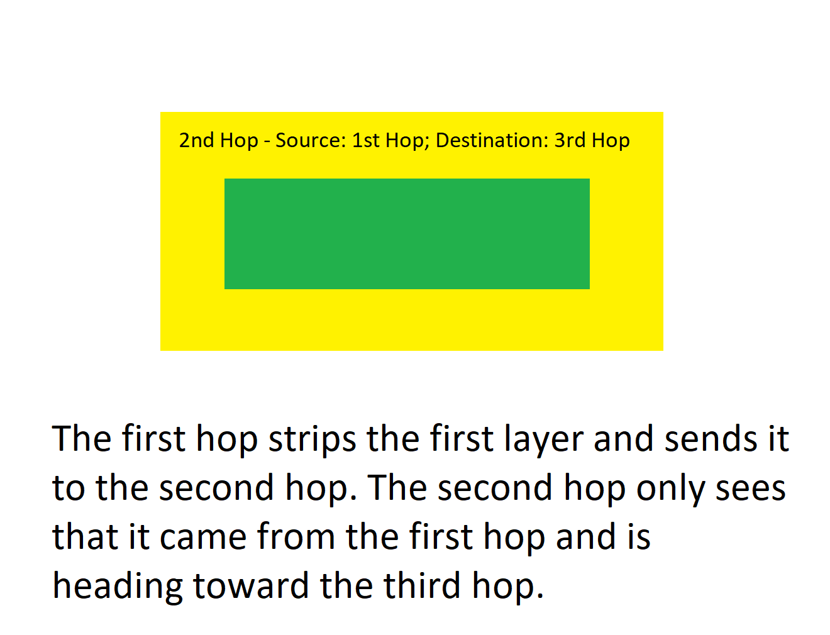
TOR

Slide 16
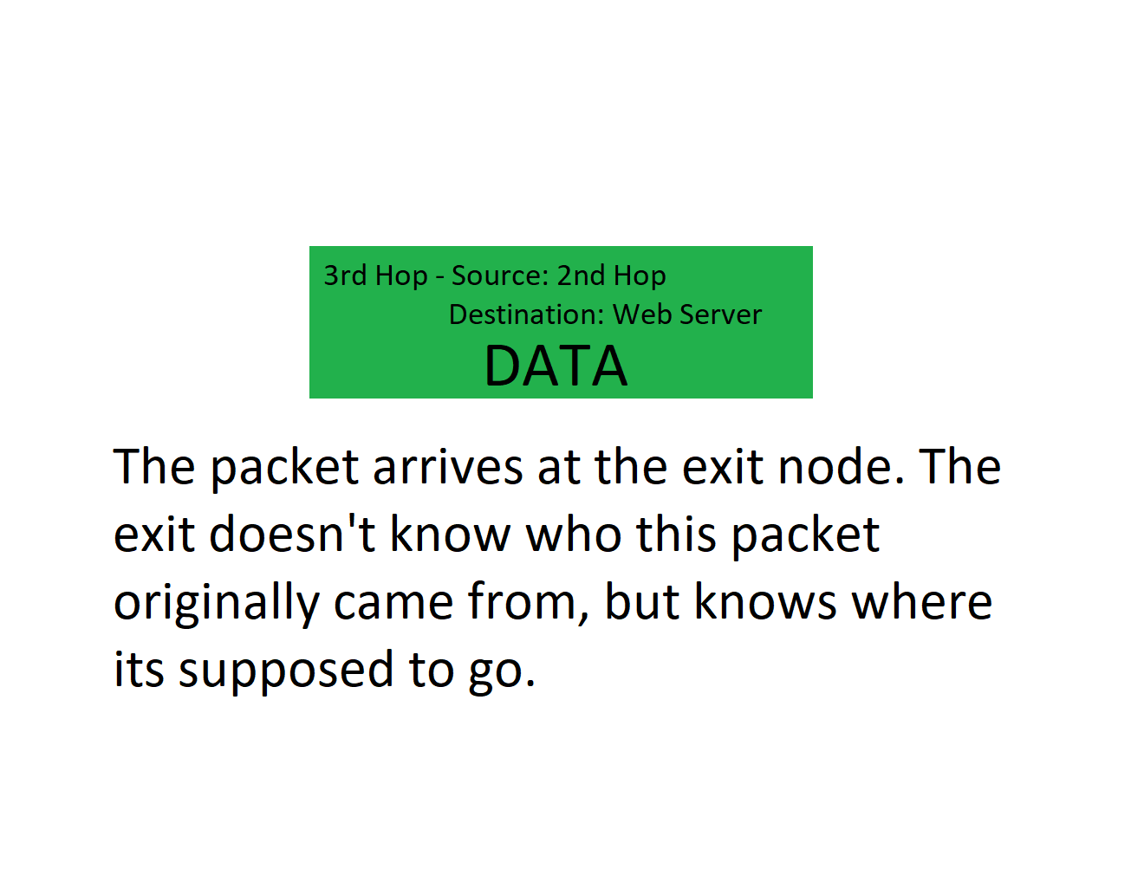
TOR

Slide 17
TOR
Issues?

Slide 18
TOR
Malicious Exit Nodes
Exit nodes see the data being sent.
Although they may not know the source address, it doesn’t matter if user credentials are provided in plain-text (http vs. https)!
Malicious Entry Nodes
If an adversary controls an entry node and has an idea of where that traffic is heading, its trivial to “mark” the IP packet headers and verify it at the destination.
Traffic Correlation Attacks
Require an adversary to have significant wide reaching control over a network (i.e. ISPs, governments).
No real “scalable” solution...

Slide 19
TOR (misc.)
VPN over TOR?
What if a malicious exit node routes that traffic to a false VPN service?
Not exactly easy, (good) VPNs will authenticate themselves to users.
TOR over VPN?
Do you trust your VPN?
What if your VPN creates a “false” TOR network that only returns you a list of nodes they control?
Easier to perform than the attack listed above.

Slide 20
Questions?

