Slide 1

SIGSEC
Memory Safety
October 18, 2016

Slide 2
News and Events
Special thanks to Tim Choh for taking over last week!
I know a lot of you are interested in having “Linux for Beginners” sessions, but I don’t want to spend SIG Security time doing so.
October 20, 25 and 27th LUG will be hosting meetings geared towards beginners!
Times? I’m alright with almost any time during those days

Slide 3
Memory Safety
Tons of vulnerabilities out there!
We’ve discussed a few of them (ShellShock, Heartbleed), but there are tons of them disclosed every week!
Exploit purchasing company, Zerodium, is offering $1.5 million for an iOS exploit that works on fully patched devices.
Last year, paid out $1 million three times.

Slide 4
Memory Safety
Today we’ll be talking about memory safety!
Buffer Overflows
Integer Overflows
Format String Vulnerabilities
Corrupting locations in memory that the operating system depends on for maintaining program control flow.
Despite being very well-known and researched, still very common in the wild.
Today we’ll be specifically discussing x86-64 on the Linux operating system.

Slide 5
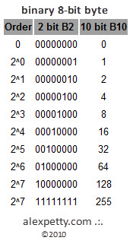
Bits, Bytes and Hex!
The smallest unit of memory is a single bit: a 0 or 1.
Bits are organized onto groups of 8, called bytes.
Bytes have values ranging from 0-255
We use hex digits to help simplify what would otherwise be extremely unwieldy:
Unlike our decimal counting system, which is in base 10, hex is in base 16.
Values: 0, 1, 2, 3, 4, 5, 6, 7, 8, 9, A, B, C, D, E, F
Each byte can be represented as 2 hex digits:
Example: 100 in decimal -> 0110 0100 in binary
0110 -> 6
0100 -> 4
64 in hex!

Slide 6
Assembly
If you are familiar with C programming, you can think of assembly as one level lower.
Final step before your code is compiled into machine code (0’s and 1’s) that your machine can execute.
We will talk about the basic structure of x86-64 on Linux (different from x86-64 on Windows)

Slide 7
Assembly
Address space is 64-bits (although much of this space isn’t utilized, even today)
Addresses are 64-bits
x86-64 is byte-addressable, meaning each address points to a single byte
x86-64 can address 2⁶⁴ bytes of memory = 8 exabytes = 8000 petabytes

Slide 8
Assembly
Registers are used to hold intermediate values and keep track of important values:
16 general purpose 64-bit registers
RAX, RBX, RCX, RDX, RSI, RDI, RSP, RBP R8, R9, R10, R11, R12, R13, R14, R15
Can access lower sections of registers
i.e EAX corresponds to the lower half of RAX, and AX corresponds to the lower half of EAX
RSP, RBP and RIP perform special functions
RSP – Stack pointer. Points to the current head of the stack
RBP – Base pointer. Points to the beginning of the current frame
RIP – Instruction pointer. Points to the next instruction to be executed.
16 floating point registers
generally don’t care about these

Slide 9
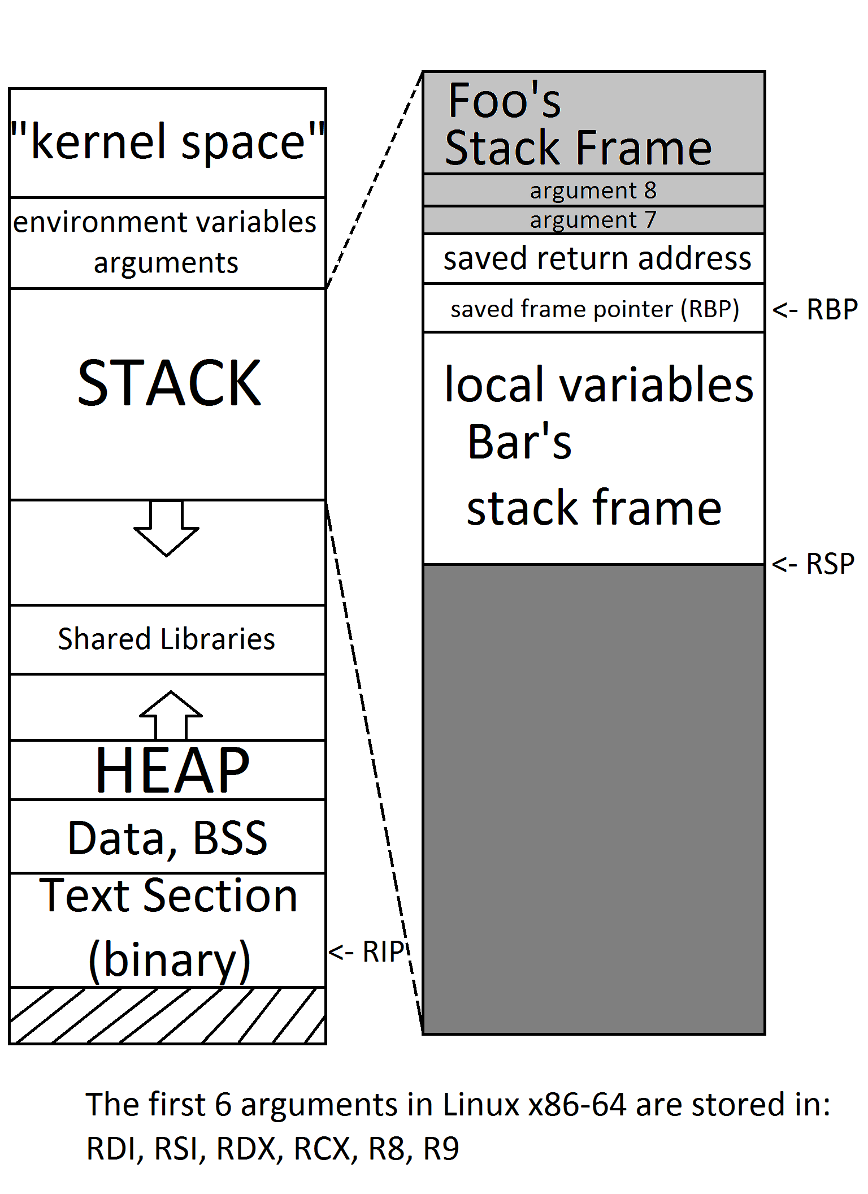

Slide 10
Buffer Overflows
Today we’ll be executing a buffer overflow to highjack control of a program.
Basic idea: We have a buffer that we can overflow (write past the bounds).
If we overflow it enough, we’ll overwrite the saved RBP and return address values.
We can overwrite the return address with another address, returning the program to a different function or even our own injected code!

Slide 11
Demo
Let’s get to it!

Slide 12
Defenses
Many ideas have been proposed..
Address Space Layout Randomization (ASLR)
Layout of memory is slightly randomized
Can’t hardcode our return addresses!
Almost non-existent overhead! Used virtually everywhere!
Data Execution Prevention (DEP)
Make the stack non-executable
Can’t inject our shellcode!
Also almost non-existent overhead! All done in hardware.
Stack Canaries
A “canary” (a random 64-bit value) is placed before the saved return address
If the canary’s value has changed, there was a stack corruption! Don’t return!
Can possibly be bypassed and does nothing for heap overflows.

Slide 13
Return-Oriented Programming
Modern day exploitation
Use small tidbits of code (called gadgets) in the existing code to execute arbitrary commands.
Defeats DEP since we are using already existing code!
Can also defeat ASLR if an address in the program is leaked
Can calculate offsets to modify your “code”
Maybe cover in the future?

