Slide 1

SIGSEC
CTF Basics
October 04, 2016

Slide 2
News and Events
Special thanks to Tomek Rabczak and Daniel Mayer for visiting last week!
Next week (unless anyone wants to volunteer to present!) we will be discussing software vulnerabilities and exploitation. ^{(my} ^{favorite!)}
Possibly have Professor Checkoway as a guest speaker?
If you have not received an email from the listserv, please see me after the meeting so I can add you.

Slide 3

Row Hammer

Slide 4
Flip Feng Shui: Hammering a Needle in the Software Stack
Compromise the public key located on another virtual machine located on the same host.
Row Hammer
Memory Deduplication
Public Key Cryptography
K. Razavi, B. Gras, E. Bosman, B. Preneel, C. Giuffrida, and H. Bos
Vrije Universiteit, Amsterdam
https://www.vusec.net/projects/flip-feng-shui/

Slide 5
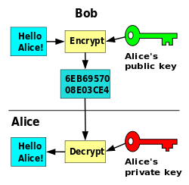
Public Key Cryptography

Slide 6
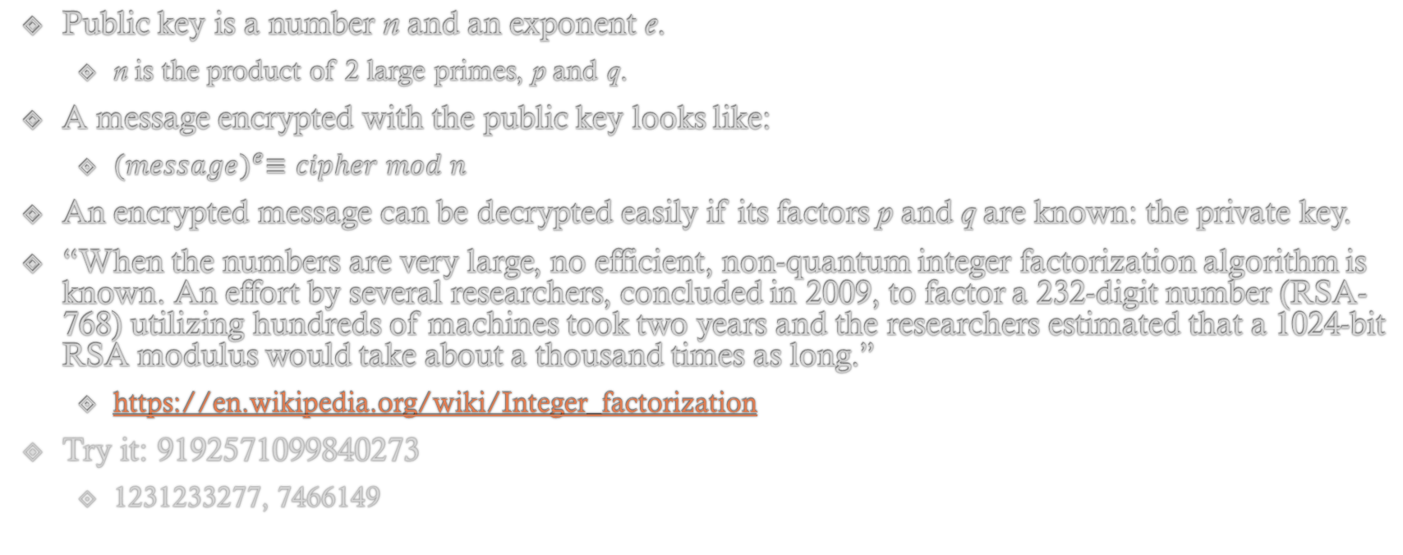
Public Key Cryptography
Public key is a number n and an exponent e.
n is the product of 2 large primes, p and q.
A message encrypted with the public key looks like:
${(message)}^{e}≡cipher mod n$
An encrypted message can be decrypted easily if its factors p and q are known: the private key.
“When the numbers are very large, no efficient, non-quantum integer factorization algorithm is known. An effort by several researchers, concluded in 2009, to factor a 232-digit number (RSA-768) utilizing hundreds of machines took two years and the researchers estimated that a 1024-bit RSA modulus would take about a thousand times as long.”
https://en.wikipedia.org/wiki/Integer_factorization
Try it: 9192571099840273
1231233277, 7466149

Slide 7
Memory Deduplication
Hypervisor running multiple virtual machines
Don’t want to waste disk space!
If two pages in memory are identical, merge them into one page and only duplicate when a write occurs!
Similar to your OS’s copy-on-write policy for virtual pages.

Slide 8
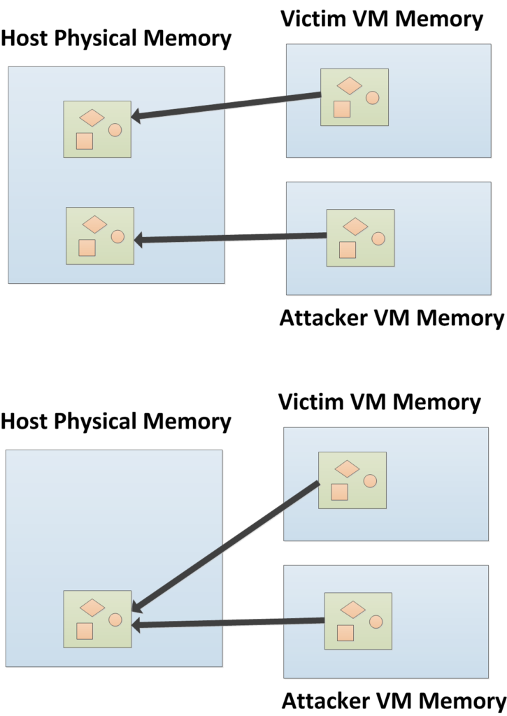
Memory Deduplication

Slide 9
Row Hammer
A unintended side-effect of DRAM due to the sheer density of modern chips.
Billions of transistors!
Memory cells can potentially leak their charge, altering the charge (value) of adjacent cells when adjacent rows are repeatedly accessed (hammered).
DDR3 memory most notably vulnerable, but there are plenty of DDR4 chips that have been shown to be vulnerable as well.

Slide 10
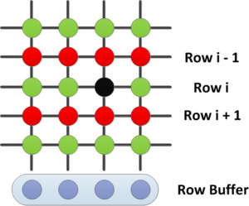
Row Hammer

Slide 11
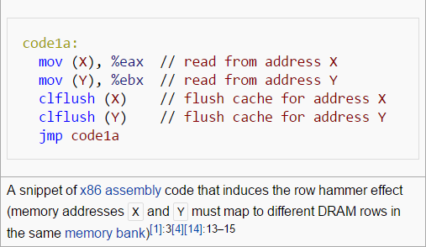
Row Hammer
https://en.wikipedia.org/wiki/Row_hammer

Slide 12
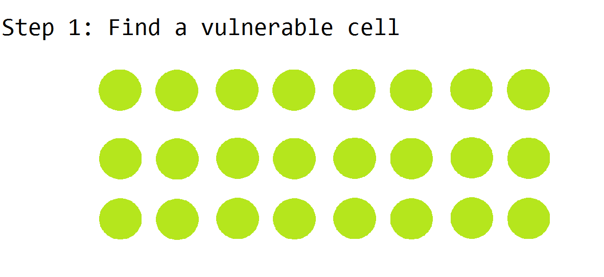
Flip Feng Shui

Slide 13
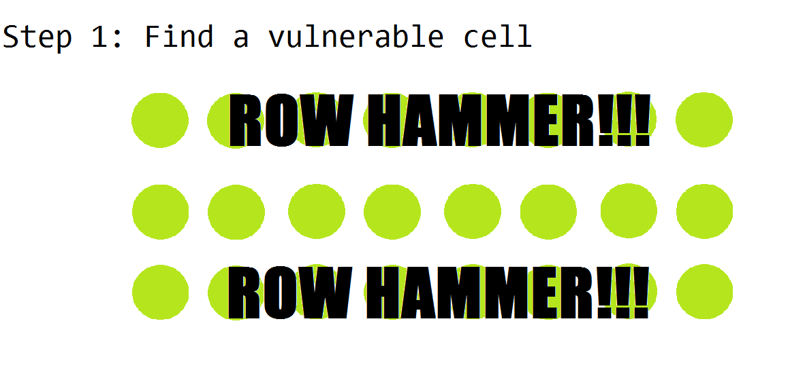
Flip Feng Shui

Slide 14
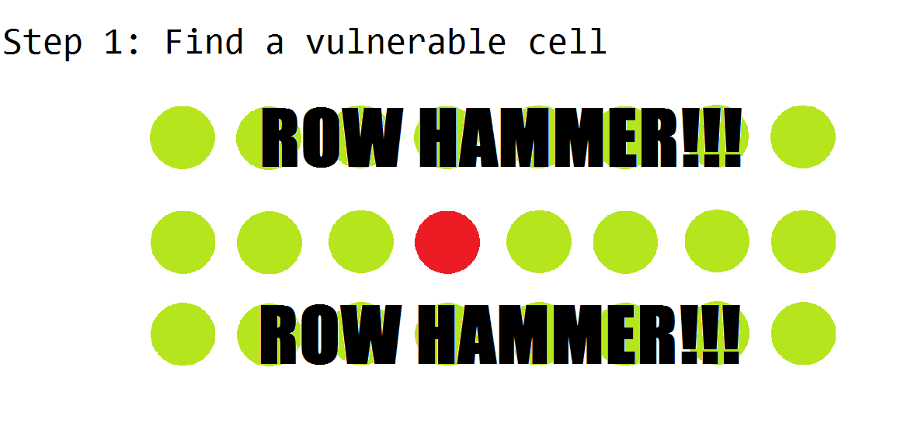
Flip Feng Shui

Slide 15
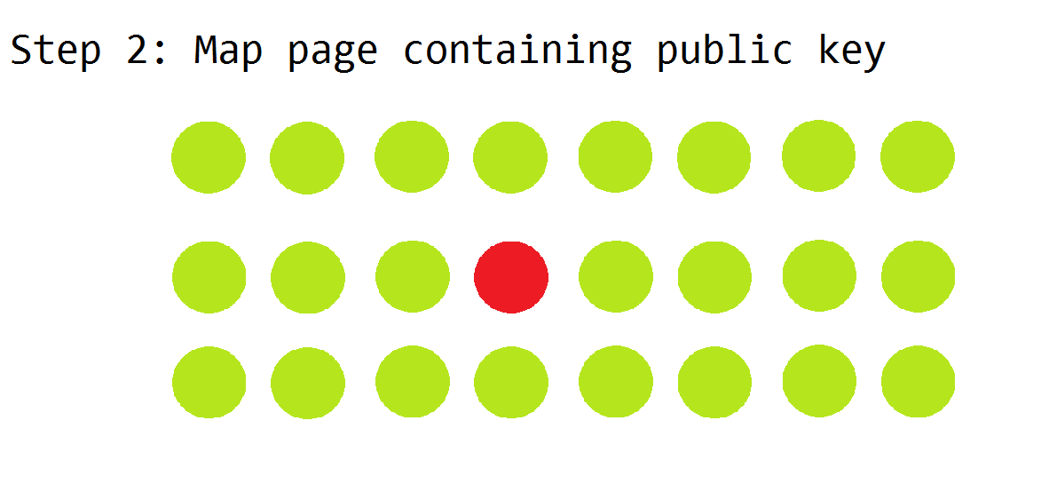
Flip Feng Shui

Slide 16
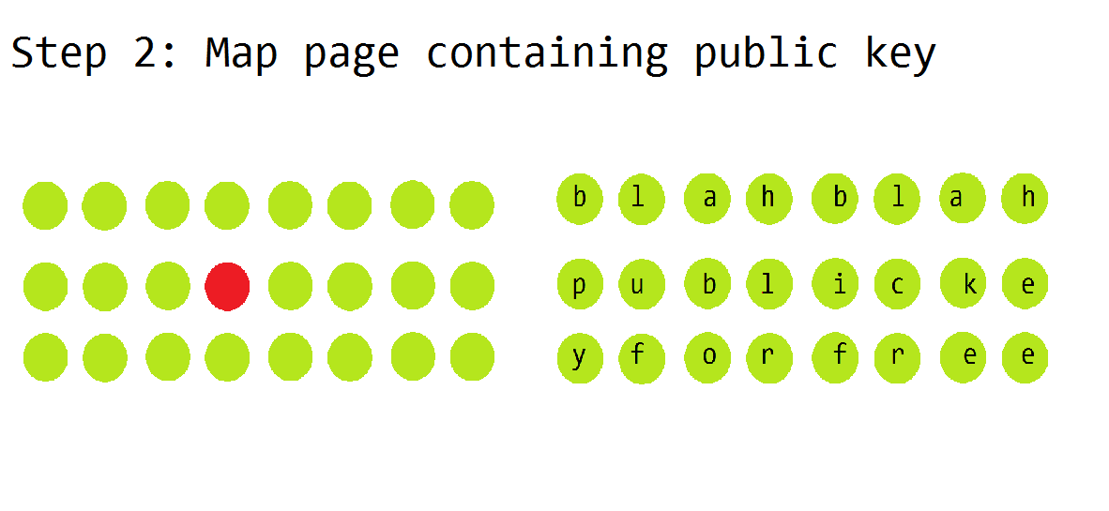
Flip Feng Shui
Attacker Victim

Slide 17
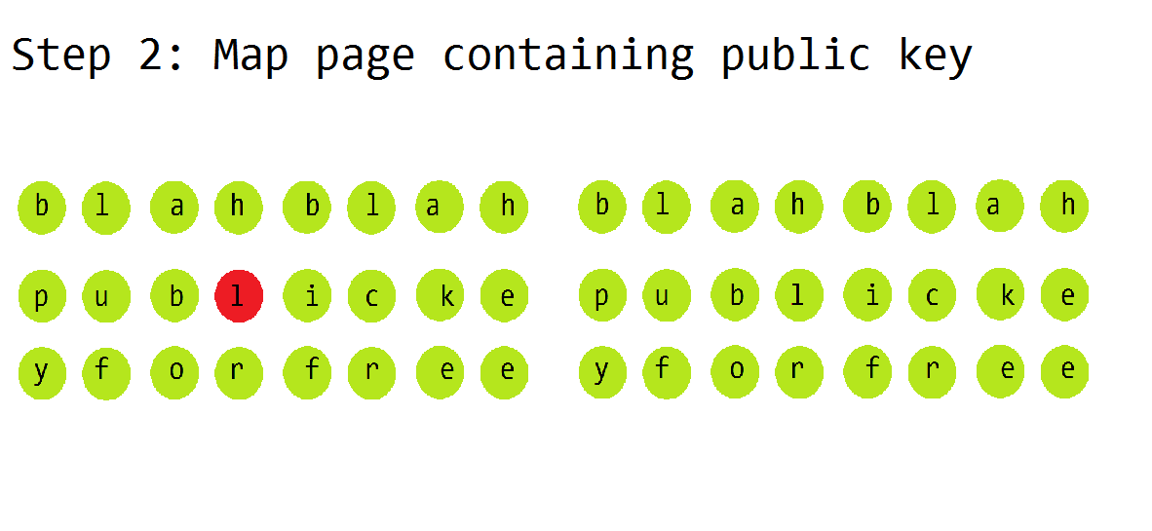
Flip Feng Shui
Attacker Victim

Slide 18
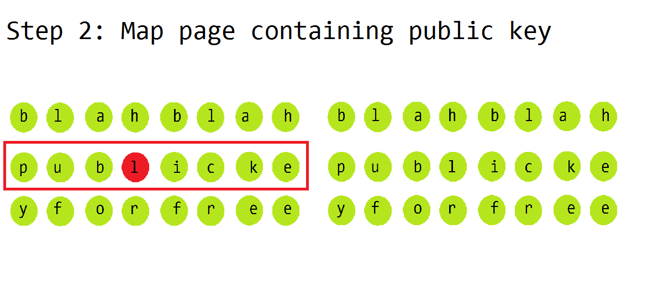
Flip Feng Shui
Attacker Victim

Slide 19
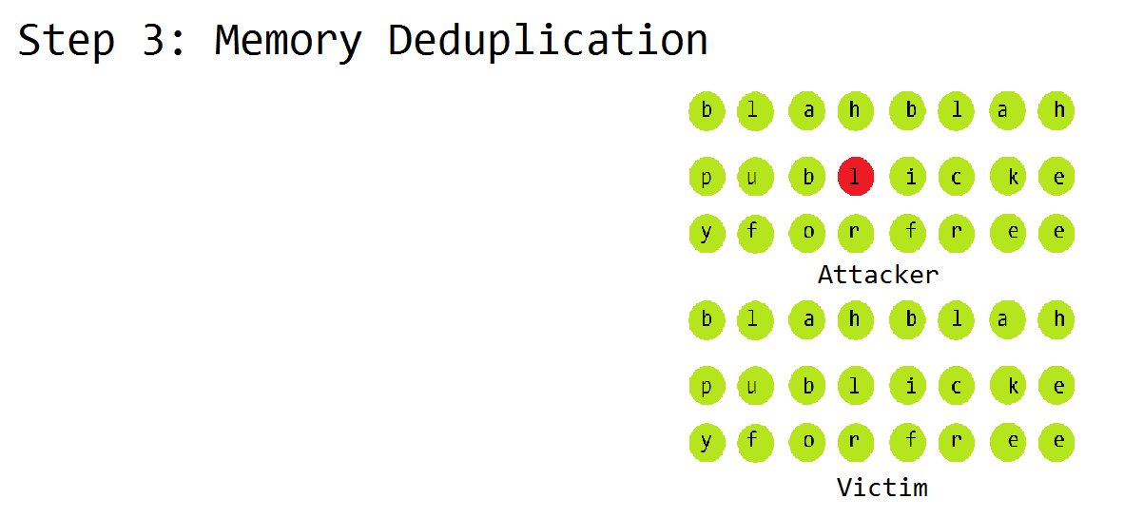
Flip Feng Shui

Slide 20
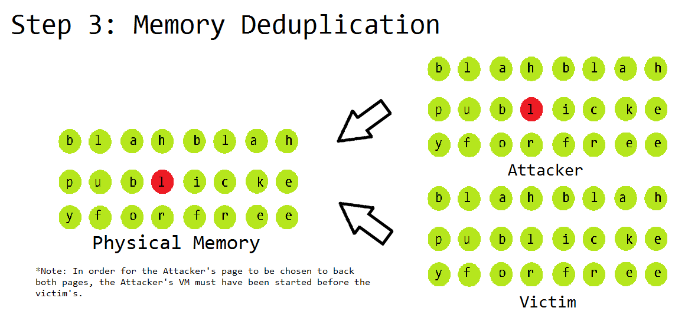
Flip Feng Shui

Slide 21
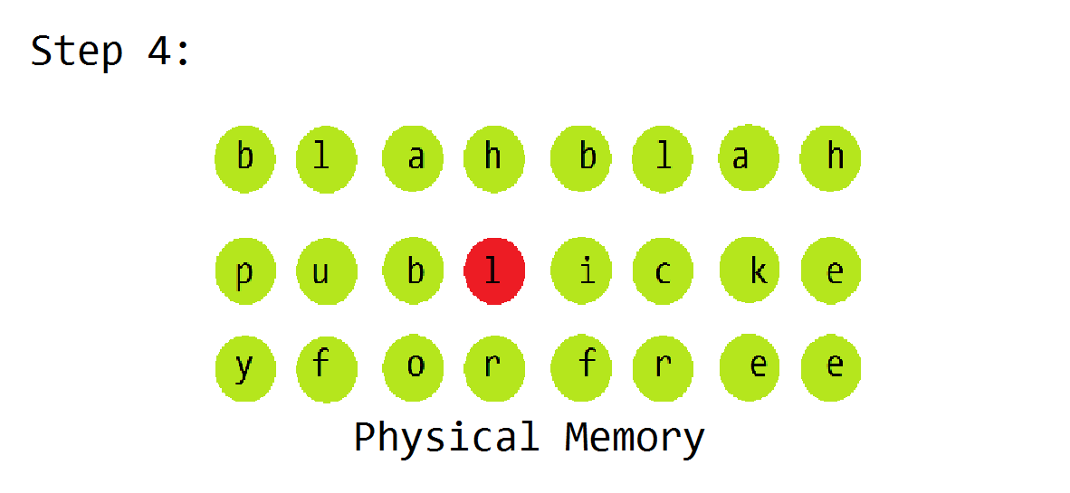
Flip Feng Shui

Slide 22
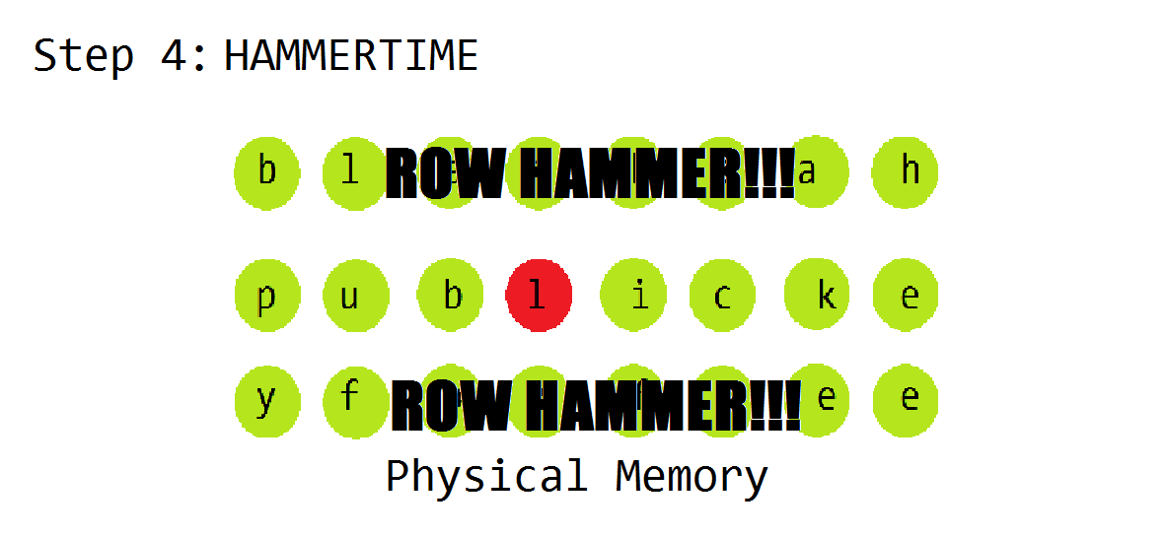
Flip Feng Shui

Slide 23

Flip Feng Shui

Slide 24
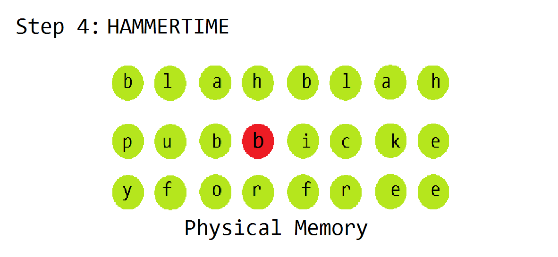
Flip Feng Shui

Slide 25
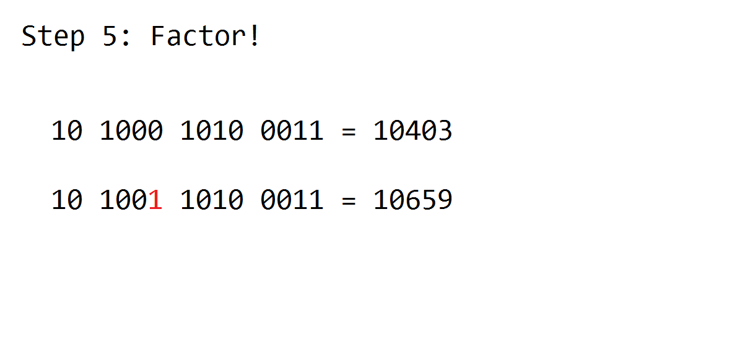
Flip Feng Shui

Slide 26
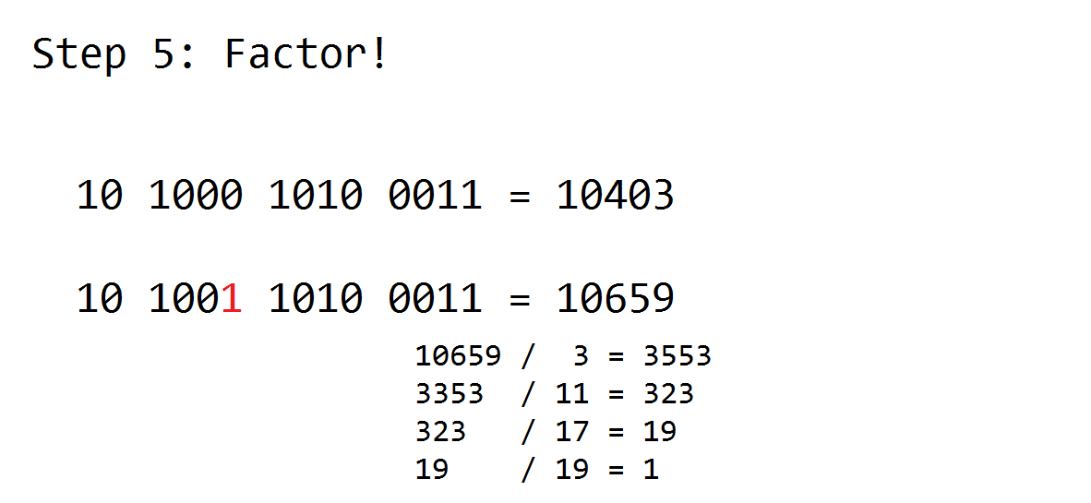
Flip Feng Shui

Slide 27
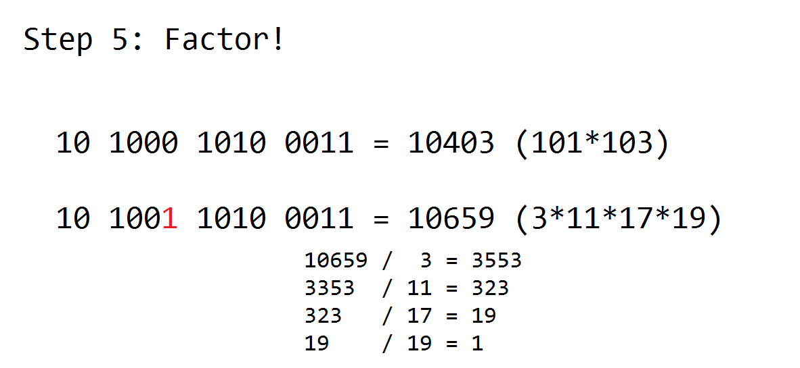
Flip Feng Shui

Slide 28

Flip Feng Shui
Once we have cracked the private key, we can authenticate as the victim!

Slide 29
Mitigations
DDR4 is “Row Hammer” aware, so more robust than DDR3 to Row Hammer.
ECC (error-correcting code) RAM can potentially stop this.
Increase the refresh rate (64hz to 32hz)
Target Row Refresh (TRR)
Some chips are still vulnerable…
Doesn’t work if more than one bit is flipped…
Increases power usage and overhead, slowing us down…
Identifies rows that have been activated rapidly and refreshes them.

Slide 30
Flip Feng Shui
Questions?

Slide 31
CTF Basics
Manifest all of your accumulated security skills in a competitive environment!
Tests a wide range of topics, including but not limited to:
Forensics
Cryptography
Reverse Engineering
Binary Exploitation
Web Exploitation
Misc. Trivia!

Slide 32
CTF Basics
The focus areas that CTF competitions tend to measure are:
vulnerability discovery
exploit creation
toolkit creation
operational tradecraft
https://trailofbits.github.io/ctf/

Slide 33
CTF Basics
2 different formats (really three):
Jeopardy Format (DEFCON CTF Qualifiers)
Teams are completely isolated from each other
Various categories of tasks
Just like jeopardy!
Teams are awarded points for completing tasks (capturing flags)
Next flag is only opened after previous task has been completed (no jumping around)
After a set amount of time, the points are tallied up and the team with the most points wins!

Slide 34
CTF Basics
Attack and Defend Format (DEFCON CTF)
Teams are given a machine (possibly multiple machines) that is running multiple services.
Points are awarded to teams for keeping their services up (defense points).
Points are also awarded for compromising another team’s services (attack points).
Teams are given some amount of time to analyze their machine prior to the competition, discovering and patching vulnerabilities while developing your own exploits.
When the competition starts, teams are connect to each other over an anonymous network and chaos ensues!

Slide 35
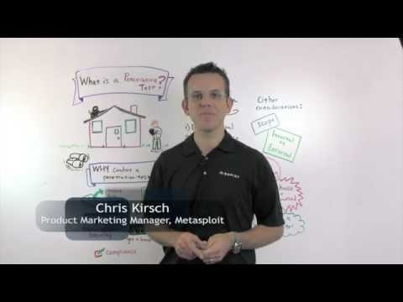
CTF Basics
https://www.youtube.com/watch?v=b7jW9X9UqiY

Slide 36
CTF Basics
Want to practice CTF challenges?
Join the SIG Security virtual lab!
CTF
Penetration Testing
Other evil activities

Slide 37
CTF Basics
2 ways to connect:
OpenVPN – currently not available ☹
working with Chase to assign a public IP address to my VM
hopefully will have it up by next week!
WiFi
Only available from the ACM, WiCS and CS lounge.
ssid: SIG Security
password: SIGSecurity2016@UIC

Slide 38
CTF Basics
192.168.0.10-19
Administrative Virtual Machines
OpenVPN and Web servers!
Should be resilient to attack, but please don’t DOS ☺
192.168.0.20-99
Challenge Virtual Machines
Feel free to attack as you please!
Try not to ruin them for others
If something breaks, please let me know so I can reset/revert them.

Slide 39
CTF Basics
192.168.0.100-200
Users connected via WiFi
DO NOT ATTACK
192.168.1.100-200
Users connected via OpenVPN
DO NOT ATTACK

Slide 40
Ethics
You will learn things that are VERY ILLEGAL to perform on networks where you do not have the express permission of the administrator!
Always double-check where you’re sending your packets! Ignorance is not a valid defense!
DO NOT BE ONE OF THOSE PEOPLE!
Hacking your neighbor’s WiFi is NOT okay and very stupid!
Always obtain written consent when possible
You have my permission to scan/attack/compromise the challenge VM’s in the virtual lab.
You can download any of those machines and run them locally
If you have any questions or need any help feel free to ask!

Slide 41
CTF Basics
Ready to pwn our first box? ☺

