Slide 1

SIGSEC
October 25, 2016

Slide 2
News and Events
We will not be hosting a “Linux for Beginners” meeting since there was not much interest (sorry!)
I still recommend that you visit linuxjourney.com and follow the tutorials.
I’ll be sending out a Doodle poll later today for next week’s topic.

Slide 3
DDoS everywhere!
Last week, DynDNS was the victim of a severe DDoS attack:
Services were down for a couple of hours
Many major web sites (Twitter, Reddit, Spotify, GitHub) were “down” for users on the East Coast for the duration of the attack.
It is not yet known who is behind the attacks or the total bandwidth.
Two significant DDoS attacks last month:
Largest DDoS ever recorded (1 Tb/s) against the ISP OVH
Brian Kreb’s blog was the victim of a large DDoS, which led to Akamai dropping him.
Both were attacked by an IoT botnet known as Mirai
IoT devices compromised by the Mirai Trojan
https://www.hackread.com/linux-mirai-trojan-a-ddos-nightmare/
http://www.eweek.com/security/ddos-attack-snarls-friday-morning-internet-traffic.html

Slide 4
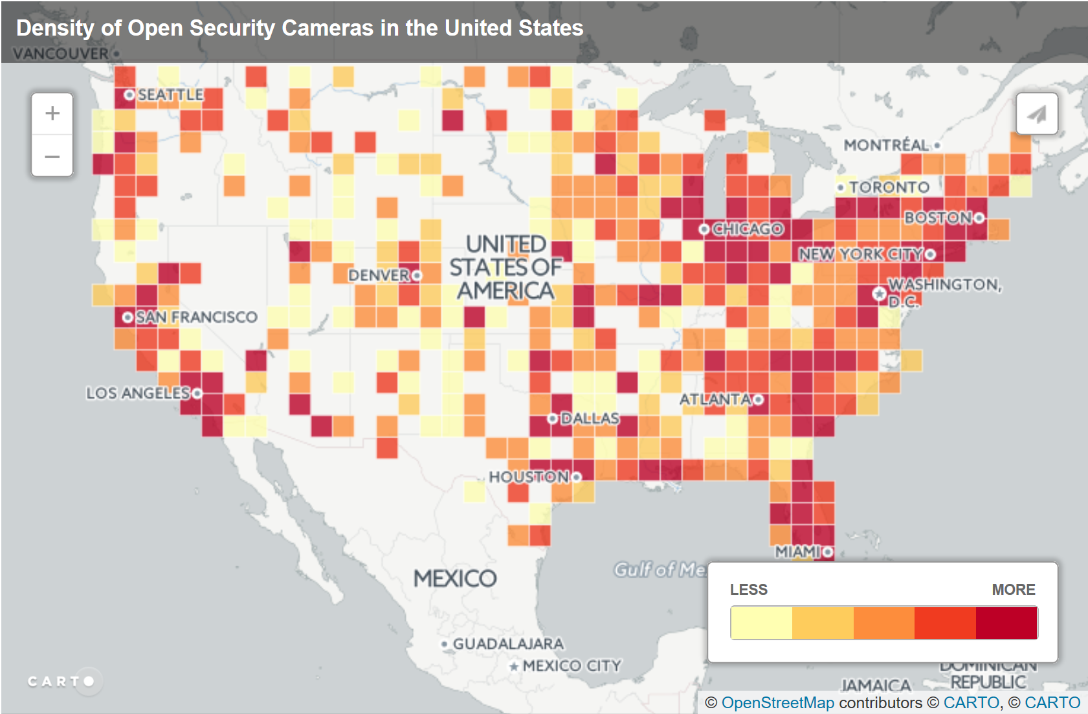
https://www.hackread.com/ovh-hosting-suffers-1tbps-ddos-attack/

