Slide 1

SIGSEC
CTF Basics
October 04, 2016

Slide 2
News and Events
Special thanks to Tomek Rabczak and Daniel Mayer for visiting last week!
Next week (unless anyone wants to volunteer to present!) we will be discussing software vulnerabilities and exploitation. ^{(my} ^{favorite!)}
Possibly have Professor Checkoway as a guest speaker?
If you have not received an email from the listserv, please see me after the meeting so I can add you.

Slide 3

Row Hammer

Slide 4
Flip Feng Shui: Hammering a Needle in the Software Stack
Compromise the public key located on another virtual machine located on the same host.
Row Hammer
Memory Deduplication
Public Key Cryptography
K. Razavi, B. Gras, E. Bosman, B. Preneel, C. Giuffrida, and H. Bos
Vrije Universiteit, Amsterdam
https://www.vusec.net/projects/flip-feng-shui/

Slide 5
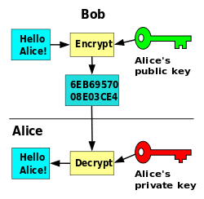
Public Key Cryptography

Slide 6
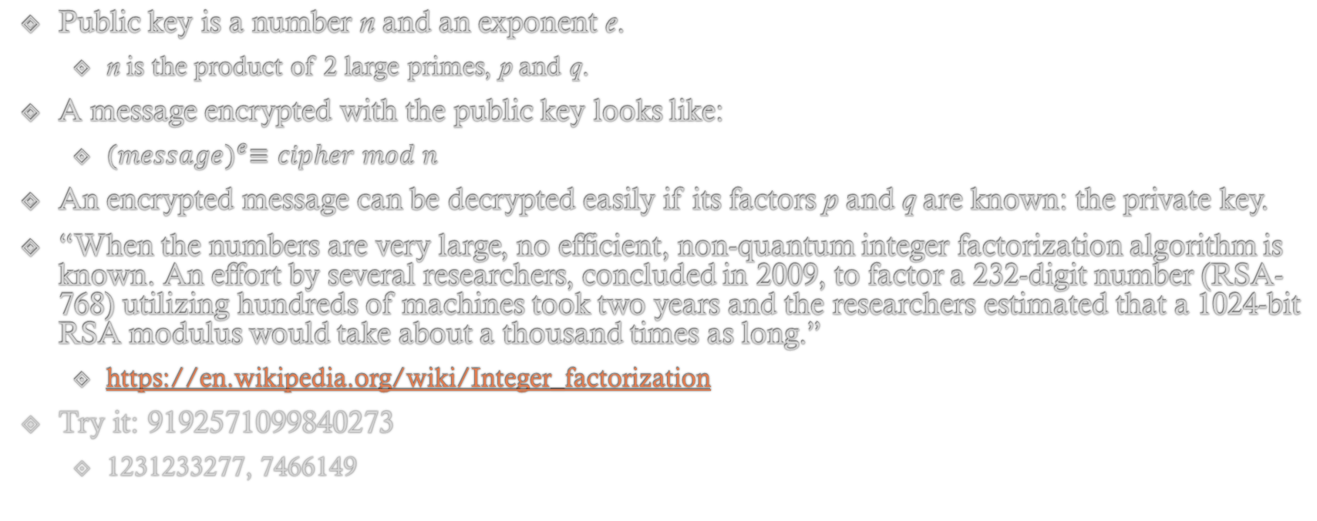
Public Key Cryptography
Public key is a number n and an exponent e.
n is the product of 2 large primes, p and q.
A message encrypted with the public key looks like:
${(message)}^{e}≡cipher mod n$
An encrypted message can be decrypted easily if its factors p and q are known: the private key.
“When the numbers are very large, no efficient, non-quantum integer factorization algorithm is known. An effort by several researchers, concluded in 2009, to factor a 232-digit number (RSA-768) utilizing hundreds of machines took two years and the researchers estimated that a 1024-bit RSA modulus would take about a thousand times as long.”
https://en.wikipedia.org/wiki/Integer_factorization
Try it: 9192571099840273
1231233277, 7466149

Slide 7
Memory Deduplication
Hypervisor running multiple virtual machines
Don’t want to waste disk space!
If two pages in memory are identical, merge them into one page and only duplicate when a write occurs!
Similar to your OS’s copy-on-write policy for virtual pages.

Slide 8
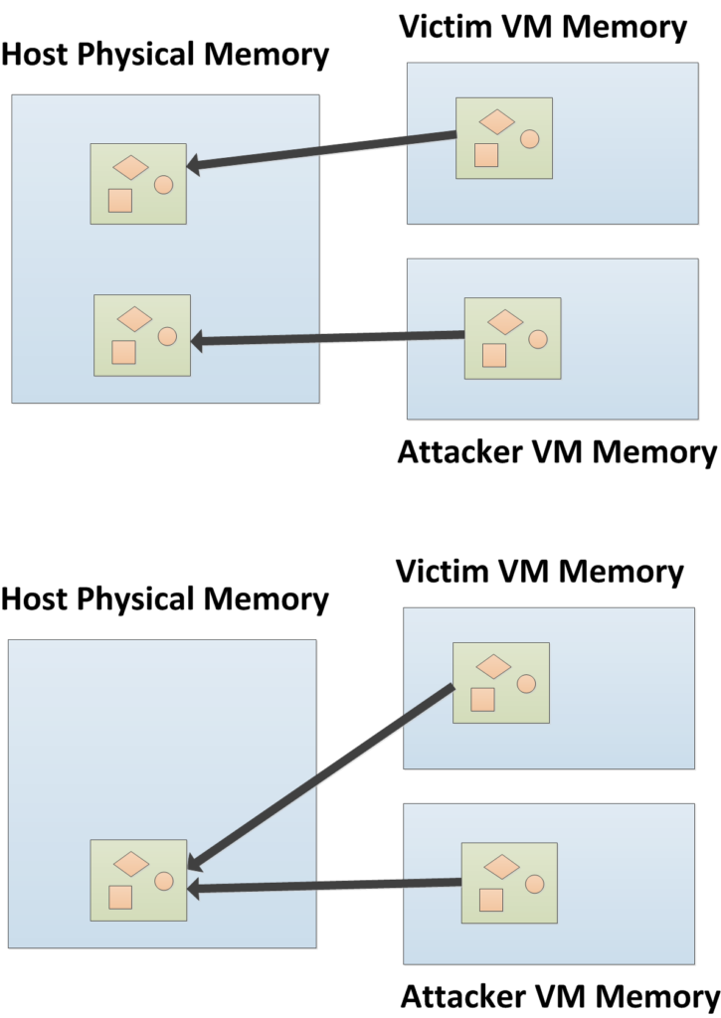
Memory Deduplication

Slide 9
Row Hammer
A unintended side-effect of DRAM due to the sheer density of modern chips.
Billions of transistors!
Memory cells can potentially leak their charge, altering the charge (value) of adjacent cells when adjacent rows are repeatedly accessed (hammered).
DDR3 memory most notably vulnerable, but there are plenty of DDR4 chips that have been shown to be vulnerable as well.

Slide 10
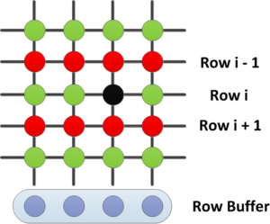
Row Hammer

Slide 11
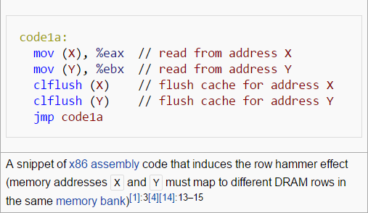
Row Hammer
https://en.wikipedia.org/wiki/Row_hammer

Slide 12
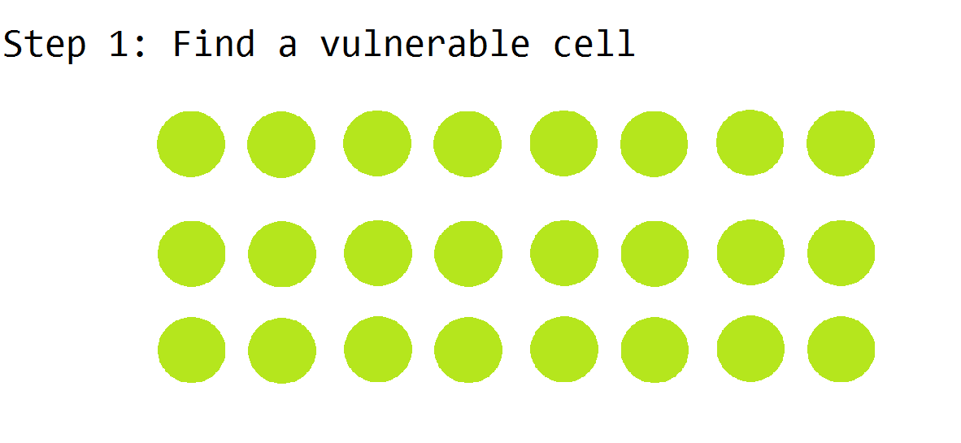
Flip Feng Shui

Slide 13
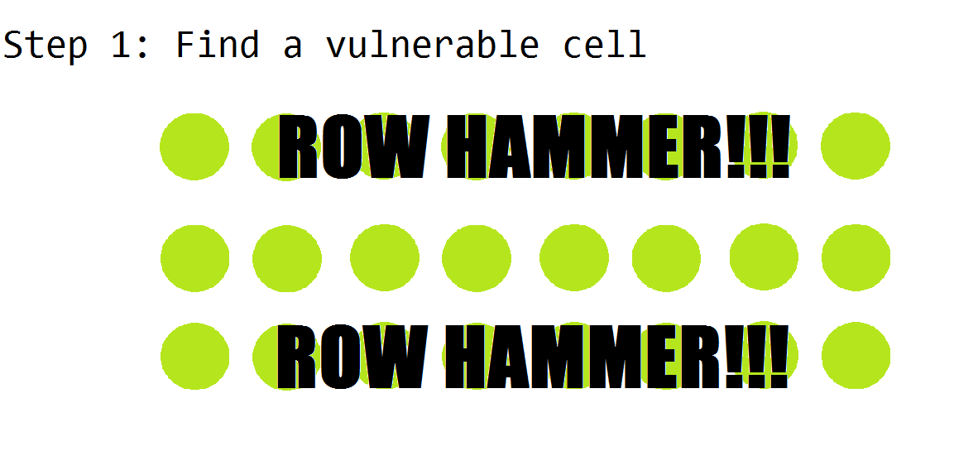
Flip Feng Shui

Slide 14
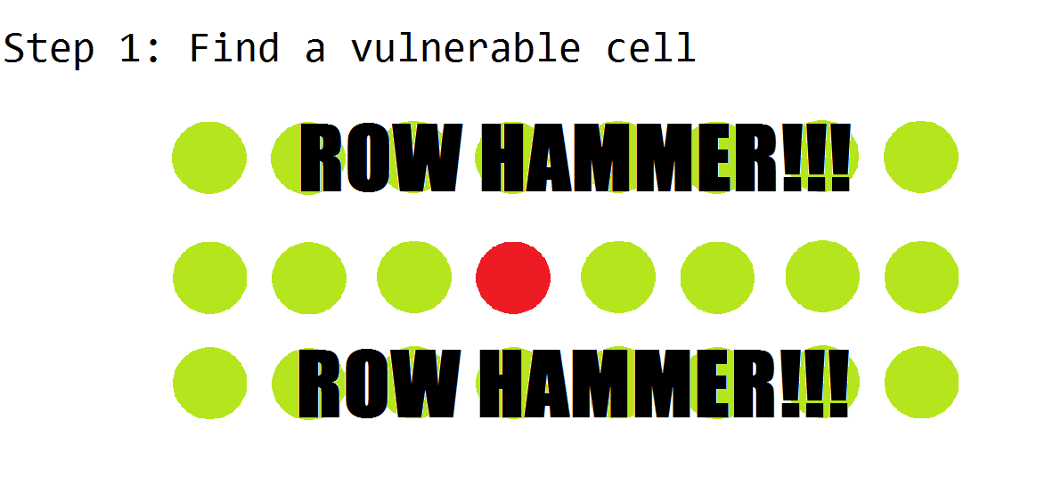
Flip Feng Shui

Slide 15
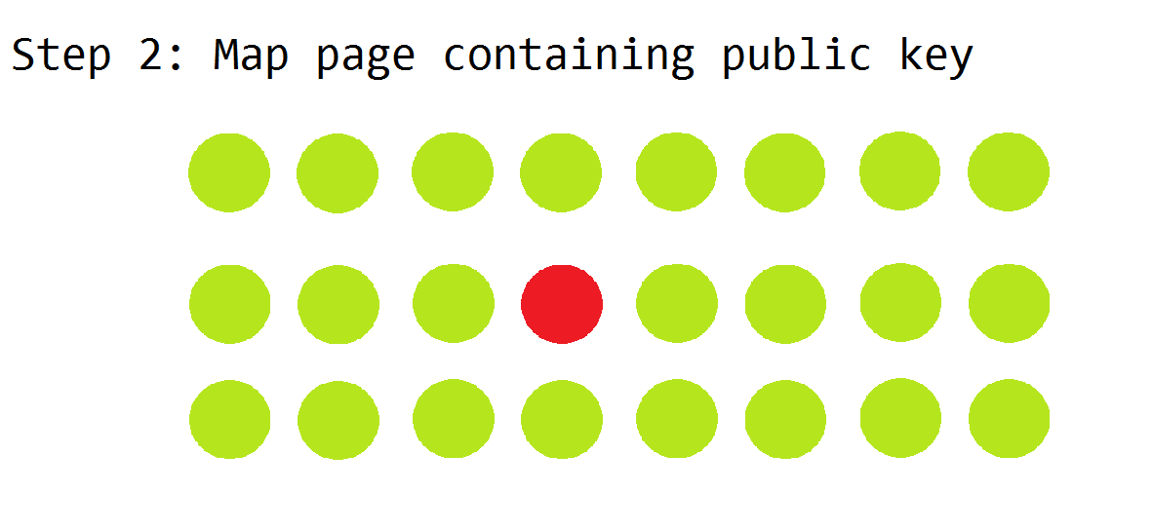
Flip Feng Shui

Slide 16
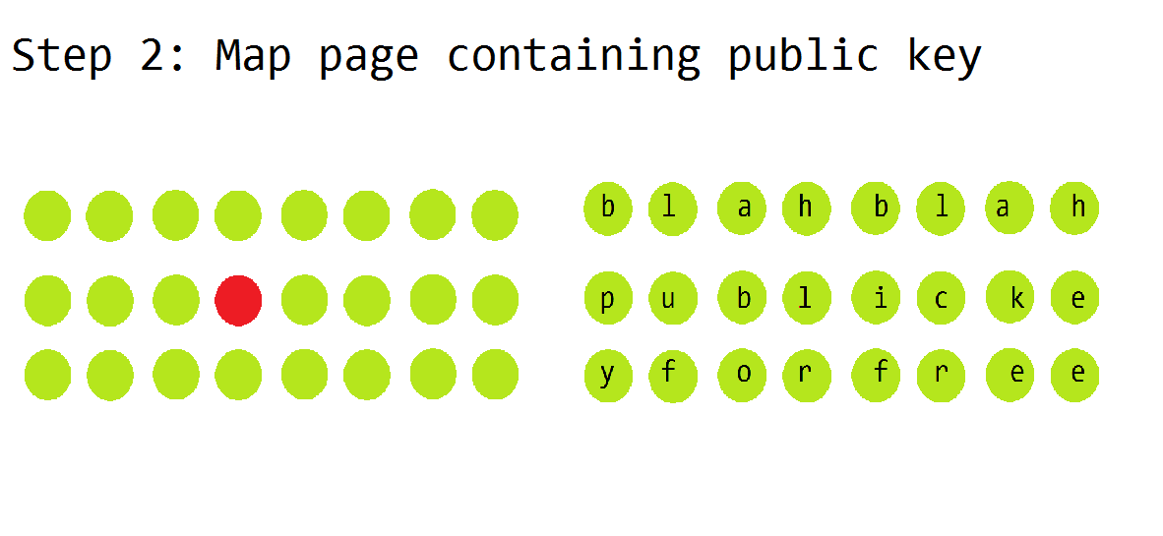
Flip Feng Shui
Attacker Victim

Slide 17
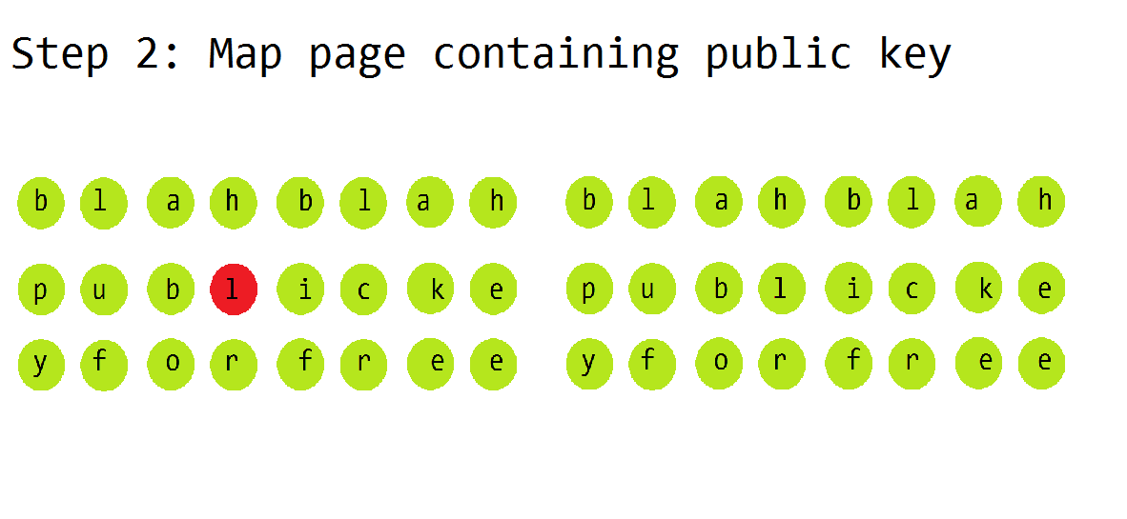
Flip Feng Shui
Attacker Victim

Slide 18
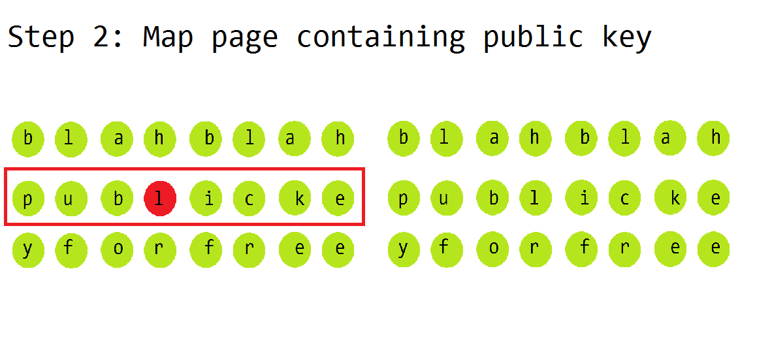
Flip Feng Shui
Attacker Victim

Slide 19
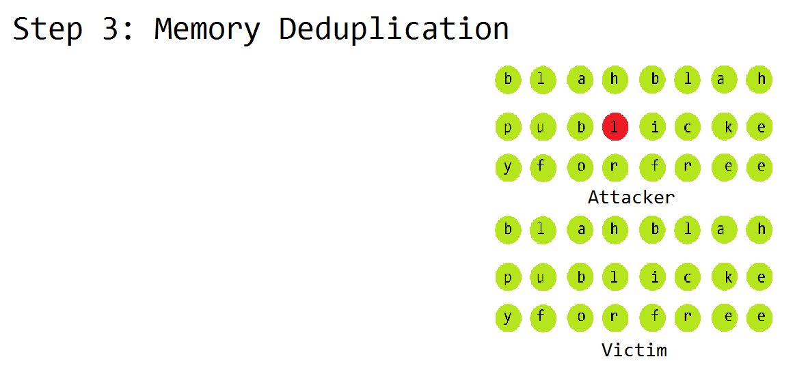
Flip Feng Shui

Slide 20
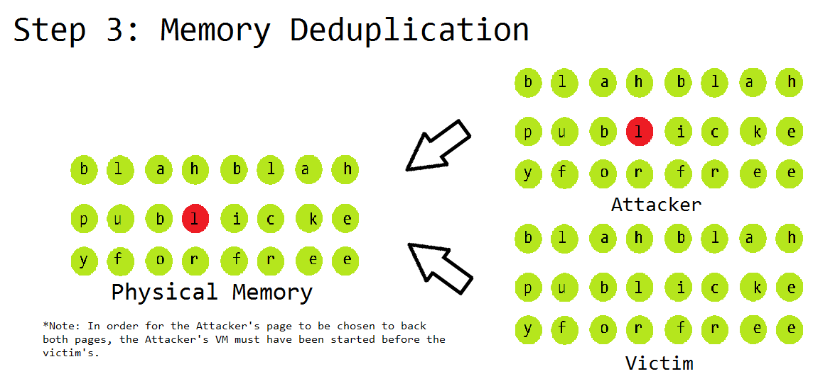
Flip Feng Shui

Slide 21
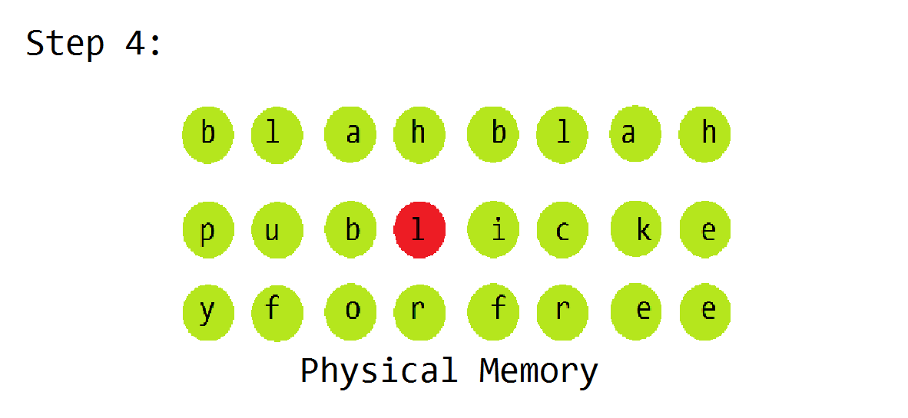
Flip Feng Shui

Slide 22
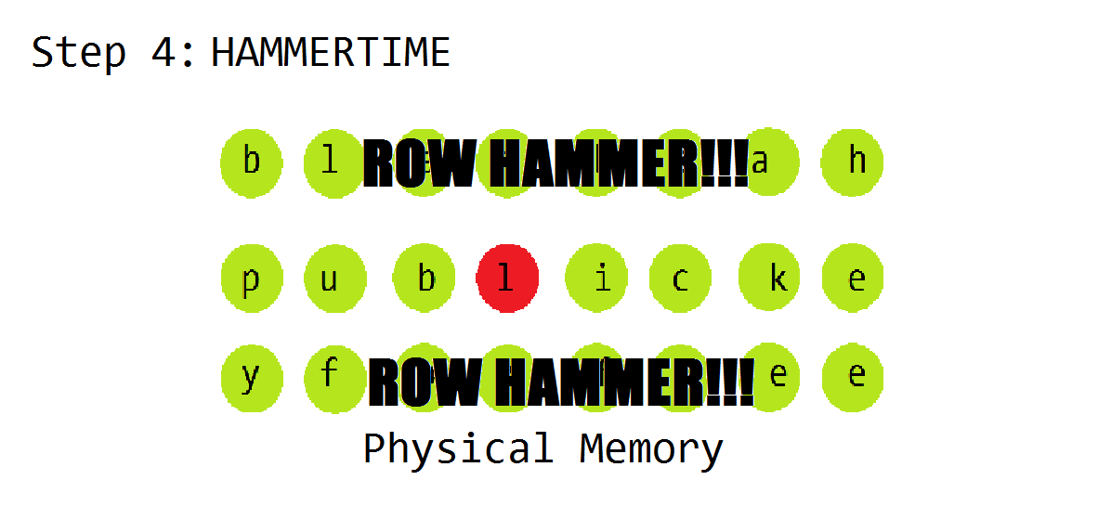
Flip Feng Shui

Slide 23

Flip Feng Shui

Slide 24
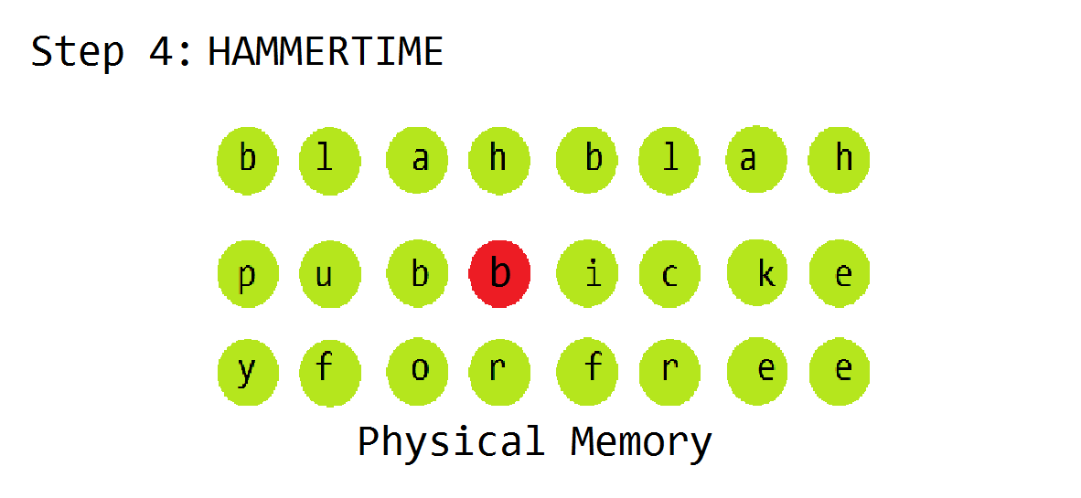
Flip Feng Shui

Slide 25
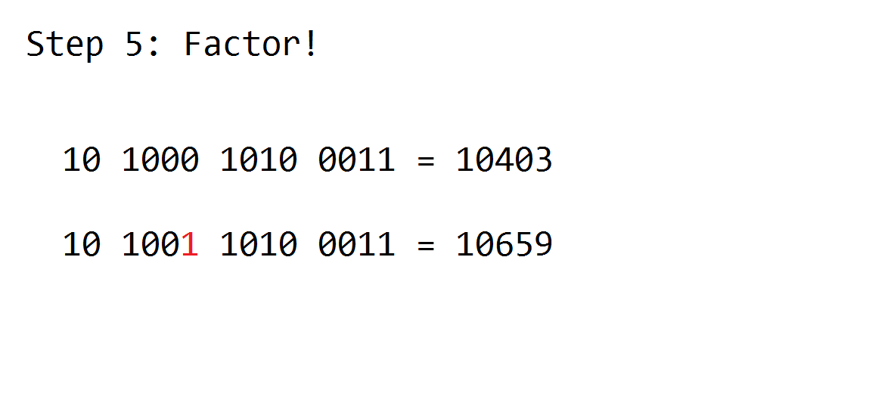
Flip Feng Shui

Slide 26
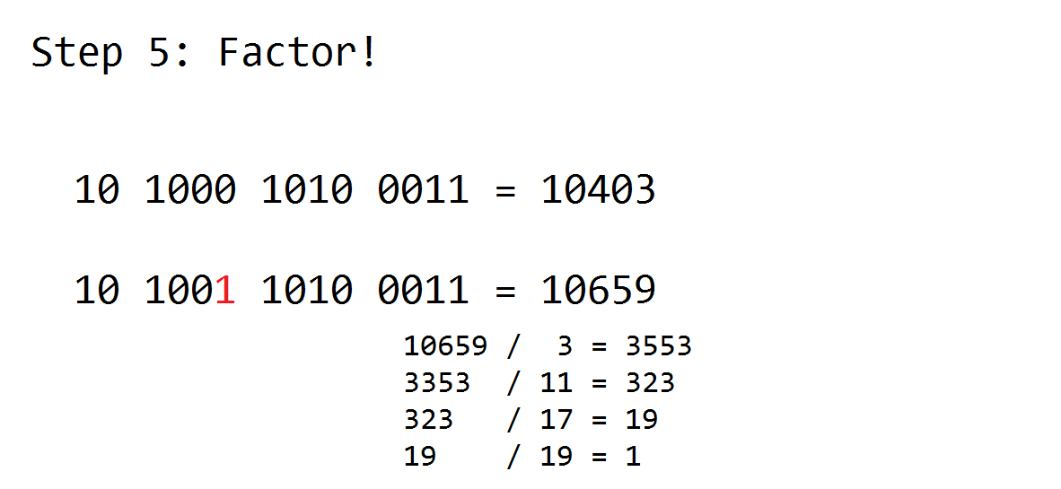
Flip Feng Shui

Slide 27
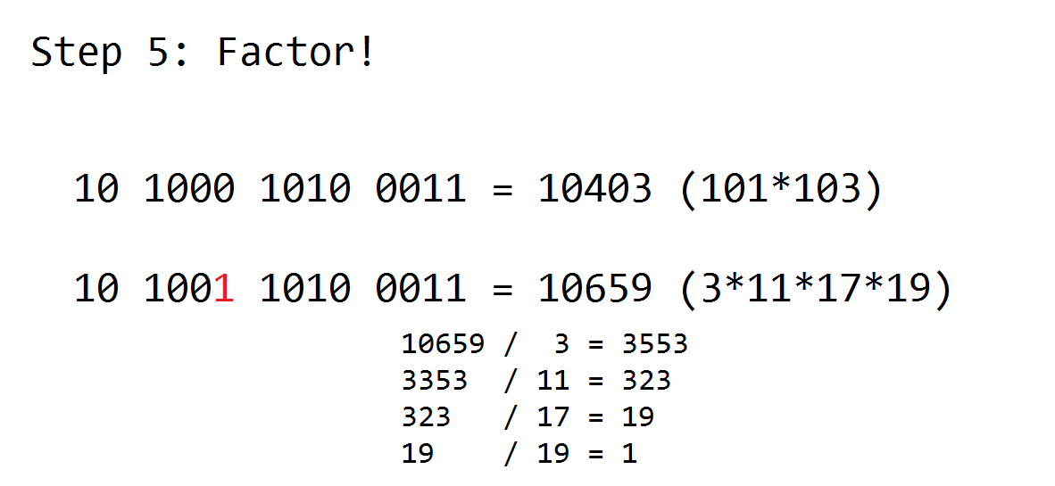
Flip Feng Shui

Slide 28

Flip Feng Shui
Once we have cracked the private key, we can authenticate as the victim!

Slide 29
Mitigations
DDR4 is “Row Hammer” aware, so more robust than DDR3 to Row Hammer.
ECC (error-correcting code) RAM can potentially stop this.
Increase the refresh rate (64hz to 32hz)
Target Row Refresh (TRR)
Some chips are still vulnerable…
Doesn’t work if more than one bit is flipped…
Increases power usage and overhead, slowing us down…
Identifies rows that have been activated rapidly and refreshes them.

Slide 30
Flip Feng Shui
Questions?

Slide 31
CTF Basics

