Slide 1

SIGSEC
Network and Wi-Fi Security
September 20, 2016

Slide 2
News and Events
The NCC Group Security Open Forum will be meeting THIS Wednesday at the Basecamp offices (30 N. Racine Ave.)
“The NCC Group Security Open Forum is an informal and open venue for the discussion and presentation of security related research and tools, and an opportunity for security researchers from all fields to get together and share work and ideas.”
https://www.meetup.com/NCCGroupChicago/
Tomek Rabczak, a member of the UIC ACM and President of LUG in 2009, will be coming next week! Tomek is currently a senior security consultant at NCC Group and organizes their open forum.

Slide 3

Shellshock (Bashdoor)

Slide 4
Shellshock
A critical vulnerability in the Bash Shell first discovered by Stéphane Chazelas in September of 2014, allowing for arbitrary command execution.
Web servers that employed Bash were potentially vulnerable
Linux (most flavors), Mac OS X (Mavericks, Mountain Lion, Lion)
Even Cygwin!
After it was publicly disclosed on September 24th, attackers exploited Shellshock within hours to create large botnets and perform DDoS and vulnerability scans. Security companies recorded millions of attacks and probes following the days of the initial disclosure.
Its discovery led to reveal further vulnerabilities that were also patched.
https://en.wikipedia.org/wiki/Shellshock_(software_bug)

Slide 5
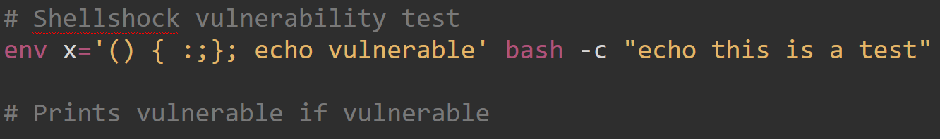
Shellshock
The vulnerability?
When passed function definitions in an environment variable, Bash would unintentionally execute commands that were concatenated at the end.

Slide 6
Shellshock
This vulnerability has been in Bash since the release of version 1.03
Release date of 1.03?

Slide 7
September 1989
25 years!!!

Slide 8
Network and WiFi Security
Brute Forcing
Denial-of-Service (DOS)
Man-in-the-Middle (MitM)
WiFi Security (WPA-2)

Slide 9
Brute Forcing
Probe internet for services on well-known ports and try to brute force credentials
ssh server (port 22)
web server (port 80)
ftp, telnet etc.
Typically only try basic/default username:password combinations
root:root
root:ubuntu
user:user
Generally unsuccessful, really only works for low-hanging fruit.

Slide 10
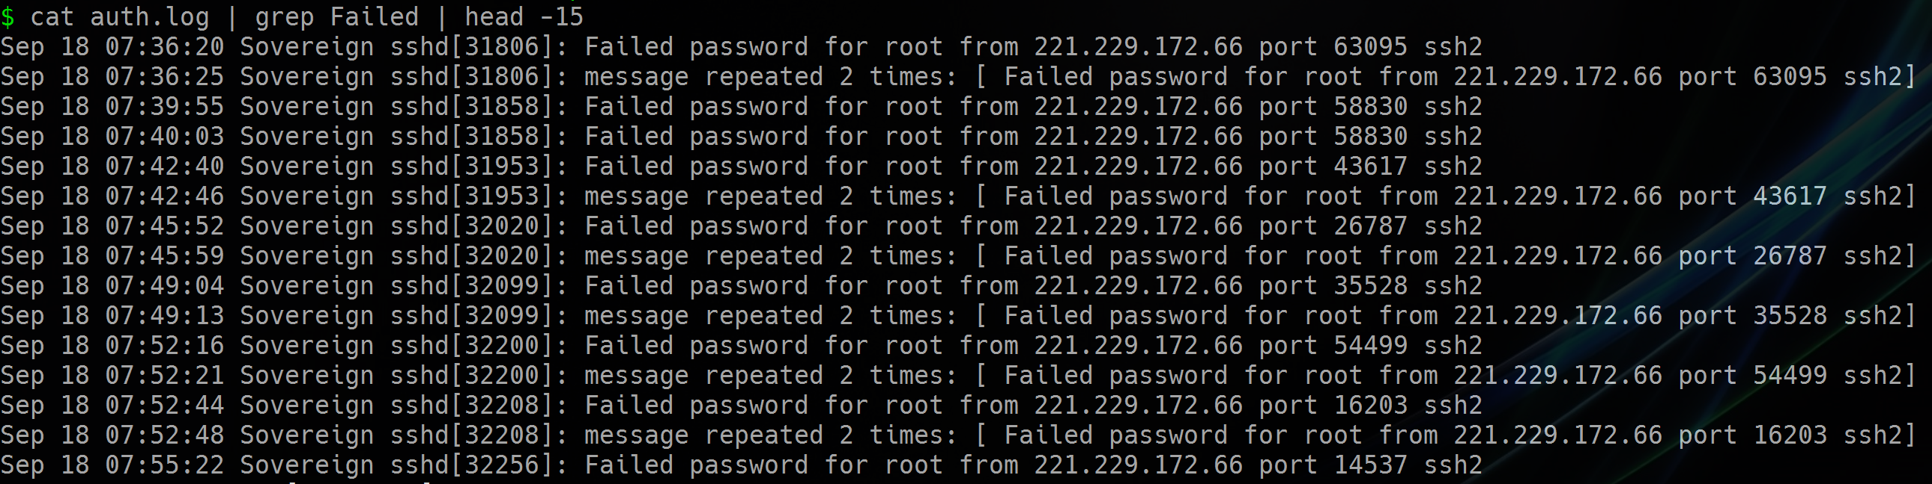

Brute Forcing

Slide 11
Brute Forcing
Solutions?

Slide 12
Brute Forcing
Firewalls
Only forward on ports that are absolutely necessary
Use strong password / authentication methods
Lockout after n failed attempts
fail2ban on Linux

Slide 13
Denial-of-Service (DOS)
Flood the server with illegitimate/bogus requests with the intention of rendering service unavailable to legitimate users.
Has many different forms and can be extremely hard to filter bogus traffic from real traffic.
Connect but send no data
Connect but send reaaaaaly sloooooooowly
Distributed-Denial-of-Service (DDOS): Multiple machines coordinated in a single DOS attack. More effective than an attack from a single machine.
Can generate more traffic
Each machine can be stealthier, making it harder to shut down

Slide 14
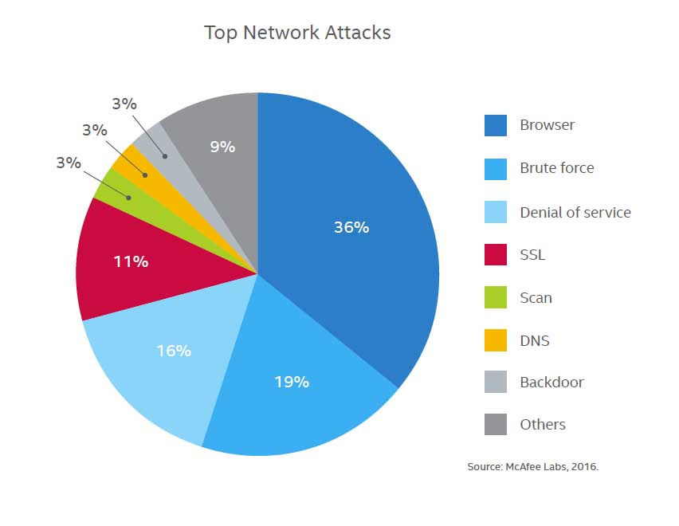
Denial-of-Service (DOS)

Slide 15
Denial-of-Service (DOS)
Reflected Attack
Send a forged request (spoofed IP address) to servers that will reply to the requests, indirectly flooding the target
Amplification
A reflected attack involving servers that will amplify the consumed bandwidth on the target by several magnitudes.

Slide 16
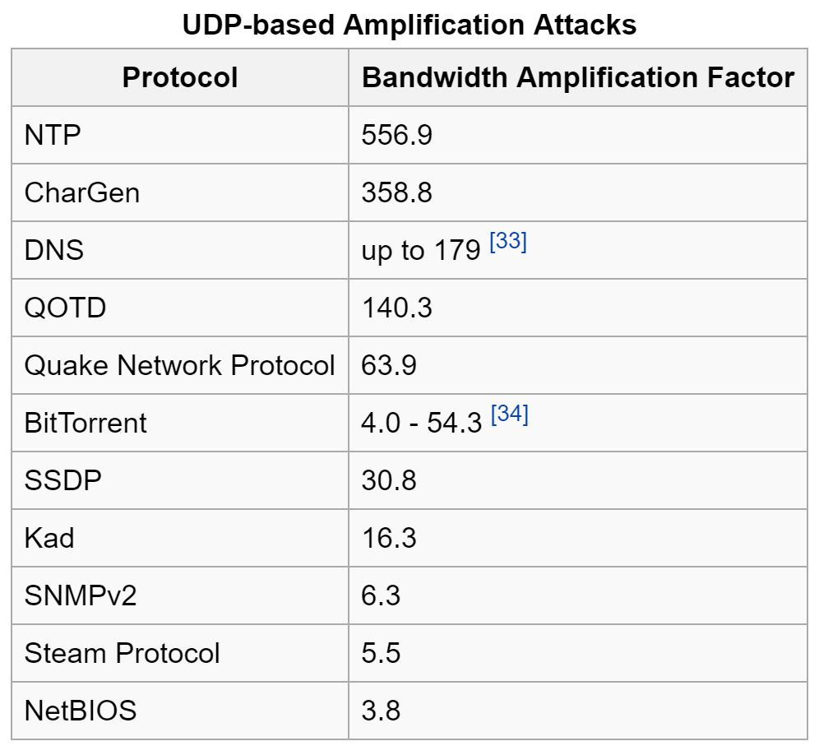
Denial-of-Service (DOS)

Slide 17
Denial-of-Service (DOS)
Solutions?

Slide 18
Denial-of-Service (DOS)
Firewalls
Simple rules aren’t likely to help against a dedicated attacker...
Intrusion Prevention Systems (IPS)
Monitor traffic and block if there is an anomaly.
Might be ineffective if the attacks do not have a signature associated with them..
Hardware
Routers and switches have rate-limiting capabilities
Third-Party “Scrubbing Centers”
Upstream service that filters malicious traffic.
Ex: Cloudflare, Verisign, AT&T

Slide 19
Man-in-the-Middle (MitM)
Third party secretly acts as a relay between two parties who believe they are communicating directly with one another.
MitM can inspect and even alter traffic.

Slide 20
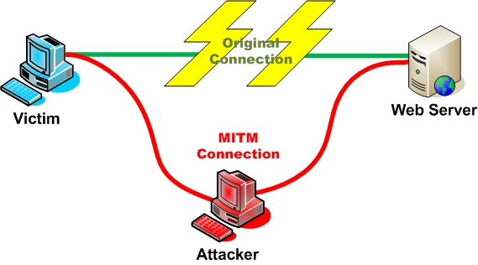
Man-in-the-Middle (MitM)

Slide 21

Man-in-the-Middle (MitM)
How does ARP work?
User A (IP address 192.168.1.101) wants to send a message to User B (IP address 192.168.1.102).
User A needs to translate the IP address to a MAC address so the switch can forward it.
User A broadcasts an ARP request to the broadcast address: FF:FF:FF:FF:FF:FF
Switch will forward messages to the broadcast address to everyone
“Who has 192.168.1.102? Tell 192.168.1.101”
User B will reply with its MAC address.
“192.168.1.102 is at 11:22:33:44:55:66”

Slide 22
Man-in-the-Middle (MitM)
Address Resolution Protocol (ARP) Spoofing
Using ARP, attacker masquerades as the gateway to victim and vice versa
Allows attacker to monitor/modify traffic between victim and gateway.
Next week: ARP and DNS spoofing workshop!

Slide 23
Man-in-the-Middle (MitM)
How does this work?
Attacker floods victim with ARP responses, saying that the gateway’s IP address can be found at the attacker’s MAC address.
To victim: “192.168.1.1 is at 45:56:49:4C:21:21”
To gateway: “192.168.1.102 is at 45:56:49:4C:21:21”
Attacker will forward packets from gateway to victim and vice versa so connection appears unaltered.
ARP is inherently unsafe! Victim will still respond to attacker’s malicious responses.

Slide 24
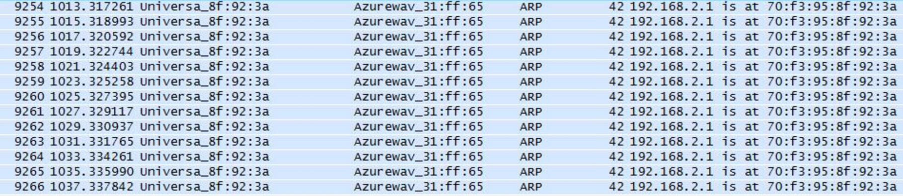

Man-in-the-Middle (MitM)

Slide 25
Man-in-the-Middle (MitM)
Solutions?

Slide 26
Man-in-the-Middle (MitM)
End-to-End Encryption
Even if the attacker is intercepting your traffic, they can’t do anything about it if they can’t read your traffic!
HTTPS (TLS)
VPN
Same as above, but only effective if the attacker is between you and the VPN!
Do you trust your VPN?

Slide 27
Man-in-the-Middle (MitM)
What can specifically be done about ARP Spoofing?
IDS/IPS can detect packet storms and respond accordingly.
Should there ever be a response without there first being a request?
Another entity claiming to be the gateway is suspicious...
Client can hard-code the MAC address of the gateway so ARP spoofing attempts fail.

Slide 28
WiFi Security (WPA-2)
WiFi has its own host of security issues...
In an open network (i.e. no encryption), its a free-for-all!
If there is no password (as is often the case) anyone can join.
Anyone can eavesdrop on anyone else’s traffic!
Today we will briefly talk about the WPA-2 Personal and Enterprise encryption schemes, which are used to authenticate clients.

Slide 29
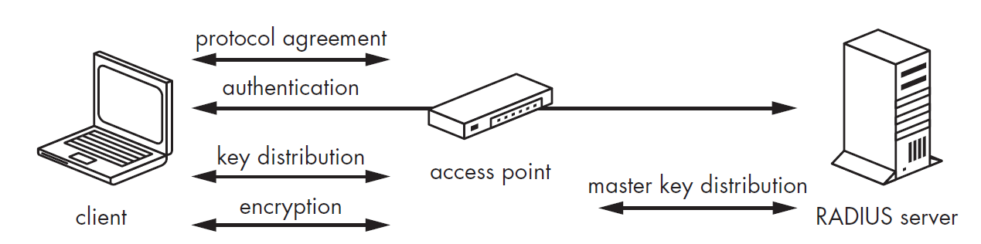
WiFi Security (WPA-2 Personal)
How does WPA-2 Enterprise work?

Slide 30
WiFi Security (WPA-2)
How does WPA2-Personal work?
Slightly simpler than the Enterprise scheme.
No RADIUS server is required
No master key step, entire process occurs between access point and client.
Uses pre-shared static keys instead of dynamically generated keys.

Slide 31
WiFi Security (WPA-2)
Four-Way Handshake
Establishes a secure connection between the access point and client
A pairwise master key (PMK), is first generated individually by the access point and client to be used in encrypt the handshake.
The PMK is generated from the following:
The passphrase (pre-shared key, or PSK)
The access point’s SSID
The SSID length
The number of hashing iterations (4096)
The resulting length in bits (256) of the generated shared key (PMK)

Slide 32
WiFi Security (WPA-2)
The PMK is then used with the following to generate the pairwise transient key (PTK), which is used to encrypt the handshake:
A random number (nonce) from the access point (ANonce)
A nonce from the client (SNonce)
The MAC address of the client
The MAC address of the access point
The handshake then generates the key to be used to encrypt communication.
A message integrity check (MIC) is sent to verify that the client has successfully authenticated.
Since the password is never broadcast (since both the access point and client must know them ahead of time), this is completely safe!

Slide 33
WiFi Security (WPA-2)
Right..?

Slide 34
WiFi Security (WPA-2)
If an attacker can capture the initial handshake, they can obtain the nonce’s used to generate the PTK.
Once you have the nonces, you have everything you need to know other than the password!
All other pieces of the key are publicly available (if you are in range of the access point)!
Can guess passwords and keep generating PMK -> PTK until we match the MIC.

Slide 35
WiFi Security (WPA-2)
But the nonces can only be captured during the initial handshake, what can an attacker do if a connection has already been established?

Slide 36
WiFi Security (WPA-2)
Spoof the access point and send a deauthorization packet, forcing the client to disconnect!
The deauth packet is non-negotiable: the client has to disconnect
Client will then try to reconnect, allowing an attacker to capture the handshake.

Slide 37
WiFi Security (WPA-2)
Solutions?

Slide 38
WiFi Security (WPA-2)
Use strong password
Attacker still has to guess it
Use WPA2-Enterprise!

