Slide 1

SIGSEC
February 7, 2017

Slide 2
News and Events
Later this month Professor Taylor will be presenting as a guest speaker. Her topic: DNS Security
Peter Snyder, PhD student working under Professor Kanich and collaborating with Professor Taylor, will be presenting his work on February 28th.
Measuring the usage and security of the Web API
More details as they become available.

Slide 3
More Ransomware Woes
A luxurious, 4-star hotel in Austria, the Romantik Seehotel Jaegerwirt, recently announced that they had to pay several thousand euros after their electronic key system was encrypted with ransomware.
Third time this has happened.
Hotel paid the ransom each time. On the third attempt, the attackers attempted to access a backdoor they installed but were shut down.
Hotel plans on going back to traditional locks and keys.
Misinformation – hotel guests were locked INSIDE of their rooms.
Source - http://www.thelocal.at/20170128/hotel-ransomed-by-hackers-as-guests-locked-in-rooms

Slide 4
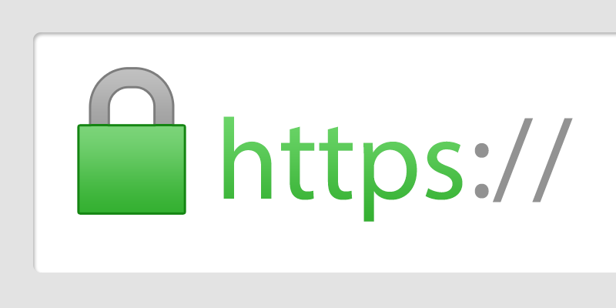
Transport Layer Security (TLS) and Certificates
We rely on it everyday in the form of HTTPS when browsing the web.
Both are used in combination to authenticate the server we are talking with and securing our data with encryption from eavesdroppers.
Today we will be discussing certificates and the role that Certificate Authorities play.
http://rigor.com/wp-content/uploads/2017/01/https.png

Slide 5

Cryptography
The process of securing information in the presence of a third-party, often known as the adversary.
Cryptosystems are based on known, computationally hard mathematical problems.
E.g. RSA revolves around the factoring problem.
The certificate system relies on public-key cryptography, whereas TLS relies on both public-key and symmetric-key cryptography.
http://pfsensesetup.com/wp-content/uploads/2013/12/sn-cryptography.jpg

Slide 6
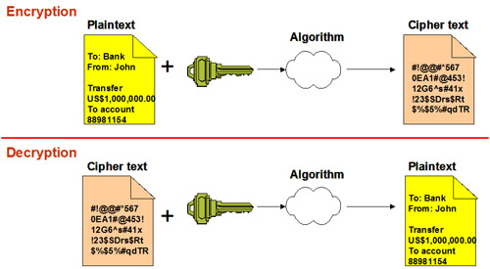
Symmetric-key Cryptography
A single key is agreed upon by both parties to encrypt messages.
Very Fast
Key must be delivered to other party securely.
Examples:
Caesar Cipher
Advanced Encryption System (AES)
http://www.securitycerts.org/images/symmetric-key-encryption.jpg

Slide 7
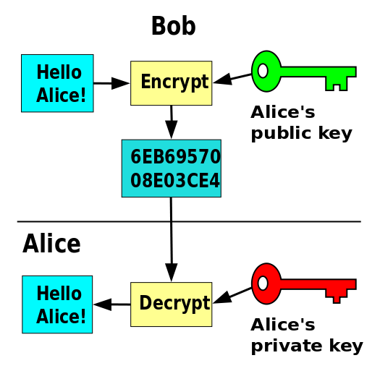
Public-key Cryptography
Pairs of asymmetric keys are used: a public key and a private key.
Public key is used to encrypt data.
Private key is used to decrypt data.
Can communicate securely in the presence of adversaries.
Limited by key size.
Slower than a symmetric key.
Examples
RSA
Diffie-Hellman key exchange
https://en.wikipedia.org/wiki/File:Public_key_encryption.svg

Slide 8
Signing and Verifying
Public/Private keys can also be used in reverse.
When using a private key to encrypt something, anyone with the public key can decrypt it.
Signatures are based on this principle.
Ex. I want to prove that this slideshow was created by me.
I take a hash of the file using SHA-512 (the digital fingerprint) and sign it with my private key. This is known as a digital signature.
When you receive the file, you take a hash of the file and verify it by decrypting the signature with my public key and comparing the two.
If they match, you know that my private key was used to create that signature and the contents have not been modified (with a high degree of certainty).

Slide 9
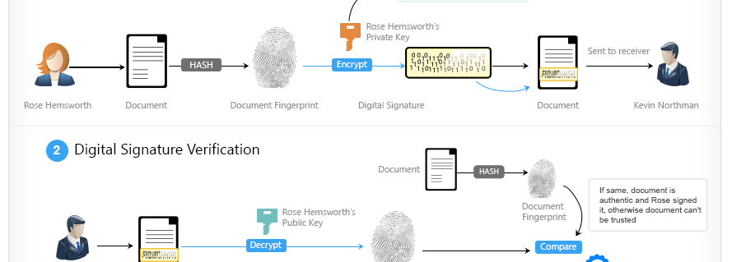
https://i0.wp.com/gwebsol.info/blog/wp-content/uploads/2016/02/digital-signature-verification.png

Slide 10

Transport Layer Security - Certificates
A certificate is not used to secure a connection.
Used for authentication. Issued by CAs to prove ownership of the public key used to encrypt communications.
“I’m Microsoft.com and this certificate issued by Symantec proves it.”
Public key used to create a secure connection in SSL/TLS enabled websites.
Browsers come installed with a suite of certificates that are trusted.

Slide 11
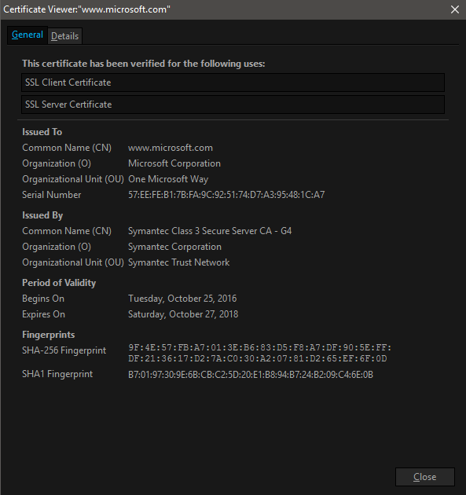
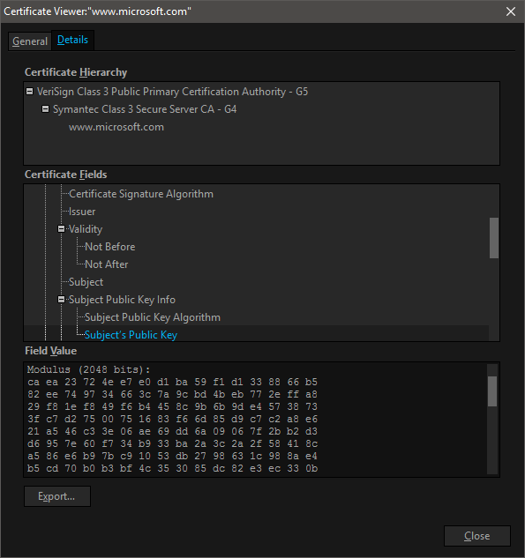
What’s in a name?

Slide 12
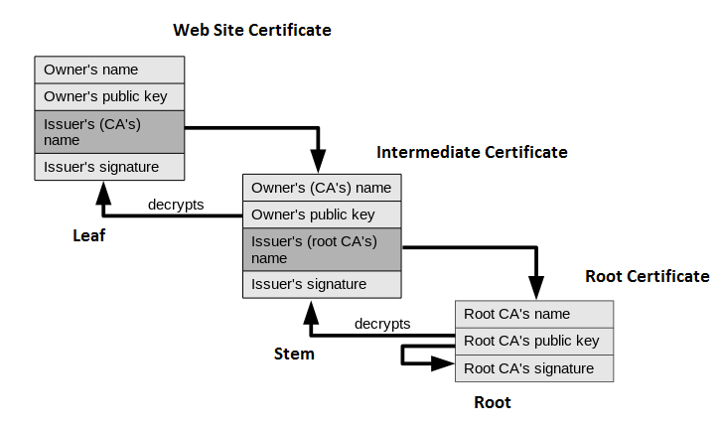
Chain of Trust
Certificates are issued in a tree structure known as the Chain of Trust.
“Leaf” nodes inherit the trust of the root.
Root certificates are not used to sign certificates for web sites.
Numerous intermediate certificates are created.
Security in the event one is compromised.
Root certificate is self-signed
Signed using own public key.
Original image at: https://upload.wikimedia.org/wikipedia/commons/d/d1/Chain_of_trust.svg

Slide 13
Certificate Authorities
Hold a very important role in securing our data.
Root Certificates are kept under EXTREME security.
Are only ever online to generate intermediate certificates.
Otherwise kept offline in a Hardware Security Module, which is extremely well guarded and kept under constant surveillance.
More details at https://arstechnica.com/security/2012/11/inside-symantecs-ssl-certificate-vault/ and http://security.stackexchange.com/questions/24896/how-do-certification-authorities-store-their-private-root-keys
There is a high-level of trust placed in all CAs. But it only takes one bad CA to spoil everything.

Slide 14
WoSign
Issued SHA-1 certificates after their planned expiration (January 1, 2017).
“From Jan 10th to to April 23rd 2015, WoSign's certificate issuance system for their free certificates allowed the applicant to choose any port for validation. Once validation had been completed, WoSign would issue certificates for that domain. A researcher was able to obtain a certificate for a university by opening a high-numbered port (>50,000) and getting WoSign to use that port for validation of control.”
In June 2015, an applicant found some problems with WoSign's free certificate service. There were actually two bugs, which we will denote N1 and N2.
Bug N1 was an issue where someone proving control of <subdomain>.example.tld also was given a cert covering example.tld.
Bug N2 was an issue where arbitrary domains can be added to an existing request after validation.
More issues at: https://wiki.mozilla.org/CA:WoSign_Issues

Slide 15
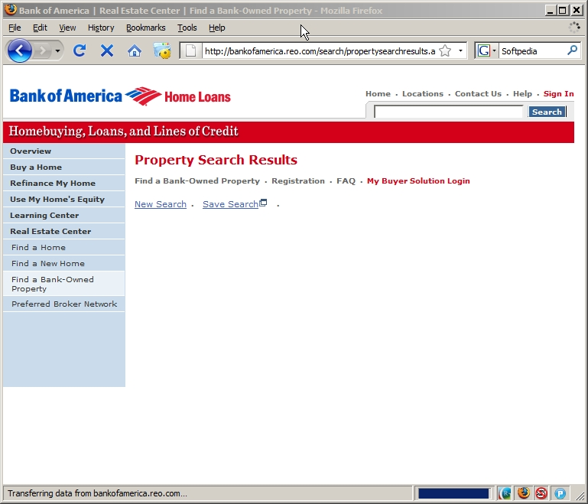
Tangent!

Slide 16
SSL Stripping
Before HTTPS was ubiquitous, it was common for websites to be sent over HTTP and only requests that contained sensitive information were sent using HTTPS.
SSL Stripping is a man-in-the-middle (MitM) attack where an attacker prevents a page from “upgrading” to an SSL connection, virtually unnoticeable by your average user.
Victim communicates with you via HTTP and you communicate with the server on their behalf using HTTPS.

Slide 17
HTTP Strict Transport Security (HSTS)
Mitigation for SSL Stripping.
Enforces that a browser only communicates with the hostname using a HTTPS connection.
Done by supplying a HSTS header over an HTTPS connection:
‘Strict-Transport-Security: max-age=31536000’
All insecure links are turned into secure links (http -> https)
If a link cannot be converted, an error is displayed and the page is not fetched.

Slide 18
Question..
Let’s say I create a website that impersonates Bank.com and have successfully poisoned Bob’s DNS cache, pointing his browser at my website. Unfortunately, Bank.com is HSTS enabled.
I want to forge the certificate for Bank.com and act as a proxy between Bob and Bank.com, transparently watching traffic between the two.
The public key in the certificate is in plaintext, so I replace it with my own and send it to Bob.
What happens next?

Slide 19
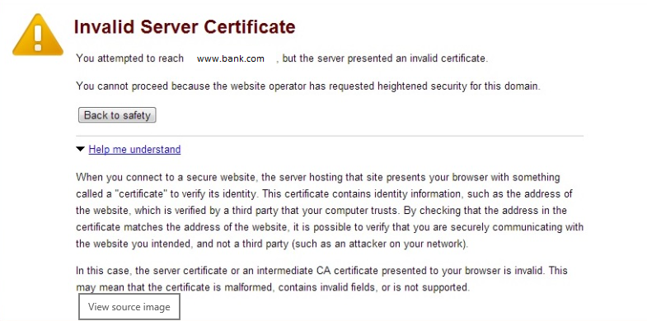
Answer
Bob’s browser will verify the signature in the certificate, which was a hash of the original certificate.
Since the public key was changed, when the browser computes the hash, it is different from the hash in the signature.
The browser displays the error message to the right.
Bob tries to click-through anyways because he didn’t read and is impatient, but the browser won’t let him in this case.

Slide 20
What about Burp Suite?
Why did we get the warnings when we tried to visit sites that used HTTPS?

Slide 21
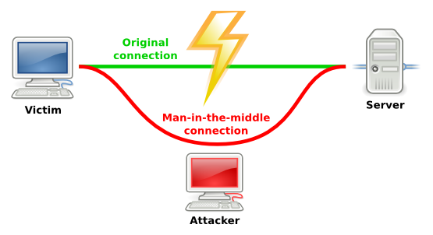


Slide 22
Questions?

