Slide 1
RBL
1. Nearly all SOCs have ROM bootloader
2. On sytem start up or reset, the ROM bootloader (RBL) starts running. The job of this RBL, is to do some very bare minimum initialisation and then find and boot from a device such as MMC card or flash
3. The RBL has got the capability to boot from a variety of devices like NOR flash, NAND flash, MMC, USB or UART.

Slide 2
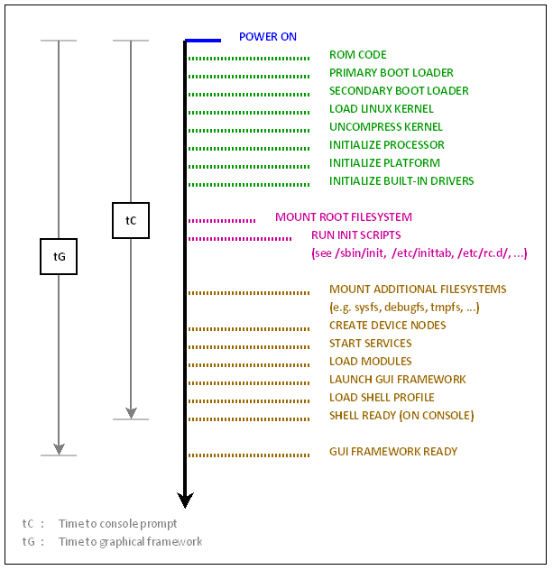
Typical Boot process

Slide 3
how does the chip know which device to boot from?
1. The chip has got a set of pins, sys_boot[4:0] pins, whose state decides what memory or peripheral to boot from.
2. Also, there is a predefined booting order in the case of both memory booting or peripheral booting.
e.g. let’s say the state of sys_boot[4:0] pins is 0b01110. Then, the booting order will be XIPwait, DOC, USB, UART3 and finally MMC1
XIPwait : Execute in Place memory with wait monitoring
DOC : DiskOnChip memory.

Slide 4
MLO boting
1. If sys_boot pins is configured to boot from MMC card, on power on, the ROM will initialise the SD/MMC device, detect a card and look for a boot image.
2. The ROM is capable of reading from the card with a filesystem. It will search for a file named MLO which should be located on the boot partition, on a partition of type FAT16/32.

Slide 5
Case Study OMAP platform
Boot Overview :
When a system is first booted, the cpu invokes the reset vector to start the code at a known location in ROM

Slide 6
Rom code Function
Performs minimal clocks,memories and peripheral configuration
Searches the booting device for valid booting image
Loads the x-loader into SRAM and executes it

Slide 7
SYSBOOT Pins
The internal ROM Code can attempt to boot from several different peripheral and memory devices, including, but not limited to: Serial (UART3), SD Card, eMMC, NAND, and USB.
The order in which these devices are searched for a valid first-stage booting image (x-loader) is determine by a set of GPIO configuration pins referred to as SYSBOOT.

Slide 8
SYSBOOT Pins
The SYSBOOT value can be read from physical address 0x480022f0, either using JTAG, or if you have linux running, use devmem2
e.g. # devmem2 0x480022f0 b
/dev/mem opened.
Memory mapped at address 0x40020000.
Value at address 0x480022F0 (0x400202f0): 0x2F

Slide 9
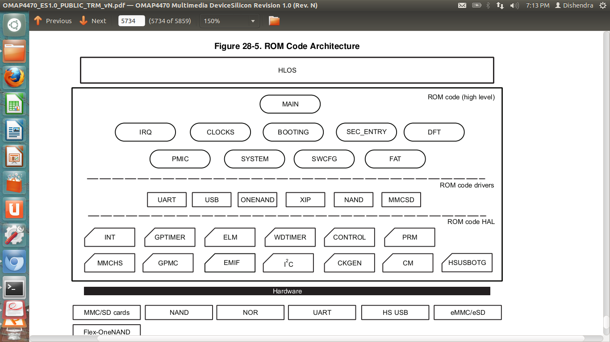
Typical ROM Code Architecture

