Slide 1
All About X-loader in Android

Slide 2
x-loader overview
The x-loader is a small first stage bootloader derived from the u-boot base code.
It is loaded into the internal static RAM by the ROM code.
The x-loader configures the pin muxing, clocks, DDR, and serial console, so that it can access and load the second stage bootloader (u-boot) into the DDR.

Slide 3
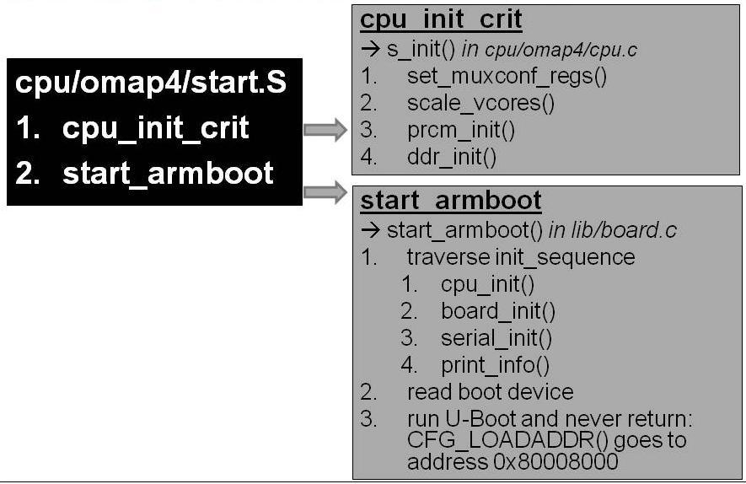
An example of x-loader in omap4

Slide 4
cpu_init_crit
There are 4 major functions called
1. set_muxconf_regs();
2. scale_vcores();
3. prcm_init();
4. ddr_init();

Slide 5
set_muxconf_regs()
Setting up the configuration Mux registers specific to the hardware. It internally calls
A. MUX_DEFAULT() : It is defined like :
/*
* IEN - Input Enable
* IDIS - Input Disable
* PTD - Pull type Down
* PTU - Pull type Up
* DIS - Pull type selection is inactive
* EN - Pull type selection is active
* M0 - Mode 0
* The commented string gives the final mux configuration for that pin
*/
#define MUX_DEFAULT()\
/*SDRC*/\
MUX_VAL(CP(SDRC_D0), (IEN | PTD | DIS | M0)) /*SDRC_D0*/\
....... .........................................................................................................

Slide 6
cpu_init_crit
Further MUX_VAL is defined as :
#define MUX_VAL(OFFSET,VALUE)\
__raw_writew((VALUE), OMAP34XX_CTRL_BASE + (OFFSET));
So the value is written in the given register to configure them appropriatly.
Following mux registers are configured.
1. SDRC
2. GPMC
3. DSS
4. UART
5. SYS_BOOT
6. JTAG
etc.

Slide 7
scale_vcores()
omap 4 : case study :
It calls omap_revision then omap_vc_init then it calls depending on the omap version scale_vcore_omap44xx.
omap_vc_init : populate the register PRM_VC_CFG_I2C_MODE and PRM_VC_CFG_I2C_CLK with the appropriate values.
omap_vcore_omap44xx : Send a data using VC Bypass command. Populate the registers PRM_VC_VAL_BYPASS and PRM_IRQSTATUS_MPU with appropriate values.

