Slide 1
U-boot Build and Code Flow
Manish Badarkhe
Notes:
<number>

Slide 2
Agenda
Introduction
ROM Code
SPL Code Flow
U-Boot Code Flow
Memory Maps
U-Boot Build/Compilation
Notes:
<number>

Slide 3
Introduction
The U-Boot utility is a multi-platform, open-source, universal boot-loader with comprehensive support for loading and managing boot images, such as the Linux kernel. It supports the following features:
Network download: TFTP, BOOTP, DHCP, NFS
Serial download: s-record, binary (via Kermit)
Flash management: copy, erase, protect, cramfs, jffs2
Flash Types: CFI NOR-Flash, NAND-Flash
Memory utilities: copy, dump, crc, check, mtest
Mass Storage Devices: IDE, SATA, USB
Boot from disk: raw block, ext2, fat, reiserfs
Notes:
Programmed Logic for Automated Teaching Operations
<number>

Slide 4
Two Stage U-Boot Booting
The size of the internal RAM in AM335X is 128KB out of which 18KB at the end is used by the ROM code. Also, 1 KB at the start (0x402f0000 - 0x402f0400) is secure and it cannot be accessed This places a limit of 109KB on the size of the U-Boot binary which the ROM code can transfer to the internal RAM and use as an initial stack before initialization of DRAM.
Since it is not possible to squeeze in all the functionality that is normally expected from U-Boot in < 110KB (after setting aside some space for stack, heap etc) a two stage approach has been adopted. Initial stage initialize only the required boot devices (NAND, MMC, I2C etc)& 2nd full stage initall all other devices (ethernet, timers, clocks etc). The 1st binary is generated MLO and the 2nd stage is generated as u-boot.img.

Slide 5
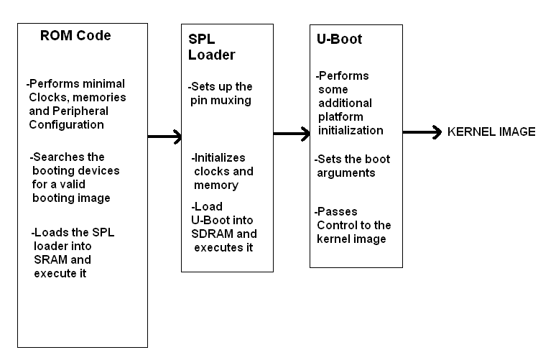
TI U-Boot Overview
Consist of ROM, SPL and U-Boot image and are loading in stages while booting.

Slide 6
ROM Code
The internal ROM Code can attempt to boot from several different peripheral and memory devices, including, but not limited to: Serial (UART3), SD Card, eMMC, NAND, and USB. The order in which these devices are searched for a valid first-stage booting image (MLO) is determine by a set of GPIO configuration pins referred to as SYSBOOT

Slide 7
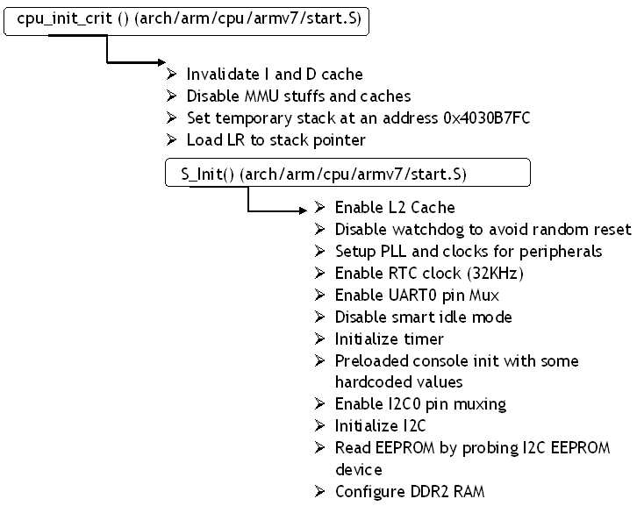
SPL Code Flow
On Start Up -

Slide 8
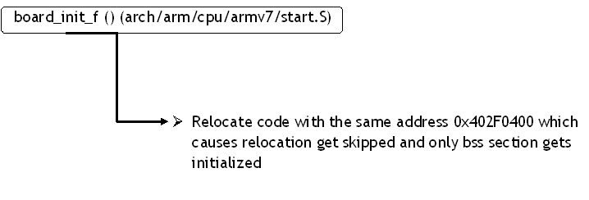
Continue …
Before Relocation -

Slide 9
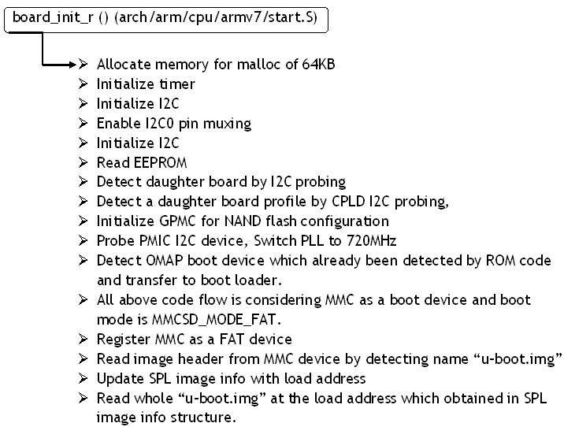
Continue …
Continue …
After Relocation -

Slide 10
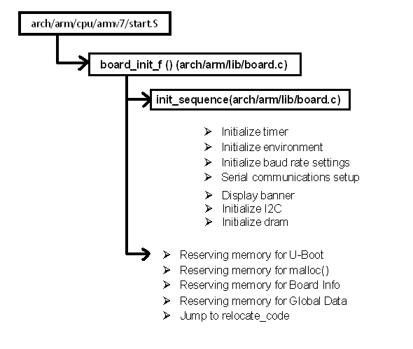
U-Boot Code Flow
Before Relocate -

Slide 11
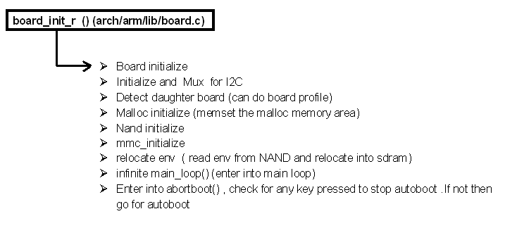
Continue …
After Relocate -
-

Slide 12
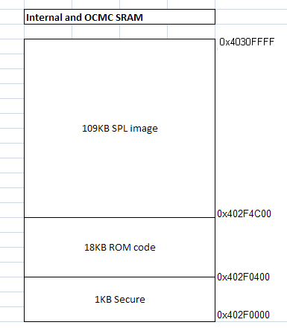
Memory Maps
Internal RAM Memory mapping
Internal SRAM 64KB
OCM RAM 64KB
It contains:
1KB secure portion
18KB ROM code
109KB of SPL image

Slide 13
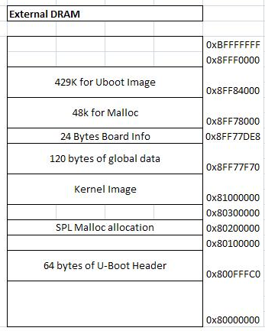
Continue …
External DRAM Memory mapping
DRAM size: 1GB
DRAM used for U-Boot
1 Bank: 256MB
It mainly contains:
U-Boot Image
Kernel Image
U-Boot Header

Slide 14
U-Boot Build/Compilation
Common files used in Build of U-Boot
Make Command :
make O=am335x CROSS_COMPILE=arm-arago-linux-gnueabi-ARCH=arm
am335x_evm
Location | Description
Makefile | This is root makefile used in compilation of Uboot.
mkconfig | This is an executable file and it runs through root makefile and use to include necessary *.h files like configuration file.[here am335x_evm.h]
config.mk | This file is used to load configurations and this file get added by Makefile
board.cfg | This file is used In order to add a new board specifications like ARCH, CPU, BOARD, VENDOR and SOC

Slide 15
Continue …
Board specific files in Build of U-Boot
Location | Description
include/configs/am335x_evm.h | Configuration file for am335x
spl/Makefile | Makefile for SPL build
arch/arm/cpu/armv7/start.S | ARM start up file
arch/arm/lib/board.c | ARM board library file

Slide 16
Continue …
Location | Description
arch/arm/cpu/armv7/omap-common/Makefile | Used by the compiler to select files to compile
arch/arm/cpu/armv7/omap-common/gpio.c | Having functions to set the gpio direction and values on gpio.
arch/arm/cpu/armv7/omap-common/lowlevel_init.S | Having low level initialization functions.
arch/arm/cpu/armv7/omap-common/spl.c | Main file for SPL build, having board initialization functions.
arch/arm/cpu/armv7/omap-common/spl_mmc.c | Having mmc init and image load functions
arch/arm/cpu/armv7/omap-common/timer.c | Timer initialization

Slide 17
Continue …
Continue …
Location | Description
arch/arm/cpu/armv7/ti81xx/Makefile | Used by the compiler to select files to compile
arch/arm/cpu/armv7/ti81xx/cache.S | Cache enable and disable
arch/arm/cpu/armv7/ti81xx/mem.c | Used for gpmc initialization

Slide 18
Continue …
Location | Description
board/ti/am335x/Makefile | Used by the compiler to select files to compile
board/ti/am335x/evm.c | Main board file
board/ti/am335x/pll.c | Main PLL configuration file
board/ti/am335x/mux.c | Main Muxing file
Execute Command :
setenv bootargs 'console=ttyO0,115200n8 ip=dhcp mem=128M root=/dev/nfs nfsroot=192.168.247.76:/opt/filesystem/am335x_fs,nolock rw';mmc rescan;fatload mmc 0 81000000 uImage;bootm 81000000

Slide 19


Slide 20


