Slide 1

CACHE
A cache is a small, fast array of memory placed between the processor core and main memory that stores portions of recently referenced main memory.
A cache is required to reduce the memory access bottleneck
Imposed on the processor core by slow memory.
Processor uses cache memory instead of memory to increase
System performance.

Slide 2
Types of Cache
Unified Cache
In processor core using Von Neumann architecture, there
is a single cache used for instruction and data.
Split Cache
In processor core using Harvard architecture, there are
two caches (i.e. I-Cache and D-Cache).

Slide 3
Cache Architecture
Cache Memory
Cache memory is dedicated memory array accessed in units called cache lines.
Cache Controller
Cache Controller uses different portions of the address issued by the processor during a memory to select parts of cache memory.

Slide 4
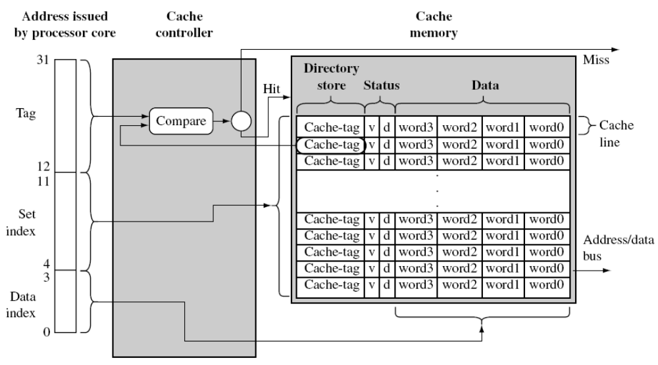

Slide 5
Cache Architecture
A Cache Memory has three main parts:
Directory Store.
Data Section.
Status Information.
All the above three parts of cache memory present for each cache line.

Slide 6
Cache Architecture
Directory Store -
It holds the address identifying where the cache line was copied from main memory.
Data Section –
Data read from main memory to cache memory are
Stored in data section
Status Information –
status bits in cache memory to maintain state information.
Two common status bits are
Valid bit
Dirty bit

Slide 7
Cache Architecture
A valid bit marks a cache line as active, meaning
it contains live data originally taken from main memory and is currently available to the processor core on demand
A dirty bit defines whether or not a cache line contains data that is different from the value it represents in main memory

Slide 8
Cache Write policy
WriteThrough –
When the cache controller uses a writethrough policy, it writes to both cache and main memory when there is a cache hit on write, ensuring that the cache and main memory stay coherent at all times.
WriteBack –
When a cache controller uses a writeback policy, it writes to valid cache data memory and not to main memory. Consequently, valid cache lines and main memory may contain different data
WriteThrough policy is slower than a WriteBack policy

Slide 9
Flushing Cache Memory
Flushing simply clears the valid bit in the affected cache line. All or just portions of a cache may need flushing to support changes in memory configuration. The term invalidate is sometimes used in place of the term flush
Flush Cache MCR p15, 0, Rd, c7, c7,0
Flush Data Cache MCR p15, 0, Rd, c7,c6, 0
Flush Instruction Cache MCR p15, 0, Rd, c7,c5, 0

Slide 10
Cleaning Cache Memory
Cleaning a cache is to force a write of dirty cache lines from the cache out to main memory and clear the dirty bits in the cache line. Cleaning a cache reestablishes coherence between cached memory and main memory, and only applies to D-caches using a writeback policy.
Test Clean Operation -
The test and clean DCache instruction provides an efficient way to clean the entire DCache using a simple loop. The test and clean DCache instruction tests a number of lines in the DCache to determine if any of them are dirty. If any dirty lines are found, then one of those lines is cleaned. The test and clean DCache instruction also returns the
status of the entire DCache in bit 30.

Slide 11
Cleaning Cache Memory
If the cache contains any dirty lines, bit 30 is set to 0. If the cache contains no dirty lines, bit 30 is set to 1. This means that you can use the following loop to clean the entire DCache:
tc_loop: MRC p15, 0, r15, c7, c10, 3
BNE tc_loop

Slide 12
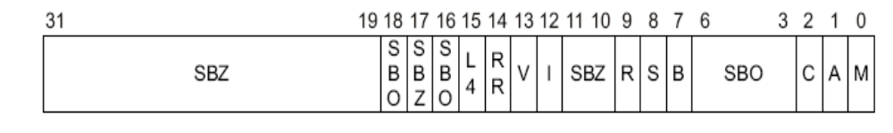
Enabling Cache and MMU
C1 control register specifies the configuration used to enable and disable the caches and MMU.
MRC p15, 0, <Rd>, c1, c0, 0 ; read control register
MCR p15, 0, <Rd>, c1, c0, 0 ; write control register
M bit - MMU enable/disable: 0 = disabled 1 = enabled.
I bit - I-Cache enable/disable: 0 = I-Cache disabled 1 = I-Cache enabled.
C bit - DCache enable/disable: 0 = Cache disabled 1 = Cache enabled.

Slide 13
Enabling Cache and MMU
The C bit is overridden by the M bit setting, if MMU disabled then DCache is also disabled.
MMU has to enabled before enabling D-cache.
The DCache supports write-through and write-back, or copyback, cache operations, selected by memory region using the C and B bits in the MMU translation tables.

