Slide 1
Real Estate Price Prediction using linear regression

Slide 2
Problem Statement and Business Goals
Problem Statement
Consider a real estate company that has a dataset containing the house price of unit area in the state of Maryland, USA. The company wishes to use the data to optimize the prices based on important factors such housing age, distance to the nearest MRT station, number of convenience stores, latitude, and longitude

Slide 3
Problem statement and Business goal
Business Goal
I am required to model the house price of unit area with the available independent variables (features) of my dataset. It will be used by the management to understand how exactly the house price of unit area vary with the independent variables. They can accordingly manipulate the design of the houses, the business strategy etc. to meet certain price levels. Further, the model will be a good way for management to understand the pricing dynamics of a new market.

Slide 4
Dataset used
The dataset is obtained from Kaggle. The data has been uploaded in my github. It includes 414 rows and 8 columns. It has independent features such house age, distance to the nearest MRT station, number of convenience stores, latitude and longitude. All of these features play a very important roll in my prediction of house price of unit area(target(y)).

Slide 5
Technique used
Language used in this project
Python
Linear regression is the technique which I used to model my prediction

Slide 6
Technique used
The following steps were used:
Import libraries: Import all the libraries needed for this project such as pandas, sklearn.model_selection, seaborn, matplotlib.pyplot
I used pandas to import my dataset
I used some basic techniques to check and clean my data such as real_estate.info(), real_estate.isnull().sum() , real_estate.dropna() etc
Data visualization is carried out by placing my data in a visual context such that certain patterns, trend and correlation that might not otherwise by detected can be exposed

Slide 7
Technique used
Data splitting
sklearn.model_selection is the library use to split our data into training and testing dataset.
80% is my training data and 20% my test data

Slide 8
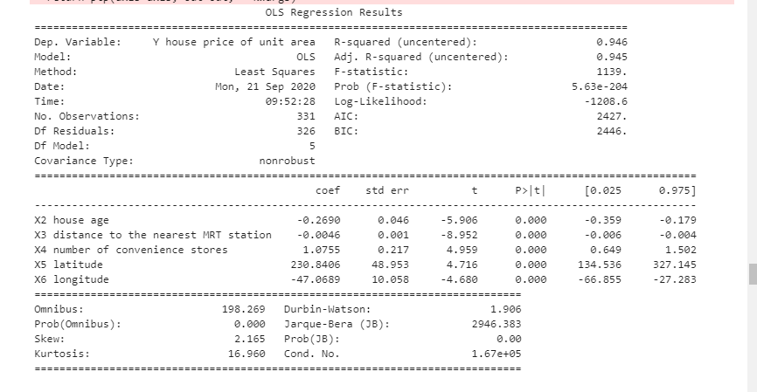
OLS REGRESSION RESULT
The p value of all the features is 00.00 and less than 0.05 which mean all the variables or features are important. My R2_Score is 94.6% which makes it good
Notes:
The p value of all the features is 00.00 and less than 0.05 which mean all the variables or features are important The sign of regression coefficient tells you whether there's positive or negative correlation between each independent variable and the dependent variable. Positive coefficient indicates as the value of the independent variable increases, the mean of the dependent varaiable also incresases and a negative cofficient indicates as the the value of the independent variable increases, the value of the dependent varaiable decreases R-squared is always between 0-100%]

Slide 9
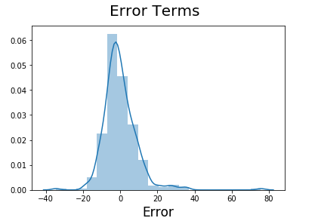
Error term
My error term is normally distributed, it indicates my assumption on the linear model is fulfilled

Slide 10
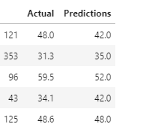
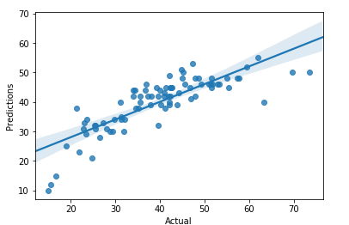
Making predictions on final score
The 20% test data is used to carryout predictions. The table shows the actual value and the predicted value of the test values of y
The graph above shows the plot of the actual vs the predicted values of y-test

Slide 11
Model performance and conclusion
Model performance
MAE = 5.4183854395275235 MSE = 49.41158174311 RMSE = 7.029337219333698
The RMSE will always be larger or equal to the MSE
The smaller the RMSE the better our prediction
Conclusion
My model has adequately addressed the problem statement and help us understand how linear regression can be used in real life to solve problems.

