Slide 1
Spatial Proteomics
Prof. Jean Fan

Slide 2
Lesson Objectives
Learn about spatial epigenomics
Analyze and visualize a new mystery dataset together

Slide 3
Why epigenetics?

Slide 4
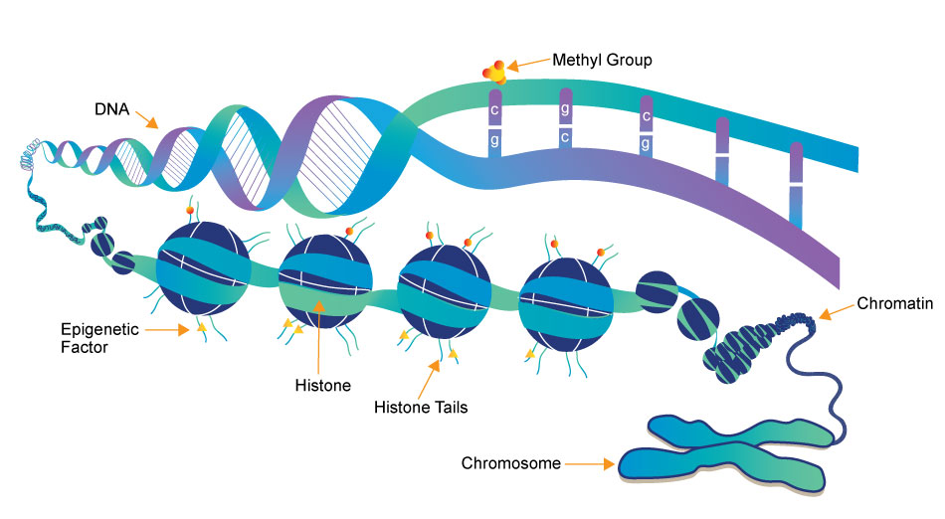
(a type of
protein)
Source: https://www.whatisepigenetics.com/fundamentals/

Slide 5
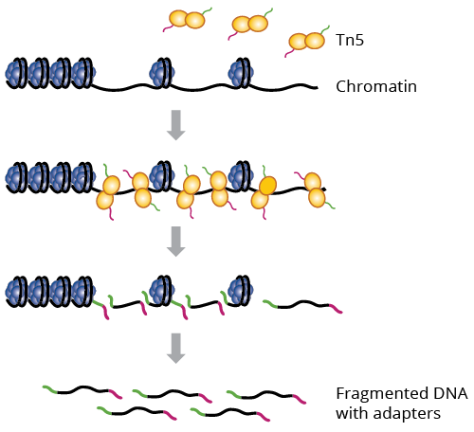

What parts of DNA are accessible for transcription?
ATAC-seq: Assay for Transposase-Accessible Chromatin using Sequencing
Why could this be interesting?
a genetically engineered hyperactive Tn5 transposase (2013) that simultaneously cuts open chromatin leaving a staggered nick and ligates sequencing adapters to these regions

Slide 6

Interpreting ATAC-seq data
Sequence:
Alignment:
Genome

Slide 7
Visualizing ATAC-seq data
Cell-type A
Cell-type B
genes
Genome

Slide 8
Food for thought
Many many RNA molecules are in a typical mammalian cell?
How many accessible regions are in the genome of a mammalian cell?
Notes:
Approximately 360,000 mRNA molecules are present in a single mammalian cell, made up of approximately 12,000 different transcripts with a typical length of around 2 kb.

Slide 9
Food for thought
If I want to sequence every RNA molecule, at least how many reads do I need to sequence?
If I want to sequence every accessible region, at least how many reads do I need to sequence?

Slide 10
Food for thought
We’ve seen a range of measurements for gene expression (0 to X copies) in a single cell
What is the range of measurements you expect for accessibility data in a single cell?

Slide 11
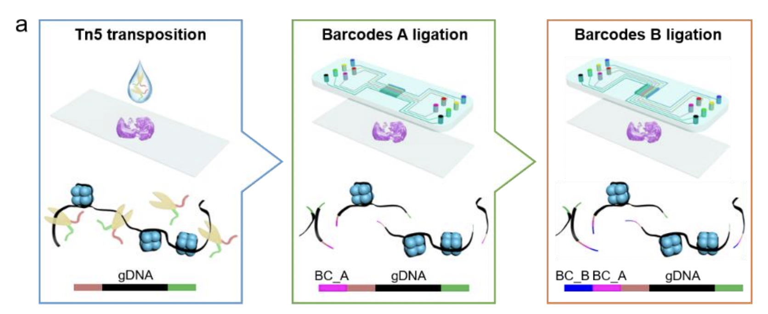
Getting to spatially resolved by sequencing (spatial ATAC-seq via DBiT-seq)
Source: https://www.biorxiv.org/content/10.1101/2021.06.06.447244v1

Slide 12
Spatial ATAC-seq
Still get count and position matrix
Instead of spot by gene, we get spot by DNA region
In theory, we can cluster and do all the same analyses as spatial transcriptomics

Slide 13
Practice Question
In spatial transcriptomics analysis, clusters of cells are transcriptionally similar (express similar genes). What do these spatial ATAC-seq clusters mean?

Slide 14
Practice Question
In spatial transcriptomics analysis, differential testing could help us identify which genes were upregulated in clusters. Can we do differential testing with ATAC-seq?
How would you interpret the results?

Slide 15
Food for thought
In spatial proteomics, we talked about how if we don’t titrate antibodies appropriately, we can get a lot of non-specific binding resulting in false positives (detecting proteins where there are none)
Are we more likely to get false positives or false negatives with spatial atac-seq?

