Slide 1
EN.580.428
Genomic Data Visualization
Lesson 5
K-means clustering
Prof. Jean Fan

Slide 2
Lesson learning objectives
Learn about and apply k-means clustering
Practice interpreting data visualizations integrating normalization, dimensionality reduction, and k-means

Slide 3
Why cluster?
Gene B
Gene B
Gene A
Gene A

Slide 4

K-means clustering algorithm
Step 1: randomly place k centroids
Gene B
Gene A

Slide 5
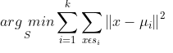
K-means clustering algorithm
Step 2: for each observation (x), find the nearest centroid
Gene B
Gene A

Slide 6
K-means clustering algorithm
Step 3: assign the observation (x) to that cluster
1
Gene B
2
3
Gene A

Slide 7

K-means clustering algorithm
Step 4: for each cluster, recompute to find a new centroid based on the observations in that cluster
Gene B
Gene A

Slide 8
K-means clustering algorithm
Step 5: repeat steps 2 through 4 until cluster assignments no longer change
1
Gene B
2
3
Gene A

Slide 9
K-means clustering algorithm
Step 5: repeat steps 2 through 4 until cluster assignments no longer change
1
Gene B
2
3
Gene A

Slide 10
K-means clustering algorithm
Step 5: repeat steps 2 through 4 until cluster assignments no longer change
1
Gene B
2
3
Gene A

Slide 11
How to pick an appropriate k?
What if I had picked k = 2?
Gene B
Gene A

Slide 12
How to pick an appropriate k?
What if I had picked k = 2?
1
Gene B
2
Gene A

Slide 13
How to pick an appropriate k?
What if I had picked k = 2?
1
Gene B
2
Gene A

Slide 14
How to pick an appropriate k?
What if I had picked k = 2?
1
Gene B
2
Gene A

Slide 15
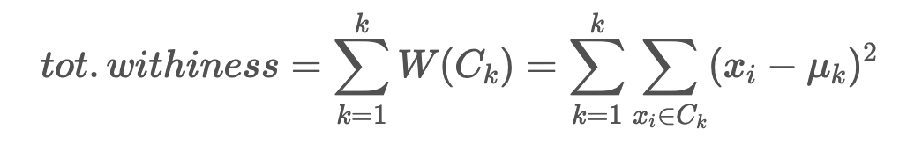
How to pick an appropriate k?
How does the within cluster sum of squares compare?
1
1
Gene B
Gene B
2
2
3
Gene A
Gene A

Slide 16
How to pick an appropriate k?
What if I had picked k = 4?
Gene B
Gene A

Slide 17
How to pick an appropriate k?
What if I had picked k = 4?
1
Gene B
3
2
4
Gene A

Slide 18
How to pick an appropriate k?
What if I had picked k = 4?
1
Gene B
3
2
4
Gene A

Slide 19
How to pick an appropriate k?
What if I had picked k = 4?
1
Gene B
3
4
2
Gene A

Slide 20
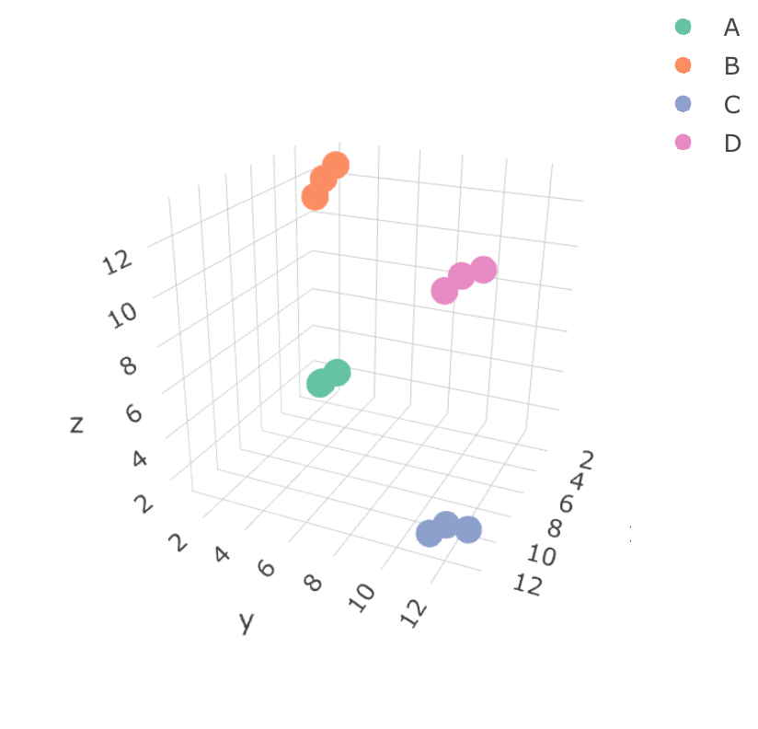
Based on this visualizations, which cell-type expresses more gene Z: cell-type B or cell-type D?
Practice

Slide 21
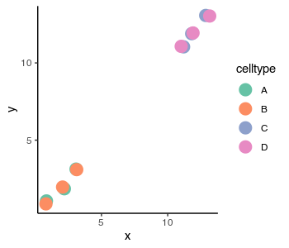
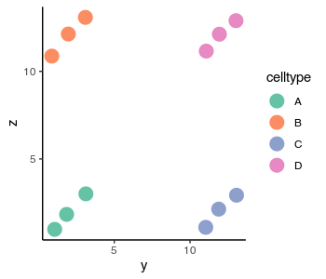

Based on this visualizations, which cell-type expresses more gene Z: cell-type B or cell-type D?
Practice

Slide 22
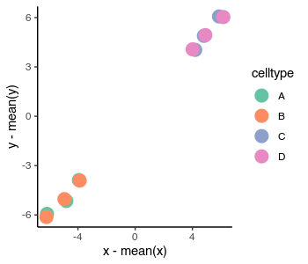
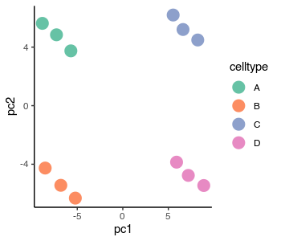
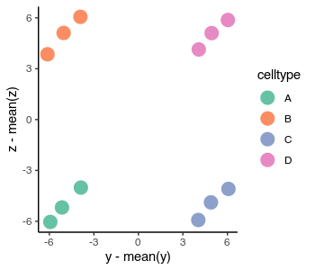
Based on these visualizations, what is the loading value of gene Z on PC2?
Practice

Slide 23
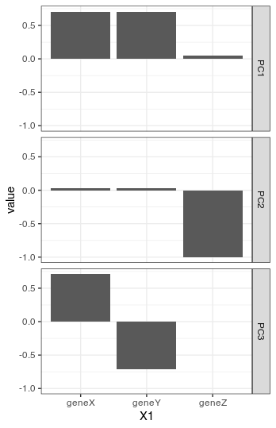
Based on these visualizations, which population expresses more gene Z: cell-type A or B?
Practice

Slide 24
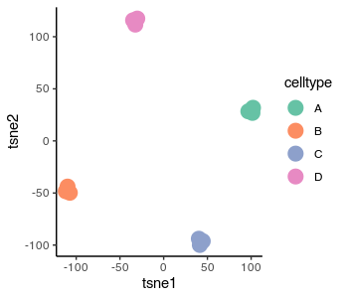
Based on this t-SNE plot, which population expresses more gene Z: cell-type A or B? What other information do you need to answer this question?
Practice

Slide 25
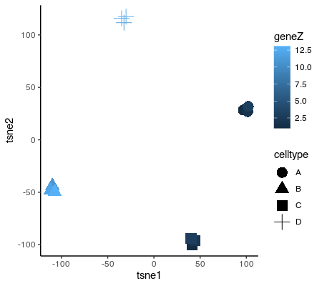
Based on this t-SNE plot, which population expresses more gene Z: cell-type A or B? What other information do you need to answer this question?
Practice

Slide 26

What can we run k-means clustering on?
Will the clusters we get be similar?
Practice
Gene expression?
PCs?
tSNE?

