Slide 1
Detection and Prevention of Advanced Persistent Threats (APT) activities in heterogenous networks using SIEM and Deep Learning
Code developed as a part of IBM funded project
Members : Balaji Bharatwaj M, Aditya Reddy M
Research Supervisor – Senthil Kumar T
In support with : Sulakshan Vajipayajula
Architect CTO Office, IMB Security Bangalore – svajipay@in.ibm.com

Slide 2
Problem statement
To design a model that detects Advanced Persistent Threats in heterogenous networks using Hidden Markov Models
Methodology
Use Wireshark to track the network and obtain the .pcap file
Export the .pcap file into CSV (Comma separated value) files. Then convert that into a variable dataframe for easy manipulation
Extract the required features from the variable data frame
Apply Hidden Markov Model to find the outliers from the dataset
Results can be visualized as a Dendrogram and Packet analysis diagram
Current Status
Completed the implementation using Hidden Markov Model and output is visualized using a Dendrogram and Packet Analysis diagram

Slide 3
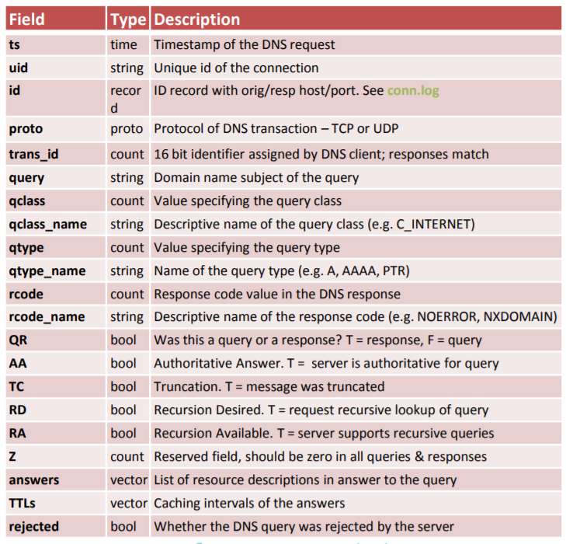
Dataset Information
DNS log dataset is used for our implementation.
Source of the dataset – secrepo.com – Samples of security related data
Dataset Features – Source: secrepo.com

Slide 4
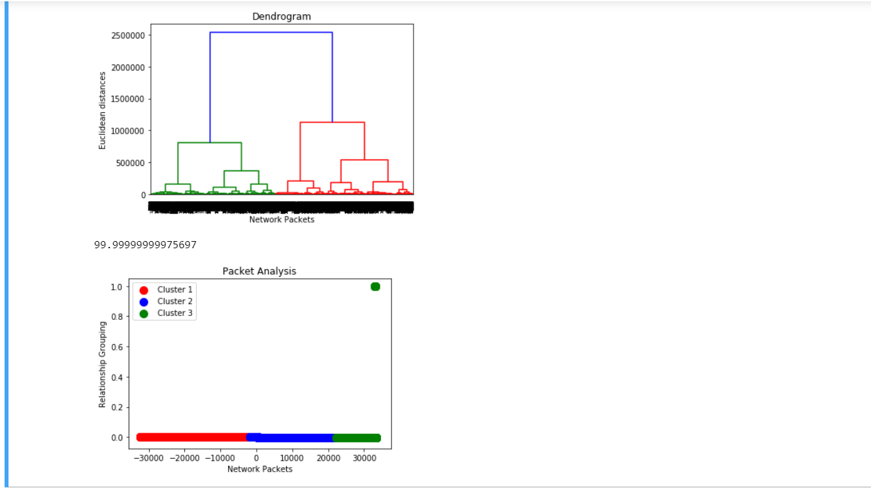
Algorithms used
For Comparison – KNN, K-Means
Implementation - HMM
Results - Output

