Slide 1
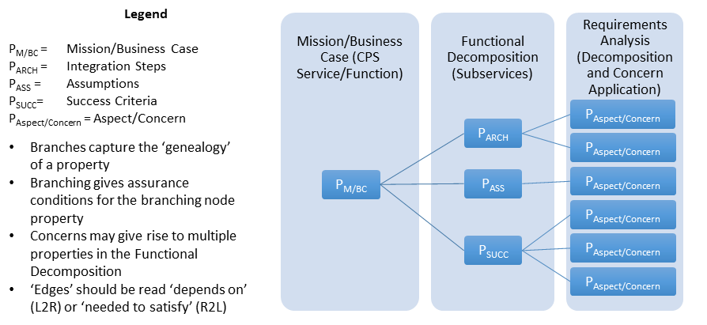
Type Theoretic Assurance of CPS
Background
property-Tree of a CPS
semantics of CPS Framework
… defines composition of concerns
formal methods for assurance of a CPS

Slide 2
Background
Applying CPS Framework to Decomposition
CPS/Function Types
Safety “Properties” of a Function: AEB
Business Case
AEB – vehicle provides automated collision safety function
Use Case
‘feature’
AEB – vehicle provides/maintains safe stopping
CPS (Therm,
HVAC, Gateway)
AEB –braking function reacts as required
Functional Decomposition/Allocation
Physical
AEB – friction function provides appropriate friction
Influence
Energy
AEB – stopping algorithm provided safe stopping
Logical
AEB – messaging function receives distance to obstacles and speed from propulsion function
Messaging
Info
AEB – distance and speed info is understood by braking function
Apply Aspects/Concerns
Generate System
Properties

Slide 3
Integrated Body Security System
Business Case
Integrated body security system
Monitors the activity of safety personnel in the course
of the response to an incident.
Provides some kind of alarm capability that can be triggered
by the person wearing the integrated body security system.
Enables the transfer of A/V/Data/Info to a storage system
in a trustworthy way.
If trustworthy, it may be used in litigation.
CPS
Integrated body security system (integrated camera-mic-siren)
Physical interactions
camera receives video signal from environment
influence: video signal
energy: electromagnetic waves (visible part of the spectrum)
mic receives video signal from environment
influence: audio signal
energy: sound waves (vibrations in the air)
siren produces an audible signal
influence: audible signal
energy: sound waves (vibrations in the air)
cellular network that processes the call [TBD]
establishes connection between dispatcher and injured party
influence: wireless signal
energy: electromagnetic waves
Use case
(enumerates scenarios (aka features), finite number of steps that describe
interactions between the actors)
Realtime awareness scenario 1 (of safety person's status when responding)
pick up audio and video
provide awareness by alerting a remote operator
Realtime awareness scenario 2 (of safety person's status when responding)
pick up audio and video
capture information about the situation for later analysis
Situation is out-of-hand
Safety person has an opportunity to sound an alarm siren
Forensics
have a log of when camera/mic fail or of when office shuts them off
having a log would enable forensic audit
System governance between logical and physical
if you have reason to doubt logical info from the system
you may do a second measurement on the system
to make sure the signal is coming through properly
Logical interactions
camera sends videofeed to SAM
messaging: sequence of bytes
- example refinement: AES-encoded
information: videofeed (digitalized video signal)
mic sends audiofeed to SAM
messaging: sequence of bytes
- example refinement: AES-encoded
information: audiofeed (digitalized audio signal)
SAM sends alarm to command center (if digital warning sent to command center)
messaging: alarm packet
information: type of alarm, timestamp, location, officer ID
SAM sends sound command to siren
messaging: command packet
information: type of sound, volume
SAM sends multimedia feed to storage
messaging: sequence of bytes
- example refinement: AES-encoded
information: combined videofeed from camera and audiofeed from mic
Actors
environment
camera
mic
siren
SAM (Situational Awareness Module)
storage
command center (receiving the warning)
// note:
// [EG] command center & storage should be separate to avoid compromising
investigations, e.g. into officer's conduct
// [MB] Can we formulate this as a question? That is, do not separate
command center & storage and ask whether a certain key property
is/isn't satisfied

Slide 4
Integrated Body Security System
Actors
environment
camera
mic
siren
SAM (Situational Awareness Module)
storage
command center (receiving the warning)
Physical (interactions)
camera receives video signal from environment
influence: video signal
energy: electromagnetic waves (visible part of the spectrum)
mic receives video signal from environment
influence: audio signal
energy: sound waves (vibrations in the air)
siren produces an audible signal
influence: audible signal
energy: sound waves (vibrations in the air)
Logical (interactions)
camera sends videofeed to SAM
messaging: sequence of bytes
example refinement: AES-encoded
information: videofeed (digitalized video signal)
mic sends audiofeed to SAM
messaging: sequence of bytes
example refinement: AES-encoded
information: audiofeed (digitalized audio signal)
SAM sends alarm to command center (if digital warning
sent to command center)
messaging: alarm packet
information: type of alarm, timestamp, location, officer ID
SAM sends sound command to siren
messaging: command packet
information: type of sound, volume
SAM sends multimedia feed to storage
messaging: sequence of bytes
example refinement: AES-encoded
information: combined camera videofeed, mic audiofeed
environment
vf1
Influence: video signal
Energy: electr. waves
af1
Influence: audio signal
Energy: sound waves
s1
Influence: audio signal
Energy: sound waves
camera
mic
siren
af2
Messaging: byte seq
Information: audiofeed
contains af1
encoding AES
command center
cmd1
Messaging: command packet
Information: type of sound, volume
Physical connection
vf2
Messaging: byte seq
Information: videofeed
contains vf1
encoding AES
Direct logical connection
SAM
alarm1
Messaging: alarm packet
Information: type of alarm, timestamp, location, officer ID
text
Description of interaction
text
Annotation
integrated body security system
Physical element
Logical element
avf1
Messaging: byte seq
Information: combined videofeed, audiofeed
contains vf2
contains af2
encoding AES
Physical & logical system
storage

Slide 5
Hierarchy of Trustworthiness Elements
Trustworthiness Elements
Resilience
Reliability
Privacy
Safety
Security
Cybersecurity
Physical security
Confidentiality
Integrity
Availability

