Slide 1
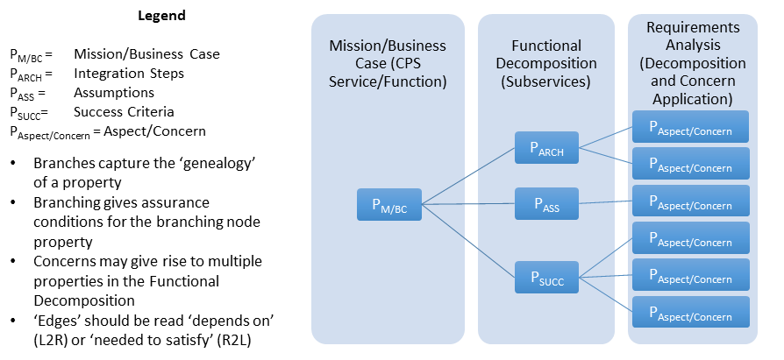
Type Theoretic Assurance of CPS
property-Tree of a CPS
semantics of CPS Framework
… defines composition of concerns
formal methods for assurance of a CPS

Slide 2
Applying CPS Framework to Decomposition
CPS/Function Types
Safety “Properties” of a Function: AEB
Business Case
AEB – vehicle provides automated collision safety function
Use Case
‘feature’
AEB – vehicle provides/maintains safe stopping
CPS (Therm,
HVAC, Gateway)
AEB –braking function reacts as required
Functional Decomposition/Allocation
Physical
AEB – friction function provides appropriate friction
Influence
Energy
AEB – stopping algorithm provided safe stopping
Logical
AEB – messaging function receives distance to obstacles and speed from propulsion function
Messaging
Info
AEB – distance and speed info is understood by braking function
Apply Aspects/Concerns
Generate System
Properties

Slide 3
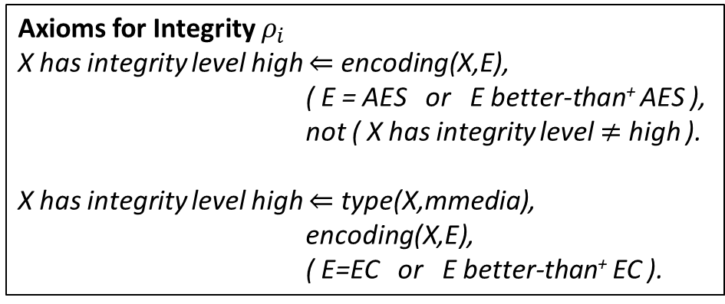
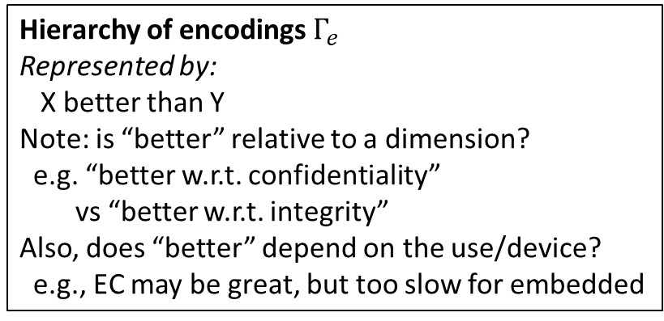
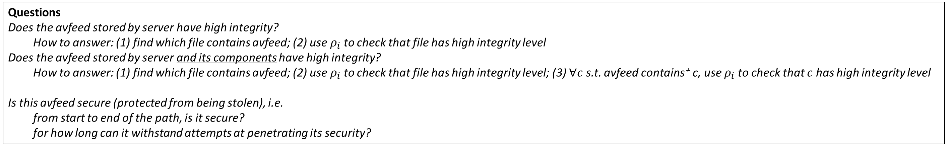
Environment
Something else we may want to model
need a mechanism for turning on/off the camera
when action is initiated, there must be a guarantee that the event is logged
Processor must have a log that is encrypted and hashed
So that it cannot be altered
vf1
type videofeed
encoding NONE
af1
type audiofeed
encoding NONE
s1
type sound
encoding NONE
sends
sends
sends
camera
mic
siren
Modeling Integrity of Body Camera
af2
type audiofeed
contains af1
encoding NONE
Needs additional details/conditions
*Keys have not been stolen…
*…and encryption is considered secure for 6 months
*Property:
physical security: key is only on a USB drive
of which there is only one copy,
which the president has
*Property (logical part of the decomposition of the storage system):
It exists in memory (for use during encryption)
only in an encrypted state
At business-case level, the feeds stored by the server have high integrity
need to decompose according to functional decomposition
use the functional decomposition slide, decompose according to it
sends
sends
vf2
type videofeed
contains vf1
encoding AES
processor
sends
cmd1
type trigger
encoding AES
bodycam
Should we make a difference between
the file being transferred and the file
stored?
E.g., could there be a different encoding?
Link?
avf1
type mmedia
contains vf2
contains af2
encoding AES
sends
server
sends
storage
Should we say explicitly that the file is stored (vs sent)?
file1
type file
contains avf1
encoding EC
Transitive closure
Use “protected from decoding with high level of confidence” or similar
Hierarchy of encodings $Γ_{e}$
Represented by:
X better than Y
Note: is “better” relative to a dimension?
e.g. “better w.r.t. confidentiality”
vs “better w.r.t. integrity”
Also, does “better” depend on the use/device?
e.g., EC may be great, but too slow for embedded
Axioms for Integrity $ρ_{i}$
X has integrity level high $⇐$ encoding(X,E),
( E = AES or E better-than⁺ AES ),
not ( X has integrity level $≠$ high ).
X has integrity level high $⇐$ type(X,mmedia),
encoding(X,E),
( E=EC or E better-than⁺ EC ).
Could be made defeasible as well
Transitive closure
Questions
Does the avfeed stored by server have high integrity?
How to answer: (1) find which file contains avfeed; (2) use $ρ_{i}$ to check that file has high integrity level
Does the avfeed stored by server and its components have high integrity?
How to answer: (1) find which file contains avfeed; (2) use $ρ_{i}$ to check that file has high integrity level; (3) $∀c$ s.t. avfeed contains ⁺ c, use $ρ_{i}$ to check that $c$ has high integrity level
Is this avfeed secure (protected from being stolen), i.e.
from start to end of the path, is it secure?
for how long can it withstand attempts at penetrating its security?
Next challenge: cover availability

Slide 4
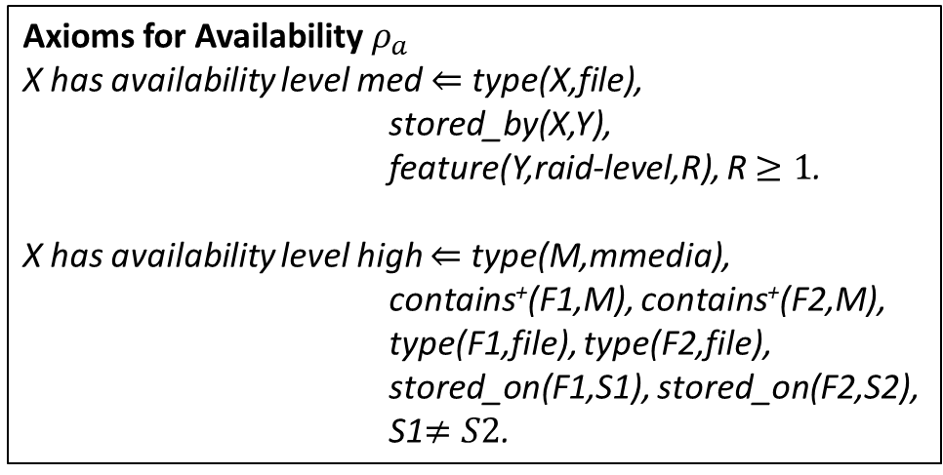
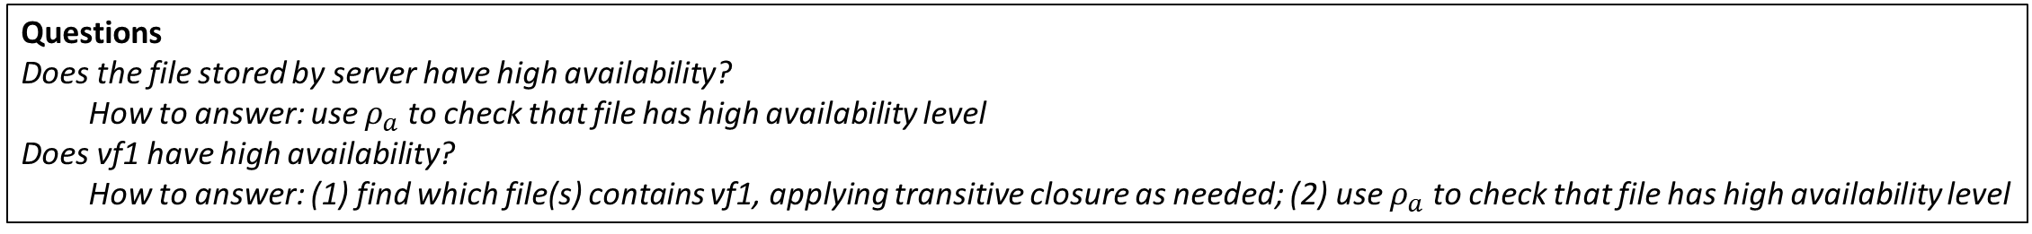
Environment
vf1
type videofeed
encoding NONE
af1
type audiofeed
encoding NONE
s1
type sound
encoding NONE
sends
sends
sends
camera
mic
siren
Modeling Availability of Body Camera
af2
type audiofeed
contains af1
encoding NONE
WILL REVISE AFTER PREVIOUS SLIDE HAS BEEN FIXED
sends
sends
vf2
type videofeed
contains vf1
encoding AES
processor
sends
cmd1
type trigger
encoding AES
bodycam
Should we make a difference between
the file being transferred and the file
stored?
E.g., could there be a different encoding?
Link?
avf1
type mmedia
contains vf2
contains af2
encoding AES
sends
server
sends
storage
Should we say explicitly that the file is stored (vs sent)?
file1
type file
contains avf1
encoding EC
Needs attention
M (mmedia) is stored on two different RAID1 systems
Conflicting conclusions from the two rules
stored-on
Added to model availability
Hierarchy of encodings $Γ_{e}$
Represented by:
X better than Y
Note: is “better” relative to a dimension?
e.g. “better w.r.t. confidentiality”
vs “better w.r.t. integrity”
Also, does “better” depend on the use/device?
e.g., EC may be great, but too slow for embedded
Axioms for Availability $ρ_{a}$
X has availability level med $⇐$ type(X,file),
stored_by(X,Y),
feature(Y,raid-level,R), R $≥1$.
X has availability level high $⇐$ type(M,mmedia),
contains⁺(F1,M), contains⁺(F2,M),
type(F1,file), type(F2,file),
stored_on(F1,S1), stored_on(F2,S2),
S1$≠S2$.
Transitive closure
Needs attention
Do these rules depend on
the objects of discourse?
Questions
Does the file stored by server have high availability?
How to answer: use $ρ_{a}$ to check that file has high availability level
Does vf1 have high availability?
How to answer: (1) find which file(s) contains vf1, applying transitive closure as needed; (2) use $ρ_{a}$ to check that file has high availability level

Slide 5
Hierarchy of Trustworthiness Elements
Trustworthiness Elements
Resilience
Reliability
Privacy
Safety
Security
Cybersecurity
Physical security
Confidentiality
Integrity
Availability

