Slide 1
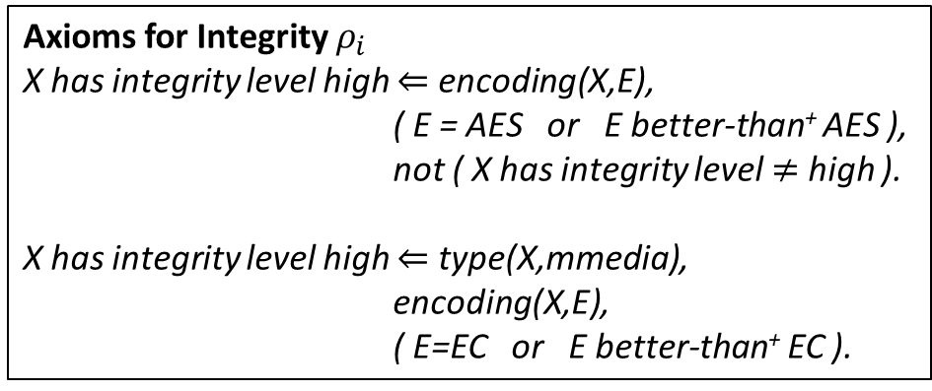
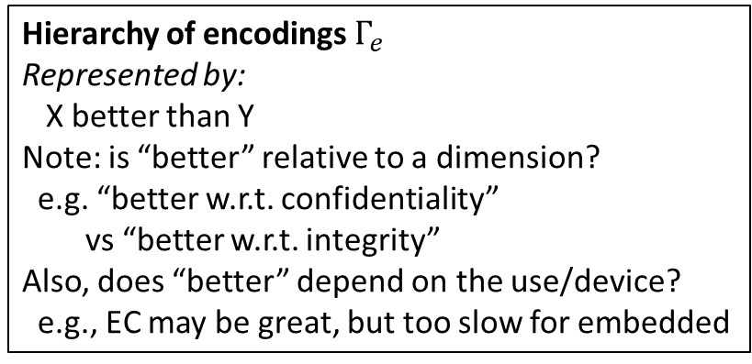
Environment
vf1
type videofeed
encoding NONE
af1
type audiofeed
encoding NONE
s1
type sound
encoding NONE
sends
sends
sends
camera
mic
siren
Modeling Integrity of Body Camera
af2
type audiofeed
contains af1
encoding NONE
sends
sends
vf2
type videofeed
contains vf1
encoding AES
processor
sends
cmd1
type trigger
encoding AES
bodycam
Should we make a difference between
the file being transferred and the file
stored?
E.g., could there be a different encoding?
Link?
avf1
type mmedia
contains vf2
contains af2
encoding AES
sends
server
sends
storage
Should we say explicitly that the file is stored (vs sent)?
file1
type file
contains avf1
encoding EC
Transitive closure
Hierarchy of encodings $Γ_{e}$
Represented by:
X better than Y
Note: is “better” relative to a dimension?
e.g. “better w.r.t. confidentiality”
vs “better w.r.t. integrity”
Also, does “better” depend on the use/device?
e.g., EC may be great, but too slow for embedded
Axioms for Integrity $ρ_{i}$
X has integrity level high $⇐$ encoding(X,E),
( E = AES or E better-than⁺ AES ),
not ( X has integrity level $≠$ high ).
X has integrity level high $⇐$ type(X,mmedia),
encoding(X,E),
( E=EC or E better-than⁺ EC ).
Could be made defeasible as well
Transitive closure
Questions
Does the avfeed stored by server have high integrity?
How to answer: (1) find which file contains avfeed; (2) use $ρ_{i}$ to check that file has high integrity level
Does the avfeed stored by server and its components have high integrity?
How to answer: (1) find which file contains avfeed; (2) use $ρ_{i}$ to check that file has high integrity level; (3) $∀c$ s.t. avfeed contains ⁺ c, use $ρ_{i}$ to check that $c$ has high integrity level
Next challenge: cover availability

Slide 2
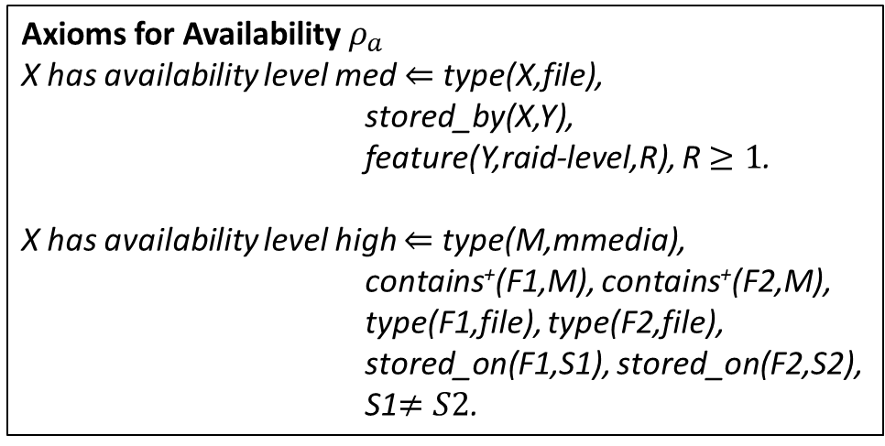
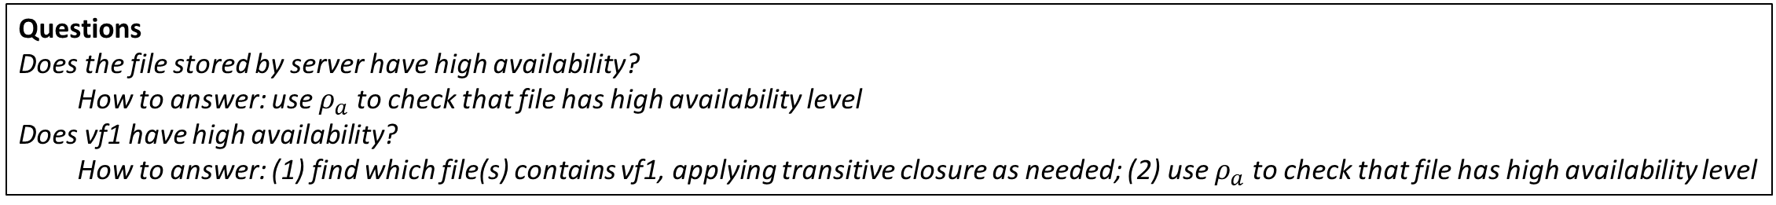
Environment
vf1
type videofeed
encoding NONE
af1
type audiofeed
encoding NONE
s1
type sound
encoding NONE
sends
sends
sends
camera
mic
siren
Modeling Availability of Body Camera
af2
type audiofeed
contains af1
encoding NONE
sends
sends
vf2
type videofeed
contains vf1
encoding AES
processor
sends
cmd1
type trigger
encoding AES
bodycam
Should we make a difference between
the file being transferred and the file
stored?
E.g., could there be a different encoding?
Link?
avf1
type mmedia
contains vf2
contains af2
encoding AES
sends
server
sends
storage
Should we say explicitly that the file is stored (vs sent)?
file1
type file
contains avf1
encoding EC
Needs attention
M (mmedia) is stored on two different RAID1 systems
Conflicting conclusions from the two rules
stored-on
Added to model availability
Hierarchy of encodings $Γ_{e}$
Represented by:
X better than Y
Note: is “better” relative to a dimension?
e.g. “better w.r.t. confidentiality”
vs “better w.r.t. integrity”
Also, does “better” depend on the use/device?
e.g., EC may be great, but too slow for embedded
Axioms for Availability $ρ_{a}$
X has availability level med $⇐$ type(X,file),
stored_by(X,Y),
feature(Y,raid-level,R), R $≥1$.
X has availability level high $⇐$ type(M,mmedia),
contains⁺(F1,M), contains⁺(F2,M),
type(F1,file), type(F2,file),
stored_on(F1,S1), stored_on(F2,S2),
S1$≠S2$.
Transitive closure
Needs attention
Do these rules depend on
the objects of discourse?
Questions
Does the file stored by server have high availability?
How to answer: use $ρ_{a}$ to check that file has high availability level
Does vf1 have high availability?
How to answer: (1) find which file(s) contains vf1, applying transitive closure as needed; (2) use $ρ_{a}$ to check that file has high availability level

Slide 3
Open questions
How to ask about other properties? (relatively simple)
What is the relationship with the UML hierarchy? For example, with the fragment below? Which questions leverage the hierarchy?
Trustworthiness Elements
Resilience
Reliability
Privacy
Safety
Security
Cybersecurity
Physical security
Confidentiality
Integrity
Availability

