Slide 1
CPS Framework Ontology Formalization and Reasoning Examples
M. Balduccini
October 20, 2017

Slide 2
Goals
Demonstrate
Formalization of CPS Model and surrounding domain
Formalization of attacks, their effects, mitigation actions
Reasoning about aspects, concerns, properties
Recursive traversal of concern trees
Reasoning about physical ramifications
Finding mitigations, reasoning about their effects

Slide 3
Summary of Examples
Simplified “Body Camera”
Camera
SAM
Minimal assumptions on knowledge about connections
Link to broader domain: admissibility of video in court
Self-driving Car: Automated Driving (1)
Camera
SAM
Consequences on car’s operations
Self-driving Car: Automated Driving (2)
Sensors
SAM
Consequences on car’s operations

Slide 4
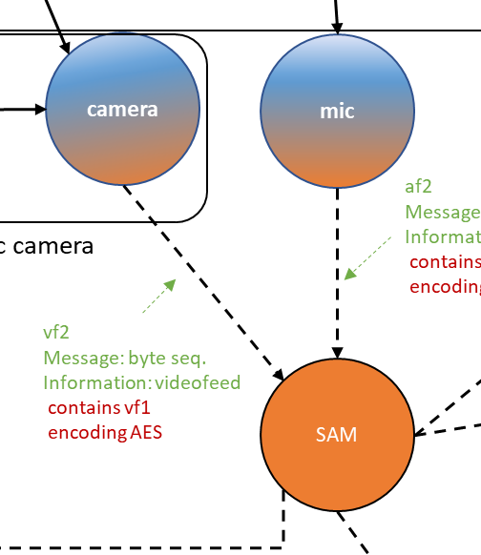
Example 1 Simplified “BodyCam”
Actors
Camera
Basic camera
Advanced camera
Two modes:
Record at less than 30 fps
Record at 30+ fps
SAM (Situational Awareness Module)
SAM controls the recording rate

Slide 5
Aspects, Concerns, Properties
Trustworthiness Elements
Safety
Reliability
Security
Physical security
Confidentiality
Integrity
Availability
Privacy
Resilience
Cybersecurity
Functionality
Functional
Aspects
Concerns
When using basic camera with encrypted memory, recording will be at less than 30 fps
SAM and camera will use
Encrypted memory
Secure boot
When using basic camera, recording will be at less than 30 fps

Slide 6
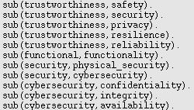
Formalization
Trustworthiness Elements
Safety
Reliability
Security
Physical security
Confidentiality
Integrity
Availability
Privacy
Resilience
Cybersecurity
Functionality
Functional
Aspect/Concern Trees
Aspects
Concerns

Slide 7
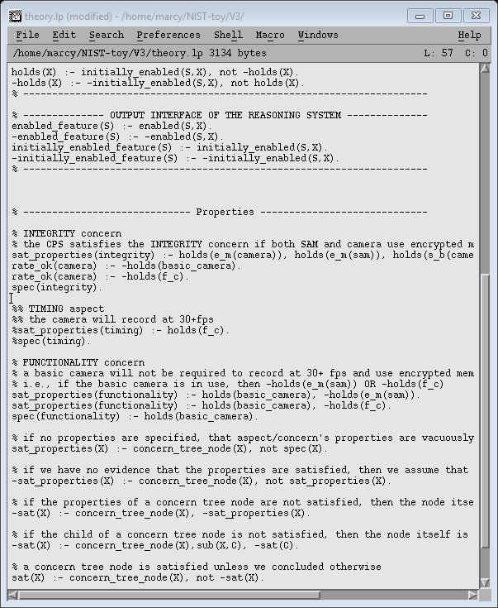
Formalization
Trustworthiness Elements
Safety
Reliability
Security
Physical security
Confidentiality
Integrity
Availability
Privacy
Resilience
Cybersecurity
Functionality
Functional
Aspect/Concern Trees
Aspects
Functionality Concern
When using basic camera with encrypted memory, recording will be at less than 30 fps
Concerns

Slide 8
Formalization
Trustworthiness Elements
Safety
Reliability
Security
Physical security
Confidentiality
Integrity
Availability
Privacy
Resilience
Cybersecurity
Functionality
Functional
Aspect/Concern Trees
Aspects
Functionality Concern
When using basic camera with encrypted memory, recording will be at less than 30 fps
Concerns
Integrity Concern
SAM and camera will use
Encrypted memory
Secure boot
When using basic camera, recording will be at less than 30 fps

Slide 9
Example 1 Body Camera

Slide 10
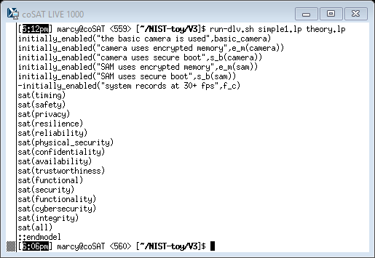
Example 1
System Configuration
SAM and camera use encrypted memory and secure boot
Basic camera is used
Recording rate set at less than 30 fps by SAM

Slide 11
Example 1
System Configuration
SAM and camera use encrypted memory and secure boot
Basic camera is used
Recording rate set at less than 30 fps by SAM
Questions
Is the integrity concern satisfied?

Slide 12
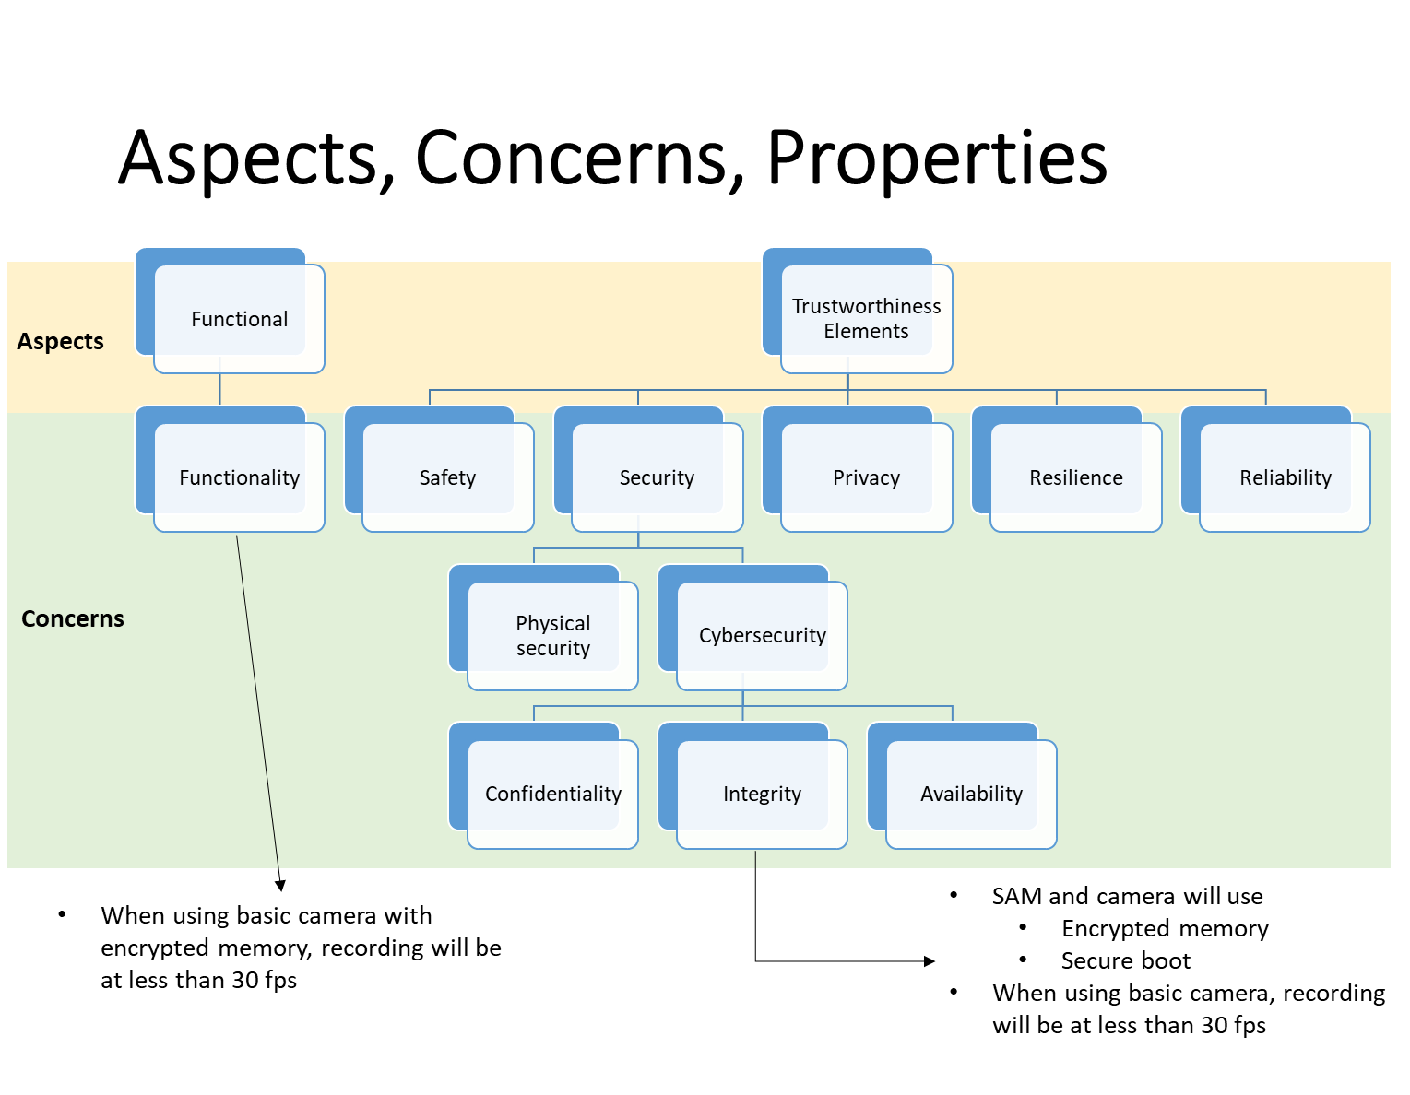
Example 1
System Configuration
SAM and camera use encrypted memory and secure boot
Basic camera is used
Recording rate set at less than 30 fps by SAM
Questions
Is the integrity concern satisfied?
Outcome of the reasoning process:
Trustworthiness concern tree (fragment)
Integrity concern is satisfied

Slide 13
Example 1
System Configuration
SAM and camera use encrypted memory and secure boot
Basic camera is used
Recording rate set at less than 30 fps by SAM
Questions
Is the trustworthiness aspect satisfied?
Outcome of the reasoning process:
Trustworthiness concern tree
Trustworthiness aspect is satisfied

Slide 14
Example 1
System Configuration
SAM and camera use encrypted memory and secure boot
Basic camera is used
Recording rate set at less than 30 fps by SAM
Questions
Are all aspects satisfied?
Outcome of the reasoning process:
Trustworthiness concern tree
All aspects are satisfied

Slide 15
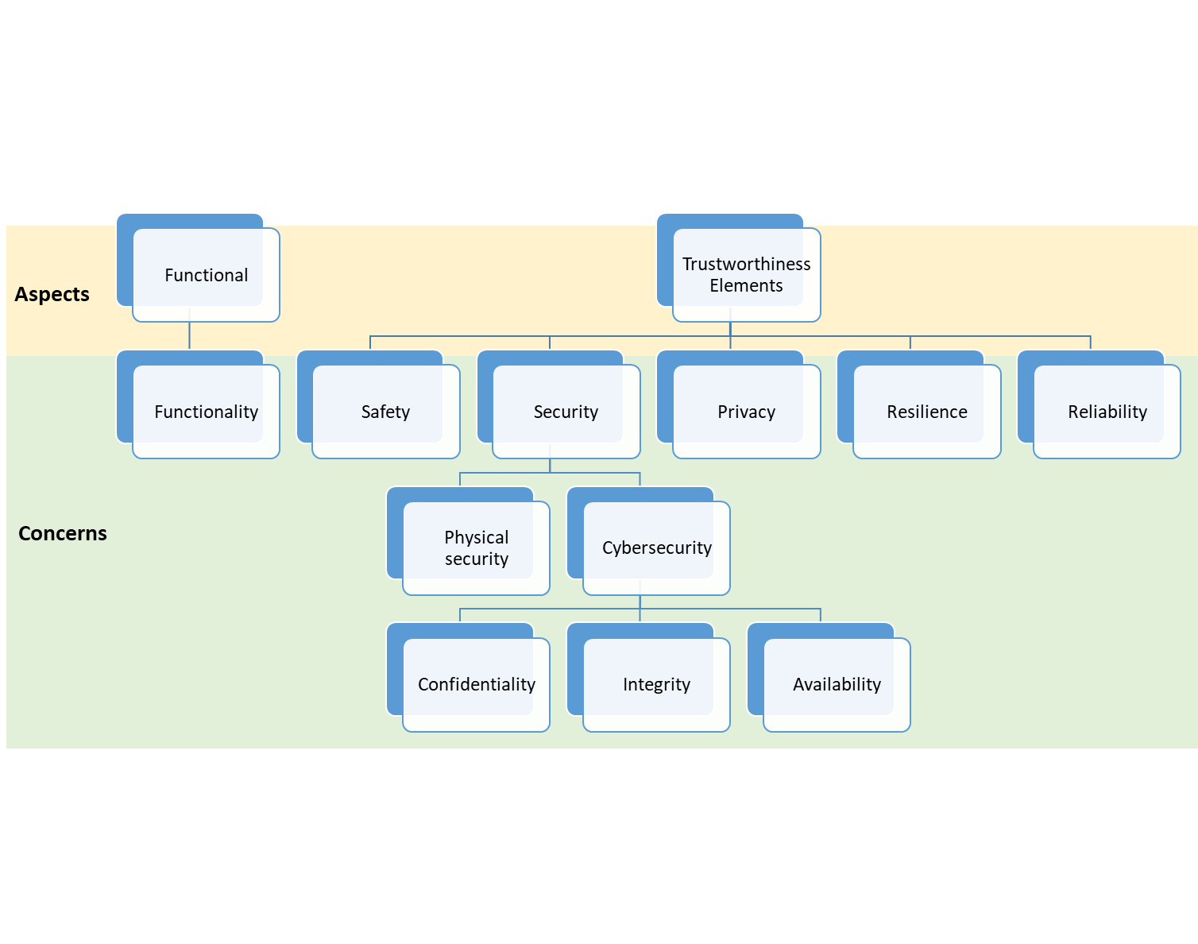
Example 1
Also tested:
Adding properties for timing aspect
Elaborating other properties
Manually disabling encrypted memory, secure boot on SAM and/or camera
Asking questions about functional, timing aspects and their concerns

Slide 16
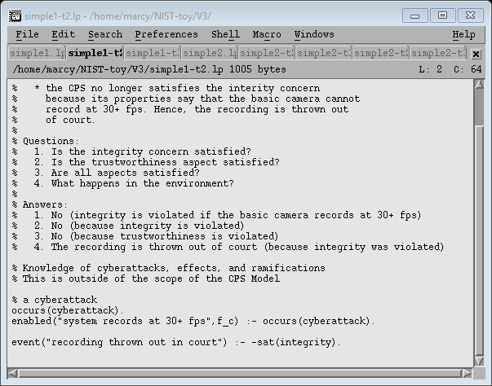
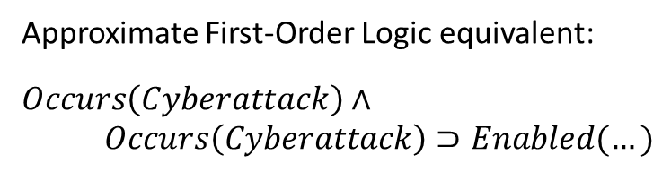
Example 1 – Step 2
System Configuration
SAM and camera use encrypted memory and secure boot
Basic camera is used
Recording rate set at less than 30 fps by SAM
A cyberattack occurs and hacks the SAM to record at 30+ fps
Approximate First-Order Logic equivalent:
$$Occurs\left(Cyberattack\right)∧$$
$$Occurs\left(Cyberattack\right)⊃Enabled(…)$$

Slide 17
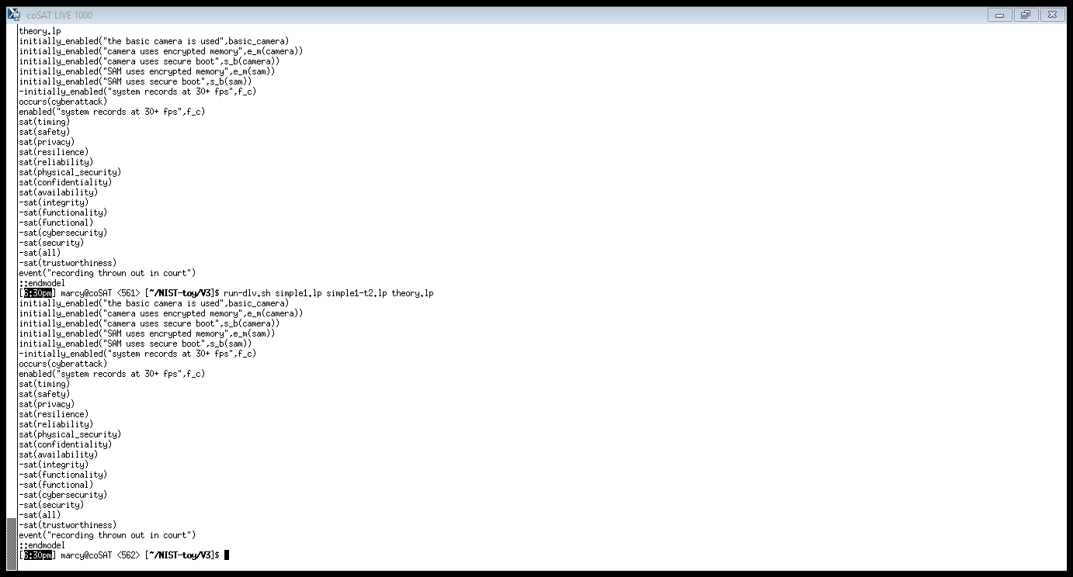
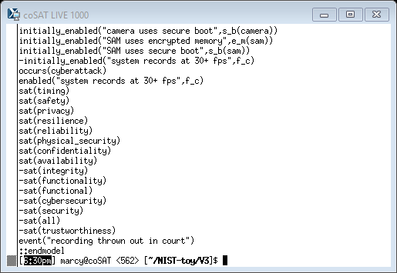
Example 1 – Step 2
System Configuration
SAM and camera use encrypted memory and secure boot
Basic camera is used
Recording rate set at less than 30 fps by SAM
A cyberattack occurs and hacks the SAM to record at 30+ fps
Questions
Is the integrity concern satisfied?
Outcome of the reasoning process:
Trustworthiness concern tree (fragment)
Integrity concern is not satisfied

Slide 18
Example 1 – Step 2
System Configuration
SAM and camera use encrypted memory and secure boot
Basic camera is used
Recording rate set at less than 30 fps by SAM
A cyberattack occurs and hacks the SAM to record at 30+ fps
Questions
Is the trustworthiness aspect satisfied?
Outcome of the reasoning process:
Trustworthiness concern tree
No

Slide 19
Example 1 – Step 2
System Configuration
SAM and camera use encrypted memory and secure boot
Basic camera is used
Recording rate set at less than 30 fps by SAM
A cyberattack occurs and hacks the SAM to record at 30+ fps
Questions
What happens in the environment?
Outcome of the reasoning process:
The recording is thrown out of court
because data integrity was violated
Conclusion based on the knowledge:

Slide 20
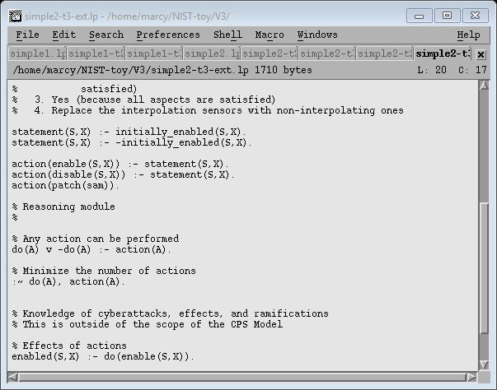
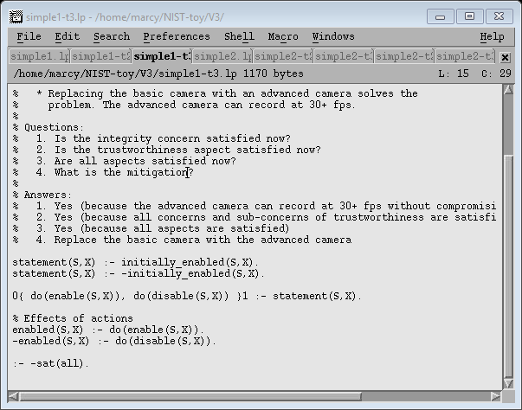
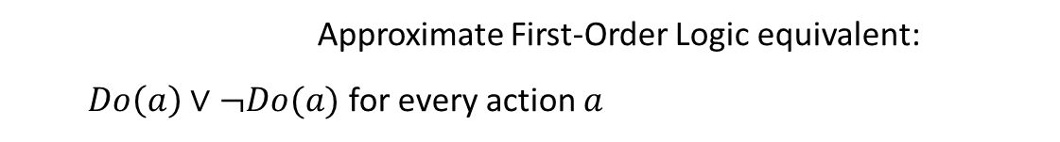
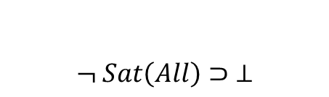
Example 1 – Step 3
System Configuration
SAM and camera use encrypted memory and secure boot
Basic camera is used
Recording rate set at less than 30 fps by SAM
A cyberattack occurs and hacks the SAM to record at 30+ fps
Questions
How can it be mitigated?
Mitigation Generation Module:
Approximate First-Order Logic equivalent:
$Do\left(a\right)∨¬Do(a)$ for every action $a$
$$¬ Sat\left(All\right)⊃ ⊥$$

Slide 21
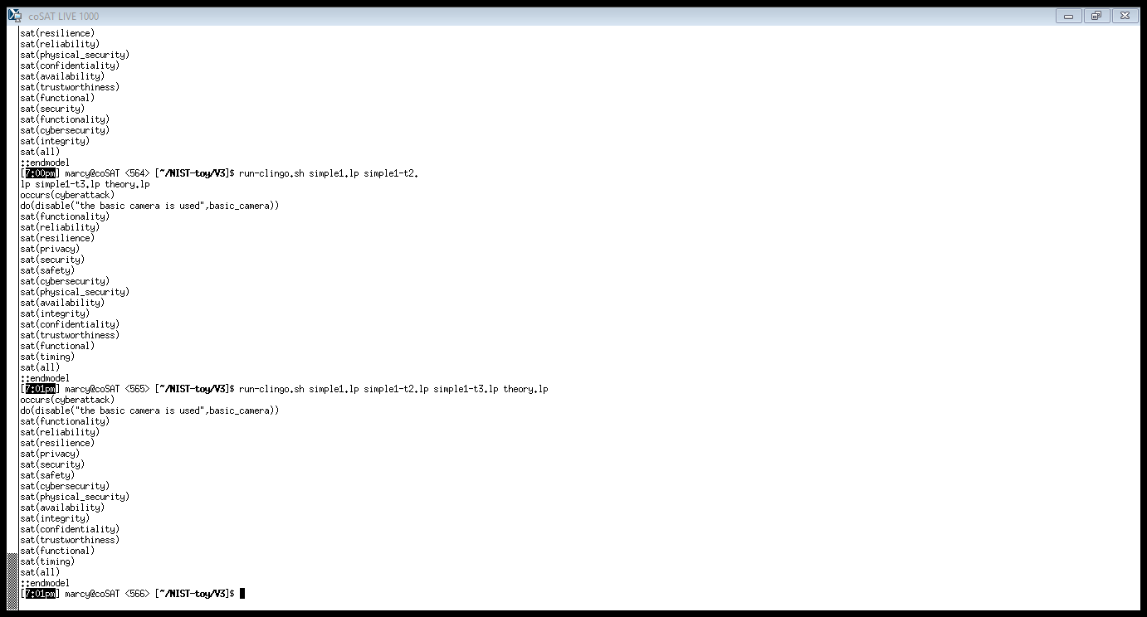
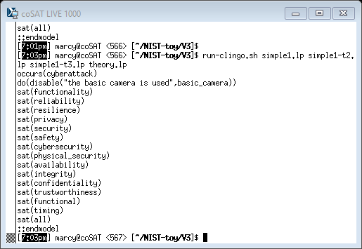
Example 1 – Step 3
System Configuration
SAM and camera use encrypted memory and secure boot
Basic camera is used
Recording rate set at less than 30 fps by SAM
A cyberattack occurs and hacks the SAM to record at 30+ fps
Questions
How can it be mitigated?
Outcome of the reasoning process:
“Replace basic camera with
advanced camera”
All aspects are satisfied

Slide 22
Example 2 Self-Driving Car (1)

Slide 23
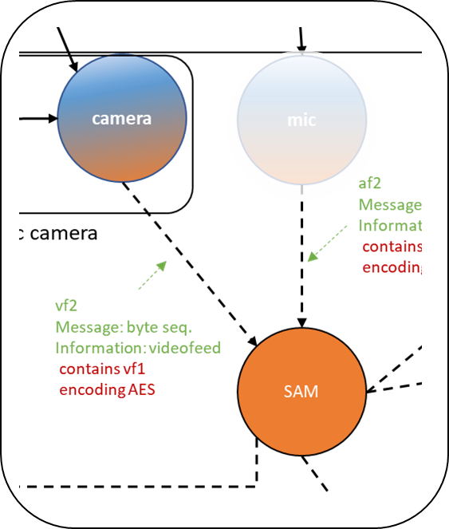
Example 2: Self-Driving Car (1)
A self-driving car uses SAM and camera for automated driving
Actors
Camera
Basic camera
Advanced camera
Two modes:
Record at less than 30 fps
Record at 30+ fps
SAM (Situational Awareness Module)
SAM controls the recording rate
engine
control

Slide 24
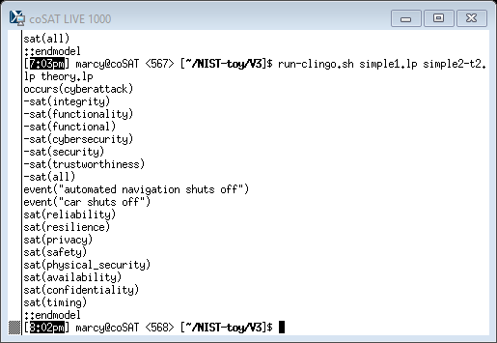
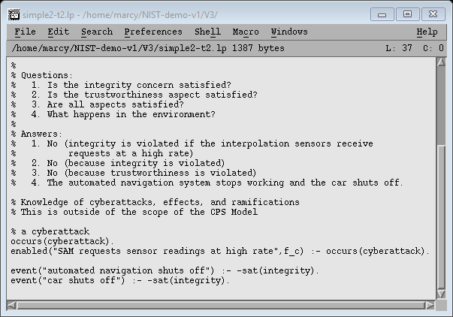
Example 2: Self-Driving Car (1)
System Configuration
SAM and camera use encrypted memory and secure boot
Basic camera is used
Recording rate set at less than 30 fps by SAM
A cyberattack occurs and hacks the SAM to record at 30+ fps
Questions
Is the integrity concern satisfied?
Is the trustworthiness aspect satisfied?
What are the physical ramifications?
How can it be mitigated?
Conclusion based on the knowledge:
“Replace the basic camera with the advanced camera”

Slide 25
Example 3 Self-Driving Car (2)

Slide 26
Example 3: Self-Driving Car (2)
A self-driving car uses SAM and sensors for automated driving
Actors
Sensors
Interpolating sensors (inaccurate hardware, interpolation compensates)
Non-interpolating sensors (accurate hardware)
SAM (Situational Awareness Module)
SAM requests sensor readings either at low rate or high rate
In interpolating sensors:
High request rate causes interpolation to be cut short
Potentially leads to inaccurate data returned to SAM

Slide 27
Example 3: Self-Driving Car (2)
System Configuration
SAM and sensors use encrypted memory and secure boot
Interpolating sensors are used
SAM requests sensor readings at low rate
Questions
Is the integrity concern satisfied?
Is the trustworthiness aspect satisfied?
Are all aspects satisfied?

Slide 28
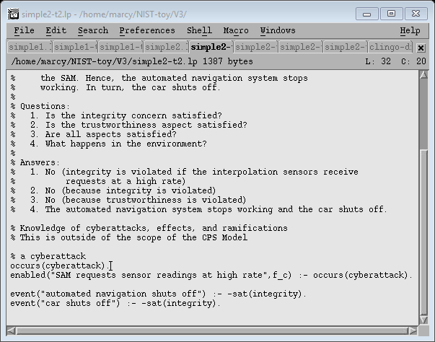
Example 3 – Step 2
System Configuration
SAM and sensors use encrypted memory and secure boot
Interpolating sensors are used
SAM requests sensor readings at low rate
A cyberattack occurs and hacks the SAM to request readings at a high rate
Questions
Is the integrity concern satisfied?
Is the trustworthiness aspect satisfied?
What are the physical ramifications?
Conclusion based on the knowledge:

Slide 29
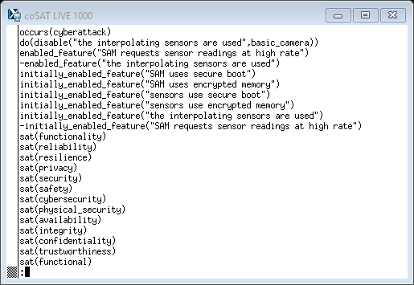
Example 3 – Step 3
System Configuration
SAM and sensors use encrypted memory and secure boot
Interpolating sensors are used
SAM requests sensor readings at low rate
A cyberattack occurs and hacks the SAM to request readings at a high rate
Questions
Is the integrity concern satisfied?
Is the trustworthiness aspect satisfied?
What are the physical ramifications?
How can it be mitigated?
Mitigation Generation Module
“Replace interpolating sensors
with non-interpolating ones”

Slide 30
Example 3 (Variant) Multiple Possible Mitigations

Slide 31
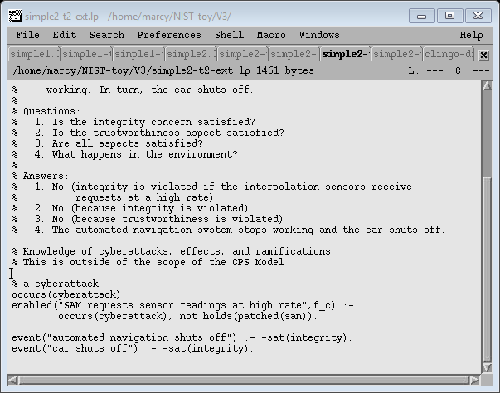
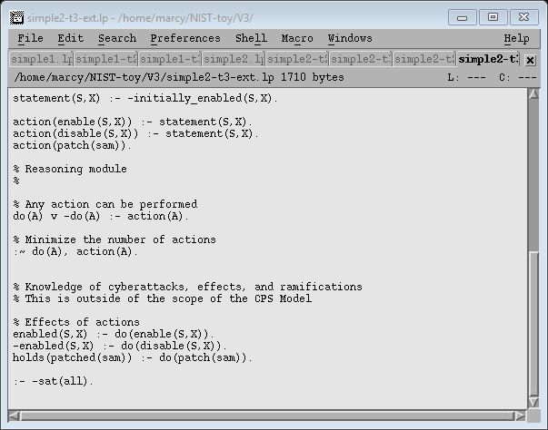
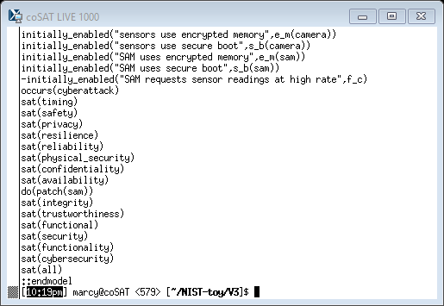
Example 3 – Step 3 (Extended)
System Configuration
SAM and sensors use encrypted memory and secure boot
Interpolating sensors are used
SAM requests sensor readings at low rate
A cyberattack occurs and hacks the SAM.
Unless a patch is applied, the SAM will request readings at a high rate.
Questions
Is the integrity concern satisfied?
Is the trustworthiness aspect satisfied?
What are the physical ramifications?
How can it be mitigated?
Solution #1
Effect of mitigation
Solution #2
“Patch the SAM”

Slide 32
Conclusions
Demonstrated
Formalization of CPS Model and surrounding domain, attacks, mitigations
Reasoning about concerns, properties, physical ramifications
Finding (multiple) mitigations, reasoning about their effects
Three examples: “BodyCam”, Self-driving Car (1 & 2)
Next Steps
Standardization of modeling of surrounding domain, attacks, mitigations
Parametrization of properties
Formalization, leverage of knowledge about CPS structure

