Slide 1
CPS Framework Ontology Use-Cases, Formalization and
Reasoning Examples
M. Balduccini and C. Vishik
November 13, 2017

Slide 2

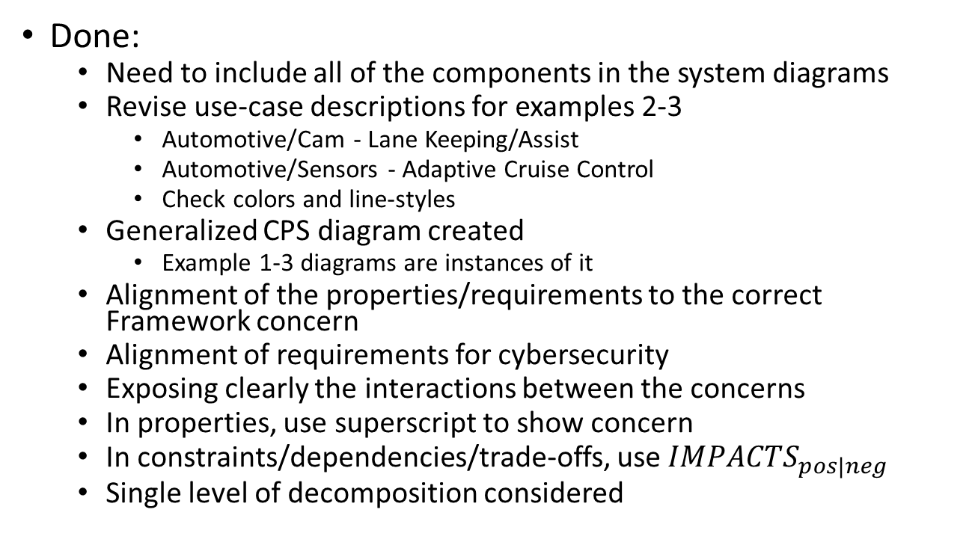
Progress
Done:
Need to include all of the components in the system diagrams
Revise use-case descriptions for examples 2-3
Automotive/Cam - Lane Keeping/Assist
Automotive/Sensors - Adaptive Cruise Control
Check colors and line-styles
Generalized CPS diagram created
Example 1-3 diagrams are instances of it
Alignment of the properties/requirements to the correct Framework concern
Alignment of requirements for cybersecurity
Exposing clearly the interactions between the concerns
In properties, use superscript to show concern
In constraints/dependencies/trade-offs, use $IMPACTS_{pos|neg}$
Single level of decomposition considered

Slide 3
Progress
To do:
Review choices with team
Create graph(s) for the ontology
Create graph(s) for constraints/dependencies/trade-offs
Update prototype
Replace screenshots
Multiple levels of decomposition
Querying for all properties for a given concern, at all levels of decomposition

Slide 4

Goals
Demonstrate
Formalization of CPS Model and surrounding domain
Formalization of attacks, their effects, mitigation actions
Reasoning about aspects, concerns, properties
Recursive traversal of concern trees
Reasoning about physical ramifications
Finding mitigations, reasoning about their effects

Slide 5
Formalization

Slide 6
Goals of the Formalization
Capture relevant knowledge about a CPS
CPS-independent: Aspects/Concerns hierarchy
CPS-specific: Properties
Constraints, dependencies, tradeoffs
General-purpose, e.g. thermodynamics
CPS-specific, e.g.:
Component dependencies
Property dependencies
Effects of malware
Enable reasoning about:
The current state of the CPS
Both logical and physical
Which Properties are violated
Which Aspects/Concerns are currently satisfied
How to reach a desired state
Recovery to mission capability

Slide 7
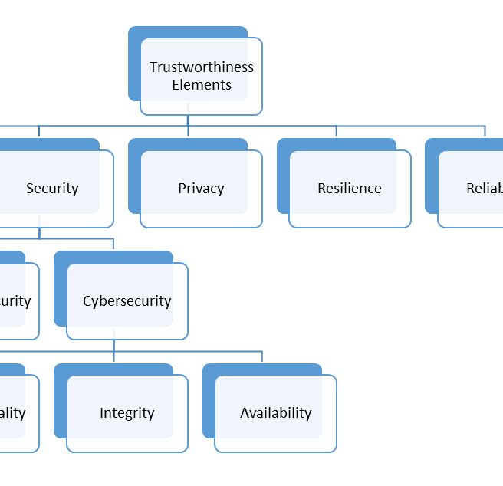
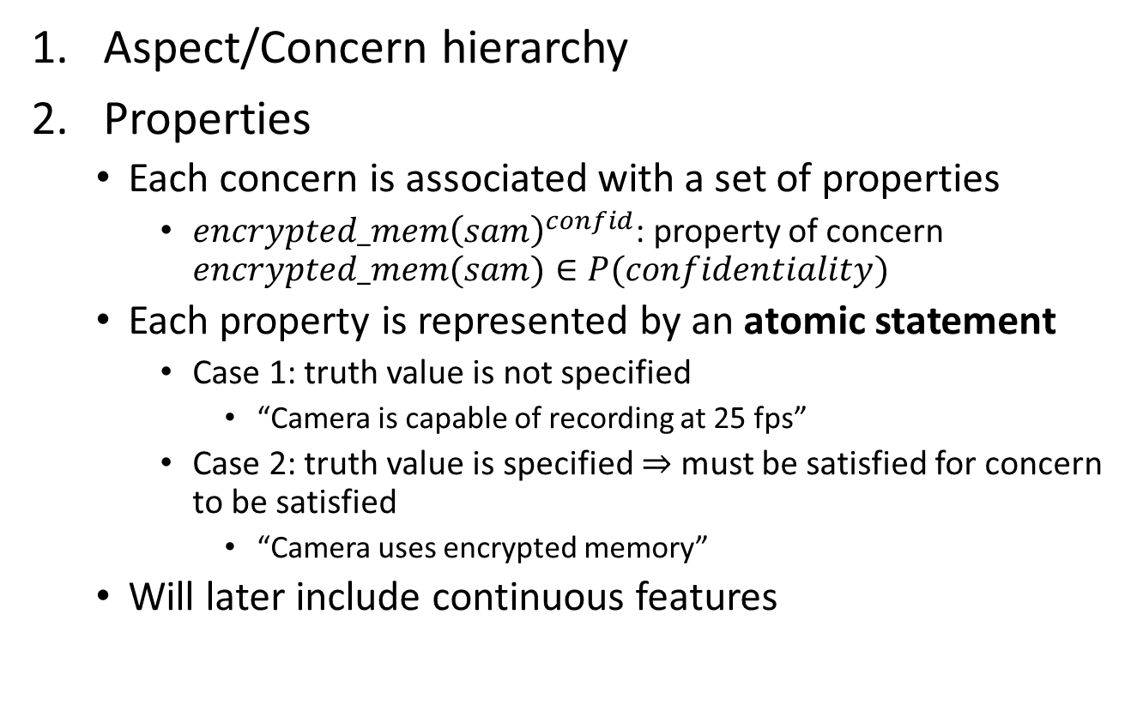

Proposed Formalization Components
Aspect/Concern hierarchy
Properties
Each concern is associated with a set of properties
$encrypted_mem{\left(sam\right)}^{confid}$: property of concern $encrypted_mem(sam)∈P(confidentiality)$
Each property is represented by an atomic statement
Case 1: truth value is not specified
“Camera is capable of recording at 25 fps”
Case 2: truth value is specified $⇒$ must be satisfied for concern to be satisfied
“Camera uses encrypted memory”
Will later include continuous features
Within CPS Framework
$P\left(c\right)$: set of properties of concern $C$

Slide 8
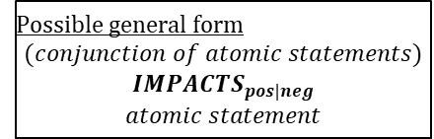
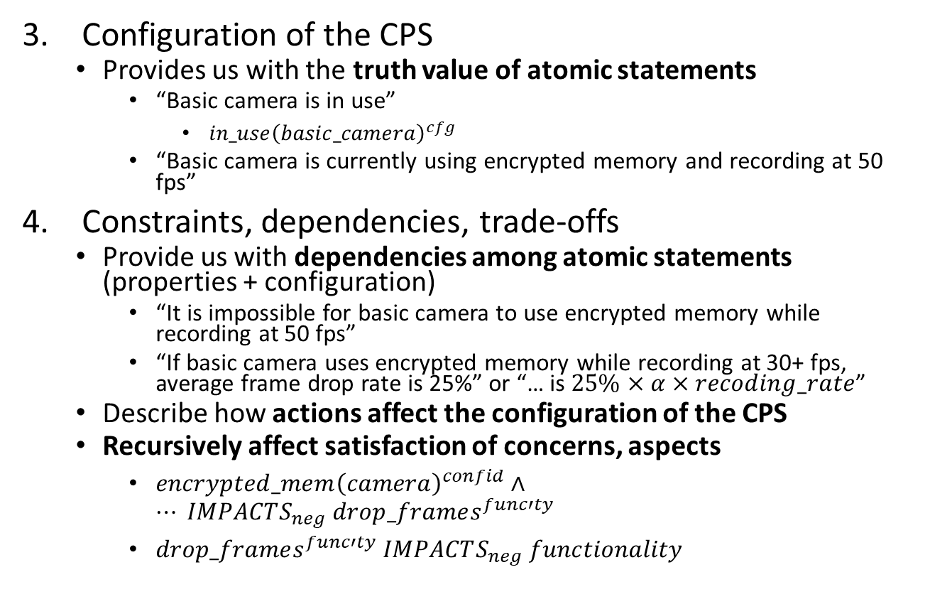
Proposed Formalization Components
Configuration of the CPS
Provides us with the truth value of atomic statements
“Basic camera is in use”
$in_use{\left(basic_camera\right)}^{cfg}$
“Basic camera is currently using encrypted memory and recording at 50 fps”
Constraints, dependencies, trade-offs
Provide us with dependencies among atomic statements (properties + configuration)
“It is impossible for basic camera to use encrypted memory while recording at 50 fps”
“If basic camera uses encrypted memory while recording at 30+ fps, average frame drop rate is 25%” or “… is $25\%$ $×$ $α$ $×$ $recoding_rate$”
Describe how actions affect the configuration of the CPS
Recursively affect satisfaction of concerns, aspects
$encrypted_mem{\left(camera\right)}^{confid}∧… IMPACTS_{neg} drop_frames^{func′ty}$
$drop_frames^{func′ty} IMPACTS_{neg} functionality$
Beyond CPS Framework
Possible general form
$$(conjunction of atomic statements)$$
$$IMPACTS_{pos|neg}$$
$$atomic statement$$
One conclusion: negative interaction between confidentiality and functionality

Slide 9
Generalized Integrated Monitoring & Control System Can be specialized into any of the example systems discussed later
“Generalized” components circled in red
Physical connection
Direct logical connection
text
Description of interaction
text
Annotation
operating environment
Physical element
o1
Influence: config change
Energy: mechanical
f1a
Influence: TBD
f1b
Influence: TBD
Logical element
Physical & logical system
cmd1
Message: command packet
Information: type of warning, attributes
reconfig
mech
input1
input2
indicator
f2b
Message: byte seq.
Information: feed
contains f1b
configurable
input
remote station
f2a
Message: byte seq.
Information: feed
contains f1a
SAM
cmd2
Message: command packet
Information: new config
notification1
Message: notification packet
Information: type of notification, timestamp, location, user ID
user
combof1
Message: byte seq.
Information: combined input feeds
contains f2a
contains f2b
integrated monitoring & control system (stand-alone part)
storage
us1
Influence: user signal
combof2
Influence: audio, video, other signals
integrated monitoring & control system
recipient

Slide 10
Aspects, Concerns, Properties for Generalized Integrated Monitoring & Control System
Trustworthiness Elements
Safety
Reliability
Security
Physical security
Confidentiality
Integrity
Availability
Privacy
Resilience
Cybersecurity
Functionality
Functional
Timing
Time-interval and latency control
Note: unless otherwise specified, “camera” refers to both basic and advanced camera
Aspects
Concerns
Input Device 1 should be capable of operating in low-speed mode and in high-speed mode
SAM uses secure boot
Input Device 1 uses secure boot
Input Device 1 maintains consistent frequency of readings
SAM uses encrypted memory
Input Device 1 uses encrypted memory

Slide 11

Summary of Examples
Simplified “Body Camera”
Camera
SAM
Minimal assumptions on knowledge about connections
Link to broader domain: admissibility of video in court
Self-Driving Car (a)
Camera
SAM
Broader domain: consequences on car’s operations
Self-Driving Car (b)
Sensors
SAM
Broader domain: consequences on car’s operations

Slide 12
Example 1 Body Camera
An integrated body security system for situational awareness and safety of security personnel

Slide 13
Example 1 “BodyCam” Diagram
Physical connection
Direct logical connection
text
Description of interaction
text
Annotation
Physical element
Logical element
operating environment
Physical & logical system
o1
Influence: angle change
Energy: mechanical
vf1
Influence: video signal
Energy: electr. waves
af1
Influence: audio signal
Energy: sound waves
cmd1
Message: command packet
Information: type of warning, attributes
targeting
mech
camera
mic
indicator
af2
Message: byte seq.
Information: audiofeed
contains af1
encoding AES
robotic camera
command center
vf2
Message: byte seq.
Information: videofeed
contains vf1
encoding AES
SAM
alarm1
Message: alarm packet
Information: type of alarm, timestamp, location, officer ID
cmd2
Message: command packet
Information: degrees, speed
officer
avf1
Message: byte seq.
Information: combined videofeed, audiofeed
contains vf2
contains af2
encoding AES
integrated body security system (stand-alone part)
storage
ws1
Influence: warning signal
Energy: waves TBD
avf2
Influence: audio-video signal
Information: sound, light waves
integrated body security system
court

Slide 14
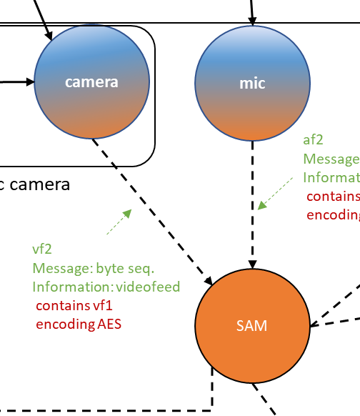
Example 1 Simplified “BodyCam”
Actors
Camera
Basic camera
Advanced camera
Two modes:
Record at 25 fps
Record at 50 fps
Security features (may be enabled)
Encrypted memory
Secure boot
SAM (Situational Awareness Module)
SAM controls the recording rate
MUST UPDATE AFTER DIAGRAM IN PREVIOUS SLIDE IS CHECKED

Slide 15
Aspects, Concerns, Properties
Trustworthiness Elements
Safety
Reliability
Security
Physical security
Confidentiality
Integrity
Availability
Privacy
Resilience
Cybersecurity
Functionality
Functional
Timing
Time-interval and latency control
Note: unless otherwise specified, “camera” refers to both basic and advanced camera
Aspects
Concerns
Camera should be capable of recording at 25 fps or at 50 fps
SAM uses secure boot
Camera uses sec. boot
SAM uses encrypted memory
Camera uses encrypted memory
Camera does not drop frames

Slide 16
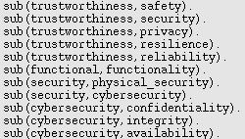
Formalization
Aspect/Concern Trees
Trustworthiness Elements
Safety
Reliability
Security
Physical security
Confidentiality
Integrity
Availability
Privacy
Resilience
Cybersecurity
Functionality
Functional
Timing
Time-interval and latency control
Aspects
Concerns

Slide 17
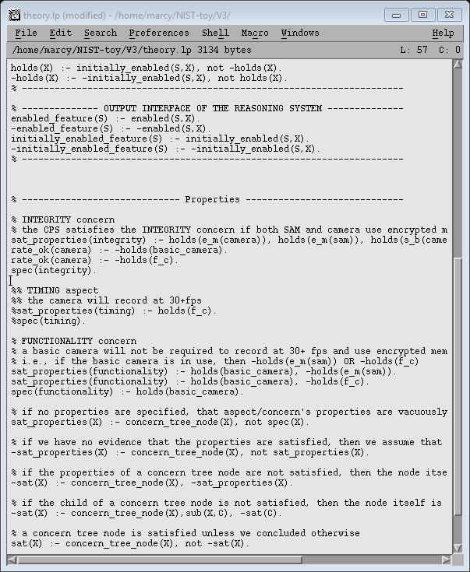
Formalization
Aspect/Concern Trees
Trustworthiness Elements
Safety
Reliability
Security
Physical security
Confidentiality
Integrity
Availability
Privacy
Resilience
Cybersecurity
Functionality
Functional
Timing
Time-interval and latency control
Aspects
Functionality Concern
MUST UPDATE ENCODING AND SCREENSHOTS
Camera will not drop frames
Concerns

Slide 18
Formalization
Aspect/Concern Trees
Trustworthiness Elements
Safety
Reliability
Security
Physical security
Confidentiality
Integrity
Availability
Privacy
Resilience
Cybersecurity
Functionality
Functional
Timing
Time-interval and latency control
Aspects
Functionality Concern
MUST UPDATE ENCODING AND SCREENSHOTS
Camera will not drop frames
Concerns
Integrity Concern
MUST UPDATE ENCODING AND SCREENSHOTS
SAM is capable of using secure boot
Camera is capable of using sec. boot

Slide 19
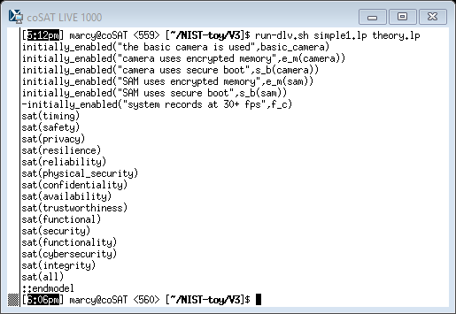
Example 1
System Configuration
SAM and camera use encrypted memory and secure boot
Basic camera is used
Recording rate set at 25 fps by SAM
MUST UPDATE

Slide 20
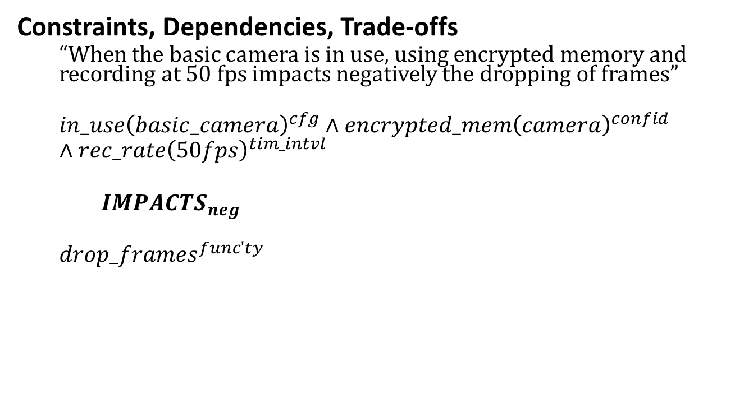
Example 1
Constraints, Dependencies, Trade-offs
“When the basic camera is in use, using encrypted memory and recording at 50 fps impacts negatively the dropping of frames”
$$in_use{\left(basic_camera\right)}^{cfg}∧encrypted_mem{\left(camera\right)}^{confid}∧rec_rate{\left(50fps\right)}^{tim_intvl}$$
$IMPACTS_{neg}$
$$drop_frames^{func′ty}$$
MUST UPDATE

Slide 21
Example 1
MUST UPDATE
System Configuration
SAM and camera use encrypted memory and secure boot
Basic camera is used
Recording rate set at 25 fps by SAM
Questions
Is the integrity concern satisfied?

Slide 22
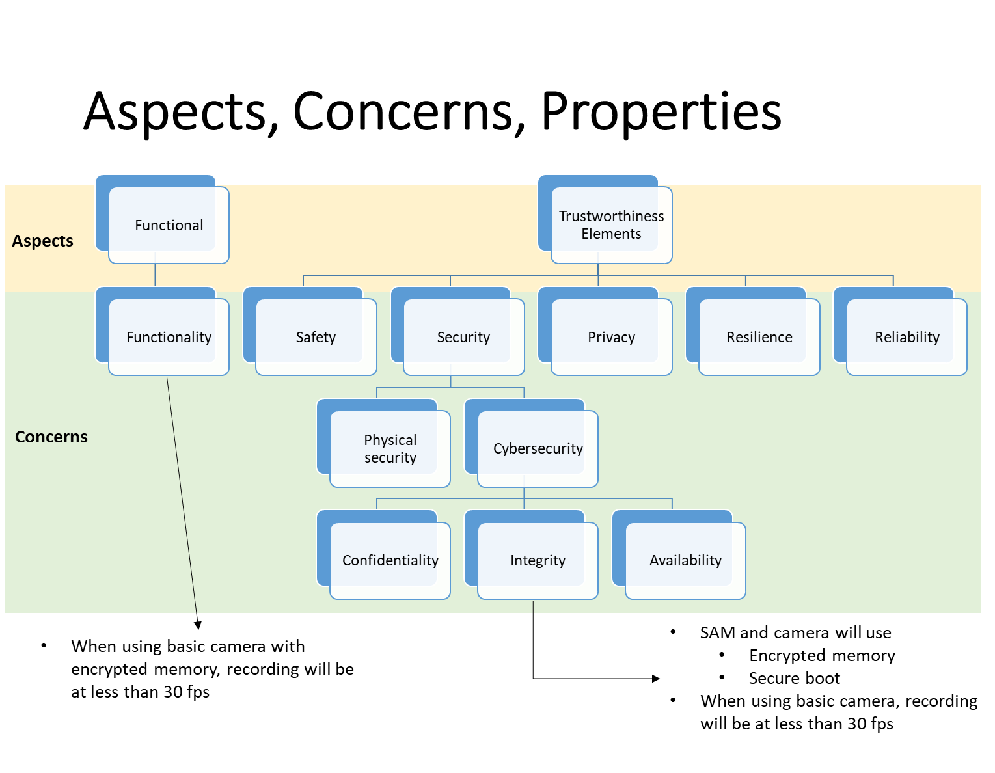
Example 1
System Configuration
SAM and camera use encrypted memory and secure boot
Basic camera is used
Recording rate set at 25 fps by SAM
Questions
Is the integrity concern satisfied?
Outcome of the reasoning process:
Trustworthiness concern tree (fragment)
MUST UPDATE
Integrity concern is satisfied

Slide 23
Example 1
System Configuration
SAM and camera use encrypted memory and secure boot
Basic camera is used
Recording rate set at 25 fps by SAM
Questions
Is the trustworthiness aspect satisfied?
Outcome of the reasoning process:
Trustworthiness concern tree
Trustworthiness aspect is satisfied

Slide 24
Example 1
System Configuration
SAM and camera use encrypted memory and secure boot
Basic camera is used
Recording rate set at 25 fps by SAM
Questions
Are all aspects satisfied?
Outcome of the reasoning process:
Trustworthiness concern tree
MUST UPDATE
All aspects are satisfied

Slide 25
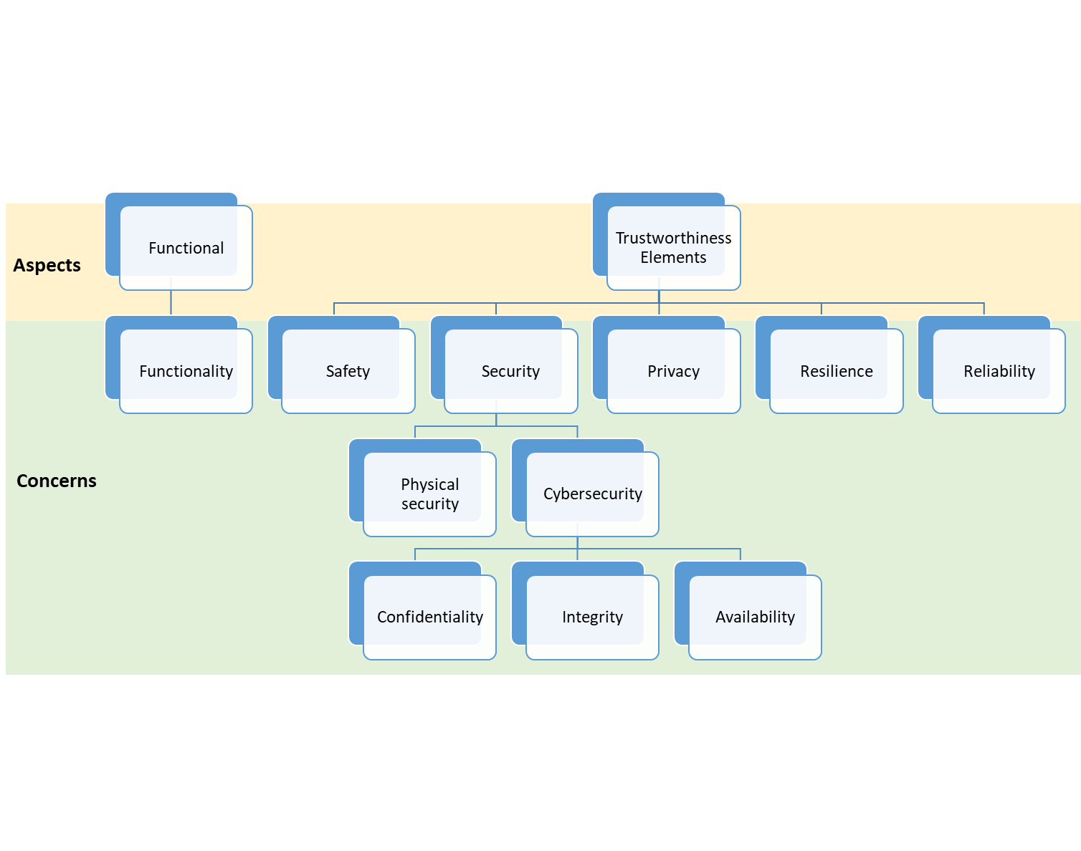
Example 1
MUST UPDATE
Also tested:
Adding properties for timing aspect
Elaborating other properties
Manually disabling encrypted memory, secure boot on SAM and/or camera
Asking questions about functional, timing aspects and their concerns

Slide 26
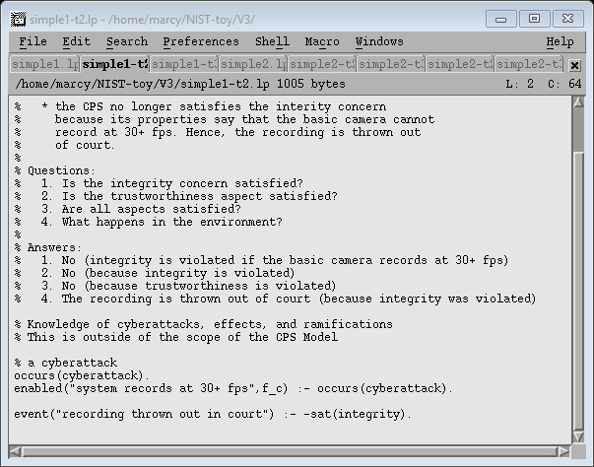
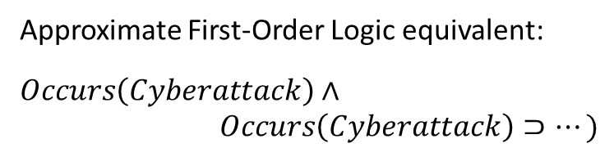
Example 1 – Step 2
System Configuration
SAM and camera use encrypted memory and secure boot
Basic camera is used
Recording rate set at 25 fps by SAM
A cyberattack occurs and hacks the SAM to activate recording at 50 fps
MUST UPDATE
Approximate First-Order Logic equivalent:
$$Occurs\left(Cyberattack\right)∧$$
$$Occurs\left(Cyberattack\right)⊃…)$$

Slide 27
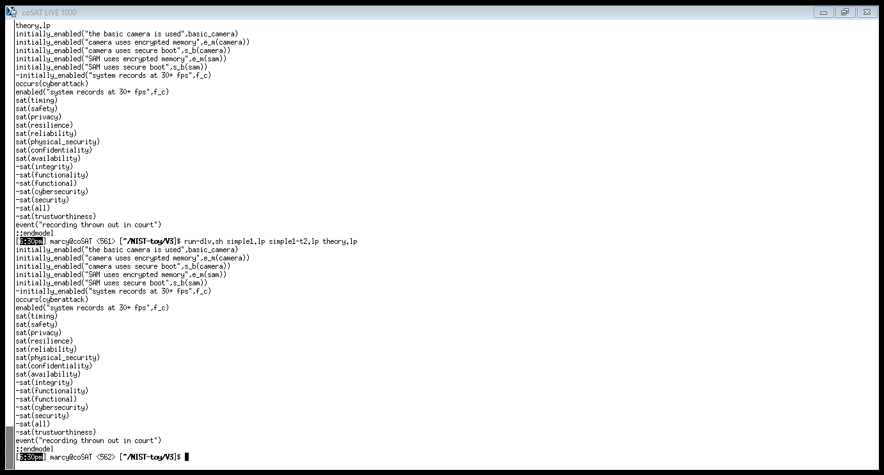
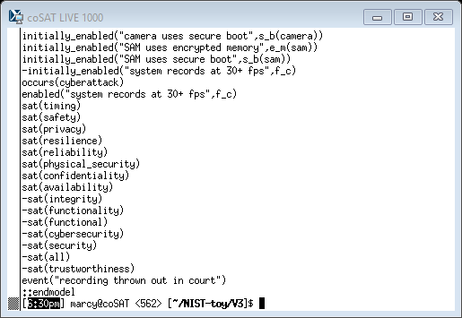
Example 1 – Step 2
System Configuration
SAM and camera use encrypted memory and secure boot
Basic camera is used
Recording rate set at 25 fps by SAM
A cyberattack occurs and hacks the SAM to activate recording at 50 fps
Questions
Is the integrity concern satisfied?
Outcome of the reasoning process:
Trustworthiness concern tree (fragment)
MUST UPDATE
MUST UPDATE
Integrity concern is not satisfied

Slide 28
Example 1 – Step 2
System Configuration
SAM and camera use encrypted memory and secure boot
Basic camera is used
Recording rate set at 25 fps by SAM
A cyberattack occurs and hacks the SAM to activate recording at 50 fps
Questions
Is the trustworthiness aspect satisfied?
Outcome of the reasoning process:
Trustworthiness concern tree
MUST UPDATE
No

Slide 29
Example 1 – Step 2
System Configuration
SAM and camera use encrypted memory and secure boot
Basic camera is used
Recording rate set at 25 fps by SAM
A cyberattack occurs and hacks the SAM to activate recording at 50 fps
Questions
What happens in the environment?
Outcome of the reasoning process:
The recording is thrown out of court
because data integrity was violated
MUST UPDATE
Conclusion based on the knowledge:

Slide 30
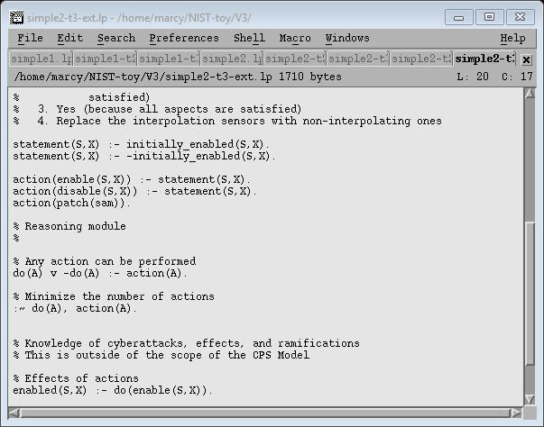
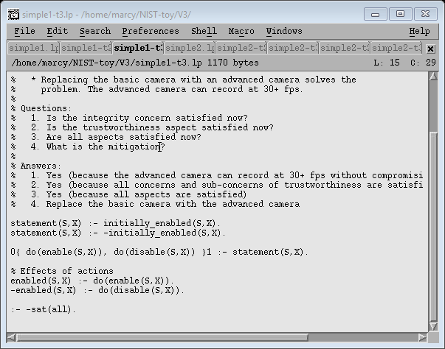
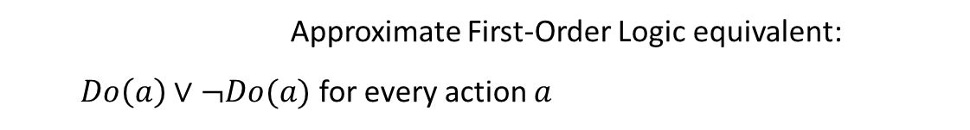
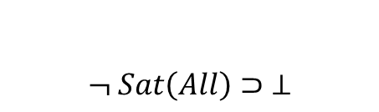
Example 1 – Step 3
System Configuration
SAM and camera use encrypted memory and secure boot
Basic camera is used
Recording rate set at 25 fps by SAM
A cyberattack occurs and hacks the SAM to activate recording at 50 fps
Questions
How can it be mitigated?
Mitigation Generation Module:
Approximate First-Order Logic equivalent:
$Do\left(a\right)∨¬Do(a)$ for every action $a$
$$¬ Sat\left(All\right)⊃ ⊥$$

Slide 31
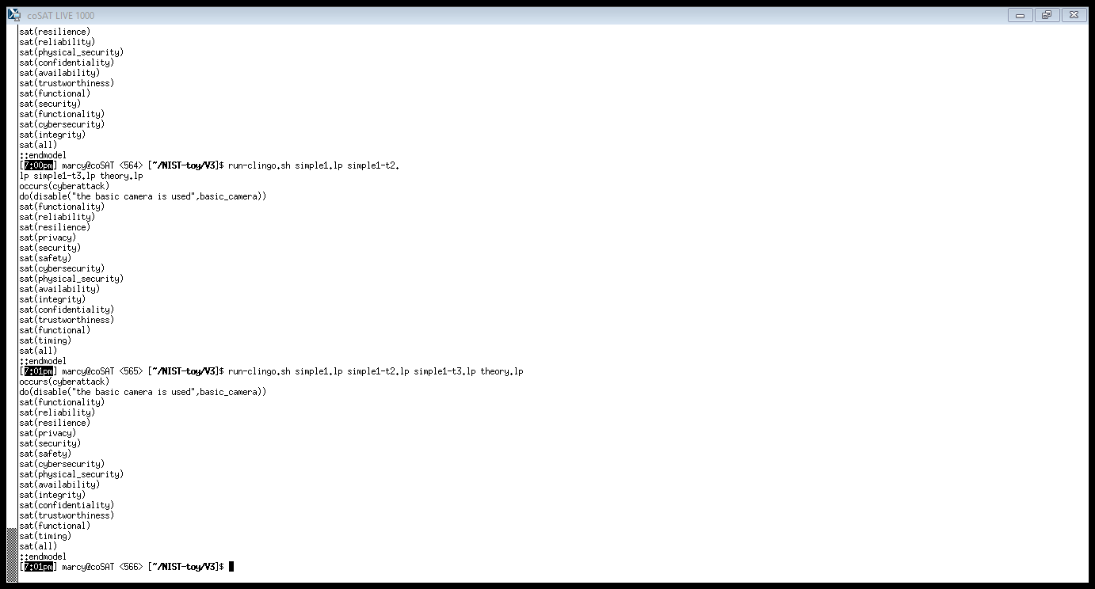
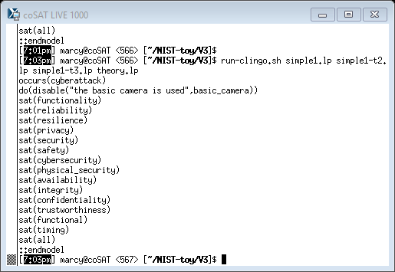
Example 1 – Step 3
System Configuration
SAM and camera use encrypted memory and secure boot
Basic camera is used
Recording rate set at 25 fps by SAM
A cyberattack occurs and hacks the SAM to activate recording at 50 fps
Questions
How can it be mitigated?
Outcome of the reasoning process:
MUST UPDATE
“Replace basic camera with
advanced camera”
All aspects are satisfied

Slide 32
Example 2 Self-Driving Car (a)
A self-driving car uses SAM and camera for lane keeping/assist

Slide 33
Example 2 Self-Driving Car (a)
Physical connection
Direct logical connection
text
Description of interaction
text
Annotation
Physical element
Logical element
operating environment
Physical & logical system
o1
Influence: angle change
Energy: mechanical
vf1
Influence: video signal
Energy: electr. waves
af1
Influence: audio signal
Energy: sound waves
cmd1
Message: command packet
Information: type of warning, attributes
targeting
mech
camera
mic
indicator
af2
Message: byte seq.
Information: audiofeed
contains af1
encoding AES
robotic camera
remote assit
vf2
Message: byte seq.
Information: videofeed
contains vf1
encoding AES
SAM
alarm1
Message: alarm packet
Information: type of alarm, timestamp, location, driver ID
cmd2
Message: command packet
Information: degrees, speed
driver
avf1
Message: byte seq.
Information: combined videofeed, audiofeed
contains vf2
contains af2
encoding AES
integrated lane keeping/assist system (stand-alone part)
storage
ws1
Influence: warning signal
Energy: waves TBD
ctrl1
Message: angle change
Information: mechanical
integrated lane keeping/assist system
steering wheel

Slide 34
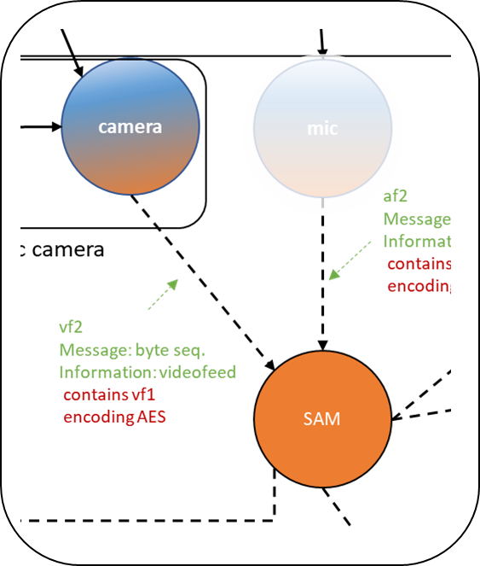
Example 2: Self-Driving Car (a)
A self-driving car uses SAM and camera for lane keeping/assist
Actors
Camera
Basic camera
Advanced camera
Two modes:
Record at 25 fps
Record at 50 fps
Security features (may be enabled)
Encrypted memory
Secure boot
SAM (Situational Awareness Module)
SAM controls the recording rate
MUST UPDATE
engine
control

Slide 35
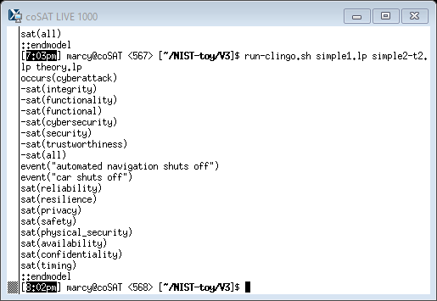
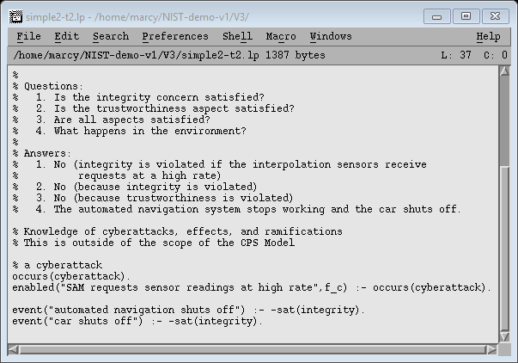
Example 2: Self-Driving Car (a)
System Configuration
SAM and camera use encrypted memory and secure boot
Basic camera is used
Recording rate set to 25 fps by SAM
A cyberattack occurs and hacks the SAM to activate recording at 50 fps
Questions
Is the integrity concern satisfied?
Is the trustworthiness aspect satisfied?
What are the physical ramifications?
How can it be mitigated?
MUST UPDATE
MUST UPDATE
Conclusion based on the knowledge:
MUST UPDATE
“Replace the basic camera with the advanced camera”

Slide 36
Example 3 Self-Driving Car (b)
A self-driving car uses SAM and sensors for adaptive cruise control

Slide 37
Example 2 Self-Driving Car (b)
Physical connection
Direct logical connection
text
Description of interaction
text
Annotation
Physical element
Logical element
operating environment
Physical & logical system
o1
Influence: angle change
Energy: mechanical
vf1
Influence: video signal
Energy: electr. waves
af1
Influence: audio signal
Energy: sound waves
cmd1
Message: command packet
Information: type of warning, attributes
targeting
mech
sensor
mic
indicator
af2
Message: byte seq.
Information: audiofeed
contains af1
encoding AES
robotic sensor
remote assit
vf2
Message: byte seq.
Information: feed
contains vf1
encoding AES
SAM
alarm1
Message: alarm packet
Information: type of alarm, timestamp, location, driver ID
cmd2
Message: command packet
Information: degrees, speed
driver
integrated adaptive cruise control system (stand-alone part)
avf1
Message: byte seq.
Information: combined feeds
contains vf2
contains af2
encoding AES
storage
ctrl1
Influence: angle change
energy: mechanical
ctrl2
Influence: angle change
energy: mechanical
ws1
Influence: warning signal
Energy: waves TBD
integrated adaptive cruise control system
accelerator
brake

Slide 38
Example 3: Self-Driving Car (b)
A self-driving car uses SAM and sensors for adaptive cruise control
Actors
Sensors
Interpolating sensors (inaccurate hardware, interpolation compensates)
Non-interpolating sensors (accurate hardware)
SAM (Situational Awareness Module)
SAM requests sensor readings either at low rate or high rate
In interpolating sensors:
High request rate causes interpolation to be cut short
Potentially leads to inaccurate data returned to SAM

Slide 39
Example 3: Self-Driving Car (b)
System Configuration
SAM and sensors use encrypted memory and secure boot
Interpolating sensors are used
SAM requests sensor readings at low rate
Questions
Is the integrity concern satisfied?
Is the trustworthiness aspect satisfied?
Are all aspects satisfied?

Slide 40
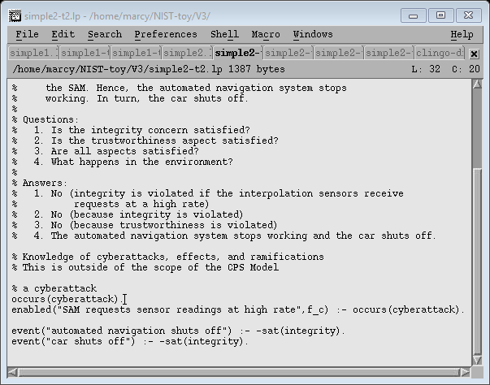
Example 3 – Step 2
System Configuration
SAM and sensors use encrypted memory and secure boot
Interpolating sensors are used
SAM requests sensor readings at low rate
A cyberattack occurs and hacks the SAM to request readings at a high rate
Questions
Is the integrity concern satisfied?
Is the trustworthiness aspect satisfied?
What are the physical ramifications?
Conclusion based on the knowledge:

Slide 41
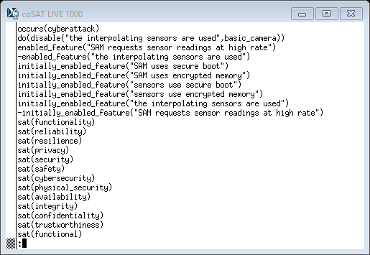
Example 3 – Step 3
System Configuration
SAM and sensors use encrypted memory and secure boot
Interpolating sensors are used
SAM requests sensor readings at low rate
A cyberattack occurs and hacks the SAM to request readings at a high rate
Questions
Is the integrity concern satisfied?
Is the trustworthiness aspect satisfied?
What are the physical ramifications?
How can it be mitigated?
MUST UPDATE
MUST UPDATE
Mitigation Generation Module
“Replace interpolating sensors
with non-interpolating ones”

Slide 42
Example 3 (Variant) Multiple Possible Mitigations

Slide 43
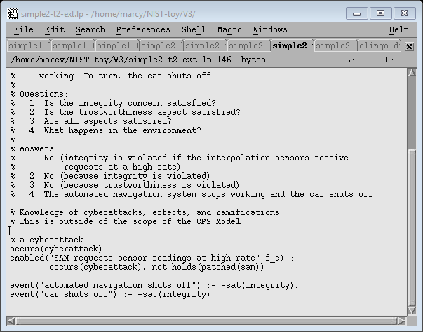
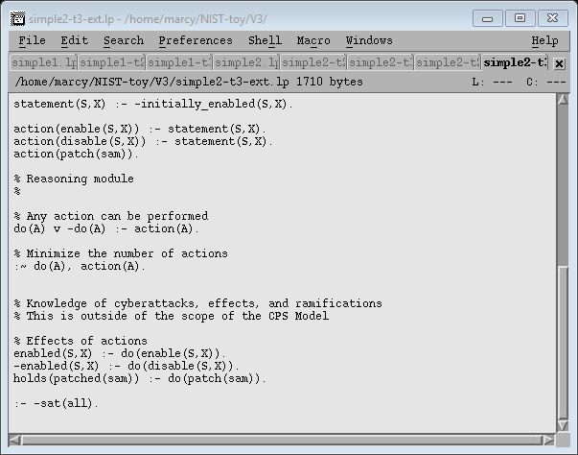
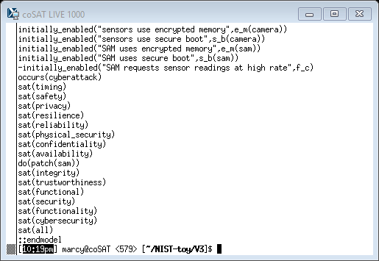
Example 3 – Step 3 (Extended)
System Configuration
SAM and sensors use encrypted memory and secure boot
Interpolating sensors are used
SAM requests sensor readings at low rate
A cyberattack occurs and hacks the SAM.
Unless a patch is applied, the SAM will request readings at a high rate.
Questions
Is the integrity concern satisfied?
Is the trustworthiness aspect satisfied?
What are the physical ramifications?
How can it be mitigated?
MUST UPDATE
Solution #1
Effect of mitigation
MUST UPDATE
Solution #2
“Patch the SAM”

Slide 44
Conclusions
Demonstrated
Formalization of CPS Model and surrounding domain, attacks, mitigations
Reasoning about concerns, properties, physical ramifications
Finding (multiple) mitigations, reasoning about their effects
Three examples: “BodyCam”, Self-driving Car (a & b)
Next Steps
Standardization of modeling of surrounding domain, attacks, mitigations
Parametrization of properties
Formalization, leverage of knowledge about CPS structure

