Slide 1
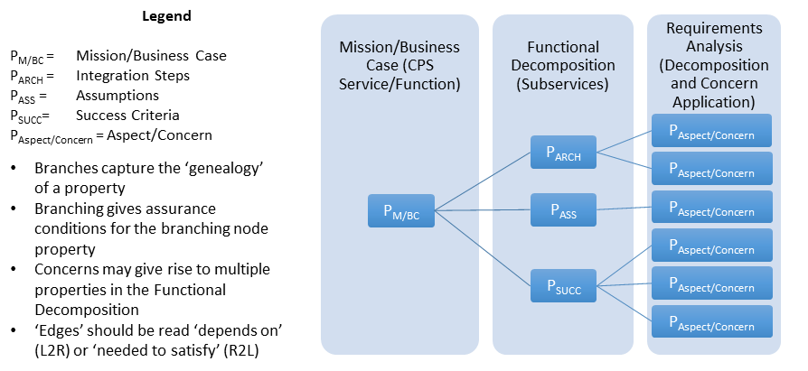
Type Theoretic Assurance of CPS
Background
property-Tree of a CPS
semantics of CPS Framework
… defines composition of concerns
formal methods for assurance of a CPS

Slide 2
Background -- Trustworthiness Concern Tree
Trustworthiness Elements
Safety
Reliability
Security
Physical security
Confidentiality
Integrity
Availability
Privacy
Resilience
Cybersecurity
Aspects
Concerns

Slide 3
Background
Applying CPS Framework to Decomposition
CPS/Function Types
Safety “Properties” of a Function: AEB
Business Case
AEB – vehicle provides automated collision safety function
Use Case
‘feature’
AEB – vehicle provides/maintains safe stopping
CPS (Therm,
HVAC, Gateway)
AEB –braking function reacts as required
Functional Decomposition/Allocation
Physical
Influence
AEB – friction function provides appropriate friction
Energy
AEB – stopping algorithm provides safe stopping
Logical
AEB – messaging function receives distance to obstacles and speed from propulsion function
Messaging
Info
AEB – distance and speed info is understood by braking function
Apply Aspects/Concerns
Generate System
Properties

Slide 4

Background
Sample properties from Communicating Smart Thermostat

Slide 5
Integrated Body Security System
Functional Decomposition
CPS/Function Types
Business Case
Integrated body security system
Monitors the activity of safety personnel in the course
of the response to an incident.
Provides some kind of alarm capability that can be triggered
by the person wearing the integrated body security system.
Enables the transfer of A/V/Data/Info to a storage system
in a trustworthy way.
If trustworthy, it may be used in litigation.
CPS
Integrated body security system (integrated camera-mic-siren)
Physical Interactions
See next page
Logical Interactions
See next page
Use case
(enumerates scenarios (aka features), finite number of steps that describe
interactions between the actors)
Realtime awareness scenario 1 (of safety person's status when responding)
pick up audio and video
provide awareness by alerting a remote operator
Stand-alone body security system has network issues
It is disconnected from the command center
It still has an operating connection with storage
Realtime awareness scenario 2 (of safety person's status when responding)
pick up audio and video
capture information about the situation for later analysis
Situation is out-of-hand
Safety person has an opportunity to sound an alarm siren
Forensics
have a log of when camera/mic fail or of when office shuts them off
having a log would enable forensic audit
System governance between logical and physical
if you have reason to doubt logical info from the system
you may do a second measurement on the system
to make sure the signal is coming through properly
Actors
officer
camera
targeting mechanism
mic
siren
SAM (Situational Awareness Module)
storage
command center (receiving the warning)
// note:
// [EG] command center & storage should be separate to avoid compromising
investigations, e.g. into officer's conduct
// [MB] Can we formulate this as a question? That is, do not separate
command center & storage and ask whether a certain key property
is/isn't satisfied
Functional Decomposition/Allocation
Potential questions
New concept: “mission”
higher level than “scenario”
missions have requirements
questions are about whether a mission is executable
Example: mission “traffic stop” requires certain features/scenarios to be working
(Take Quebec code 132 for example)
Example question: is any of the missions no longer executable?
Assumption: components of the system have been assessed w.r.t. concerns, e.g. security
In the case of armed robbery: safety concern is much higher
maybe they don’t want car lights on. Is the camera equipped with its own?

Slide 6
Integrated Body Security System
Functional Decomposition (Diagram)
Note: items in purple will be
updated during our 10/11/17
meeting
Actors
officer
camera
targeting mechanism
mic
siren indicator
SAM (Situational Awareness Module)
storage
command center (receiving the warning)
Physical (interactions)
camera receives video signal from environment
influence: video signal
energy: electromagnetic waves (visible part of the spectrum)
mic receives video signal from environment
influence: audio signal
energy: sound waves (vibrations in the air)
siren indicator produces an audible signal
influence: audible signal
energy: sound waves (vibrations in the air)
targeting mechanism re-orients the camera
influence: angle change
energy: mechanical
Logical (interactions)
camera sends videofeed to SAM
message: sequence of bytes
information: videofeed (digitalized video signal)
example refinement: message is AES-encoded
mic sends audiofeed to SAM
message : sequence of bytes
information: audiofeed (digitalized audio signal)
example refinement: message is AES-encoded
SAM sends alarm to command center (if digital warning
sent to command center)
message : alarm packet
information: type of alarm, timestamp, location, officer ID
SAM sends sound command to siren indicator
message : command packet
information: type of sound, volume
SAM sends re-orientation command to targeting mechanism
message: command packet
information: degrees, speed
SAM sends multimedia feed to storage
message : sequence of bytes
information: combined camera videofeed, mic audiofeed
example refinement: message is AES-encoded
indicator sends <WHAT> to officer
message: …
information: ...
operating environment
vf1
Influence: video signal
Energy: electr. waves
af1
Influence: audio signal
Energy: sound waves
s1 (result of actuation)
Influence: audio signal
Energy: sound waves
o1
Influence: angle change
Energy: mechanical
targeting
mech.
camera
mic
indicator
af2
Message: byte seq.
Information: audiofeed
contains af1
encoding AES
command center
robotic camera
cmd1
Message: command packet
Information: type of sound, volume
vf2
Message: byte seq.
Information: videofeed
contains vf1
encoding AES
SAM
alarm1
Message: alarm packet
Information: type of alarm, timestamp, location, officer ID
Physical connection
cmd2
Message: command packet
Information: degrees, speed
Direct logical connection
officer
text
Description of interaction
text
Annotation – to be encoded
as properties
avf1
Message: byte seq.
Information: combined videofeed, audiofeed
contains vf2
contains af2
encoding AES
integrated body security system (stand-alone part)
Physical element
storage
Logical element
Physical & logical system
integrated body security system

Slide 7

Integrated Body Security System
Realtime Operator Awareness (ROA)
Reliability “Properties” of ROA Function by Functional Decomposition
Function: Realtime Operator Awareness (ROA)
The ability to send an alarm to the command center at the push of a button (Based on Realtime awareness scenario 1 given earlier)
as well as the ability to send a continuous AV feed to the storage component.
Focus: Reliability "properties" of ROA function
Property breakdown according to functional decomposition
* High-level property: “The SAM must be able to receive data from camera and mic” [logical]
Business case:
Integrated body security monitors the activity of safety personnel in the course
of the response to an incident and provides some kind of alarm capability that
can be triggered by the person wearing the integrated body security system.
Use Case 'feature': integrated body security system sends a/v feed to storage and sends alarm to command center as required
CPS: SAM combines videofeed and audiofeed into a/v feed
Messaging:
- [camera to SAM] messaging function receives videofeed from camera
- [mic to SAM] messaging function receives audiofeed from mic
Information: videofeed and audiofeed are understood by SAM
The above property depends on the following
* High-level property: “The camera must be in working condition” [physical]
Influence: video sensor is in working condition
Energy: lighting is sufficient for recording
* High-level property: “ The mic must be in working condition” [physical]
Influence: audio sensor is in working condition
Energy: background noise is sufficiently low for recording
* High-level property: “ The SAM must be able to send data to the storage component” [logical]
CPS: SAM forwards a/v feed to storage as required
Messaging: messaging function receives a/v feed from SAM
Information: combined videofeed, audiofeed is understood by storage
* High-level property: “The SAM must be able to send alarm to the command center” [logical]
CPS: SAM sends alarm to command center as required
Messaging: messaging function receives alarm command from SAM
Information: alarm information is understood by command center
Not relevant:
* The siren must be able to emit an alarm sound [physical]
* The targeting mechanism must be able to orient the camera [physical]
* The SAM must be able to control the targeting mechanism [logical]
* The SAM must be able to control the siren [logical]

Slide 8
Integrated Body Security System
Reliability “Properties” of ROA Function -- High-level Diagram
Actors
officer
camera
targeting mechanism
mic
siren indicator
SAM (Situational Awareness Module)
storage
command center (receiving the warning)
Physical (interactions)
camera receives video signal from environment
influence: video signal
energy: electromagnetic waves (visible part of the spectrum)
mic receives video signal from environment
influence: audio signal
energy: sound waves (vibrations in the air)
siren indicator produces an audible signal
influence: audible signal
energy: sound waves (vibrations in the air)
targeting mechanism re-orients the camera
influence: angle change
energy: mechanical
Logical (interactions)
camera sends videofeed to SAM
message: sequence of bytes
information: videofeed (digitalized video signal)
example refinement: message is AES-encoded
mic sends audiofeed to SAM
message : sequence of bytes
information: audiofeed (digitalized audio signal)
example refinement: message is AES-encoded
SAM sends alarm to command center (if digital warning
sent to command center)
message : alarm packet
information: type of alarm, timestamp, location, officer ID
SAM sends sound command to siren indicator
message : command packet
information: type of sound, volume
SAM sends re-orientation command to targeting mechanism
message: command packet
information: degrees, speed
SAM sends multimedia feed to storage
message : sequence of bytes
information: combined camera videofeed, mic audiofeed
example refinement: message is AES-encoded
indicator sends <WHAT> to officer
message: …
information: ...
operating environment
vf1
Influence: video signal
Energy: electr. waves
af1
Influence: audio signal
Energy: sound waves
s1 (result of actuation)
Influence: audio signal
Energy: sound waves
o1
Influence: angle change
Energy: mechanical
targeting
mech.
camera
mic
indicator
af2
Message: byte seq.
Information: audiofeed
contains af1
encoding AES
command center
robotic camera
cmd1
Message: command packet
Information: type of sound, volume
vf2
Message: byte seq.
Information: videofeed
contains vf1
encoding AES
SAM
alarm1
Message: alarm packet
Information: type of alarm, timestamp, location, officer ID
Physical connection
cmd2
Message: command packet
Information: degrees, speed
Direct logical connection
officer
text
Description of interaction
text
Annotation – to be encoded
as properties
avf1
Message: byte seq.
Information: combined videofeed, audiofeed
contains vf2
contains af2
encoding AES
integrated body security system (stand-alone part)
Physical element
storage
Logical element
Physical & logical system
integrated body security system

