Slide 1


Version Control with Git
Saturday April 18th, 18:00 CEST
Manuel Ballesteros
SCADA Engineer
Siemens-Gamesa
#ElSWYPencasa
#YoMeQuedoEnCasa

Slide 2
Why we are here?

Slide 3
Agenda
18:00-18:15: Presentation
18:15-20:00: Workshop

Slide 4
How to participate
Option 1: interrupt and asks questions whenever you want. Simply unmute your microphone and speak.
Option 2: write your question on the chat. From time to time we will check it and answer the questions.

Slide 5
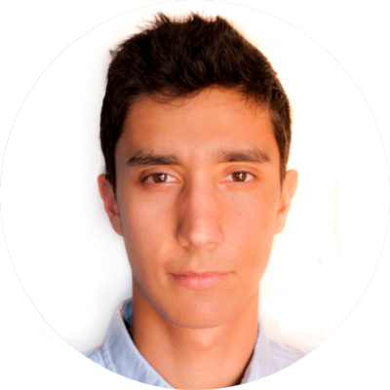
Version Control with Git
Arturo Medina
Software Engineer
Ericsson R&D

Slide 6




Social Media
@IEEEYP_Spain
@ypspain
IEEE Young Professionals Spain

Slide 7
Contact
Manuel Ballesteros – Past Chair
m.ballesteros.carballo@ieee.org
Arturo Medina - Chair
arturomedina@ieee.org
Brayan Impata – Vice Chair
brayan.impata@ua.es
Javier Andión - Treasurer
j.andion@ieee.org
Ramon Medrán - Secretary
rmedranmedran@ieee.org
Team ☺
yp@ieeespain.org

Slide 8


Slide 9
THANKS TO ALL GRACIAS

