Slide 1

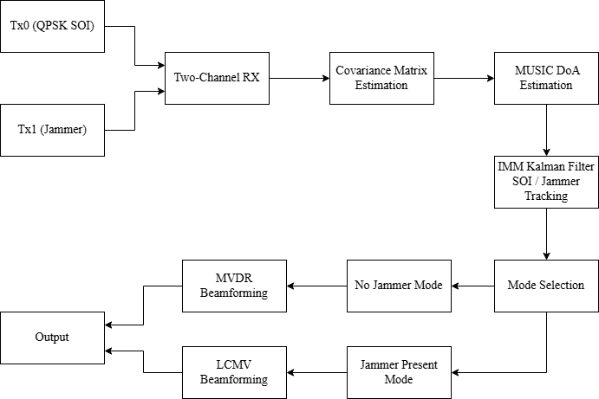
Marmara University
Department of Electrical and Electronics Engineering
EE4084 Kalman and Bayesian Filters
Course Project Presentation
Dynamic DoA Tracking and
Jammer Suppression
MUSIC • IMM Kalman Filter • MVDR/LCMV Beamforming • ADALM-Pluto SDR
Name Surname: Mehmet Burak ALTINTAŞ
Project Platform: 2-RX ADALM-Pluto Software Defined Radio (SDR)
Instructor : Prof. Dr. Engin MAŞAZADE
Goal: estimate the dominant DoA, track it with IMM Kalman filtering, and switch beamforming strategy when a jammer appears.
EE4084 Kalman and Bayesian Filters • Project Presentation • 1/15
Notes:
Hello, this is my EE4084 Kalman and Bayesian Filters course project presentation. The project title is Dynamic DoA Tracking and Jammer Suppression. The main idea is to combine direction of arrival estimation, IMM Kalman filtering, and adaptive beamforming on an ADALM-Pluto SDR based setup. Tx0 is used as the QPSK signal of interest, and Tx1 is used as a stronger CW jammer. The receiver has two channels, so the system has to adapt its interpretation of the dominant MUSIC peak depending on whether the jammer is active or not.

Slide 2
Presentation roadmap and required project points
The video will explicitly cover motivation, models, filter design, comparative results, and system demonstration.
1. Motivation
2. Process model
3. Measurement model
Why DoA tracking alone is not enough when a stronger jammer dominates the receiver.
Kalman/IMM angular state transition model: angle, angular velocity, angular acceleration.
MUSIC DoA estimate used as the scalar angle measurement of the Kalman filter.
4. Filter design
5. Comparative results
6. Demonstration
IMM Kalman filter with CP, CV, and CA motion models and adaptive measurement noise.
No-jammer result versus jammer-present result with suppression and tracking metrics.
Bandicam recording of GUI: Tx1 off, Tx1 on, then return to no-jammer mode.
EE4084 Kalman and Bayesian Filters • Project Presentation • 2/15
Notes:
This slide maps the presentation to the project requirements. I will first explain the motivation. Then I will describe the process model, which is the angular motion model of the DoA. After that I will explain the measurement model based on MUSIC. The filter design section explains the IMM Kalman filter. Then I will compare the no-jammer and jammer-present results. Finally, the video demonstration will show the GUI and how the system changes its mode when Tx1 jammer is enabled or disabled.

Slide 3
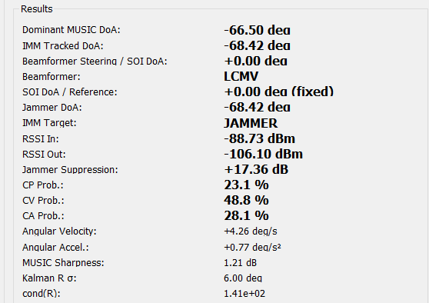
Motivation: a strong jammer changes the meaning of the DoA estimate
With two receiver channels, the receiver can track one dominant source, so the operating mode is essential.
Problem in dynamic interference
A jammer can be much stronger than the desired QPSK SOI.
The received covariance matrix is then dominated by the jammer.
MUSIC returns the dominant source direction, not necessarily the SOI direction.
A wrong physical interpretation of the DoA causes wrong beamforming decisions.
Proposed solution
No jammer: dominant MUSIC peak is SOI → IMM tracks SOI → MVDR steering.
Jammer present: dominant MUSIC peak is jammer → IMM tracks jammer → LCMV nulling.
SOI is known at 0° broadside during jammer-present operation.
Measured jammer-present snapshot: LCMV mode, IMM target = JAMMER, suppression ≈ 17.36 dB.
EE4084 Kalman and Bayesian Filters • Project Presentation • 3/15
Notes:
The motivation is that a strong jammer changes the meaning of the DoA estimate. The receiver has two channels, so MUSIC can reliably detect only one dominant direction. If Tx1 jammer is off, that direction is the SOI. If Tx1 jammer is on and has higher gain, the dominant direction becomes the jammer. Therefore, the system cannot simply treat every MUSIC peak as the SOI. The project solves this by using an adaptive operating mode. Without jammer, the filter tracks the SOI and MVDR is used. With jammer, the filter tracks the jammer and LCMV is used to null it while preserving the known SOI direction at 0 degrees.

Slide 4
System overview: MUSIC → IMM Kalman → MVDR/LCMV switching
The same estimation chain is used in both modes, but the beamformer and interpretation change.
Key design principle: Do not force a two-channel MUSIC estimator to separate SOI and jammer simultaneously; instead, use controlled mode information and known SOI broadside reference.
EE4084 Kalman and Bayesian Filters • Project Presentation • 4/15
Notes:
This is the complete block diagram. The transmitter side has Tx0 for QPSK SOI and Tx1 for CW jammer. The receiver has two channels. First, the covariance matrix is estimated. Then MUSIC estimates the dominant DoA. The raw MUSIC angle is passed to the IMM Kalman filter. After that, mode selection decides whether the system is in no-jammer mode or jammer-present mode. In no-jammer mode, MVDR is used. In jammer-present mode, LCMV is used. The key design point is that the system does not try to separate SOI and jammer at the same time using only two channels. Instead, it uses the known SOI broadside direction and mode information.

Slide 5
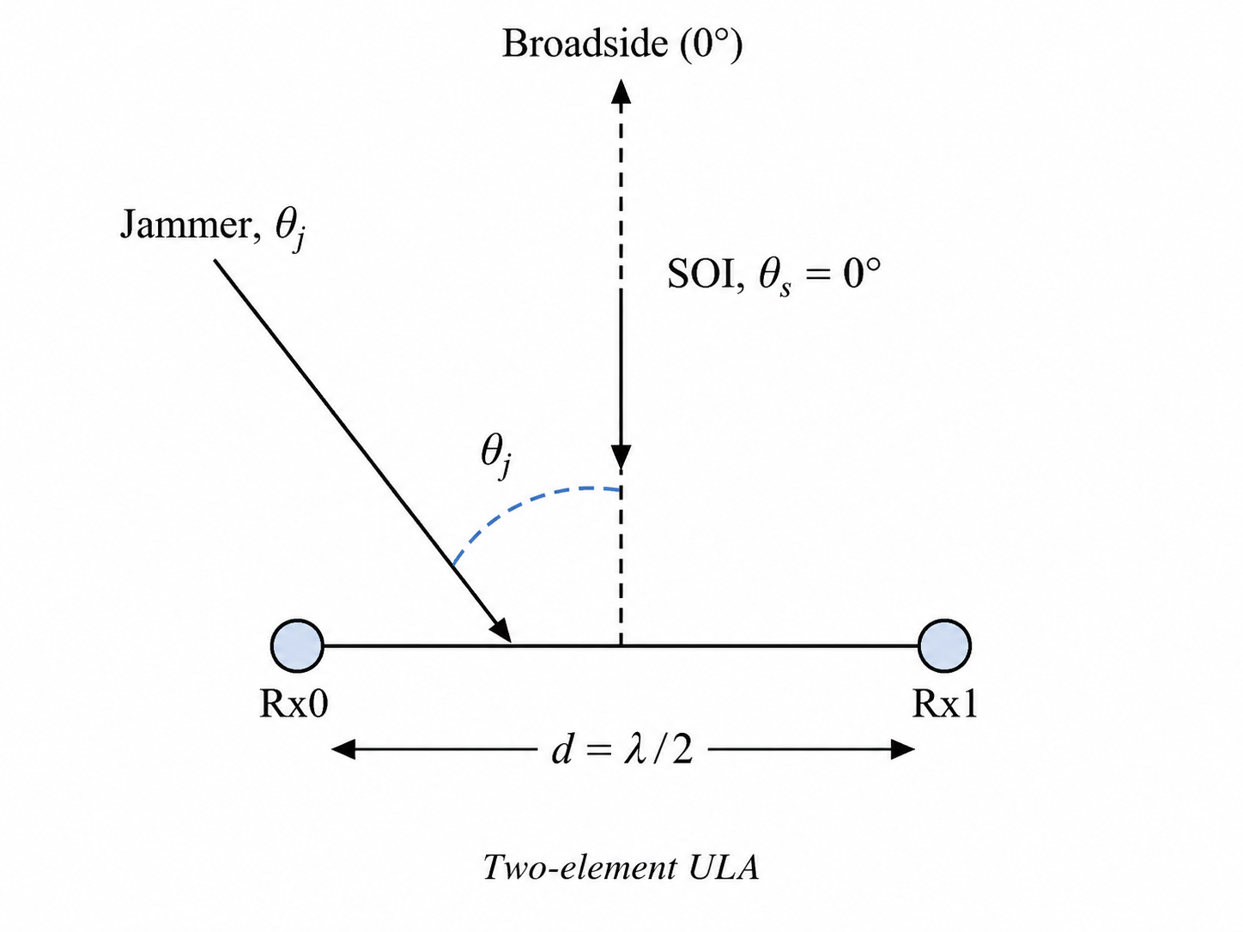
Experimental setup and signal configuration
PlutoSDR transmits both the desired QPSK signal and the jammer signal, then receives with two channels.
Hardware and RF settings
Platform: ADALM-Pluto SDR / AD936x.
Receiver: two enabled RX channels.
Center frequency: 2.1 GHz.
Sampling rate: 5 MS/s.
ULA spacing: d = λ/2.
Transmitted signals
Tx0: QPSK SOI, gain = −20 dB.
Tx1: CW jammer, gain = −3 dB.
Jammer is 17 dB stronger at transmitter side.
SOI reference in jammer mode: 0° broadside.
EE4084 Kalman and Bayesian Filters • Project Presentation • 5/15
Notes:
The experimental setup uses an ADALM-Pluto SDR or AD936x based configuration. The receiver has two enabled channels. The center frequency is 2.1 GHz and the sampling rate is 5 mega samples per second. Tx0 transmits a QPSK signal of interest with minus 20 dB gain. Tx1 transmits a CW jammer with minus 3 dB gain. Therefore the jammer is 17 dB stronger at the transmitter side. In the jammer-present mode, the SOI is assumed to be at broadside, which is 0 degrees. The antenna model is a two-element ULA with half-wavelength spacing.

Slide 6
Process model: Kalman angular state transition
The process model predicts the angular state used by the IMM Kalman filter.
State vector
Why multiple models?
xₖ = [ θₖ, θ̇ₖ, θ̈ₖ ]ᵀ
CP model: almost stationary angular source.
CV model: constant angular velocity motion.
CA model: maneuvering or accelerated angular motion.
IMM combines them using Bayesian probabilities.
θₖ: direction of arrival angle.
θ̇ₖ: angular velocity.
θ̈ₖ: angular acceleration.
All states are in angular units, not Cartesian position.
Tracking interpretation
State transition model
The same angular state is used for SOI tracking when Tx1 is off and jammer tracking when Tx1 is on.
xₖ = F xₖ₋₁ + wₖ FCA = [[1, Δt, 0.5Δt²], [0, 1, Δt], [0, 0, 1]]
EE4084 Kalman and Bayesian Filters • Project Presentation • 6/15
Notes:
The process model describes angular motion. The state vector contains direction of arrival angle, angular velocity, and angular acceleration. This is not a Cartesian position tracking problem. The filter tracks how the DoA angle changes over time. The constant acceleration transition matrix is shown as a representative model. The IMM structure uses three motion models: CP, CV, and CA. CP is useful for nearly stationary sources, CV for smooth angular motion, and CA for maneuvering behavior. The same state definition is used whether the physical source is the SOI or the jammer.

Slide 7
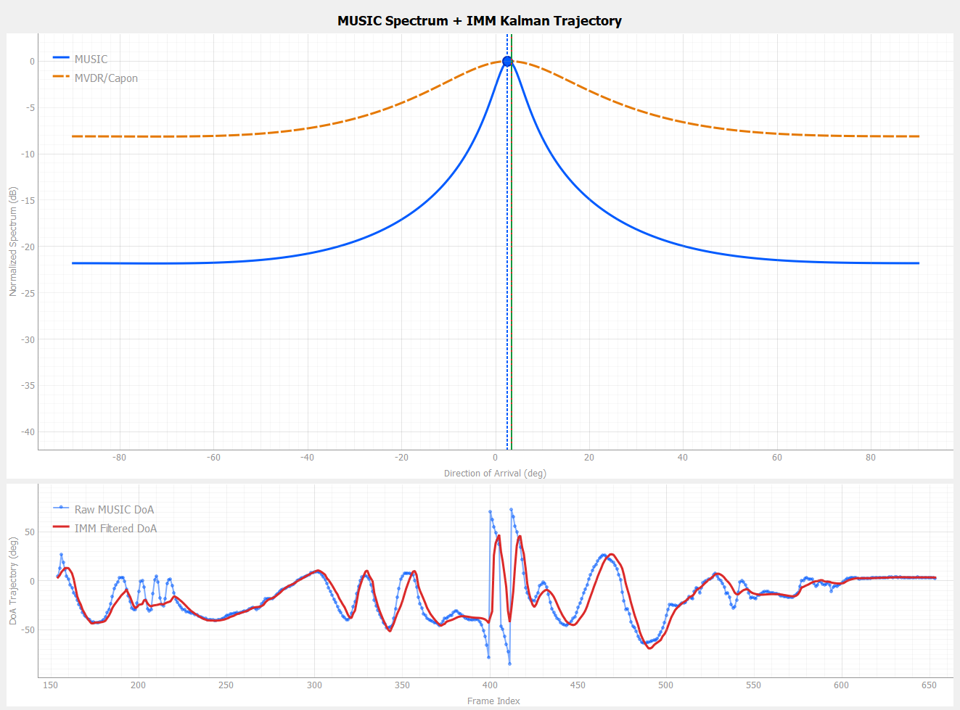
Measurement model: MUSIC DoA as Kalman measurement
The Kalman filter receives a scalar angle measurement from the MUSIC estimator.
Raw measurement generation
Rxx = (1/N) Σ x(n)xᴴ(n)
MUSIC peak gives the observed DoA angle
MUSIC measurement
PMUSIC(θ) = 1 / [aᴴ(θ)EnEnᴴa(θ)]
zₖ = θ̂MUSIC,k = arg maxθ PMUSIC(θ)
Measurement equation
zₖ = Hxₖ + vₖ, H = [1 0 0]
The filter directly observes only angle; velocity and acceleration are inferred from the process model.
EE4084 Kalman and Bayesian Filters • Project Presentation • 7/15
Notes:
The measurement model starts from the received IQ data. The covariance matrix is estimated for each frame. Then eigenvalue decomposition separates the signal and noise subspaces. The MUSIC pseudo-spectrum is evaluated by scanning angles from minus 90 to plus 90 degrees. The angle that maximizes the MUSIC spectrum becomes the raw measurement z_k. The Kalman measurement matrix observes only the angle component of the state, so angular velocity and acceleration are not directly measured. They are inferred through the dynamic process model and the Kalman update.

Slide 8
IMM Kalman filter design and Bayesian model probabilities
The IMM filter stabilizes DoA tracking and selects the most plausible angular motion model.
IMM cycle
Probability update
Mix previous model-conditioned estimates.
Run CP, CV, and CA Kalman filters in parallel.
Compute innovation and likelihood for each model.
Update model probabilities and combine estimates.
Λₖ⁽ⁱ⁾ ∝ exp(−0.5ν²/S) / √S
μₖ⁽ⁱ⁾ = Λₖ⁽ⁱ⁾ μ̄ₖ⁽ⁱ⁾ / ΣⱼΛₖ⁽ʲ⁾ μ̄ₖ⁽ʲ⁾
x̂ₖ = Σᵢ μₖ⁽ⁱ⁾ x̂ₖ⁽ⁱ⁾
Kalman update per model
Important distinction
νₖ⁽ⁱ⁾ = zₖ − Hx̂ₖ|ₖ₋₁⁽ⁱ⁾
IMM switches between motion models, not between source identities. The source identity is selected by the jammer state: SOI when Tx1 is off, jammer when Tx1 is on.
Kₖ⁽ⁱ⁾ = Pₖ|ₖ₋₁⁽ⁱ⁾Hᵀ / Sₖ⁽ⁱ⁾
x̂ₖ|ₖ⁽ⁱ⁾ = x̂ₖ|ₖ₋₁⁽ⁱ⁾ + Kₖ⁽ⁱ⁾νₖ⁽ⁱ⁾
EE4084 Kalman and Bayesian Filters • Project Presentation • 8/15
Notes:
The IMM filter has a Bayesian multiple-model structure. First, it mixes the previous model-conditioned estimates. Then it runs the CP, CV, and CA Kalman filters in parallel. Each model produces an innovation. If a model explains the measurement well, its innovation is smaller and its likelihood becomes higher. The model probabilities are then normalized. The final state estimate is the weighted sum of the model-conditioned estimates. One important point is that IMM switches between motion models, not source identities. The physical identity of the tracked source is controlled by the operating mode.

Slide 9
Practical filter details: adaptive measurement noise and safeguards
Real-time SDR data is noisy; the tracker must avoid overreacting to unreliable MUSIC peaks.
Measurement reliability indicators
Two-channel limitation
MUSIC peak sharpness: sharp peak means reliable DoA.
Condition number of Rxx: ill-conditioned covariance reduces confidence.
RSSI level: weak signal increases uncertainty.
Rσ is increased when measurements become unreliable.
With two RX channels, MUSIC estimates one dominant source. Therefore, source interpretation is based on Tx1 jammer state, not simultaneous multi-source resolution.
Image / mirror peak issue
Phase mismatch, IQ imbalance, and multipath may create image peaks.
A wrong image peak can move the LCMV null to an incorrect angle.
Phase calibration is therefore important for null depth.
Mode-change handling
When target label changes, the IMM tracker is reinitialized.
This avoids long transients from SOI angle to jammer angle.
The GUI reports IMM target: SOI or JAMMER.
EE4084 Kalman and Bayesian Filters • Project Presentation • 9/15
Notes:
In practice, the raw MUSIC peak is not always equally reliable. Therefore, I used adaptive measurement noise. If the MUSIC peak is sharp, the filter can trust the measurement more. If the peak is flat, if the covariance matrix is ill-conditioned, or if the signal is weak, the measurement noise is increased. I also reinitialize the IMM tracker when the tracked target label changes between SOI and JAMMER. This avoids long transients. Another practical issue is the two-channel limitation. The system estimates only one dominant source, so the source interpretation is based on the jammer state. Image peaks and phase calibration errors can also reduce nulling performance.

Slide 10
Beamforming design: MVDR versus LCMV
The beamformer uses the filtered DoA differently in no-jammer and jammer-present modes.
No-jammer mode: MVDR
Jammer-present mode: LCMV
Dominant MUSIC peak is interpreted as SOI DoA.
IMM output is used as the steering direction.
Objective: minimum output power with distortionless SOI response.
Dominant MUSIC peak is interpreted as jammer DoA.
SOI is fixed at θs = 0° broadside.
Constraints: unity gain at SOI, zero gain at jammer.
wMVDR = R⁻¹a(θs) / [aᴴ(θs)R⁻¹a(θs)]
C = [a(θs) a(θj)], f = [1 0]ᵀ
wLCMV = R⁻¹C(CᴴR⁻¹C)⁻¹f
Suppression metric = RSSI In − RSSI Out, displayed only during active jammer + LCMV mode.
EE4084 Kalman and Bayesian Filters • Project Presentation • 10/15
Notes:
The beamforming strategy is different in the two modes. In no-jammer mode, the system uses MVDR. The MVDR beamformer is steered toward the IMM-filtered SOI direction and minimizes output power while keeping unity response toward the SOI. In jammer-present mode, the estimator tracks the jammer, not the SOI. Therefore the beamformer should not steer to the IMM direction. Instead, the SOI direction is fixed at 0 degrees and LCMV is used. LCMV has two constraints: unity gain toward the SOI and zero response toward the jammer. The suppression metric is shown only in this jammer-present mode.

Slide 11
Software implementation workflow in the GUI
The Python application runs SDR acquisition, estimation, filtering, beamforming, and visualization in real time.
Frame-level processing loop
Adaptive decision and output
Configure AD9361/PlutoSDR RX and TX channels.
Generate Tx0 QPSK SOI and optionally Tx1 CW jammer.
Read two-channel IQ frame from RX0 and RX1.
Apply fixed Rx1 phase calibration.
Estimate Rxx and compute MUSIC spectrum.
Find dominant MUSIC peak.
Select tracking target: SOI or JAMMER.
Run IMM Kalman update.
Calculate MVDR or LCMV weights.
Display DoA, trajectory, RSSI, suppression, and model probabilities.
Live Tx1 ON/OFF switching is handled by restarting cyclic TX buffers inside the SDR worker thread, so the GUI can demonstrate no-jammer → jammer-present behavior during one run.
EE4084 Kalman and Bayesian Filters • Project Presentation • 11/15
Notes:
The GUI implementation processes data frame by frame. First, the PlutoSDR is configured. Tx0 generates the QPSK SOI, and Tx1 can generate the CW jammer. The receiver reads two-channel IQ data. A fixed phase calibration is applied to the second receive channel. Then the covariance matrix and MUSIC spectrum are calculated. The dominant peak is passed to the IMM filter. Depending on the Tx1 state, the tracker target is SOI or JAMMER. Then MVDR or LCMV weights are calculated and applied. The GUI displays the spectrum, trajectories, RSSI values, suppression, and model probabilities. A useful implementation detail is that the Tx1 jammer can be switched live by restarting cyclic TX buffers in the worker thread.

Slide 12
Comparative result 1: no-jammer case
Tx1 is disabled, so MUSIC peak corresponds to SOI and MVDR beamforming is used.
Observation
Dominant MUSIC peak is near the SOI direction.
Raw MUSIC trajectory fluctuates due to measurement noise.
IMM Kalman output smooths the angular trajectory.
Beamformer mode is MVDR because no jammer is active.
Suppression metric is not displayed in this mode.
Purpose of this test: verify SOI tracking and show the benefit of IMM filtering over raw MUSIC DoA.
EE4084 Kalman and Bayesian Filters • Project Presentation • 12/15
Notes:
This is the no-jammer result. Tx1 is disabled, so only the QPSK SOI is active. The upper plot shows the MUSIC spectrum. The dominant peak corresponds to the SOI direction. The lower plot compares raw MUSIC DoA with the IMM-filtered DoA. The raw measurement is noisier, while the IMM output is smoother and dynamically more consistent. Since there is no jammer, the beamformer is MVDR and the jammer suppression metric is not displayed. This test verifies that the system works as a normal dynamic SOI tracking receiver.

Slide 13
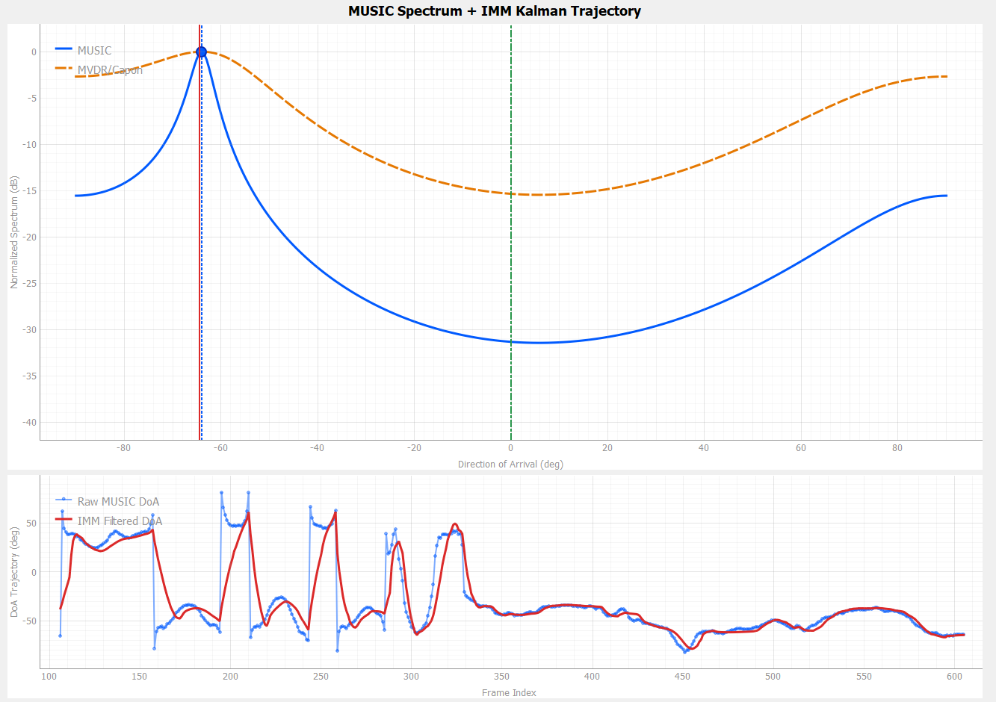
Comparative result 2: jammer-present case
Tx1 is active and stronger, so MUSIC peak corresponds to jammer and LCMV nulling is used.
Observation
Dominant MUSIC DoA: −66.50°.
IMM tracked jammer DoA: −68.42°.
SOI reference remains fixed at 0° broadside.
Beamformer mode switches to LCMV.
LCMV suppresses the tracked jammer direction.
Purpose of this test: verify jammer tracking and show that LCMV uses the filtered jammer angle as a nulling constraint.
EE4084 Kalman and Bayesian Filters • Project Presentation • 13/15
Notes:
This is the jammer-present result. Tx1 is active and stronger than the QPSK SOI. Therefore, the dominant MUSIC peak corresponds to the jammer direction. In the measurement shown here, the dominant MUSIC DoA is about minus 66.50 degrees, and the IMM-tracked jammer angle is about minus 68.42 degrees. The SOI reference is kept fixed at 0 degrees broadside. The beamformer switches to LCMV, so the tracked jammer angle is used as the nulling direction. This result verifies the intended jammer tracking behavior.

Slide 14
Measured jammer-present snapshot and comparison
The measurement panel confirms the operating mode, DoA values, RSSI values, and suppression metric.
Measured values
Dominant MUSIC DoA
−66.50°
IMM jammer DoA
−68.42°
SOI reference
0.00° fixed
Beamformer
LCMV
RSSI In
−88.73 dBm
RSSI Out
−106.10 dBm
Jammer suppression
17.36 dB
MUSIC sharpness
1.21 dB
Interpretation
Because Tx1 is active, suppression is meaningful. The measured 17.36 dB value indicates that the beamformed output power is significantly lower than the input under active LCMV nulling.
EE4084 Kalman and Bayesian Filters • Project Presentation • 14/15
Notes:
This slide shows the measurement panel from the jammer-present case and summarizes the key values. The dominant MUSIC angle is minus 66.50 degrees. The IMM-tracked jammer angle is minus 68.42 degrees. The SOI reference remains fixed at 0 degrees. The beamformer is LCMV. RSSI In is minus 88.73 dBm and RSSI Out is minus 106.10 dBm, giving a suppression value of approximately 17.36 dB. This metric is only meaningful while the jammer is active and the system is in LCMV mode.

Slide 15
Demonstration plan, limitations, and conclusion
The Bandicam video should show the mode transition clearly and end with measured results.
Limitations
Start with Tx1 OFF: show SOI tracking + MVDR.
Enable Tx1: show MUSIC peak moving to jammer and IMM target = JAMMER.
Confirm LCMV mode and suppression value appear.
Disable Tx1: show return to SOI tracking + MVDR.
Mention final YouTube link permissions before submission.
Two RX channels allow one dominant DoA estimate at a time.
SOI is assumed fixed at 0° in jammer-present mode.
Phase mismatch and multipath can create mirror/image peaks.
Suppression depends on DoA accuracy and calibration quality.
Conclusion and future extension
MUSIC provides raw DoA; IMM Kalman stabilizes tracking.
MVDR is used in no-jammer mode; LCMV is used in jammer-present mode.
Future work: run the real-time chain on Pluto ARM Cortex-A9 and accelerate covariance/beamforming blocks on Zynq Z-7010 programmable logic.
Final takeaway: the project demonstrates a complete estimation + adaptive beamforming loop for dynamic jammer-aware receiver operation.
EE4084 Kalman and Bayesian Filters • Project Presentation • 15/15
Notes:
In the Bandicam demonstration, I will start with Tx1 off and show SOI tracking with MVDR. Then I will turn Tx1 on and show that the dominant MUSIC peak becomes the jammer direction, the IMM target changes to JAMMER, the beamformer becomes LCMV, and the suppression value appears. Finally, I will disable Tx1 and show the return to SOI tracking and MVDR. The main limitations are the two-channel array, the fixed broadside SOI assumption during jammer mode, and sensitivity to phase calibration. The final conclusion is that MUSIC, IMM Kalman filtering, and adaptive MVDR/LCMV beamforming can be integrated into a practical jammer-aware receiver. Future work will move the processing to the Pluto SDR ARM Cortex-A9 and use Zynq Z-7010 programmable logic for hardware acceleration.

