Slide 1
Guided research Summer 2016 A sequence learning approach to sentiment analysis on call-center conversation data
Mohammad Baniasad
m_baniasad14@cs.uni-kl.de
Supervisor: Reza Yousefi

Slide 2
problem explanation
classification of voice data
context of call center
caller calls the potential client to ask for a meeting
classification with respect to
satisfaction
spoken language
success
…
‹#›

Slide 3
assumptions
there is a lot of variance in voice which is not needed for the “success/unsuccess” classification
most of the data related to “success/unsuccess” class is lying in the text representing the voice call
“Speech to text” technologies are mature enough and most of difference would be in classification of texts representing the voice

Slide 4
Divide and conquer
available data samples are small
Part 1: text binary classification on normal text
what are the possible solutions
what are the challenges
part 2:binary classification on calldata
speech to text solution
classification results

Slide 5
Pipeline and task devision
A phone conversation classification
phone conversation
perfect transcription
speech recognition
transcribed
text
semantic analysis
classifier
e.g.%89
e.g.
%89 - X ?
classified output
‹#›
Notes:
divide and conquer
there are companies which are already manual transcription
available corpus in german which can be very helpful

Slide 6
Binary text classification

Slide 7
Datasets
 | labeled | pos/neg | unlabeled | Description
english aclImdb reviews | 50,000 | train 12500/12500 test 12500/12500 | 50,000 | *Stanford University highly polar movie reviews on IMDB
German amazon reviews | 12,000 | train 3000/3000 test 3000/3000 | 317,378 | *Weimar University Amazon reviews
English amazon reviews | 12,000 | train 3000/3000 test 3000/3000 | 105,220 | *Weimar University Amazon reviews

Slide 8
Classifiers
LSTM
Dynamic LSTM
Bidirectional LSTM
Doc2vec
Facebook/fastText
bayes

Slide 9
LSTM
Adopted code from *TFlearn
each word gets a unique identifier
document is list of ids
embedding of documents
1 lstm layer with 128 units
softmax
Hyper parameters
number of epochs
word embedding
dropout
optimizer

Slide 10
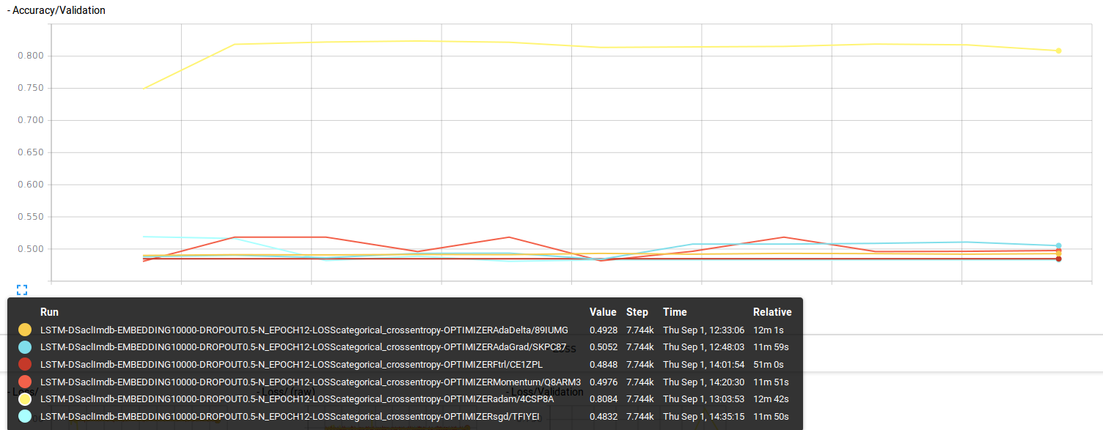
optimizer
adam: ~80% accuracy
optimization step
visualization using Tensorboard

Slide 11
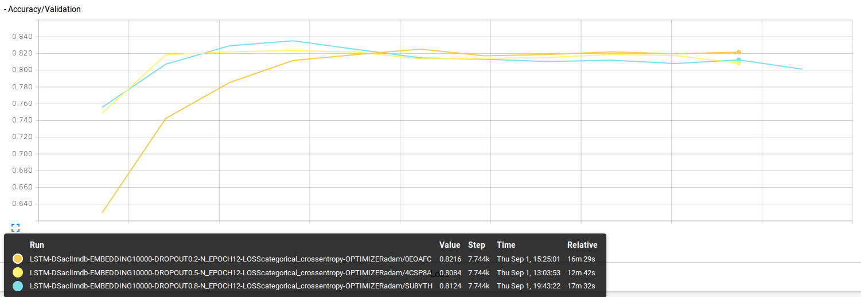
Dropout
20%: ~80% accuracy
optimization step

Slide 12
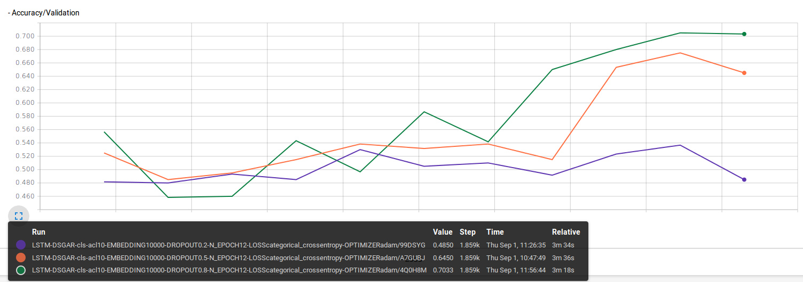
Dropout
German Amazon reviews
80%: ~80% accuracy

Slide 13
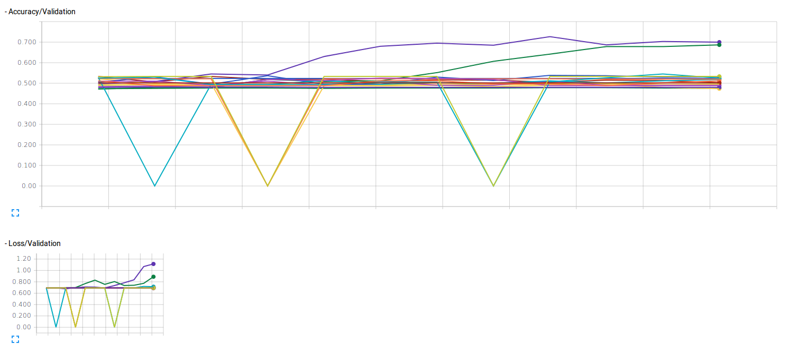
DLSTM
all possible runs with DLSTM
different optimizers
different droupout

Slide 14
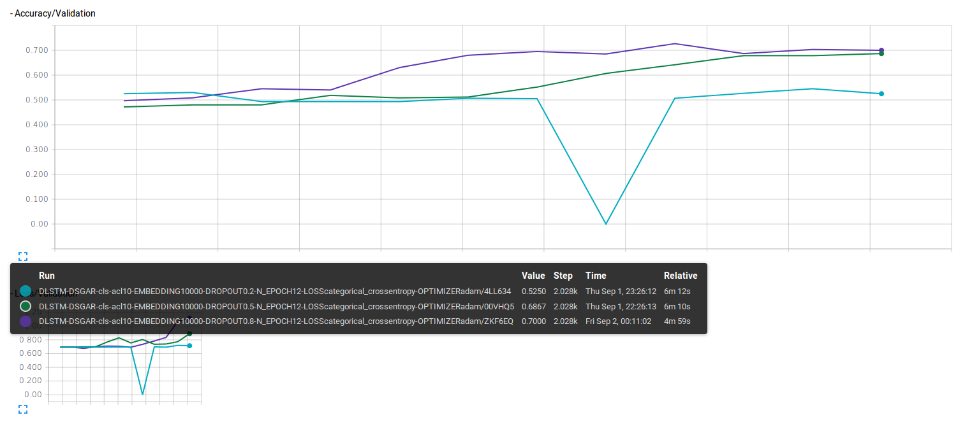
Best DLSTM results

Slide 15
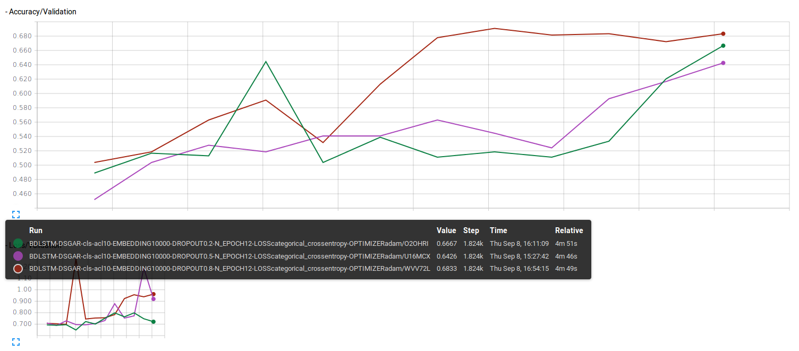
BDLSTM

Slide 16
NLTK & Stemming
Natural Language Toolkit
NLTK is a leading platform for building Python programs to work with human language data.
Stemming
aufeinander aufeinand
aufeinanderbiss aufeinanderbiss
aufeinanderfolge aufeinanderfolg
aufeinanderfolgen aufeinanderfolg
aufeinanderfolgend aufeinanderfolg
Notes:
in linguistic morphology and information retrieval, stemming is the process of reducing inflected (or sometimes derived) words to their word stem, base or root form
Natural Language Toolkit
NLTK is a leading platform for building Python programs to work with human language data. It provides easy-to-use interfaces to over 50 corpora and lexical resources such as WordNet, along with a suite of text processing libraries for classification, tokenization, stemming, tagging, parsing, and semantic reasoning, wrappers for industrial-strength NLP libraries, and an active discussion forum.

Slide 17
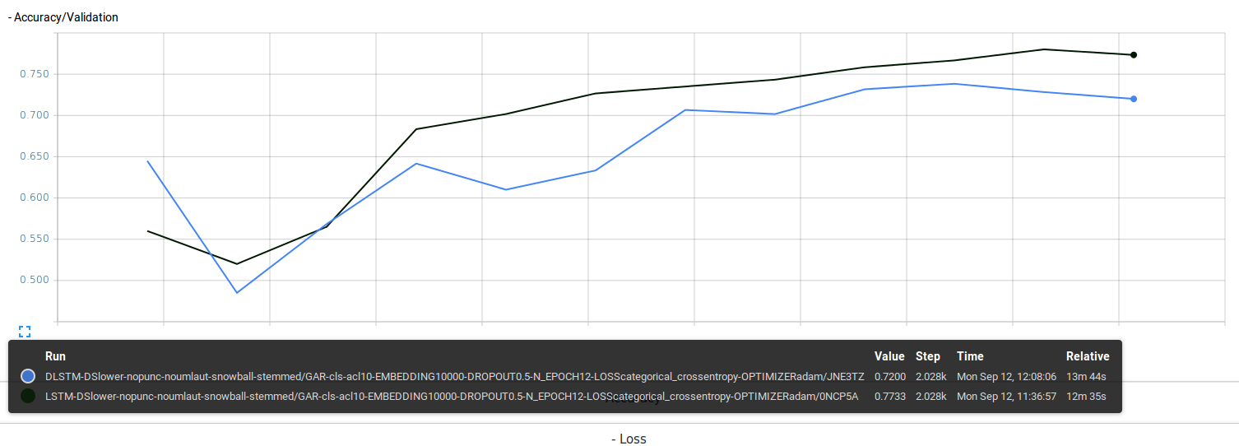
Stemming on DLSTM and LSTM
better performance after stemming

Slide 18
Conclusion on NN approaches
dataset | best configuration | best accuracy
aclIMDB | LSTM - adam optimizer - 20% dropout | 0.82.16
German Amazon reviews | LSTM - adam optimizer - 80% dropout | 0.7033, 0.7733 with stemming
English Amazon reviews | LSTM - adam optimizer - 50% dropout | 0.7450

Slide 19
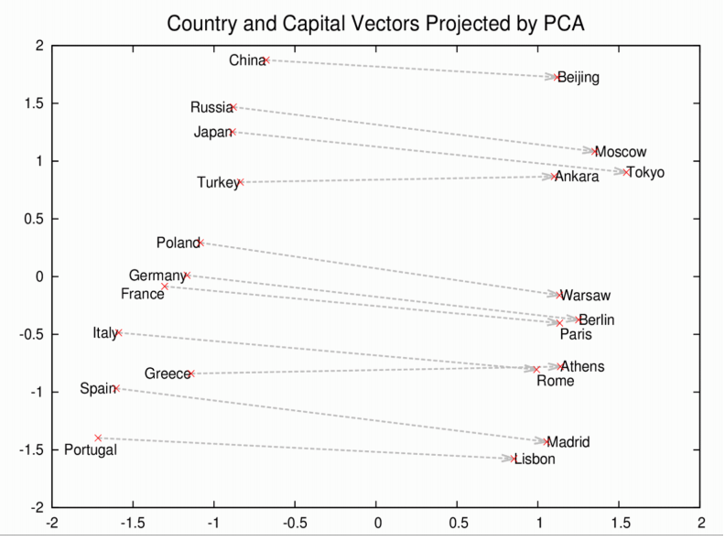
word2vec and doc2vec
Notes:
Word2vec is a two-layer neural net that processes text. Its input is a text corpus and its output is a set of vectors
doc2vec using either hierarchical softmax or negative sampling

Slide 20
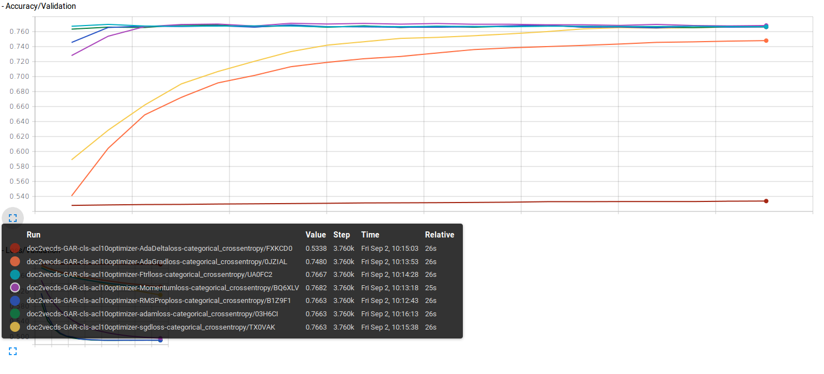
DOC2VEC
linear regression on output vectors of doc2vec for GermanAmazonReview dataset

Slide 21
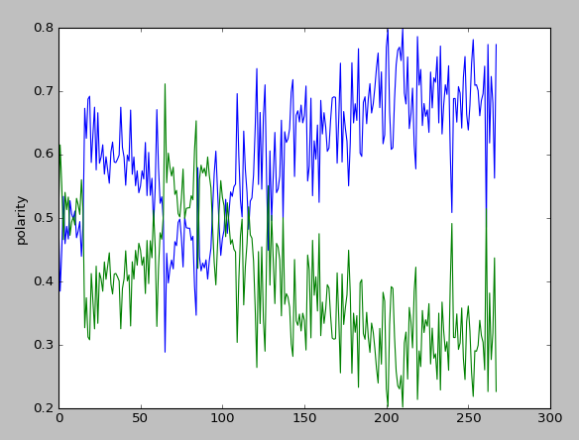
Polarity/length
experiment for online polarity estimation
effect of length of document on polarity probability
green for positivity.

Slide 22
Facebook/fastText
FastText is a library for efficient learning of word representations and sentence classification.
Very fast
learning in 10X faster than word2vec
Very active development
last commit less than 48 hours ago
Written in C
memory efficent
Built in document classifier with package
No document to vector api

Slide 23
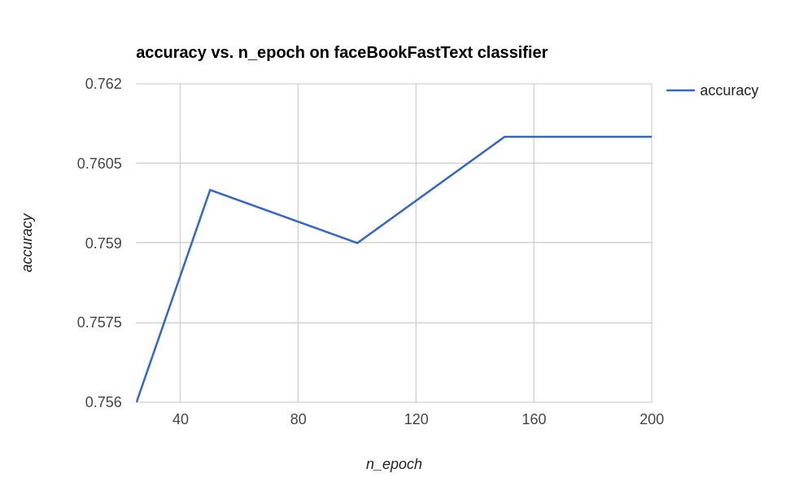
facebook/fastText
accuracy measured using fastext’s built in classifier over German Amazon Reviews

Slide 24
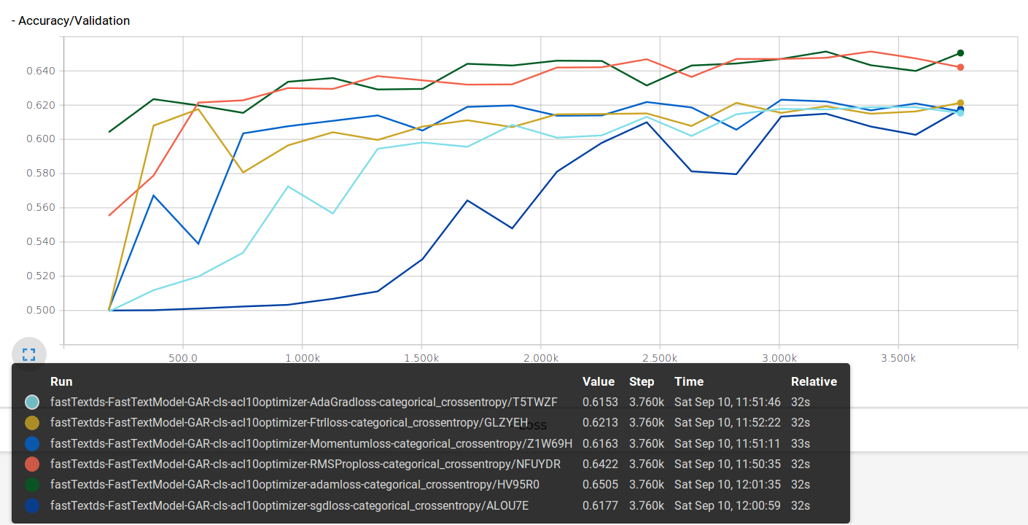
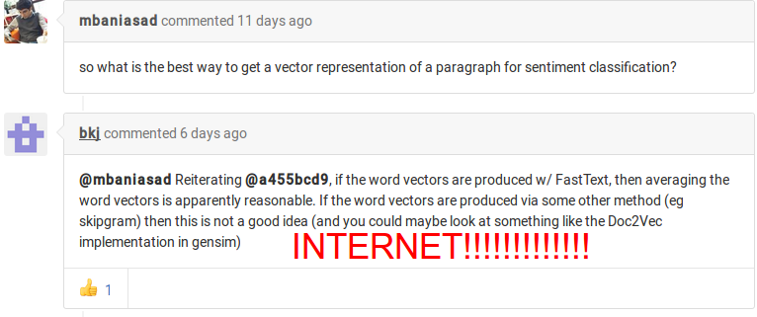
accuracy measured using average vectors of words for document -over German Amazon Reviews

Slide 25
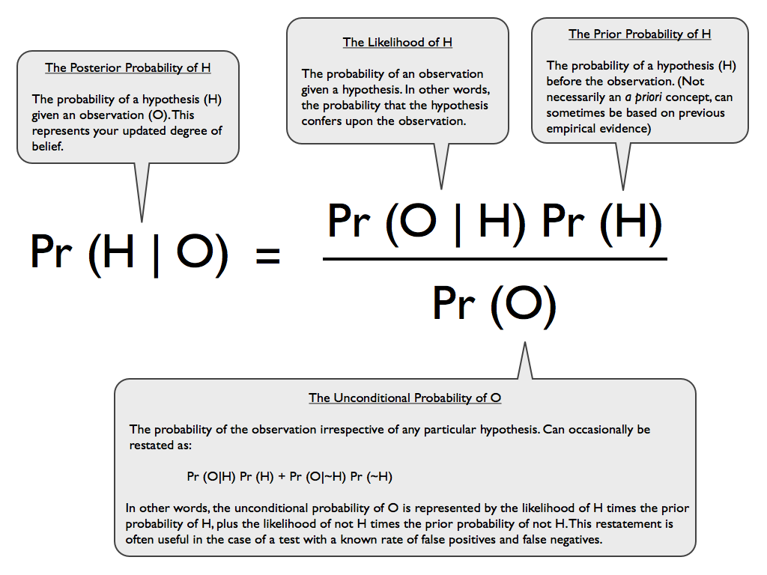
Bayes theorem

Slide 26
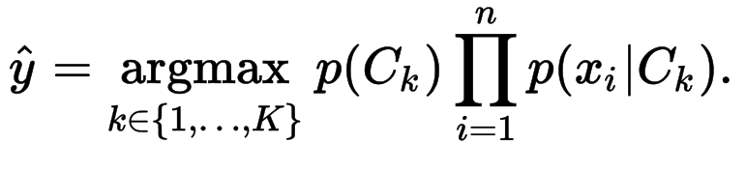
Bayes classifier
a complete implementation is accessable in sklearn library

Slide 27
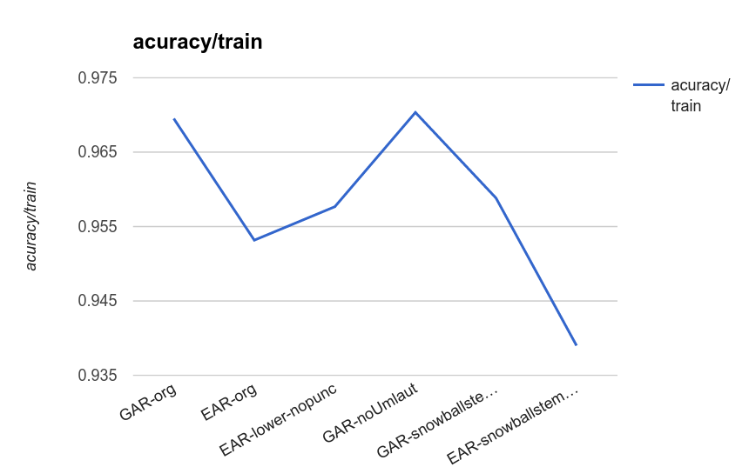
Bayes

Slide 28
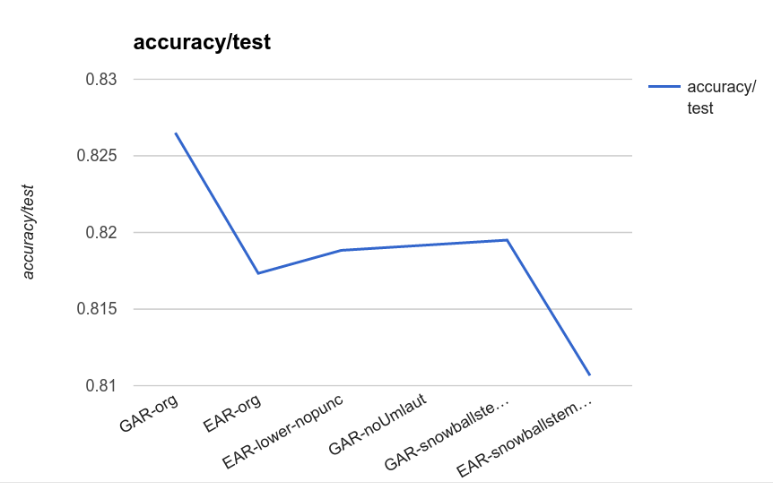
Bayes

Slide 29
Pipeline view
A phone conversation classification
phone conversation
perfect transcription
speech recognition
transcribed
text
semantic analysis
classifier
e.g.%89
e.g.
%89 - X ?
classified output
‹#›

Slide 30


Speech to text

Slide 31
Final dataset
 | labled | pos/neg | unlabled | Description
CallData | 507 | train 462/135 | 762 | *Matelso call data
labeled data is biased toward neg.
using equal amount of neg/pos for test
negative samples will be chosen randomly on each run

Slide 32
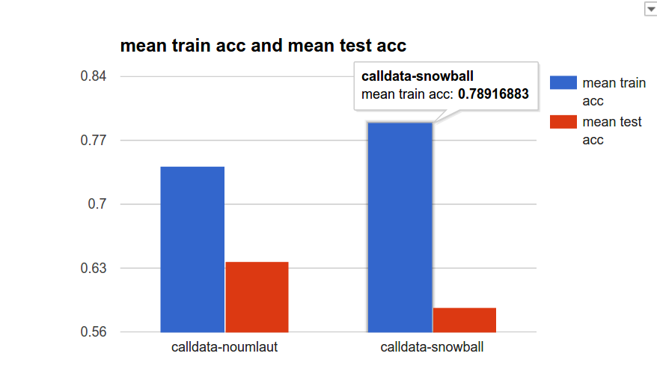
Bayes cross validation

Slide 33
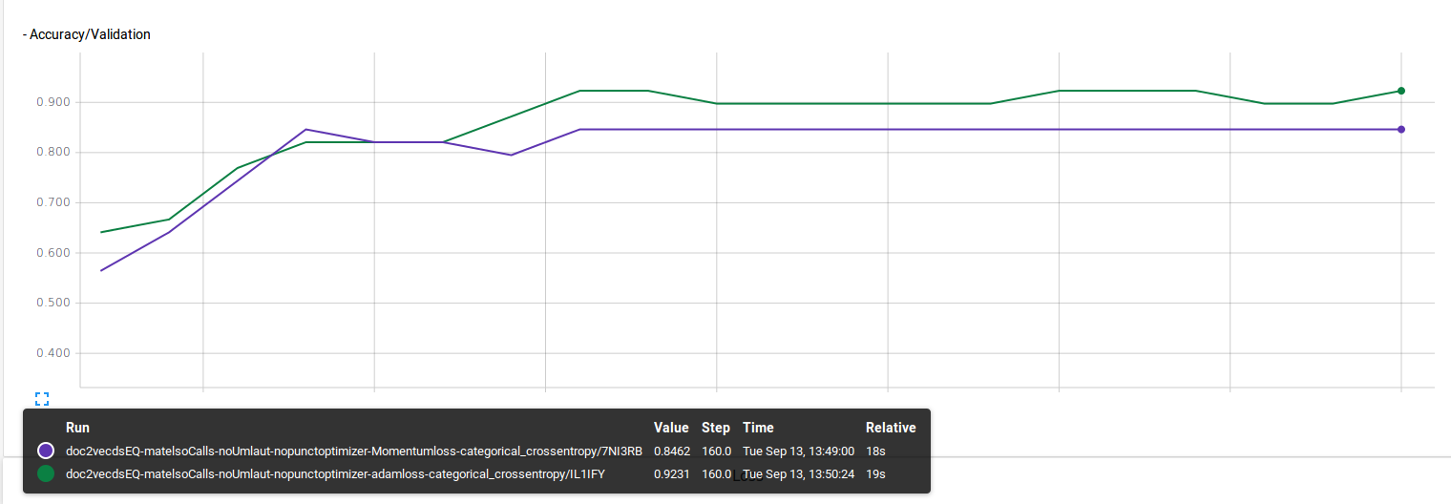
Doc2vec

Slide 34
Results
Classification of text documents
Pre processing
stemming results in overfitting in bayes
stemming can help LSTM compete with state of the art techniques
Best Classifier
Naïve Bayes
doc2vec and fasttext
best classifier is heavily dependent to the nature of problem and distribution of words
choosing hyper parameters like dropout is also depends to the nature of dataset
‹#›

Slide 35
future works and possible applications
Researching for possibility of using other available metadata and incorporating it in the learning process
classifications other than polarity
language classification
monitoring comments/(voiced)contents in social media
‹#›

Slide 36
datasets
http://www.uni-weimar.de/en/media/chairs/webis/corpora/corpus-webis-cls-10/
https://www.cs.cornell.edu/people/pabo/movie-review-data/
MatelSo call traking data
tools
tflearn - http://tflearn.org
tensorFlow - https://www.tensorflow.org
tensorBoard - https://www.tensorflow.org/versions/r0.7/how_tos/summaries_and_tensorboard/index.html
natural language toolkit - http://www.nltk.org
snowball stemmer -http://snowball.tartarus.org/algorithms/german/stemmer.html
doc2vec -https://radimrehurek.com/gensim/models/doc2vec.html#id6
facebook-fasttext -https://github.com/facebookresearch/fastText
sklearn naive Bayes- http://scikit-learn.org/stable/modules/naive_bayes.html

Slide 37
Thank you
Questions and comments

