Slide 1
MOBILE BANKING

Slide 2
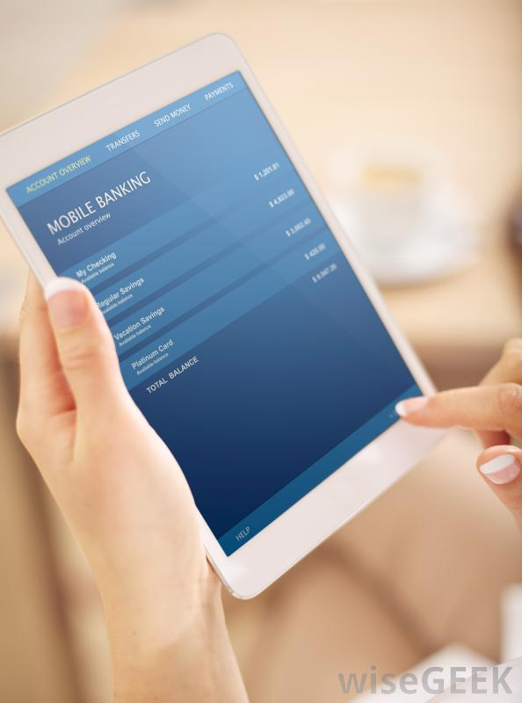
INTRODUCTION
Mobile banking is a term
used for performing
balance checks,
account transactions,
payments etc.
via a mobile device
such as a
mobilephone.

Slide 3
WHAT IS MOBILE BANKING ?
Mobile banking is a way for the customer to perform banking actions on his or her cell phone or other mobile device. It is a quite popular method of banking that fits in well with a busy, technologically oriented lifestyle. It might also be referred to as M-banking or SMS banking.

Slide 4
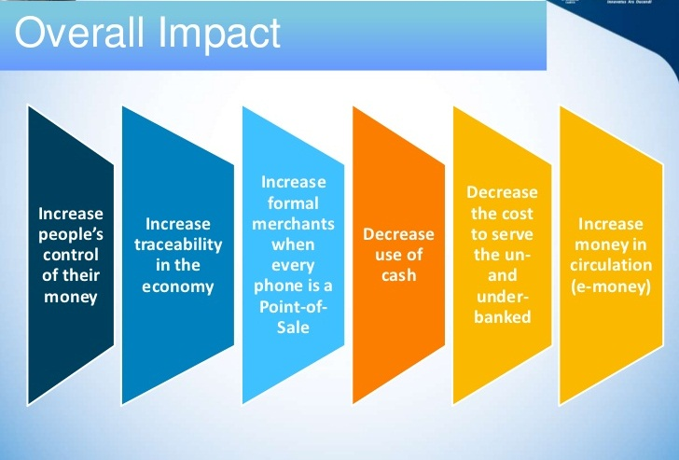

Slide 5
REASONS OF GENESIS OF MOBILE
Introduction of new technologies.
Control costs, removal of cost duplication
Cater to increasing online channel customers
Personalize customer interactions
Unparalleled convenience and proactive customer
service

Slide 6
CLASSIFYING SERVICES
On the basis of originator of service session
Push
Pull
On the basis of nature of service
5. Transaction Based
6.Enquiry Based

Slide 7
MOBILE BANKING SERVICES
Account Information
Payments, Deposits, withdrawals
and Transfers
Investment
Support
Content Services

Slide 8
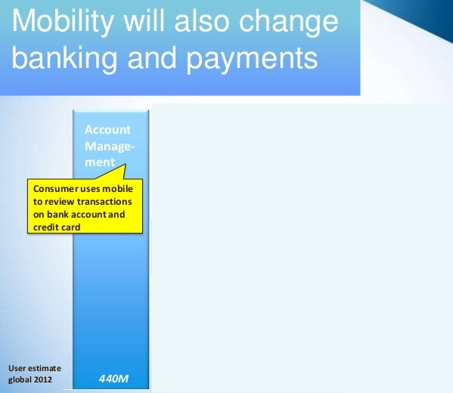

Slide 9
PRODUCT BENEFITS
Customer Benefits:
Secure, Convenient and easy method of payment
Anywhere anytime paymentMerchant Benefits
Merchant Benefits:
Additional payment method for customers
Small payment amounts can be accepted
Portable payment options for merchants on move Banks
Bank Benefits:
Additional channel for customer payments
Use of existing Infrastructure
Value added service to customers

Slide 10
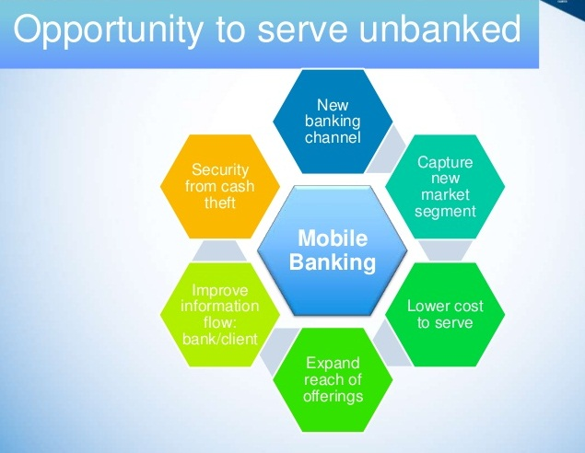

Slide 11


